Slide 1
FEK Team Final Presentation
CS 5604 Information Storage and Retrieval, Dr. Edwards Fox
TA: Ziqian Song
Eddy Powell, Chao Xu, Han Liu, Rong Huang, Yanshen Sun
Dec 10, 2019
Virginia Tech, Blacksburg, VA 24061

Slide 2
Outline
Introduction
Tools and Platforms
What We Have Achieved
Future Work
Conclusion

Slide 3
Introduction
Provide an interface for the work completed this semester by all teams
View the Tobacco and ETD datasets
Use Kibana to manipulate and visualize the data

Slide 4
Tools and Platforms
Elasticsearch, Kibana
Node.js, Python, HTML, Javascript, CSS, MySQL, Reactivesearch
Postman and Jupyter Notebook
Ceph

Slide 5
Achievements
Instruction for using Kibana
Instruction for using Postman (mainly for developers)
Build a user-friendly website with all functionalities

Slide 6
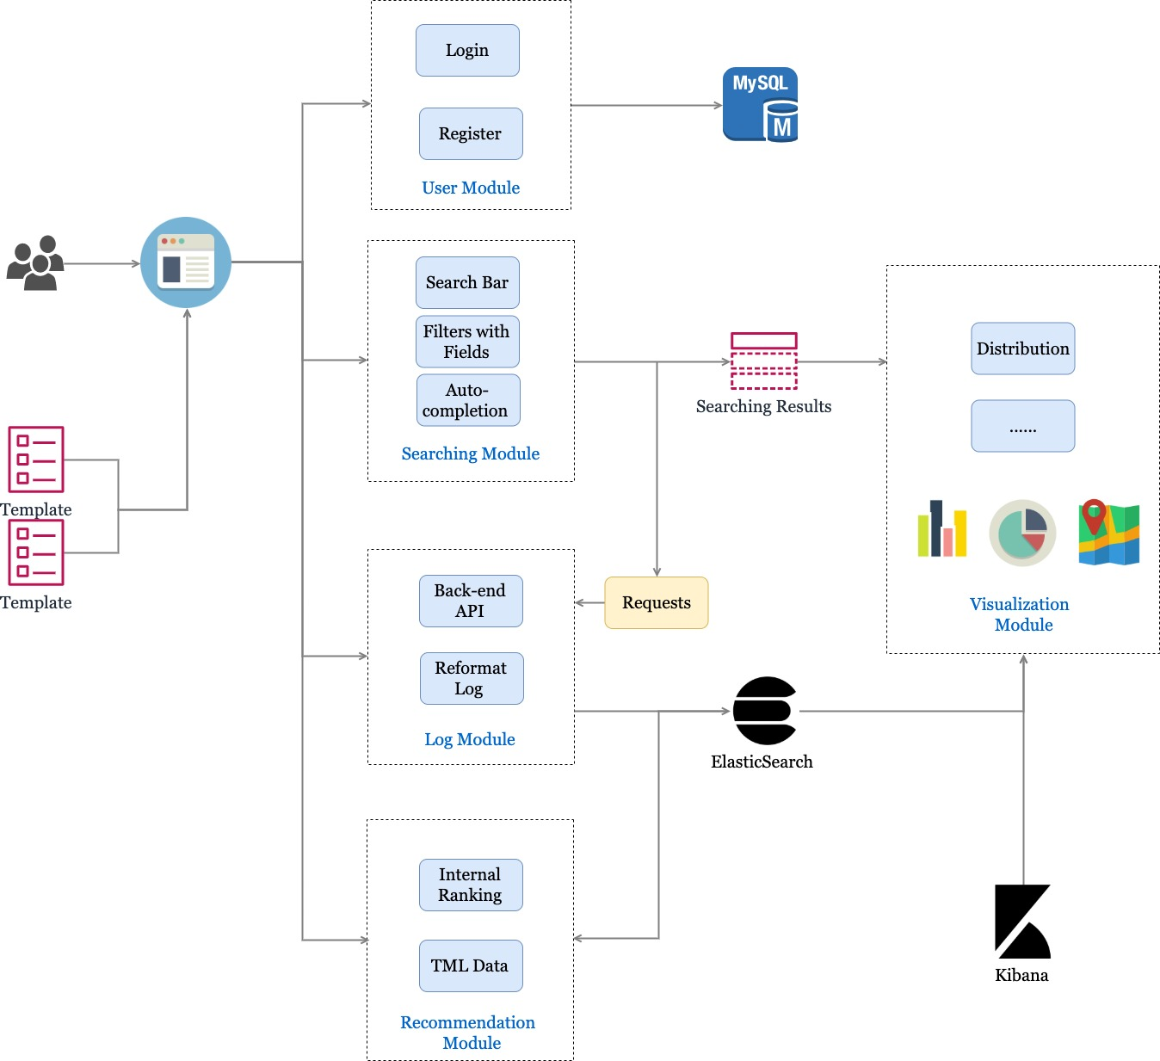
Achievements
User Module
Searching Module
Log Module
Visualization Module
*Recommendation Module

Slide 7
Admin
Can monitor users on dashboard
Perform CRUD operations for current users

Slide 8
Searching
Technique
Functionality
Demo
Explanation

Slide 9
Searching Components
JavaScript
Create-react-app: initialize the react application
Reactivesearch: build UI components and connect Elasticsearch
Fancybox: displays the searching page
HashRouter: build multiple pages and routes in one app
Axios: promise based HTTP client for the browser and node.js
Filepond: support uploading files with fancy boxes

Slide 10
Searching Functionalities
Ability to search on the ETD and Tobacco Datasets
Support multiple filters with metadata and date
Auto-suggestion in search bar
Highlighting in results
Customization of queries
  Use of “&&” and “:” to search in specific few fields
  Auto-suggestion starts from 3rd characters in search bar

Slide 11
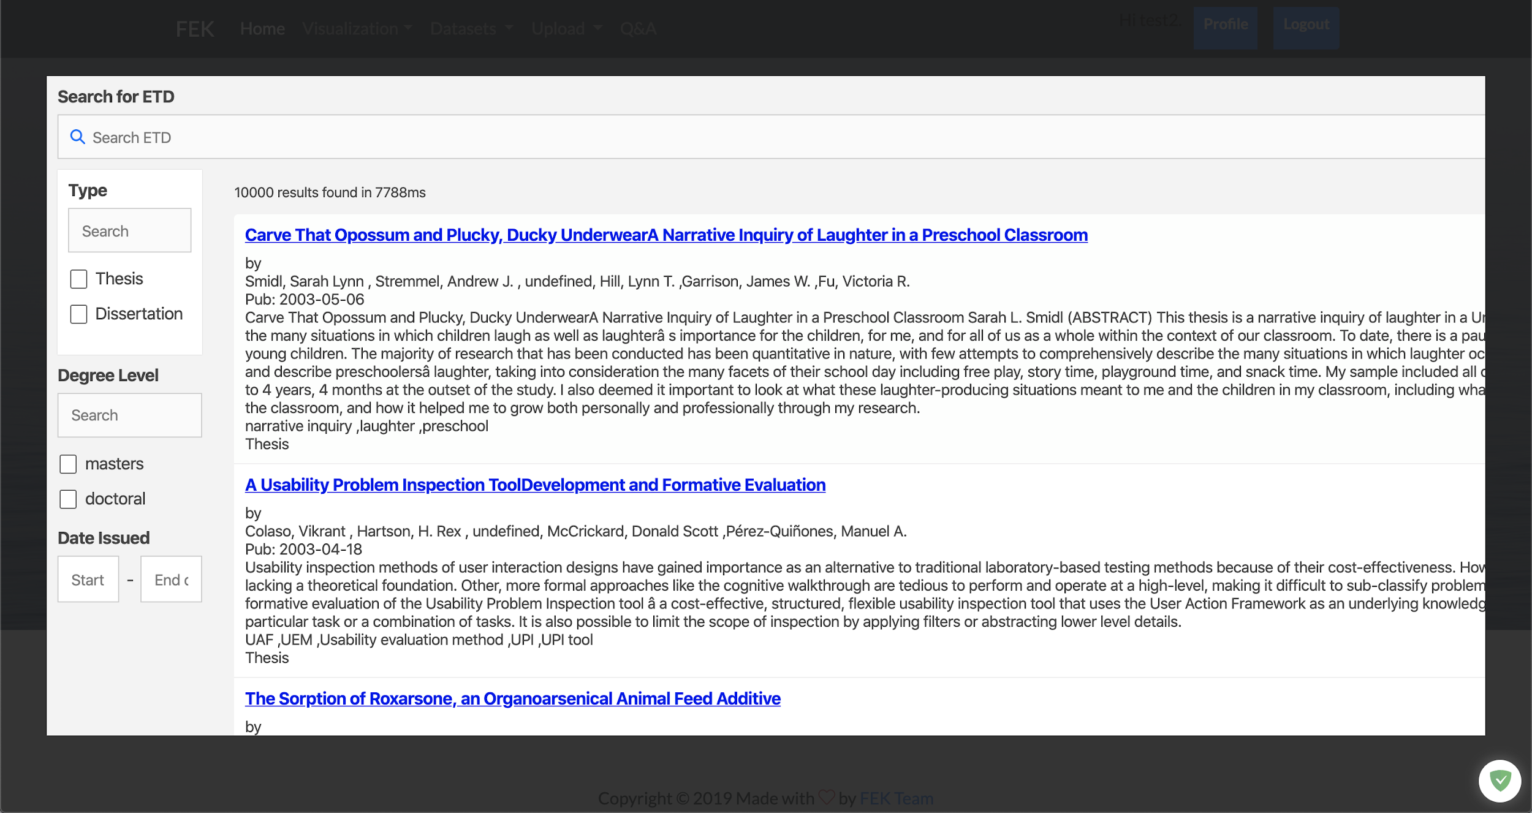
Searching demo

Slide 12
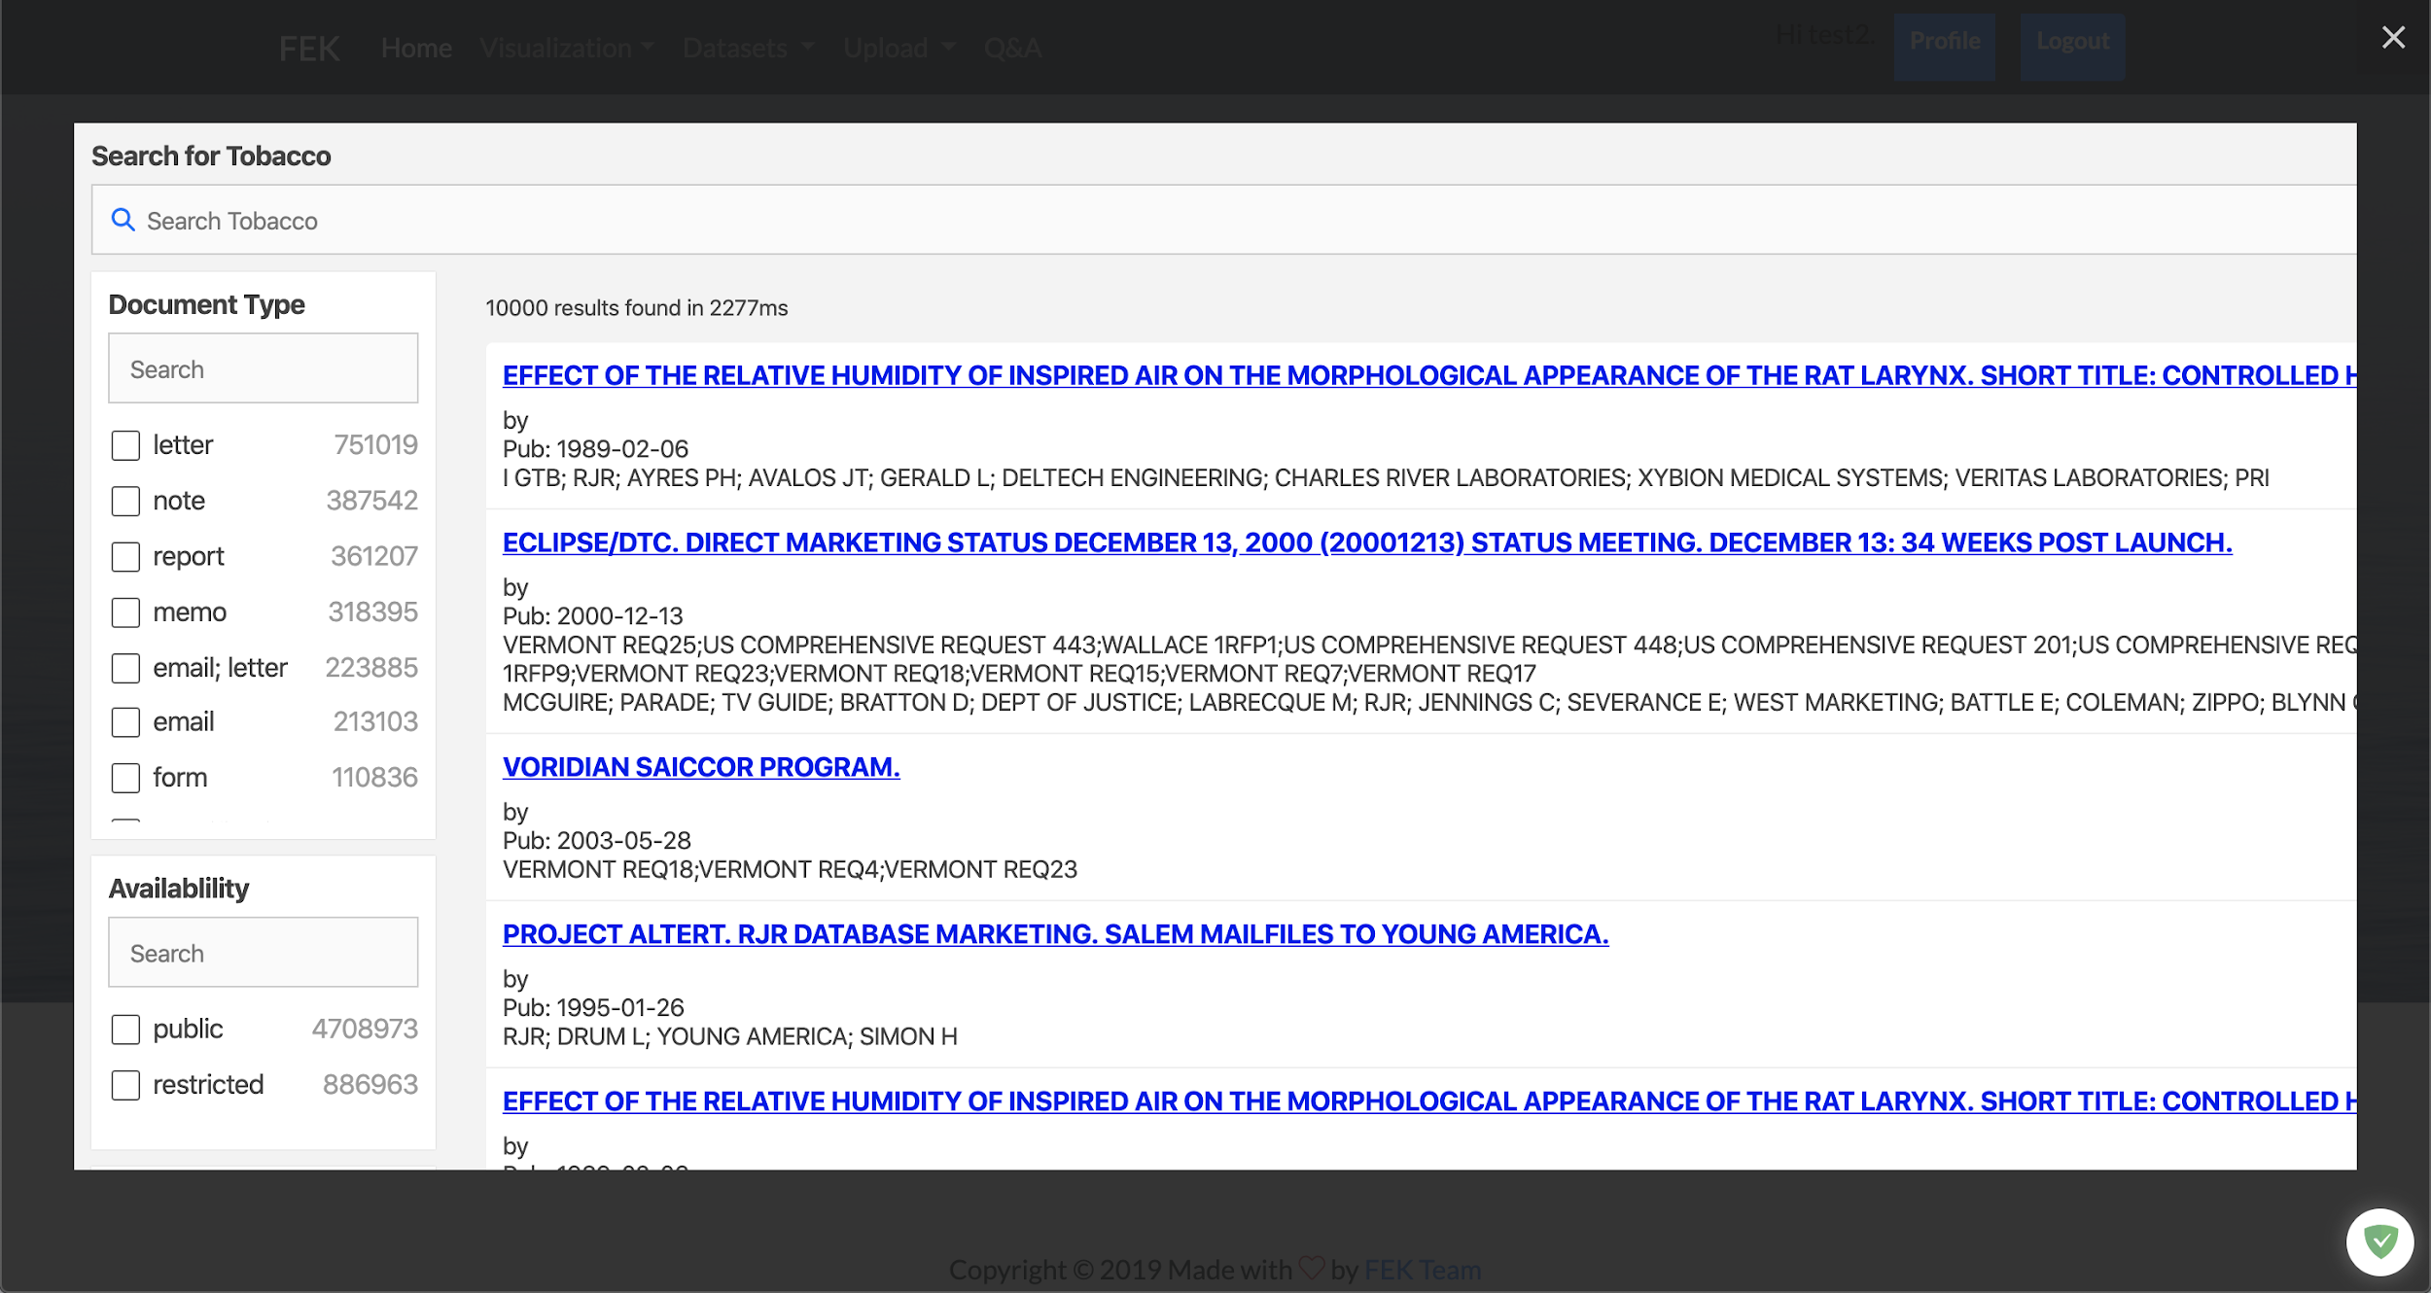
Searching demo

Slide 13

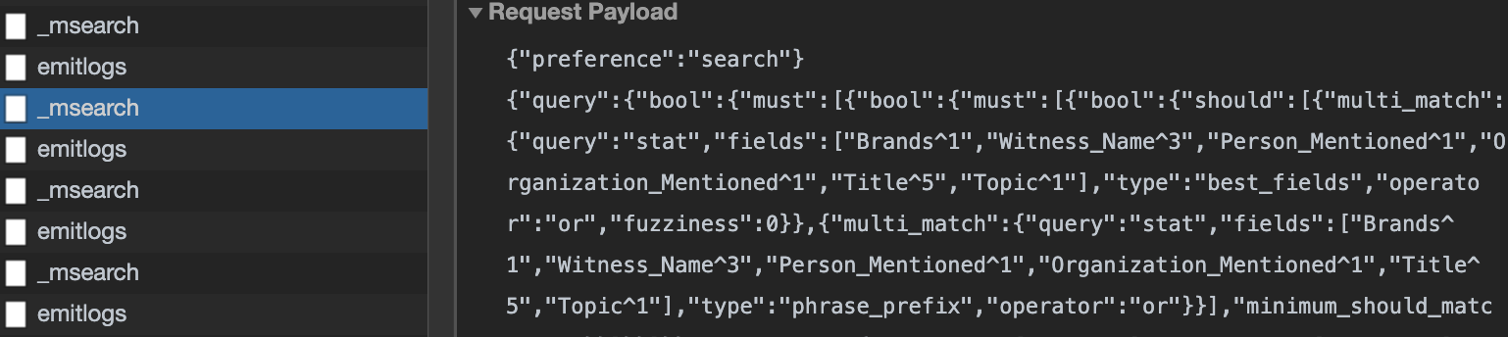
Searching requests
Requests for auto-completion

Slide 14
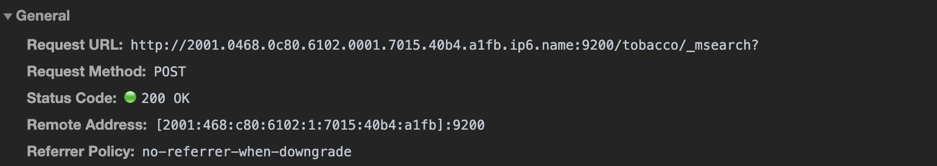
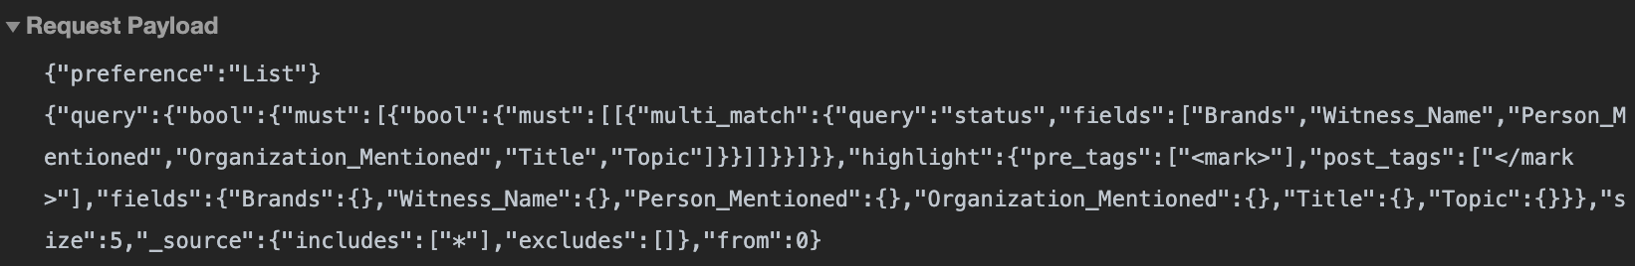
Searching requests
Requests for searching results

Slide 15
Log System
A custom record of search query, filters applied, user information, and hitting events
Saved both on Ceph and Elasticsearch

Slide 16
Log System
-- Data flow through requirements
Webpage
Search Request
Elasticsearch
Response
User hit event/ Search response success
Flask log
Persist logs
Search response fail
Ceph
Request Error Exception

Slide 17
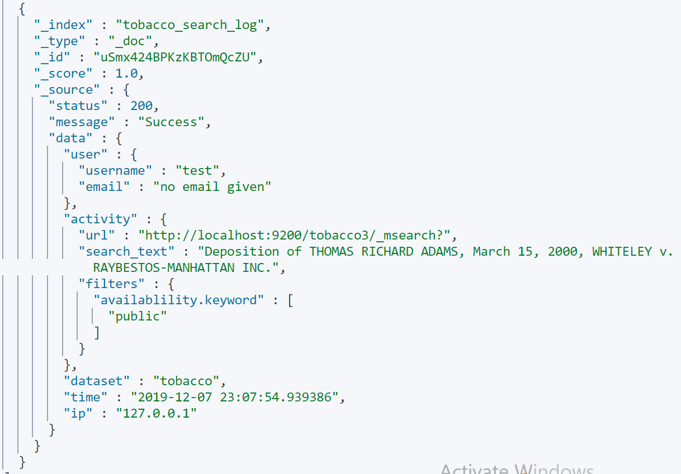
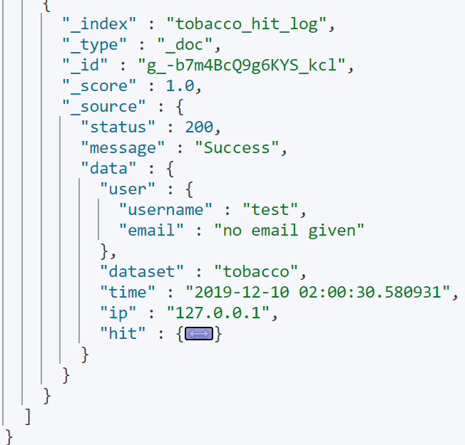
Log System -- Example
Search log example Hit log example
Original document record

Slide 18
Visualizations for ETD and Tobacco
Goals:
Visualize the data with charts, maps, tables
Build user-friendly interfaces to display visualizations
Approaches:
Python Packages: matplotlib, pyecharts
Kibana

Slide 19
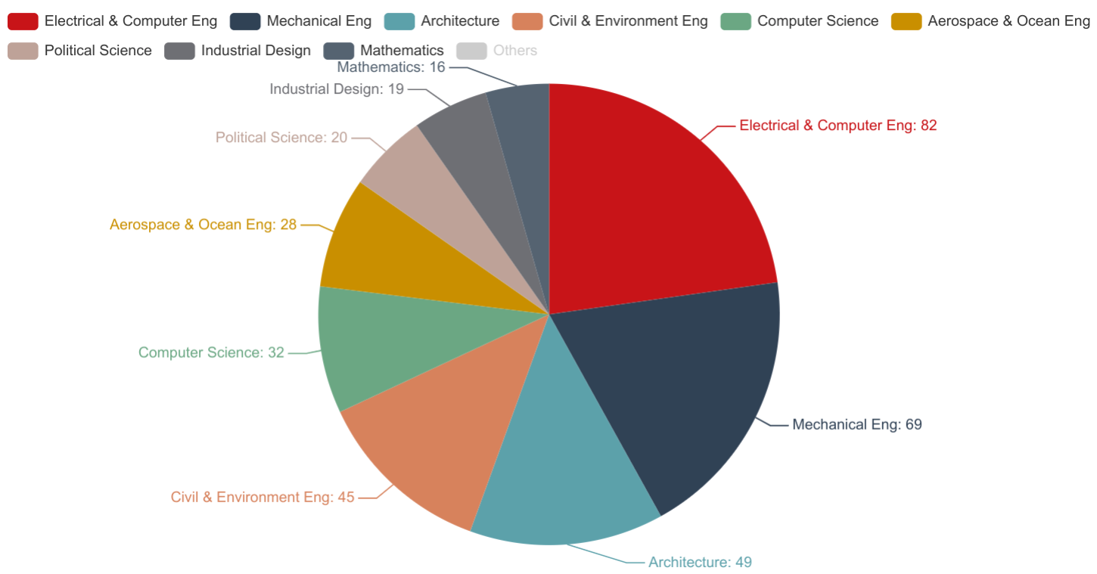
Visualizations - Python Packages
Advantages:
More flexibility of graph types
Allow us to process contents
Allow users to interact with data
Disadvantages:
Take too much time to clean and process the data
Hard to make it dynamic

Slide 20
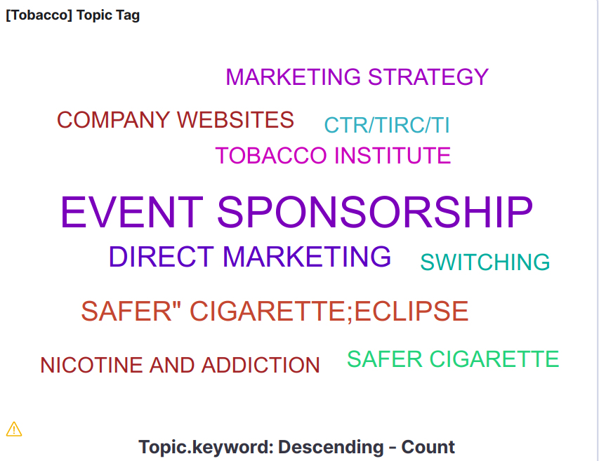
Kibana Visualizations-Tobacco Settlement Documents
Types of visualizations include: DataTable, Tag graph, Pie chart, Area Graph, Gauge
The keywords utilized mainly include: brands, cases, languages, topics
A demonstration of Tag Graph

Slide 21
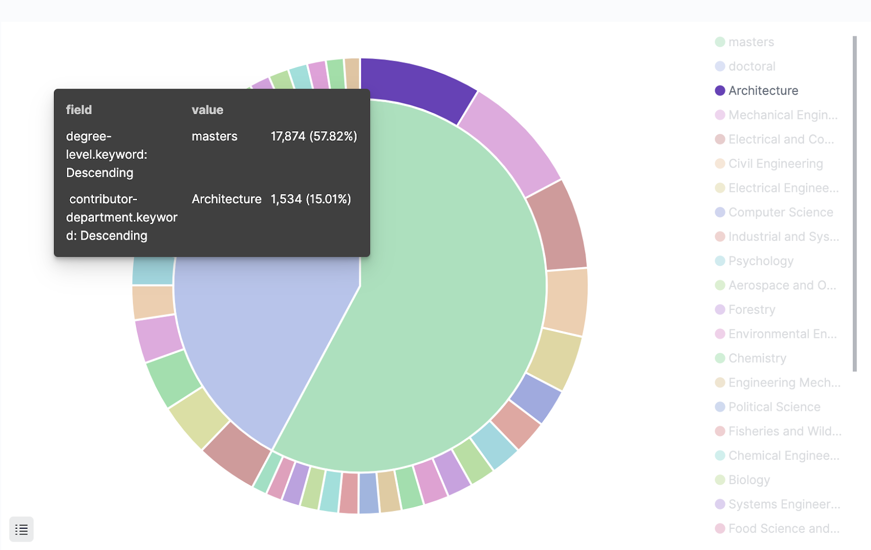
Kibana Visualizations-ETDs
Kibana is used to create a series of visualizations for users to understand the ETD dataset.
Types of visualizations mainly include:
Table, Charts, Maps
The keywords utilized mainly include:
Level of Degree, Department, Discipline, Issue Date
A demonstration of a pie chart

Slide 22
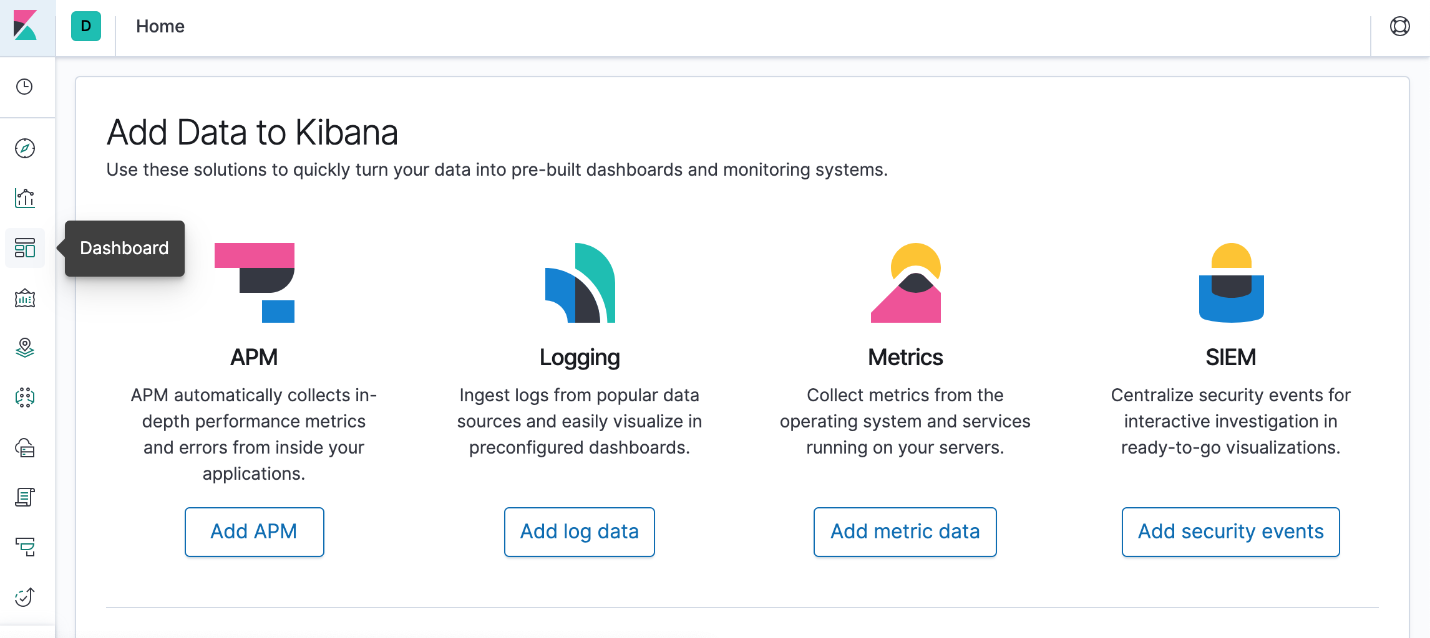
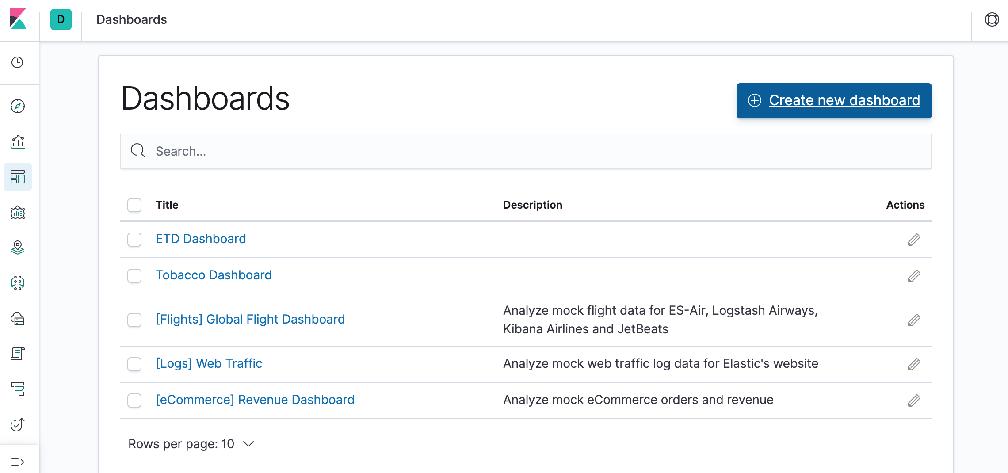
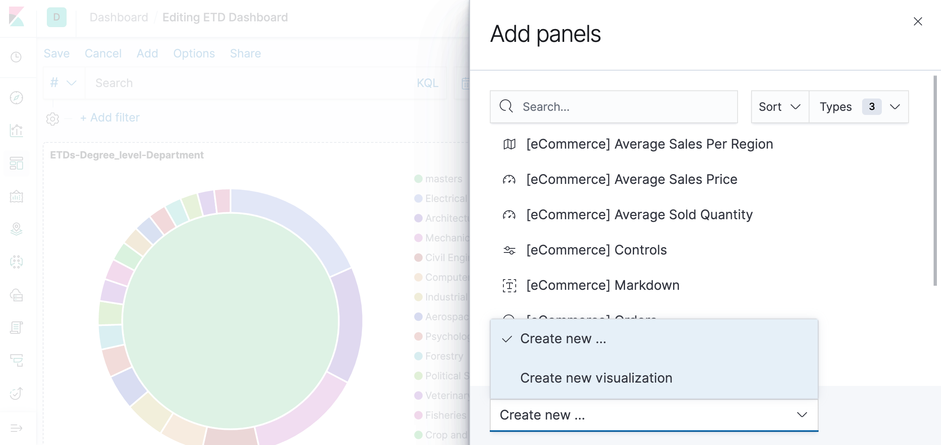
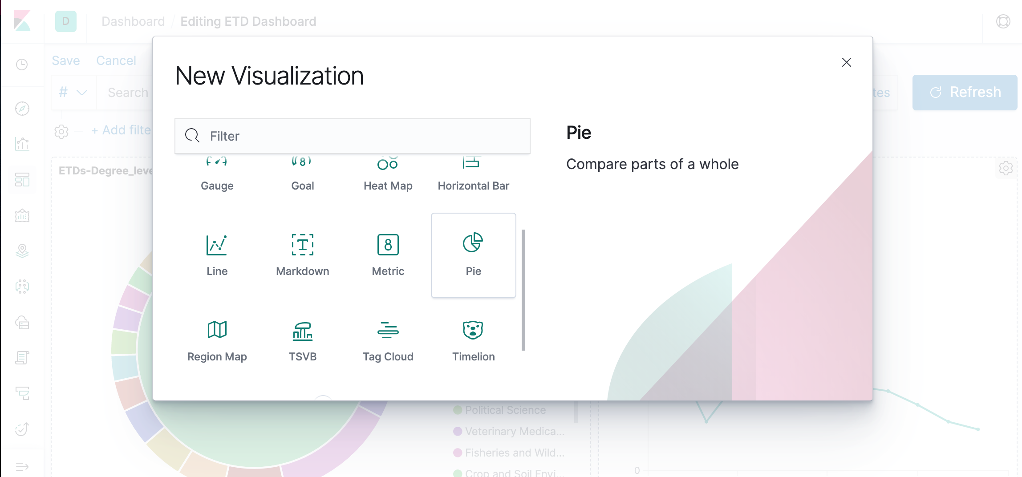
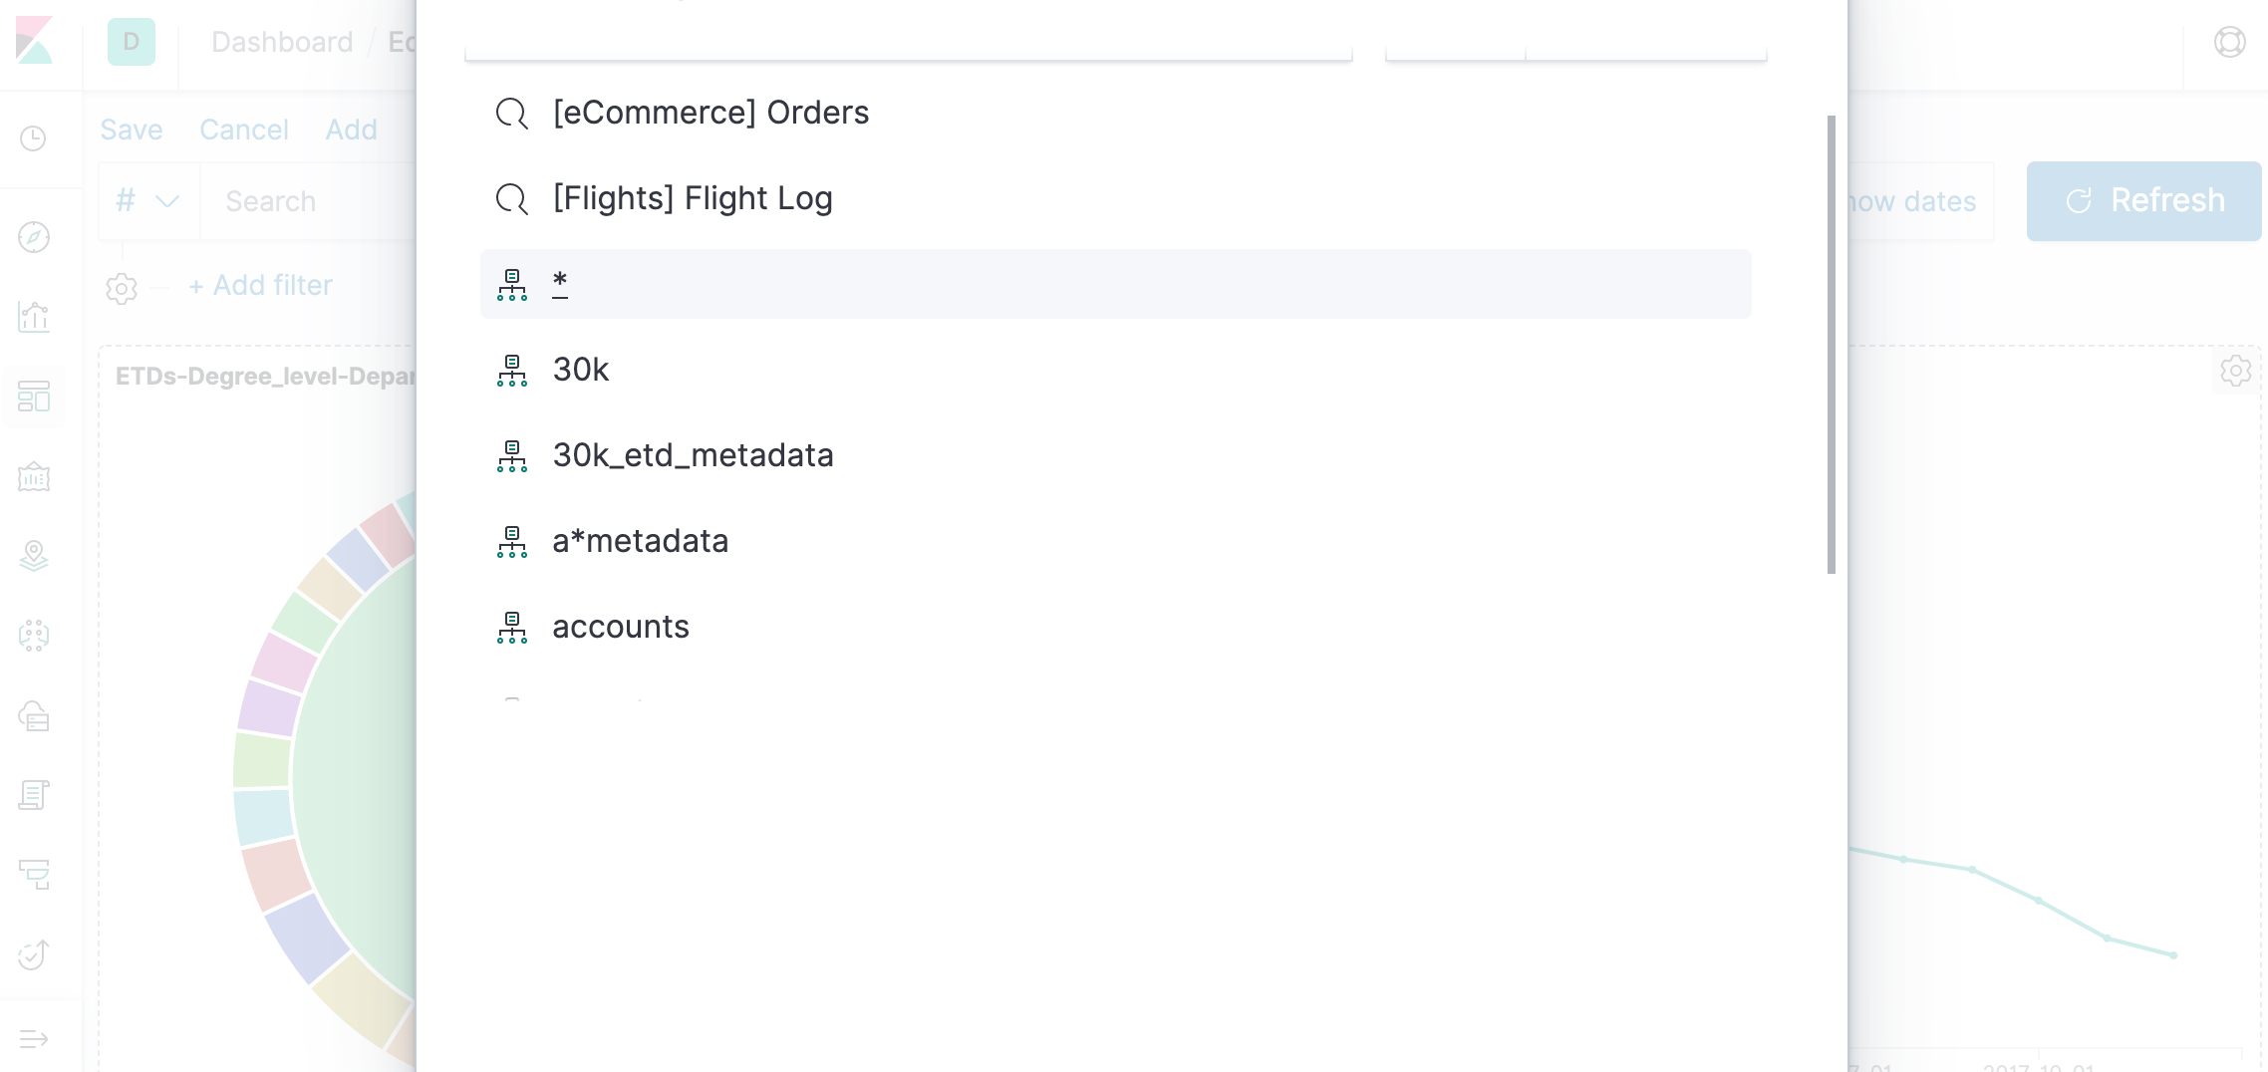
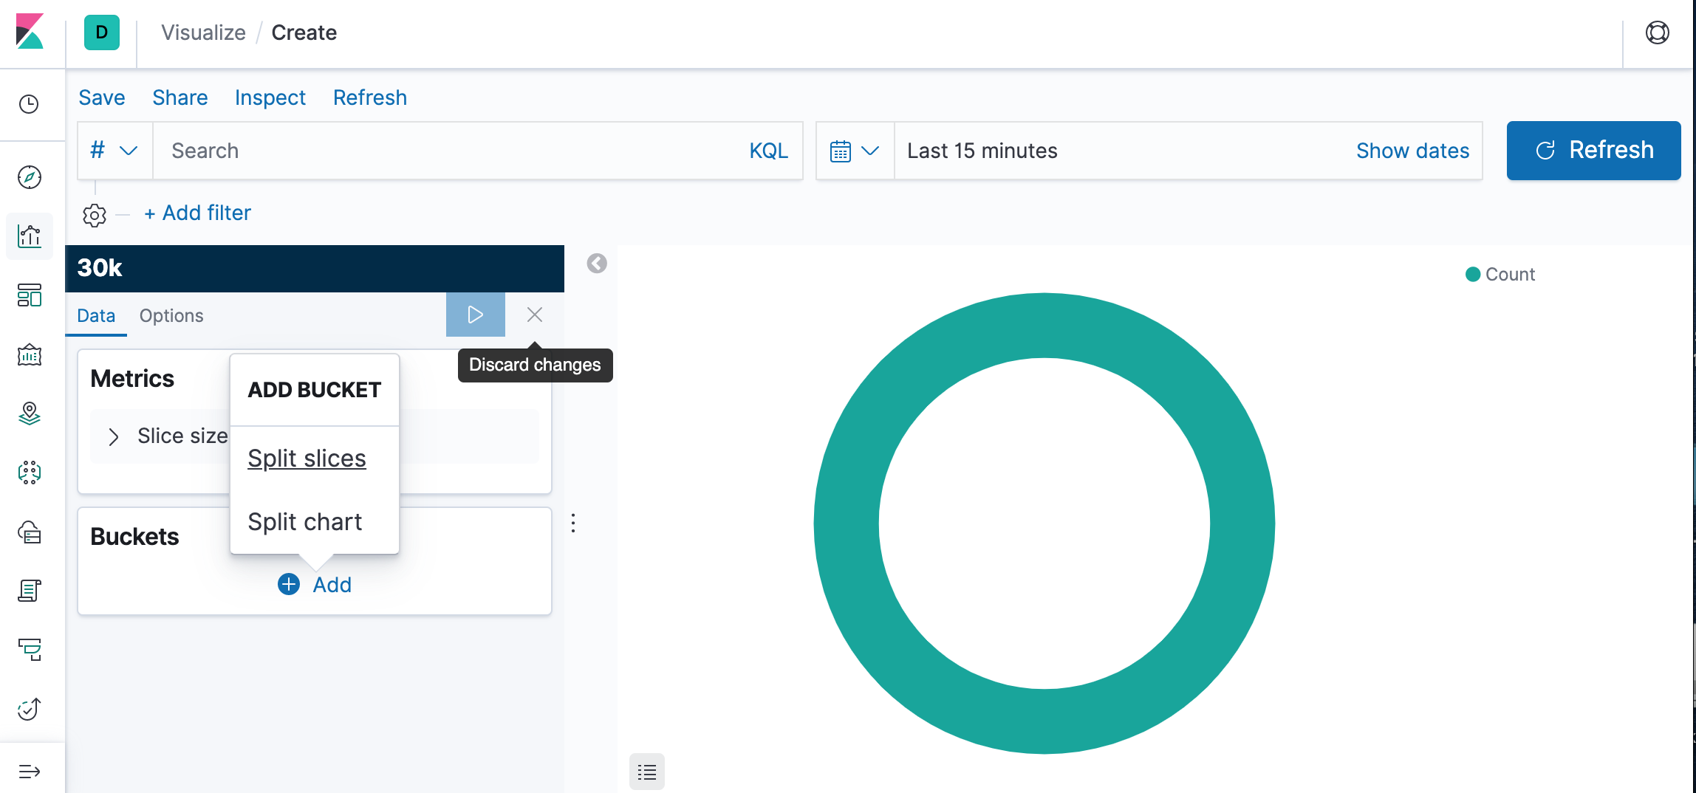
Kibana Visualizations

Slide 23
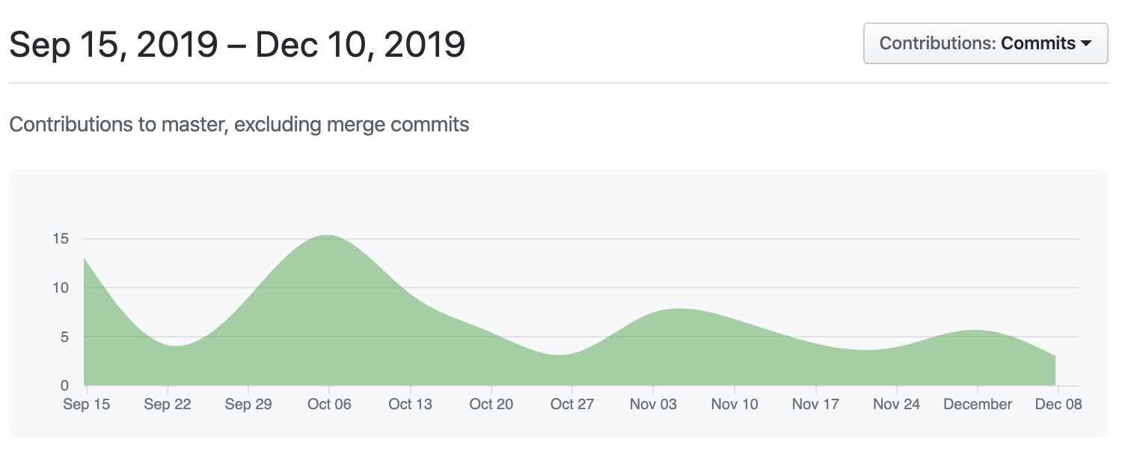
Summary
Github 2 repos, each has 110+ commits:
  ‘master’ for dev and test locally
  ‘prod’ for cloud deployment

Slide 24
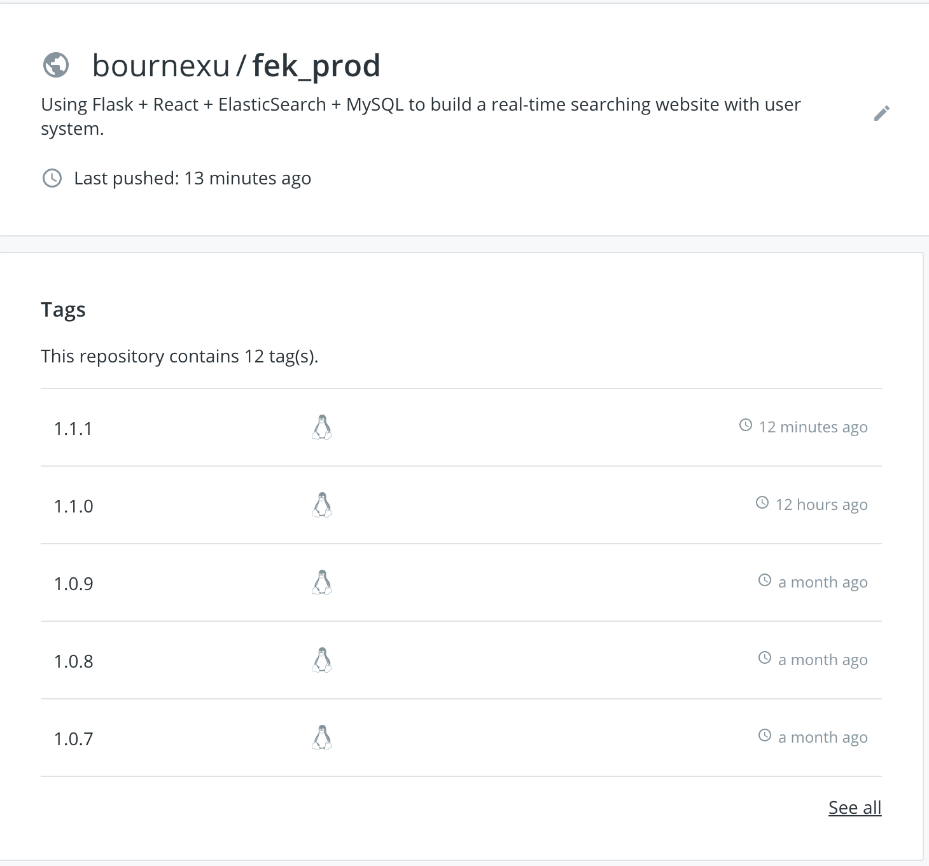
Summary
We have released 10+ versions
Now, we are at version fek_prod 1.1.1

Slide 25
Future Work
Complete unit tests for INT’s CI/CD.
Implement the TML team’s recommendation module.
Chapter 9 Section 5: Evaluation¹
Chapter 8 & Chapter 19 in textbook
Welcome to our Github to report issues and give feedback in the future
Zhai, C., & Massung, S. (2016). Text data management and analysis: a practical introduction to information retrieval and text mining. Morgan & Claypool.
Notes:
Chapter 9 section 5 (9.5) Search engine evaluation must rely on users. In order to create a test collection, we have to create a set of queries, a set of documents, and a set of relevance judgments.
Test on query speed and response speed of webpage
More functions assisting user searching

Slide 26
Conclusion
Special thanks for Dr.Fox and the CME, CMT, ELS, TML, INT groups.
Without the help from all of you guys, we couldn’t have achieved as much!!!
Funding: IMLS LG-37-19-0078-19

Slide 27
Live Demo
http://2001.0468.0c80.6102.0001.7015.b2eb.3731.ip6.name:3000/
Our website must be run through the VT network. This requires being physically in range or using VT’s VPN service

