Slide 1

Reclamation through Extraction
Shaun Rosier, PhD
Assistant Professor, Landscape Architecture
School of Design, College of Architecture, Arts, and Design

Slide 2
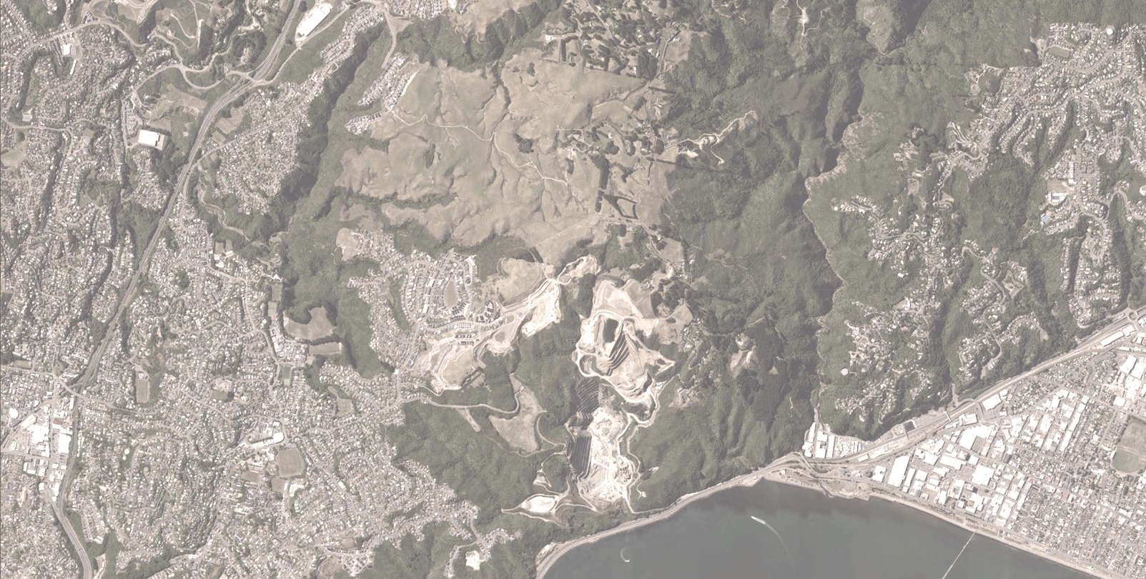
Large Image
Horokiwi, New Zealand

Slide 3
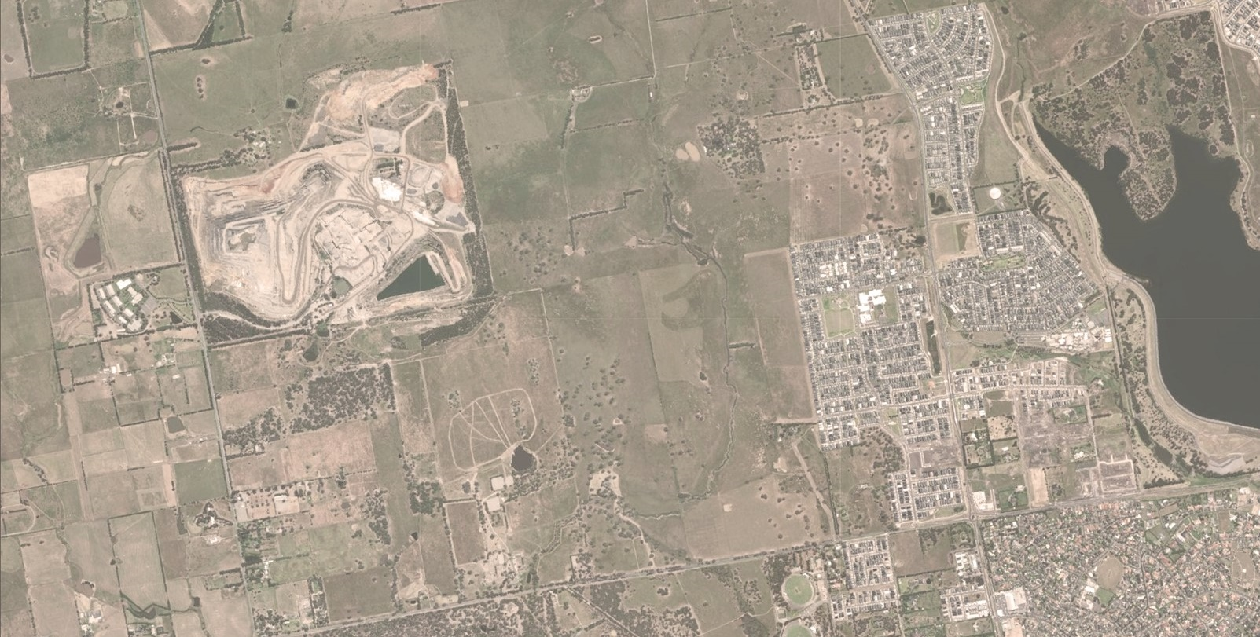
Large Image
Melbourne, Australia

Slide 4
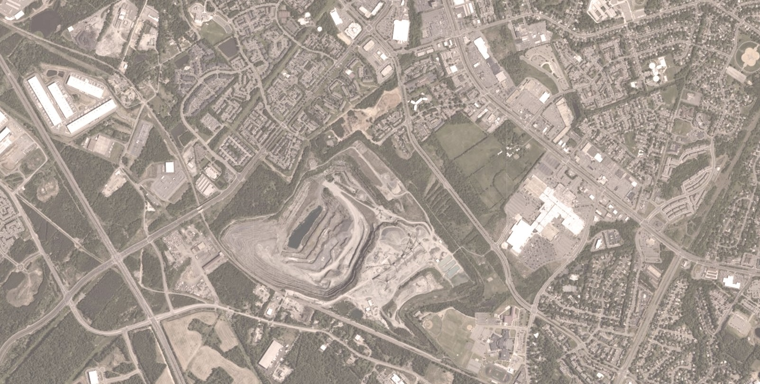
Large Image
Manassas, Virginia
Notes:
Horokiwi in New Zealand, Melbourne in Australia, and Manassas in Virginia each exhibit a contemporary condition characterized by the encroachment of the urban field upon what were once rural or peri-urban sites of extraction. As we can see in these aerial images, suburbia, infrastructure, places we shop, eat and live in are no surrounding the very holes in the ground that produced them.

Slide 5
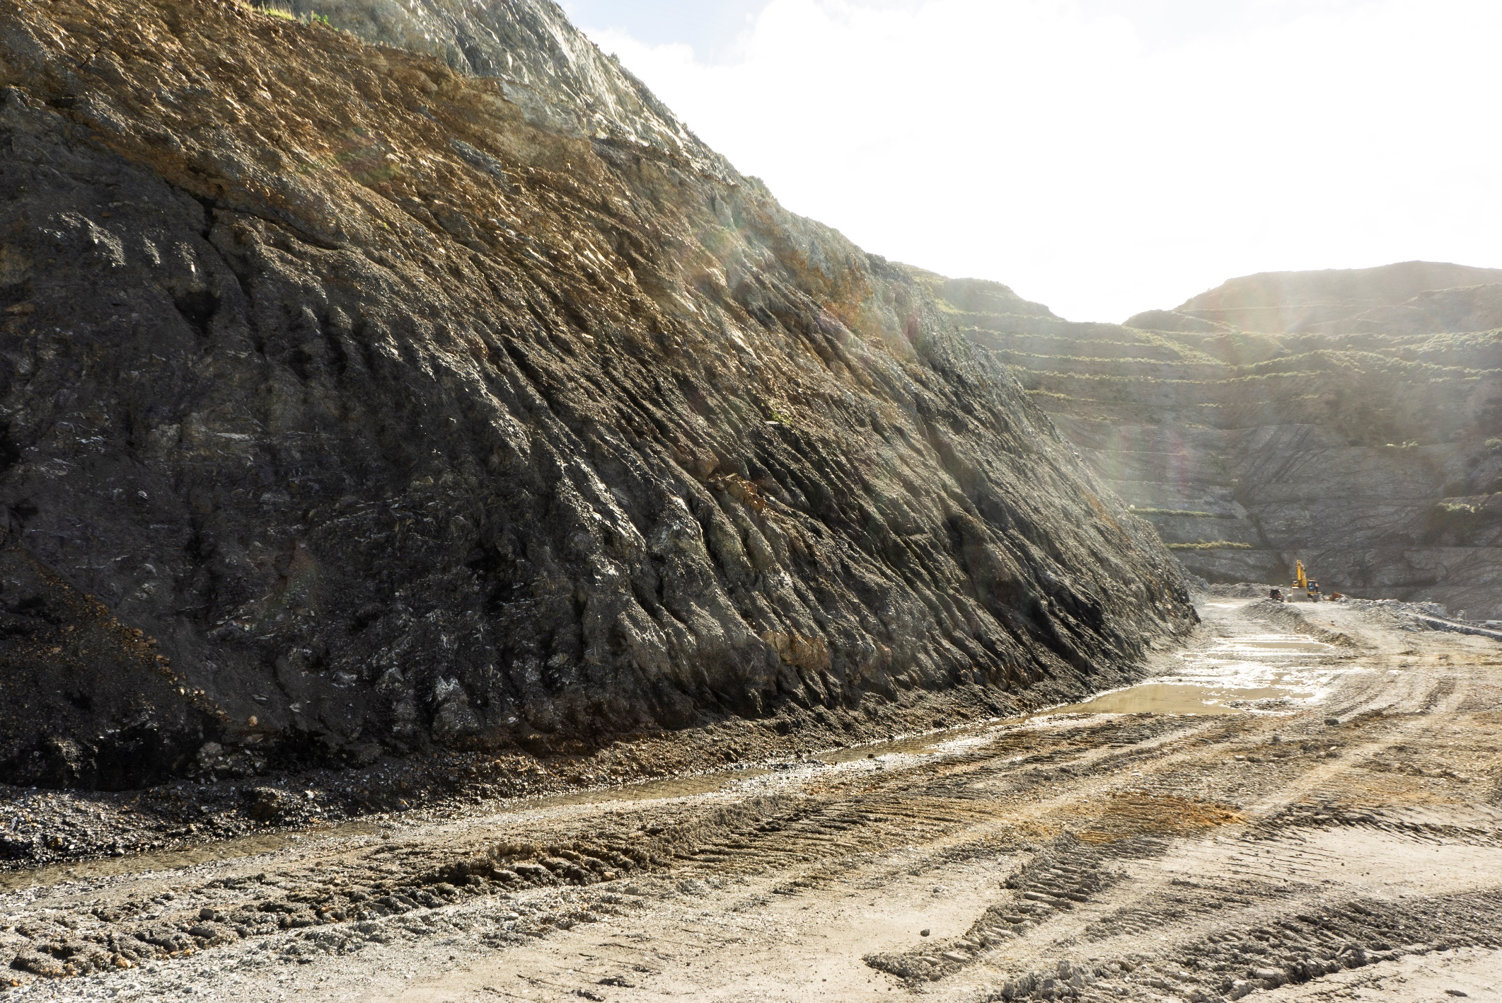
What to do with a hole in the ground
Problem only going to get worse
Predominant approaches not suited to these contexts and problems
Mismatch between community and operator priorities
How to stretch a dollar further
Notes:
This problem is only going to get worse as urban sprawl continues in both developed and developing countries, which will only put more pressure on existing remediation approaches that are not necessarily well suited to these contexts. Similarly, issues around funding and responsibility will only worsen as quarry operators either sell sites so they can exit quietly or just leave entirely with the job half finished because current funding structures have proven inadequate or simply beatable by corporations.

Slide 6
Landscape Architecture is the ambulance at the bottom of the (quarried out) cliff
Notes:
In light of this problem, right now landscape architecture is the proverbial ambulance at the bottom of the cliff, responding well after the damage has been done.

Slide 7
How can landscape architectural design operate within the economics and operations of extraction?
Notes:
But what if this wasn’t the case, what if we can integrate landscape architectural design methodologies into the operations and economics of extraction so that its not just cleaning up at the end but rather a continuous and unfolding process?
This is the research question posed by this presentation.

Slide 8
What is the current state of play?
Notes:
In order to contextualise the proposed solution to this question, there are several pre-existing approaches to dealing with post-extraction landscapes that are worth introducing first

Slide 9



Predominant approaches to dealing with post-extraction landscapes
Progressive Rehabilitation
Geomorphic Restoration
Post-Mining Landscape Design
“mining and restoration [is] a coherent, single process”
Martin Duque et al., 2021, p. 400
“Reconstruct landforms that reduce the effect of natural geomorphic processes” DePriest et al., 2015
Public space design to provide amenities, though typically omits large-scale topographical alterations
Notes:
We have three similar but distinct enough predominant approaches: Progressive Rehabilitation, Geomorphic Restoration, and what I’ve termed Post-Mining Landscape Design.
The former two emerged from the natural and physical sciences, whereas the latter is a form of landscape architectural design that may or not involve scientific practices.

Slide 10
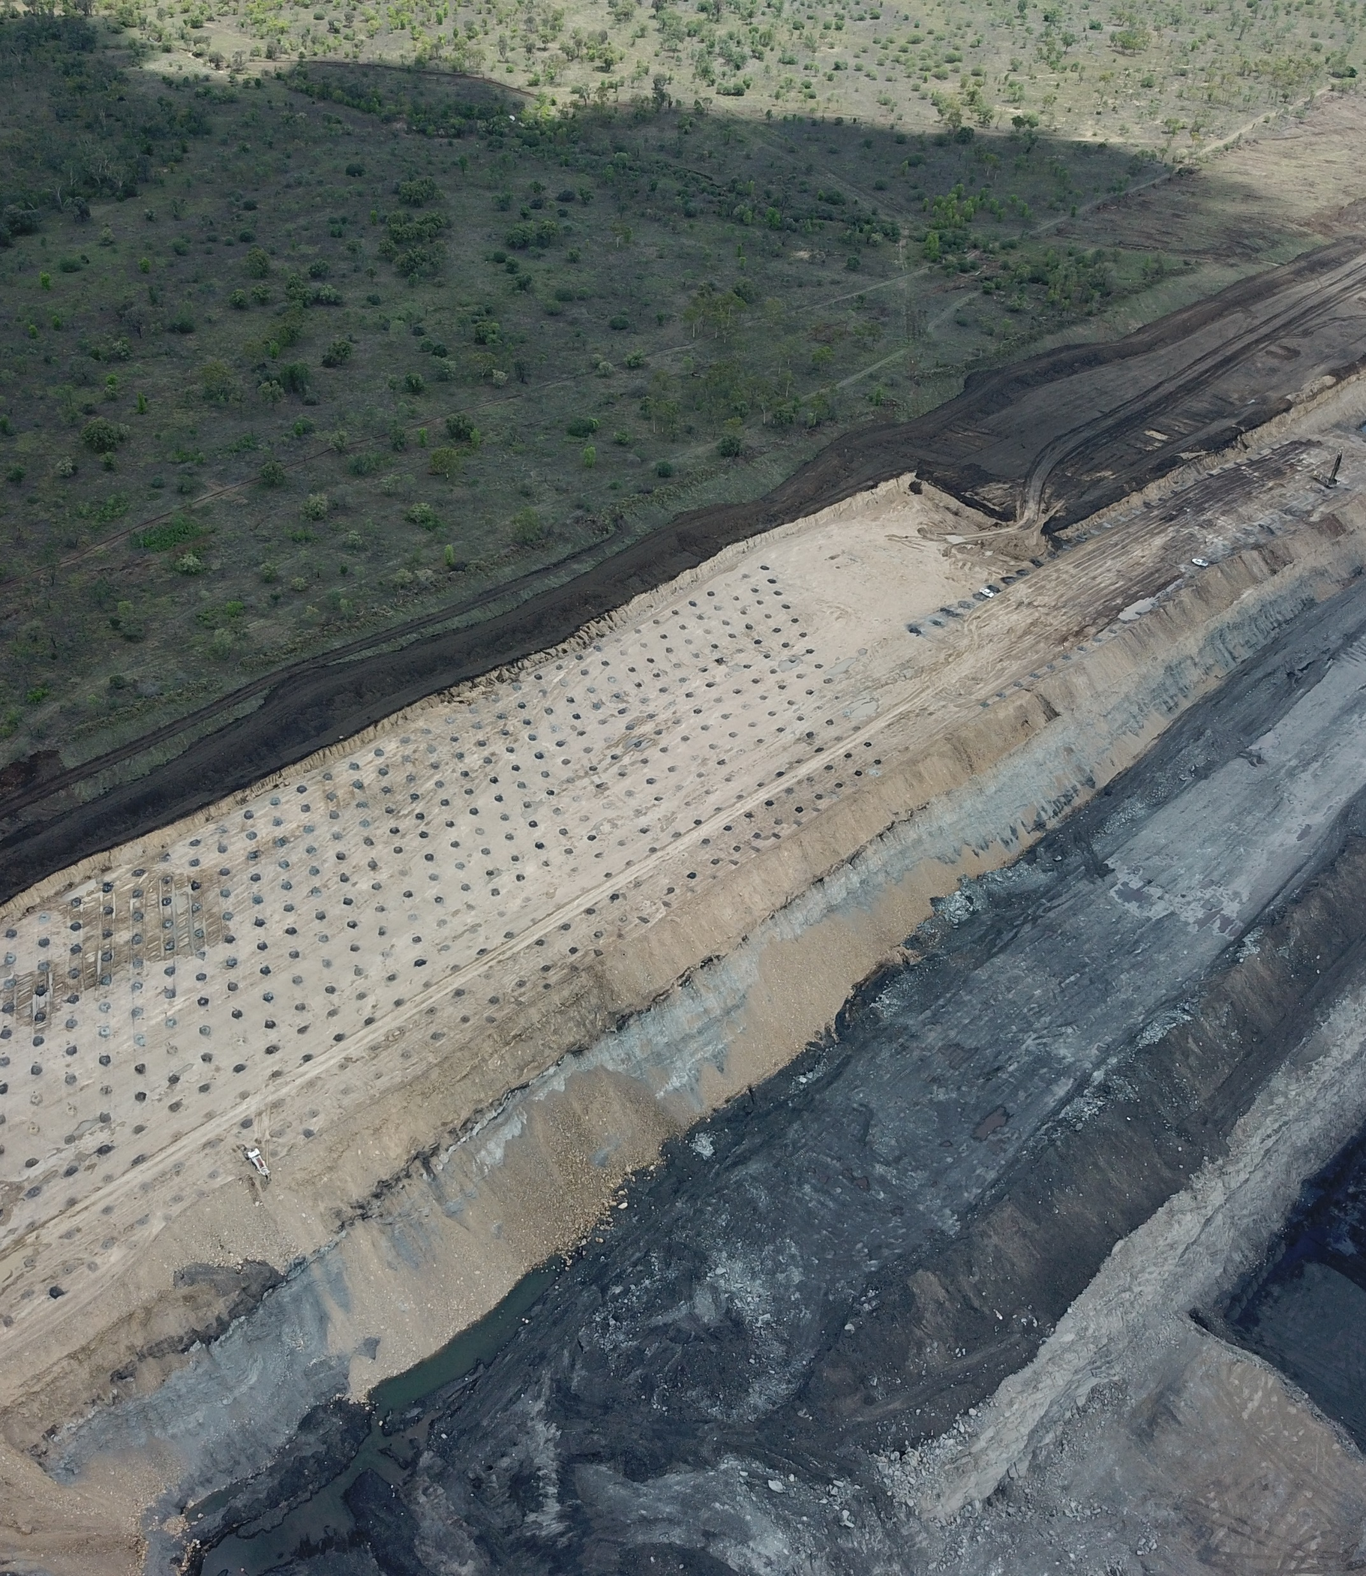

Photo and Quote
The conventional approach involves stabilizing and greening over minimally or unaltered post-extraction topography
Progressive Rehabilitation
Source: https://globalroadtechnology.com/environmental-best-practice-for-mining-part-2-mine-site-rehabilitation/
Notes:
First is Progressive Rehabilitation which is the most conventional and widely spread approach that typically relies on revegetation strategies in areas that are no longer in operation. This allows for a cheaper and quicker remediation process than starting post-extraction.

Slide 11
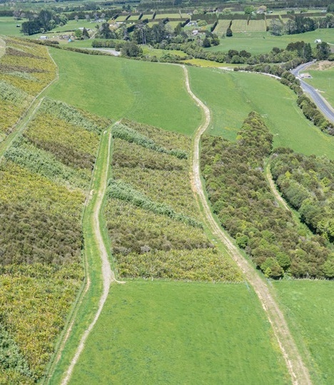
Photo and Quote
Leaving behind monolithic landforms covered with vegetation.
An overt desire to appear ‘natural’ as cheaply as possible
Almost exclusively technoscientific in approach
Progressive Rehabilitation
Source: https://www.waihigold.co.nz/about-mining/rehabilitation/
Notes:
However, it does little to rework the altered topography, is typically devoid of extensive design, and assumes that greening over is the most appropriate response. Similarly, it is also quite restrictive in the landscape typologies that are possible due to the cost and scientific preoccupations.

Slide 12
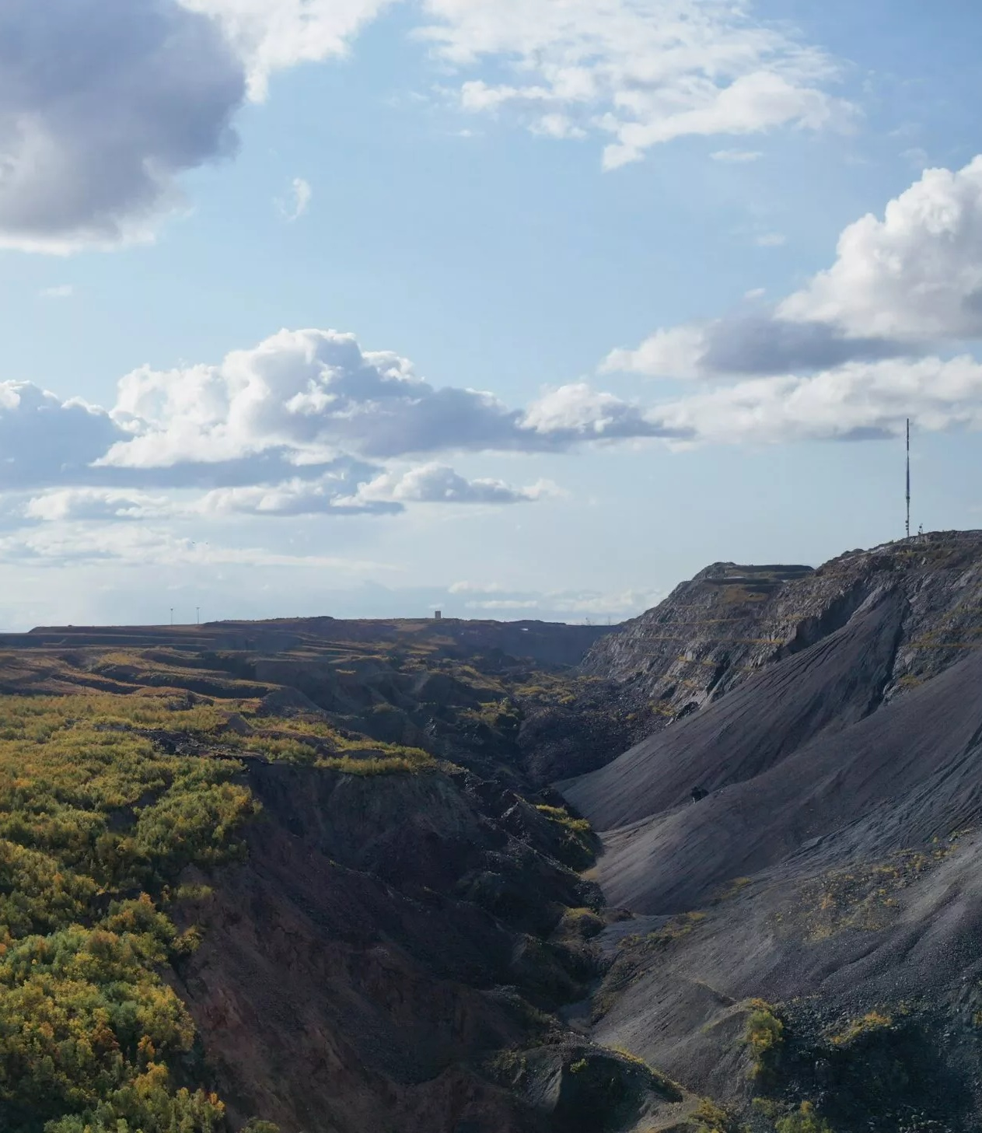
Photo and Quote
Shift from creating unstable geomorphic conditions based on ‘old school’ techniques
Geomorphic Restoration
Source: https://vast-la.com/kiruna/
Notes:
Second we have Geomorphic Restoration which is a more contemporary and developing approach

Slide 13
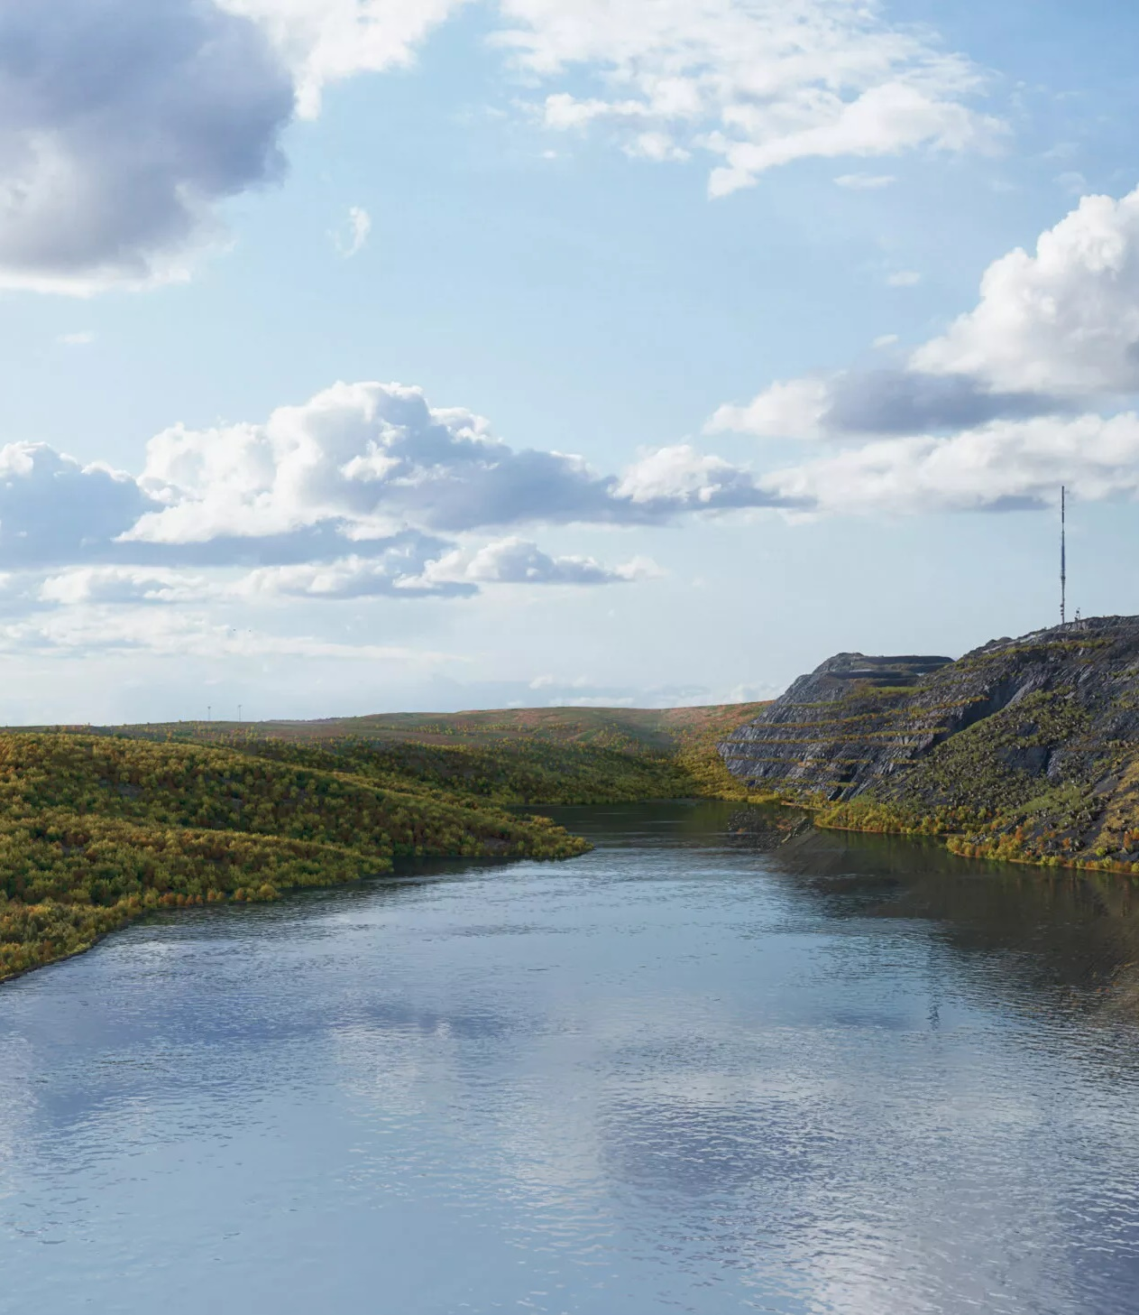
Photo and Quote
To stable conditions where erosion and sedimentation forces across the landscape are balanced
Geomorphic Restoration
Source: https://vast-la.com/kiruna/
Notes:
That is based on designing landform and hydrologic profiles in order to balance erosion and sedimentation forces by mimicking analogous landscapes that exhibit this force balance.

Slide 14
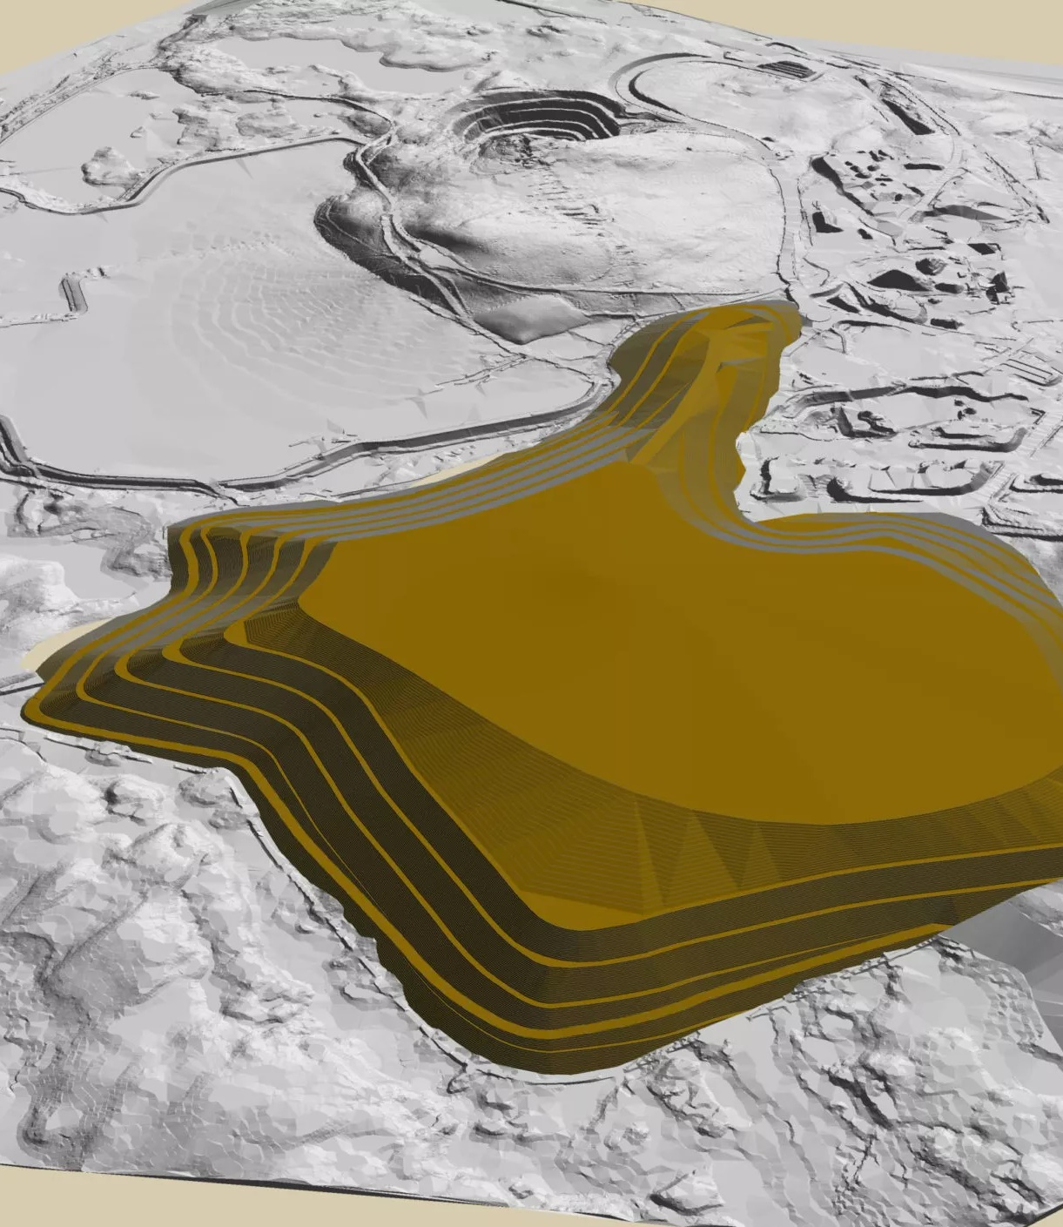
Photo and Quote
VAST approaches this from a landscape architectural position
Advanced 3D modelling of existing, proposed, and analogous unaltered landscapes
Geomorphic Restoration
Source: https://vast-la.com/svappavaara/
Notes:
VAST, a small landscape architecture office in Sweden, employ this method from a designers perspective and have had immense success. Whilst they’re still operating from a position that prioritises natural restoration, largely because the sites they work with are very remote, the fact they’ve looking to go beyond just technoscientific processes is promising.

Slide 15
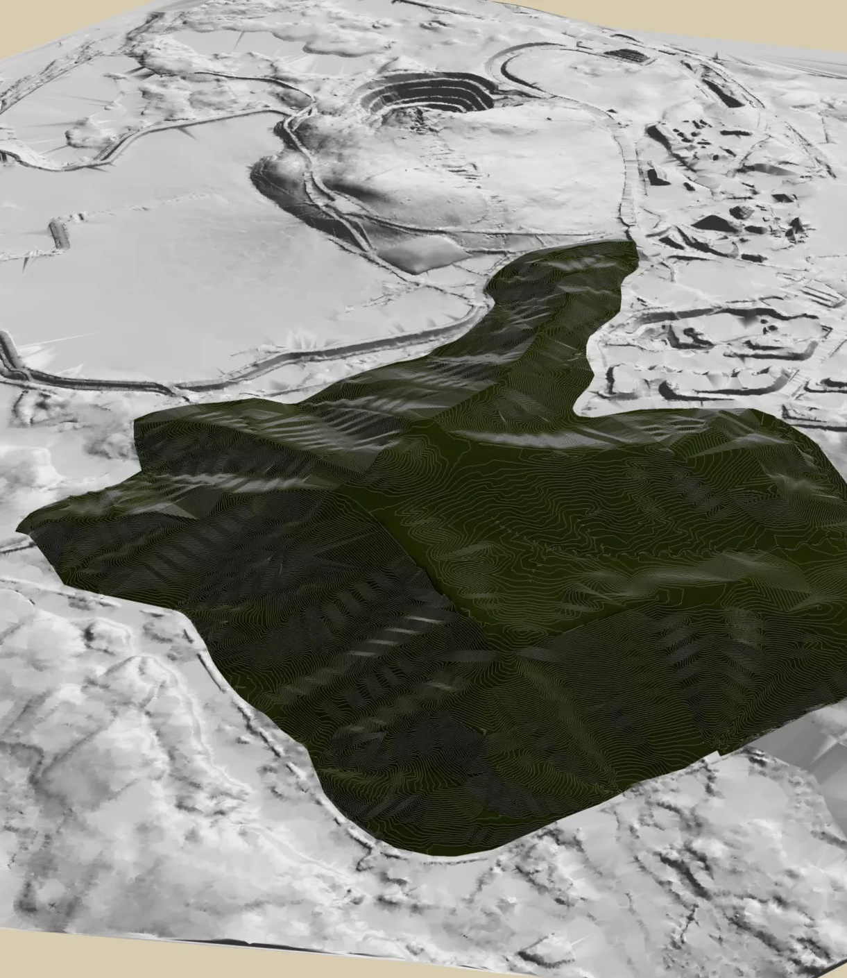
Photo and Quote
Leading to a landscape system that is self-maintaining
LA perspective folds in a much wider range of concerns and creative problem-solving outcomes
However…less relevant to urban/peri-urban quarries
Geomorphic Restoration
Source: https://vast-la.com/svappavaara/
Notes:
They’re method allows them to fold in a much wider range of concerns and perspectives inherent to landscape architectural praxis, leading to truly innovative works. However, due to the nature of the work, geomorphic restoration is by and large much less relevant to the urban quarries in question here

Slide 16
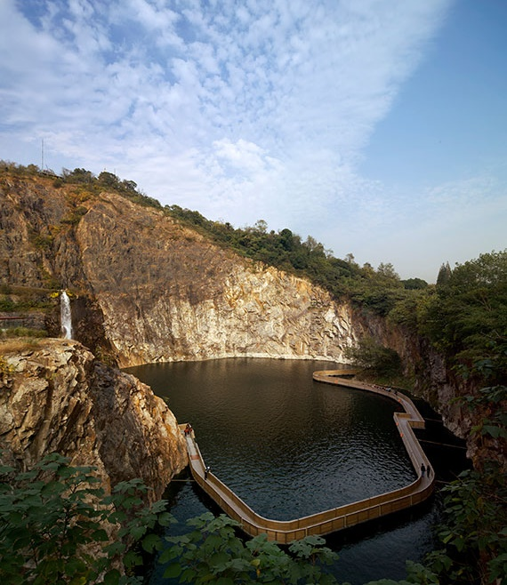
Photo and Quote
Designers engaged with the problem long after extraction has been completed
Typically involves the creation of a curated series of views and post-industrial objects in the form of a park
Post-Mining Landscape Design
Source: https://landezine.com/quarry-garden-in-shanghai-botanical-garden/
Notes:
Lastly we have the quarry design approach we’re most familiar with, one that takes place well after extraction has been completed, typically to create a park landscape.

Slide 17
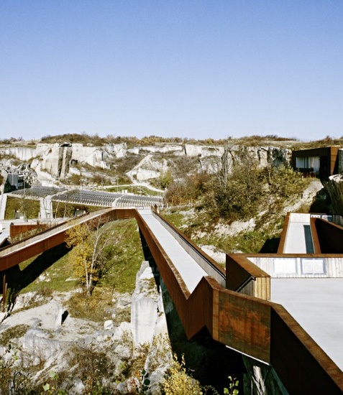
Photo and Quote
However, limitations exist in the ability to seriously reconfigure landscape structure
Lack of machinery, capital, and will to create big moves
Post-Mining Landscape Design
Source: https://www.awg.at/project/rom-e/
Notes:
Whilst there are numerous incredibly successful projects in this modality, they’re still largely restricted in their ability to seriously reconfigure the landscape structure due to capital, machinery and the will to do so no longer being present.

Slide 18
Design-Led Progressive Reclamation
Notes:
In response to the question posed earlier, I would like to propose a 4th approach that I’ve termed Design-led Progressive Reclamation

Slide 19
WHAT THIS CURRENTLY IS AND WHAT IT ISN’T
IT IS an initial outline of a proposed approach or methodology
IT ISN’T a tested or implemented solution to a problem
Notes:
To preface things, its worth noting that this is a outline of a proposed methodology intended to open the door to further inquiry and experimentation

Slide 20
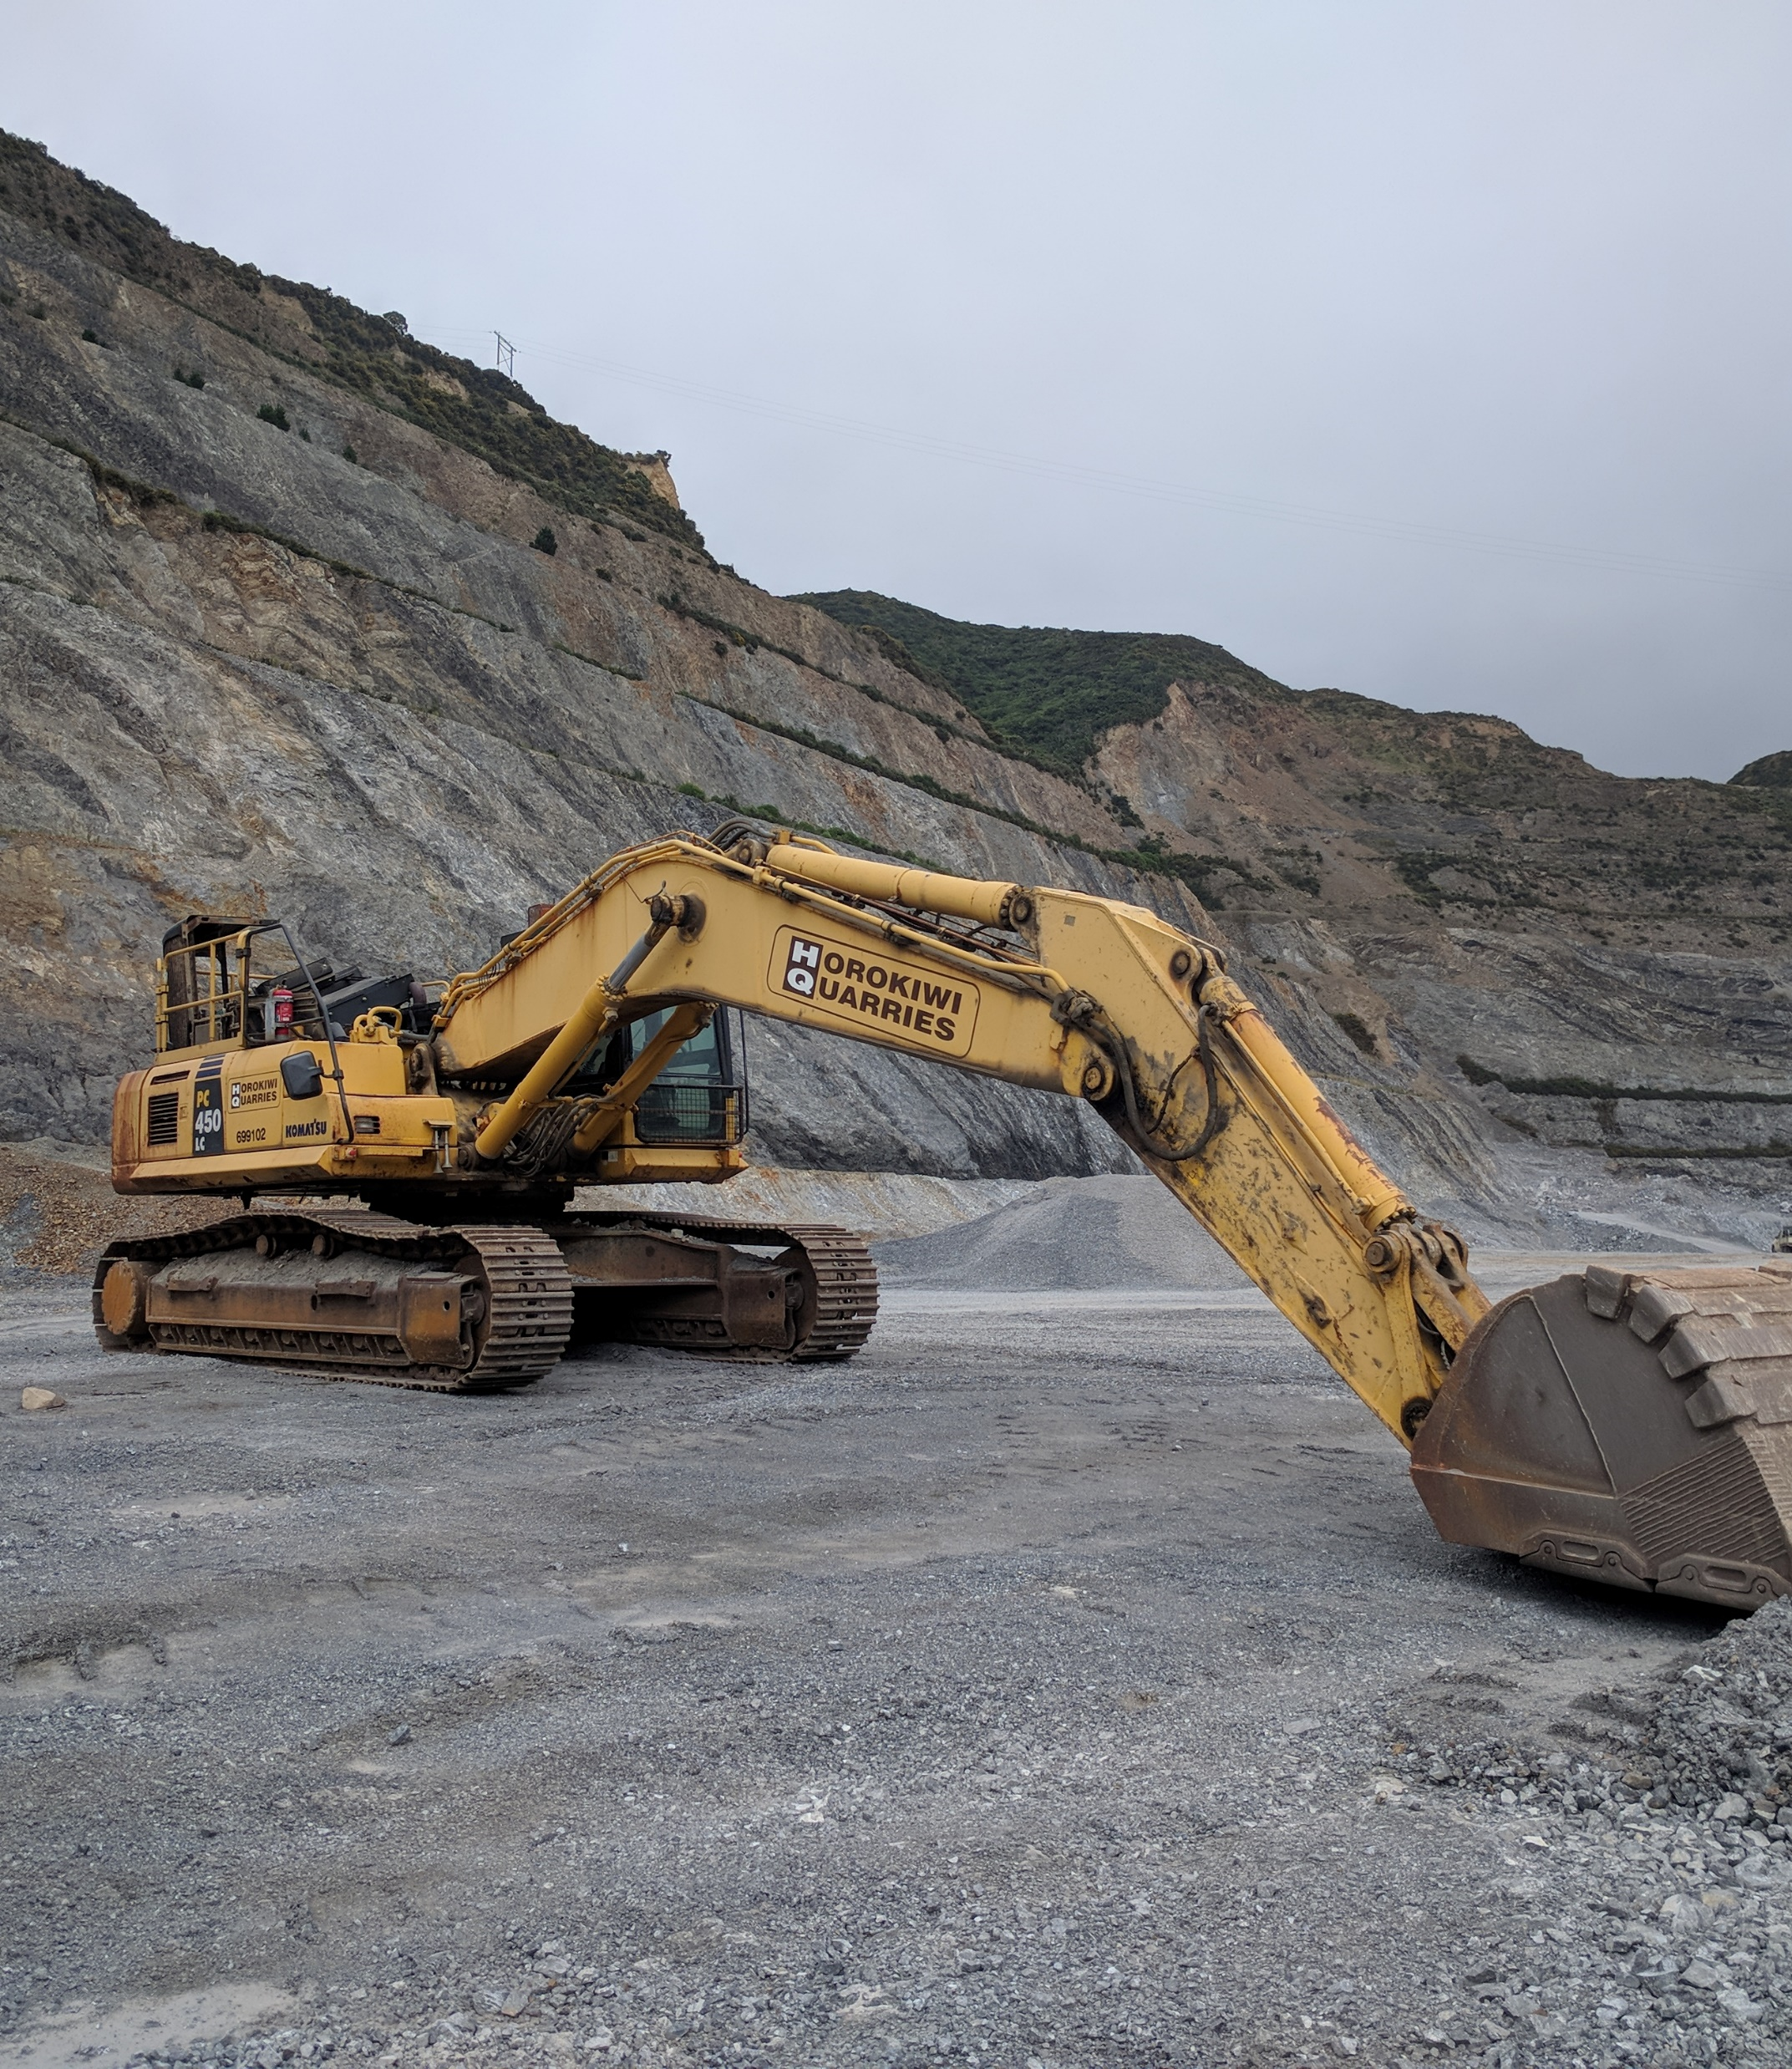
Photo and Quote
Embed the landscape architect within processes and economics of extraction
Create designed form through material cut
Opens up whole reclamation project to radical experimentation
Design-Led Progressive Reclamation
Notes:
This approach is premised on having landscape architectural design embedded within the processes and economics of extraction so that the eventual final form of the park can be created through cut, as opposed to minor adjustments after the fact. Doing so opens up the whole design process to radical experimentation in terms of what a quarry park can be.

Slide 21
Design-Extraction Timeline
PHASE 1
PHASE 2
PHASE 3
PHASE 4
Extraction begins.
Large scale scenario planning.
Initial designing
Dialogue with material extraction
Extraction winds down.
’Finishing’ topographical changes made
Full transition to public park landscape through final ‘panoptic’ design moves.
Design-Led Progressive Reclamation
Notes:
Here is an initial phasing diagram for this process which I will break down further by using some drawings from my practice-based research.

Slide 22
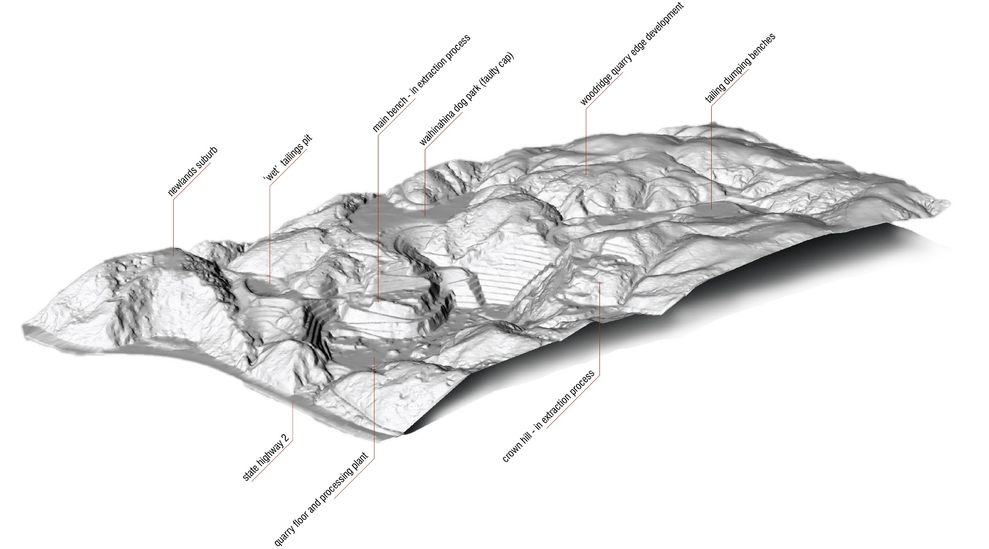
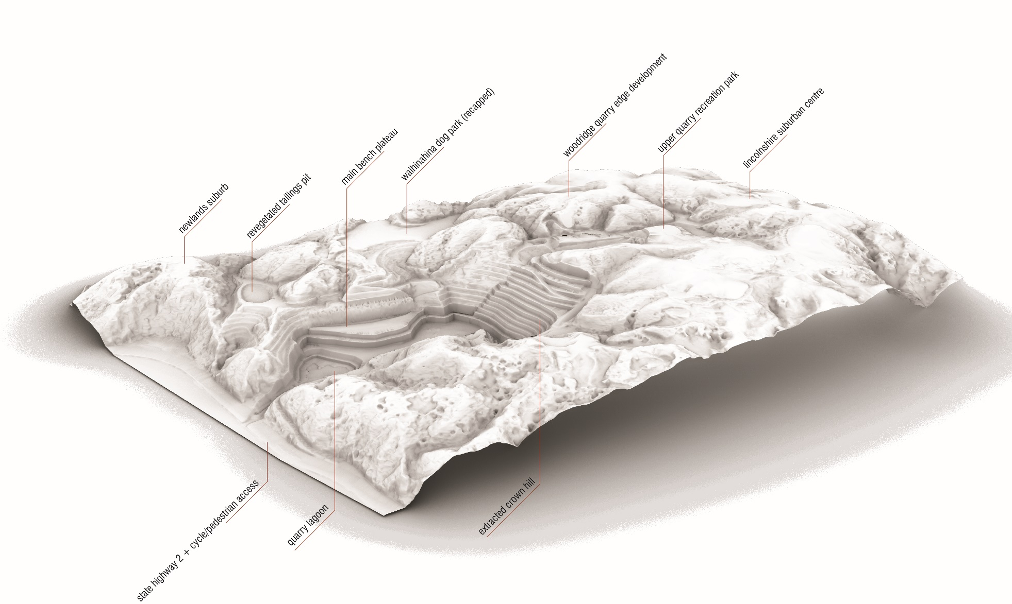
Photo and Quote
“design and planning considerations are identified, catalogued, and logically integrated into a series of alternatives” (Jaakson, 1981, p.33)
Not making choices but instead revealing means of evaluation
PHASE 01: Design-Led Progressive Reclamation
Notes:
The first phase begins with a scenario planning activity where a series of alternative situations based on a series of variables or desired outcomes are compared and contrasted. Doing so doesn’t provide a direction to go forward with, but it does provide a range of imminent as opposed to transcendent criteria to evaluate the design work that follows

Slide 23
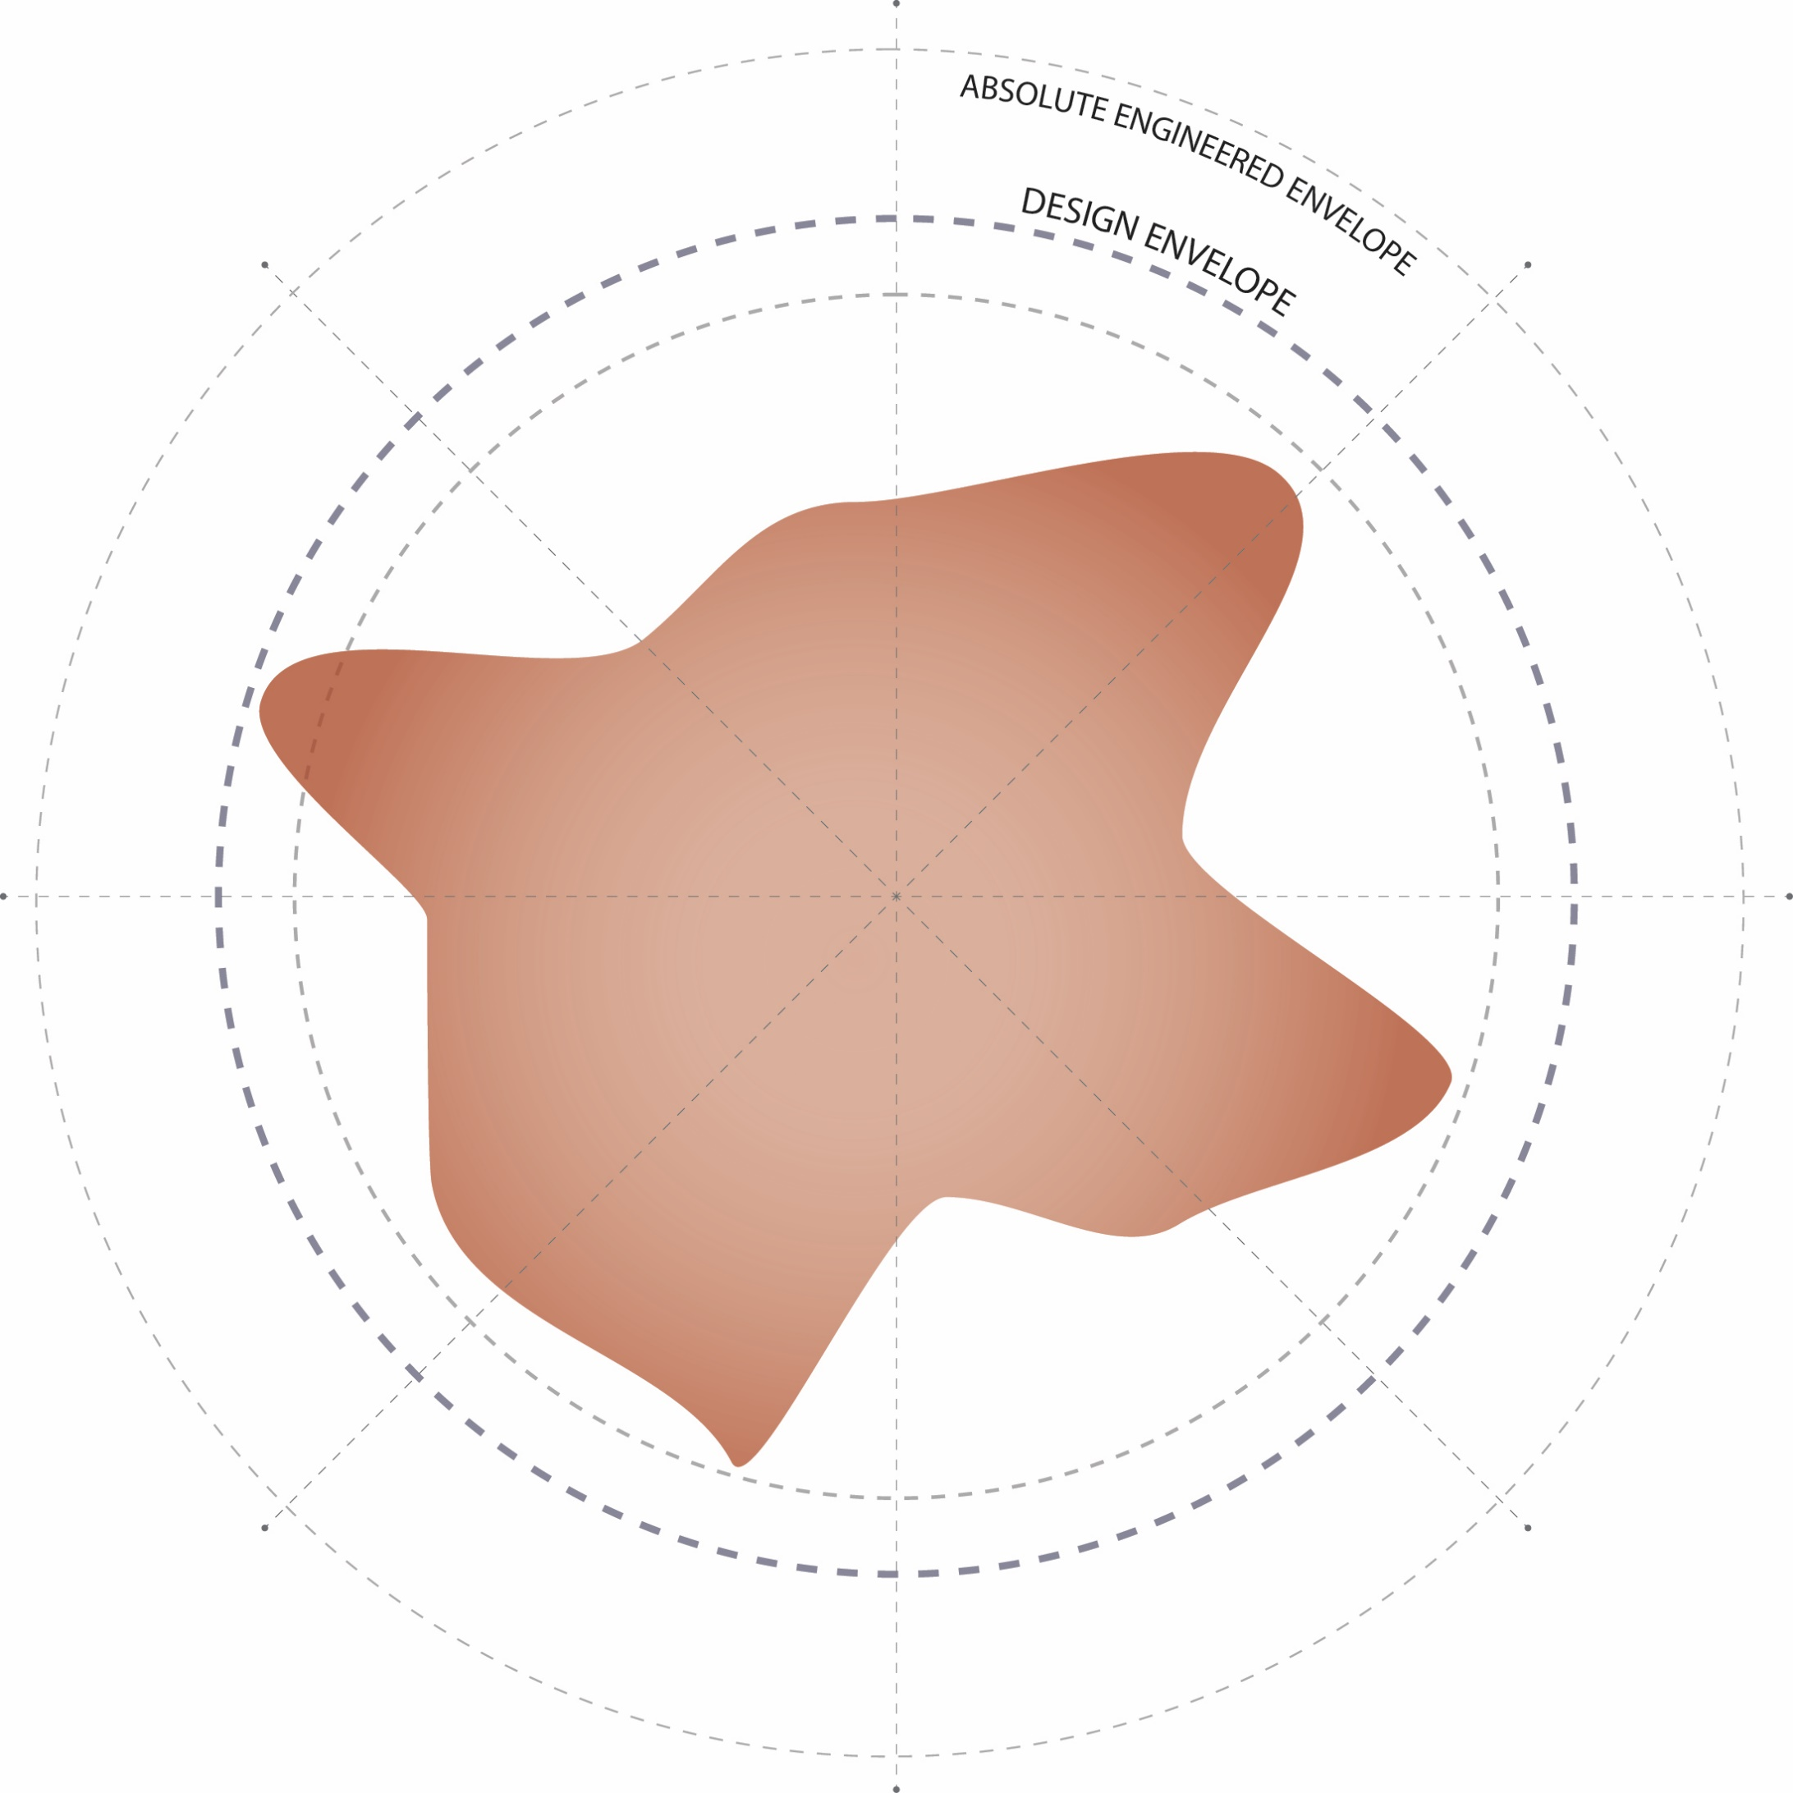
Determining a ‘design envelope’
Cost, safety, practicalities, timelines, operations, economics
Material conditions
PHASE 02: Design-Led Progressive Reclamation
Notes:
The second phase is where the significance of this method emerges. Here the landscape architect develops a design envelope or a realm of possibilities with inside which any design move is possible.

Slide 24
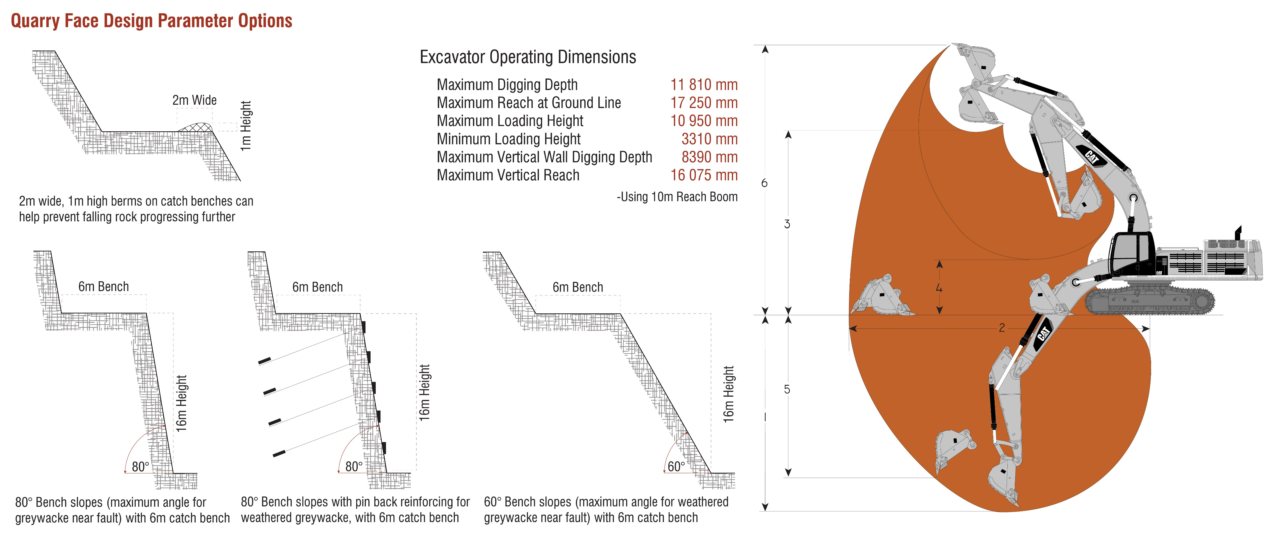
PHASE 02: Design-Led Progressive Reclamation
Notes:
Determining this envelope requires close attention to site-specific material conditions, local, state, and national laws relating to quarry geometries and the spatial capabilities of the machinery employed to craft this landscape

Slide 25
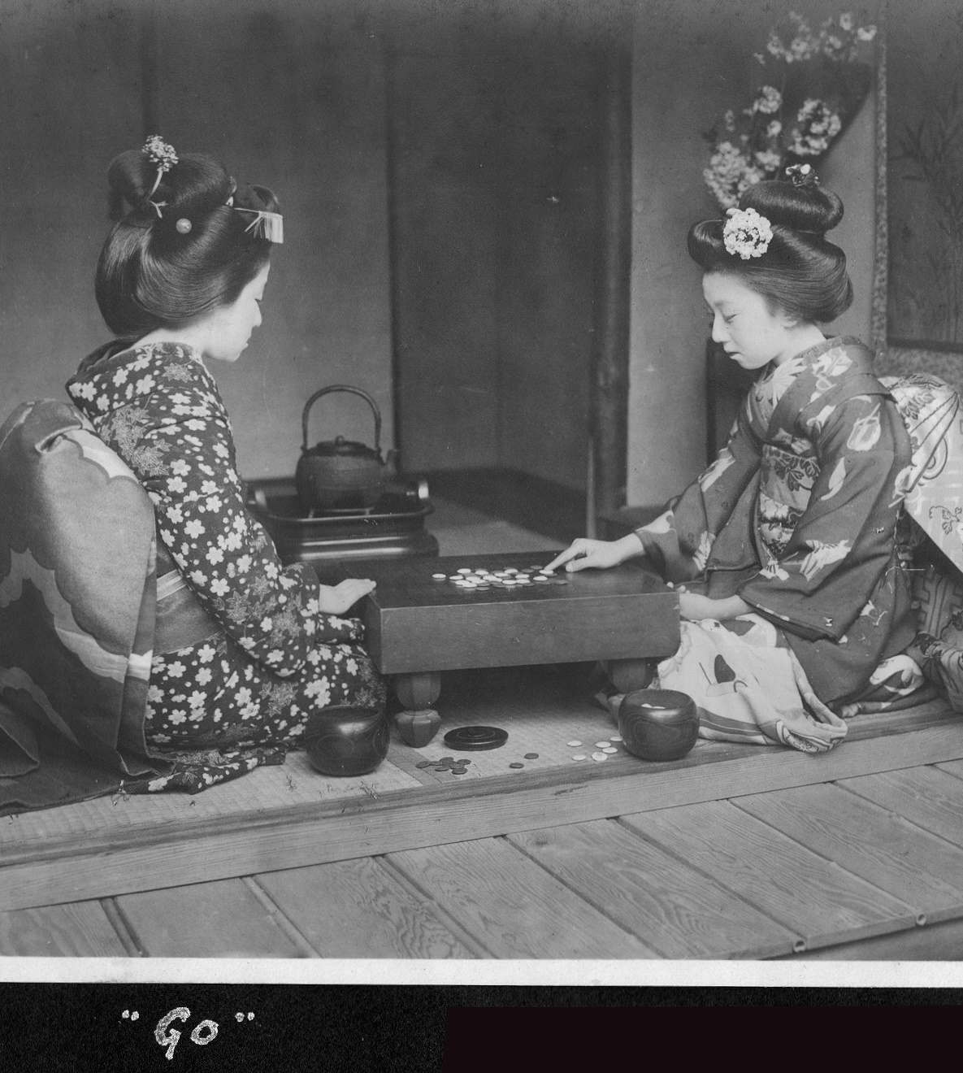
’Game Playing’
Design research paired with scientific practice
Ongoing field of experimentation that can be documented and recorded
PHASE 02: Design-Led Progressive Reclamation
Source: ”Go”, by Elstner Hilton, Japan, 1914-1918. (CC BY 2.0). Cropped Frame. https://www.flickr.com/photos/adavey/4867276096
Notes:
The intent is to open the whole process from a closed ‘scientific best practice’ to open field of experimentation where designers, engineers, and ecologies are partaking in a ‘game playing’ exercise that both tests and develops new rules for the problem at hand

Slide 26
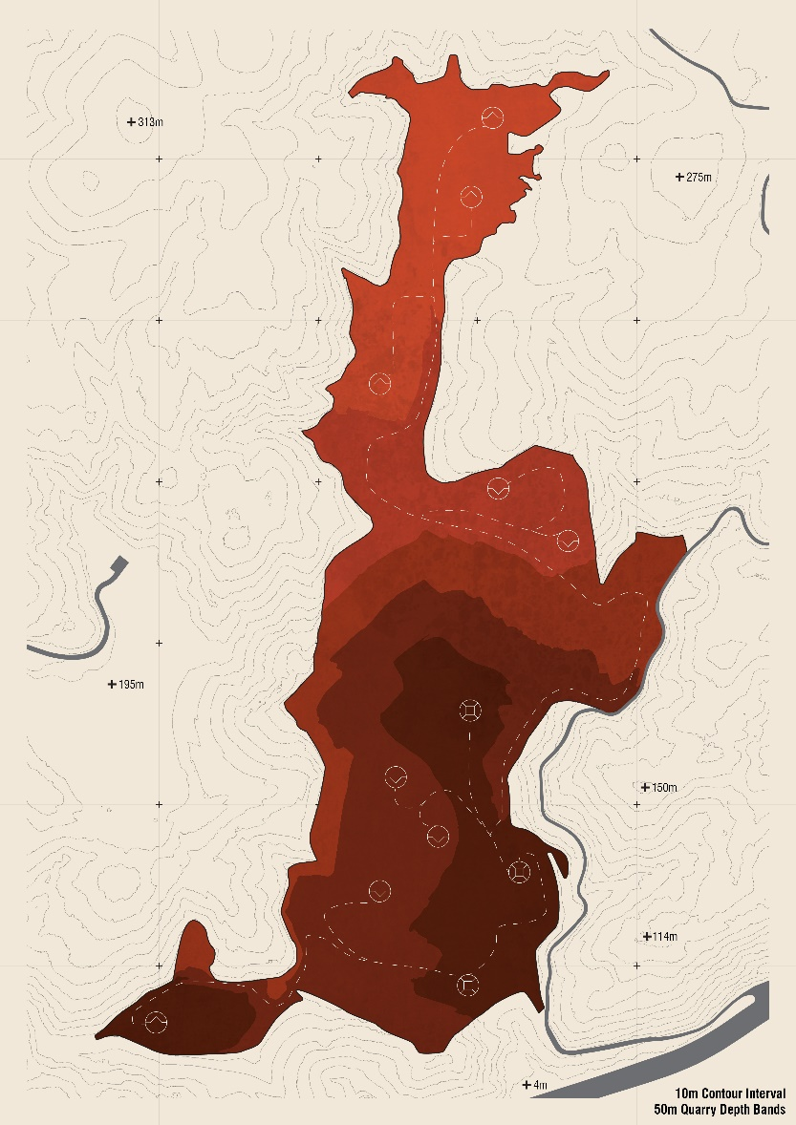
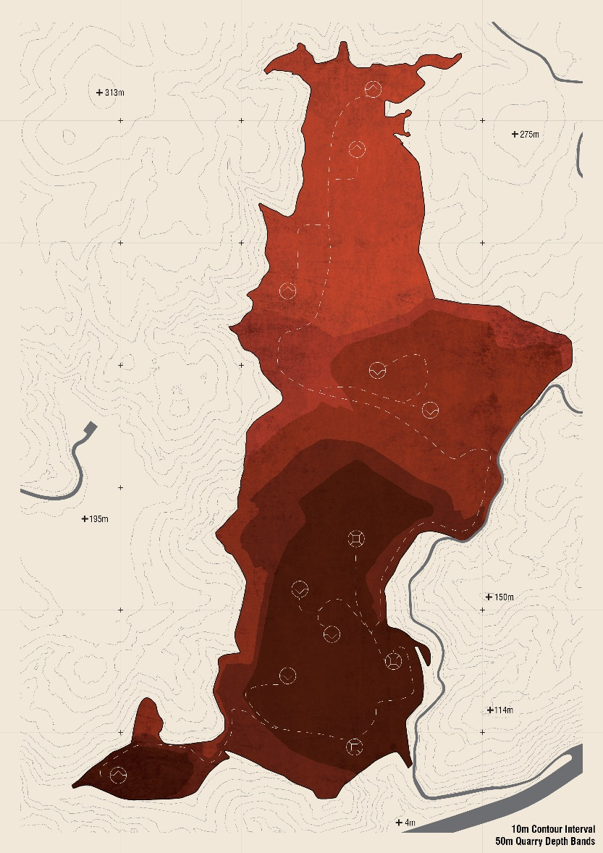
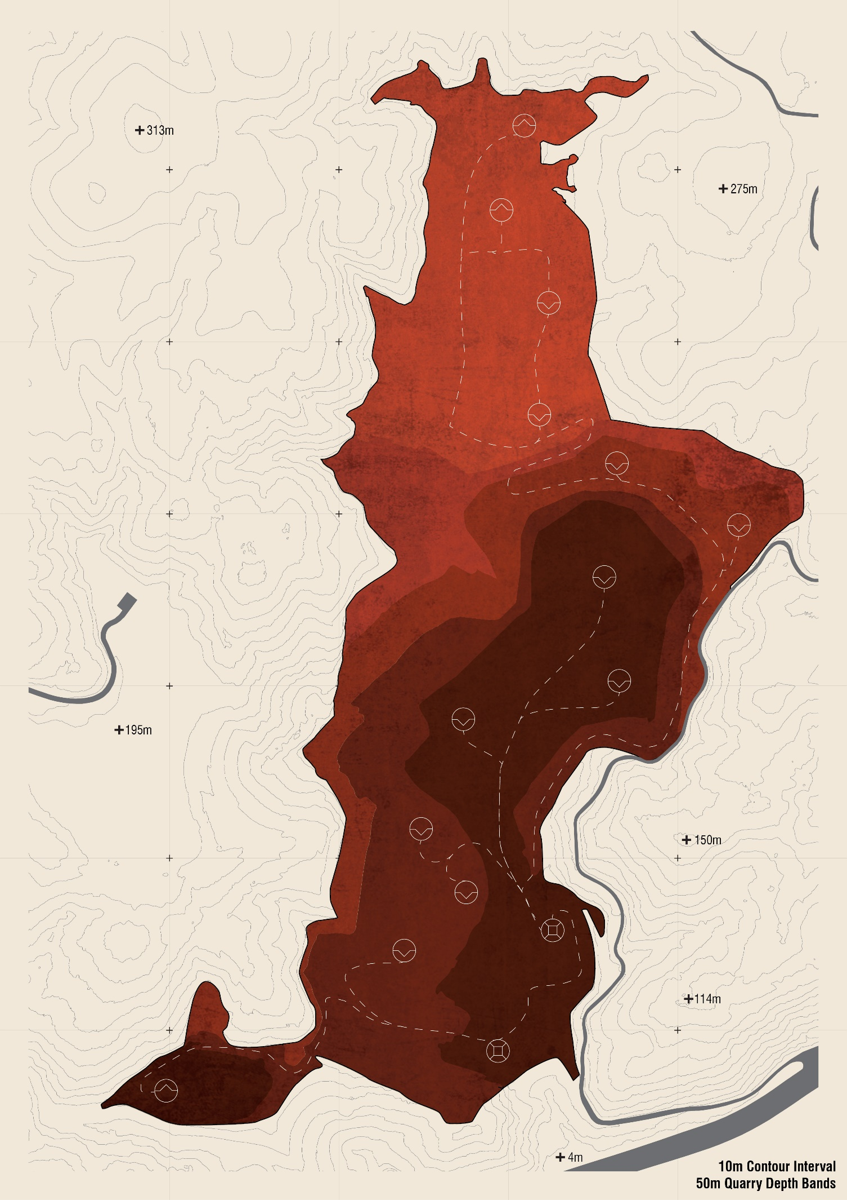

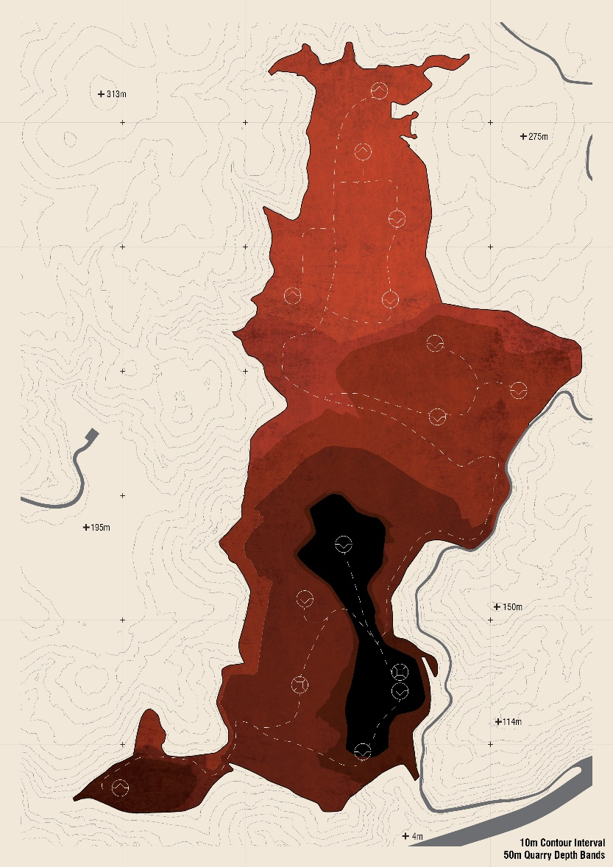
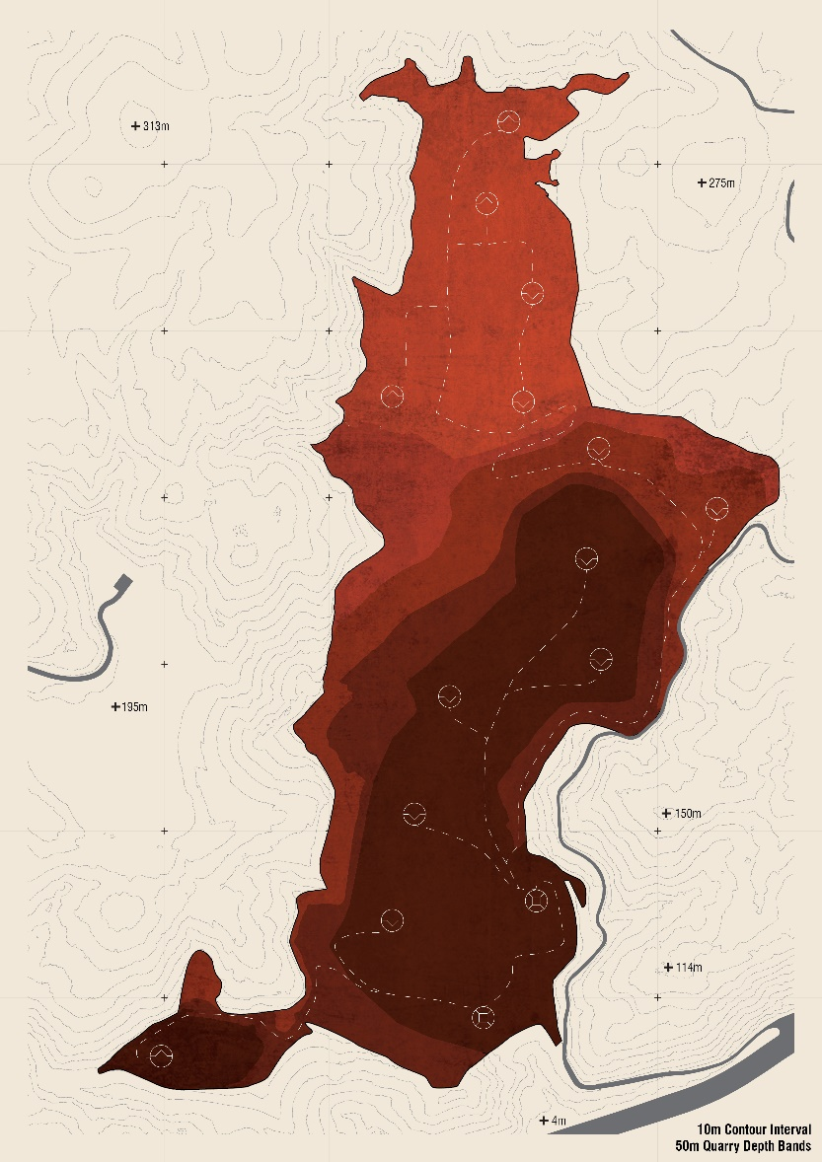
Extraction Operation
Deposition Operation
Processing Operation
Note: The right-side image was remarkably close to later published projection by the quarry operator
PHASE 02: Design-Led Progressive Reclamation
Notes:
This becomes translated into initial large-scale schemes or scenarios, through which the landscape becomes restructured from a design perspective at the same time as economic desires are satisfied

Slide 27
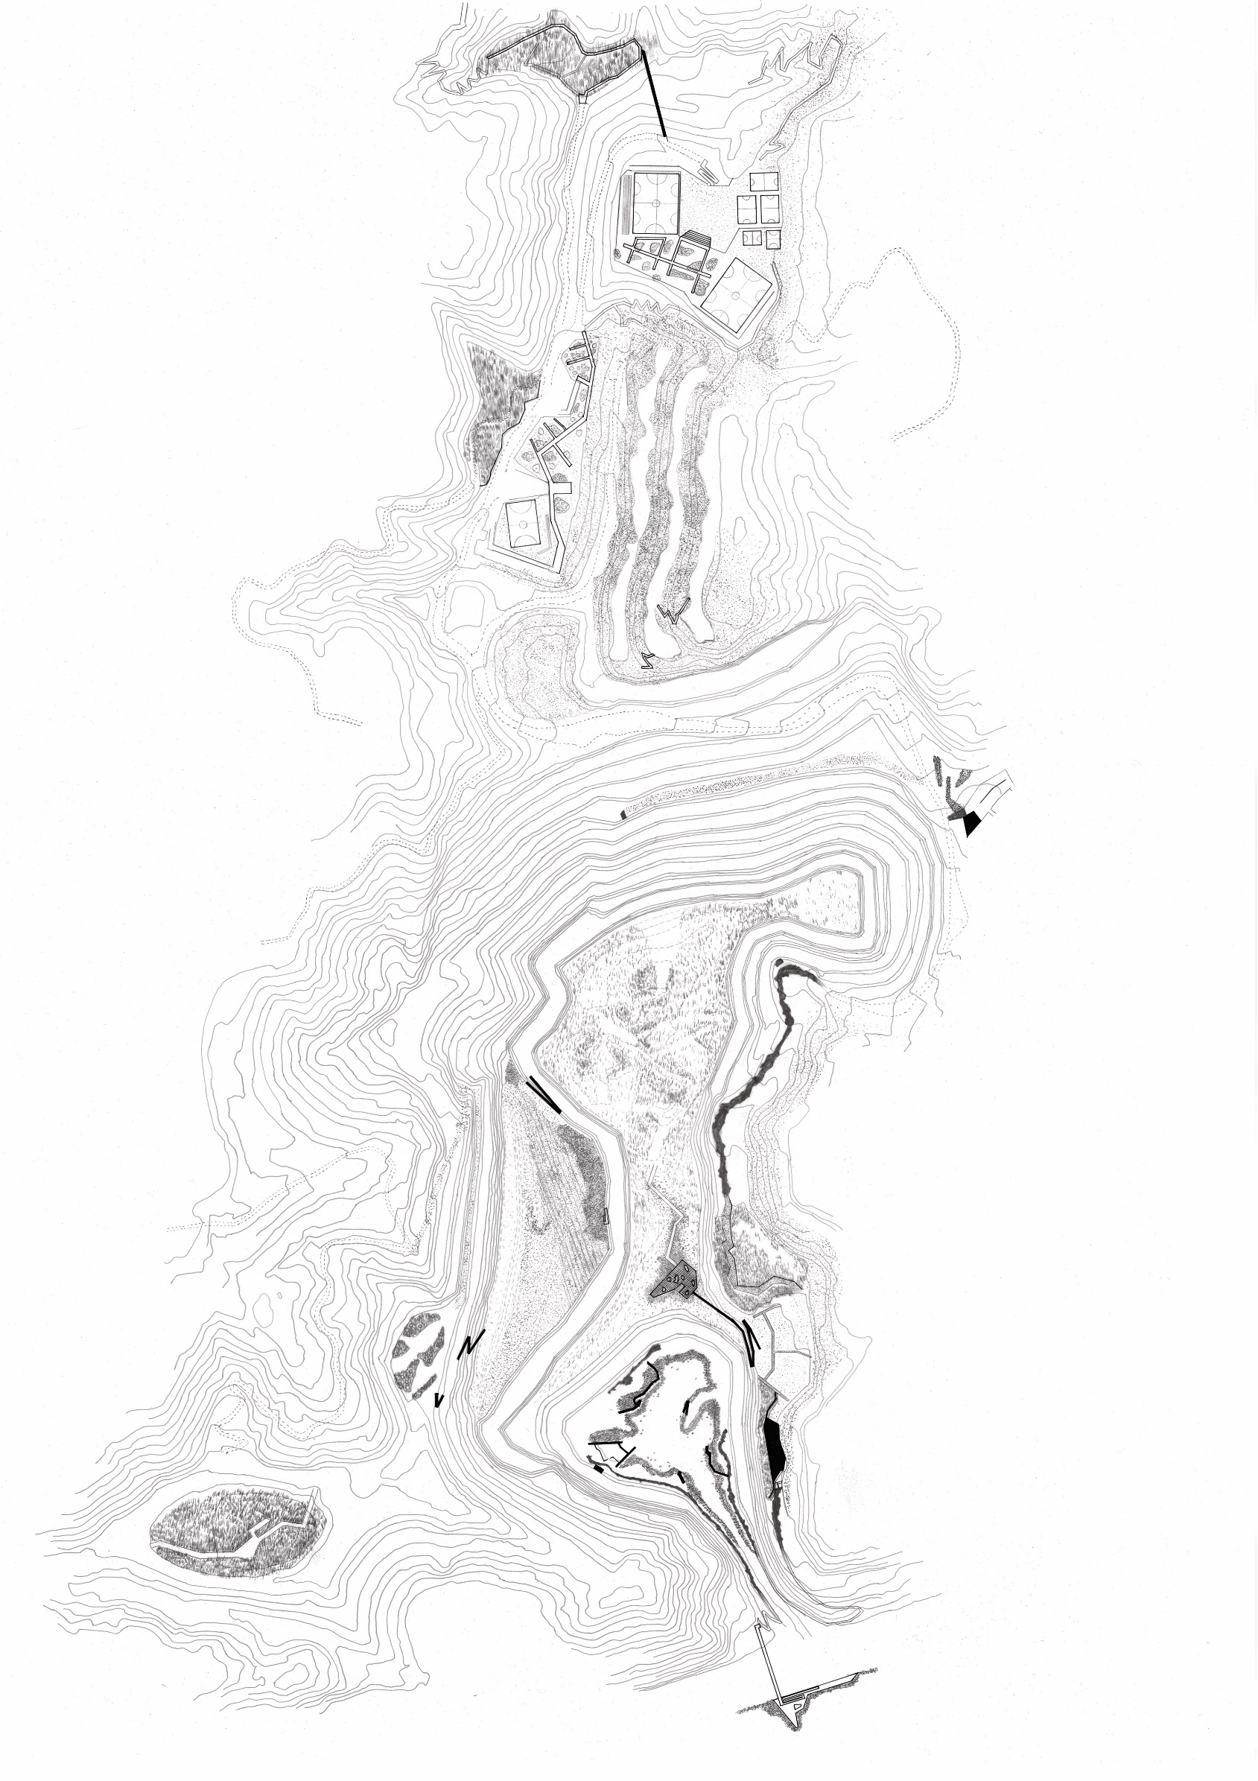
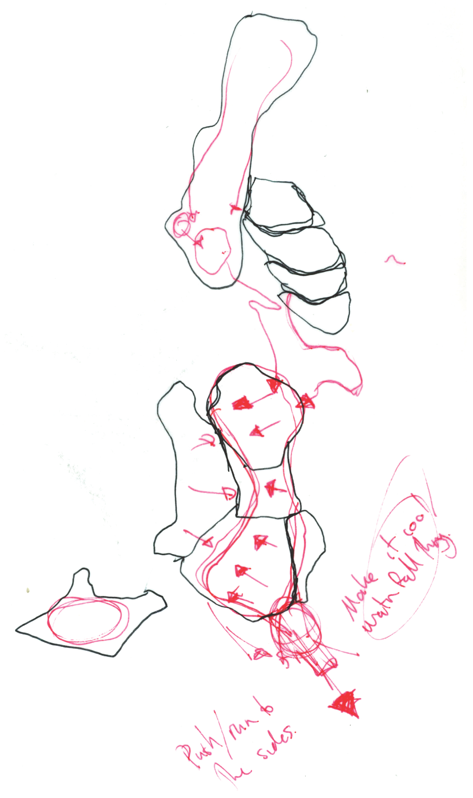
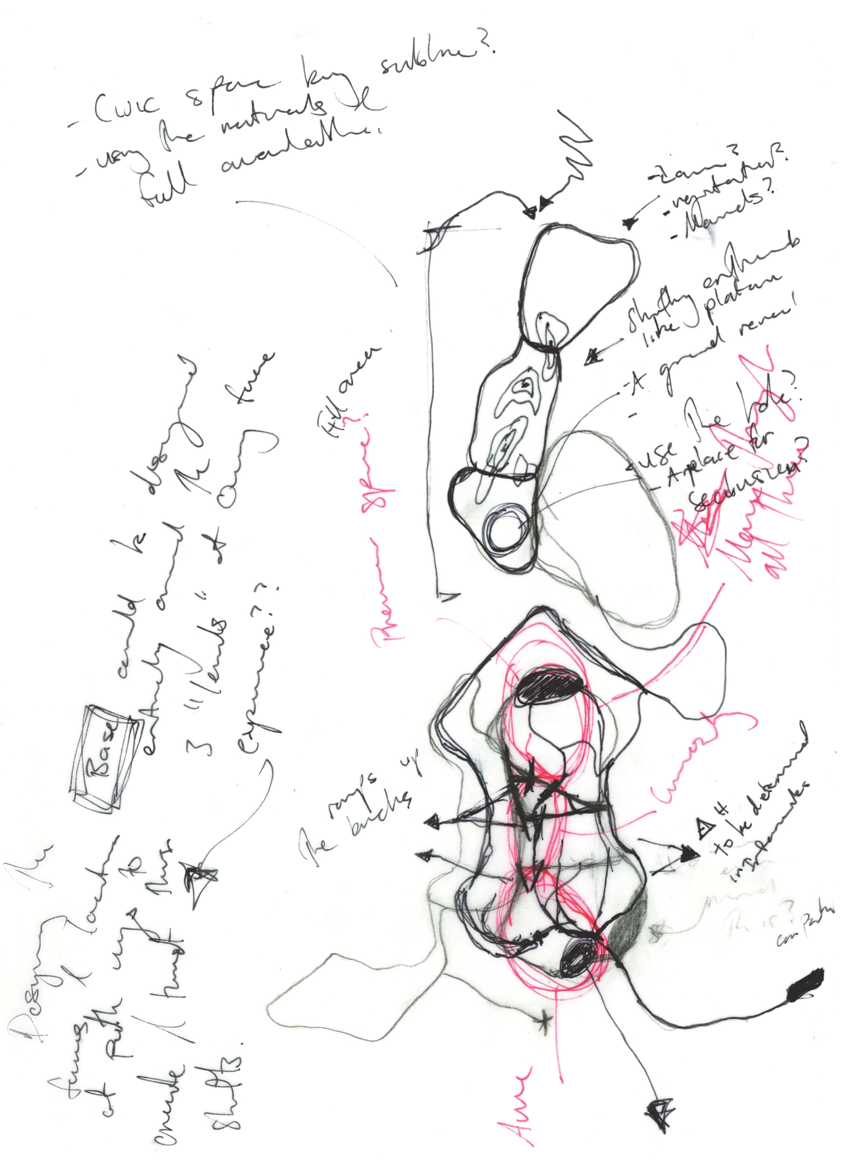
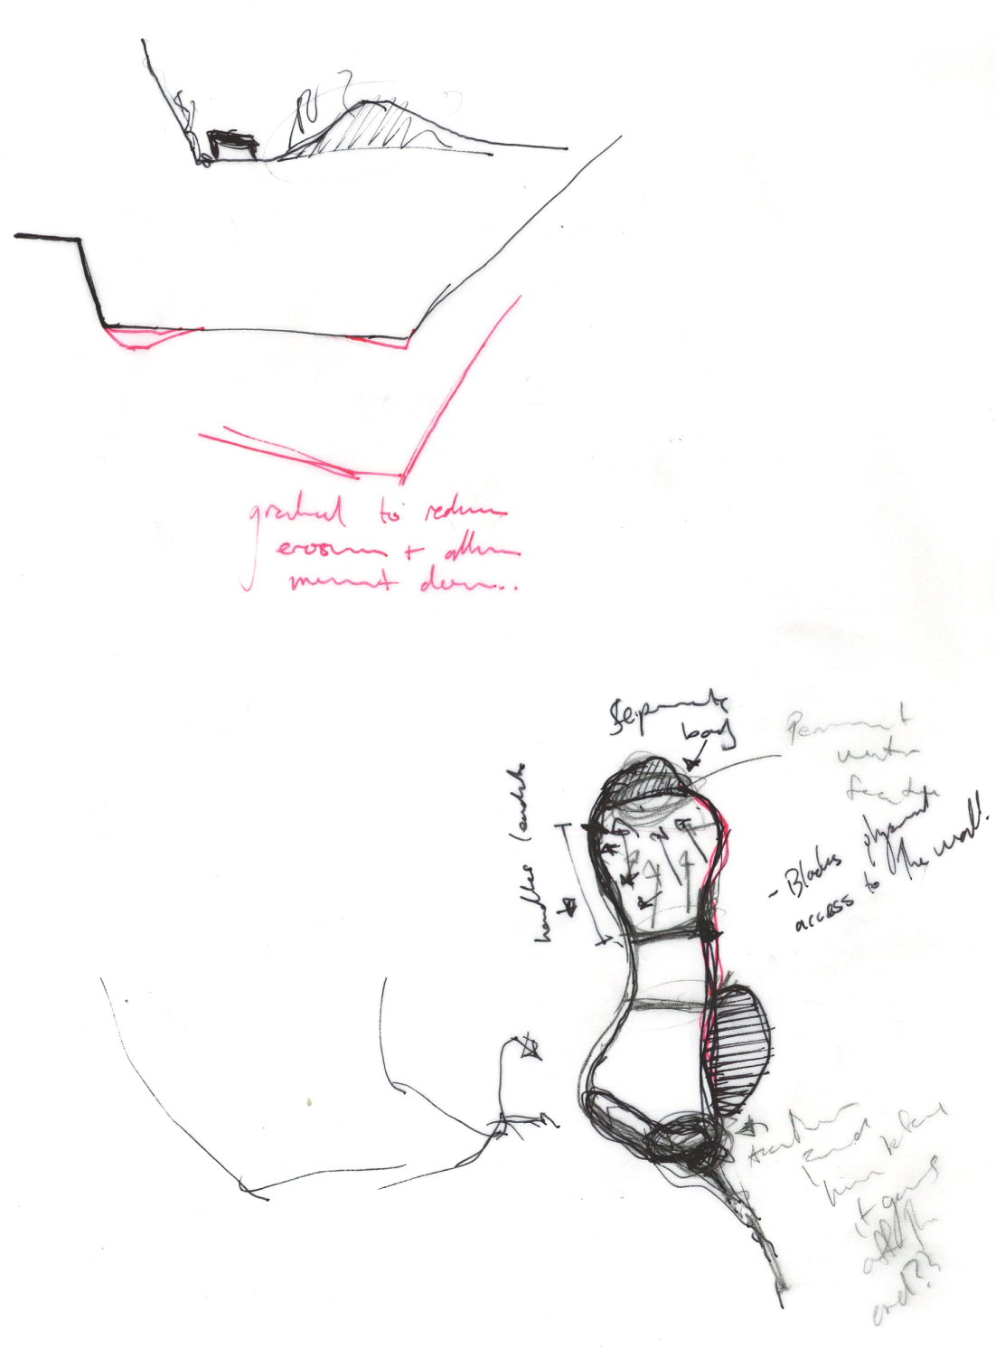
Large-scale topographical moves completed in conjunction with extraction finishing up on site
PHASE 03: Design-Led Progressive Reclamation
Notes:
The third phase marks a transitional phase where extraction finishes in different areas across the site allowing for finer topographical and planting activities to occur, setting the stage for the final transformational process.

Slide 28
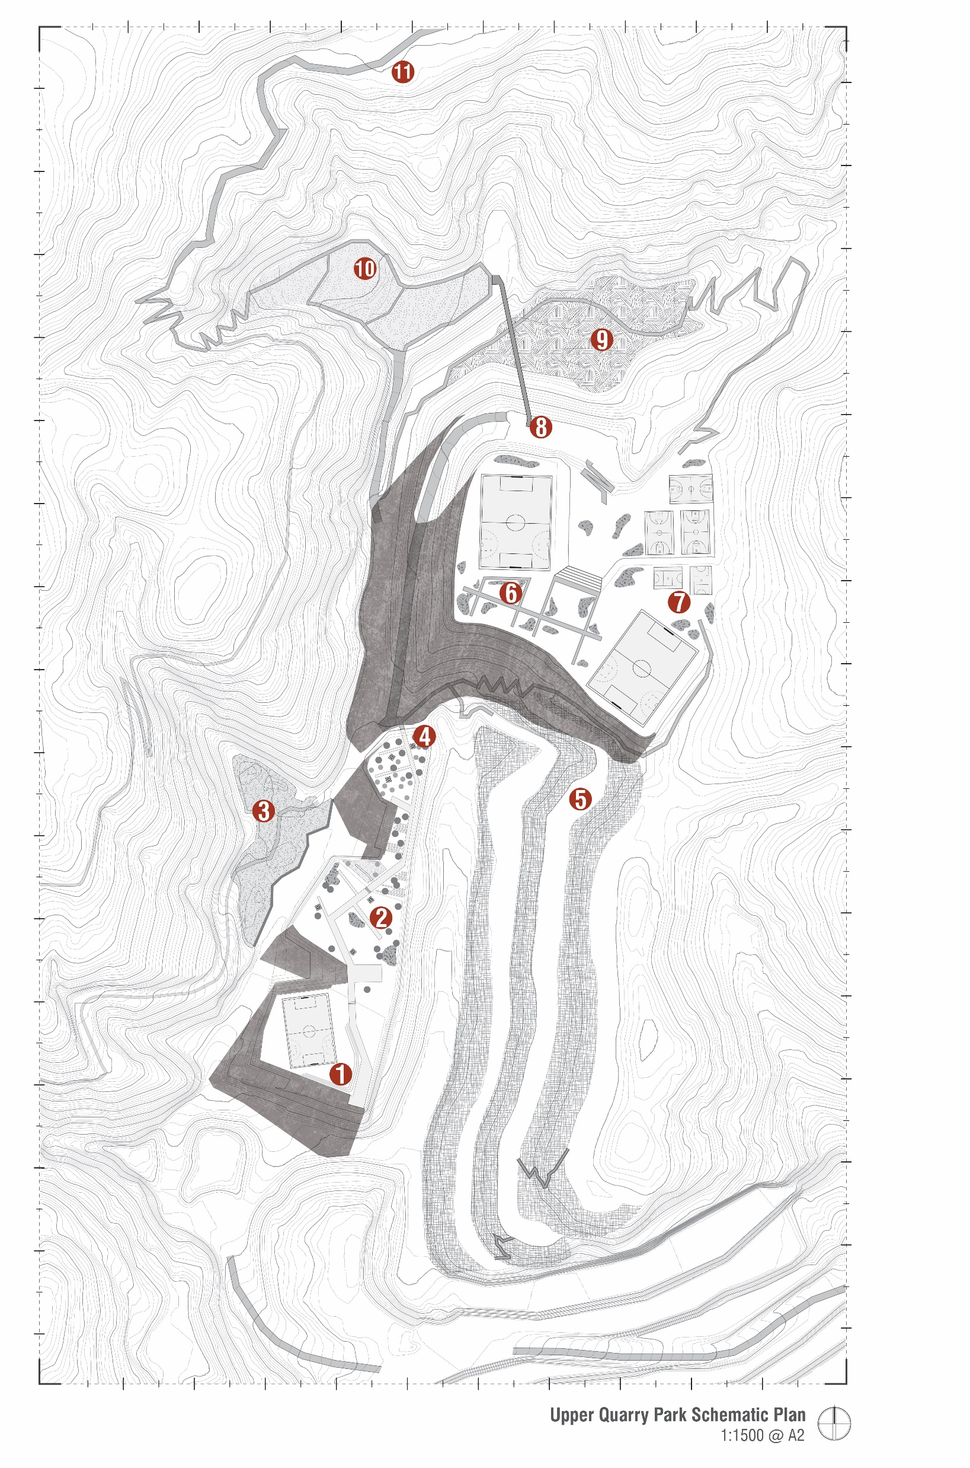
Implementation of more traditionally designed elements based on the landscape structure
Allows for previously unforeseen strategies or activities to be included within the quarry’s interior
‘Finishing touches’
PHASE 04: Design-Led Progressive Reclamation
Notes:
The last phase is in some way the same process as more traditional post-mining landscape design where the site transitions from extraction to occupation.

Slide 29
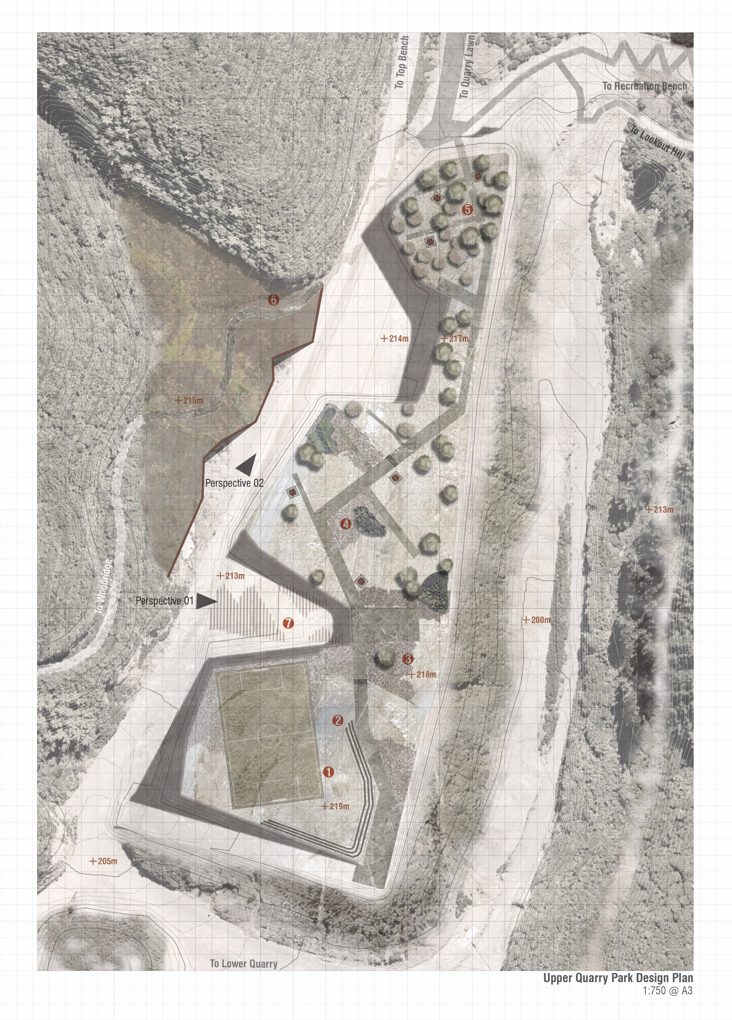
Implementation of more traditionally designed elements based on the landscape structure
Allows for previously unforeseen strategies or activities to be included within the quarry’s interior
‘Finishing touches’
PHASE 04: Design-Led Progressive Reclamation
Notes:
Though by restructuring the landscape much earlier in the process that is currently possible, a range of previously unforeseen spatial strategies or activities can be implemented on site.

Slide 30
Why?
Notes:
Why go to all this effort? Why are current approaches not enough?

Slide 31
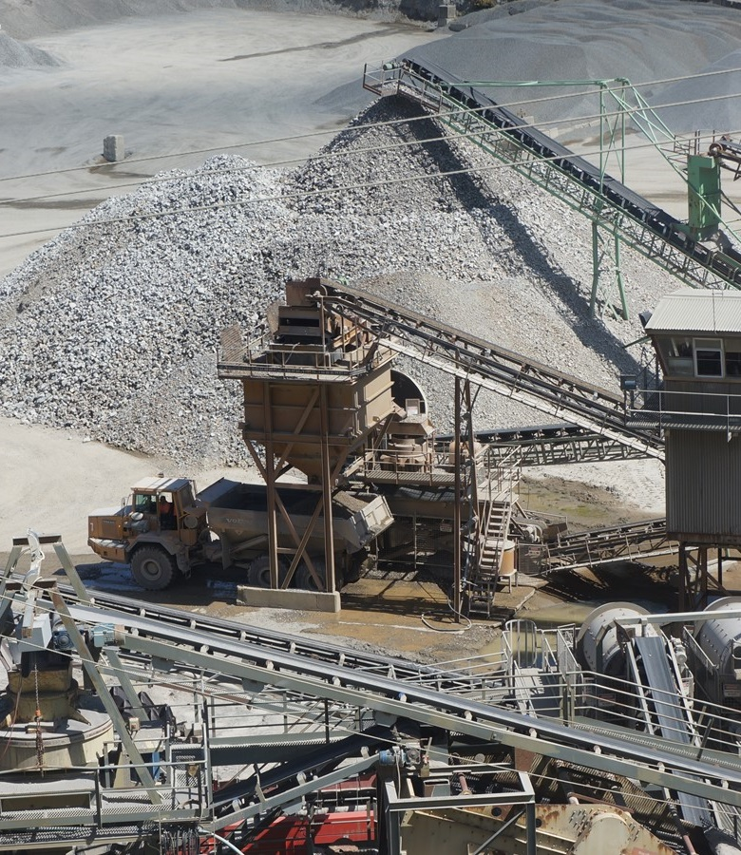
Lost connection to materiality
‘Reciprocal landscapes’
(Hutton, 2020)
Going beyond seeing ‘nature’ as something ‘out there’ separate from ourselves
Notes:
First, this approach allows us as designers to really elevate the material conditions of these sites and bring them back into the public consciousness. In line with Jane Hutton’s notion of reciprocal landscapes, if we go beyond viewing these sites as unnatural, and everything that is green as natural, we can design landscapes that allow encounters with the locations that have fueled the construction of our cities.

Slide 32
Greater cost-saving measures
Ensures that operators actually pay for remediation works
Partially removes financial burden from municipalities
Notes:
Second, this approach offers a significant cost savings opportunities for both the quarry operators and the local or regional governments that will eventuate inherit these landscapes. Just as progressive rehabilitation and geomorphic design save costs through reducing the double handling of material and staged implementations, this method would do the same on top of the cost savings made possible by crafting the designed landscape across a longer timeframe with machinery already on site.

Slide 33
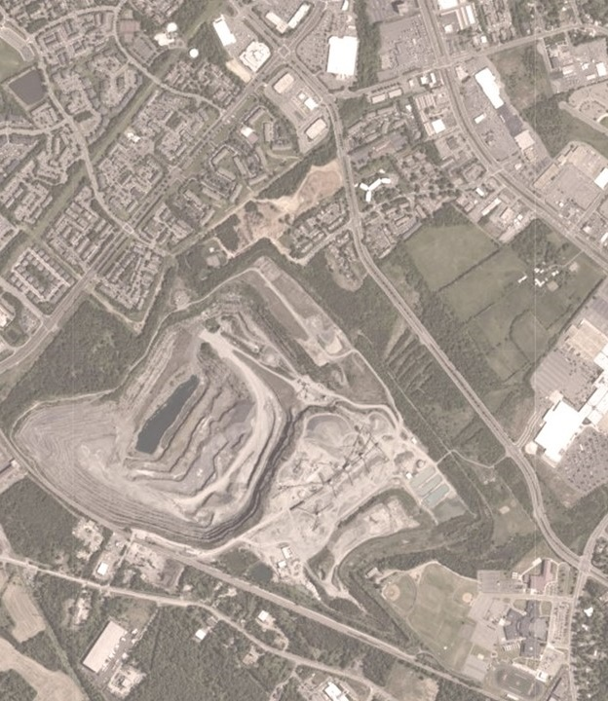
Extraction as an urban structuring device
‘Scenario planning’ instead of fixed development images or projections (Jaakson, 1981)
Unfolding public relationship to extraction and the eventual park landscape
Notes:
Lastly, bringing design into the equation much earlier allows for extraction to become an urban structuring device. We need to be much more urbanistic and structural in our thinking in order to address these problems. Just covering up the site with green stuff isn’t enough any more. Approaching it urbanistically also allows the side to be unfolded and encountered across a range of time scales.
We need a new way to design these sites of extraction so that we can bring socio-cultural consciousness into contact with these sites of extraction. Kids don’t know where their food comes from, and most adults don’t know where their concrete, aggregate, or benchtop comes from. Telling people facts has been shown to be ineffective in instigating change. What we need in order to create meaningful change towards environmental attitudes is designing encounters with the material and immaterial of landscape. Only then might we change our consumption and exploitation of land.

Slide 34
Conclusion

Slide 35
Limitations
Far less relevant for rural or otherwise untouched landscapes
Complex relationships between operator, designers, community, and municipality
Legislation barriers

Slide 36
Lines of Inquiry
Partnerships with design industry partners working in similar modes
Design-led/practice-led research
Traditional scholarship
Embracing the role of design as mode and object of inquiry

Slide 37
Bibliography
Connolly, P. (1995). 101 Ideas About Big Parks. Kerb: Journal of Landscape Architecture, 1, 20-35.
DePriest, N. C., Hopkinson, L. C., Quaranta, J. D., Michael, P. R., & Ziemkiewicz, P. F. (2015). Geomorphic landform design alternatives for an existing valley fill in central Appalachia, USA: Quantifying the key issues. Ecological Engineering, 81, 19-29. https://doi.org/https://doi.org/10.1016/j.ecoleng.2015.04.007
Hutton, J. (2020). Reciprocal Landscapes: Stories of Material Movements. Routledge.
Jaakson, R. (1981). Recreation design alternatives for a disturbed urban landform. Landscape Planning, 8(1), 31-68. https://doi.org/https://doi.org/10.1016/0304-3924(81)90040-X
Martin Duque, J. F., Tejedor, M., Martin Moreno, C., Nicolau, J. M., Sanz Santos, M. A., Sanchez Donoso, R., & Gomez Diaz, J. M. (2021). Geomorphic landscape design integrated with progressive mine restoration in clay quarries of Catalonia. International Journal of Mining, Reclamation and Environment, 35(6), 399-420.

Slide 38
Reclamation through Extraction
Shaun Rosier, PhD
Assistant Professor, Landscape Architecture
School of Design, College of Architecture, Arts, and Design

