Slide 1

An evaluation of power performance for a small wind turbine in turbulent wind regimes
Nicholas J. Ward
Ph.D. Student, Energy Engineering
Advisor: Dr. Susan W. Stewart
The Pennsylvania State University

Slide 2
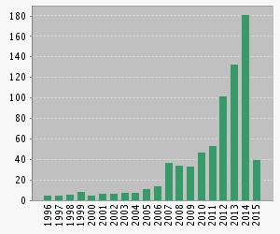
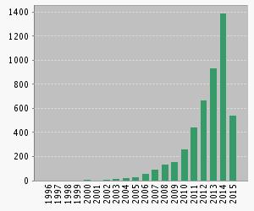
Why study turbulence?
Increased attention towards engineering and economic feasibility in lower wind speed regimes [Ewing et al (2008)]
Progressive damage and shortened turbine lifetime via stochastic loads [Saranyasootorn & Manuel (2008)]
Increased interest in turbulence for future academic study [Web of Science]
  180 publications in 2014 (top)
  1400 cited articles in 2014 (bottom)
Publications
Citations
Year

Slide 3
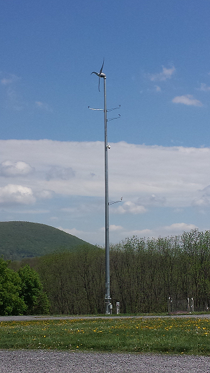
Wind Turbine & Site

Slide 4
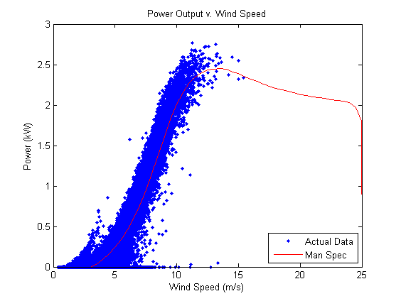
Methodology
Collect site characteristics data from wind turbine location
Determine relationship between P and TI
Quantify statistical distribution of in situ TI frequency
Verify/compare results with IEC standards, Albers (1997) and Sunderland et al (2013)

Slide 5
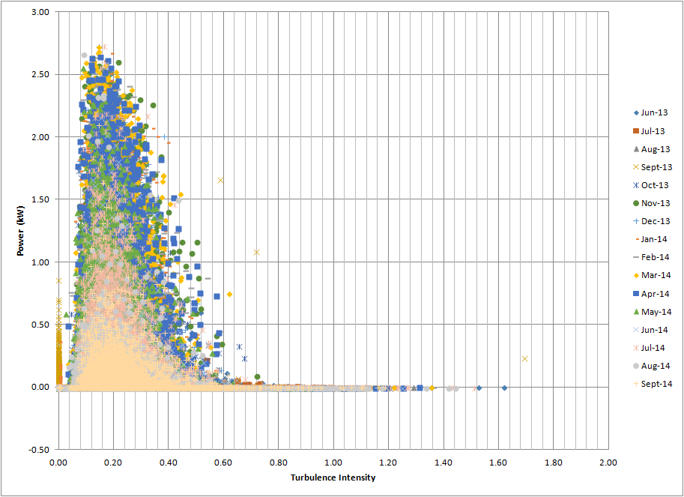
The turbine power and turbulence intensity were quantified over 15 months (6/13-9/14). Excluding anomalies like turbine maintenance, power exhibits strong statistical correlation with turbulence intensity.

Slide 6
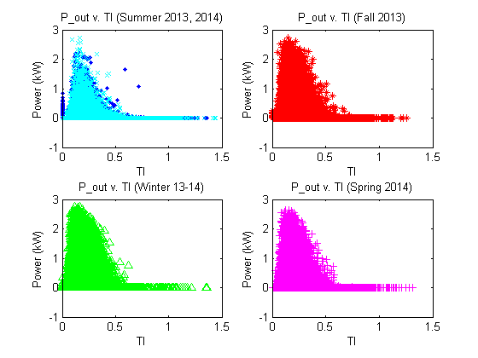
Seasonal Variation of Power & Turbulence Intensity

Slide 7
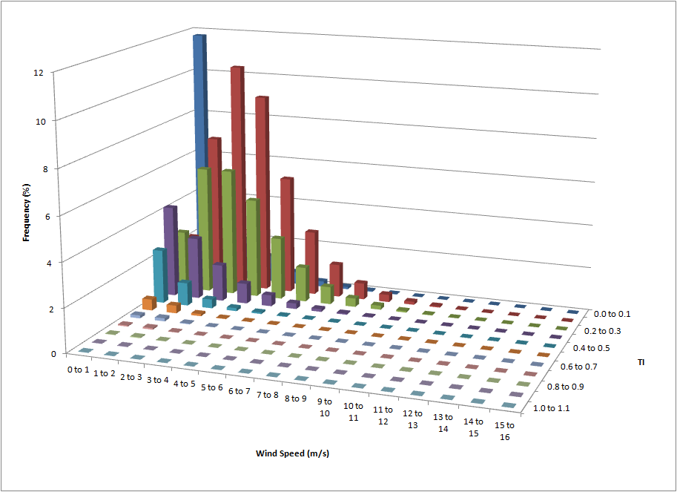
Common industrial practice requires a Weibull distribution for frequency of wind speed [Woolmington et al (2014)]. However, an empirical distribution match for turbulence intensity is more difficult.

Slide 8
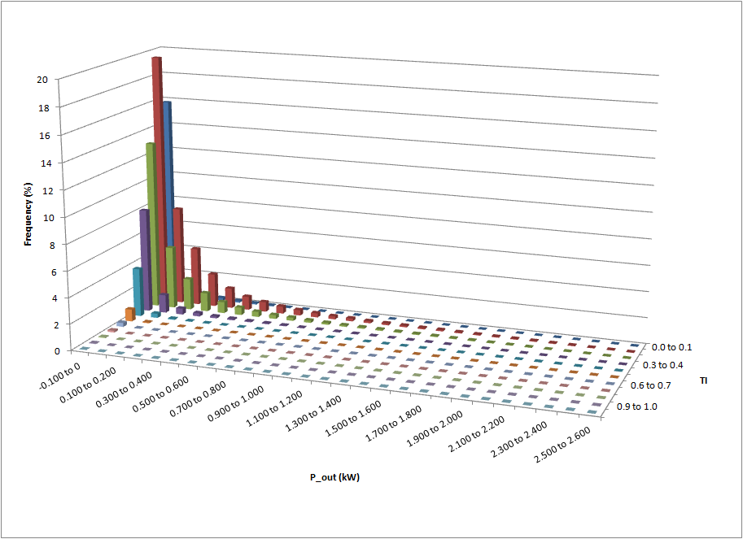
Wind speed dependence for the turbine power curve enables statistical correlation between frequency of occurrence for power and TI.

Slide 9
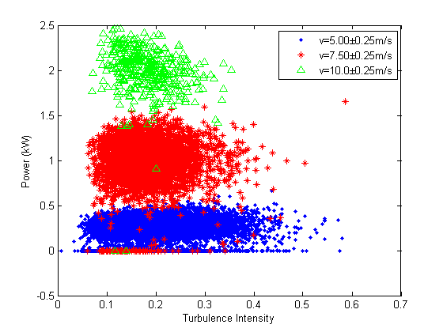
The culmination of these turbulence intensities at constant velocities enable “binning” of turbine power output. With smaller wind speeds, the power output increases for increased TI, exhibiting periods of overdrive.

Slide 10
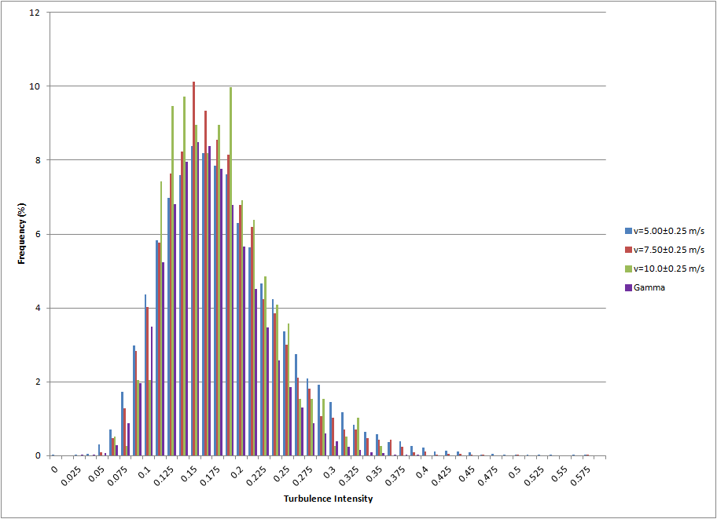
Turbulence intensity tends to follow a Gamma distribution (k=12, θ=0.014) at constant wind velocity.

Slide 11
Relative Error Between Gamma Function and Observed TI
Wind Speed (m/s) | Min Error (%) | Max Error (%) | Mean Error (%)
5.00±0.25 | 0.00 | 1.66 | 0.45
7.50±0.25 | 0.00 | 1.67 | 0.42
10.0±0.25 | 0.00 | 3.18 | 0.79

Slide 12
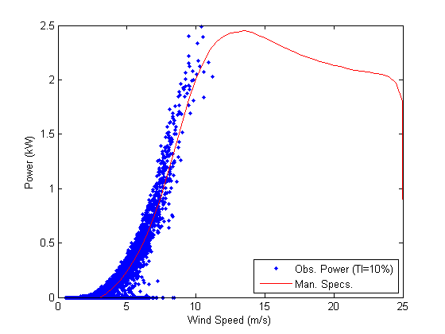
Example of TI Integration into Wind Turbine Power Curve

Slide 13
Conclusions & Future Work
The gamma function is a good indicator to estimate power performance incorporating TI
Power output increased by as much as 60% for lower wind speeds at higher TI, but decreased power by as much as 17% for high wind speeds and TI
A more standardized approach for TI integration into the power curve was tested and correlated well with results from Sunderland et al (2013) and Albers (1997)
Over-performance is possible for low wind speed regimes with high TI
This process can be integrated into (or verified by) industry accepted programs like WT_Perf and FAST for computer simulations predicting stochastic loads due to turbulence and their effects on power production for any turbine size in any location

Slide 14
Acknowledgments
Research advisor: Dr. Susan Stewart
Mr. Brian Wallace
Aerospace & Energy Engineering Departments
Penn State Center for Sustainability

Slide 15
References
Ewing et al (2008). “Analysis of Time-varying Turbulence in Geographically-dispersed Wind Energy Markets.” doi:10.1080/15567240701232162
Saranyasootorn & Manuel (2008). “On the propogation of uncertainty in inflow turbulence to wind turbine loads.” doi:10.1016/j.jweia.2008.01.005
Web of Science
Manwell et al (2010). “Wind Energy Explained: Theory, Design and Application.” 2nd Edition. ISBN: 978-0-470-01500-1
Wang et al (2014). “A new turbulence model for offshore wind turbine systems.” DOI: 10.1002/we.1654
Woolmington et al (2014). “The progressive development of turbulence statistics and its impact on wind power predictability.” doi: 10.1016/j.energy.2014.03.015
Albers (1997). “Turbulence and Shear Normalisation of Wind Turbine Power Curve.”
Sunderland et al (2013). “Small wind turbines in turbulent (urban) environments: A consideration of normal and Weibull distributions for power prediction.” doi:10.1016/j.jweia.2013.08.001

Slide 16
Questions?

Slide 17
Quantifying Power and Turbulence
Turbine power (P) is a function of the cube of the velocity (v), air density (ρ) and rotor area (A) [Manwell et al (2010)]
Turbulence intensity (TI) is the ratio of the standard deviation (σ) to the mean wind speed (V) [Wang et al (2014)]
It can therefore be quantified that turbine power can related to turbulence intensity

Slide 18
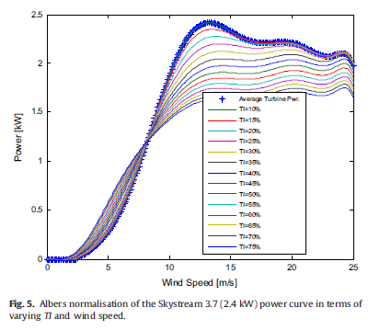
Sunderland et al (2013) Key Figure

Slide 19
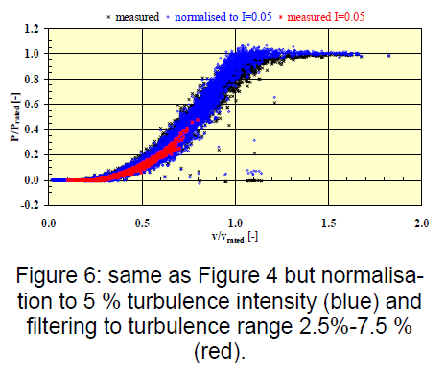
Albers (1997) Key Figure

