Slide 1

Gaming and Political Extremism
CS 4624 Multimedia, Hypertext, and Information Access
Dr. Edward A. Fox
Virginia Tech, Blacksburg, VA 24061
Niko Olson, Mauricio Lovelace, Earl Carter
May 3, 2023

Slide 2
Outline
Project Overview
Timeline
Problem & Motivation
Deliverables
Visualizations
Problems & Solutions
Future Work & Project Expansion Ideas
Experience Gained
Acknowledgements
References

Slide 3
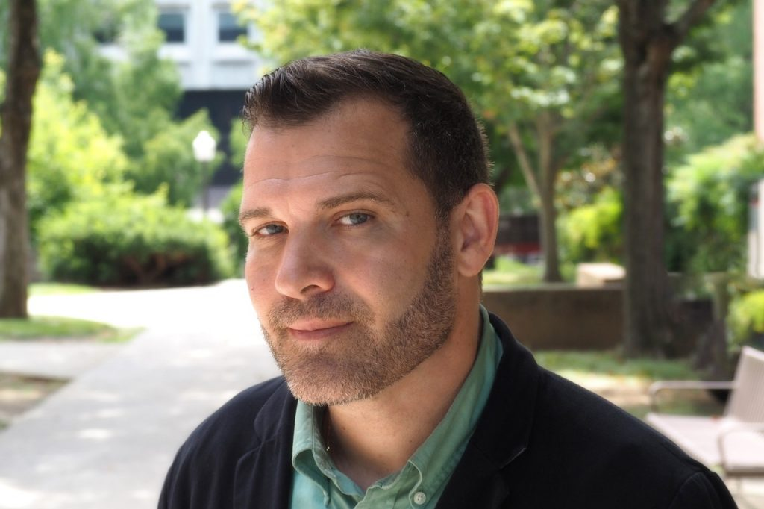



Project Overview
Client
  Dr. Ivory
  Virginia Tech Gaming and Media
Effects Laboratory
Problem
  Examining Political Extremism in Games
Deliverables
  Code
  Dataset
  Visualizations
Dr. James Ivory

Slide 4
Timeline
February 14
Reassess Milestones
February 28
Begin Data Scraping
March 14
Finish Data Scraping
March 31
Clean Data & Create Visualizations
April 7
Begin User Manual, Final Report, and Final Presentation
April 17
Finalize User Manual, Final Report, and Final Presentation
May 3
Finish research and make recommendations regarding NLP and sentiment analysis

Slide 5

Problem & Motivation
Problem:
Track & gather data relating to political extremism and engagement in the gaming community
  Conduct empirical analysis on data and present findings
Motivation:
Politically extreme communities are a societal problem
  Likened to public health issue
Do certain communities give rise to extreme beliefs?
Notes:
Track political extremism and engagement within the larger gaming community
Societal problem to solve

Slide 6
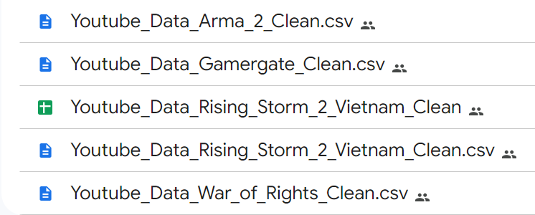
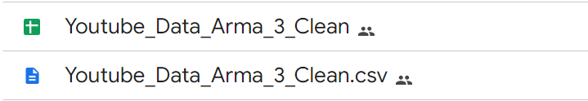

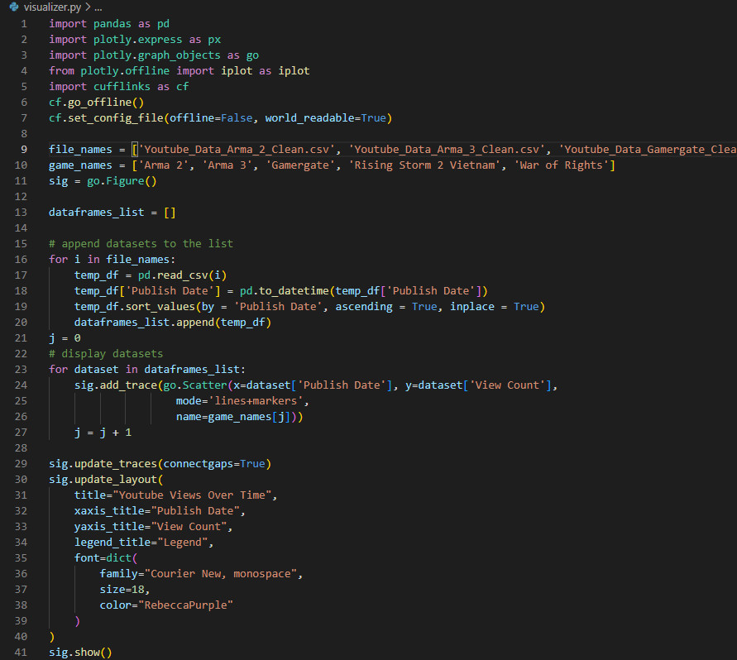
Deliverables
YouTube Metadata Scraper Script
  Apps Script (Javascript)
Data Repository
  CSVs and gsheets
Database cleaned
  Pandas Python library
  CSV modules
Visualizations created
  Plotly Python library

Slide 7
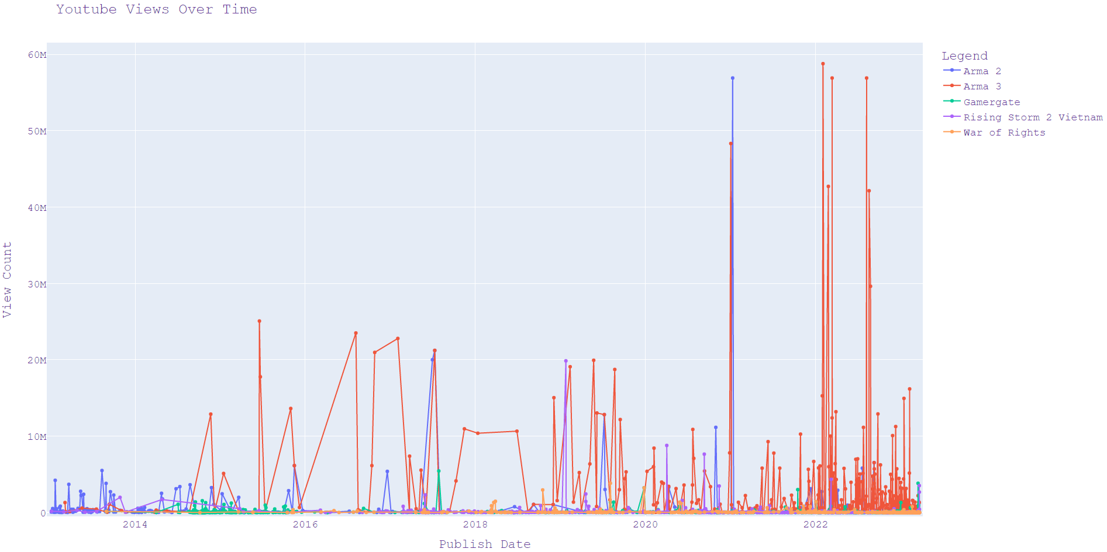
Visualizations and Findings
2016 U.S president election
Jan 6 2021
Gamergate

Slide 8
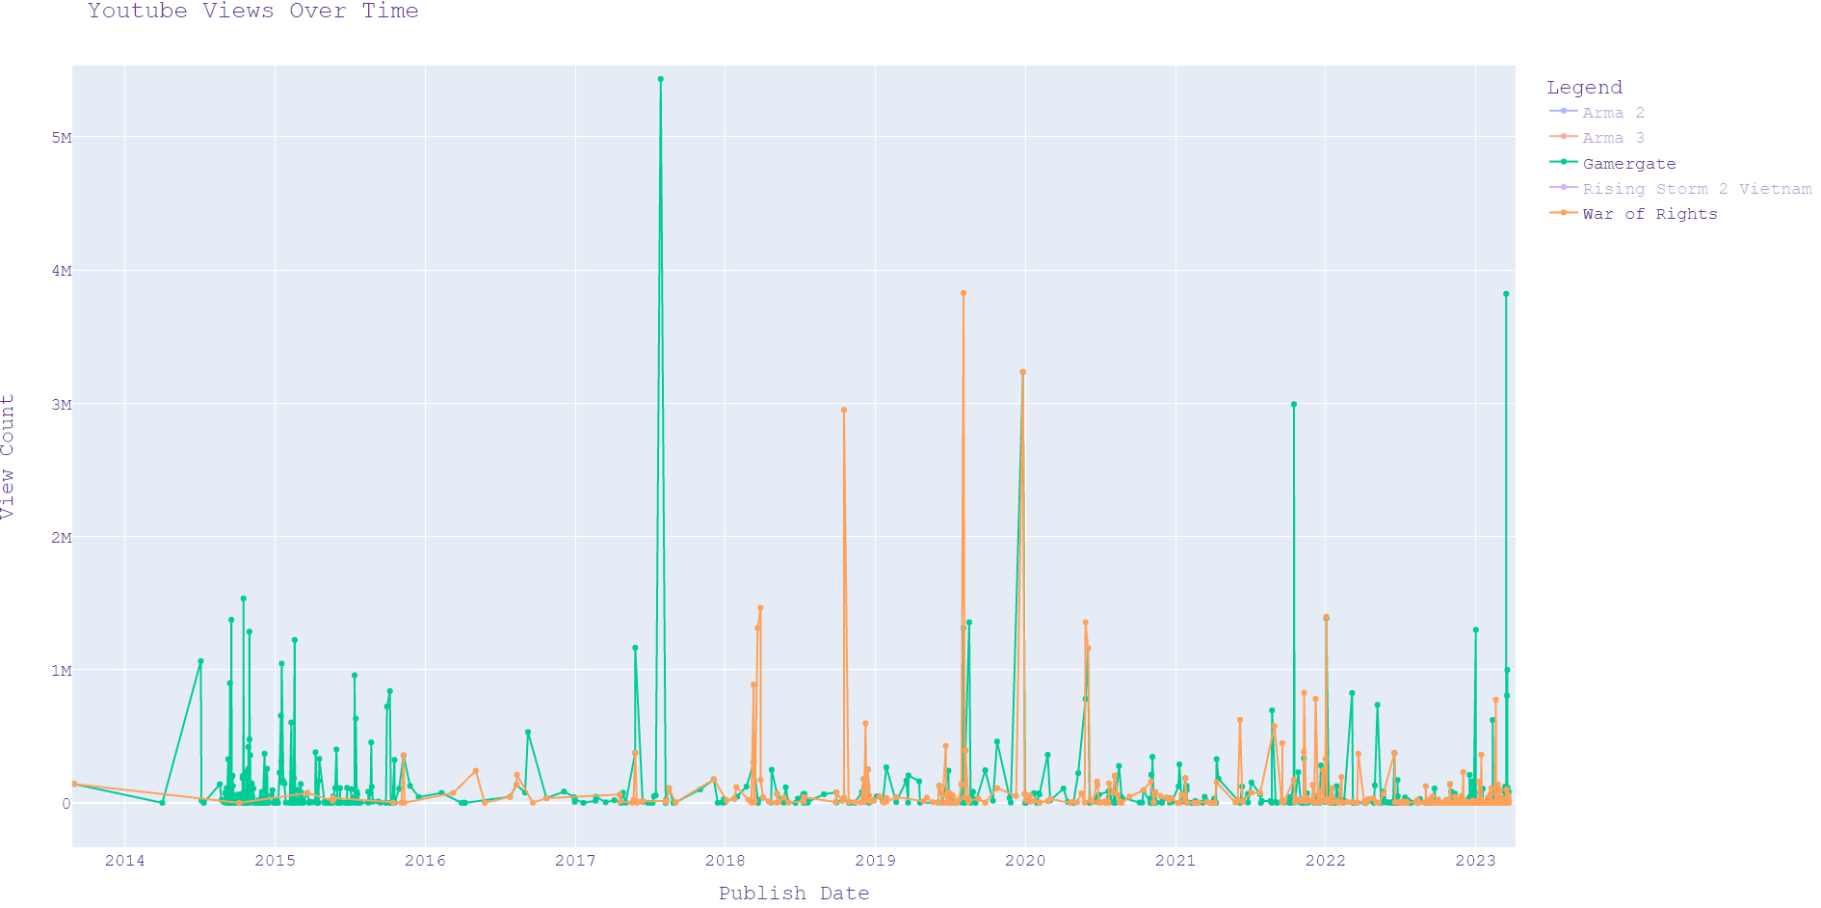

Slide 9
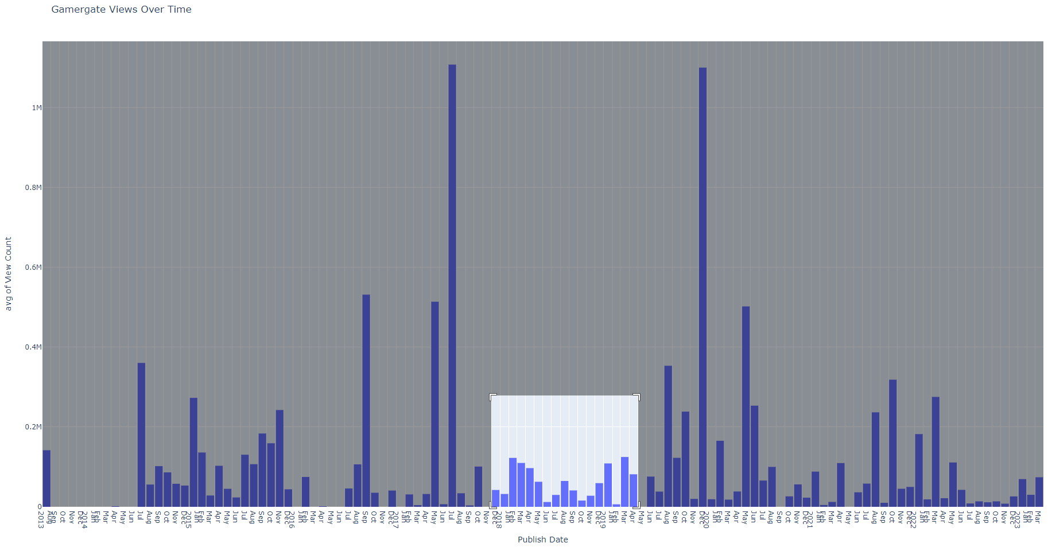

Slide 10
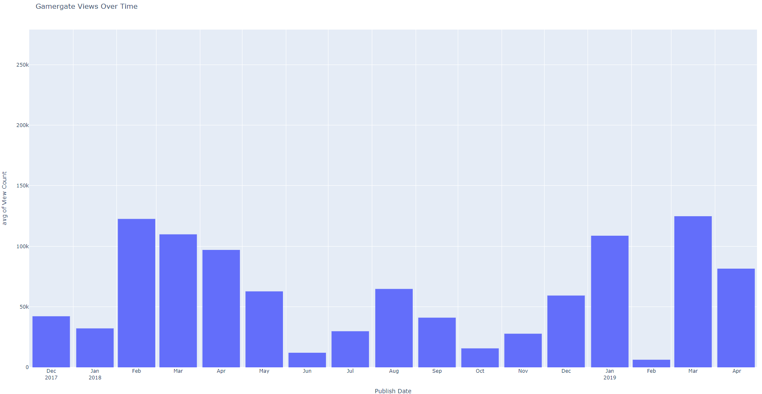

Slide 11

Problems and Solutions
Collecting YouTube Data
  Youtube API Scripting language
  Bugs, errors, learning curve
Data Cleaning
  Repeats, unrelated data, blanks
Data Visualization
  Design choices, interactivity
Changing client vision

Slide 12

Future Work & Project Expansion Ideas
Data Analysis
  Political Event Timeline
Comment Collection
  Youtube API
Source Expansion
Sentiment Analysis

Slide 13
Experience Gained
Client interaction
Collaboration and delegation
Google’s scripting language
Data shaping, processing, and visualization
Scheduling
Research
Tool consideration

Slide 14


Acknowledgements
Grants:
Research Leave Augmentation from VT Institute for Creativity, Arts, and Technology (ICAT), Spring 2023
Client:
Dr. Ivory
Michael Senters
Professor:
Dr. Fox

Slide 15
References
Costello, M., Barrett-Fox, R., Bernatzky, C., Hawdon, J., & Mendes, K. (2020). Predictors of Viewing Online Extremism Among America’s Youth. Youth & Society, 52(5), 710–727. https://doi.org/10.1177/0044118X18768115
Kowert, Rachel, et al. “Not Just a Game: Identity Fusion and Extremism in Gaming Cultures.” Frontiers, Frontiers, 21 Sept. 2022, www.frontiersin.org/articles/10.3389/fcomm.2022.1007128/full#h11.

