Slide 1
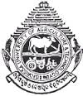



SUSTAINABLE MANAGEMENT OF AGROECOLOGICAL RESOURCES FOR TRIBAL SOCIETIES (SMARTS) ORISSA UNIVERSITY OF AGRICULTURE AND TECHNOLOGY BHUBANESWAR (INDIA)

Slide 2
Updates on ongoing project activities
3 Tribal villages adopted
30 farmers in Tentuli (3rd year)
26 farmers in Talachampei (2nd year)
20 farmers in Bayakumutia (1st year)
Integrated Tribal Development Agency (ITDA) of Mayurbhanj district in the same agroclimatic zone will adopt maize-cowpea CAPS in 1000 ha in tribal populated villages.

Slide 3

Updates on ongoing project activities (contd…)
760 on farm soil samples collected from research plots in Tentuli and Talachampei villages and analyzed for soil physico-chemical parameters (BD, pH, available nutrients and organic carbon).
One AHP survey was conducted on 31st July, 2013 in Kendujhar, India to assess the preference of participating farmers regarding CAPS with the objectives of increased labor savings, yield, profit and soil quality.

Slide 4
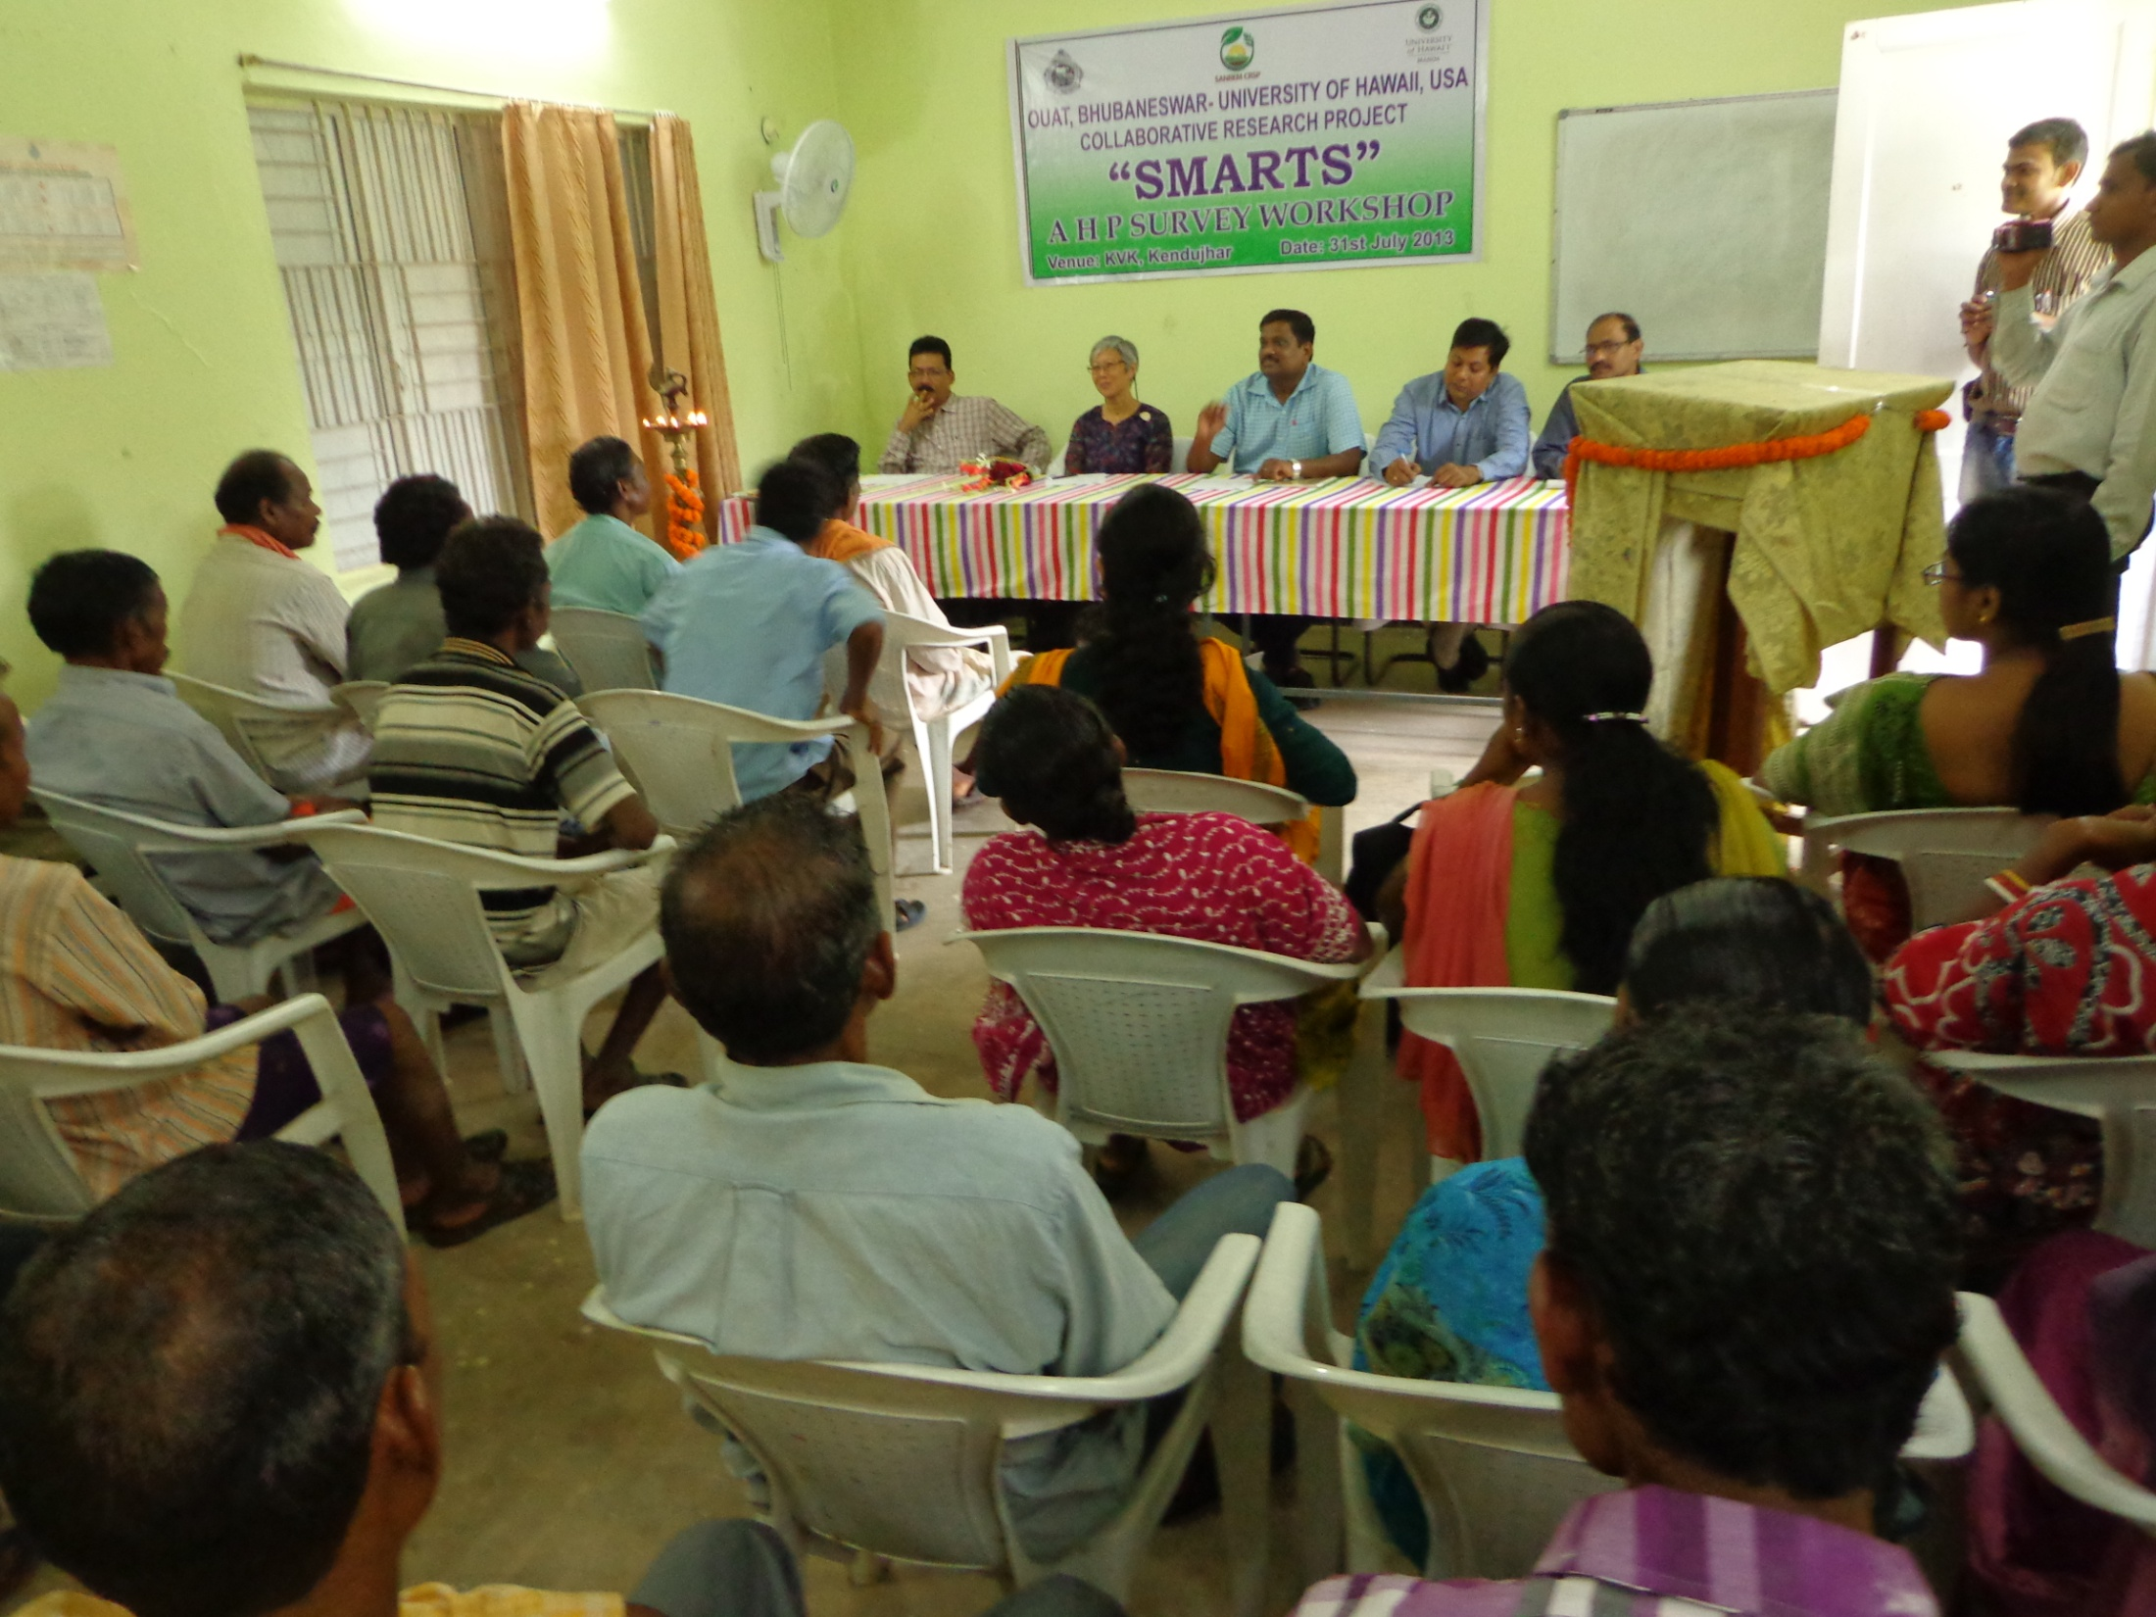

Slide 5
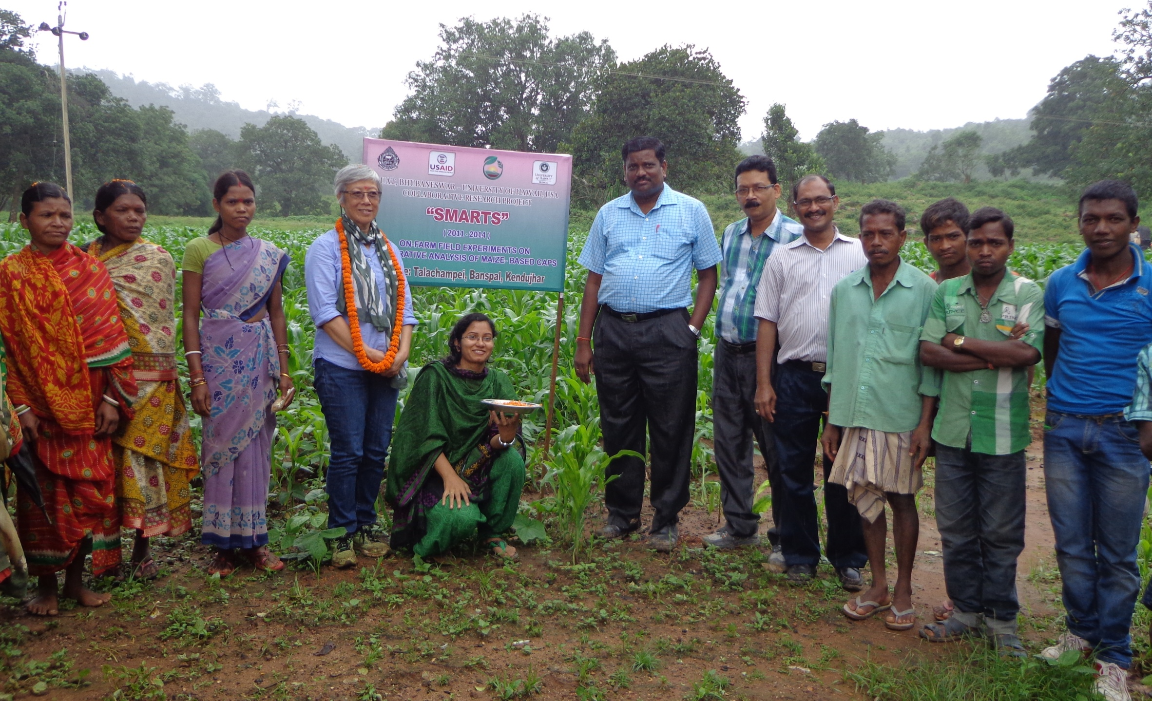

Slide 6
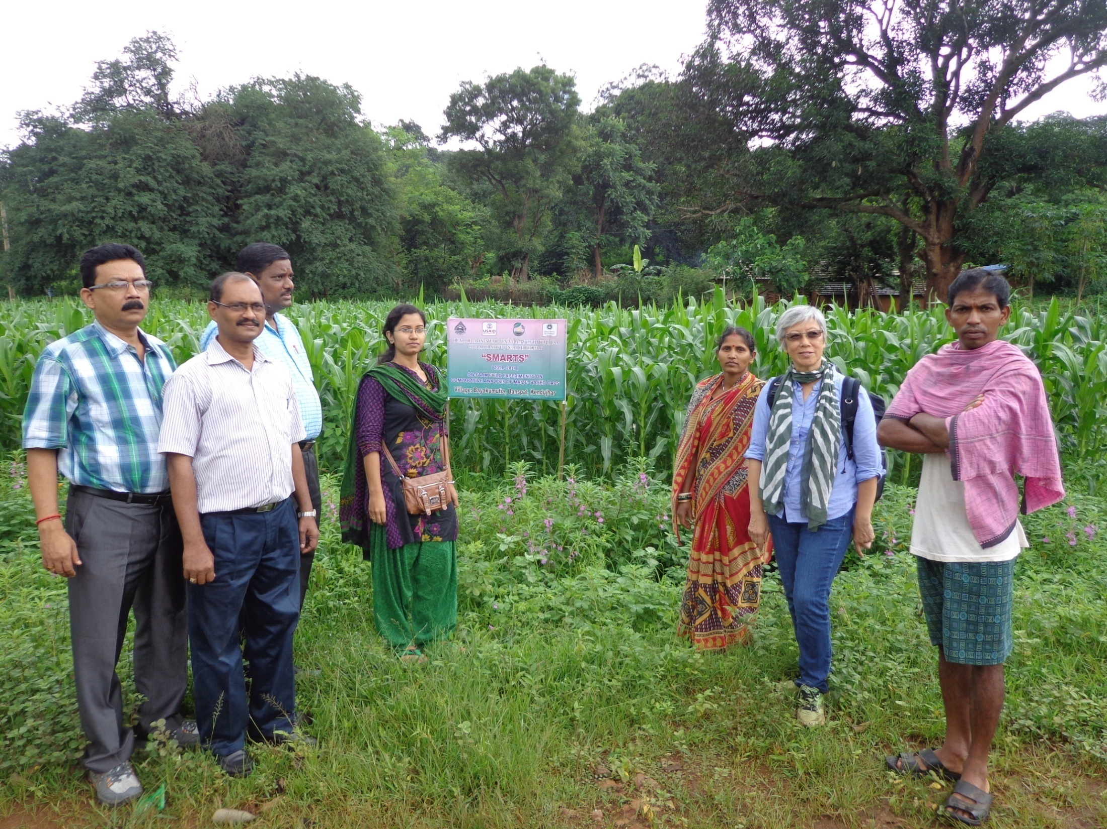

Slide 7
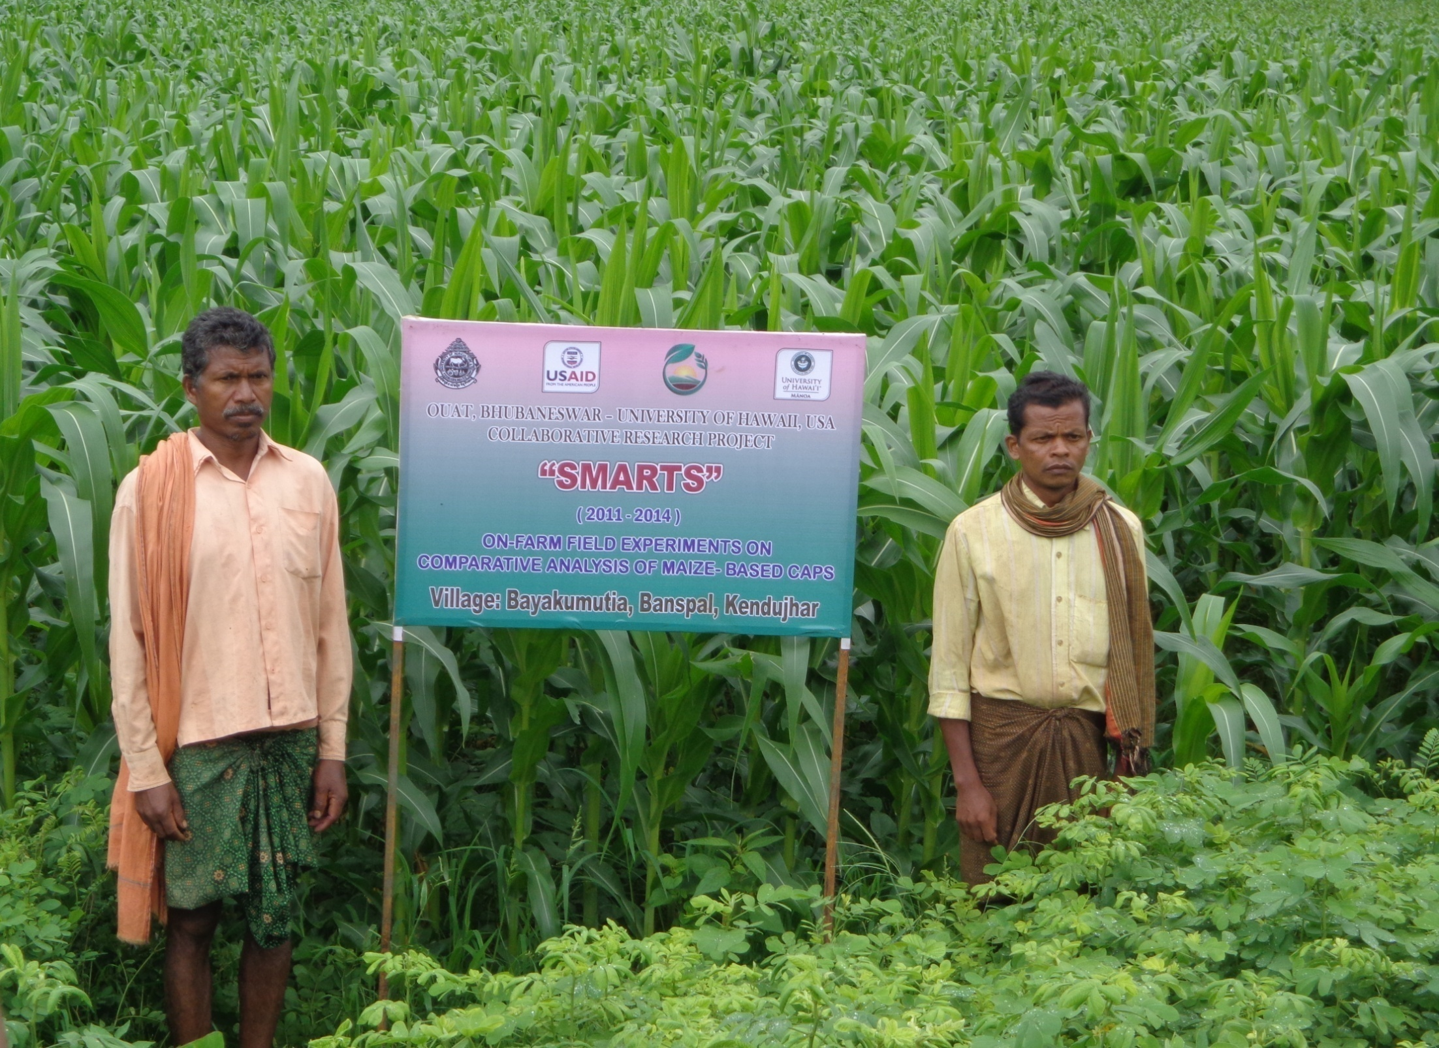

Slide 8
Student Research Activities
One student from India, continuing her Ph.D. in University of Hawaii at Manoa, is working on effect of Conservation Agriculture Production System (CAPS) on soil organic carbon fractionation, moisture retention capacity, soil microbiological activity and water stable aggregates.

Slide 9
Student Research Activities (contd…)
4 Post graduate student fellows have completed research work and submitted dissertations on project related activities on 29th
July, 2013.
Assessment of maize based CAPS on soil health in the hilly terrain of North Central Plateau Zone of Odisha.
Economic impact of soil and water conservation practices on conservation agriculture production system (CAPS) in North Central Plateau Zone of Odisha.
Intercropping studies in banana for improving soil health and farm income.
Planting pattern and nutrient management strategy for maize+ cowpea intercropping under rainfed conditions.

Slide 10
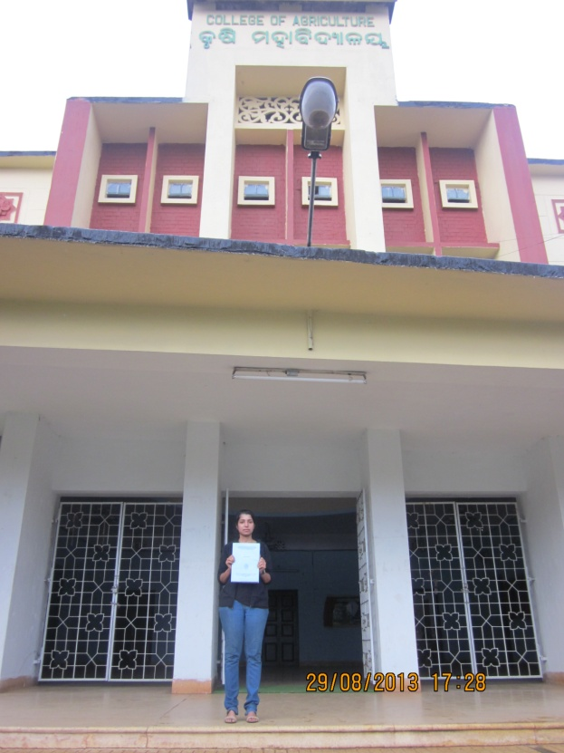
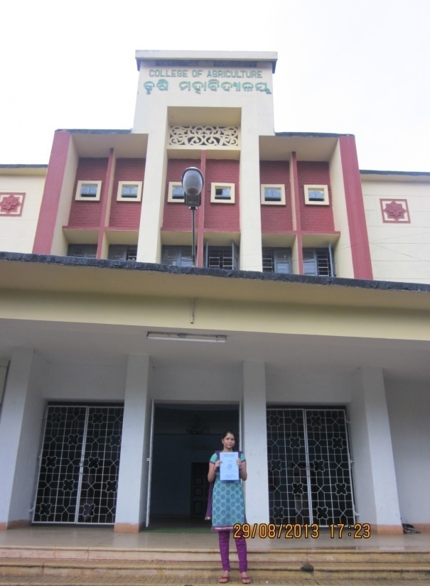
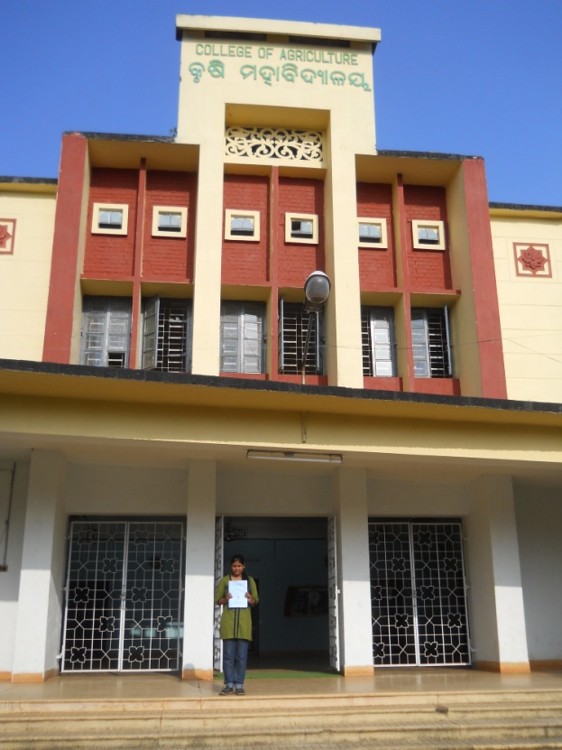
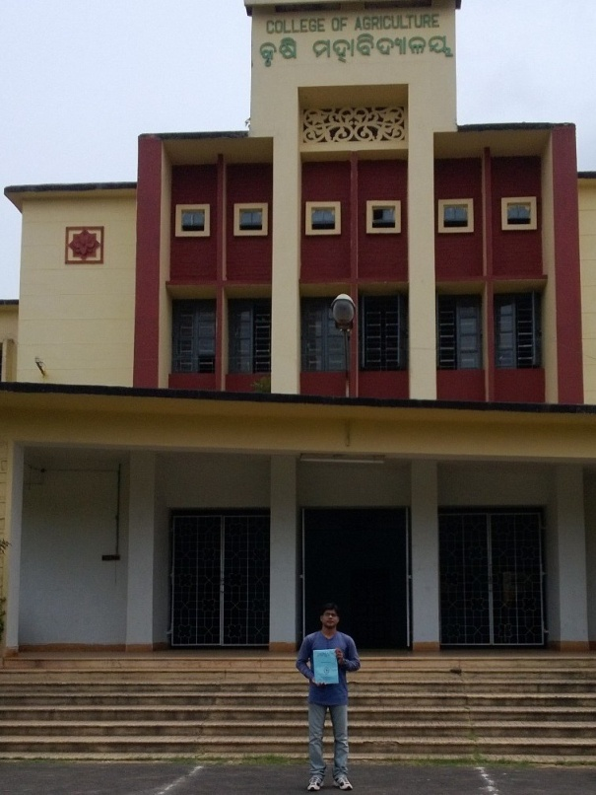

Slide 11
Student Research Activities (contd…)
Two Masters level student fellows, one in Agronomy and the other in Soil Science, have begun their research work with SMARTS fellowship during the academic year 2013-14.
Two students visited Kathmandu, Nepal during March 26-27, 2013, under the exchange program and attended an International Conference ‘F-CASA’ where they presented posters on on-station and on farm SMARTS research work.

Slide 12
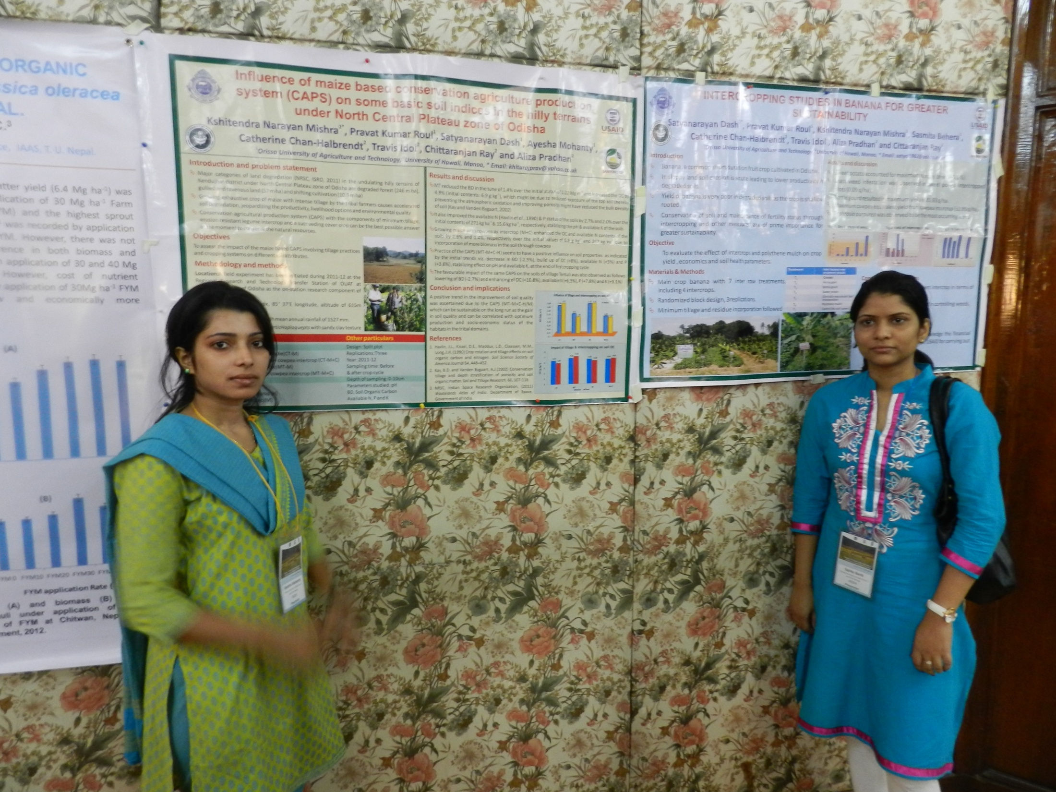

Slide 13
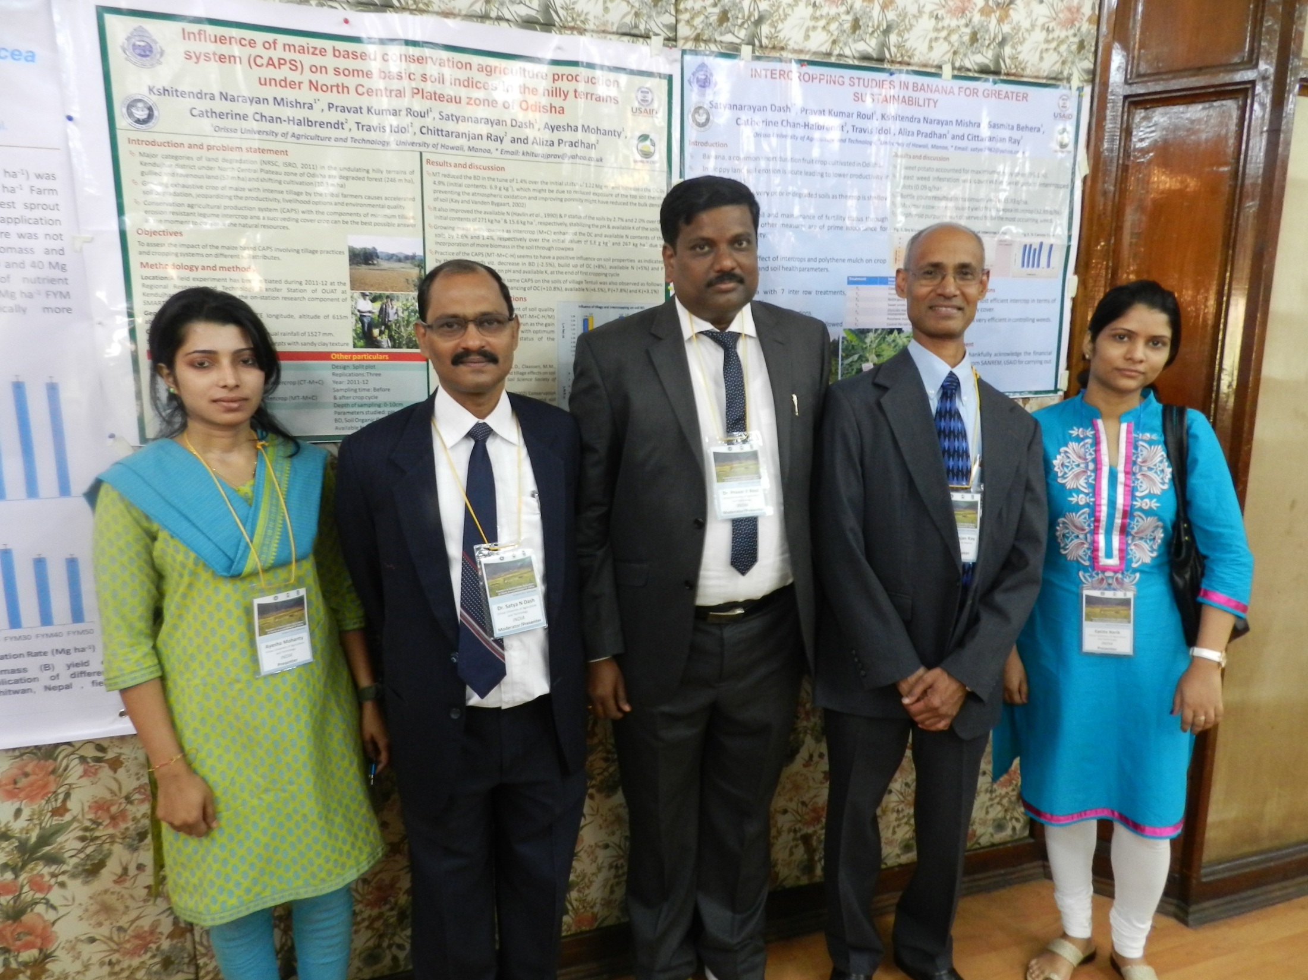

Slide 14
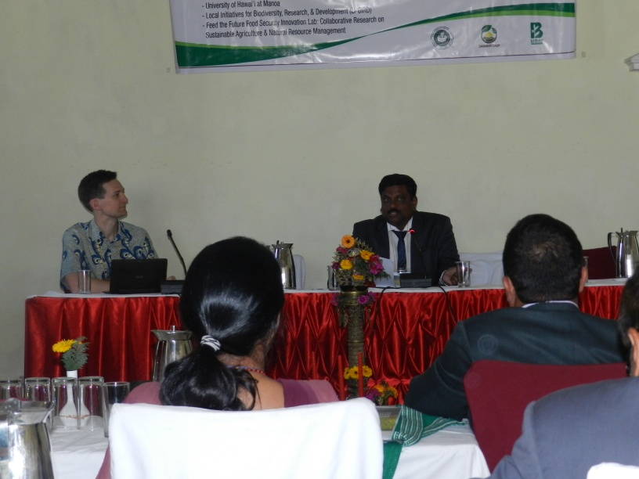
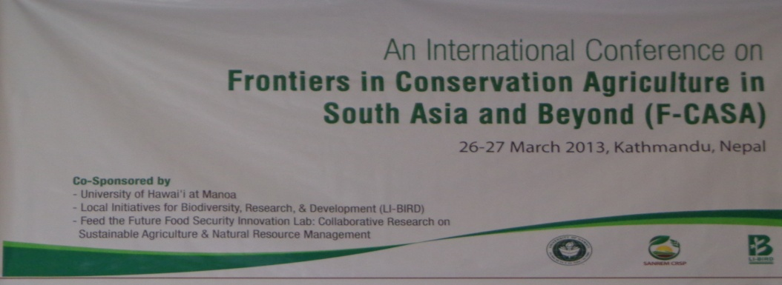

Slide 15
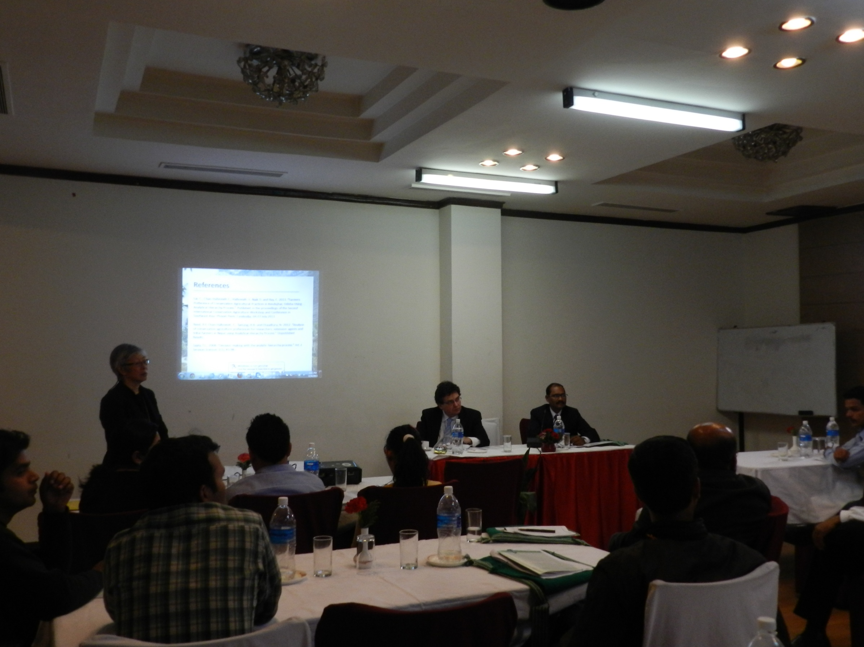

Slide 16
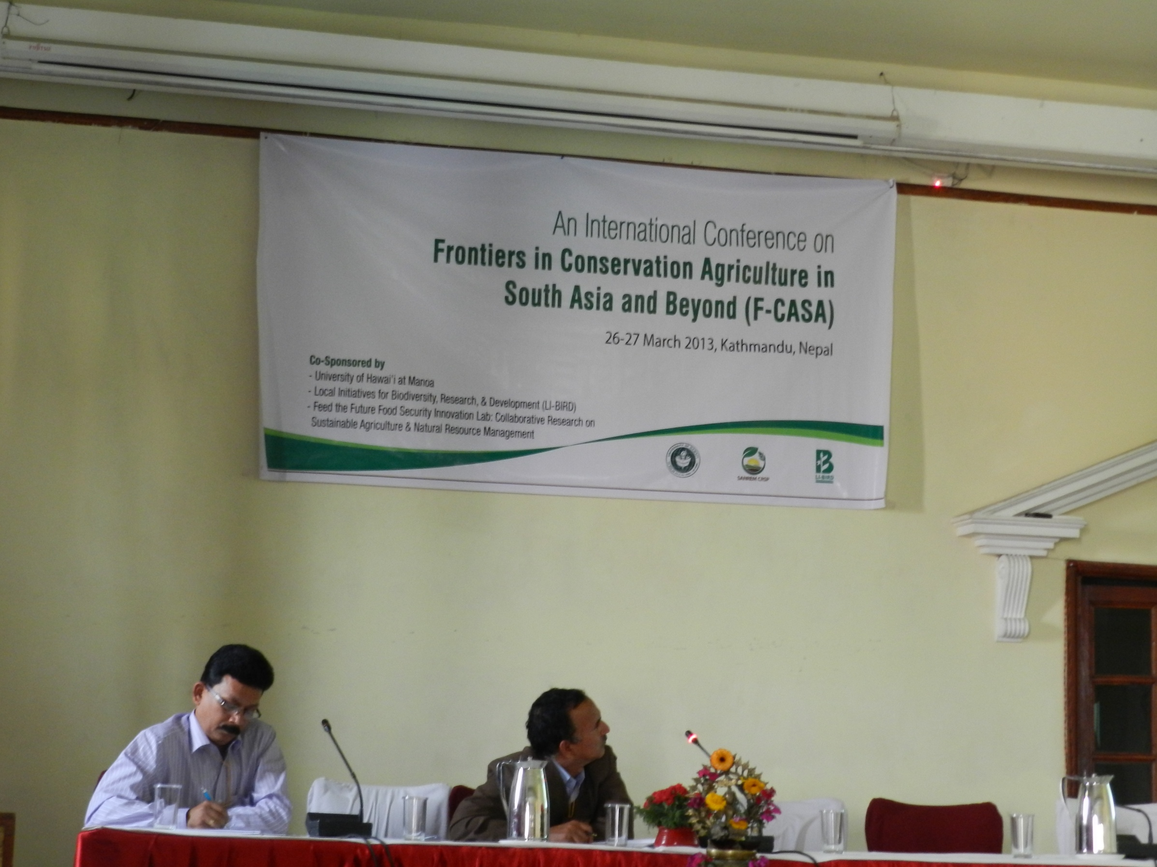

Slide 17
Trainings, Presentations and Publications
One training session on harvesting, post-harvest crop care and plant residue management was conducted on 15th December, 2012 in Keonjhar, Odisha which involved 100 participants (49 females, 51 males). Participants included village households, the SMARTS project team, the program coordinator, KVK scientists and SMARTS student fellows.
One District level workshop on maize-based conservation agriculture involving 80 participants (30 female, 50 male) viz. farmers and extension personnel was organized on 30th January, 2013 by the District Agriculture Department of Kendujhar, India where SMARTS project scientists acted as resource persons and delivered on maize-cowpea CAPS for sustainable tribal farming.

Slide 18
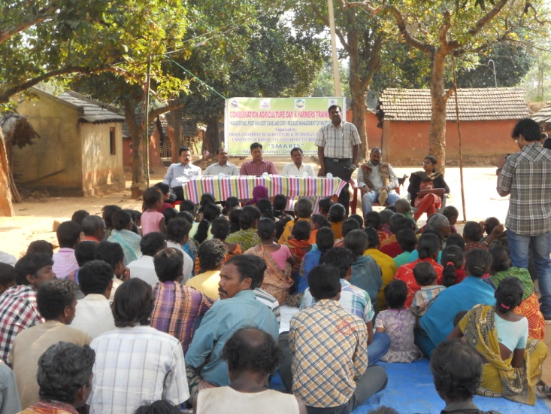

Slide 19
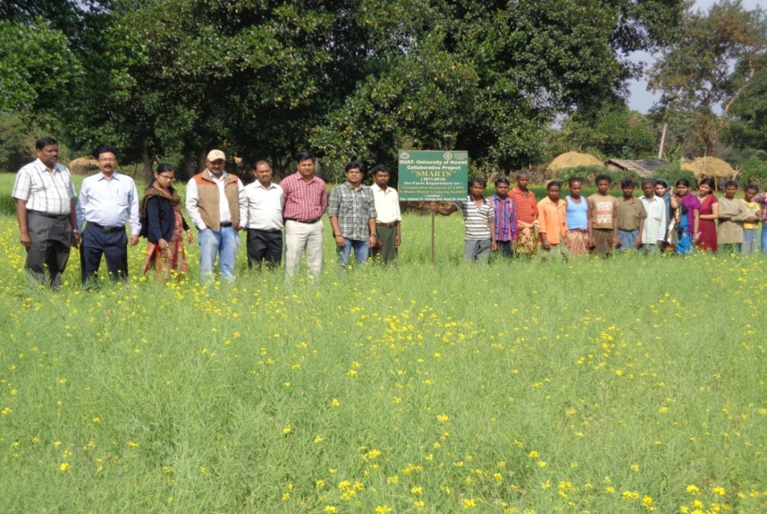

Slide 20

Trainings, Presentations and Publications (contd…)
One oral presentation entitled “Conservation Agriculture Production Systems (CAPS) in tribal societies of India” and another poster presentation on “Effect of Conservation Agriculture Production System (CAPS) on maize based tribal farming situations of Odisha, India” were presented at the Annual Convention of American Society of Agronomy, Cincinnati, Ohio (22nd October, 2012).
A presentation regarding maize based CAPS under tribal farming situations was given to the Minister, Secretary and Director of Agriculture, Govt. of Odisha and all district heads of allied departments.

Slide 21
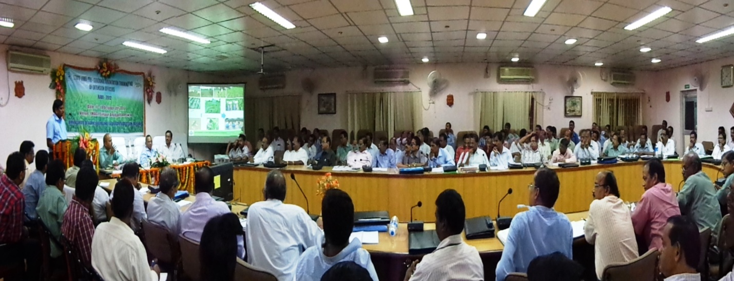

Slide 22

Trainings, Presentations and Publications (contd…)
One poster regarding Maize based CAPS [Nabanita, B., R.K. Nayak, K.N. Mishra, P.K. Roul, S.N. Dash, M.M. Behera, C. Chan-Halbrendt and T.W. Idol. 2013. “Impact of maize-based conservation agriculture system on soil properties in North Central Plateau Zone of Odisha.”] was presented at 77th Annual Convention of Indian Society of Soil Science, held at Punjab, Ludhiana, (3-6 December, 2012).
Two papers on conservation agriculture were presented on 3rd International Agronomy Congress held at New Delhi, during 26-30 November, 2012.

Slide 23
Trainings, Presentations and Publications (contd…)
Five oral and two posters were presented in an international conference “Frontiers in Conservation Agriculture in South Asia and Beyond (F-CASA)”, held on March 26-27, 2013 in Kathamandu, Nepal.
Oral presentations
Roul, P.K., P. Ray, K.N. Mishra, S.N. Dash, E. Barik, C. Chan Halbrendt, T.W. Idol, A. Pradhan and C. Ray. 2013. Influence of maize-based conservation agricultural practices (CAPs) on productivity, profitability and soil fertility in rainfed uplands of Odisha.
Pradhan, A., T. Idol, P.K. Roul, K.N. Mishra, C. Chan-Halbrendt, J. Halbrendt and C. Ray. 2013. Effect of tillage and intercropping on crop productivity, profitability and soil fertility under tribal farming situations of India.

Slide 24
Trainings, Presentations and Publications (contd…)
Lai, C., C. Chan-Halbrendt, J. Halbrendt, B. Reed, C. Ray and D. Naik. 2013. Highlighting mental perception gaps between professional and farm of four conservation agricultural treatments: a focus on Tentuli Village, Kendjuhar, India.
Reed, B., C. Chan-Halbrendt, C. Lai, J. Habrendt, P.K. Roul, and B. Paudel. 2013. Using multiple objective linear programming and economic surplus analysis to predict the economic impact of CA adoption: A case study in Odisha, India.
Reed, B, C. Chan-Halbrendt, B.B. Tamang, J. Halbrendt, N.K Chaudhary. 2013. Using Analytic Hierarchy Process to understand smallholder perceptions of conservation agriculture adoption in Nepal and India.

Slide 25
Trainings, Presentations and Publications (contd…)
Poster presentations
Mishra, K.N., P.K. Roul, S.N. Dash, A. Mohanty, C.Chan-Halbrendt, T. Idol, A. Pradhan and C. Ray. 2013. “Influence of maize-based conservation agriculture production system (CAPS) on some basic soil indices in the hilly terrains of Odisha.”
Dash, S. N., P. K. Roul, K. N. Mishra, S. Behera, C. Chan-Halbrendt, T. Idol, A. Pradhan and C. Ray. 2013. “Inter cropping studies in banana for greater sustainability.”
One oral presentation on “Measuring the economic impact of conservation agriculture adoption in rural India using linear programming and economic surplus analysis.” Presented at the University of Hawaii at Manoa College of Tropical Agriculture and Human Resources (CTAHR) and College of Engineering (COE) 2013 Student Research Symposium, Honolulu, Hawaii, 12-13, April 2013.

Slide 26
Book Chapters
Two book chapters on SMARTS research work in India are published in Conservation Agriculture in Southeast Asia and Beyond. Eds. Michael J. Mulvaney, Manuel R. Reyes, Catherine Chan-Halbrendt, Stephane Boulakia, Kaesorn Jumpa, Chinapatana Sukvibool and Samran Sobatpanit. Published as WASWAC Special Publication No. 7. Bangkok, Thailand: Funny Publishing, 2013:
Halbrendt, J., L. Shariq, C. Lai, T. Idol, C. Ray, P.K. Roul and K.N. Mishra 2013. “Development of an integrated approach for introducing conservation agricultural practices to the tribal communities of Odisha, India.” 73-84.
Lai, C., C. Chan-Halbrent, H. Halbrendt, D. Naik and C. Ray. 2013. “Farmers’ preference of conservation agricultural practices in Kendujhar, Odisha using the analytic hierarchy process.” 85-98.

Slide 27

Book Chapters (contd…)
Authors of another three papers regarding their research on maize based CAPS in Kendujhar, are invited to write a chapter in a book that has already been accepted by CABI for publication.

Slide 28
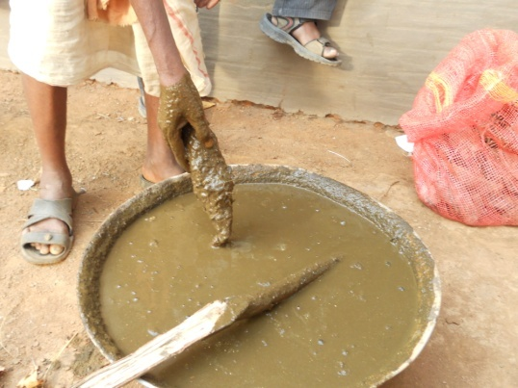

Slide 29
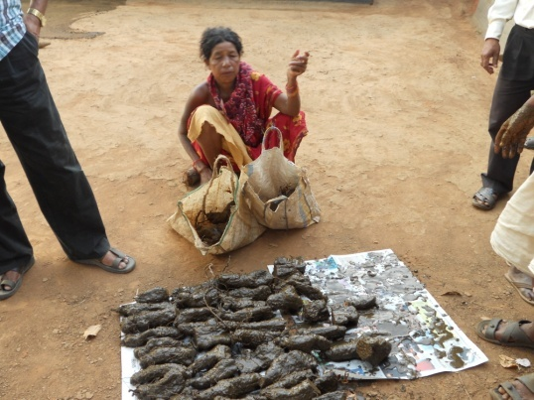

Slide 30
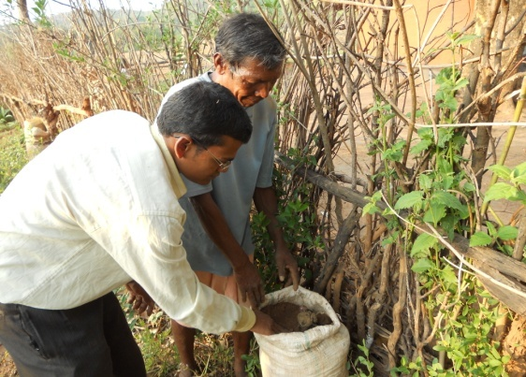

Slide 31
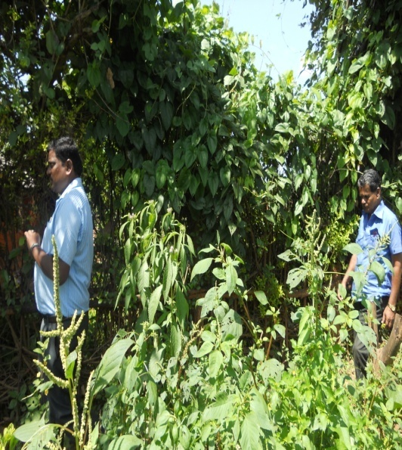

Slide 32
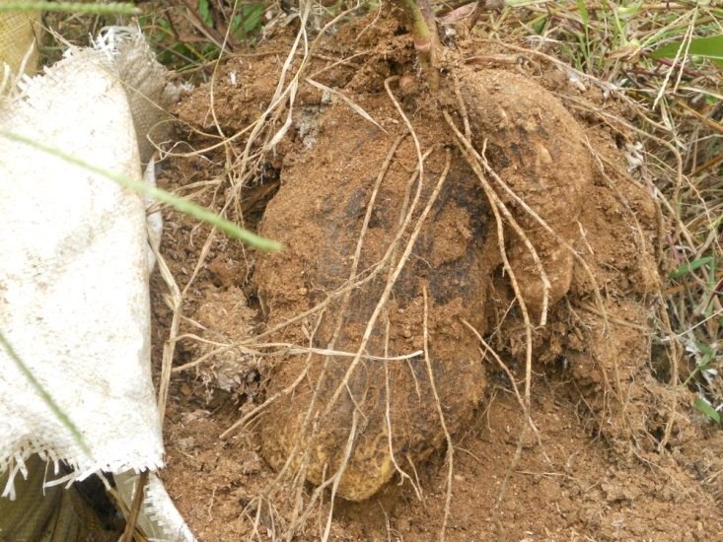

Slide 33
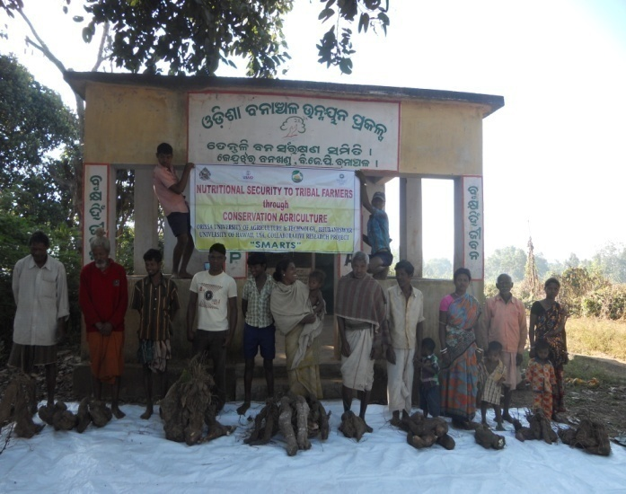

Slide 34
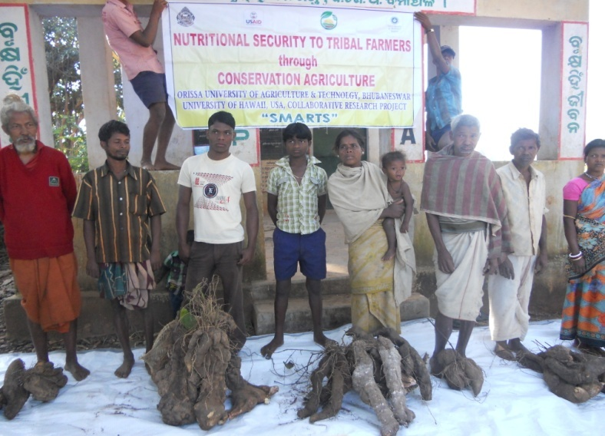

Slide 35
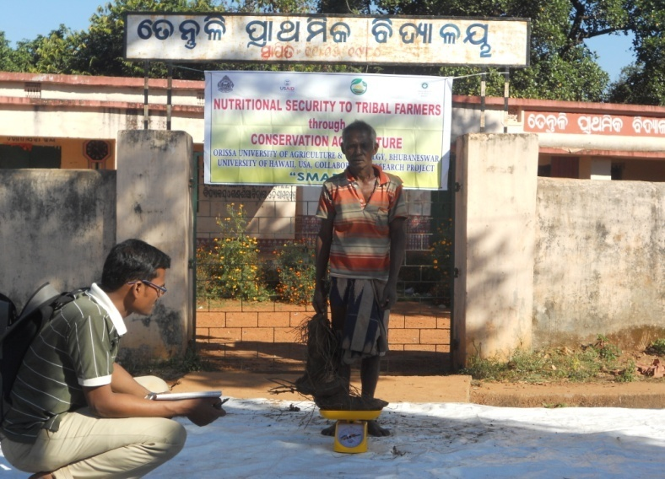

Slide 36
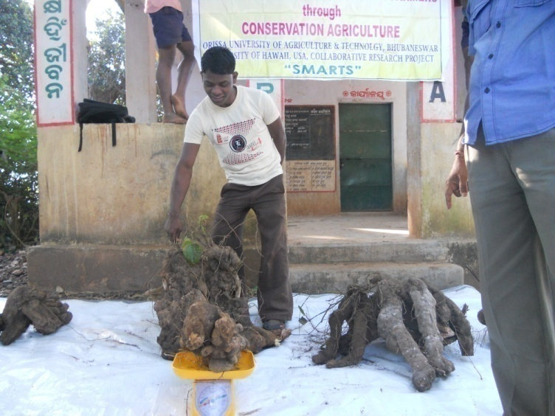

Slide 37
Thank You

