Slide 1
Collegiate Times Grades
James O’Hara
Hang Lin
Client: Alex Koma, managing editor, Collegiate Times
Blacksburg
May 1, 2014
Virginia Tech
CS 4624

Slide 2
Outline
Overview of project
Design, development, evaluation process
Problems encountered
Lessons learned

Slide 3
Project overview
The Collegiate Times collects Virginia Tech course grades
Collated into a publicly available database
The CT recently changed web hosts and has not migrated the database
The project will create a new public home for this data

Slide 4
Design guidelines
Prominently display data
Must be easy to understand
Data must be sortable
Data must be paginated
Queries must be easy and productive
Must be identifiable with Collegiate Times brand

Slide 5
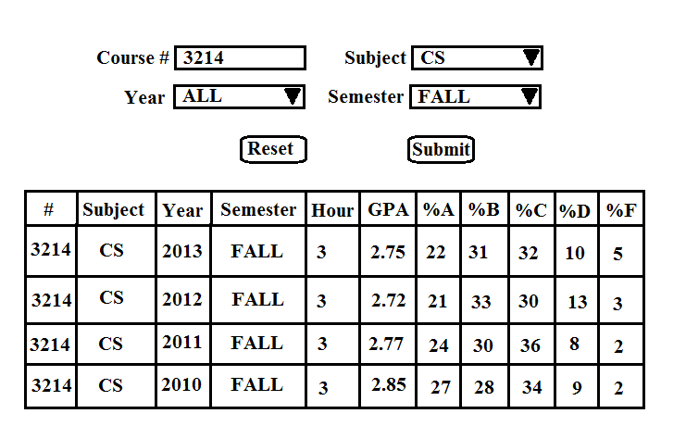
Design

Slide 6
Prototype
HTML form process user request
Connects to database
Queries database with information provided by user
Outputs results into table with PHP
Formats table with Javascrpipt

Slide 7
Evaluation
Usability inspection
Collegiate Times experts:
  Sorted dropdowns
  Denote required criteria
  Explain database
Computer science experts:
  Prevent SQL injection
  Limit query size
  Report back user’s query in English

Slide 8
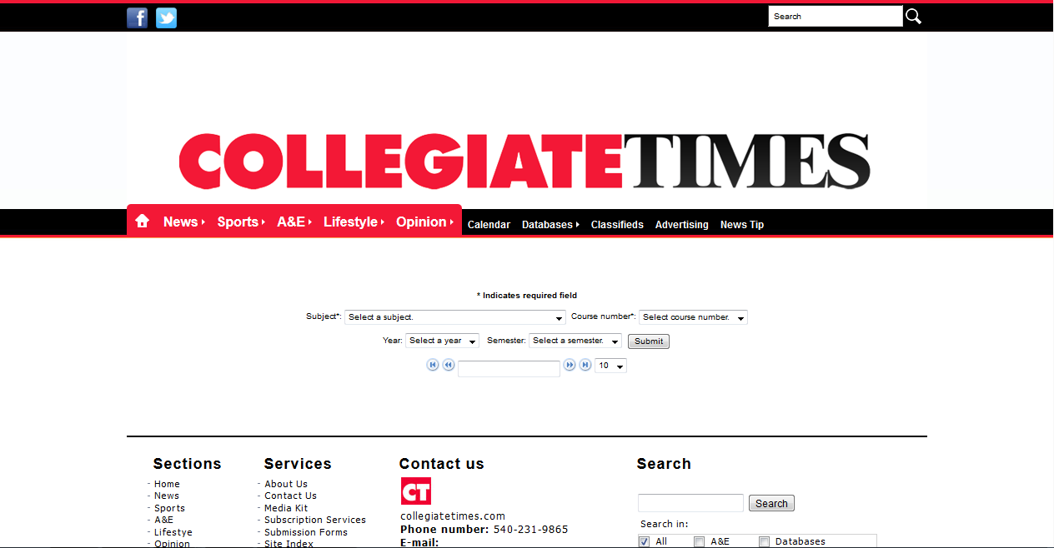
Final product

Slide 9

Final product

Slide 10
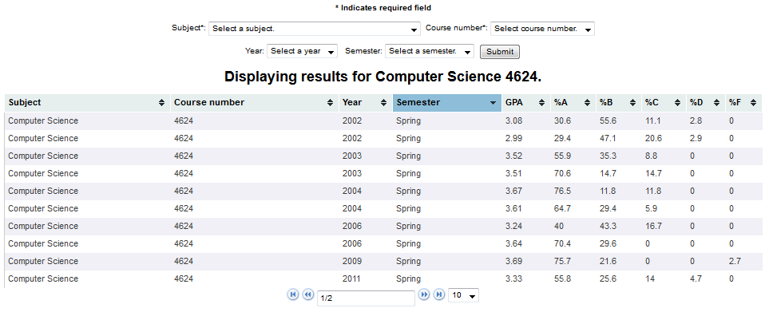
Final product

Slide 11
Problems
Data hidden or missing
Dynamic dropdowns not populating
Querying correctly
Tablesorter extension

Slide 12
Lessons Learned
Working with a client
How to use SQL
Developing for the future
Working around missing information
The full development cycle

