Slide 1

CS6604 Project
Ensemble Classification
Project Team:
Kannan, Vijayasarathy
Soundarapandian, Manikandan
Alabdulhadi, Mohammed
Hamid, Tania
Project Client:
Yinlin Chen
VT, Blacksburg
03/06/2014

Slide 2
Introduction
Project Objective:
  Developing classifiers to aid in Transfer Learning and classify educational resources for the Ensemble portal.
Machine Learning (Text Classification)
Notes:
How presentation will benefit audience: Adult learners are more interested in a subject if they know how or why it is important to them.
Presenter’s level of expertise in the subject: Briefly state your credentials in this area, or explain why participants should listen to you.

Slide 3
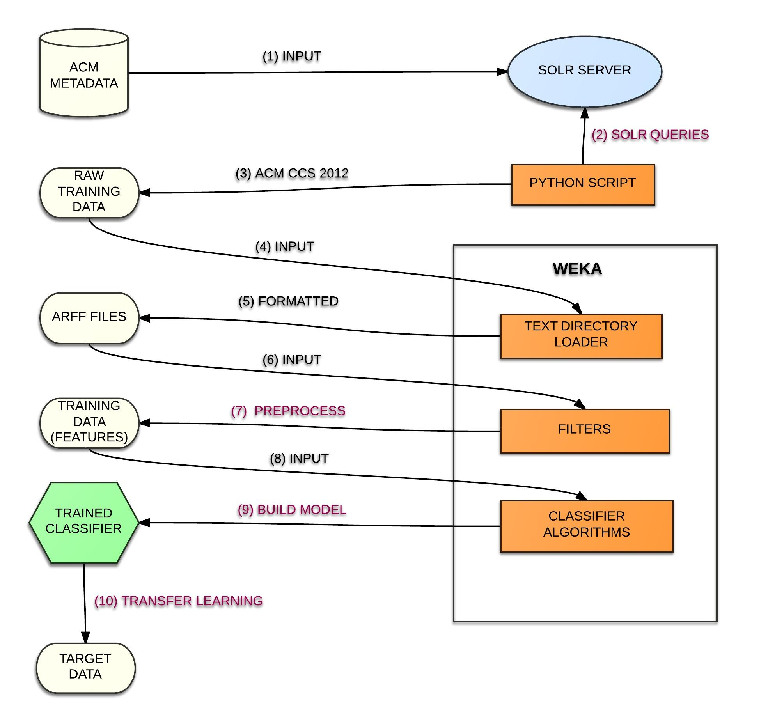
The Big Picture
Notes:
Lesson descriptions should be brief.

Slide 4
Results – All Classes
Instance Size | No. of Classes | Filter | Classification Algorithm | % of Accuracy | Test Option
26695 | 54 | String to Word Vector, SMOTE, Randomize | Naïve Bayes Multinomial | 40 | Cross-validation (3 Folds)
26695 | 54 | String to Word Vector, SMOTE, Randomize | Naïve Bayes Multinomial | 52 | Use Training Set
26695 | 54 | String to Word Vector, SMOTE, Randomize | J48 | 39 | Cross-validation (3 Folds)
26695 | 54 | String to Word Vector, SMOTE, Randomize | J48 | 67.55 | Use Training Set

Slide 5
Results – Reduced Classes
Instance Size | No. of Classes | Filter | Classification Algorithm | % of Accuracy | Test Option
10002 | 10 | String to Word Vector | Naïve Bayes Multinomial | 75.8 | Cross-validation (3 Folds)
12003 | 12 | String to Word Vector | Naïve Bayes Multinomial | 67.2 | Cross-validation (3 Folds)
10002 | 10 | String to Word Vector | SMO | 76.8 | Cross-validation (3 Folds)
12003 | 12 | String to Word Vector | SMO | 65.66 | Cross-validation (3 Folds)

Slide 6
Future Work
Classifier Accuracy improvement
Adding more features
  Conference name
  Author Name
  Bibliographic references
Include all classes of ACM CCS
Single-Class Classifiers
Transfer Learning to Ensemble portal

Slide 7
Challenges
  Size of the training data set
  Data Filtering and Preprocessing
  Pruning the taxonomy
  Classifier Accuracy
  Weka Performance and Reliability
Notes:
Put tick mark against challenges resolved
Weka performance: concern for large data sets, aiming to deploy it on distributed platform
Classifier Accuracy : in progress. Improved it from 45 to 67 using various combination of filters

Slide 8

Questions ?

