Slide 1


COVID-19 Fake News Detection
By: Vincent DiPerna, Michael Blair, Sungjeon Choi, and Safa Kamran
Course Instructor: Mohammed Farag
CS 4624 Multimedia/Hypertext Capstone
Virginia Tech, Blacksburg, VA 24061
4/18/2023

Slide 2
Outline
Background
Categories
Completed Work
Preprocessing Script
Preprocessing Script Output
Preprocessing Script Statistics
Categories Chosen
AI Model Implementation (Preprocessing)
Formatting Training Data
AI Model Implementation (Training)
AI Model (Testing)
Website Implementation
Backend
Flask Server
Added Functionality
To-Do
Challenges
Lessons Learned
Future Work
Acknowledgements
References

Slide 3

Background
Problem: Misinformation about Covid-19 spread on Twitter
Goal: Help identify/categorize tweets that are misinformation
Solution: Web page where you can input a tweet and it will categorize the tweet

Slide 4

Completed Work
Preprocessing
Back-end
Front-end
AI Model

Slide 5
Preprocessing Script
The script is invoked on the command line using “main.py” followed by the JSON file that is to be analyzed
The JSON file must contain a JSON list of JSON objects
The script first opens the files, and loads the AI models into memory
Each tweet is parsed, and added to a SQL commands file for later integration into a MySQL database
The text is further parsed and then running through the AI model

Slide 6
Preprocessing Script (continued)
The links from each tweet are also saved in a file
The script can process about 1000 tweets per second, and the limiting factor is the model which takes a significant amount of time to run
Multithreading was considered, but was not implemented in the end
  The number of tweets was so large that dividing up the work for separate threads proved to be time consuming and very memory consumptive
  The combination of the files afterward had a lot of overhead as well
The script will output some statistics on the tweets analyzed including the percentage of tweets in each classification category

Slide 7
Preprocessing Script Output
sqlcommands.txt - A text file containing the INSERT SQL commands for inserting data into a SQL database
tweettexts.txt - A file containing the text of each tweet nicely formatted for the AI model training
tweetlinks.txt - A file containing all the links associated with each tweet that are not twitter links

Slide 8
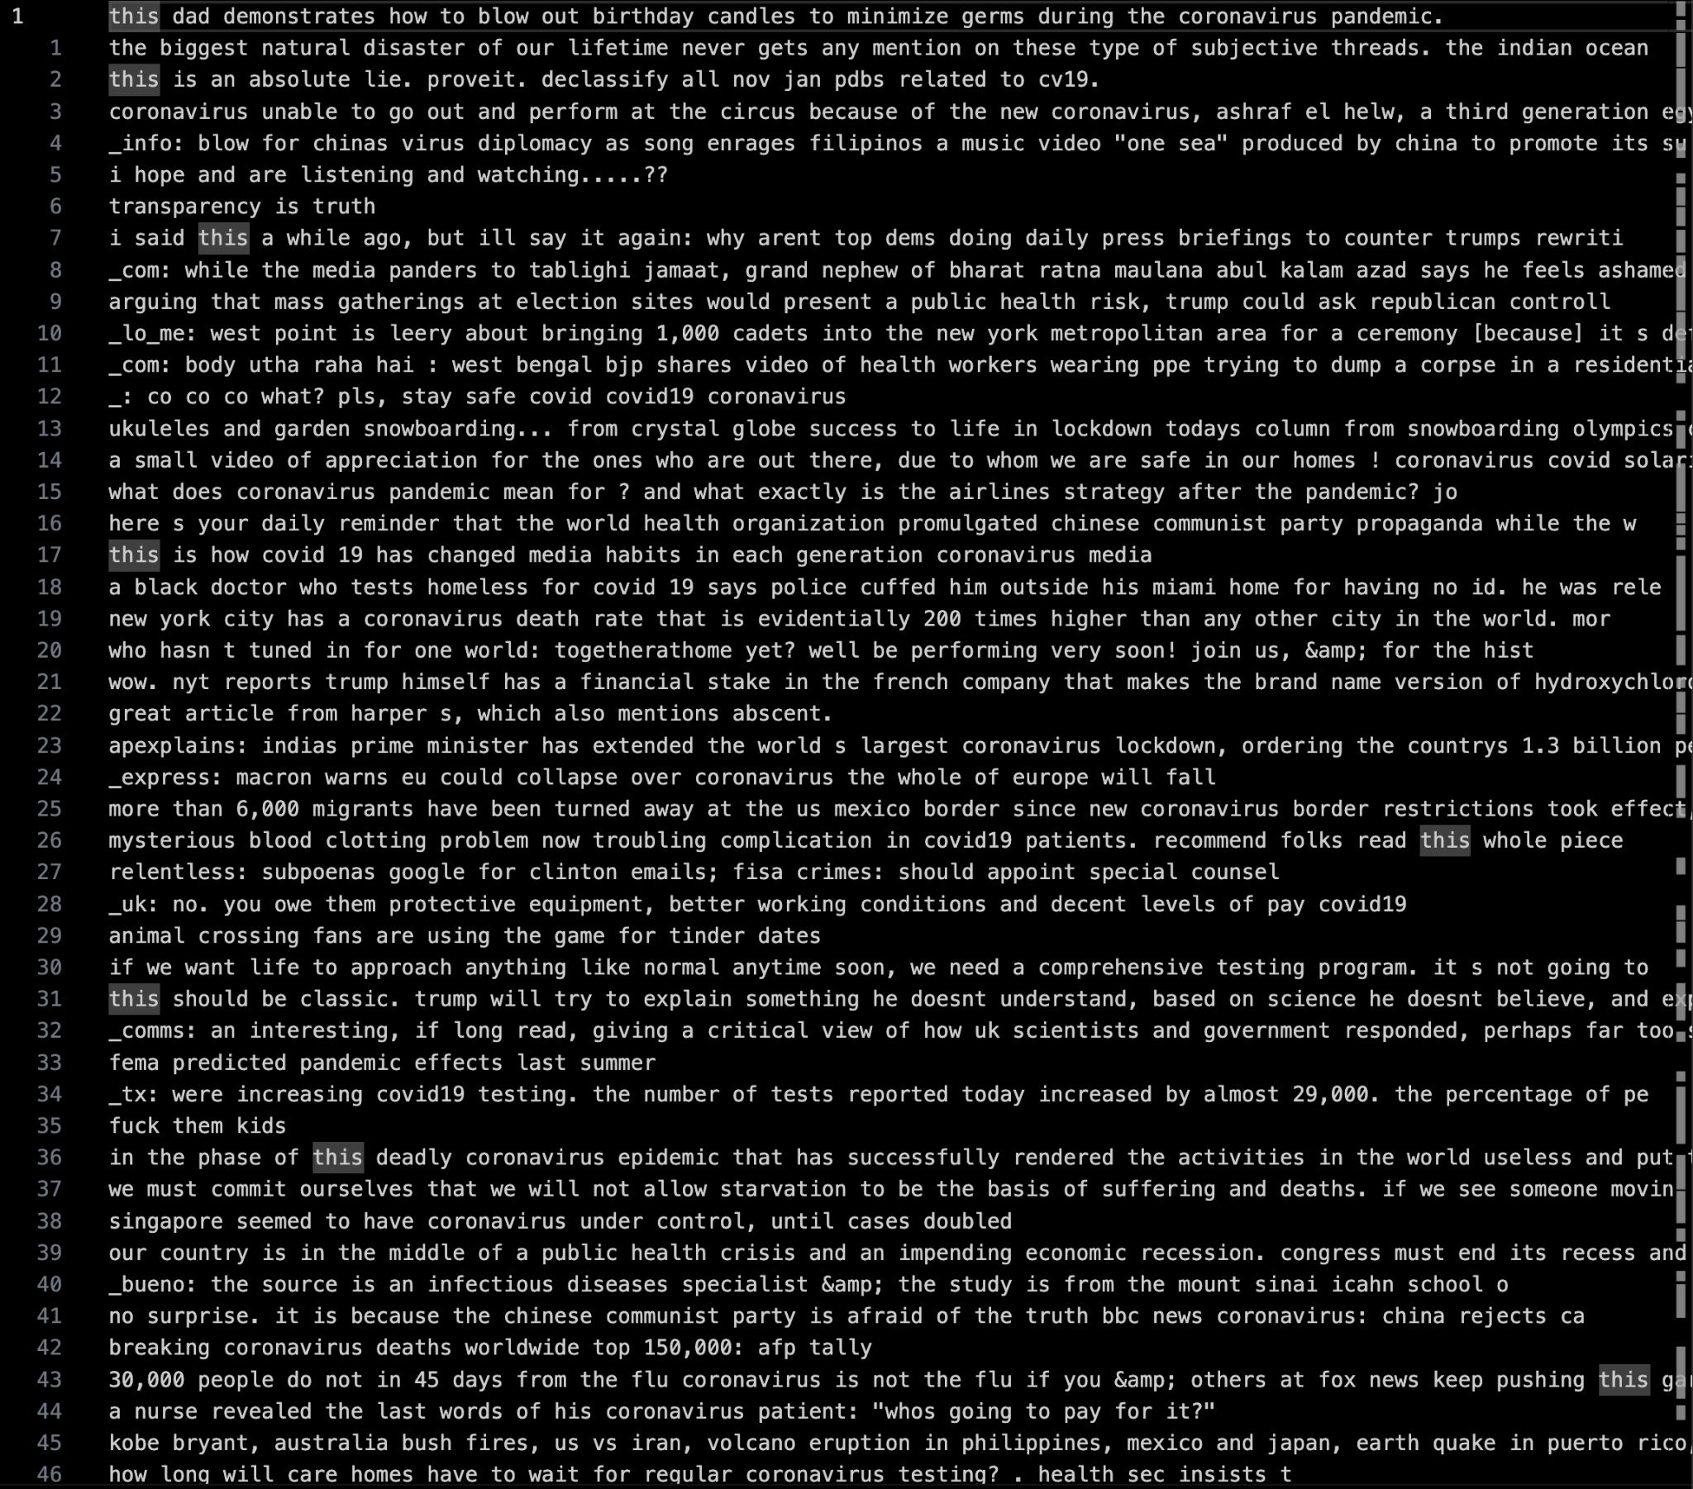
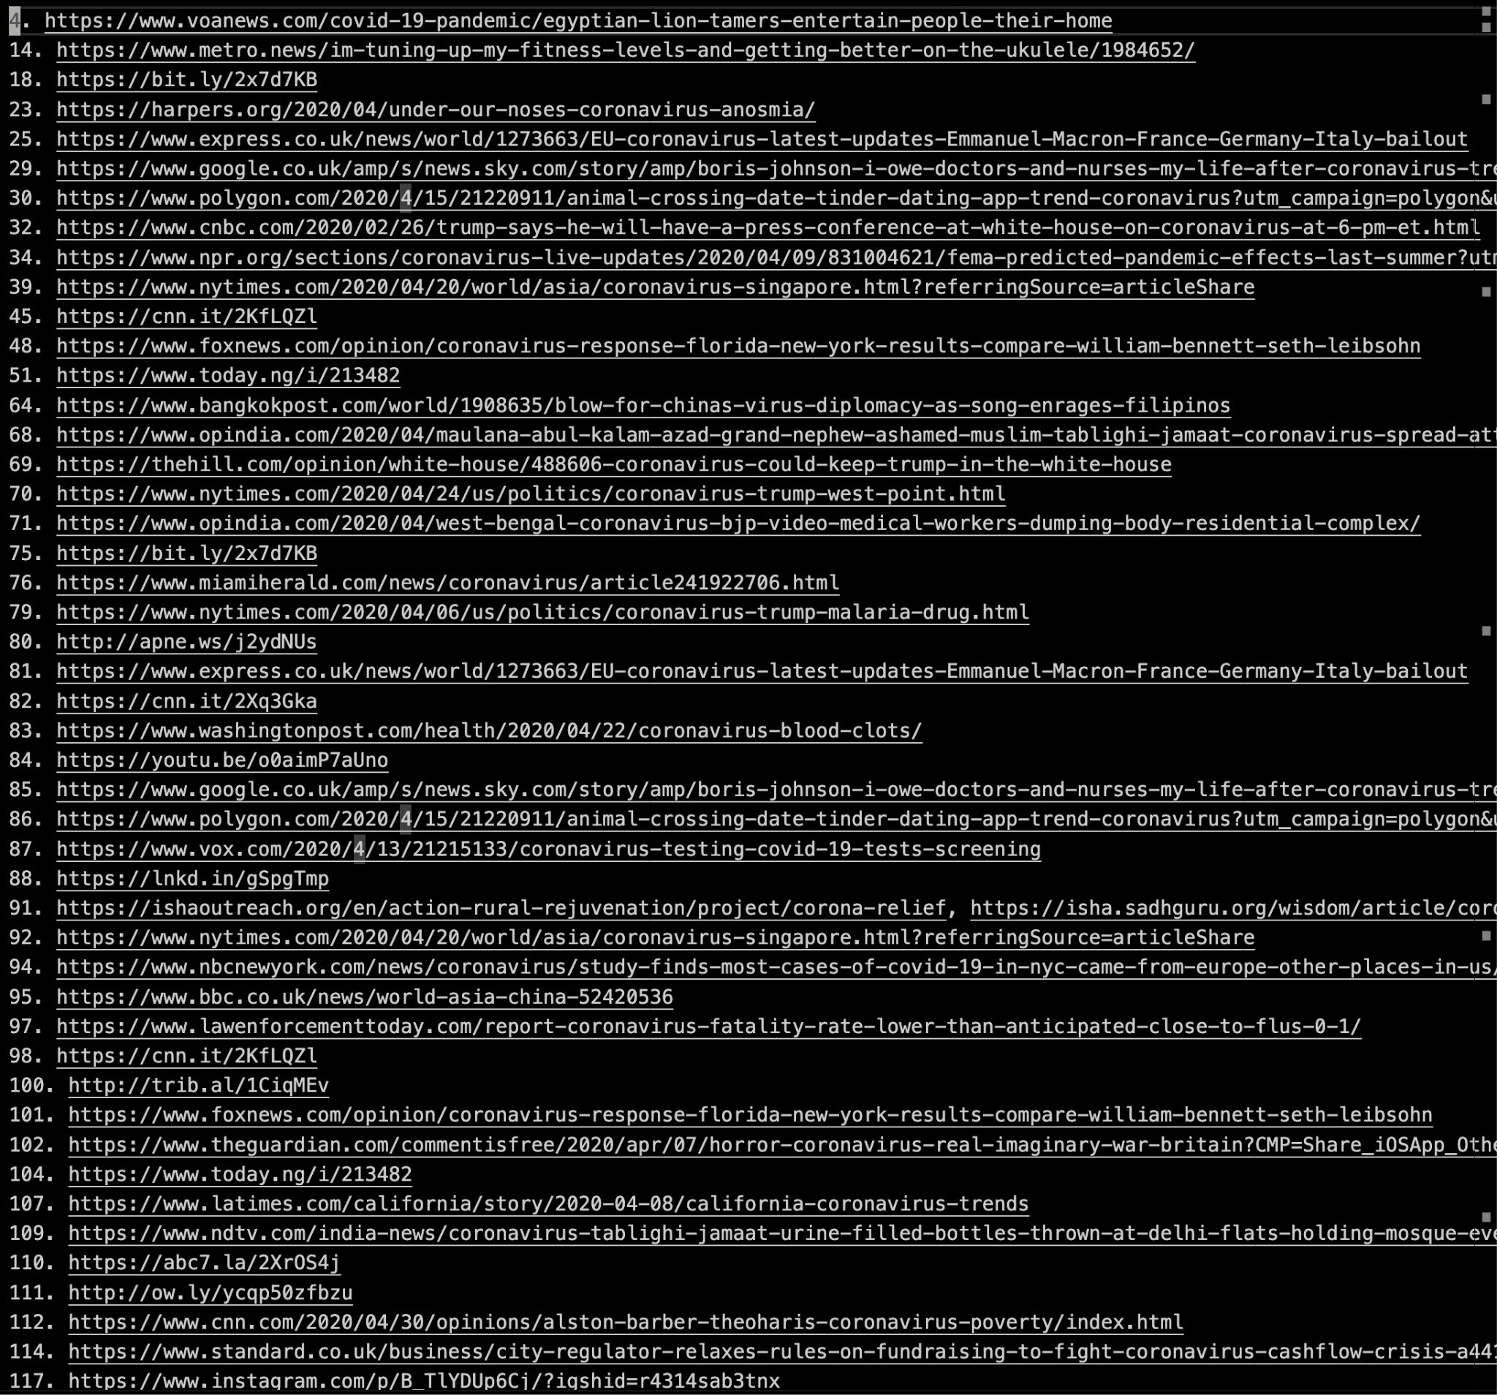
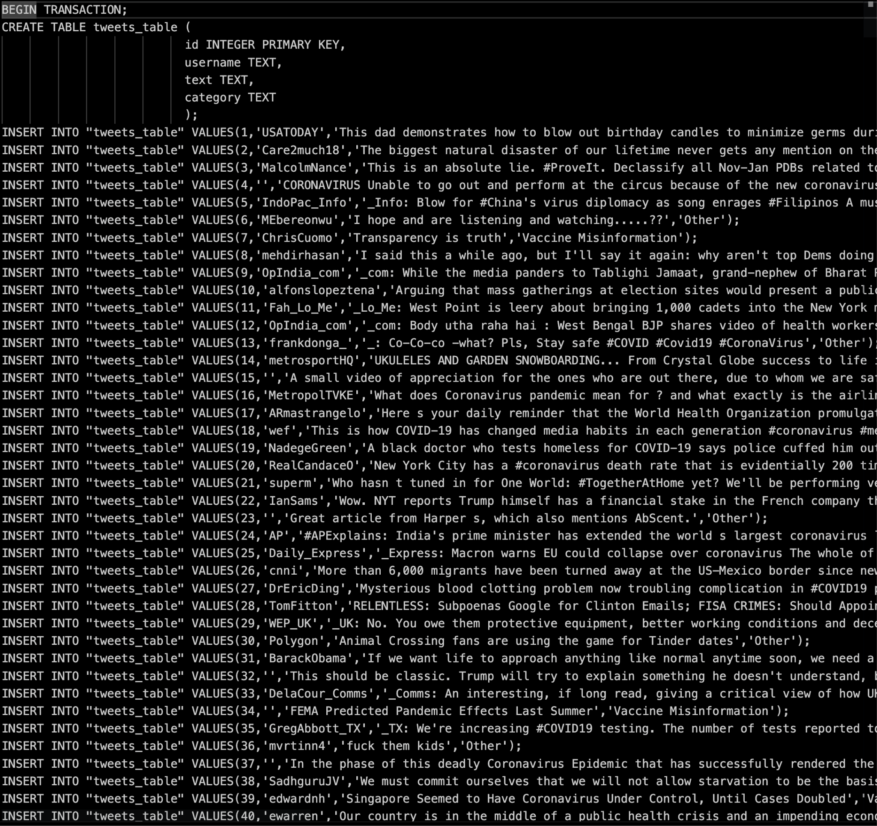
Preprocessing Script Output (continued)
tweettext.txt
tweetlinks.txt
sqlcommands.txt

Slide 9
Preprocessing Script Statistics
The statistics from running the script on about 1 million tweets was
  Vaccine Misinformation - 34.2%
  Treatment Misinformation - 13.2%
  Other (including Truth) - 52.9%
Since there were are only two misinformation categories, the results are a skewed a bit towards vaccine misinformation
With more categories and a wider range of test data, the model could have been made more accurate
However with the limited amount of time for this project, we were unable to train the model with more categories

Slide 10



Categories Chosen
Treatment
Vaccine
Other

Slide 11
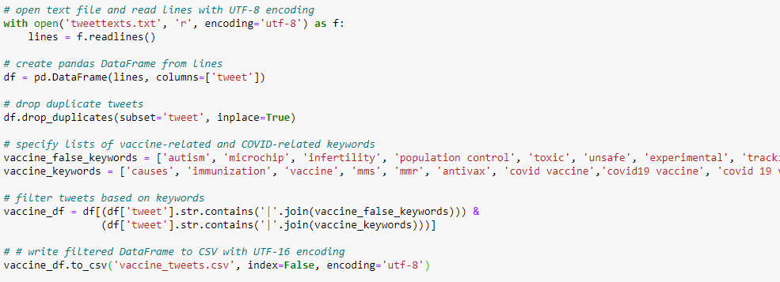
AI Model Implementation (Preprocessing)
17.5 Million Tweets
Manually filter tweets after keyword match

Slide 12
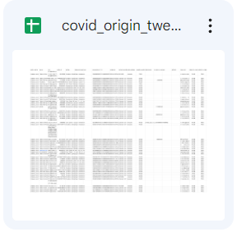
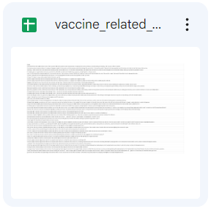
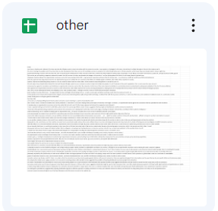
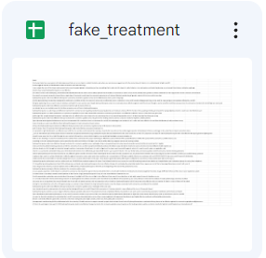
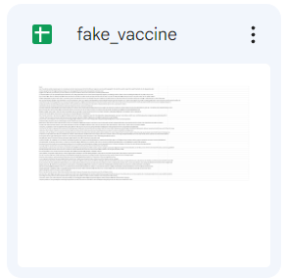
Formatting Training Data

Slide 13
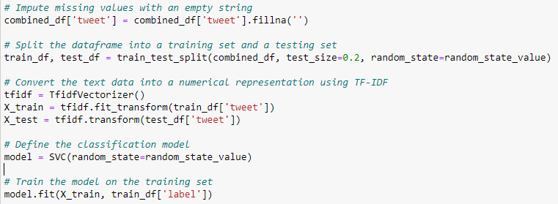
AI Model Implementation (Training)
Model: Support Vector Classification (SVC)
Split: 80/20

Slide 14
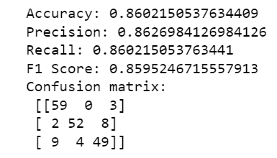
AI Model (Testing)
Metrics from sklearn
Confusion Matrix

Slide 15


Website Implementation
MySQL Database
Wildfly Server run locally
JSF / XHTML frontend
Java backend
EC2 server run via AWS
Flask server running AI model for detection

Slide 16
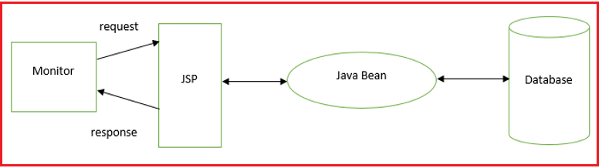
Backend
Java backend
  Two Controllers -> Links File Download, Tweet Controller
  Tweet Entity Bean
  Tweet Facade Bean

Slide 17
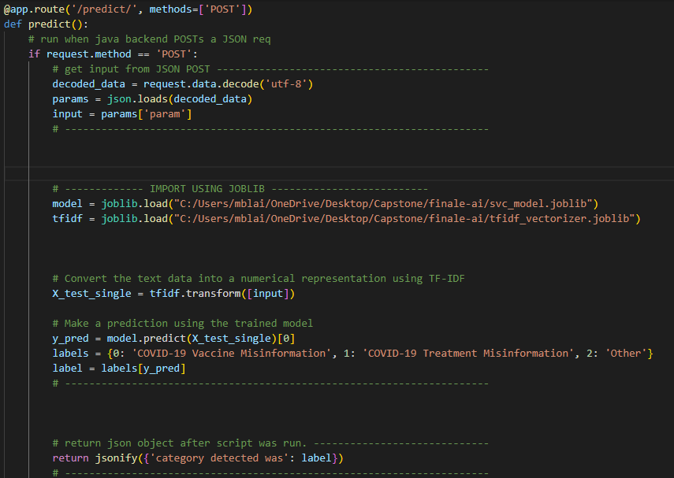
Flask Server
Impossible to call python AI script via JSF
Calling Flask server through Java backend
  POST request URL set up
  BufferedReader to get output

Slide 18
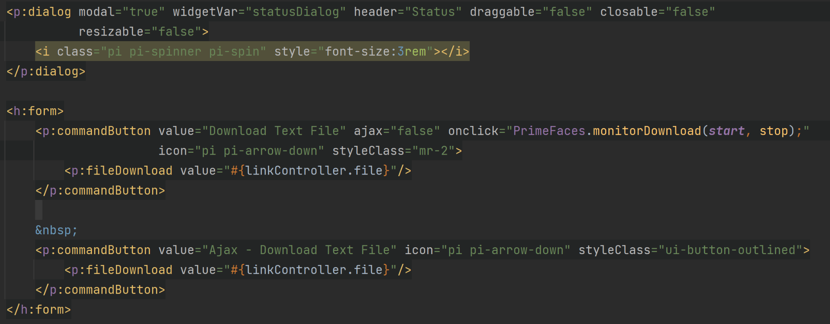
Added Functionality
Downloadable text file of links connected to tweets
PDF viewer of final report
User input for AI detection

Slide 19
To-Do
4/27: VTechWorks final draft submission
  Report
  Presentation
  Source code and remaining deliverables
5/2: Final checklist for VTechWorks and project peer reviews
  Report
  Dataset
  Code
  Software

Slide 20

Challenges
Manually detecting tweets is tedious
Spelling errors in tweets
Massive Size of Files
Inexperience with certain technologies
Components dependent on each other

Slide 21

Lessons Learned
Start work on milestones early
  Task may take longer than expected
  Questions arise when work begins
Size constraints need to be addressed early in the project
Communication is key

Slide 22

Future Work
Making the preprocessing script multithreaded
Creating more categories for the AI model and training it
More data to train the AI model with
Potential use for a better/more advanced model
Deploy everything to EC2 for final presentation

Slide 23

Acknowledgements
Client/Instructor: Dr. Mohamed Farag
  Email: mmagdy@vt.edu
UTA: Enmu Liu
Previous Team: Eric Wiley, Tung Nguyen, Fareeza Zameer, Ferrin Kirby, Kyle Toroc, and Campbell Dalen

Slide 24
References
A. Rovetta and A. S. Bhagavathula, “COVID-19-Related Web Search Behaviors and Infodemic Attitudes in Italy: Infodemiological Study,” JMIR public health and surveillance, 05-May-2020. [Online]. Available: https://www.ncbi.nlm.nih.gov/pmc/articles/PMC7202310/. [Accessed: 13-Feb-2023].
Center for Diseased Control and Prevention, “How to address COVID-19 vaccine misinformation,” Centers for Disease Control and Prevention, 03-Nov-2021. [Online]. Available: https://www.cdc.gov/vaccines/covid-19/health-departments/addressing-vaccine-misinformation.html. [Accessed: 13-Feb-2023].
Miami Dade College, “Libguides: Fake News (and how to fight it),” LibGuides at Miami Dade College Learning Resources, 29-Nov-2022. [Online]. Available: https://libraryguides.mdc.edu/FakeNews. [Accessed: 13-Feb-2023].
S. K. W. Chu, R. Xie, and Y. Wang, “Cross-language fake news detection - researchgate.net,” Cross-Language Fake News Detection, Nov-2020. [Online]. Available: https://www.researchgate.net/publication/347563252_Cross-Language_Fake_News_Detection. [Accessed: 14-Feb-2023].

