Slide 1

HateCorp: Cross-Platform Data Collection for Online Hate Groups
Presenters: Shruti Phadke,Rohit Kumar Chandaluri
Course: CS6604 Digital Libraries Fall 2019
University: Virginia Tech
City: Blacksburg, VA, 24060
Date: 12/05/2012

Slide 2
Motivation

Slide 3

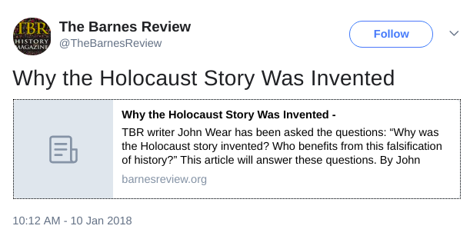
Social media can provide an efficient and fast communication for hate groups to exchange information and spew radical beliefs and activism, amplifying what are otherwise fringe opinions.

Slide 4

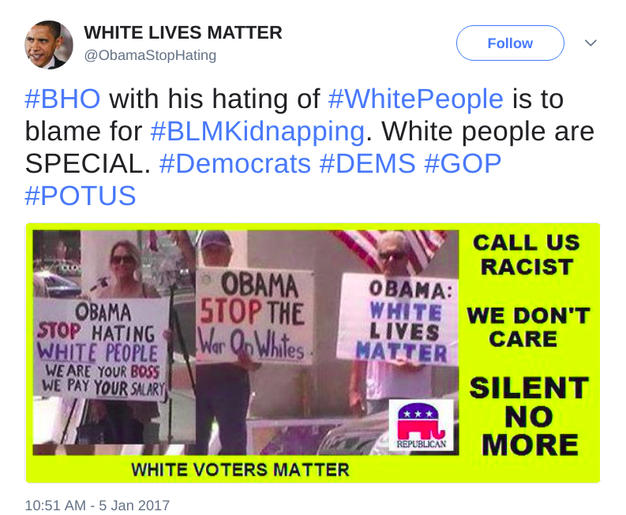
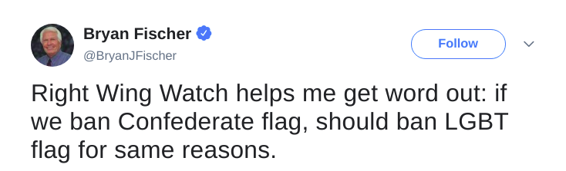
In a mounting number of hate crimes against various minorities, perpetrators sought support and publicized their actions on various social media platforms.

Slide 5


Church shooting at Charleston, synagogue shooting in Pittsburgh and New Zealand mosque shooting are just a few of the many incidents that have recently reinforced concerns about organized hate on social media.
To this date, the research community has not developed a strong understanding of how hate groups use social media to frame their messages and share information.

Slide 6





Research Questions
How do hate groups use social media?
How do hate groups use different social media spaces?

Slide 7
HateCorp : Digital Library of Cross-Platform Hate Group Data
Research Task 1: Creating a dataset of hate group communication across multiple platforms
Research Task 2: Observing various linguistic, informational and social engagement trends in the cross-platform data

Slide 8
Introduction
SPLC (Southern Poverty Law Center) is a non-profit social justice organization dedicated to monitoring hate group activity in the United States.
Along with the names of the hate groups, SPLC also signifies the hate ideology they identify with.

Slide 9
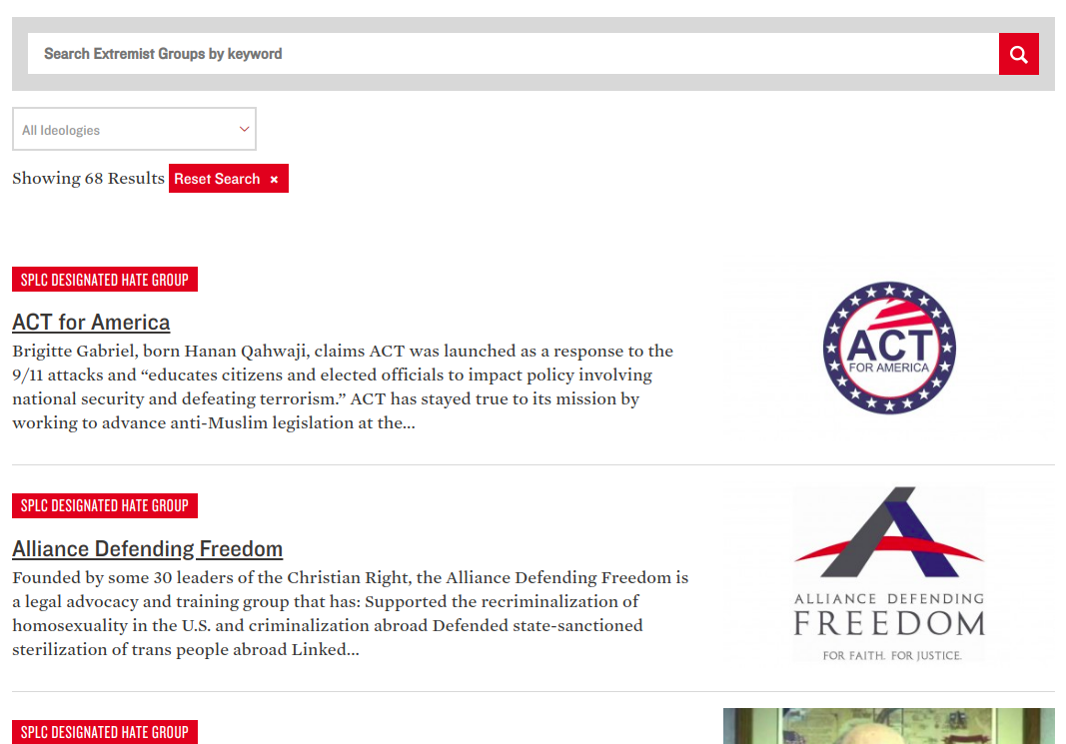

Slide 10
Introduction
SPLC (Southern Poverty Law Center) is a non-profit social justice organization dedicated to monitoring hate group activity in the United States.
Along with the names of the hate groups, SPLC also signifies the hate ideology they identify with.
We focused on following 5 ideologies.
White Supremacy
Anti-Muslim
Religious Supremacy
Anti-LGBT
Anti-Immigration

Slide 11




Mapping Social Media Accounts Across Platforms
SPLC contains 367 hate groups list with their ideologies.
We needed to identify social media accounts of hate groups across different social media platforms .
Manually searched for the accounts existence and verified the websites content with the ideology of the group.
For every organization we searched on
Twitter
Facebook
You tube
Instagram
Pinterest

Slide 12

Accounts and Data Points [1 April 2019 - 1 Oct 2019]
 | Accounts | Data
 | 98 | 49350
 | 108 | 42402
 | 92 | 25000
 | 17 | 4300
 | 3 | 21020
 | 20 | 350

Slide 13
Collected public tweets posted by the hate accounts using HTML page scraping.
Our code was inspired by the GitHub repository of Henrique Jefferson.
(https://github.com/Jefferson-Henrique/GetOldTweets-python)

Slide 14
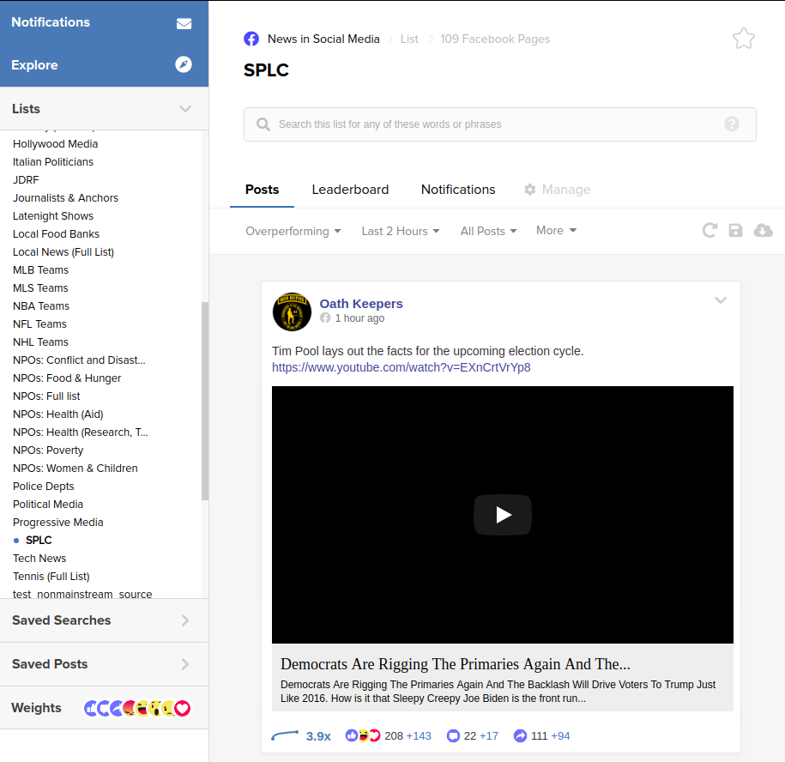
CrowdTangle API
Social Science Research One Grant

Slide 15
Google YouTube API
25K videos
621K comments

Slide 16
Trends
Linguistic
Informational
Social Engagement

Slide 17
Indexing collected data into Elasticsearch
Elasticsearch is based on Map reduce concept with master and slaves to work with big data.
Elasticsearch is mostly used as a search engine.
It also provides various analytical tools that work on big data.
Elasticsearch indexes all the content that we pass it in a JSON format.
Text cleaning
  To enable word-based visualizations, we first need to clean the text of all punctuation, stopwords and inline URLs.

Slide 18







Final fields in dataset after cleaning
Organization: The name of the hate organization as obtained from the SPLC website
Ideology: Ideology of the organizations as described in the Background section
Text: Text of the message cleaned using the steps explained above
Links: URL domains extracted from the links embedded in the text
Replies: Number of replies on Twitter and the number of comments on Facebook and YouTube
Reactions: Number of likes for tweets and Facebook posts, and upvotes for the YouTube videos
Created UTC: The epoch timestamp in seconds for every post

Slide 19
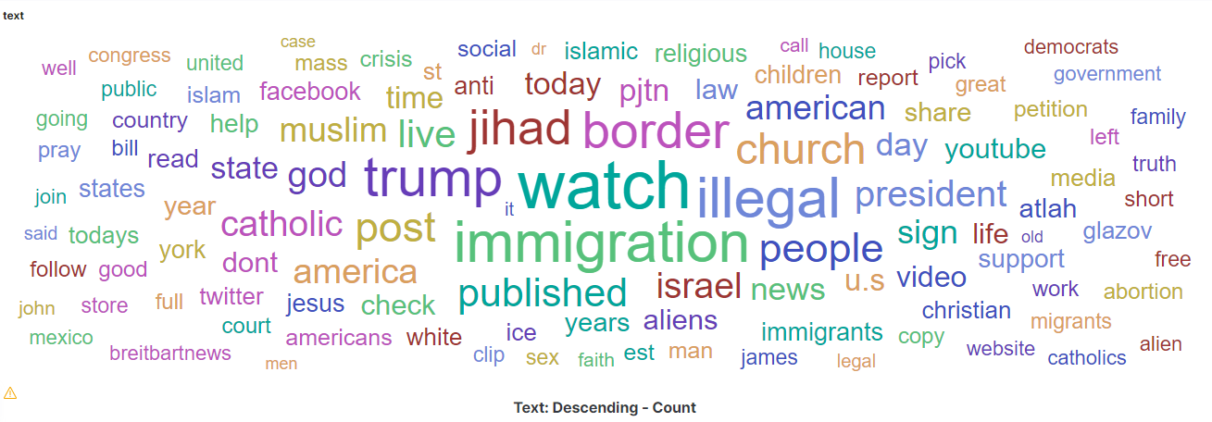
Word Count Visualization

Slide 20
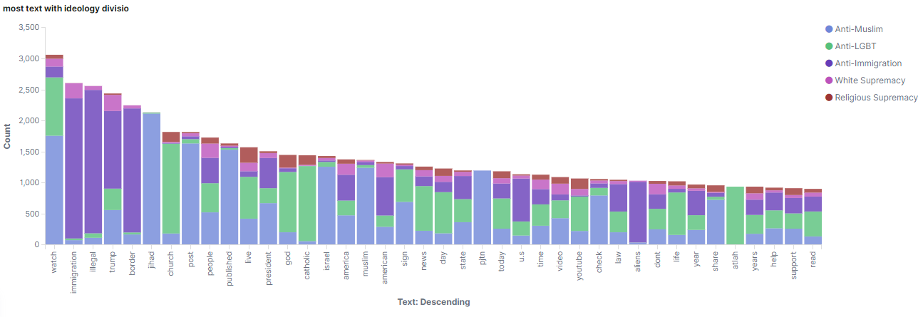
Most used word usage in each ideology visualization

Slide 21
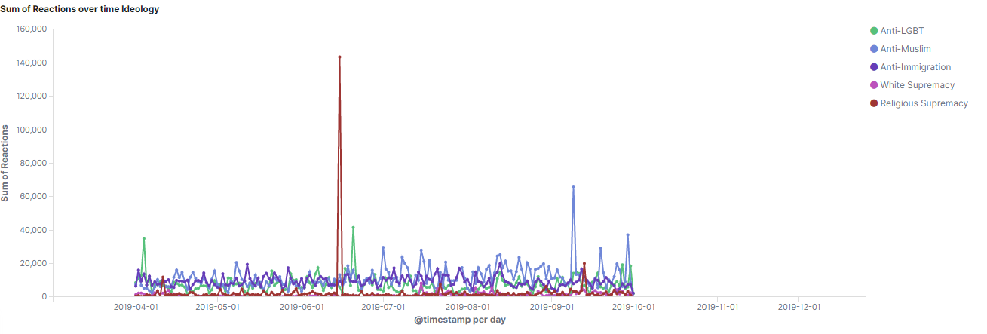
Reactions count over time in each ideology visualization

Slide 22
Advanced Linguistic Trends
Sparse Additive Generative Models of Text [SAGE]
Unlike Multinomial Dirichlet distributions, SAGE distributions are added in logarithmic space.
AGE is especially useful in constantly evolving datasets—such as this—where a significant portion of the probabilities in LDA might not be well-calibrated.
 | Facebook | Twitter | YouTube
White Supremacy | prison, liberals, stupid, negro, nazis | racial, whites, race, difference, superior | monthly, pledge,buchanan,wilson,steve
Anti-LGBT | prayer, join, jesus, god, abortion | predator, pedo, church, life, homo | militant,church,join,subscribe,media

Slide 23
Advanced Information Trends: Domain Networks
Connect two URL domains if they are shared by the same account
Color the edges based on where they are shared
Blue: Only Twitter
Red: Only Facebook
Green: Both

Slide 24
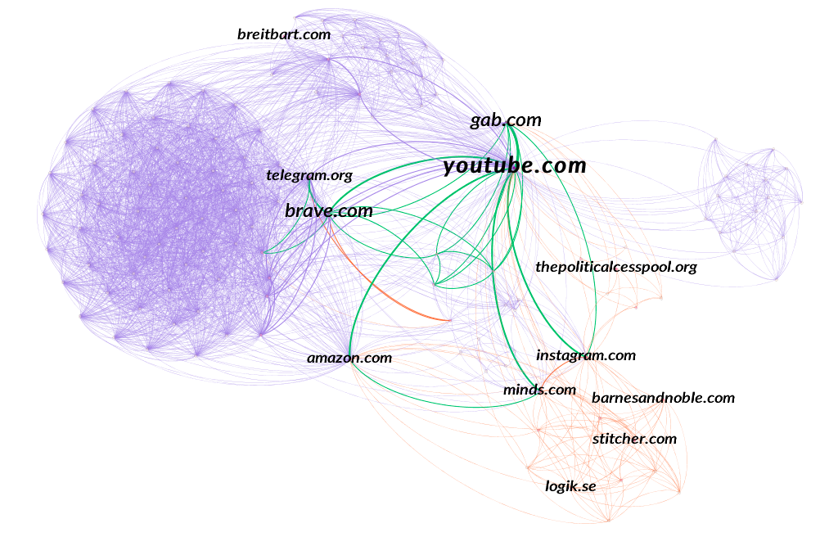
White Supremacy Domain Network

Slide 25
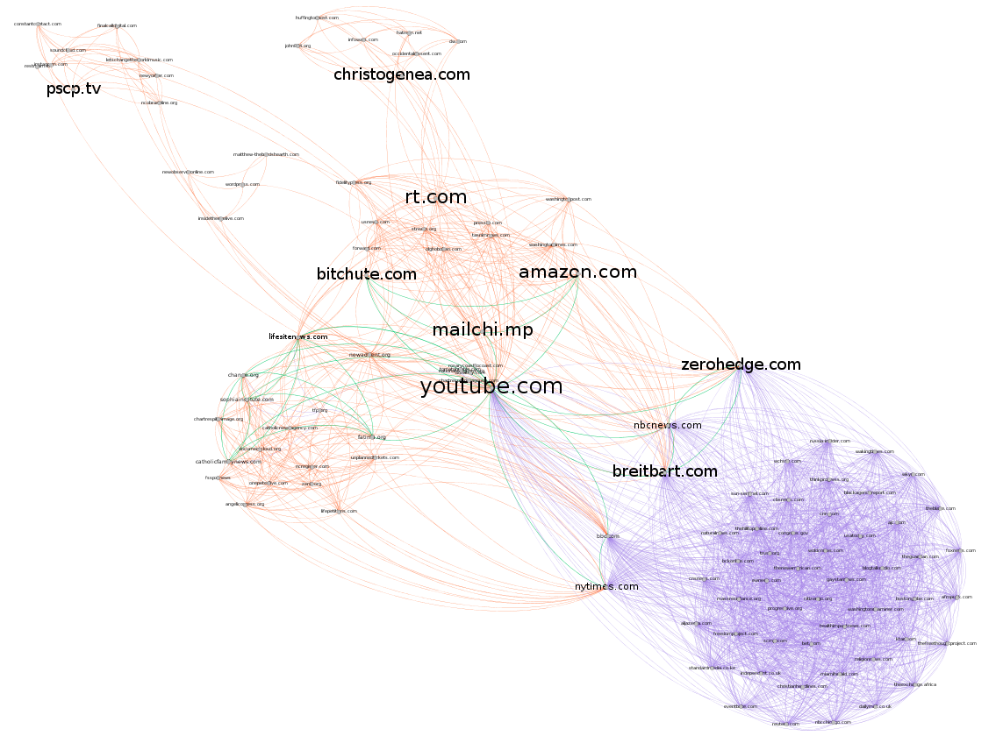
Religious Supremacy Domain Network

Slide 26



Future work
A real-time data collection pipeline can be built using Kibana and Elasticsearch to update the visualizations created every 15 minutes. This can give an overview of the latest trends in hate group activity online.
More complex machine learning models can be incorporated with the Kibana visualizations to have complex analyses such as SAGE and domain graphs in near real-time.
By adding differential privacy to the data, this platform can be made public to be used by other researchers and enthusiasts.

Slide 27


THANK YOU

