Slide 1

Low Level Jet properties
from lidar measurements
in the Gulf of Maine
Yelena Pichugina^{1, 2}, Robert Banta² , Alan Brewer², Aditya Choukulkar^{1, 2}, Melinda Marquis², Mike Hardesty^{1, 2},
Ann Weickmann^{1, 2}, and Scott Sandberg²
¹Cooperative Institute for Research in Environmental Sciences, Boulder, CO
²National Oceanic and Atmospheric Administration, Boulder, CO
NAWEA June 11, 2015

Slide 2
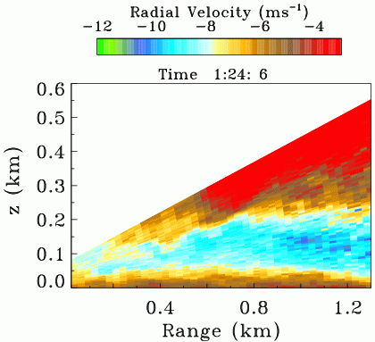
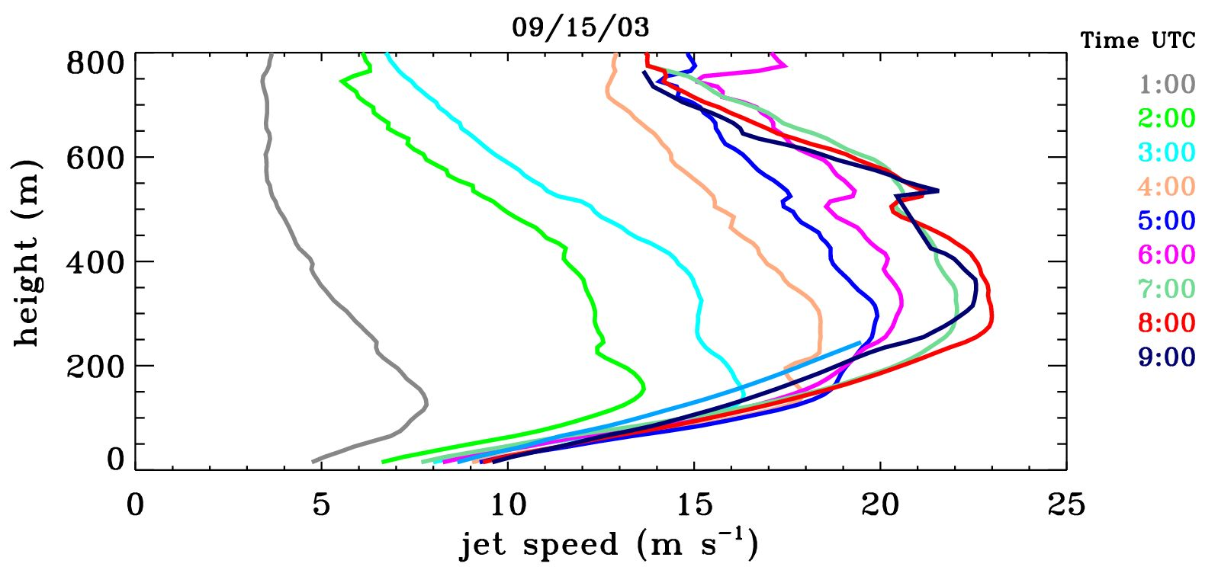

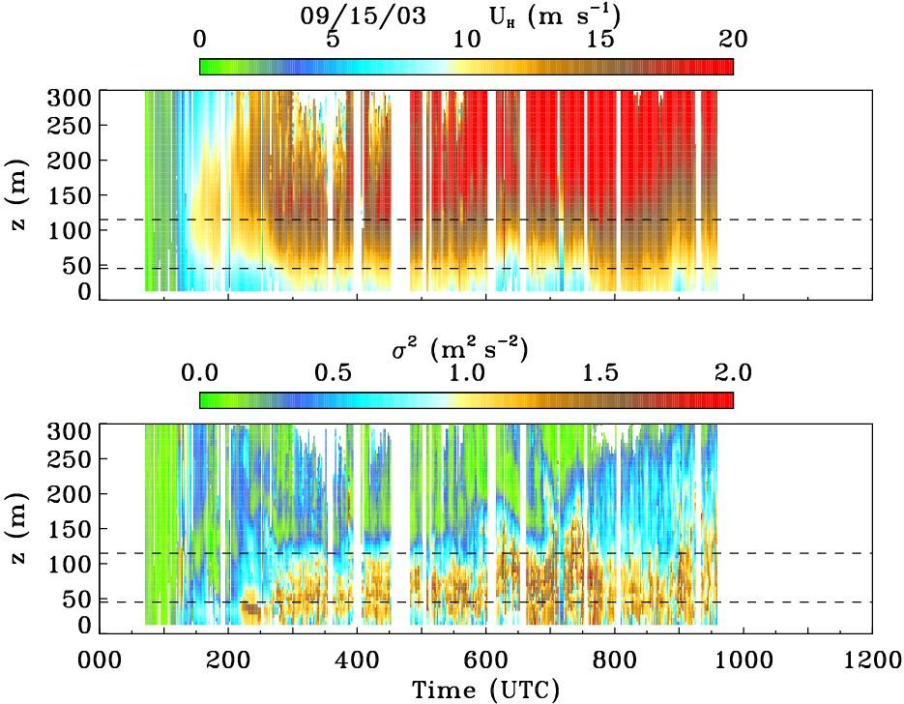
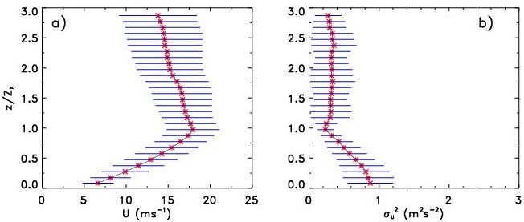
LLJ features from lidar measurements
midnight
1:00
2:00
3:00
4:00
5:00
6:00
7:00
8:00
9:00
LLJ
sunset
U (m s⁻¹)
U (m s⁻¹)
σ² (m ² s⁻²)
σ² (m ² s⁻²)
Notes:
Low Level Jets (LLJs) are well known phenomena in the Great Plains
Frequently occurred within the rotor layer
Winds at higher height separate from the lower layer near the surface and accelerate creating the LLJ
Strong wind shear trough the layer of the turbine blades span
The strong shear below jet maxima produces larger values of turbulence
LLJ importance for Wind Energy operations
A major source of wind power and shear-generated turbulence
Damaging impact on wind turbines through increased loads and fatigue

Slide 3

    Motivation
    Could LLJs be observed offshore?
    frequency, strength, height
    Magnitude of shear within rotor layer?
    How accurate are hub-height winds calculated from surface measurements?
    Power estimates based on hub-height wind speed vs rotor equivalent wind speed

Slide 4
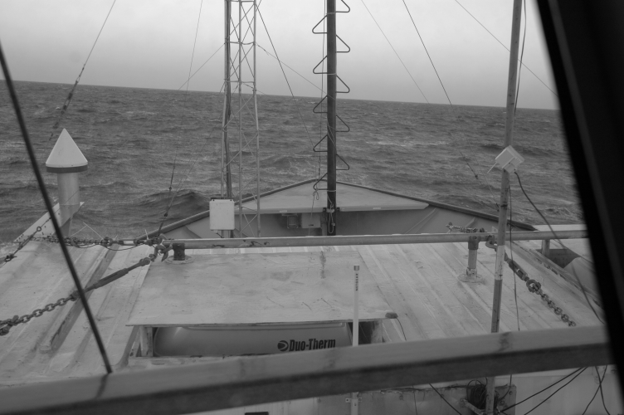
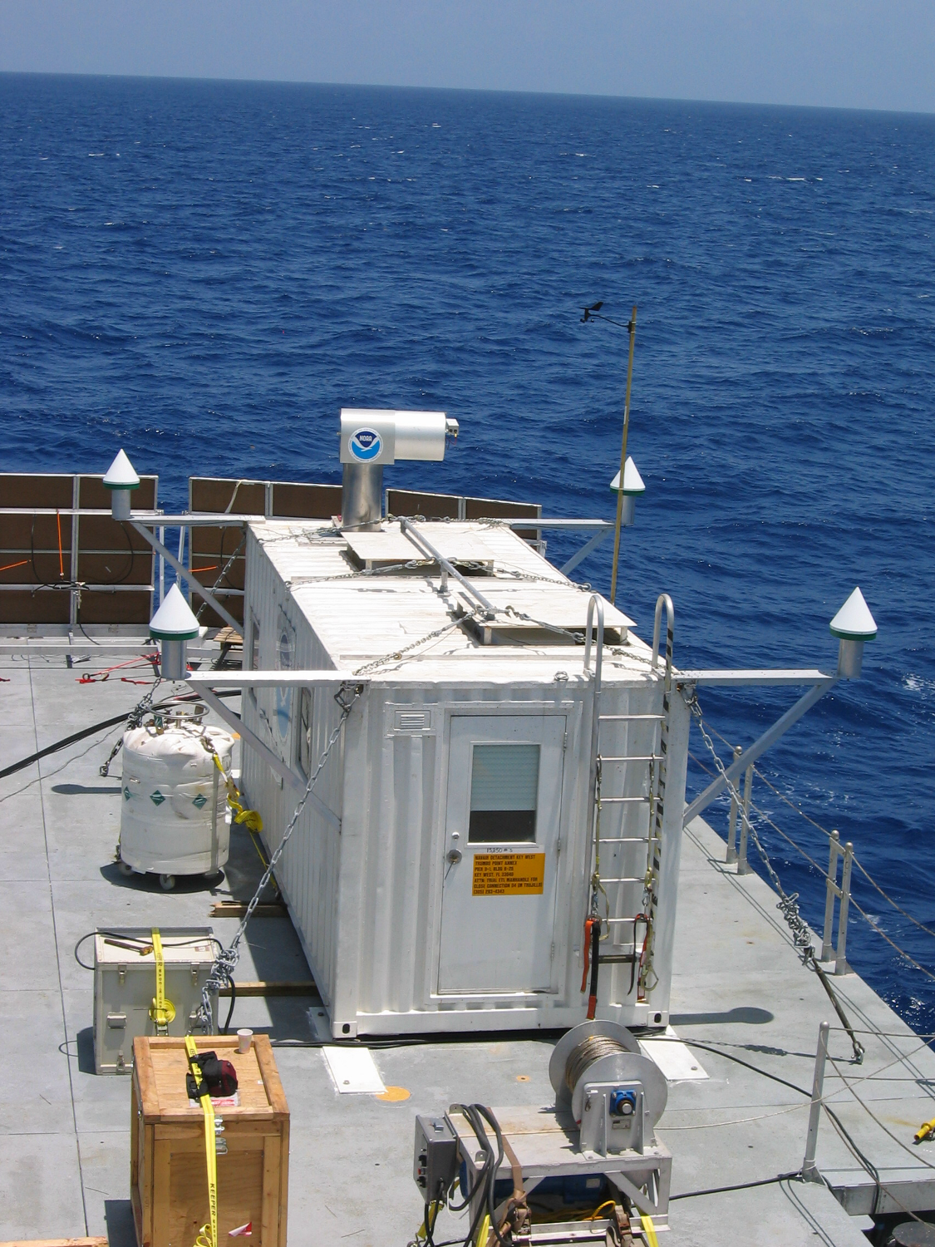
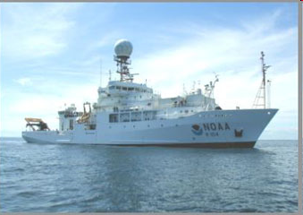
Lidar measurements from the
New England Air Quality Study (NEAQS)
July 09-August 12, 2004
Pointing angle error
< 0.5º - normal sea
< 1º - rough sea
NOAA Research Vessel
Notes:
The experiment was designed to track urban pollution plumes

Slide 5
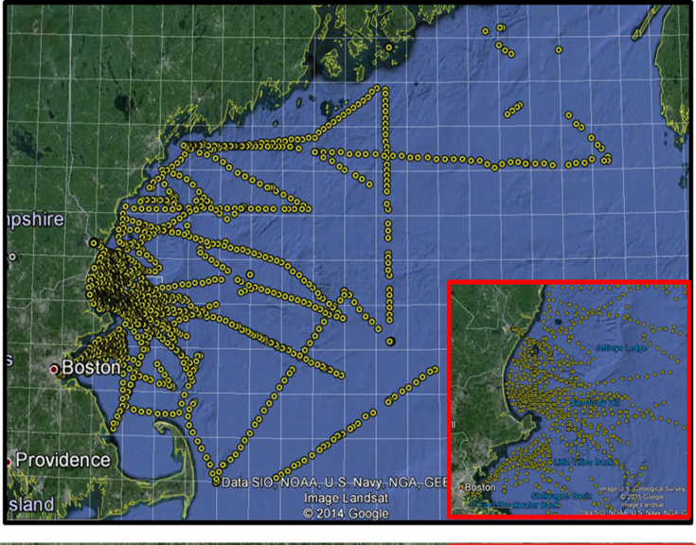
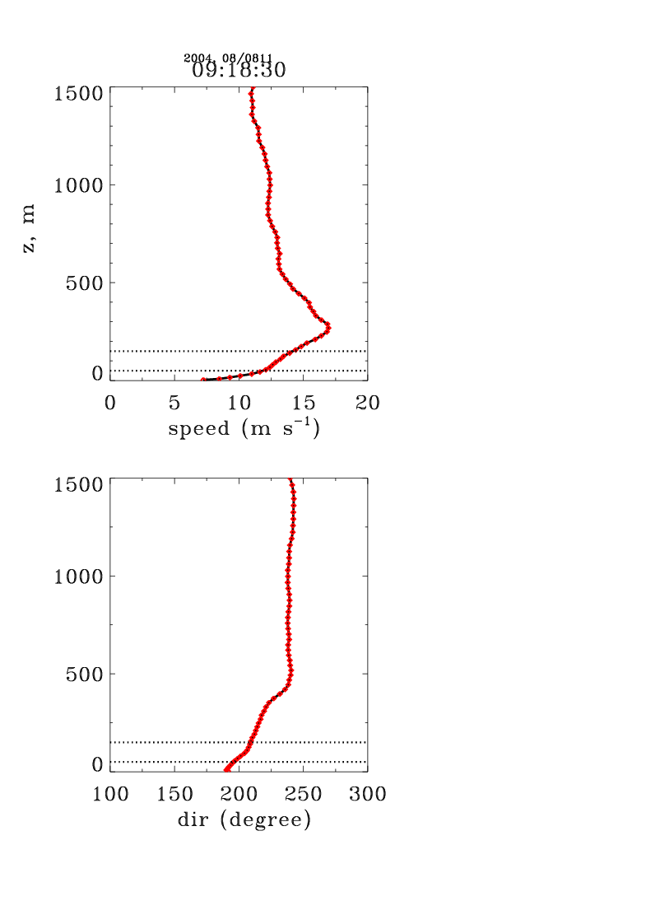
Lidar dataset:
15-min averaged profiles of wind speed and direction
Profiles of wind speed and direction
About 2000 profiles of wind speed were analyzed to indicate LLJ properties (frequency, strength, height of jet maxima), and
wind shear through the layer of 50-150 m
Notes:
Google map image of ship tracks during the NEAQS-04 experiments. Each yellow dot represents individual location of lidar measurements at a given time. A better resolution map, inserted on the bottom right corner, illustrates data points in the dense-measurement areas.

Slide 6
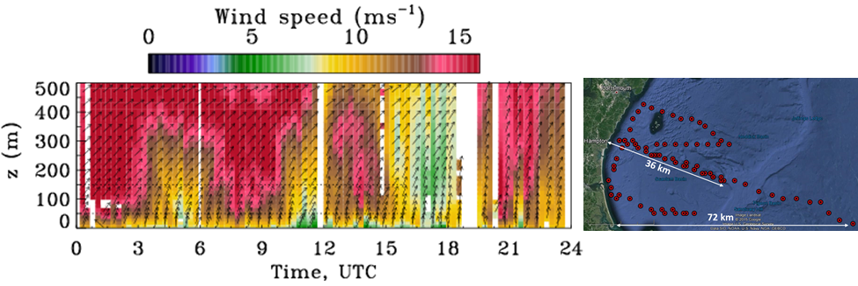
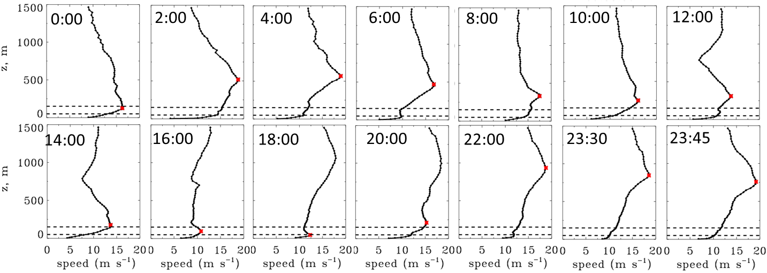
LLJs along ship tracks
August 11

Slide 7
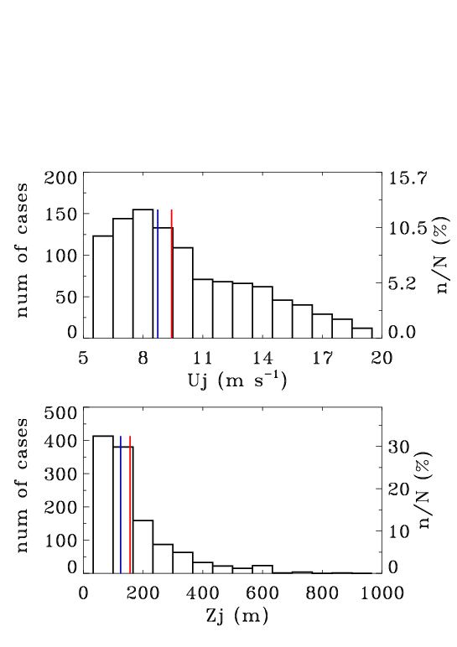
72% of 15-min wind speed profiles show LLJs
LLJ speed
LLJ height
mean=9.4 m s⁻¹
median=8.7 m s⁻¹
mean=156.6 m
median=124.7 m

Slide 8
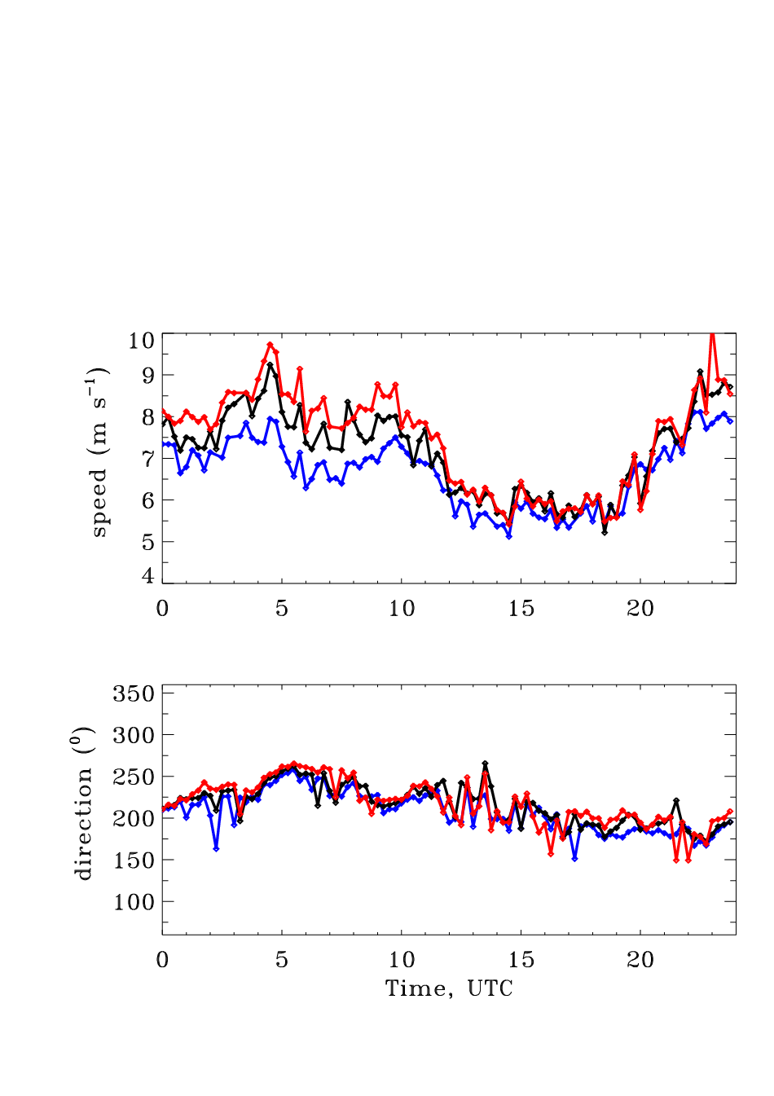
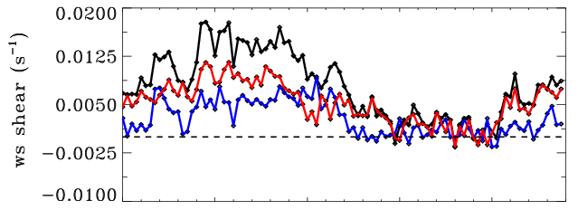

Mean shear through the rotor layer
(July 9 - August 12)
50 m
100 -150 m
100 m
50 -150 m
150 m
50 -100 m
Wind speed
Wind speed shear
Wind direction
Wind directional shear
Wind shear stronger:
- at night hours
- below hub-height
Wind directional shear is not significant

Slide 9
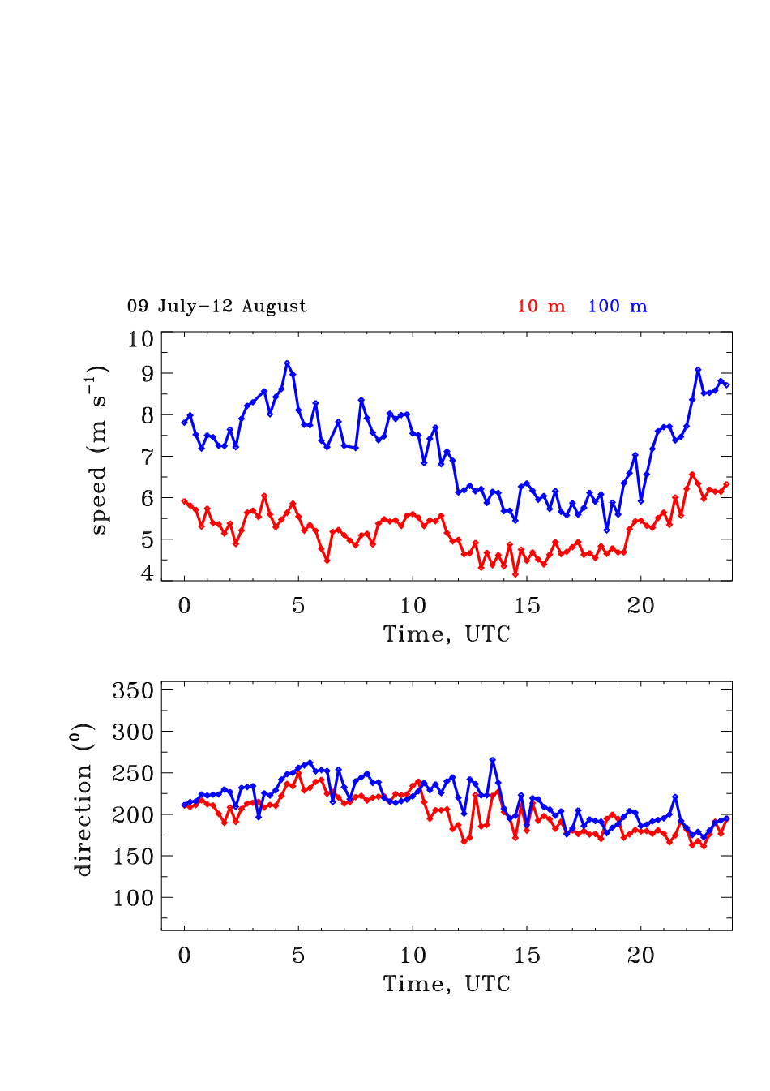
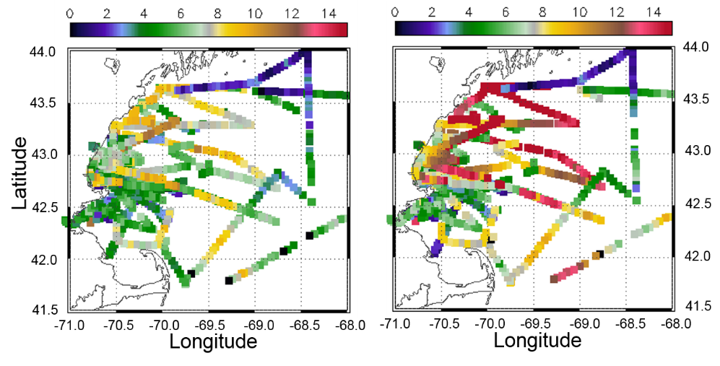
Surface and hub-height winds
U=U_{REF}(Z/Z_{REF})^{α}
10 m
100 m
10 m 100 m

Slide 10
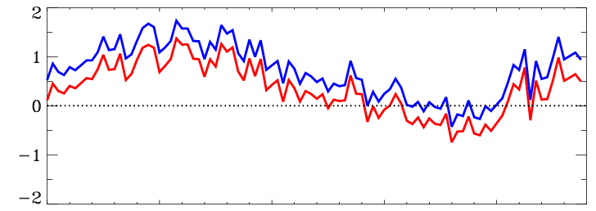
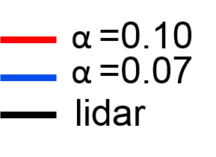
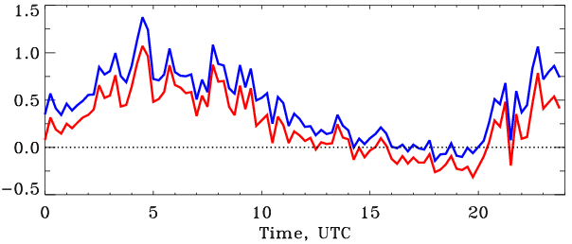
Measured and computed winds at 100 m
∆ws (m s⁻¹)
P=1/2 ρ AU³C_{P}
ρ =1.23 kg/m air density
C_{P} = 0.4 (power coefficient)
A= 7850 m² (circle area, π R²)
∆P (MW)
Experiment- mean power bias:
0.23 MW (α =0.10)
0.42 MW (α =0.07
Notes:
The experiment-mean biases of 0.23 and 0.43 MW indicate losses in the power prediction for this period by using power-law relations with shear exponent (α) of 0.1 or 0.07, respectively. For sample period of August 11 (Fig.3.1) the bias in the power production were 1.6 and 2.2 MV, respectively.

Slide 11
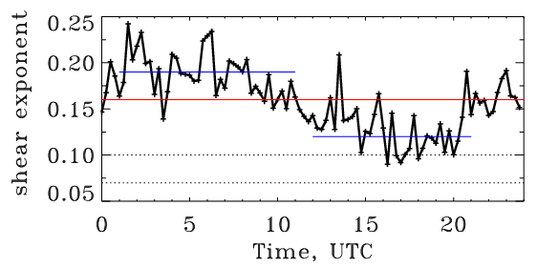
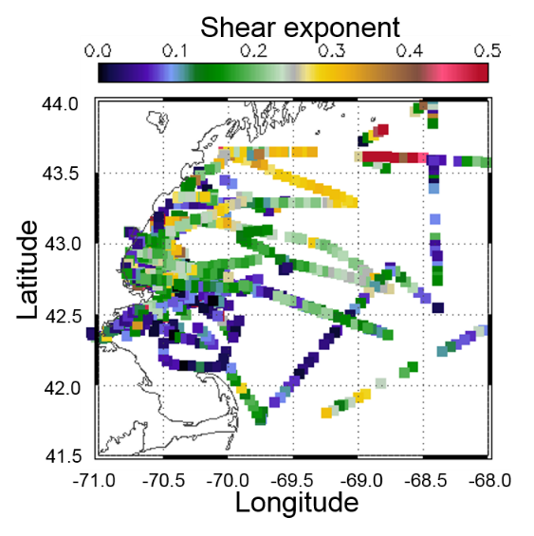
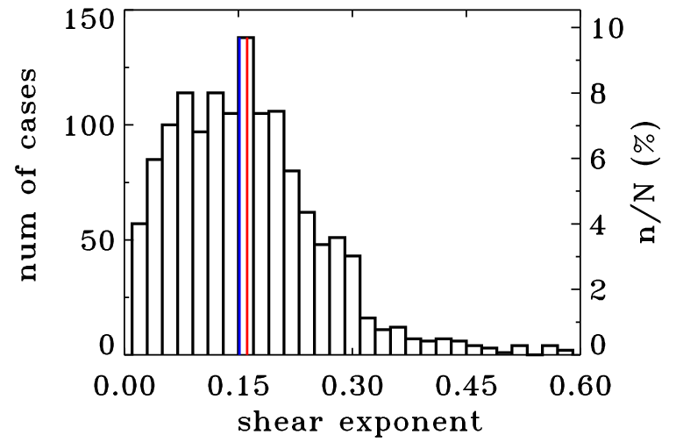
Can a value of the shear exponent (α) be found from measurements?
0.19
0.16
0.12
0.1
0.07
mean: 0.16
median: 0.15
count: 1624

Slide 12




Prediction of Offshore
Wind Energy Resources (POWER)
NOAA models used in the study
Rapid Refresh RAP 13 km
High Resolution Rapid Refresh HRRR 3 km
North American Mesoscale RR NAMRR 12 km
NAMRR Contiguous United States NAMRR Conus 4 km

Slide 13
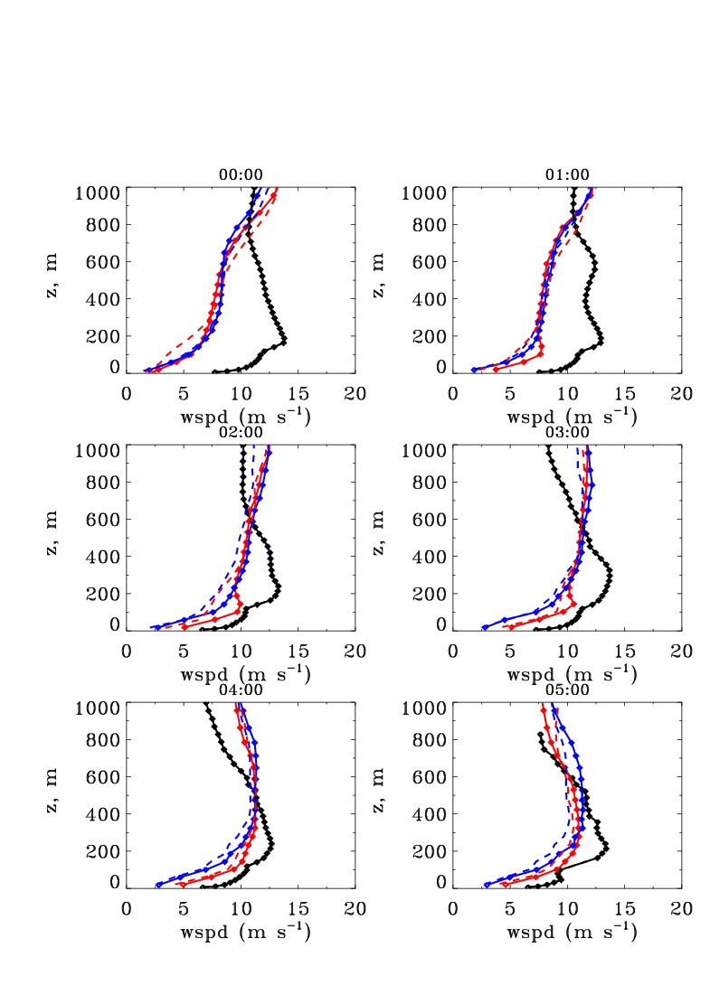
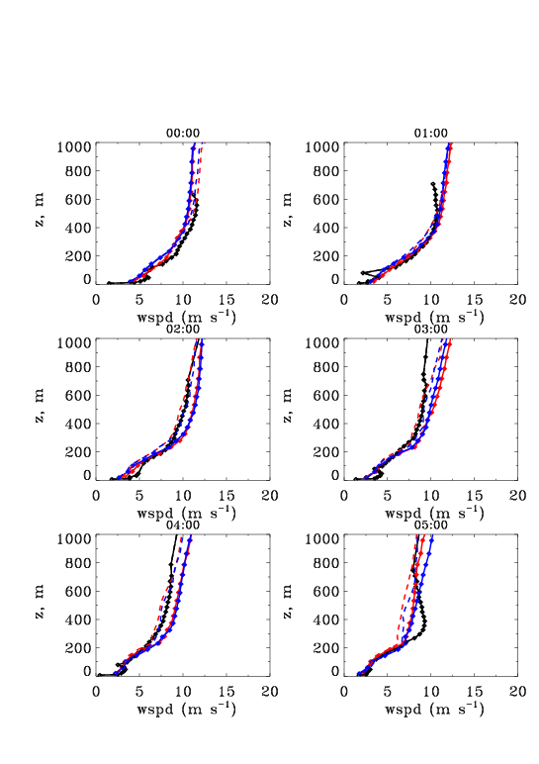
Examples of lidar-measured and modeled wind profiles
July 16
August 9
02:00
03:00
02:00
03:00
04:00
05:00
04:00
05:00
Lidar
RAP, HRRR
NAM P, NAM C
Greater discrepancies - for LLJ-like profiles

Slide 14
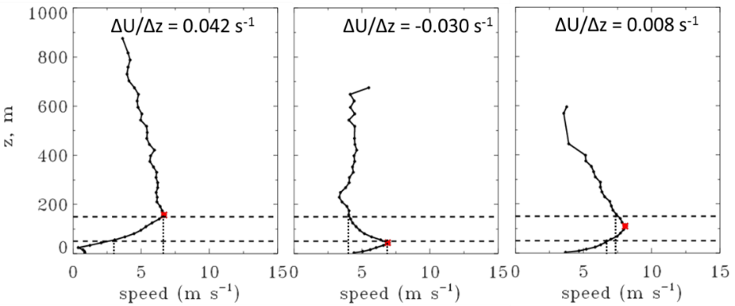
Shear through the rotor layer
In all cases power estimates using hub-height winds can produce significant errors

Slide 15
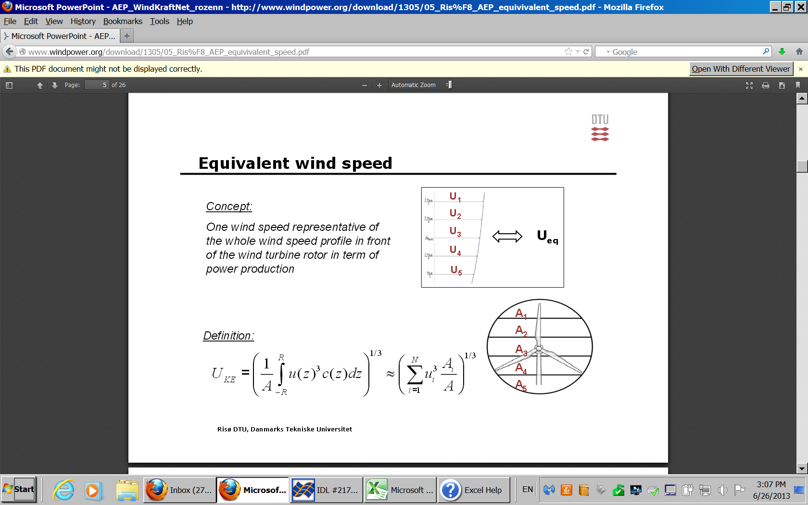
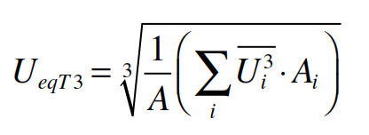
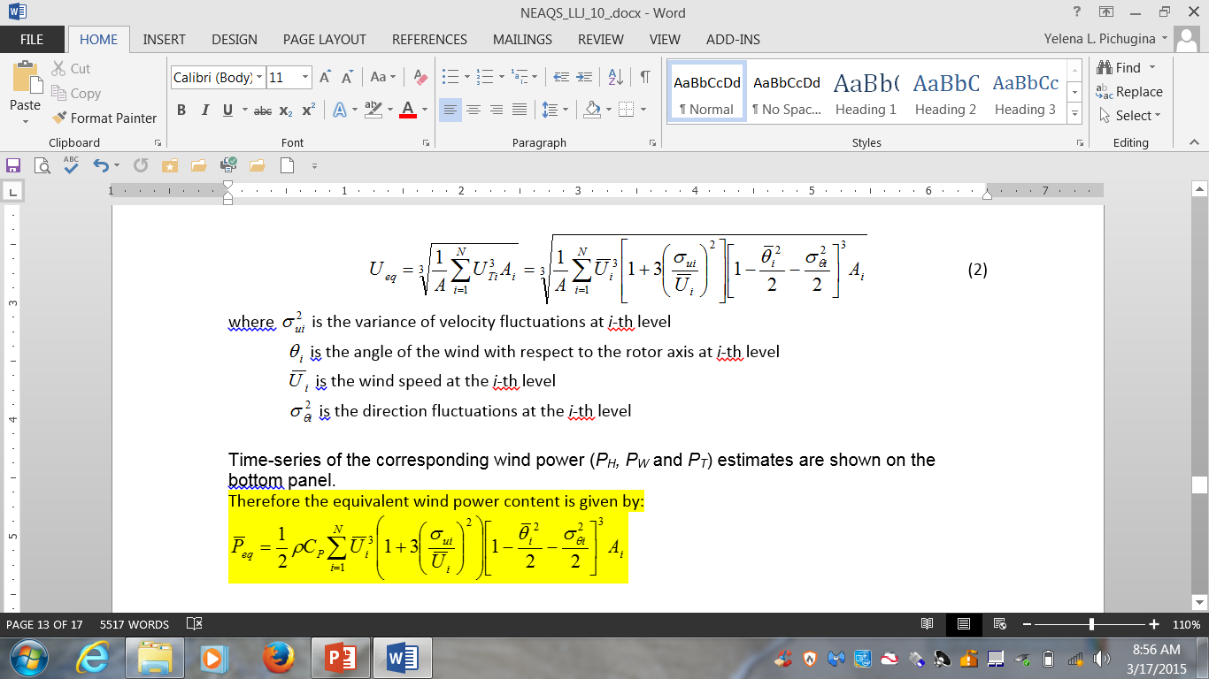
Techniques to compute the rotor equivalent wind speed
(1)
Wagner et al., 2009
(2)
Choukulkar et al., 2015
Notes:
It was shown (Wagner 2009) for winds over flat terrain, that the correlation between the electrical power and the wind speed
improved as the electrical power was plotted as a function of a weighted wind speed measured at more points
on the vertical over the turbine swept rotor area. But their work did not include the inﬂuence of parameters like wind direction and
turbulence variations.

Slide 16
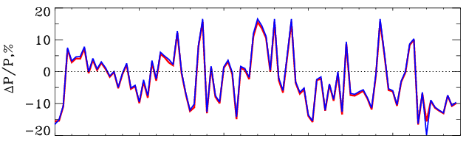
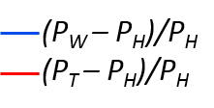
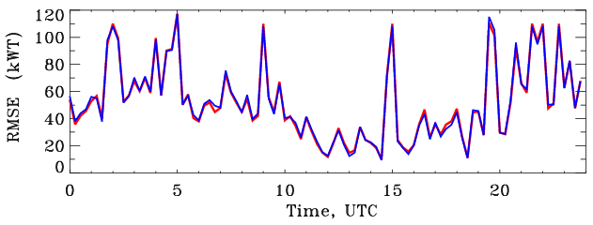
Normalized bias of wind power computed by the hub-height and the rotor equivalent wind speed
mean:
1.04%
1.49%
mean:
51.kWT
52 kWT

Slide 17
Conclusions
Wind profiles obtained from ship-borne Doppler lidar measurements often show LLJs within turbine rotor heights
- more frequently during nighttime hours
The maximum of jet speed varies from 5 to 20 ms⁻¹, with the mean value of 9.4 ms⁻¹
Jet heights are spread up to 600 m, with the mean value of 156.6 m
LLJs can significantly modify wind profiles producing vertical wind-shear of 0.03 s⁻¹ or more across the rotor layer of 50-150 m
Extrapolation of near-surface winds to hub height power-law relation show biases of 0.25 s⁻¹
The shear exponent (α), found from lidar data, show diurnal variations from 0.1 to 0. 25, with the mean value of 0.16 for the entire experiment
A two techniques for calculating rotor layer equivalent wind were tested and show 1-1.5% less power compare to the power estimated by hub-height wind.

Slide 18

Thank you!
Questions?
Yelena.Pichugina@noaa.gov

Slide 19
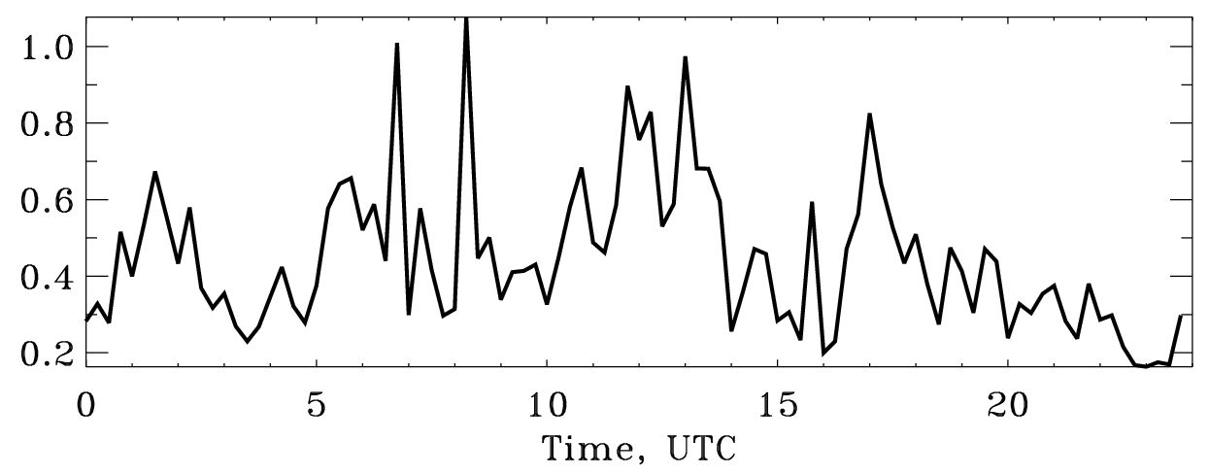
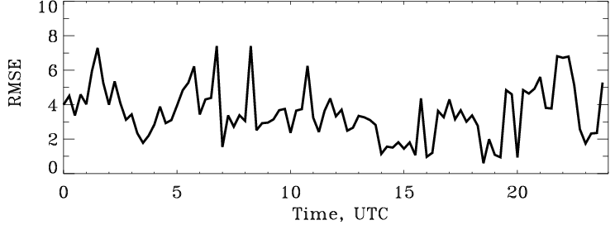
Normalized bias of the power based on the rotor equivalent wind computed by using 2 techniques
mean: 0.45%
(P_{W} – P_{T})/P_{H}
mean: 3.52 kWT

Slide 20
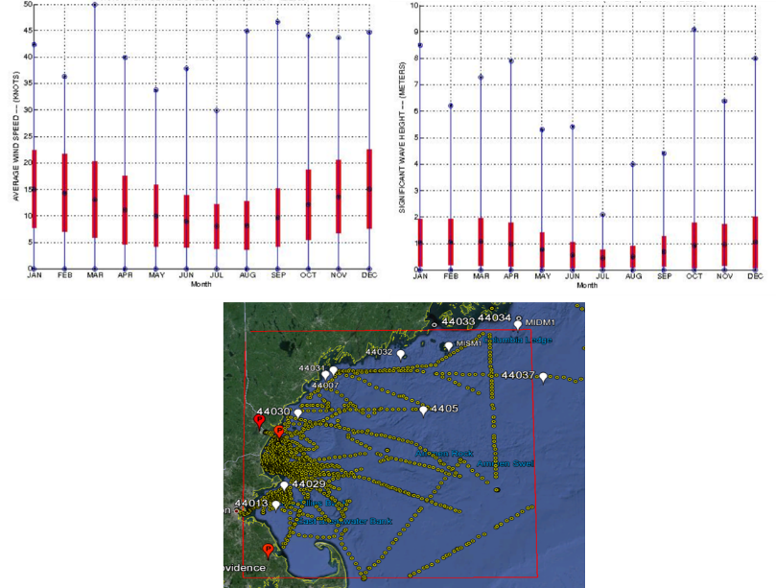
The NCBD buoy’s data
Data from the Lighted Buoy BF NOAA 44013, located 16 n miles east of Boston
(www.ndbc.noaa.gov)
The summer period during the experiment was characterized by the low winds and the wave height averaged over 10 years
Buoy-based sonic anemometer measurements are not representative of the higher elevation winds due to the unknown shear/stability profiles [Sienkiewicz, 2014]

Slide 21
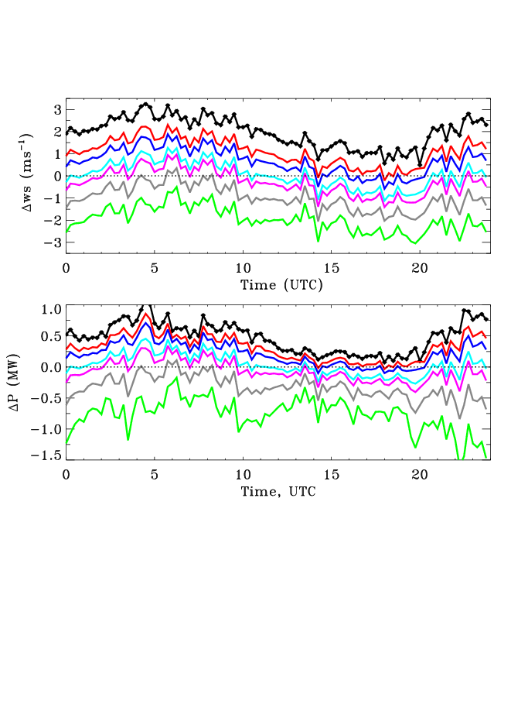
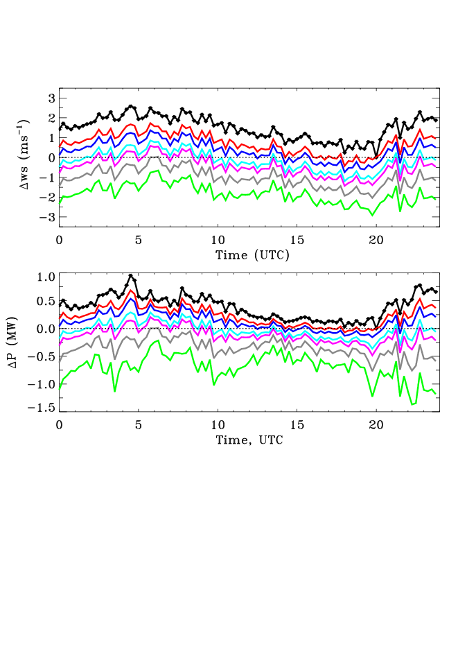
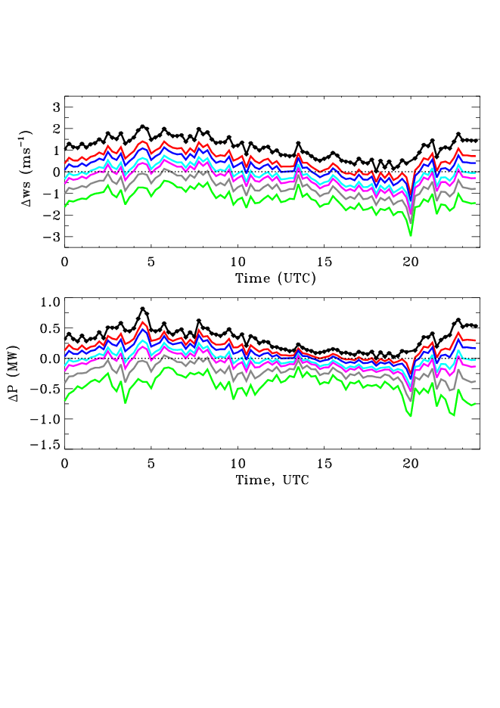
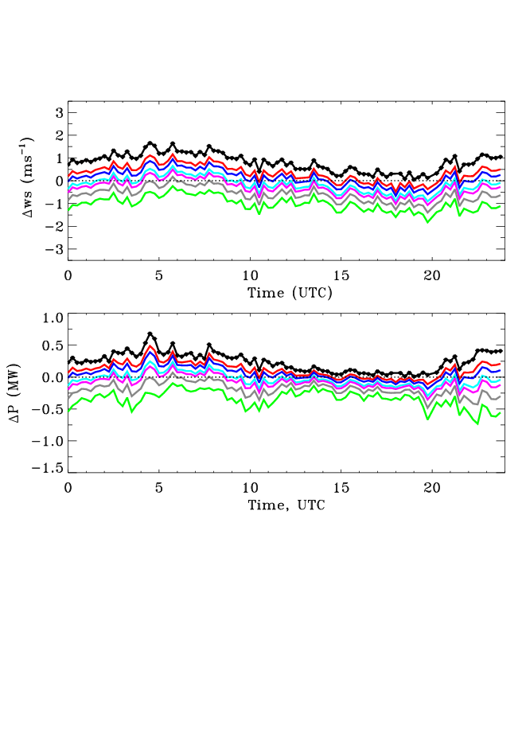
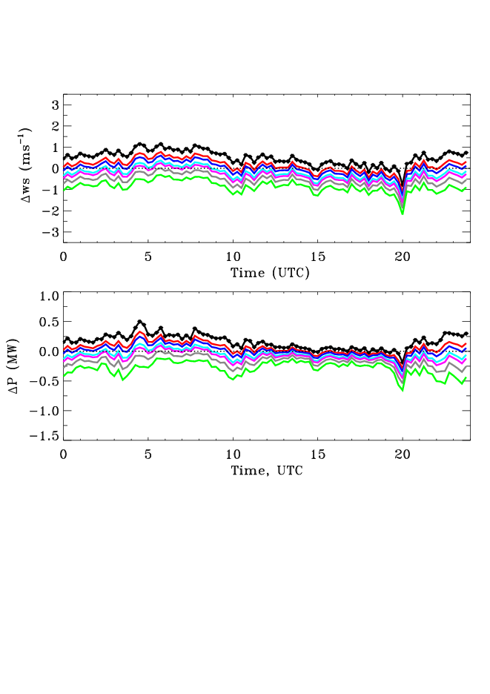
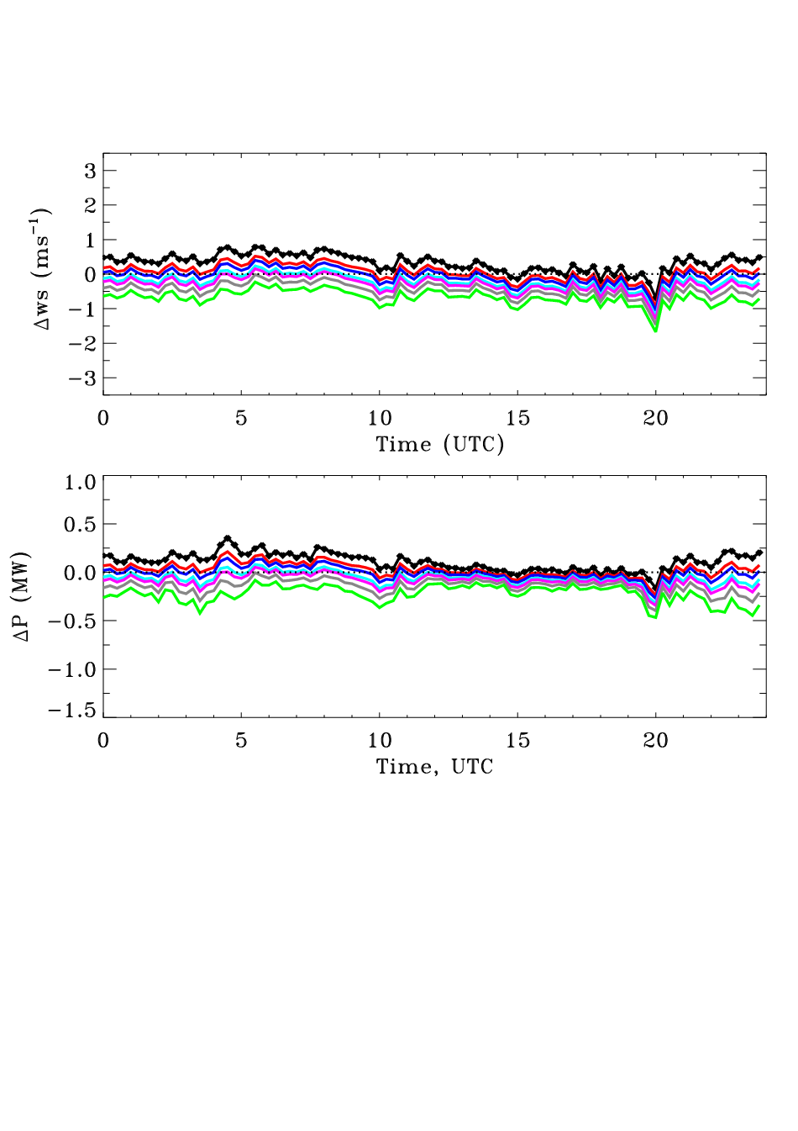
The bias between measured hub-height wind and computed by the power-law by using different values of shear exponent and referenced heights
α=0.07
α=0.10
α=0.14
α=0.16
α=0.20
α=0.25
Z_{REF}=10m
Z_{REF}=15m
Z_{REF}=25m
Z_{REF}=35m
Z_{REF}=45m
Z_{REF}=55m
Time series of the bias between measured hub-height wind and computed by the power-law by using six different values of shear exponent (α) as indicated by the color bar at the top of the figure. The referenced wind used in the computations are also lidar measured wind at the referenced height (Z_{REF}) as indicated on the each panel. Black lines and black diamond symbols in each panel show difference between winds measured at hub-height and referenced height.

