Slide 1

Prompting Best Practices
How Are Libraries or Their Home Institutions Creating, Sharing, Applying, and Adapting GenAI Policies?
Virginia (Ginny) Pannabecker (vpannabe@vt.edu)
Assistant Dean and Director, Research Collaboration and Engagement
University Libraries, Virginia Tech | June 11, 2024
Workshop Folder (temporarily available): bit.ly/PannabeckerPromptingBestPracticesGAIL2024. Archived materials linked on Slide 8 (last slide)
CC-BY SA 4.0 License

Slide 2
Agenda
1:15 - 1:18 Welcome and Agenda
1:18 - 1:30 Brief review of select policies on Gen AI in Teaching, Learning, Research
1:30 - 1:45 Breakout Groups Discussion
  You will be assigned to a breakout room for group discussion
  Introduce yourselves to each other with:
    Your name, institution, title, (pronouns if you’d like to share)
    One comment about (and a link if you have one) for a policy on Gen AI in teaching, learning, or research at your institution, a policy you’ve seen elsewhere, or a comment on such policies in general
  Identify Someone to be the Group Recorder and Reporter
    Please add notes to your group’s notes document [LINK]
  Discuss example policies shared in the overview or in your group’s introductions
    What is useful or essential in these policies?
    How are you or others in your institution applying them in your work or recommending them to others?
    What would you add to existing policies?
    What questions or concerns do you have?
    How do these policies or institutions approach policy updates?
1:45-1:55 Group Report Backs 1-2 minute report back from each group
1:55-1:58 Wrap up and links to the shared discussion documents for reference.
A note on language: I’m using ‘policy’ as a placeholder for formal policies or less formal institutional guidance and similar

Slide 3
What is important to include in policies on Gen AI in teaching, learning, or research?
Share your thoughts in chat

Slide 4

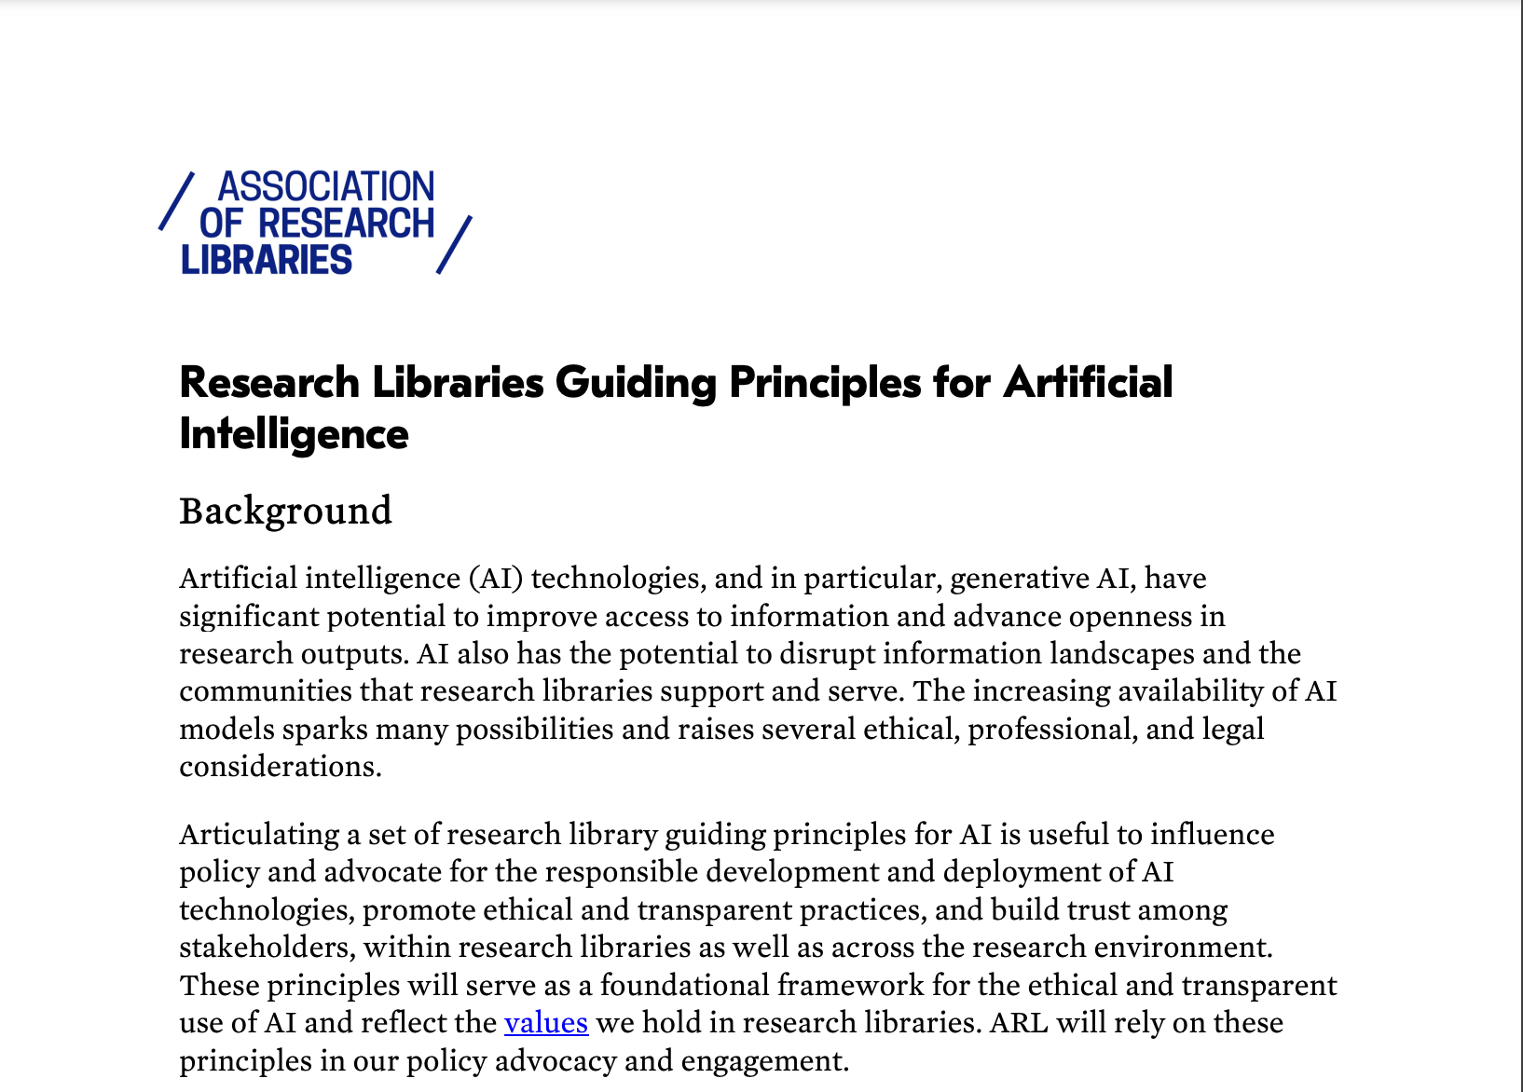
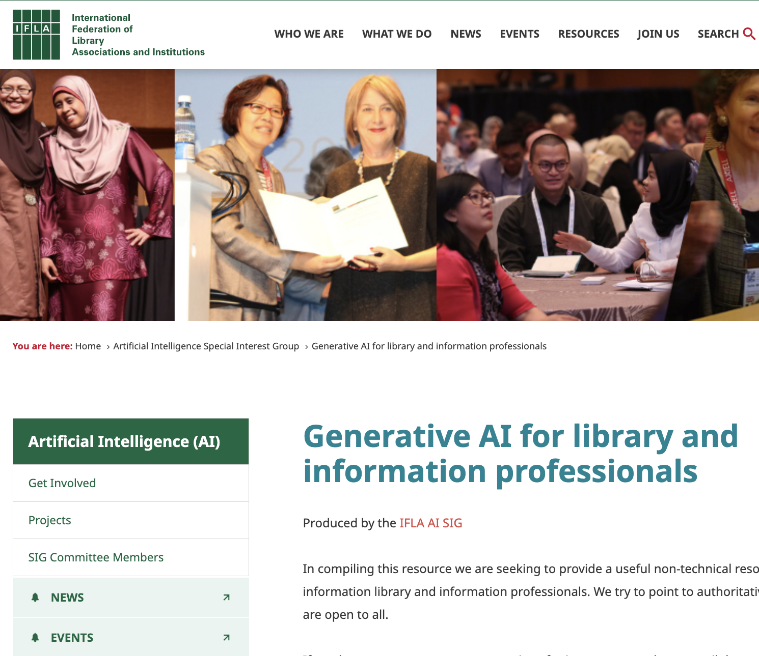
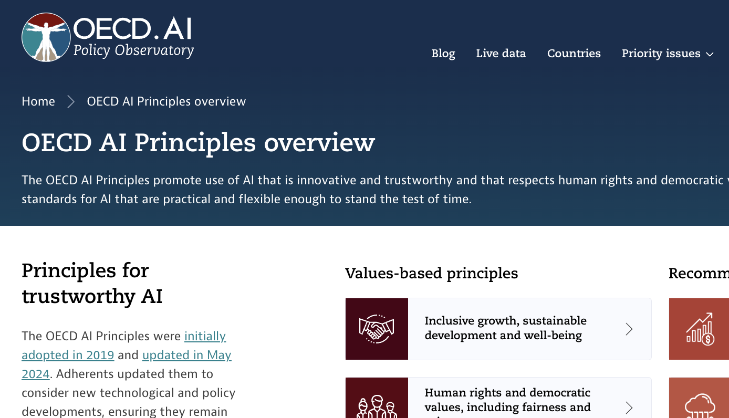
General Resources
Collections
OECD AI Policy Observatory which provides
  Information on over 6000 AI Policy initiatives from 60 countries, territories and the EU (OECD.AI, 2021)
  OECD AI Tools and Metrics Catalogue to develop and use AI that is trustworthy
AI Ethics Guidelines Global Inventory from AlgorithmWatch (AW)
2020 AI Readiness Index developed by Oxford Insights and the International Research Development Centre (IDRC)
Linking Artificial Intelligence Principles (LAIP) Dashboard -- AI Principles / statements collection
Worldwide AI Ethics dashboard developed by AI Robotics Ethics Society researchers

Slide 5
Highlights of Selected Policies
Spreadsheet (Text links to temporary workshop folder. See Slide 8 (last slide) for archived materials)
Introduction to AI, Gen AI
Why it matters (in education, in research, to audience addressed)
Institutional Approach
Specific Guidelines in contexts
Limitations -- Accuracy, transparency (or lack), intellectual property (IP)
Data Privacy and Security
Practice: Responsibility for your work / teaching, Accuracy, Reflection, Evaluation of tools, Ethical Use, Human / Technology Balance, Explore, Disciplinary differences, Citation / appropriate use
Examples, Resources, Training
Other specifics like Social and Environmental Impact, Accessibility

Slide 6
Breakout Discussions
  Introduce yourselves to each other with:
    Your name, institution, title, (pronouns if you’d like to share)
    One comment about (and a link if you have one) for a policy on Gen AI in teaching, learning, or research at your institution, a policy you’ve seen elsewhere, or a comment on such policies in general
  Identify Someone to be the Group Recorder and Reporter
    Please add notes to your group’s notes document
  Discuss example policies shared in the overview or in your group’s introductions
    What is useful or essential in these policies?
    How are you or others in your institution applying them in your work or recommending them to others?
    What would you add to existing policies?
    What questions or concerns do you have?
    How do these policies or institutions approach policy updates?
Group Notes: see the links to materials on Slide 8 – during the presentation, a link was shared in chat to the group shared documents

Slide 7
Groups Report Back

Slide 8
Thank you! Questions?
Presentation Folder
(Presentation Google Drive folder will be available for a limited time. Recording at GAIL YouTube channel. Slides and materials archived in GAIL 2024 OSF and at VTechWorks institutional repository.

