Slide 1
Notes:
Opener for our session.

Slide 2
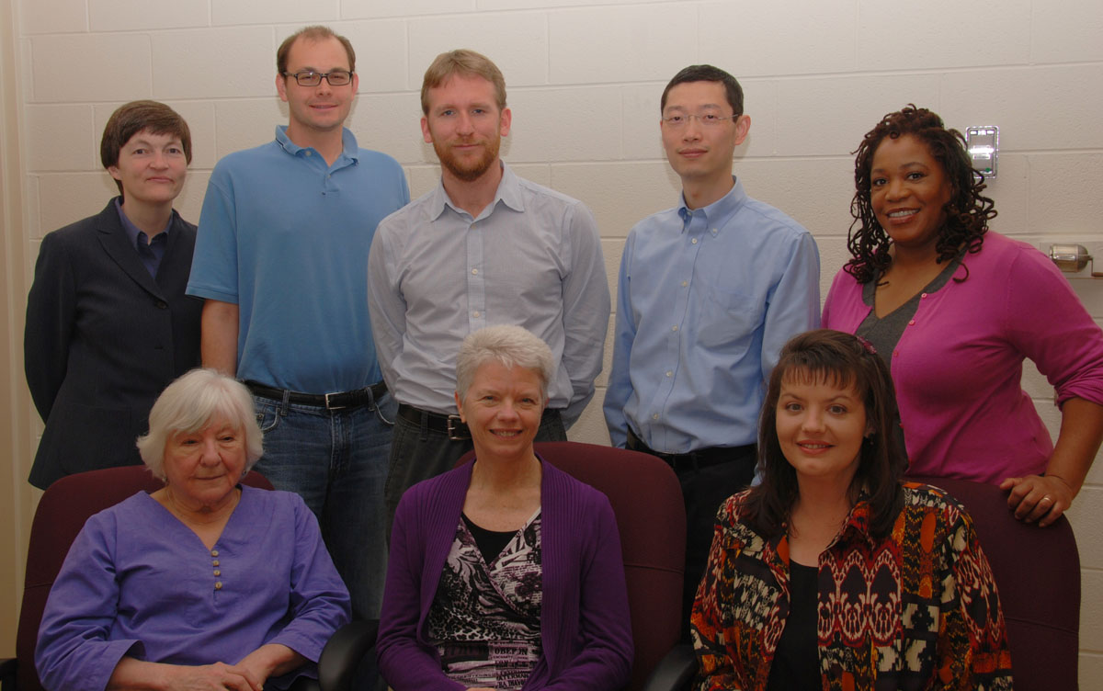
Gail McMillan
Kimberli Weeks
Jane Wills
Anne Lawrence
Keith Gilbertson
Zhiwu Xie
Nathan Hall
Paul Mather
Tracy Gilmore
Students
History, ETDs, Preservation
Services & Standards
VT ImageBase, Metadata
EJournals, Metadata
Open Source
Data Management
VTechWorks
Notes:
Introductions: Who (stand up) and what

Slide 3
A Little History:
From the Scholarly Communications Project to the Digital Library and Archives
Thanks to Internet Archive’s Wayback Machine
http://archive.org/web/web.php
Notes:
5 minute history of the department.

Slide 4


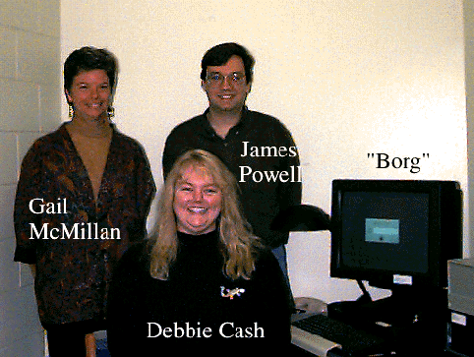
Notes:
Oct. 1996 first server named borg
James Powell created our logo—SCP was the missing piece of the puzzle of your brain. Used until 2000
Yes, it’s hard to read but that tiled background! Tables! Pictures!
1st ej: JIAHR, 1990—brand new pub, e-only
2nd ej: Catalyst, began dual formats 1991
3rd, JTE, 1992—began dual formats 1992 but had issues back to beginning, 1989

Slide 5
Before the Web there was the Gopher
Notes:
Gopher was an Internet interface or protocol from U Minnesota. Text only.
It began 1991, we began using it in 1993, the year the WWW went public. We quickly migrated and even I could create web pages with minimal training from James.
Journal of the International Academy of Hospitality Research ASCII; PostScript with no. 6
Community Services Catalyst full text
Journal of Fluids Engineering raw data only
Journal of Technology Education text + graphics
Journal of Analytical and Experimental Modal Analysis article abstracts
Veronica – the search engine system for the Gopher protocol, an acronym for "Very Easy Rodent-Oriented Net-wide Index to Computer Archives"

Slide 6
Notes:
1997
International interest in what we were doing.

Slide 7
Notes:
Graduate School dean approached the library—were we interested in talking about ETDs?
Duh!
Immediately created a web page so everybody (students, faculty, Grad School personnel, Library personnel) could see the process and the results.
1st uni to require Jan. 1, 1997.
More about ETDs later.

Slide 8
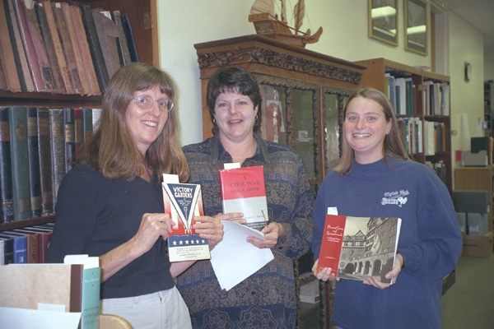
Notes:
1995-2007 Spec and SCP were under one department head.
1996—first web page—no templates, not models, no standards.

Slide 9
Notes:
Financial support from VIVA during 1996/98 contributed to hiring student assistants and digitizing local, regional, and Civil War history images housed in University Libraries' Special Collections.

Slide 11
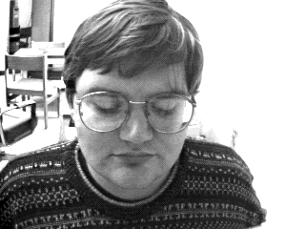
Notes:
In 2001 we added a search function and linked to Ask a Librarian.
Collaboeations across the university and across the state (VHP) and the region—Ulster Scots, South Atlantic Humanities Center (NEH funded: VT, VHF, UVa collab).

Slide 12
Notes:
Through collaboration with Landmark Communications, SCP began providing access to local and regional news reports for the Virginia Tech university community and the Blacksburg Electronic Village (BEV).
Roanoke Times 1992-
Virginian Pilot 1994-
WDBJ7 (CBS affiliate) 1995-2008
International News 1997-

Slide 13
Notes:
2001 IAWA Bio DB

Slide 14

Notes:
2004 ASPIRES grant
The same look and functionality today

Slide 15
Notes:
2005 First year we had a template for most of our web pages
Carolyn Kletnieks, designed logo, used 2005-2010
Finish up w/ETDs
4 quadrants—users adapting our system, students submitting ETDs, scanning BTDs (Bound Theses and Dissertations), and the NDLTD.

Slide 16
Notes:
2010 we finally adopted the VT look for our web site, tabs for our areas of responsibility.
separate web sites for universities wanting to adapt our ETD system and another for our students

Slide 17
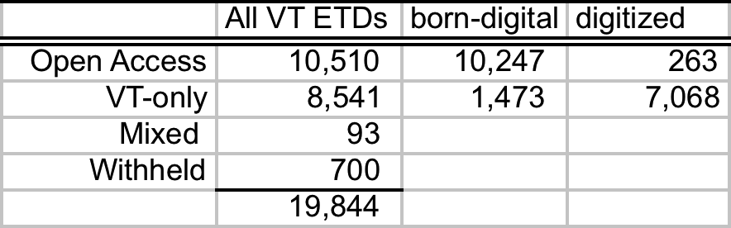
Notes:
Most asked question: how many do we have and do students make them publicly available?

Slide 22
Notes:
Pass the baton to Kimberli who will talk more about DLA services and the standards and best practices to which we try to adhere.

Slide 23
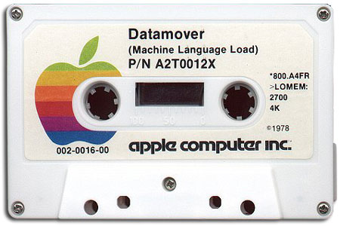
Who are we and what do we do?
We are a digital library,
specializing in digital archiving,
and growing a digital repository.
Digital Libraries
Collect and provide access to digital information, and provide library services surrounding that information.

Slide 24
2010-11 ASERL Digital Collection Reports
What is some of DLA’s digital information?
Collection | Current Total No. of Files: | Current Total File Size in GB | Number of times items accessed
ETDs and BTDs (Files) | 33,037 | 200.07 | 6,874,543
Ejournal Articles | 15,473 | 3.54 | 2,709,748
Digital images | 208,762 | 2,592.33 | 3,578,614
Digital Books | 221 | 9.19 | 20,581
Faculty Archives | 1,299 | 1.18 | 75,076
IAWA | 2,030 | 0.02 | 440,334
VA Tech Pubs (Employee of Week, Library & DLA Annual Reports, VT Magazine Archive, Collegiate Times, Spectrum, Conductor, Graduate News | 3,329 | 1.82 | 167,712
Virginia News Collection | 361,010 | 3.58 | 66,158
International News Collection | 2,356 | 15.00 | 14,651
Totals | 627,517 | 2,827 | 13,947,417

Slide 25

Digital Library Services
Intellectual property advisement
Technical advisement
Collection Development
Scholarly Publishing
Scholarly Publishing
Indexing, Searching
User Interface & Browsing
Faculty Archives
Research test bed (short-term project support, long-term maintenance)
ETDs and BTDs
Digital images
IAWA
Collection Reports, Use Statistics
Ejournal Articles
VA Tech Pubs
VA News
InterNews
Acquisitions
Accessibility
Identifying / Cataloging / Metadata
Availability / Embargo
Interoperability & Sharing
Donor (Faculty) Support
Patrons – World Wide Access & Support

Slide 26




















Lotus notes
Word Perfect
MS Office documents
HTML files
Folders / Files
Images
Sound
Video
Relational Data
Dynamic Web Apps
******* HELP *******
Metadata Crosswalks
Scripting Crosswalks
ISO Standards
Archival File formats
IANA / PRONON
Contact DLA
Digital Archives

Slide 27
A PLACE TO START . . . New to Digital Preservation http://digitalpreservation.ncdcr.gov/newtodp.html Digital Preservation Tutorial http://www.dpworkshop.org/dpm-eng/eng_index.html OpenDOAR - http://www.opendoar.org/ Digital Preservation - 36,000+ Views http://www.youtube.com/watch?v=pbBa6Oam7-w Getty – Electronic Publications http://www.getty.edu/research/publications/electronic_publications/ | I KNOW THE BASICS . . . Managing Electronic Public Records Recognizing Perils & Avoiding Pitfalls http://www.records.ncdcr.gov/tutorial_erecs_20081027/index.html Open Access -http://www.jisc.ac.uk/publications/programmerelated/2010/openaccessmainbrochure.aspx Library of Congress Digital Preservation Formats http://www.digitalpreservation.gov/formats/index.shtml Virginia Tech’s Web Accessibility Guidelines http://www.accessvt.atc.vt.edu/index.html MetaArchive http://www.metaarchive.org/
SHOW ME MORE . . . DMP Tool - https://dmp.cdlib.org/ Metadata Standards Crosswalk http://www.getty.edu/research/publications/electronic_publications/intrometadata/crosswalks.html File Format Conversion Tool - http://www.nationalarchives.gov.uk/PRONOM/Format/proFormatSearch.aspx?status=new | INTERESTING PLACES TO RESEARCH . . . Data.gov - http://www.data.gov/ W3C – Semantic Web - http://www.w3.org/standards/semanticweb/ Linked Data Tools - http://www.linkeddatatools.com/index.php DataOne - http://www.dataone.org/ Viewshare http://viewshare.org/about/community/ OAI-ORE http://www.openarchives.org/ore/

Slide 28
Notes:
2001 and 2012 VT ImageBase

Slide 31
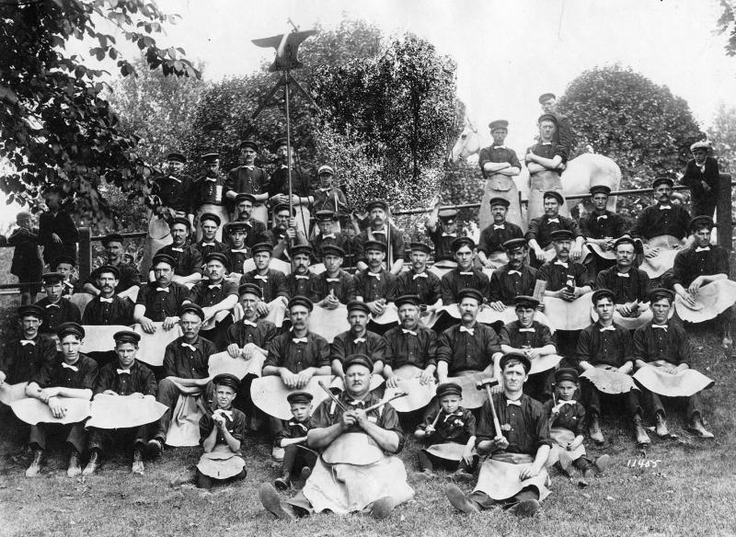
Notes:
ns4968
Title Railroad farriers
notes The "men in funny skirts" are farriers; they shoe horses. The technique they use is blacksmithing, but farriers are specific usually. There is a horse in the upper right of the picture (the back end of one). The farrier would put the horses hoof in the lap of the skirt. It would keep him from getting kicked in the privates! From William Rogers 9/17/02
source Norfolk & Western Historical Photograph Collection

Slide 33
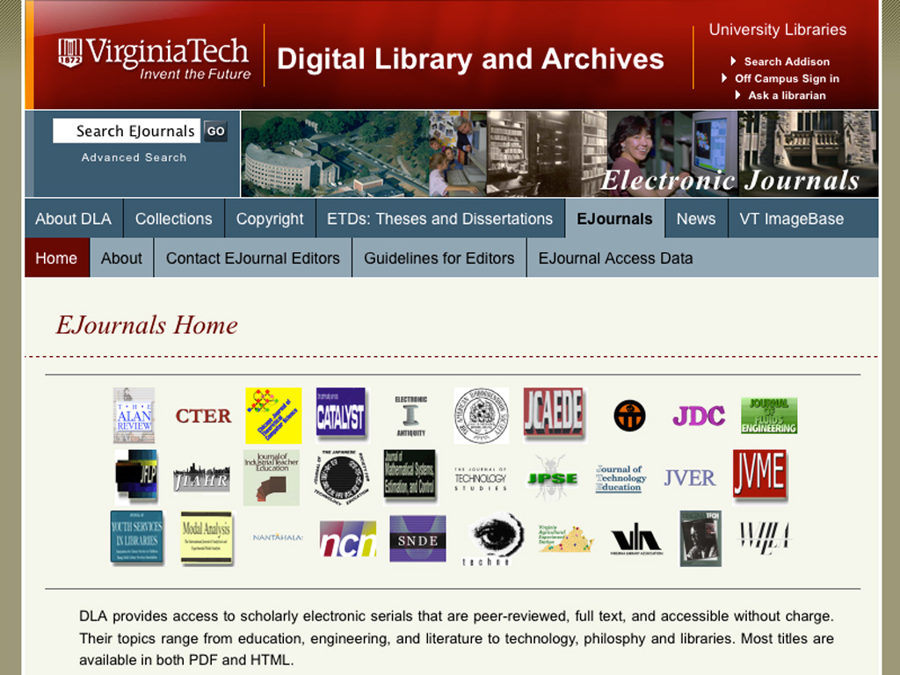
Notes:
Hi. I’m Anne Lawrence, DLA Online Editor. DLA hosts 38 electronic open access journals. Topics include literature, education, and technology. In the next few minutes I’ll briefly explain our procedure for posting journals and how this relates to other areas of the library.

Slide 34
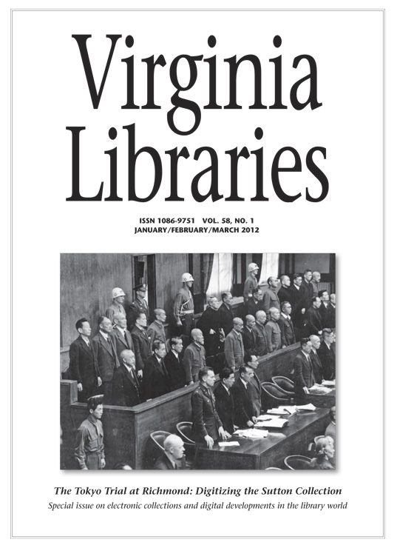
Notes:
A familiar title to many of us is Virginia Libraries, the quarterly publication of the Virginia Library Association. DLA hosts the full text version covering 1996 to the present. This is a PDF of the cover of the most recent issue. I will explain our process using this issue and this cover article, “The Tokyo Trial at Richmond” as an example.
We typically receive a PDF of an issue. We prepare the PDF file for posting by embed the fonts in the pdf, extracting images to create the HTML version, splitting the PDF into article length files, and add metadata to each file.

Slide 35
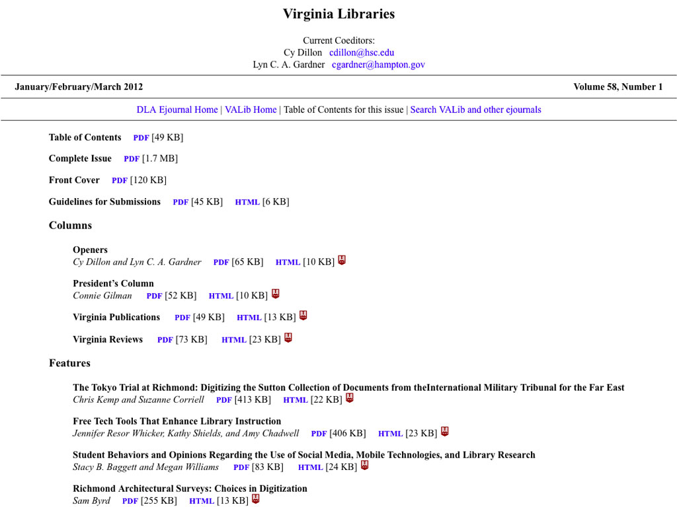
LibX
Notes:
Next, we create an HTML version of the Table of Contents, with links after each article for each file format, usually PDF and HTML. We create metadata as COinS for each article and add it after each article. I’ll explain more about COinS shortly. The COinS are usually not visible. However, the LibX plugin recognizes COinS and displays an icon for each one.

Slide 36
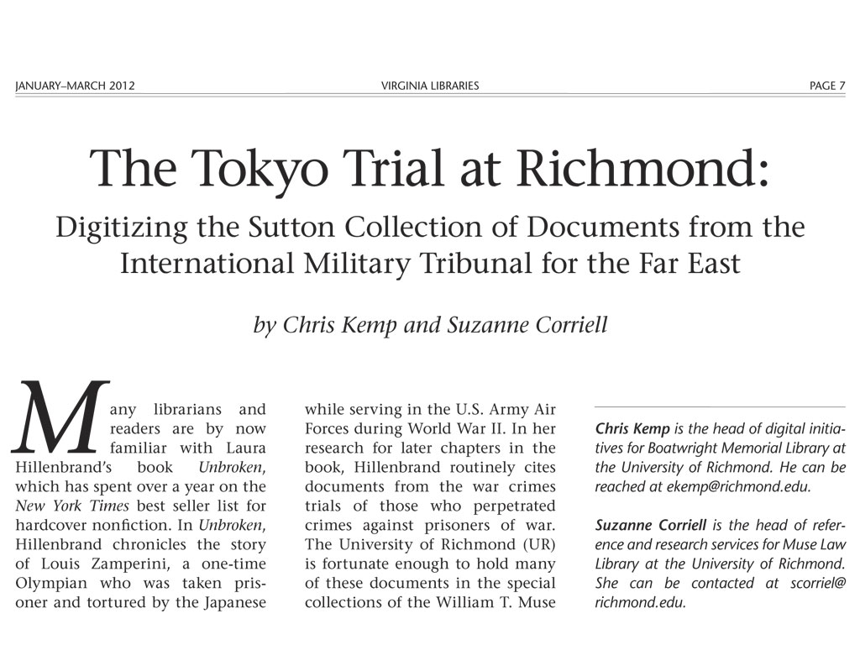
Notes:
Next, we prepare the articles. This is the beginning of the cover article, which we received as a PDF. We create an HTML version that meets all university and federal accessibility requirements. It will also reflow well on mobile devices. We use a text editor to create clean HTML and cascading style sheets and server side includes to format our pages in a maintainable way.

Slide 37
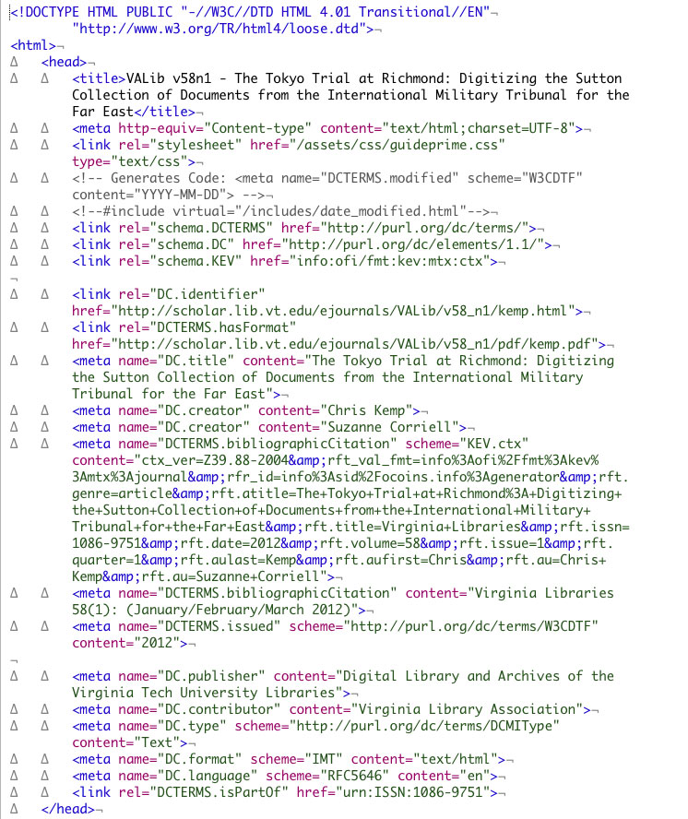
Notes:
We add a series of metadata tags to the head of each HTML file. The metadata is based on Guidelines for Encoding Bibliographic Citation Information in Dublin Core Metadata. This metadata is collected by DLA’s OAI-PMH harvester to provide metadata for Summon. Search engines such as Google, also harvest the metadata. Since adopting this set of metatags, our listings in Google Scholar are more accurate and have increased significantly in number. The metadata fields include a bibliographicCitation field which relates the article to the journal issue from which it came. The Guidelines recommend repeating this field in both human and machine readable form.

Slide 38
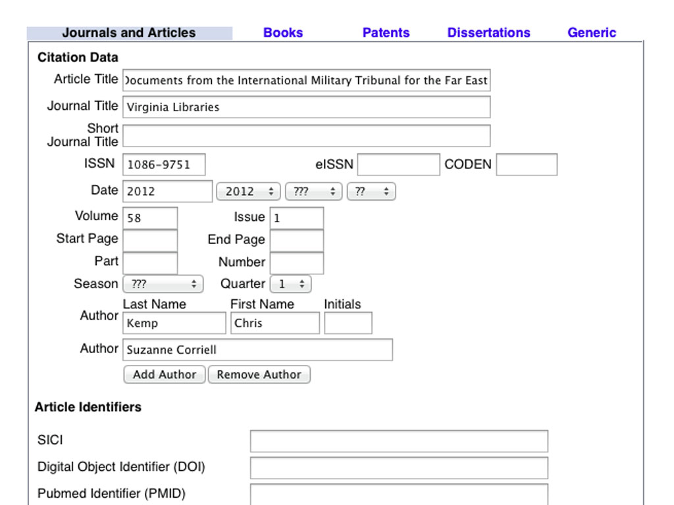
Notes:
The recommended machine readable form of the bibliographicCitation field is a ContextObject. ContextObjects are used in the NISO OpenURL standard, Z39.88. It is necessary for our library’s link resolver from Serials Solution. ContextObjects are also used by bibliographic citation software, such as Zotero. COinS is an acronym for ContextObject in Spans. It is a way of placing a ContextObject in the body of an HTML page. Shown is the Online COinS Generator. It contains metadata for this article

Slide 39
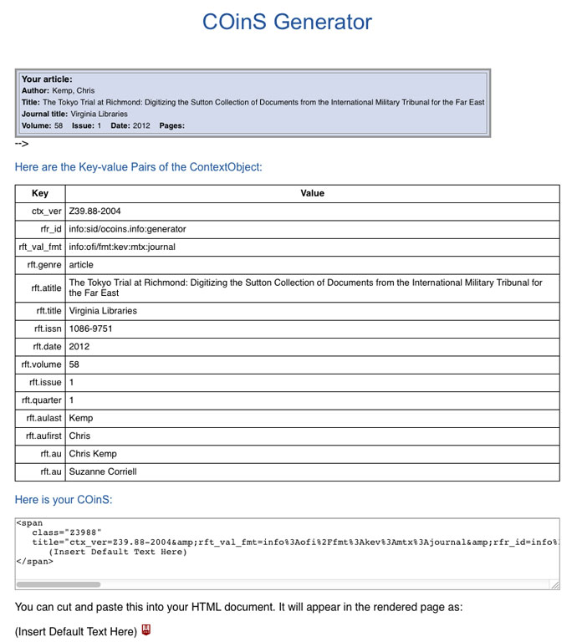
Notes:
This is the result of the COinS Generator. The ContextObject consists of key value pairs. The results are copied into the metatag in the head of the article HTML file, and as a COinS in the table of contents and in the body of the article. Zotero and LibX recognize the COinS in the body.

Slide 40
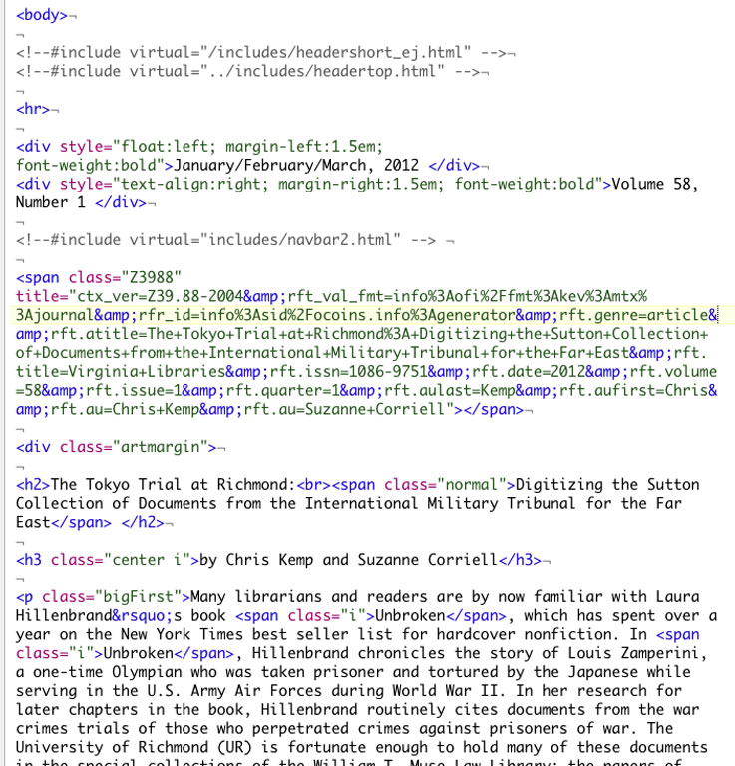
Notes:
This view of the HTML source shows the COinS for this article.
Circle the COinS

Slide 41
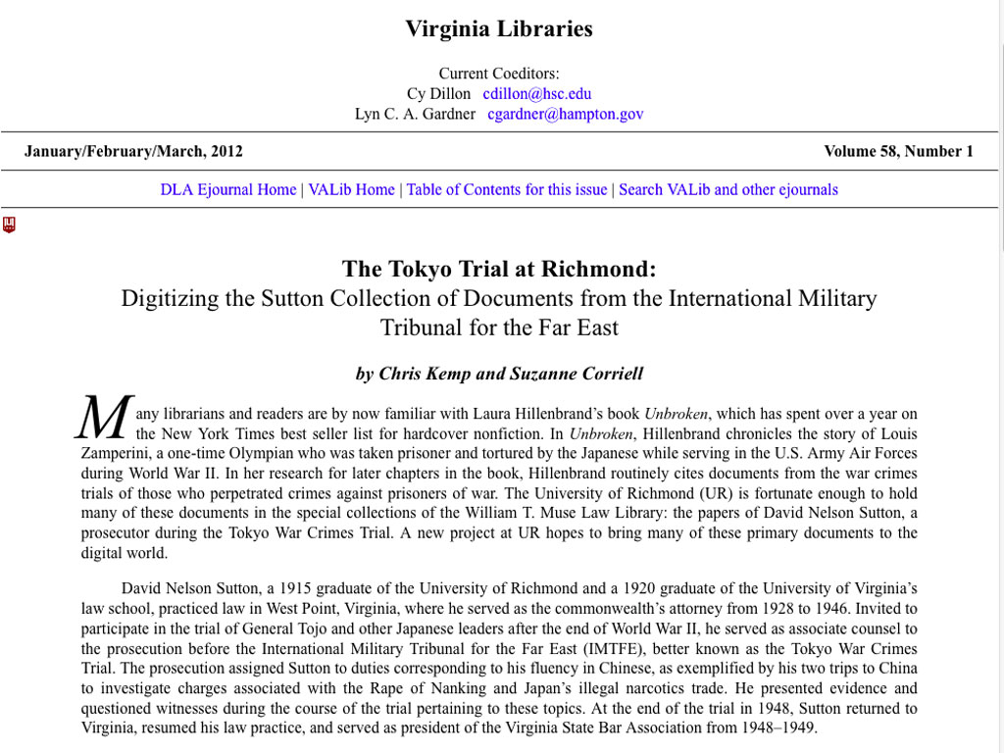
Notes:
And here is the finished HTML version of the article. The beginning LibX icon is visible because of the COinS added to the beginning of the article.

Slide 42
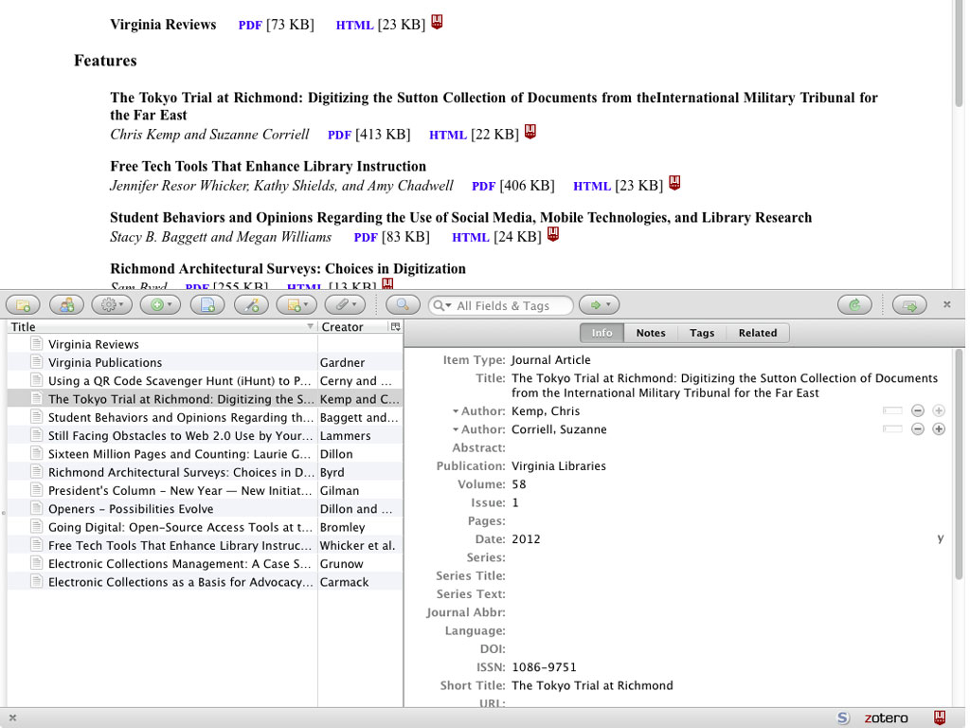
Zotero
plugin
Notes:
This view of the Table of Contents shows the Zotero listings at the bottom of the page. The left column lists all the articles in the table of contents. The right column shows the fields for the cover article. Zotero has extracted this bibliographic information from the COinS on this page.

Slide 43
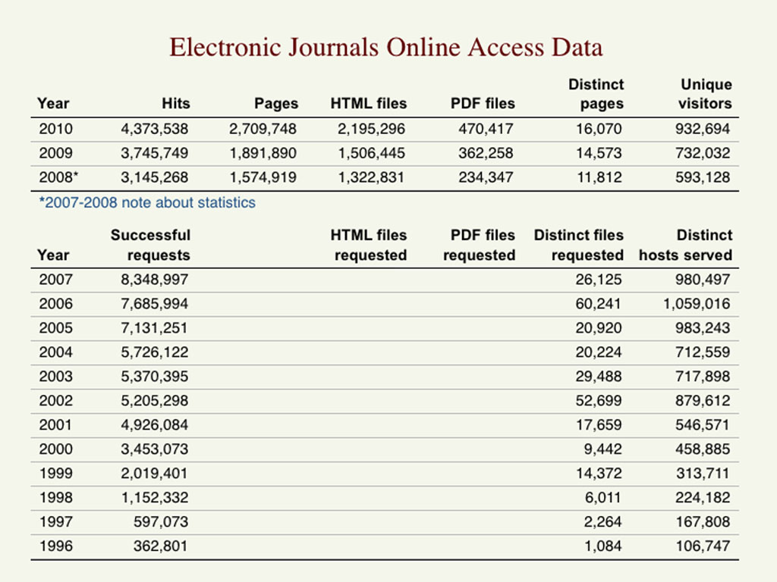
Notes:
This is the access data for ejournals through 2010. We changed our statistics package for the 2008 and later data, which explains the break in numbers. We served 2.7 million pages in 2010, with almost a million unique visitors. It is a popular international resource.

Slide 44

Openness in libraries
An underdeveloped and yawn-inducing comparison of open source and open access for library folk
Notes:
This set of slides is a comparison of open source and open access, and is intended to help those who know about one of these philosophies to understand the other.

Slide 45
Open Source
Software with free availability of the source code used by programmers in the creation of the software, with a license that does not impose burdensome restrictions on distribution or use
Condensed from the Open Source Definition of the Open Source Initiative (http://www.opensource.org/osd.html)
Notes:
Computer software is typically created by computer programmers who write instructions for the computer in specialized code called programming languages. The programming language is then translated to another code that is easier for computers to understand, but very difficult for humans. In some commercially purchased software, the programming language code, or source code, is not made available with the software. Open Source is a movement to make software source code available to all users, lowering the cost of software maintenance and customization.

Slide 46
Open Access
Making academic works, especially scholarly journal articles, available at no charge and without licensing restrictions
Based on Peter Suber’s Open Access Overview
(http://www.earlham.edu/~peters/fos/overview.htm)
Notes:
Academic researchers typically write articles about their work, and publish the articles in academic journals. Many articles in traditional journals are made accessible through subscription charges paid by libraries to vendors or organizations. Open Access is a movement to make scholarly works available to everyone, without cost barriers.

Slide 47
Claimed Advantages
Open Source
Open Access
Allows for easier software maintenance, which is 75% of the typical software life cycle
Most open source software is available free of monetary charge, making tools available for those who might not afford them
With high availability of source code, software bugs in popular projects can be detected and fixed sooner
Possible increase in citations for open access works
Making research widely available increases the rate of progress in academic fields
Librarians hope that the movement will eventually result in lower journal costs
Notes:
Advocates of open source and open access claim that the benefits of these approaches lead to cost efficiencies and quality improvements over typical approaches. Open Source advocates believe that the cost of software production and maintenance is lower with open source techniques, and that new technologies are incorporated sooner. Open Access advocates believe that these techniques will lower the cost of scholarly communication and increase the pace of research advances.

Slide 48
Popularization
Open Source
Open Access
Started by computer scientists with a background in academia
Made widespread by hackers (computer professionals and hobbyists with high ideals)
Marketed to Fortune 500 companies, and popularized after they began using the software
Started by academics with a background in computer science.
Executed in a more organized, more complete fashion by physicists
Awareness created by librarians
Push carried on by academics
Notes:
Open Source and Open Access principles both saw initial experimentation at the hands of computer scientists and academics, but spread to a larger population after other groups applied these practices. Open source became widely accepted after usage by Fortune 500 companies. The Open Access movement was strengthened when Fields Medalist mathematician Timothy Gowers organized a boycott of Elsevier, a publisher of high cost academic journals.

Slide 49
Enablement through Internet technology
The popularity of open source computer software, and the opportunity for widespread, open access availability of research articles were both made possible through Internet, and especially World Wide Web technologies.
Notes:
The Internet has been important in the development of open source and open access movements, because it has enabled easy global communication and made self publication easy.

Slide 50
Naming
Open Source
Open Access
The term “open source” was coined by open source developer Eric Raymond and chosen at a software summit in December 1998 as a useful term for hackers to market the concept to others
I have not yet tracked down the origin of the term, but it appears to have been in wide use after the Budapest Open Access Initiative in December of 2001
Notes:
The terms “open source” and “open access” appear to have been in widespread use near the beginning of the 2000 decade.

Slide 51
Gift Economy/ Gift Culture
Open Source
Open Access
Open Source has been referred to as a gift economy, where software developers (or their sponsors) benefit the world by giving software away for free.
Traditional Journal publishing has been called a gift economy, but with some bitterness because journal publishers are believed to be the primary beneficiaries
Open Access can shift the benefits of the gift economy from journal publishers to other academics
Notes:
Open Source and traditional academic publishing have both been called gift economies. In traditional academic publishing, the term has been used in a negative fashion to illustrate that academic researchers, often sponsored through public funds, are donating work to publishers that then build a business from their sweat. In Open Source, the term has been applied positively because some of the early founders of the movement were idealists who claimed to be creating and distributing software primarily through their goodwill and for the benefit of humanity.

Slide 52
Reputation: A motivation for participation
Open Source
Open Access
Software developers and users gain reputation in the open source community by initiating or contributing projects
According to Eric Raymond, this motivation has been underplayed because of the idealist nature of early founders
Academics gain reputation by publishing in academic journals, whether open access or closed access
This has long been commonly accepted, especially with the notion that tenure-track academics must “publish-or-perish”
Notes:
Open Source software developers and academics both gain reputation points by making their work widely available to others. There are differences between the two cultures in expression and emphasis of this idea.

Slide 53
Peer Review
Open Source
Open Access
Review of work from other programmers before it is included in a project
Continuing review of work from users and more programmers as the software becomes widely used and software bugs are discovered
Not blind reviews
Follows typical models for peer review in academic publishing, including overall impact and merit of research processes and results
After publication, other researchers may attempt to replicate or criticize the research results
Sometimes blind or dual-blind reviews
Notes:
Peer review is important in the open source and open access movements. In open source, peer review is more prominent than in traditional development processes, because the work of programmers is on display for all to see. In the open source movement, you might say that software code is published first before it is fully reviewed. In the open access movement, peer review follows models for traditional academic publishing, which means that peer review largely occurs before publication.

Slide 54
Quality Perceptions
Open Source
Open Access
Several studies show that large open source projects have fewer bugs and security issues than traditional software
Some non-technical users perceive open source software to be of low quality, because the user interface and documentation are often designed for other programmers
Varies widely by project
At present, traditionally published journals in some fields may be perceived to be of higher quality than traditional journals. Established, leading journals tend to be traditionally published.
Perceptions may adjust when more researchers begin publishing in open access journals, and when tenure committees consider the open access movement
Notes:
Quality in software, both open source and closed source, varies widely from project to project. Trained systems administrators and programmers, depending on their backgrounds, tend to view open source software as higher quality than closed source software. Non-technical software users often view open source software as lower quality, perhaps because it has traditionally been designed for use by other programmers. In the academic publishing world, there is some perception that traditionally published journals, which include established, leading journals, are currently of higher quality. The perception may change as the open access movement continues to evolve.

Slide 55
Websites for Free and Open Source Software in Libraries
EIFL-FOSS: http://www.eifl.net/foss
FOSS4LIB: http://foss4lib.org
LYRASIS, maintainer of the FOSS4LIB site, has also been hosting webinars about open source in libraries. Contact Peter.Murray@lyrasis.org for more information.
Notes:
These websites contain lists of open source software that is useful in library projects, as well as decision making tools about when to use open source versus closed source software.

Slide 56
Examples of Open Source at VT Library
Linux and BSD based operating systems on the servers
Apache http web server
LibX library toolbar
DSpace, Postgresql database, and other software components that build VTechWorks, the institutional repository
Notes:
Virginia Tech University Libraries use many open source software projects. Here are some examples.

Slide 57
Data Management @ DLA
Notes:
Many funding agencies, most notably NSF, NEH, and NIH, now require data management planning as a prerequisite for grant application. We at DLA is working towards helping the VT faculty members to fulfill these requirements.

Slide 58
What We Do
Assist data management planning
Develop repository and infrastructure
Exemplary projects
Notes:
So what do we do? First, we assist DMP; second, we develop the repository and the IT infrastructure, and finally we work on a few exemplary projects to showcase our capabilities.

Slide 59
Assist DMP
“Data Management Planning for Research Grants”
  VT Faculty Development Institute (FDI) workshop
  VT Research Administrator Program
ASERL Data policies:
http://datapolicywatch.pbworks.com
One-on-one consultation
Notes:
To assist DMP, starting from this semester we offer a 2-hour long data management workshop to VT faculties through the Faculty Development Institute or FDI.
Starting with little fanfare, our attendance grows from13 to 25 then to a record-breaking 73 people.
The experience so far clearly demonstrates the enthusiasm as well as the strong demands for the data services across all VT campuses.
We also run a wiki-style web site called data policy watch via ASERL to track changes in federal, state, and institutional data policies within ASERL and SURA members.
Of course we also do one-on-one consultation and review DMPs for the faculties. This got us, mostly Nathan, quite some last-minute requests.

Slide 60
A One-Size-Fits-All Repository?
Data diversity
Separation of concerns
Core competencies of the IR
Layering cake and linked data
Notes:
Data preservation carries its unique challenges and opportunities.
One of the challenges is on the institutional repository or IR. Many universities run IRs these days. The question is, can we just dump the research data into the IR the same way we archive and open access our research articles and images, etc?
We realize that research data can be too diverse to be lumped into one big category. Astronomical observation data can be totally different from the DNA sequencing data or the computational fluid dynamics simulation data. It’s not quite realistic to require all research data be transformed into a handful of fixed file formats. Even if we can, indexing, searching, presenting and using these data in a meaningful way are still major challenges. Looking at these problems, I started to think, maybe we shouldn’t even consider doing all these within an archival repository.
What we need is to clearly define the core services we provide for research data. If some services are not provided, maybe the IR should provide enabling APIs so that these services can be provided elsewhere, and in this sense we form an eco-system to foster value-addition. I believe this approach is not only in line with the OAIS reference model but also reflects the age-old computer science wisdom of separation of concerns. I would think a layering cake or linked data model would be suitable for this type of implementation.

Slide 61
Differentiate Storage Needs
Local Storage
Near Line Storage
Cloud Storage
Notes:
During our workshops and consultations we were frequently asked questions such as, here’s 2 T of data, can you take it from us today? Or, we’re generating 500M of data per day, can you guys put them online for us? The underlying message is clear, that the research communities need better storage and access solutions for data. And we may not be able to solve this problem alone, therefore collaborations across the department and even the university boundaries seems not only beneficial but also necessary.
At VT we started to approach the issue by differentiating the storage needs. We started to approach the University IT to tap into the so-called near line storage system. A pilot project with the VT Center for Geospatial Information Technology put in a request to store about 14 TB of geospatial data to the near line storage.
Another option is the cloud storage. A very interesting feature of the cloud storage is that, if extensive data processing is required to use the data, these processing can be done in the same cloud data center that stores them. This eliminates the burden for the the users to download the datasets first, and at the same time saves us quite a lot of bandwidth cost. This is the model that Amazon uses to run its public datasets and we may borrow this for our storage needs. The cloud storage can also be a good fit if near line storage is unavailable or we need temporary overflow storage space until we expand other options. One other feature of the cloud storage is that, the more we use, the cheaper the unit cost is, so there may be concrete gains for multiple universities to bundle up and negotiate a better rate. We VA universities could benefit even more because the largest Amazon cloud region is located in Northern Virginia.

Slide 62
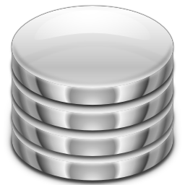
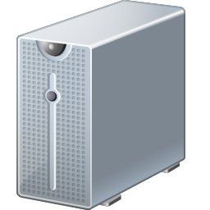

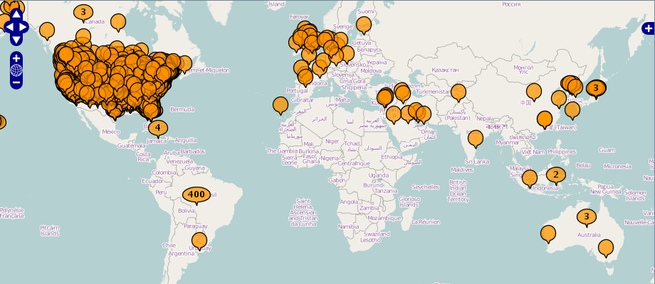
Exemplary Project
VTechWorks
fishtraits.info
FishTraits Data
exchange
drives
FishTraits metadata
queries,
analysis,
comments,
…
map
visualize
recollection
server
Notes:
In this slide I’ll briefly share another pilot data project we’re currently working on. The FishTraits project starts from a database created by Prof. Frimpong from VT Department of Fish and Wildlife Conservation. The database contains various traits of more than 700 species of fish. We plan to dump the database file into VTechWorks, VT’s IR, then use the data and metadata to not only drive a live database that allows database queries, analysis, and partial downloads in different formats, but also another server used to visualize the data in different ways. On top of that, the data may also be shared with the DataONE network via a compliant interface. This project may be considered an example of the repository architecture I mentioned earlier.

Slide 63
VTechWorks Collections
Library initiatives
Research and Informatics
Learning and Outreach
Articles
Data sets
Proceedings
Student journals
Student presentations
Final projects (coursework)

Slide 64
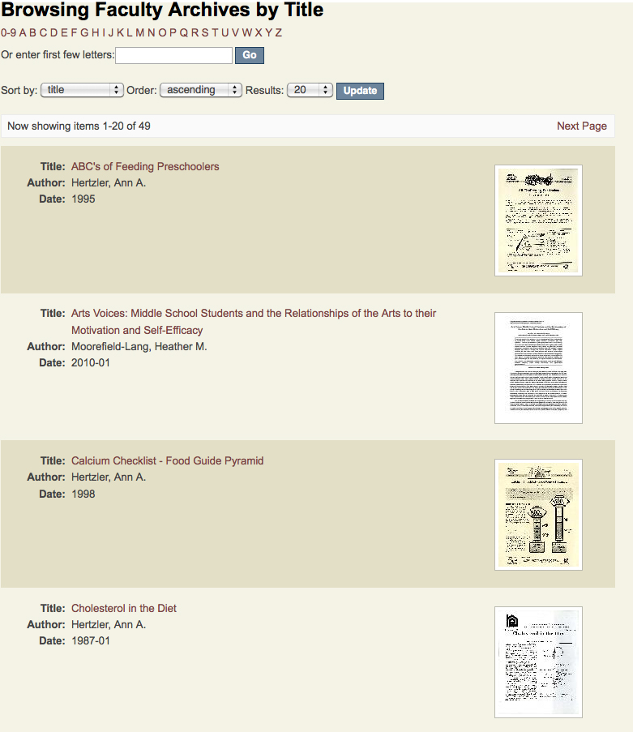

Slide 65
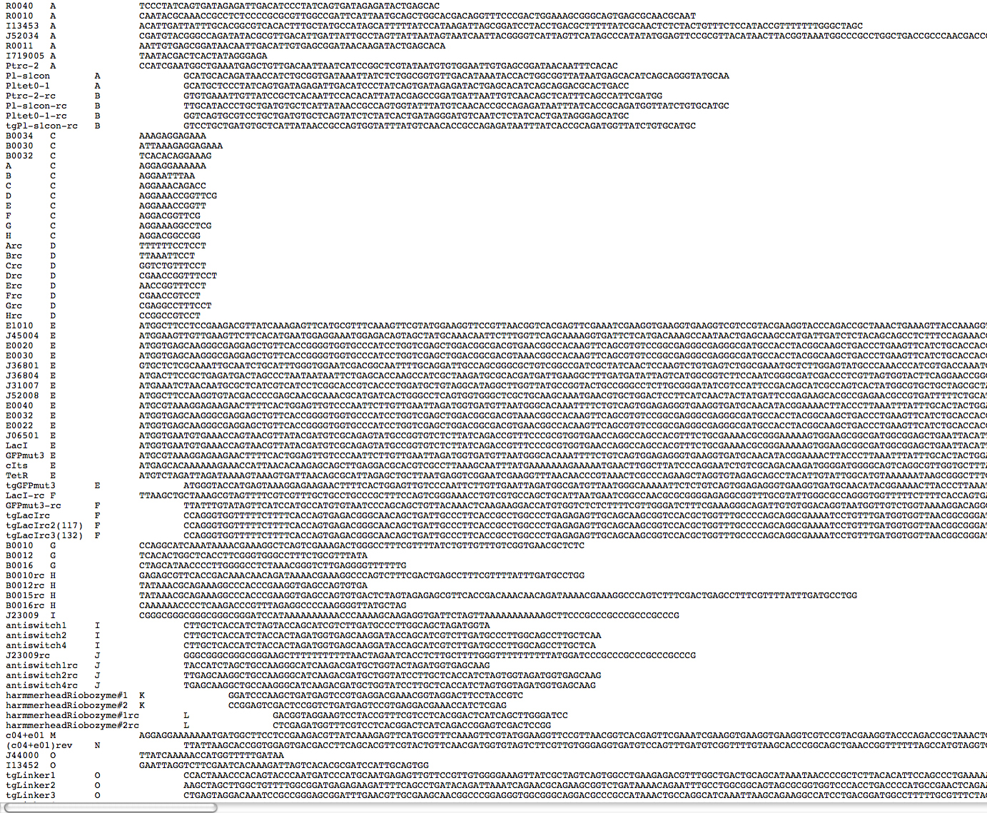

Slide 66
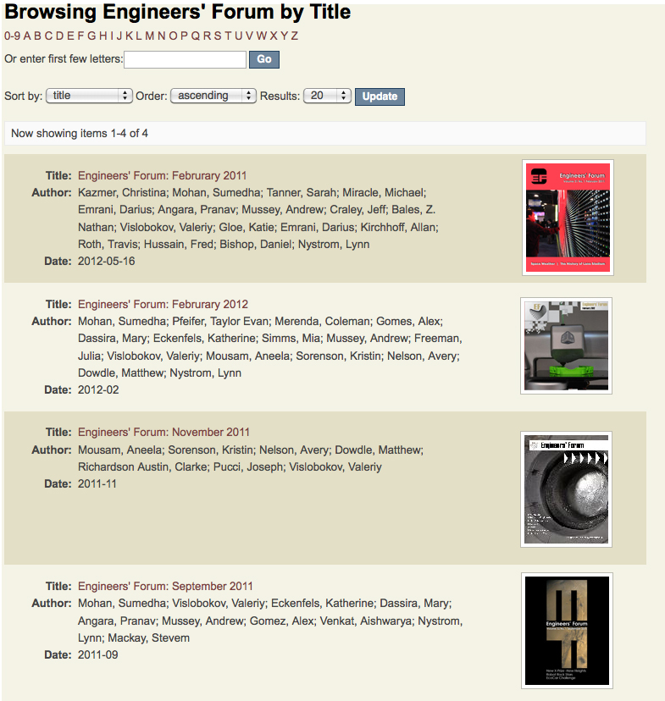

Slide 67
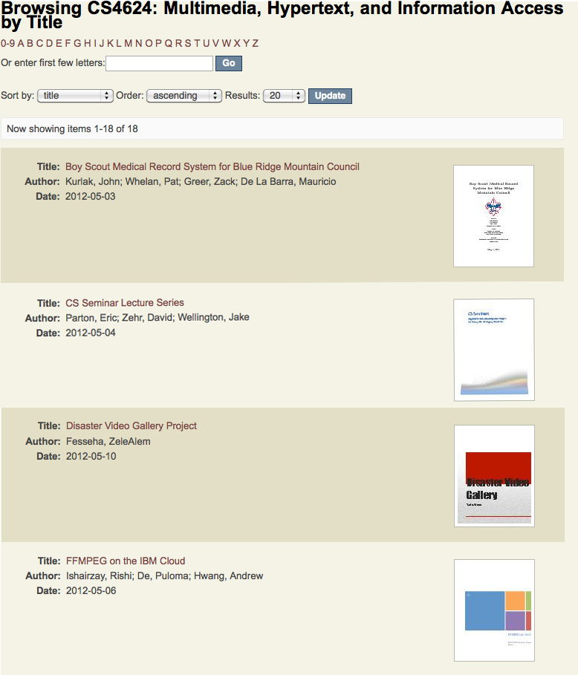

Slide 68
VTechWorks Collections
Library initiatives
Research and Informatics
Learning and Outreach
Library Collections and Services

Slide 69
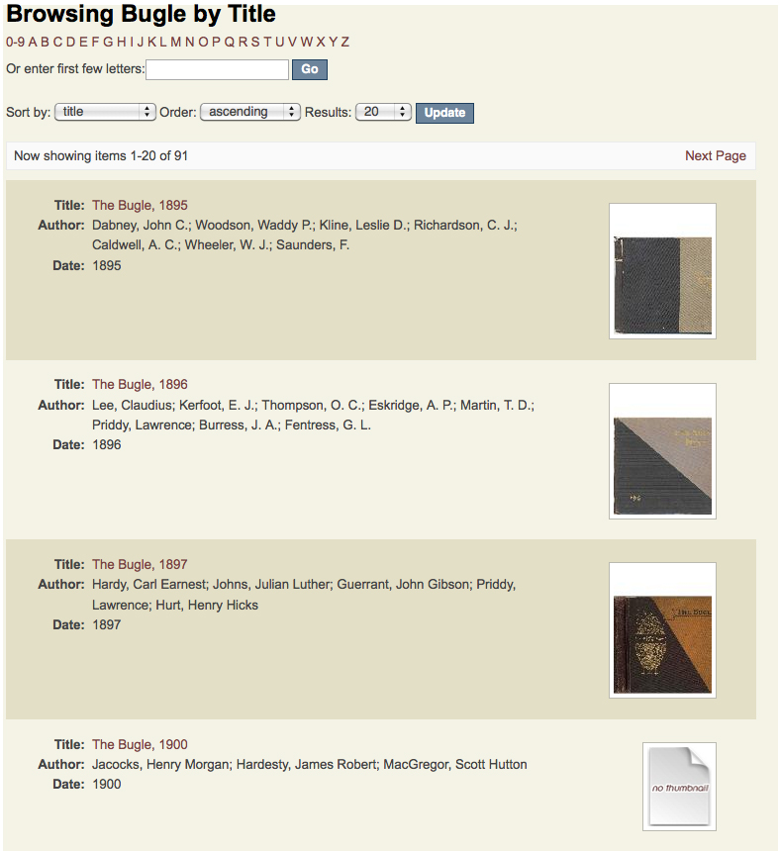

Slide 70
