Slide 1
Classification of Arabic Documents
Project Final Presentation – Dec. 6, 2012
CS 5604 : Information Storage and Retrieval
Instructor: Prof. Edward Fox
GTA : Tarek Kanan
ProjArabic Team
Ahmed Elbery

Slide 2
Outline
Arabic documents classification: Motivation
Arabic documents classification: Challenges
Model
Model Details
Results and Evaluation

Slide 3
Arabic documents classification:
Motivation
Rich set of Arabic documents
Now > 65M Internet users of Arabic
Arabic NLP needed for increasing Arabic internet content
Notes:
Here I just want to recall the motivation for ATC

Slide 4
Arabic documents classification:
Challenges
Techniques built for English language processing may not apply to Arabic because:-
  Arabic is very rich with complex morphology
  Arabic has a very different and difficult syntax and grammar
Notes:
Challenges
Due to the great difference between Arabic and other language in morphology Syntax structure and grammar, Techniques built for other language processing may not apply to Arabic because

Slide 5
Project model
Preprocessing
Classification
Arabic
Documents
Feature Extractor
Naive Bayes
Tokenizer
Stemmers
Classification
Result
k-Nearest Neighbors
Tokens
Stems
Top Terms
Support-vector machines
Decision tree
Notes:
Project model
For tokenization and stemming I used a ready built java program and played with its code to add some functions.
For the Feature extirpation and classification I implemented them using Matlab

Slide 6
Data Set
100 Docs
Arabic Spring
50 Docs
50 Docs
Politics
Violence

Slide 7
Preprocessing
Feature Extractor
Tokenizer
Stemmers
Tokens
Stems
Top Terms
Notes:
Scan the doc word by word
1- Remove stop words (, Pronouns, Prepositions,..),
2-Remove non-arabic letters , numbers and punctuations
3- Names
Removing names is not an easy task
1- no capital letters, In English for example names are identified by capital letters, But in Arabic the concept of capital letters does not exist s we need another techniques
2- most Arabic names actually come from verbs and can be used as adjectives
3- some tech. may be based on sentence analysis
But the problem is complexity of aarabic
i.e. that basic sentence structure for Arabic is very flexible
subject verb object
verb subject object
verb object subject
So to solve this problem, I played with the code of the ready built Arabic stemmer by using a list of names
But also this solution is not effective since we need to add all names in this list
As well, it can not deal with the compound names
tokenizes
Names detection, is a performance-complexity tradeoffs (removing names, working with diacritics)
removing names: some name are actually from verbs + language complexity (structure of the sentence)
For stemmer:
working with diacritics is a performance-complexity tradeoffs, increases the complexity , without reducing the efficiency (the words gold & go)

Slide 8
Preprocessing
Feature Extractor
Tokenizer
Stemmers
Tokens
Stems
Top Terms
Notes:
Finds the stem for each word
An important tradeoff here is “working with diacritics”
To show the importance of diacritics we use the example words gold & go
diacritics are important, to differentiate between words with the same characters sequence but with different meanings.
ذهب can appear in many docs with out identifying a certain topic or category
But when we see the word ذهب Gold this may be an identifier that the documents are about economics, money ,..
So we need to differentiate between these two words, we can not do this without diacritics
But on the other hand working with dictated docs is very difficult not only because it increases the character pace from 28 letters to > 300 char.
But also diacritics are subjected to many complex Arabic grammars. So If we want to consider the diacritics we have to consider the Arabic grammar and syntax which is a very complex problem.
So in the project I used docs that are not dilacerated or with very little diacritics.
For stemmer:
working with diacritics is a performance-complexity tradeoffs, increases the complexity , without reducing the efficiency (the words gold & go)

Slide 9
Preprocessing
Feature Extractor
Tokenizer
Stemmers
Tokens
Stems
Top Terms
Notes:
Feature Extraction : extract the most informative terms from documents.
Reduce the processing requirements (Time, Memory, & Disk space)
Increases classifier efficiency by removing noise features and avoiding over fitting
Using only the highest 10% may not affect classifier accuracy*
Many techniques could be used
Term Frequency
Tf.idf
Correlation Coefficient Chi²
Information Gain (IG)

Slide 10
Example
Doc P-1 :
Systems Politics nation area Liberty International Politics Government
Doc P-2
Politics Systems nation area Kill nation Politics Government
Doc V-1
Violence Systems Weapon Weapon Militias Violence Kill Government Burn
Doc V-1
Burn Systems Weapon Militias Violence Kill Kill Government
Notes:
Example
This is an example showing 4 Docs
These docs are made manually because working with real documents will results in a large number of terms that can not be displayed here

Slide 11
Example- Cont.
Notes:
First
The FE finds the count for each term in each doc.
And then find the term frequency dividing the term count by the number of terms in its doc
Then find the df and idf and finally the tf.idf

Slide 12
Example- Cont.
Notes:
To find the highest term weights
The EF sums the tf.idf for each term and find selects the terms with the max weights

Slide 13
Example- Cont.
Notes:
These are the selected terms and weights

Slide 14
Preprocessing
The output matrix
……. | term3 | term2 | term1
 |  |  |  | Doc1
 |  |  |  | D0c2
 |  |  |  | Doc3
 |  |  |  | ..…
Class
tf-idf values
Notes:
This is the output matrex for the feature extractor which is used for building the classifier model, it is Composed of term weights and the classes
The same processing is done for the test data except we do not need to find weights for all terms but only the top selected terms

Slide 15
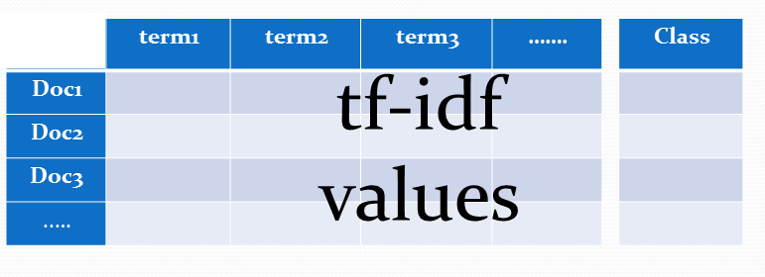
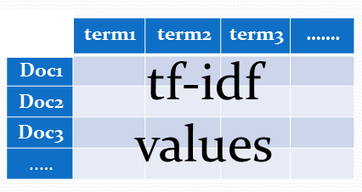
Classifier
Training Set
Classification Algorithm
Test Set
Class | Doc
P | 1
V | 2
V | 3
… | ..…
Classifier
(Model)
Notes:
In the classification we have two main phases
Modle building
And testing

Slide 16
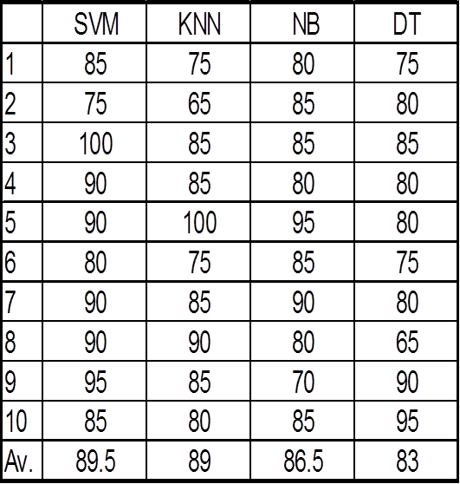
Results and Evaluation
Accuracy
100 Docs (50+50)
10 times
80% training
20% test
Accuracy
Notes:
To find the accuarcy of the algorithm I ran the model tem times and find the accuracy in each time
These are the specifications for the run

Slide 17
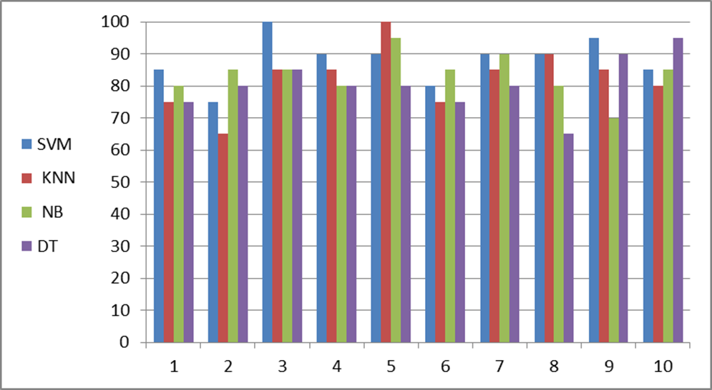
Results and Evaluation
Accuracy
Correlation coefficient
Notes:
This is the accuracy and the correlation coefficient for the 4 algorithms
It is clear that SVM and KNN are correlated which means they behave similarly when changing the data sets

Slide 18
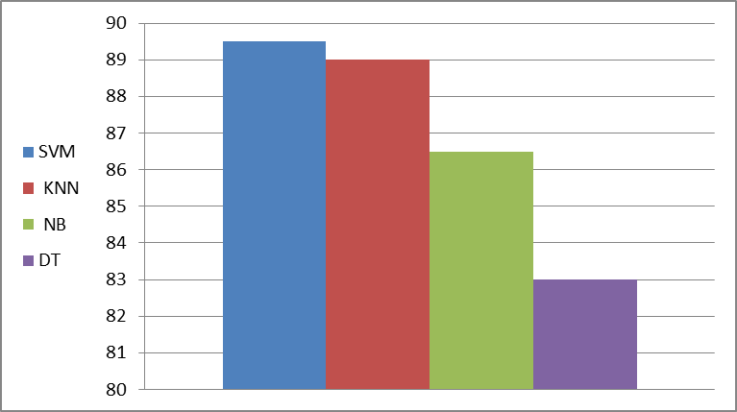
Results and Evaluation
Av.
Accuracy

Slide 19
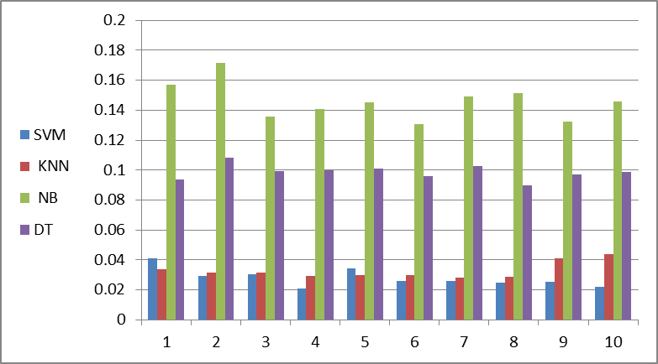
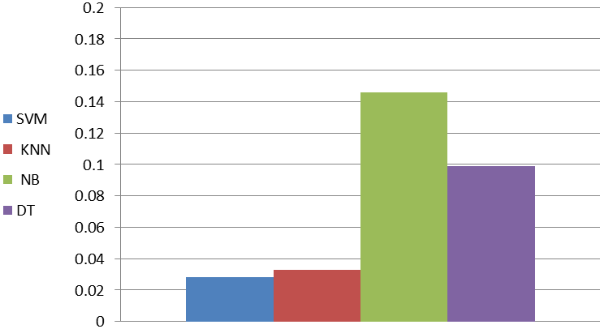
Results and Evaluation
Time
Av.
Time
Notes:
For building the model and the classification not for previous

Slide 20
Future work
Test the different parameters of the classifier
  Feature ratio
  Feature selection parameters
Classifier parameters.
Statistically analysis the results.
Notes:
Other students can use this model to check the effect of the feature ratio on the performance
Can also ad chi2 parameter as a selection criteria and compare between different selectors
Also can study the effect different classification algorithms parameters such as K for the KNN
And finally can statistically analyze the algorithm to find the relation between them

Slide 21

Ahmed Elbery

