Slide 1
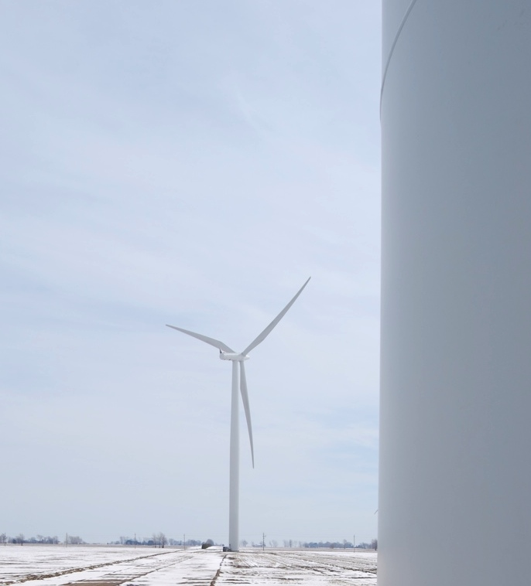


Windtell
Wind Farm
Analytics and Performance
Management
Rupp Carriveau
Director, Turbulence and Energy Laboratory
Lumley Centre for Engineering Innovation
The University of Windsor

Slide 2
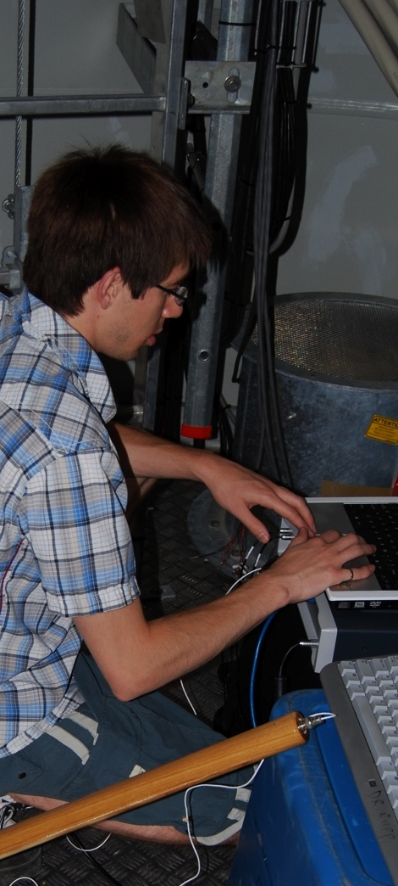
Windtell
Project Impetus
GROWING BUT MATURING WIND INDUSTRY
Wild West pioneering days of onshore development are transitioning to challenges of innovative operations and maintenance.
In many cases, commercial farms are ageing differently and more rapidly than anticipated.
Still much to be understood in the dynamic interaction of full scale turbine groups (turbine to turbine, farm to farm).
PROJECT ORIGINS
Culmination of extensive field research program working exclusively with full scale commercial wind farms since 2008.
Working Partnerships with various Canadian Wind Farms and the Wind Energy Institute of Canada (WEICan) have made the project possible.
Notes:
Where in the panel? →The research end of the spectrum. Looking for so-called “startling” revelations that may not be be uncovered playing it “safe”.
Don’t foget JJ’s 50k budget for parts per year.

Slide 3
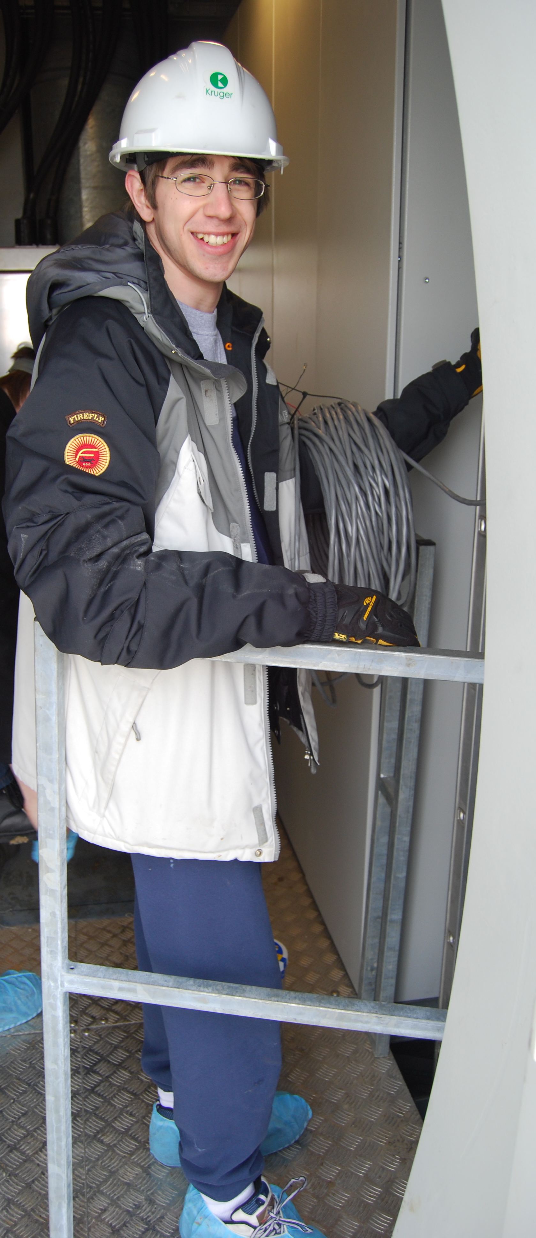
Windtell
Project Objectives
DEVELOP AN INTELLIGENT, SEMI-AUTONOMOUS OPERATIONS MANAGEMENT TOOL TO IMPROVE THE LIFE-TIME PROFITABILITY OF COMMERCIAL WIND FARMS.
Maximum Profit ~ f(optimize(performance management))
Higher order, comprehensive monitoring, near-real-time analyses to enable adaptive operations.
The challenge is to maximize profit for the life of the asset – how long is that? Do you run ‘hard and short’ or ‘easy and long’?, etc.
DEVELOP A RESEARCH TOOL CAPABLE OF EXPLORING ANTICIAPTED AND PREVIOUSLY UNKNOWN RELATIONSHIPS BETWEEN WIND FARM OPERATIONAL VARIABLES.
Powerful querying capability of broad, high resolution database.
Semi-autonomous agent, “Mr. Smith” tears through data seeking correlations, outliers, and anomalies.
Notes:
We take a slightly different approach – try to think of things always in terms of, “How do we maximize profit for the life of the asset” – how do manage our asset today and tomorrow to ensure this outcome? Because you can always maintain something to last forever – but you could go broke doing it.

Slide 4
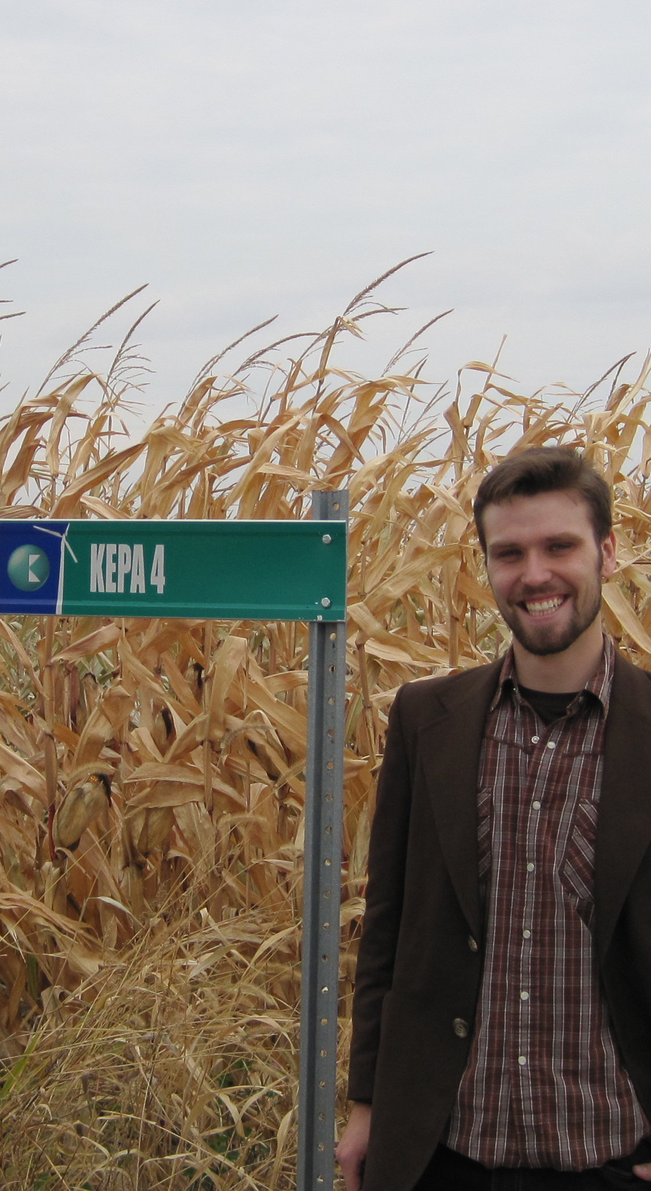
Windtell
The Analytical Database Tool
HOW DOES IT WORK?
Built on open source MySQL DBMS.
Custom queries are built through graphic selection or scripts.
Post processing outputs are rendered graphically by interactive javascript charting and visualization libraries (d3.js).
Populated with highest resolution Farm SCADA data.
Expands to include custom user inputs (manual maintenance logs, etc.), and/or additional sensors (structural health monitoring, temperature, icing, LIDAR, etc.).
Notes:
A multi-agent, client/server application capable of intelligently storing and analyzing historical wind data.
We aim to produce a multi-agent, client/server application capable of intelligently storing historical wind data for subsequent examination. The application supports custom queries aided by an interactive visualization of the wind farm. Data is stored and retrieved from a relational database (using the open-source MySQL DBMS), and returns views rendered as charts using the latest dynamic and interactive javascript charting and visualization libraries (d3.js), and can also export standard .csv files. The optimization of a wind farm presents a unique opportunity to leverage graph theory to better understand the inter-related behavior of groups of turbines. We propose an intelligent, server-side agent capable of predicting and categorizing interactions such as wake scenarios not based on models, but on real historical data.

Slide 5
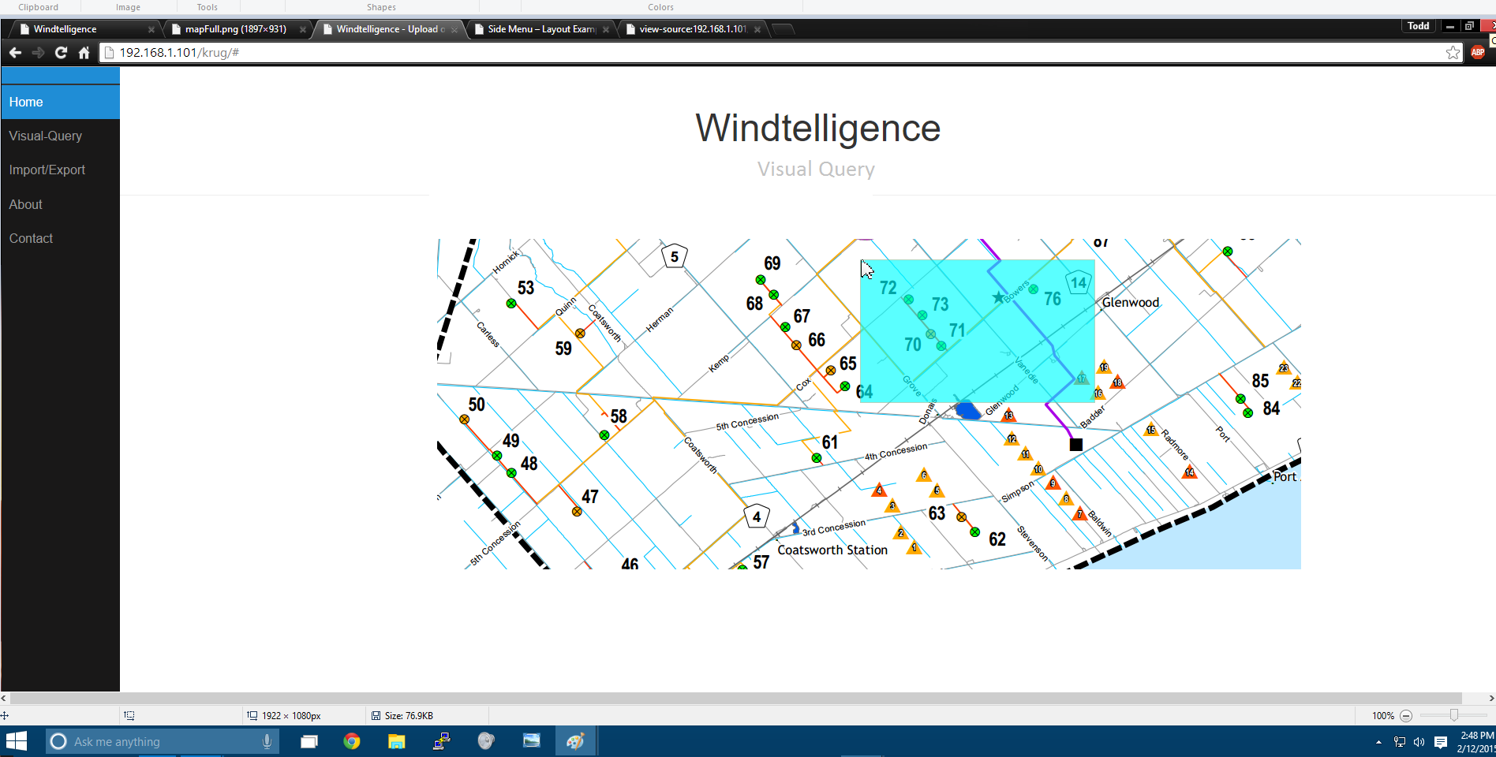
Windtell | Early Days
Screen Shots
Notes:
Users can select the assets they wish to work with – it will then make all of their tags accessible for additional graphic or script based queries.

Slide 6
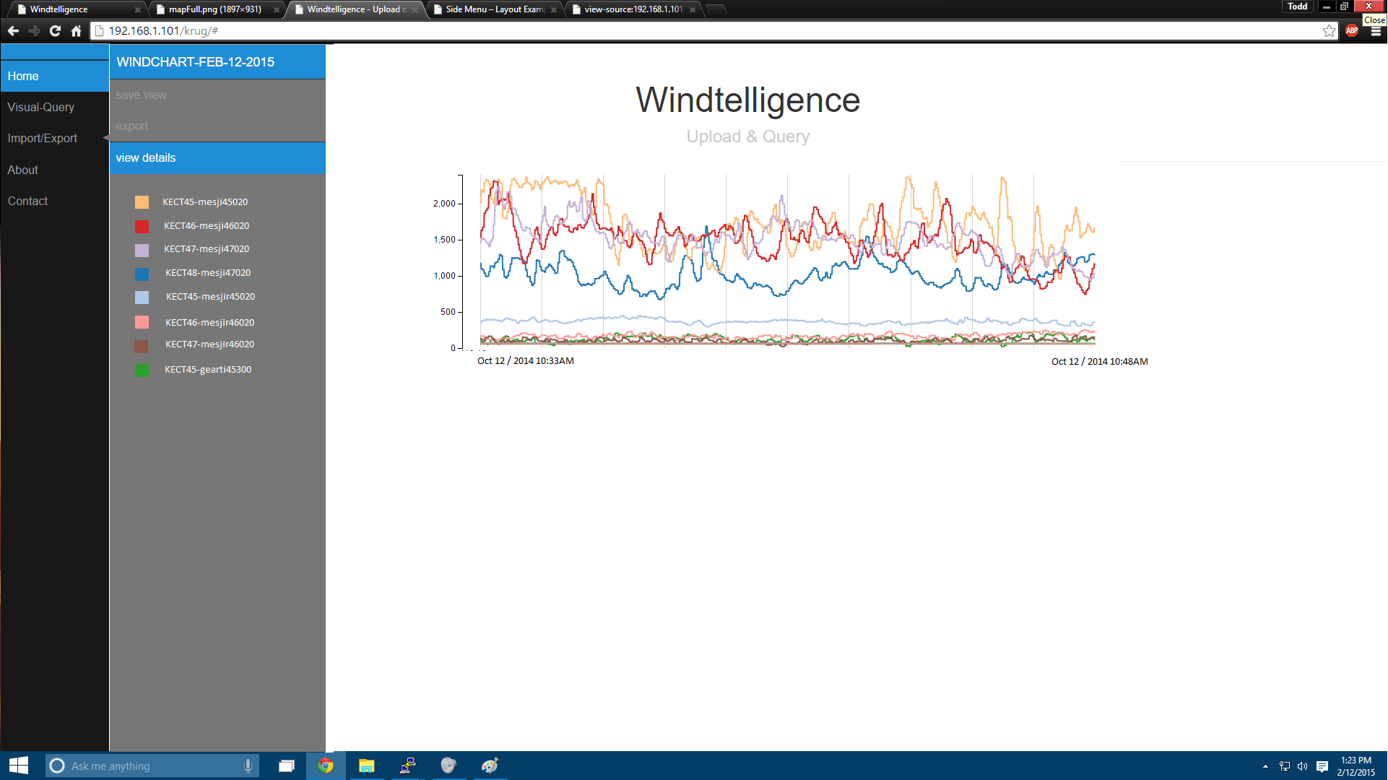
Windtell | Early Days
Screen Shots
Notes:
Graphs (here without even axes titled!) will be produced instantly based on the query you have provided. Power here.

Slide 7
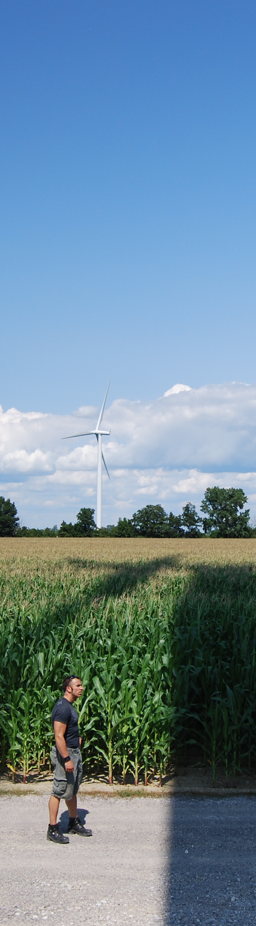
Windtell | Application Examples
Sample Potential Outputs
OUTPUT TESTS
Borrowing from previous “hand assembled” analyses Ref[1-3], we attempted to recreate them using the Windtell tool – validating database functionality, illustrating significant time savings, and introducing the potential for real time monitoring and control.
We have also generated new “sample” outputs currently being analyzed.
Demonstration outputs include:
  Common wake-effected loss tracking.
  Structural loading observations.
  2 year high and low power performer analysis.
  Anomaly tracking.

Slide 8
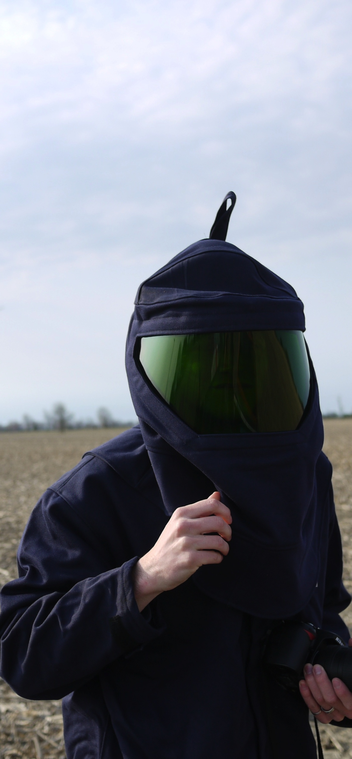
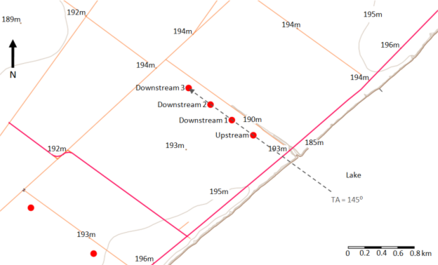
Windtell | Application Examples (Validation)
Wake Effected Losses [1]
Notes:
Four machines selected for analysis. Front two are utilized here.

Slide 9
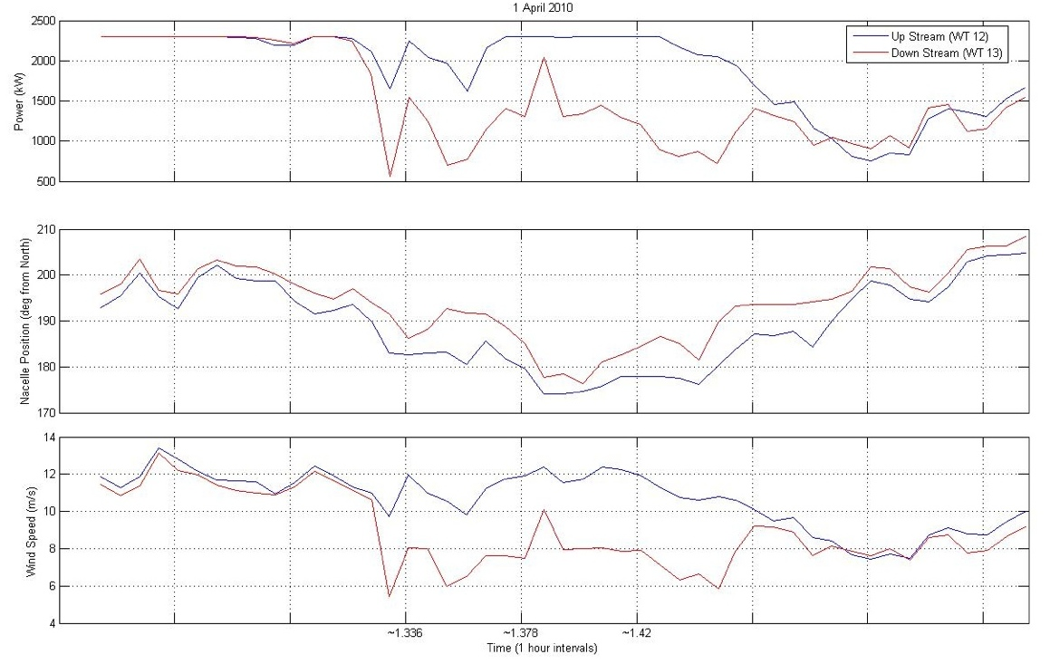
Windtell | Application Examples (Validation)
Wake Effected Losses [1]
POWER
COLLINEAR ALIGNMENT
[WAKE SHADOWING]
NACELLE POSITION
WINDSPEED
Notes:
Four machines selected for analysis. Front two are utilized here. Graphical evidence of losses. Detailed loss compilations for any time period are possible.

Slide 10
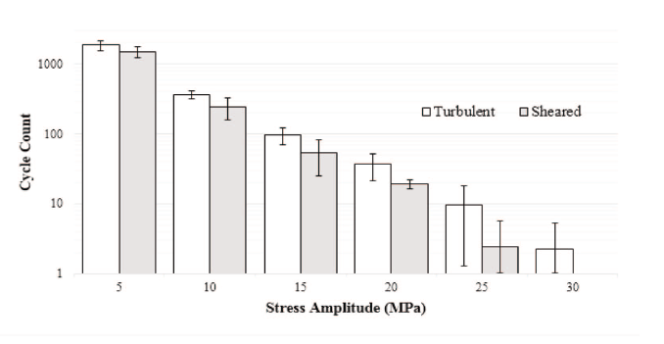
Windtell | Application Examples (Validation)
Structural Loading Insights [2,3]
WT4 Turbine Tower Cyclic Loading Comparing Turbulent and Sheared Winds | U =17 m/s +/- 0.5 m/s [2,3]
Notes:
Rainflow type load counting can be invoked. Could be valuable for an owner to appreciate apparent increased loading cycles in turbulent conditions (here for a specific case). No error bars here (in this one)!
Turbine is located in close proximity to meteorological tower.
Meteorological tower measurements used to categorize wind profiles into two classes:
High-turbulence, low-shear condition: Turbulent
[TI>11%, α<0.2], [very unstable to near neutral]
High-shear, low-turbulence condition: Sheared
[TI<11%, α>0.2], [very stable to stable]

Slide 11
Windtell | Application Examples
Wake Effected Losses
  Wake-Affected Power Deficit for WT8 2012-2014
  Waking alignments occurred 20% of time.
  Cumulative power deficit over period between WT7 and WT8 is 8%.

Slide 12
Windtell | Application Examples
2 Year Power Performance Observations 2012-2014
Notes:
Questions.
1. Why are these particular turbines under/over performing (Availability? Siting? Dynamic Influences at Different Wind Speeds (turbulence, wakes, etc.))

Slide 13
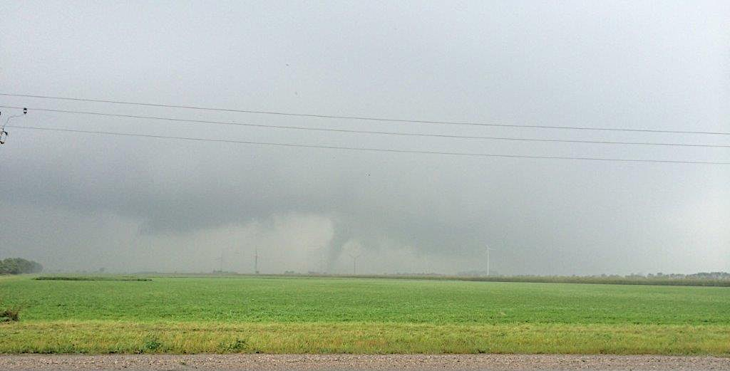
Windtell | Application Examples
Testing Mr. Smith With a Tornado
T17
T16
T18
T15
FUNNEL
Notes:
Recent tornado hit the farm.

Slide 14
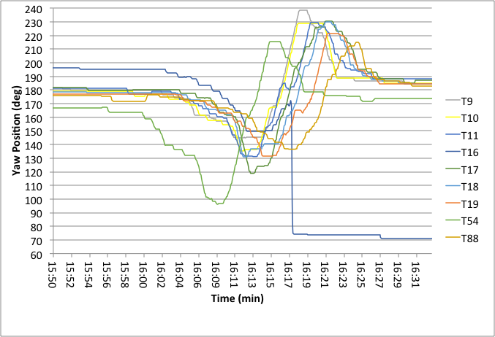
Windtell | Application Examples
Testing Mr. Smith With a Tornado
Notes:
Limited capability automated agent “located” one of tornado impacts on farm – failure of the yaw drives. Regression analysis tools utilized to spot anomaly.

Slide 15
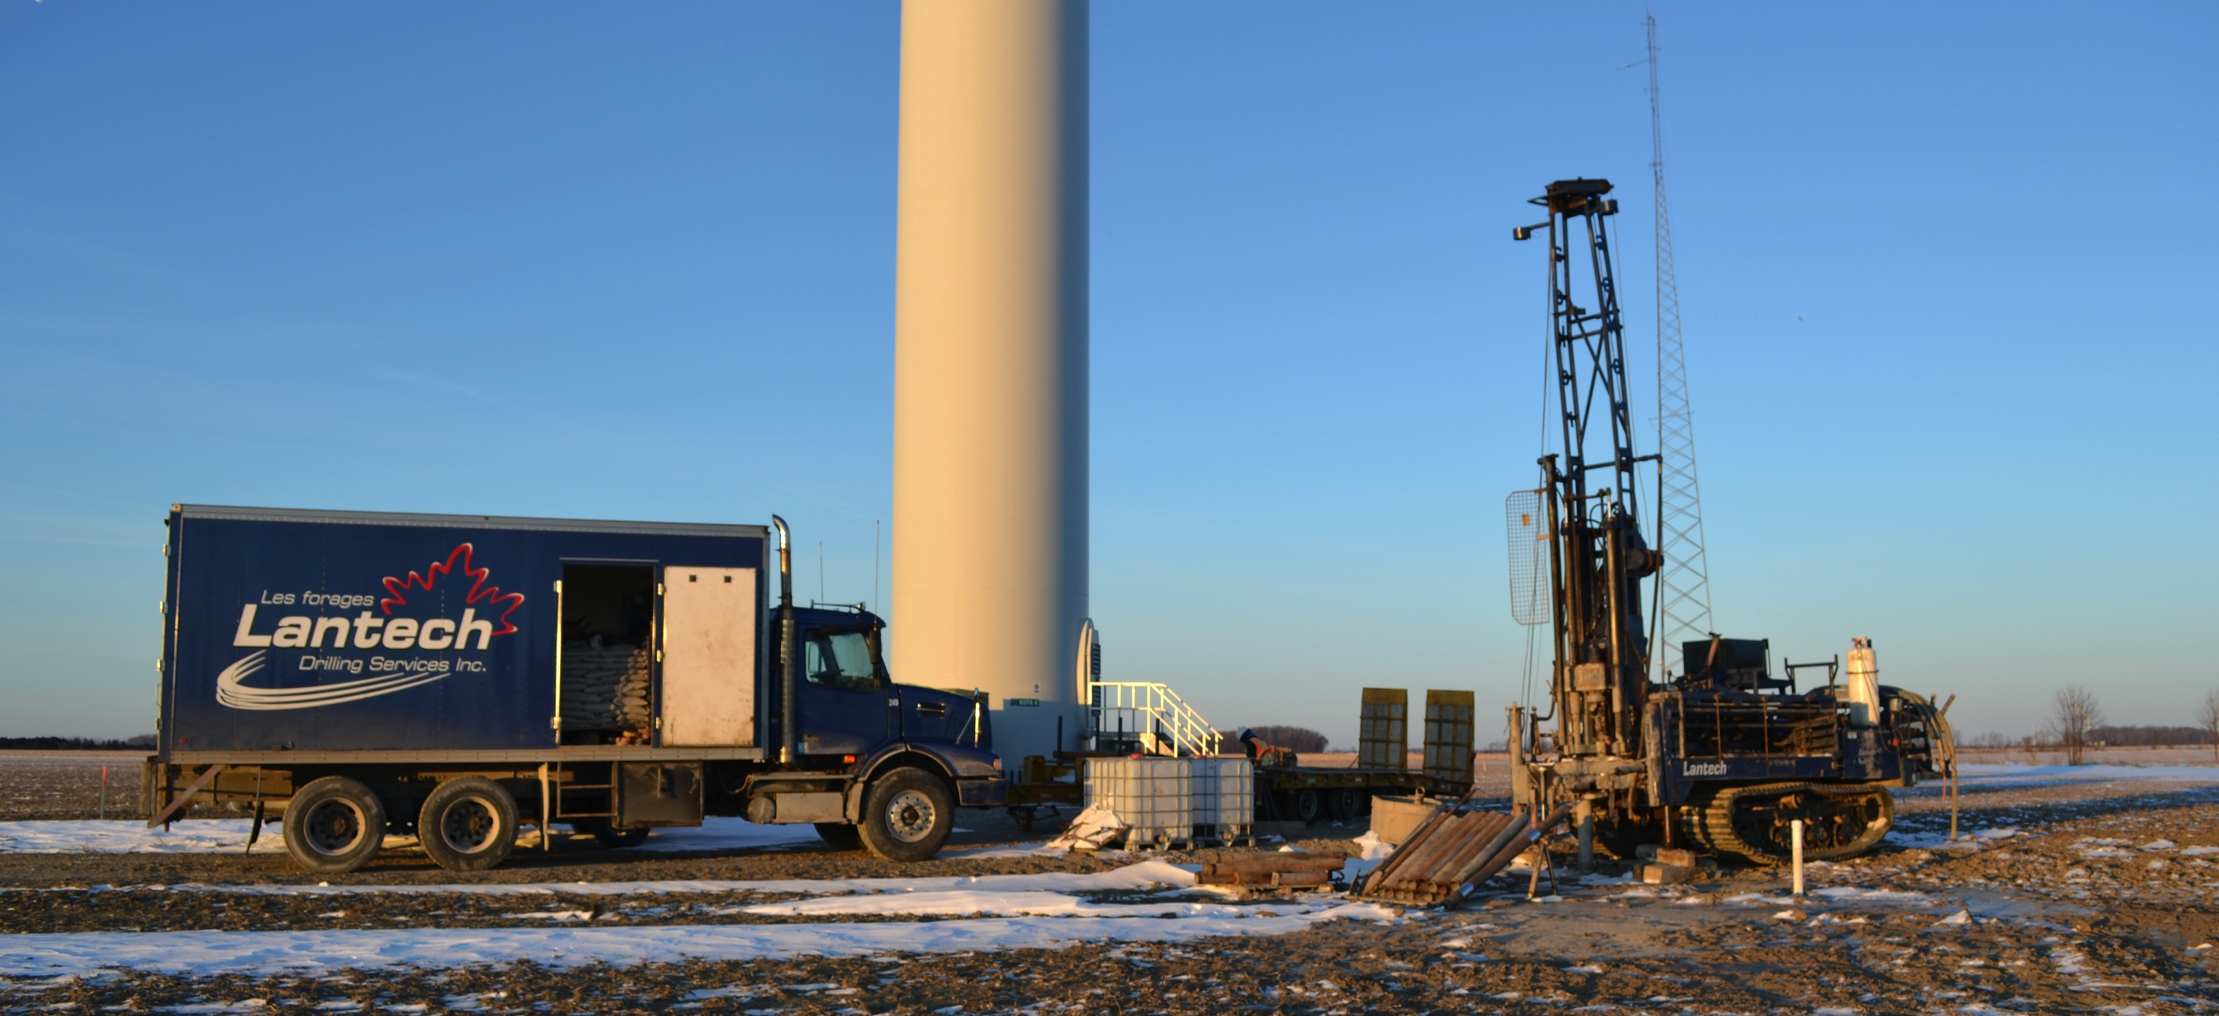

Windtell | Upcoming Application
Future Inputs
UWin-Western Geotech Install
Foundations may not be “fixed” boundary conditions as most models would have you believe.
Notes:
With Western, we are investigating the impact of the cyclic structural loading of the turbine on the foundation system (soils too). Then looking at the subsequent effect on the top side structural dynamics (from an altered foundation).

Slide 16
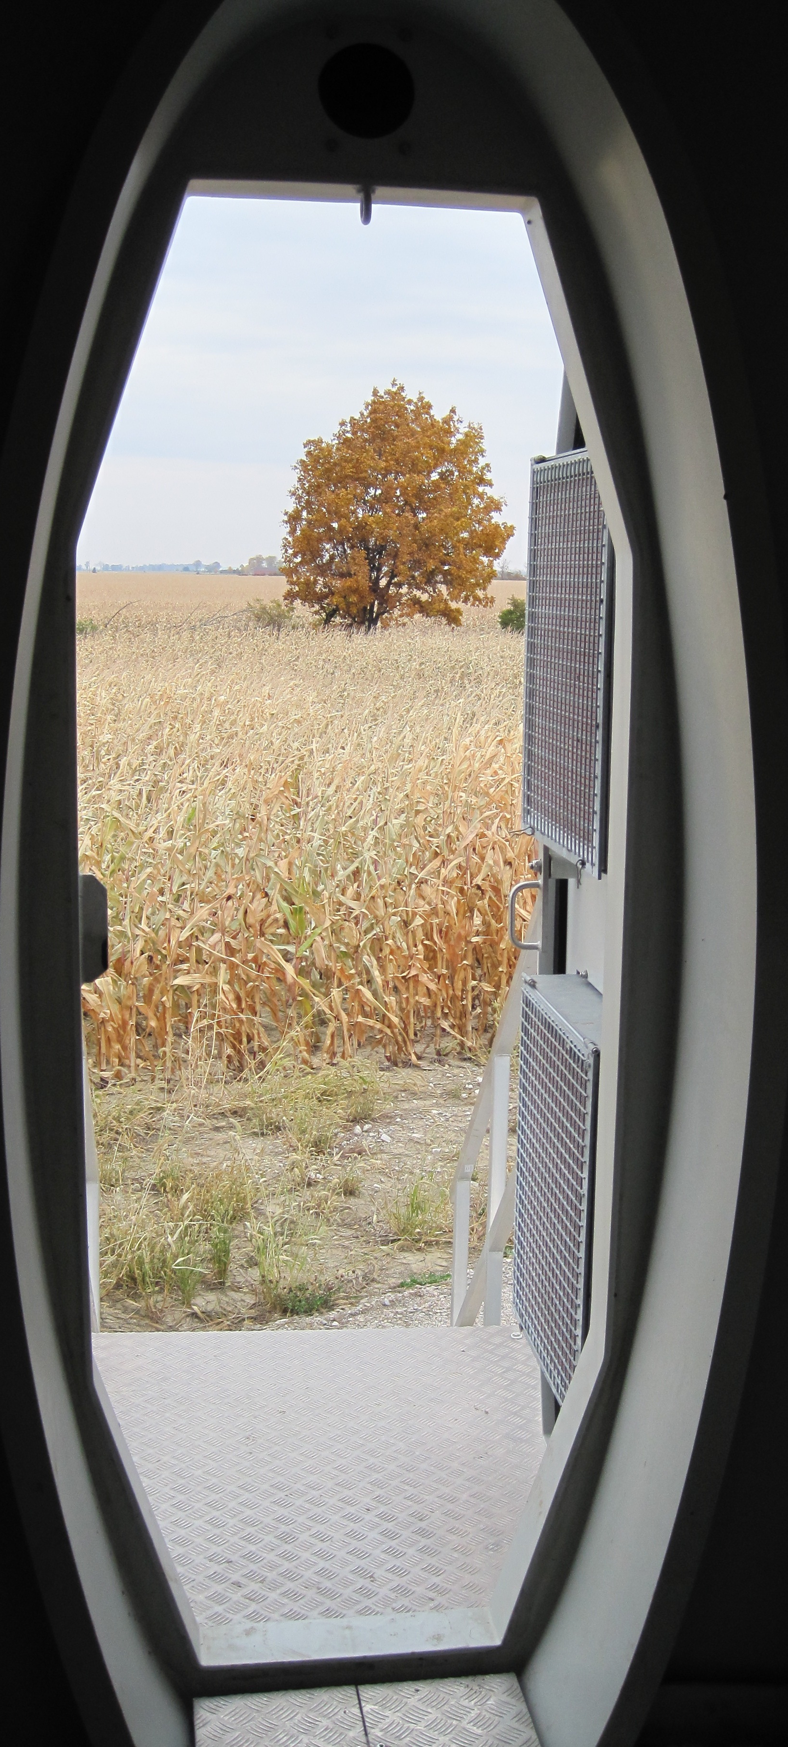
Windtell
Conclusions and Next Steps
CONCLUSIONS
The Windtell Performance Management Tool has shown promise as a potential enabler for users to make conventional and less conventional historical data analyses through its ability to incorporate previously incongruent data streams.
NEXT STEPS
Improve user interface and robustness.
Implement “real time” analysis.
Consider operation tuning control opportunities.
Report on most valuable analyses – feed back into Sandia and IEC-like efforts.
Consider recommendations to OEMs for strategic sensor embedments, smart components that map their own service life expectancy, etc.
Map service life estimation to depreciation.

Slide 17










Windtell
Acknowledgement and Appreciation
David Ting
Robert Kent
Jean Roy
Kyle Bassett
Michael Cookson
Adam Mourad
JJ Davis
Andy Jenner
Phil McKay
Paul Veers
Ning Cao
Paul Dawson
Jamie Smith
Ben Karlson
Jeff Bas
Tim Newson
Jason Stoner
Todd Baert
Scott Harper
Marianne Rogers

Slide 18
Windtelligence
References
[1] McKay, P.; Carriveau, R.; S-K Ting, D. Wake Impacts on Downstream Wind Turbine Performance and Yaw Alignment. Wind Energy, 16(2), 221-234, 2013.
[2] Smith, J.; Carriveau, R.; S-K Ting, D. Turbine Power Production Sensitivity to Coastal Sheared and Turbulent Inflows. Wind Engineering, 39(2), 183-192, 2015.
[3] Smith, J.; Carriveau, R.; S-K Ting, D. Inflow Parameter Effects on Wind Turbine Tower Cyclic Loading. Wind Engineering, 38(5), 477-488, 2014.

Slide 19

Thanks for Your Time and Attention.
Rupp Carriveau, Turbulence and Energy Laboratory
University of Windsor, Lumley Centre for Engineering Innovation

Slide 20
Windtell | Application Examples (Validation)
Structural Loading Insights [2]
Mean Base Bending Moment Comparing Turbulent and Sheared Winds [2]
Notes:
Mean base bending moments examined for “Sheared” and “Turbulent” wind cases.
Turbine is located in close proximity to meteorological tower.
Meteorological tower measurements used to categorize wind profiles into two classes:
High-turbulence, low-shear condition: Turbulent
[TI>11%, α<0.2], [very unstable to near neutral]
High-shear, low-turbulence condition: Sheared
[TI<11%, α>0.2], [very stable to stable]

