Slide 1
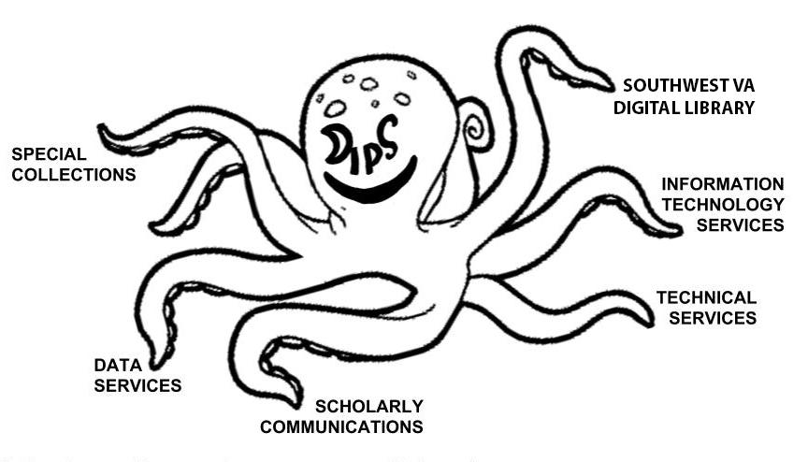
Middle-Where?
Preservation as Negotiation for Workflow Integration
Alex Kinnaman & Luke Menzies, Virginia Tech
Middle-Where?
Preservation as Negotiation for Workflow Integration
Alex Kinnaman & Luke Menzies, Virginia Tech
Abstract
Our Preservation Development Timeline
At Virginia Tech University Libraries (VTUL), our unit, Digital Imaging and Preservation Services (DI&PS), is a newly formed team whose goal is to establish a fully integrated digital curation system that encompasses data creation and digitization, long-term preservation and storage, and stable, robust access.
Any new preservation work must be built on the remnants of what has gone before, both in terms of hardware and software, and in terms of institutional structures, procedures, and people. Development of a new digital curation systems is also constricted by available funding and expertise. Our case study addresses the challenges, pitfalls, and successes of our team's efforts to produce such a system, in terms of concrete, practical workflows. In order to accomplish our goals we are working together with units from all across the library in order to enable these technologies to work together in addition to their respective library department faculty working together.
2004: VT is a founding member of MetaArchive
2014: VT joins APTrust
Nov. 2016: An analysis functional requirements for a proposed preservation system is conducted using the NDSA Levels of Preservation. Preservation Policy started.
Jan 2017: Archivematica is selected as a preservation tool
Mar 2017: First test ingest into AM
May 2017: First upload to APT
Nov. 2017: Digital Preservation Coordinator hired
Feb. 2018: Digital Preservation Technologist hired
April 2018: 2nd ingest into AM to evaluate workflow
June 2018: Confluence is launched to collect, organize, and develop relevant documentation and resources
Aug 2018: Reconfiguration of AM with two different pipelines to accommodate both of our storage destinations
Sep 2018: Preparation for the third ingest into a new AM instance; development of Preservation Profiles
Ongoing: Meeting with departments and stakeholders
Figure 1: Digital Imaging and Preservation Services
(DI&PS) partners and stakeholders
VTUL Content
VTechWorks: more than 67,000 items, over (46%) are theses and dissertations
VTechData: 905 datasets
Special Collections: 4800 digital items, 48594 in Image Base, not including grant projects
Materials digitized by VTech Digital Creation Suite: TBD! Currently 1000 items and growing
VTUL Tools
APTrust
Archivematica
Archive-It
ArchivesSpace
Bag-it
DSpace
Fedora Repository
Homegrown tools
MetaArchive
MetaArchive plugins
Preservation Profiles
VT Archive
Our Contribution
Our goal to use digital preservation as a method for integrating our University Libraries’ current workflows has several outcomes that can contribute to the digital preservation community:
A model for integrating workflows using both external tools and local infrastructure
Our preservation system is an ongoing initiative that is not limited by short-term funding or restrictive project timelines
Our Middleware
Our "middleware" comes in two forms:
software tools to fill gaps between the various departments, workflows, and larger software tools
'people-ware' in terms of negotiating, persuading, and motivating others to incorporate new tools and workflow processes

Slide 2
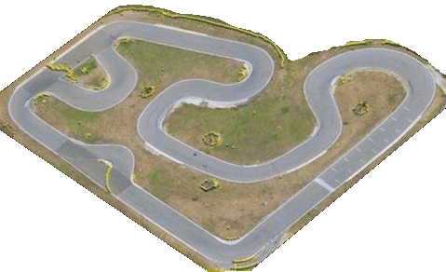
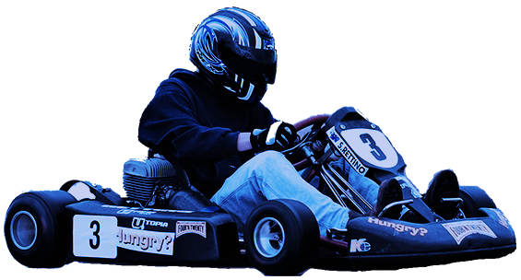
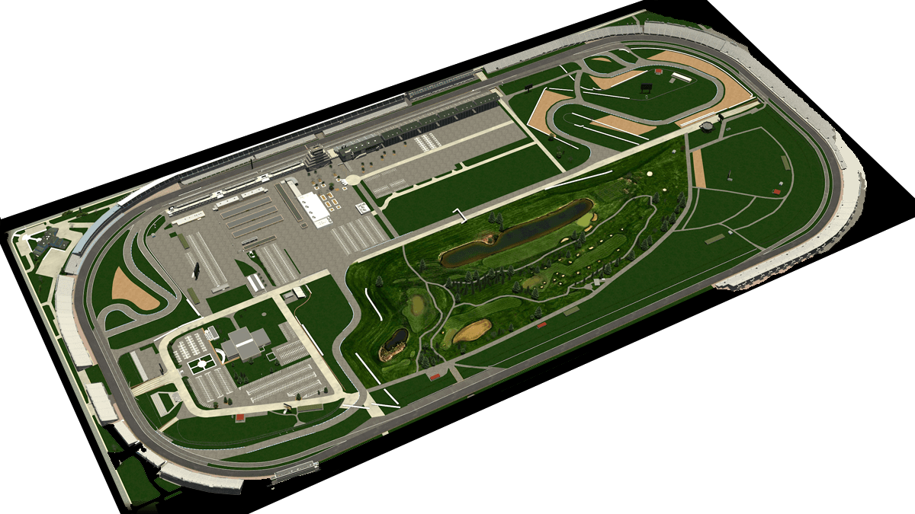
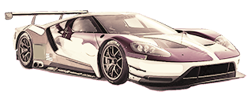
Middle-Where?
Preservation as Negotiation for Workflow Integration
Alex Kinnaman & Luke Menzies, Virginia Tech
Middle-Where?
Preservation as Negotiation for Workflow Integration
Alex Kinnaman & Luke Menzies, Virginia Tech
Challenges & Techniques
Challenges | Examples | Techniques
Pre-existing workflows, positions, and software mean that there can be reluctance to adopt new approaches or change their current workflows. | e.g. It was difficult to communicate the distance between cataloging and metadata, with the desire being to impose new metadata production workflows, distinct from long-practiced cataloging workflows. | We researched metadata standards and communicated the need for these standards to faculty and staff.
Small software tools to fill in the gaps between all-encompassing tools like Fedora, DSpace, Archivematica, and our ILS software. | e.g. We need tools that can be used by a layperson with limited experience in these specific technologies | We hired a Digital Preservation Technologist, who developed a digital object formatter tool based on community needs.
Integrating data production, preservation, metadata, and access into a single system was more than even the most inclusive tools or combinations of tools could handle. | e.g. We wanted our digital objects to have robust metadata records that could both track the object throughout the system and be updated with PREMIS event metadata, without needing to touch our AIPs. | We are working to implement an RDF triplestore metadata server. This will allow for continual updating of PREMIS event metadata, eliminate the metadata "bottleneck", and disconnect access upload and cataloging workflows.
Building trust and communicating our vision effectively to a diversity of stakeholders | e.g. Our department was relatively new, with some members hired fresh out of library school. | We consistently reach out to other departments, working laterally to build relationships and trust with stakeholders. This type of work proved to be more valuable than any technical preservation efforts.
There was no single location for unified documentation for digital curation activities in the Library. | e.g. Documentation is scattered over local machines, personal computers, VT's GitHub site, the wikis for APTrust and MetaArchive, and in the memories of particular employees. | We used Atlassian's Confluence software to build a site for comprehensive, unified documentation. It is also a tool for collaboration and communication with the departments with whom we cooperate.
We work to draw expertise from well-established library units in order to accomplish inter-departmental goals. While other library units are self-contained and specialized in their fields, DI&PS works in the interstices between these units. We aim to "fill the gaps" and integrate other library units into a comprehensive data curation system. Many of the challenges we have experienced are in communicating with our stakeholders, selecting and integrating software, and managing our workflows.
Small Go-Cart Track
vs.
Complex Motor-Speedway
As we integrate large-scale preservation services into well-established library workflows, we are working to expand from a small-scale system that only supports our department and immediate stakeholders, to building a unified digital curation system that provides services for the entire VTUL, and beyond.

Slide 3
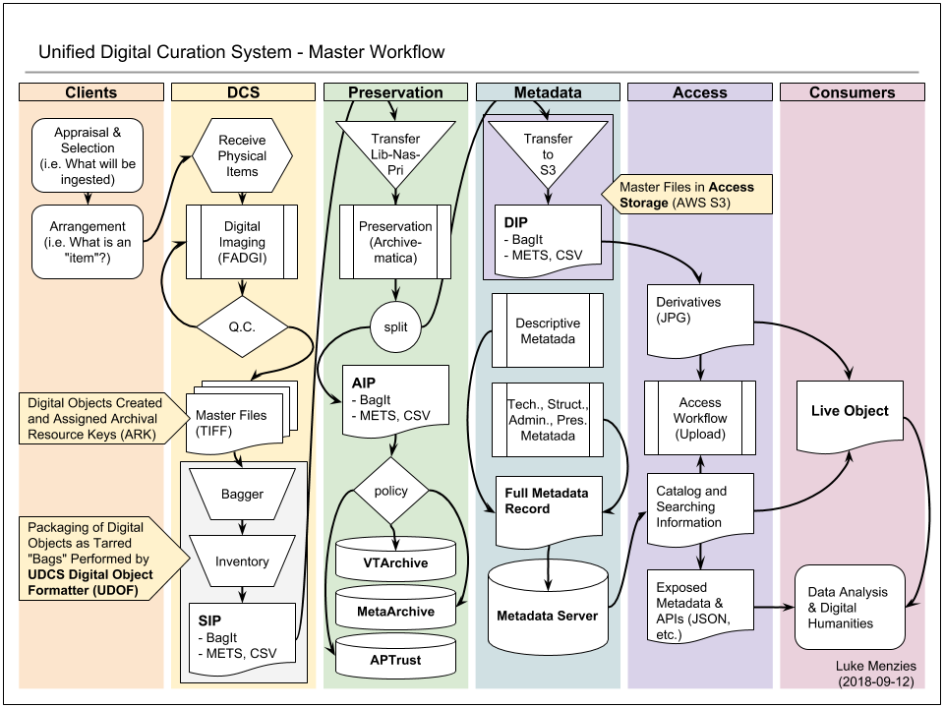
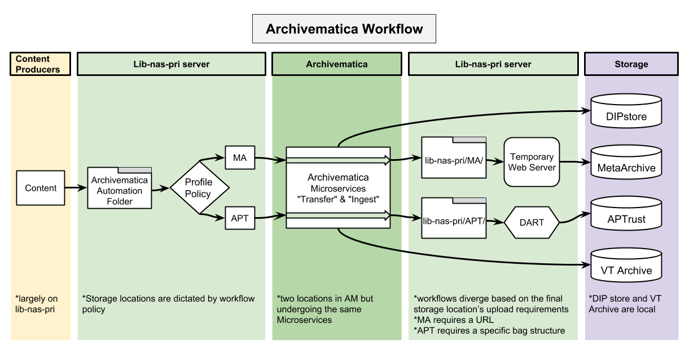
Middle-Where?
Preservation as Negotiation for Workflow Integration
Alex Kinnaman & Luke Menzies, Virginia Tech
Middle-Where?
Preservation as Negotiation for Workflow Integration
Alex Kinnaman & Luke Menzies, Virginia Tech
The Digital Curation "Motor-speedway"
Alex Kinnaman
(2018-08-10)
Figure 3: Our Archivematica Workflow
Figure 2 outlines the entire digital curation workflow beginning with clients, our Digital Creation Suite and other digitization units, digital preservation, metadata creation, and consumer access.
Figure 3 outlines the design of our Archivematica instance, which separates content based on final external storage destination but also sends all DIPS to the access platform and local storage.
Figure 2: The Unified Digital Curation System and Master Workflow

Slide 4


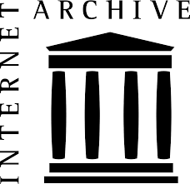

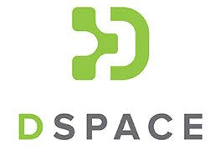


Middle-Where?
Preservation as Negotiation for Workflow Integration
Alex Kinnaman & Luke Menzies, Virginia Tech
Middle-Where?
Preservation as Negotiation for Workflow Integration
Alex Kinnaman & Luke Menzies, Virginia Tech
Middle-Where?
Preservation as Negotiation for Workflow Integration
Alex Kinnaman & Luke Menzies, Virginia Tech
Comparison
Our Techniques
Next Steps for VTUL
What other academic libraries are doing:
The University of Michigan Bentley Historical Library has created an end-to-end system integrating ArchivesSpace, Archivematica, and DSpace. This was a two-year grant-funded project.
MIT Libraries iMIT Libraries created a Digital Sustainability Lab between the Curation and Preservation Services and the Institute Archives and Special Collections Unit in order to integrate ArchivesSpace, Archivematica, BitCurator, and AtoM.
University of Houston Libraries formed the Digital Preservation Task Force to assess their current preservation and recommend new technology and develop a Preservation Policy.
Bibliothèque nationale de France conducted a study on the organizational and human resource challenges they experienced while building their preservation system.
What Virginia Tech has:
Ongoing financial support from library administration
Infrastructural support from administration and IT Services
Two digital preservation faculty members
Digital Preservation Coordinator manages the storage spaces, communicates with stakeholders, and creates and manages workflows and documentation
Digital Preservation Technologist researches and develops tools and communicates with IT Services
A desire from fellow faculty to have a unified curation system
Support from IT to establish and update new technology
Two geographically distributed preservation storage services (APTrust and MetaArchive) and one local storage system
Ultimately we want people in our library to work together to preserve our content. We want established workflows to plug-in to the preservation system efficiently without adding more work for our colleagues. Steps taken thus far include the following:
Archivematica workflow:
Two “inboxes” for each storage destination
Two pipelines to keep content separate
Two DIP folders for final content prep and upload to either storage service
Collaboration: manage workflow documentation and collaboration with other departments, using Confluence software
Consortia Participation: adapt internal workflows to automate upload to APTrust and MetaArchive; engage fully with these services
Documentation: establish and upgrade formal Digital Preservation Policy; build trust by informing stakeholders and providing accountability
Preservation Profiles: evaluate content for preservation needs and prioritize collections objectively
Tools Development: connect the component software, platforms, storage locations, and technical infrastructure that supports the unified digital curation system
Outreach: communicate with colleagues and VTech faculty to understand preservation needs and obtain feedback
Workflow Integration: collaborate with digital imaging teams to establish governance and impose high standards for metadata
Web Archiving: enhance the metadata, scope, and usability of our web archive
Short-term
Continue evaluating our preservation system and making improvements
Develop additional policy on transparency and succession
Establish a triplestore database and metadata server
Expanding our digital preservation program to legacy collections
Enhance our web archiving program
Long-term
Developing workflows for new content types, such as 3-D objects, and complex digital objects such as software preservation and videogames, and other born-digital ephemera (Tweet archives)
Conduct an internal audit of our three repositories with the goal of having our results peer-reviewed
Continue outreach

Slide 5
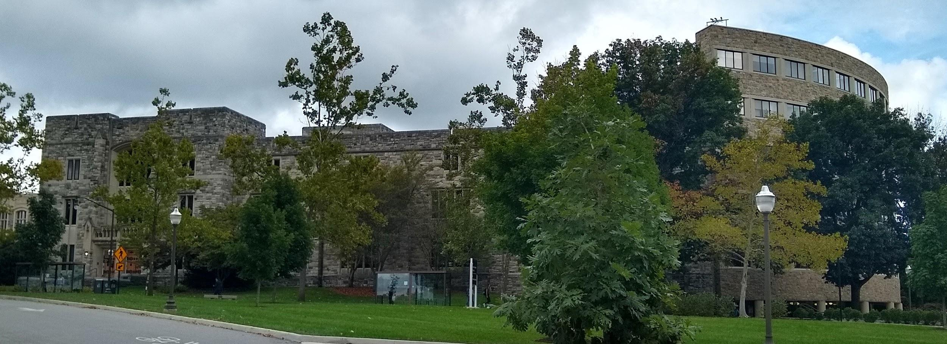
Middle-Where?
Preservation as Negotiation for Workflow Integration
Alex Kinnaman & Luke Menzies, Virginia Tech
Middle-Where?
Preservation as Negotiation for Workflow Integration
Alex Kinnaman & Luke Menzies, Virginia Tech
References
Contact
Artefactual. (2018) Archivematica documentation 1.7.2. Archivematica. Retrieved from https://www.archivematica.org/en/docs/archivematica-1.7/
Bantin, P., Ed. (2016). Building trustworthy digital repositories. London: Rowman & Littlefield.
Bermes, E. and Fauduet, L. (2009). The human face of digital preservation: Organizational staff and challenges, and initiatives at the Bibliotheque national de France. iPRES 2009. Retrieved from https://pdfs.semanticscholar.org/1355/f7e198cd3173c48e1382c668ee5b8c0c67a2.pdf
Consultative Committee for Space Data Systems. (2011). Audit and certification of trustworthy digital repositories: Recommended practice. CCSDS 650.0-M-1. Magenta Book.
Consultative Committee for Space Data Systems. (2012). Reference model for an open archival information system (OAIS). CCSDS 650.0-M-2. Magenta Book.
Digital Imaging & Preservation Services. (2018). Digital Imaging & Preservation Services Home. Retrieved from https://webapps.es.vt.edu/confluence/display/DIPS/Digital+Imaging+and+Preservation+Services+Home
Eckard, M. And Pillen, D. (2017). Case study: Streamlining digital archiving workflows at the Bentley Historical Library. Journal of Digital Media Management. Vol 6, 1-13. Retrieved from https://deepblue.lib.umich.edu/bitstream/handle/2027.42/139043/Eckard-Pillen_JDMM_v6n1_Streamlining-Digital-Archiving-Workflows.pdf
Erickson, C. (2013). Lessons Learned: Implementing Rosetta in the Harold B. Lee Library. Harold B. Lee Library. PowerPoint slides. Retrieved from https://sites.lib.byu.edu/digitalpreservation/wp-content/uploads/sites/21/2012/04/Erickson_ELUNA_2013.pdf
Ghering, C. (2016). Implementation: Ingest process: Michigan State University's digital archives program. In Building trustworthy digital repositories. P. C. Bantin (Ed.). London: Rowman & Littlefield.
Glick, K. and Wilczek, E. (2006). Ingest guide for university electronic records. Version 3.1. Retrieved March 3, 2018, from http://dca.lib.tufts.edu/features/nhprc/reports/3_1_draftpublic2.pdf
Harvey, R. (2010). Digital curation. A how-to-do-it-manual. New York: Neal-Schuman Publishers, Inc.
Lyle, J. (2016). Implementation: Ingest process: Submission and "pre-ingest" activities. In Building trustworthy digital repositories. P. C. Bantin (Ed.). London: Rowman & Littlefield.
Research Libraries Group. (2002). Trusted digital repositories: Attributes and responsibilities. Mountain View, CA. Retrieved March 3, 2018, from https://www.oclc.org/content/dam/research/activities/trustedrep/repositories.pdf
Rosenthal, D., Robertson, T., Lipkis, T., Reich, V., Morabito, S. (2005). Requirements for digital preservation systems: A bottom-up approach. Stanford University Libraries. Stanford, CA. Retrieved January 30, 2018, from https://archive.org/details/arxiv-cs0509018
Schmidt, L. (2016). Theory: Ingest process. In Building trustworthy digital repositories. P. C. Bantin (Ed.). London: Rowman & Littlefield.
Schumacher, J., Thomas, L., VandeCreek, D., Erdman, S., Hancks, J., Haykal, A., ..., Spalenka, D. (2014). From theory to action: "Good enough" digital preservation solutions for under-resourced cultural heritage institutions. A digital POWRR white paper for the IMLS. Retrieved January 30, 2018, from http://commons.lib.niu.edu/bitstream/handle/10843/13610/FromTheoryToAction_POWRR_WhitePaper.pdf;sequence=1
Smith, K. (2013). Integrating tools into our process and workflows. Engineering the Future of the Past. MIT Libraries. Blog post. Retrieved from https://libraries.mit.edu/digital-archives/integrating-tools/
Thompson, S., Wu, A., Krewer, D., Manning, M., and Spragg, R. (2015). Preserving the fruit of our labor: Establishing digital preservation policies and strategies at the University of Houston Libraries. iPRES 2015. Retrieved from https://fedora.phaidra.univie.ac.at/fedora/get/o:429562/bdef:Content/get
University of Houston Libraries Digital Preservation Task Force. 2015. University of Houston Libraries Digital Preservation Policy. University of Houston Libraries. Retrieved from http://info.lib.uh.edu/sites/default/files/docs/DigPresPolForWeb20150917.pdf
Waugh, A. (2007). The design and implementation of an ingest function to a digital archive. D-Lib Magazine, 13(11/12), n.p. Retrieved September 14, 2017, from http://www.dlib.org/dlib/november07/waugh/11waugh.html
Alex Kinnaman, Digital Preservation Coordinator
Digital Imaging & Preservation Services (DI&PS)
University Libraries | Research & Informatics
alexk93@vt.edu
Luke Menzies, Digital Preservation Technologist
Digital Imaging & Preservation Services (DI&PS)
University Libraries | Research & Informatics
limen@vt.edu

