Slide 1


Preservation and Curation of
ETD Research Data
and
Complex Digital Objects
Notes:
What is an ETD, ultimately?
Training ground for new scholars/researchers
Need to make sure the ETD prepares them for a career
Evidence record is key to all research.

Slide 2
Workshop Schedule
09:00-09:15 am Welcome
09:15-09:45 am Interactive Overview
09:45-10:30 am Guidance Briefs
10:30-10:45 am Break
10:45-11:20 am Storage Guidance Brief
11:20-11:45 am Curation Tools Demo
11:45-12:00 pm Wrap up
Notes:
Lots of territory to cover in the next xx minutes…I will move fast!

Slide 3
Welcome and Workshop Background
Instructors
Curriculum
  ETDplus project (IMLS, 2014-17)
Notes:
ETD Project
Colleges and universities and the programs responsible for managing the submission, archiving, and dissemination of electronic theses & dissertations (ETDs) increasingly are concerned about administering and making available the research datasets and complex digital objects (multimedia files, software, etc.) that often accompany these scholarly works. These assets represent a rich source of information that can help to substantiate the dissertation and provide assurance that the foundation for replicable research is available for future researchers. These datasets and complex digital objects are also of great value and interest to libraries seeking to advance their missions in the digital age.
ETD datasets and complex digital objects however, do pose curation and preservation challenges for institutions in terms of the viability of formats, file sizes, accessibility rights, dissemination pathways, and change-management issues. Recent reports, workshop evaluations, projects, surveys, and focus groups have indicated that U.S. colleges, universities and ETD/IR programs of all sizes are requesting and in need of generalized yet adaptable guidance documentation, shared curation technologies, and corresponding training materials to bridge the preservation and curation gap for these valued scholarly assets.

Slide 4
Learning Objectives
Learn about emerging methods to support students’ digital object management

Slide 5
Learning Objectives
Practice using an prototype tool
designed to support student
ETD supplementary materials submission

Slide 6
Learning Objectives
Understand how to begin working to improve current ETD programs based on expanding lifecycle management practices for ETDs

Slide 7
Exercise
On the stickies provided, please answer the following question:
What content types does your institution’s ETD program currently accept? (one type per YELLOW sticky note)
Notes:
Cluster the answers on the wall or on a white board—have attendees group them and look at the range of file types. How many just accept PDFs for ETDs? How many accept video/audio? Data? How many don’t know WHAT they accept?
Host a discussion about how their programs define the types of files they accept.
15 minutes total (4 min to write, 3 to group, 8 to discuss. TIME THESE STEPS SO YOU DON’T GO OVER TIME!!)

Slide 8
Exercise
On the stickies provided, please answer the following question:
What content types does your institution’s digital preservation program currently support? (one type per BLUE sticky note)
Notes:
Cluster the answers on the wall or on a white board—have attendees group them and look at the range of file types. How many don’t know? How many have no program? How many accept everything and preserve everything?
Discuss the implications of different approaches—and what it means for ETD programs that don’t have digital preservation support.
15 minutes total (4 min to write, 3 to group, 8 to discuss. TIME THESE STEPS SO YOU DON’T GO OVER TIME!!)

Slide 9
ETDplus Team:
Educopia Institute
MetaArchive Cooperative
NDLTD
ProQuest
Carnegie Mellon University
Colorado State University
HBCU Library Alliance
Indiana State University
Oregon State University
Penn State University
Purdue University
University of Louisville
UNC School of Library and
Information Science
University of North Texas
University of Tennessee
Knoxville
Virginia Tech University

Slide 10

Guidance Briefs

Slide 11
Guidance Briefs - Foundation
What do students need to know about digital content management in relation to their research outputs?
Notes:
Copyright, Data Structures, Format, Metadata, Storage, Version Control

Slide 12
Guidance Briefs - Foundation
How might the ETD—as a common rite of passage in research careers—be used to help students learn how to structure, share, and manage their digital content appropriately?
Notes:
Copyright, Data Organization, File Formats, Metadata, Storage, Version Control

Slide 13
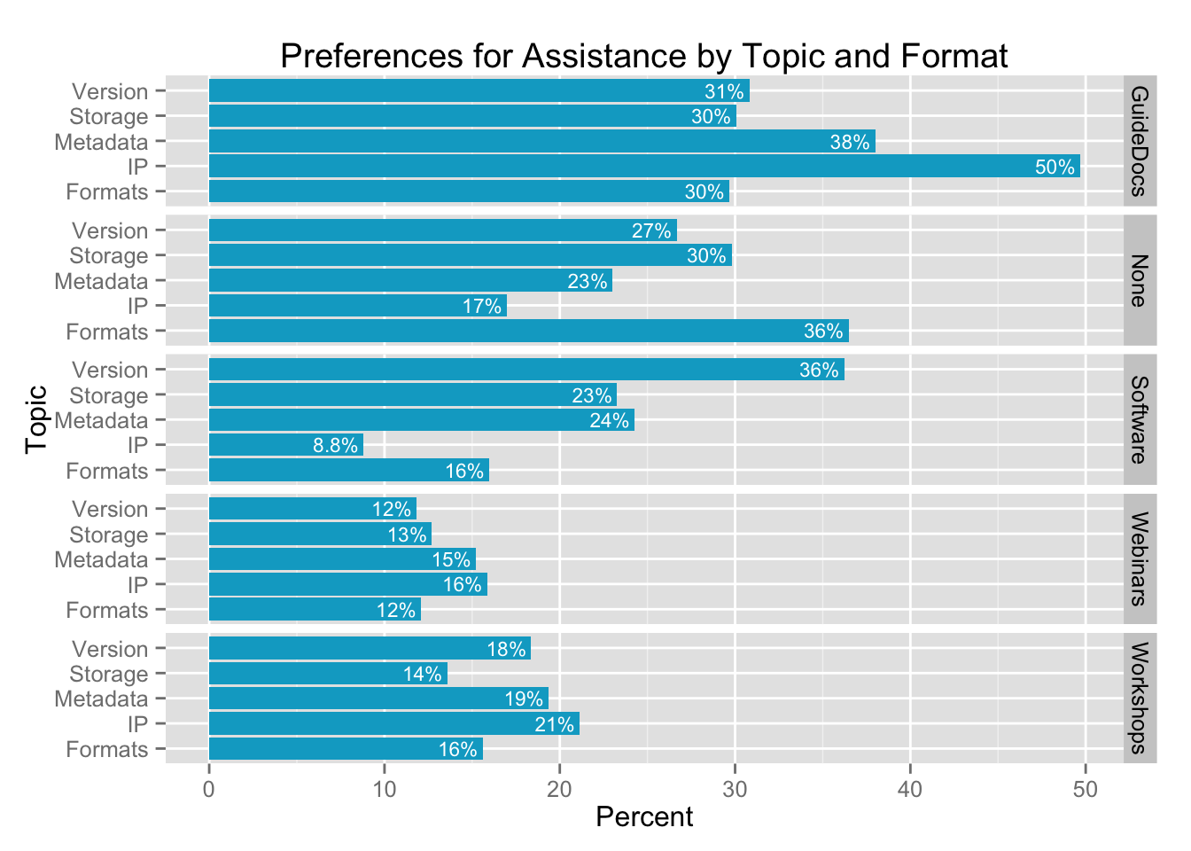
Notes:
Creation of guidance briefs was informed by a needs analysis run at 8 institutions. We surveyed nearly 800 students and more than 50 staff members. This slide shows results of the student responses re: what they want to have.
Note they are not keen on webinars or workshops. Guidance docs were far and away the most popular pick for students. We focused our energy on these documents and then built workshop materials around those documents. The documents do not depend upon the workshops; students can use either and/or both to learn a range of important digital curation options and operations.

Slide 14
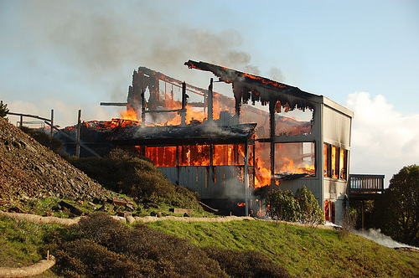
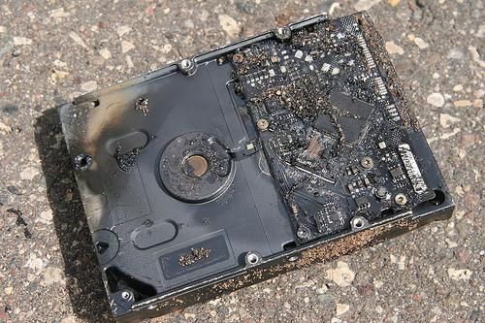
Understanding Digital Loss (DataONE)
Natural disaster
Facilities infrastructure failure
Storage failure
Server hardware/software failure
Application software failure
External dependencies (e.g. PKI failure)
Format obsolescence
Legal encumbrance
Human error
Malicious attack by human or automated agents
Loss of staffing competencies
Loss of institutional commitment
Loss of financial stability
Changes in user expectations and requirements
CC image by momboleum on Flickr
CC image by Sharyn Morrow on Flickr
SOURCE: DataONE Education Module: Data Management. DataONE.
Retrieved June 30, 2016. From http://www.dataone.org/sites/all/documents/L01_DataManagement.pptx
Notes:
So why do we care about telling students about digital curation?
The costs of not doing data management can be very high!

Slide 15
https://educopia.org/deliverables/etdplus-guidance-briefs

Slide 16
Example
Source - Guidance Briefs: Managing Your ETD Research Files

Slide 17

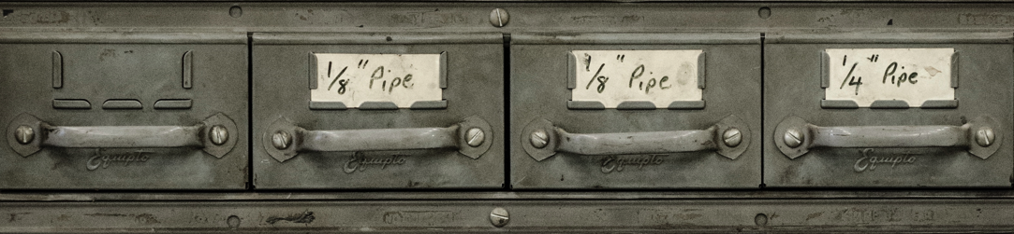
Storage
Basic recommendations:
Maintain at least one local (i.e., non-cloud-based) copy of your content
Maintain at least three separate complete copies of your research content
Maintain at least one copy in a different geographic location
Maintain a history of changes in at least one location (e.g., using a “Time Capsule” software package to automatically back up your content without deleting older copies)
Document in a text file how, when, and where you store and back up your materials
Systematize your folder- and file-name conventions using human-identifiable information
Use naming conventions to mark versions of files, e.g., using consecutive numbers to track a file through all edits and revisions that take place to it. (e.g., filename-v12.txt)
Make sure your filenames are followed by the correct file extension (e.g., .txt, .csv)
Avoid using special characters in all file and folder names (e.g., \?:*?<>{}[]&$,;.!)
Document the formats you are managing and the potential sustainability issues
Save a copy of your research files in non proprietary formats, so that you don’t need a software license to render and use them.
Back-up: A copy of your digital content,
ideally stored in a different location
from the original, usually made to
prevent data loss.
Preservation: The “series of managed
activities necessary to ensure continued
access to digital materials for as long as
necessary”. –Digital Preservation Coalition
Where and how you choose to store
your research materials and writings
will determine how long they survive.
To mitigate against loss, make your
own back-ups on a regular, formalized
schedule (e.g. daily or weekly).
Threats to storage environments:
-Natural disaster
-Human error
-Human malice
-Drive failure
-Format obsolescence
-Media obsolescence
-Bit rot
-Business failure
-Software or hardware error
Advanced recommendations:
Produce and maintain an inventory of all of your content, documenting file names, sizes, locations, and types
Create and regularly check “checksums” or
digital signatures for your most important
research files. Checksums can be generated
by several open source tools and utilities and
they can be stored in your inventory.
Monitor your content to ensure missing, moved, and renamed files are automatically brought to your attention. A tool like “Fixity” can scan specified folders or directories on a regular basis and report changes to you via email.
Resources
For “back-up” advice, see Jesus Vigo,
Best Practices to Back up Your Data
For more on cloud-based backups, please see Charles Beagrie Ltd. How Cloud Storage can address the need of public archives in the UK
For general information, see also Personal Digital Archiving
Source - Guidance Briefs: Managing Your ETD Research Files

Slide 18

Copyright
US Copyright is a legal tool authors and
creators use to signal what other people
can – or cannot – do with their works.
Public Domain: Works are in the public
domain once a defined period of copyright
protection has lapsed, at which point they
are no longer governed by copyright and can
be freely used by anyone.
If you are using a work that is within copyright,
but meets certain “fair use” criteria, courts
have found that no formal permission is needed.
The criteria that are taken into account include
the purpose (e.g., educational and research uses
favor fair use while commercial uses do not); the
type (e.g., factual or nonfiction-based information
may favor fair use; highly creative work likely will
not); the amount (e.g., small quantities vs. a
significant portion of the original work); and the
effect (e.g., no negative impact on the copyright
holder). http://copyright.gov/circs/circ01.pdf
Giving credit is no substitute for asking permission!
Creative Commons (recommended)
-CC0: a waiver (no license)
-CC-BY: attribution
-CC-BY-ND attribution, no derivatives
-CC-BY-NC: attribution, non-commercial
-CC-BY-SA: attribution, share alike
More: https://creativecommons.org/
Resources
NCA “Best Practices in Fair Use in Scholarly Research” https://www.natcom.org/fair_use.aspx
CAA “Code of Best Practices in Fair Use for the Visual Arts” http://www.collegeart.org/pdf/fair-use/best-practices-fair-use-visual-arts.pdf
Cornell University “Fair Use Checklist” http://copyright.cornell.edu/policies/docs/Fair_Use_Checklist.pdf
What can copyright protect?
literary works
musical works, including accompanying words
dramatic works, including accompanying music
pantomimes and choreographic works
pictorial, graphic, and sculptural works
motion pictures and other audiovisual works
sound recordings
architectural works
What about my copyright?
Copyright for a work you author automatically belongs
to you. However, copyright may not extend to research outputs you produce as part of your thesis or dissertation. For example, data is only thinly protected by copyright; specifically designating a CC license to accompany datasets (e.g., CC0) is a good approach for simultaneously sharing and protecting these outputs.
Source - Guidance Briefs: Managing Your ETD Research Files

Slide 19

Data Organization
Whether your data is organized in lists,
arrays, hash sets, dictionaries, queues,
trees, heaps, or relational databases, it is
important to be aware of disciplinary norms,
as well as both institutional and funder
requirements, that will make its deposit,
storage, and long-term support more likely. Increasingly, the path for long-term support
involves taking steps to make sure your data
is deposited alongside data collected by
others in your field or discipline.
Questions to consider for any data project:
What are the data organization standards for your field?
What are the data export options for your software?
What forms of the data will be needed for future access?
The DataONE Best Practices database provides individuals with recommendations on how to effectively work with their data through all stages of the data lifecycle. https://www.dataone.org/best-practices
Structuring your data well enables you to:
-Reproduce results
-Reuse it in the future
-Share it with others
-Gain and retain credibility
-Comply with IRB/funder requirements
The decisions you make about how you
organize and structure your data today
will have implications for how you and
others can access and make use (or
sense!) of that data in the future.
Context and Data Documentation:
Include the following in a readme text file:
The data’s purpose
A list of the files in your data package
Data dictionary listing and describing
all variables
Data Organization Principles:
Use one variable per column
Make one observation per row
Use human-readable column name
Include one table per tab
Include an ID or key to indicate any
relationship between tables
Do:
-Consider what your NULL values are and
how they are represented
-Consider whether a more robust data
dictionary is required
-Use standard data representation (e.g.,
(YYYYMMDD for dates)
Do Not:
-Use formatting to convey information
-Place comments in cells
-Use special characters in field names
-Use blank spaces or symbols in column
names
Discipline-based data repository examples:
-Social Sciences: ICPSR
-Genomics: GenBank
-Earth Sciences: NASA’s Earthdata
-Archaeology: tDAR
-Oceanography: NODC
-BioSciences: Dryad
Source - Guidance Briefs: Managing Your ETD Research Files

Slide 20
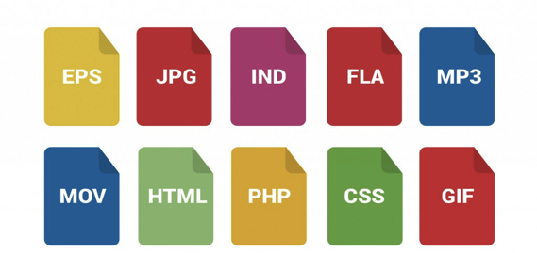
File Formats
How to select file formats:
-Use software that imports and exports data in
common formats.
-Ask advisors and colleagues what formats they
use.
-Choose a format with functions that support
your research needs.
-Save final versions of your content in multiple
formats in order to spread your risk across
multiple software platforms (e.g., docx, pdf, and
txt; or mp4, avi, and mpg).
There is no perfect file format. Each will
have advantages and disadvantages
depending on your research uses. Select a
file format, or set of file formats, that helps
you complete your research now, and that
you can access again in the future. This is
important both for your research outputs
(what you create) and your research inputs
(materials you use in the research process).
Common file types include:
-Images: jpg, gif, tiff, png, ai, svg, ...
-Video: mpeg, m2tvs, flv, dv, ...
-GIS: kml, dxf, shp, tiff, ...
-CAD: dxf, dwg, pdf, …
-Data: csv, mdf, fp, spv, xlx, tsv, ...
-Text: txt, rtf, tvi, doc, pdf…
Consider what might happen if you can no
longer use your software. Whether the
software publisher goes bankrupt, the
latest version refuses to read older data,
or you can’t afford a personal license for it
after you graduate, the end result is the
same. Losing access to your software can
mean losing your data, especially if it is the
only software that can read your data.
Many ETD programs favor pdf files. If you
export your research outputs to pdf, make
sure you:
Embed your fonts
Embed (and test!) hyperlinks
Stabilize your web-based resources and citations (using a tool like Robust Links, Archive-It, or PermaCC)
Store supplementary materials as separate files
Verify the PDF/A compliance (use Acrobat Pro “Preflight” feature under “Edit)
Before you undertake any conversion, you need to identify what characteristics of your data are important to maintain during the conversion. For example, are the colors in a document or image important? Is the pagination essential? What about references? You will want to test these after your conversion is complete to ensure that you have a conversion that will meet your needs.
Additional Resources:
-List of File Formats (Wikipedia)
-Recommended Formats Statement (Library
of Congress)
-Evaluating Your File Formats (UK National
Archives)
-Reformatting Guides (US National Archives)
If you use website-based materials as evidence or references, take precautions to ensure that if the content moves, changes, or disappears, you still have evidence of its existence. Current tools to help you ensure the longevity of these materials include Robust Links and Archive-It. You can also take screenshots of important digital content in order to preserve the look and feel of an object.
Source - Guidance Briefs: Managing Your ETD Research Files

Slide 21
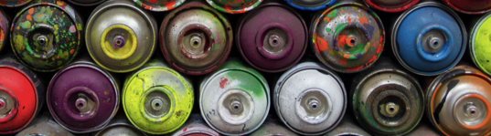
Metadata
ETD metadata tips:
Your abstract needs a clear description and keywords relevant to your work.
Be careful with over-reliance on
spell-check functions. For example,
Microsoft Office does not spell-
check capital letters, which can
impact titles.
Create keywords that are not in
your title. This will increase the
discoverability of your work.
Define any acronyms you use
(repeat them in both letters and
in natural language).
Proofread all of your metadata,
including department name and
advisor name, prior to submission.
Typical metadata requested about a pdf during the ETD submission process:
Most ETD submission processes do not collect metadata about the additional files you may submit (e.g., datasets, audio or video files, image files, GIS files, CAD files, software code, etc.). To help make sure that you and your readers will be able to understand what these additional files are and how they may be referenced, used, or built upon, you can develop a simple spreadsheet-based inventory of these items. This inventory should clearly identify how many additional files you are including, what they are, who created them, and what rights and licensing information they are governed by. Submit this inventory spreadsheet as part of your ETD package.
Metadata describes and documents
research, data, and publications. More
simply, it is information that is created
and stored alongside content (such as a
thesis or dissertation) in order to help
users find and understand that content.
The quality of the metadata you provide
is key to ensuring the future accessibility
and usability of your work.
For every research file you create, you
should also produce metadata describing:
-Who created the content?
-What is it?
-When and Where was it created?
-How and Why was it developed?
Why might you need metadata?
if your research produces images, audio,
video, software, datasets, or other non-text
components, these may not be encom-
passed within the metadata collected during
the submission process. In order to make
sure these files are discoverable and usable
in the future, you will need to actively create
metadata and store it with the files.
Title Author/Creator Advisor Resource Type Date Language | Description/Abstract Subject Identifier Degree Information Rights management information
A file without metadata is like a can with
no label - impossible to understand with-
out opening it (and perhaps even then!)
Source - Guidance Briefs: Managing Your ETD Research Files

Slide 22
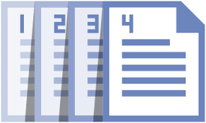
Version Control
Software-Assisted Version Control
There are also software tools that can
help you version your content. These
tools store your content in such a way
that they can remember its state from
revision to revision. Usually, they also
allow you to “check in” and “check out”
your content, ensuring that revisions
never happen simultaneously in two
different locations (e.g., if collaborating
researchers both attempt to revise the
same file at the same time, or a researcher
unwittingly tries to revise the same file on
two different machines). Key differences
between these software-assisted methods
and the manual methods include:
You can only view and edit the
working version of a file
When you change a file, you can
save a revision and attach a short
summary of your changes.
Research is active and iterative. You
will edit and re-edit your research
materials many times before finishing
your thesis or dissertation. How will
you know that you are working with the
most current revision of your materials?
Version Control: The process of managing
changes to your files over time (aka,
revision control or source control)
Manual Version Control
A simple method to store the current
revision is at the end of the file name. This
way, files can be grouped by their names
and sorted by version number:
•filename-v01.jpg
•filename-v02.jpg
•…
You can also use dates to designate version
numbers, using year-month-day (20150930)
to help your computer sort versions in
chronological order:
•filename-20160402.jpg
•filename-20160407.jpg
•…
If the files you are using are created or
edited collaboratively, incorporate names or
initials so you know who updated which
version:
•filename-20160402-KES.jpg
•filename-20160407-WTC.jpg
•…
Resources (For more information)
The digital humanities center MATRIX (Michigan State University) provides advice on how to structure file names based on oral history projects that is broadly applicable: http://ohda.matrix.msu.edu/2012/08/file-naming-in-the-digital-age
Udacity offers a free online course on how to use Git and GitHub with interactive exercises to familiarize you with using the tools.
https://www.udacity.com/course/how-to-use-git-and-github--ud775
Another helpful GitHub guide is available from Hello World. https://guides.github.com/activities/hello-world/
The Subversion community provides free access to the book Version Control with Subversion: http://svnbook.red-bean.com/
Source - Guidance Briefs: Managing Your ETD Research Files

Slide 23
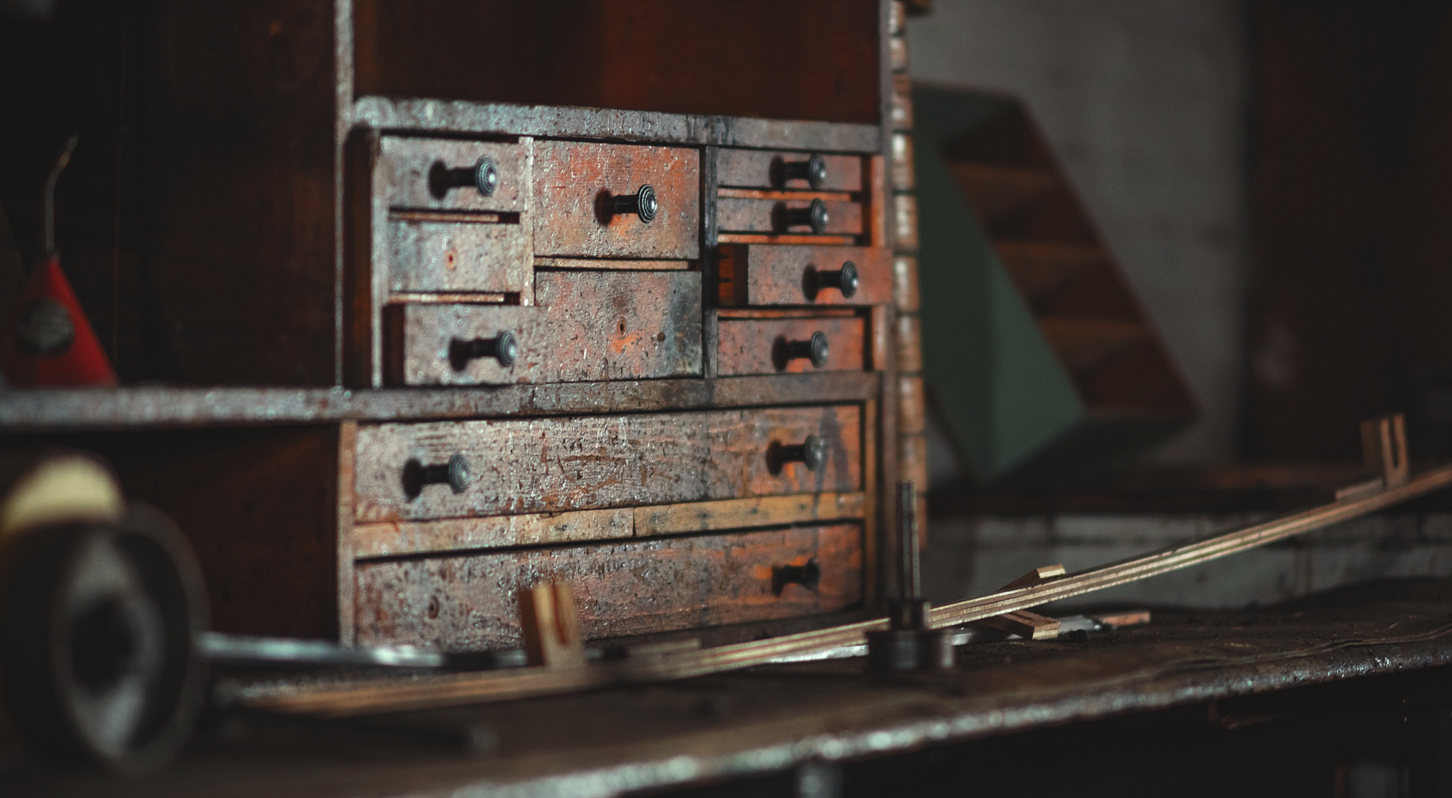
ETDplus Curation Workbench
Source: Eric Parks, Unsplash: https://unsplash.com/photos/InbWYO6Bvw4
Notes:
Config file
https://github.com/EducopiaInstitute/etdplus/blob/master/config/initializers/etdplus.rb

Slide 24
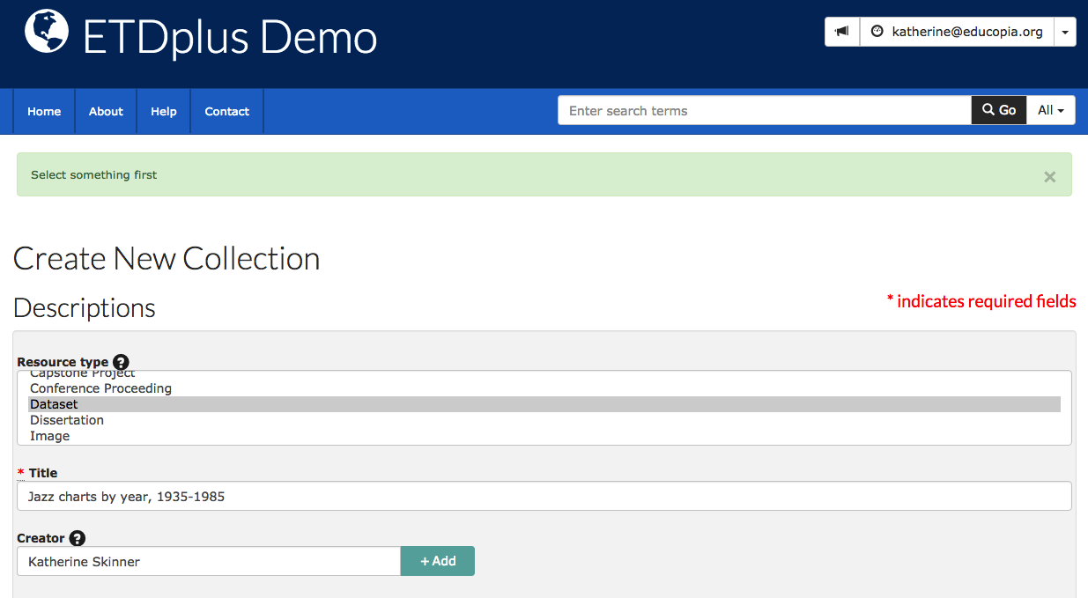
Open Guides, Tools, Training
Notes:
Deliverable 2: ETD Curation Workbench.
Web-based tool that is designed to assist students in preparing and packaging ETD supplementary materials for long-term preservation and access. The Curation Workbench includes configurable functions and features that integrate basic preservation actions such as virus scans, integrity checks, file format identification and validation, personally identifiable information scans, and metadata and versioning support into a simple data upload and review workflow. The tool also packages uploaded data and metadata as “Bags” that users can download and ingest into an array of repository and storage environments.

Slide 25
etdplusdemo.educopia.org

Slide 26
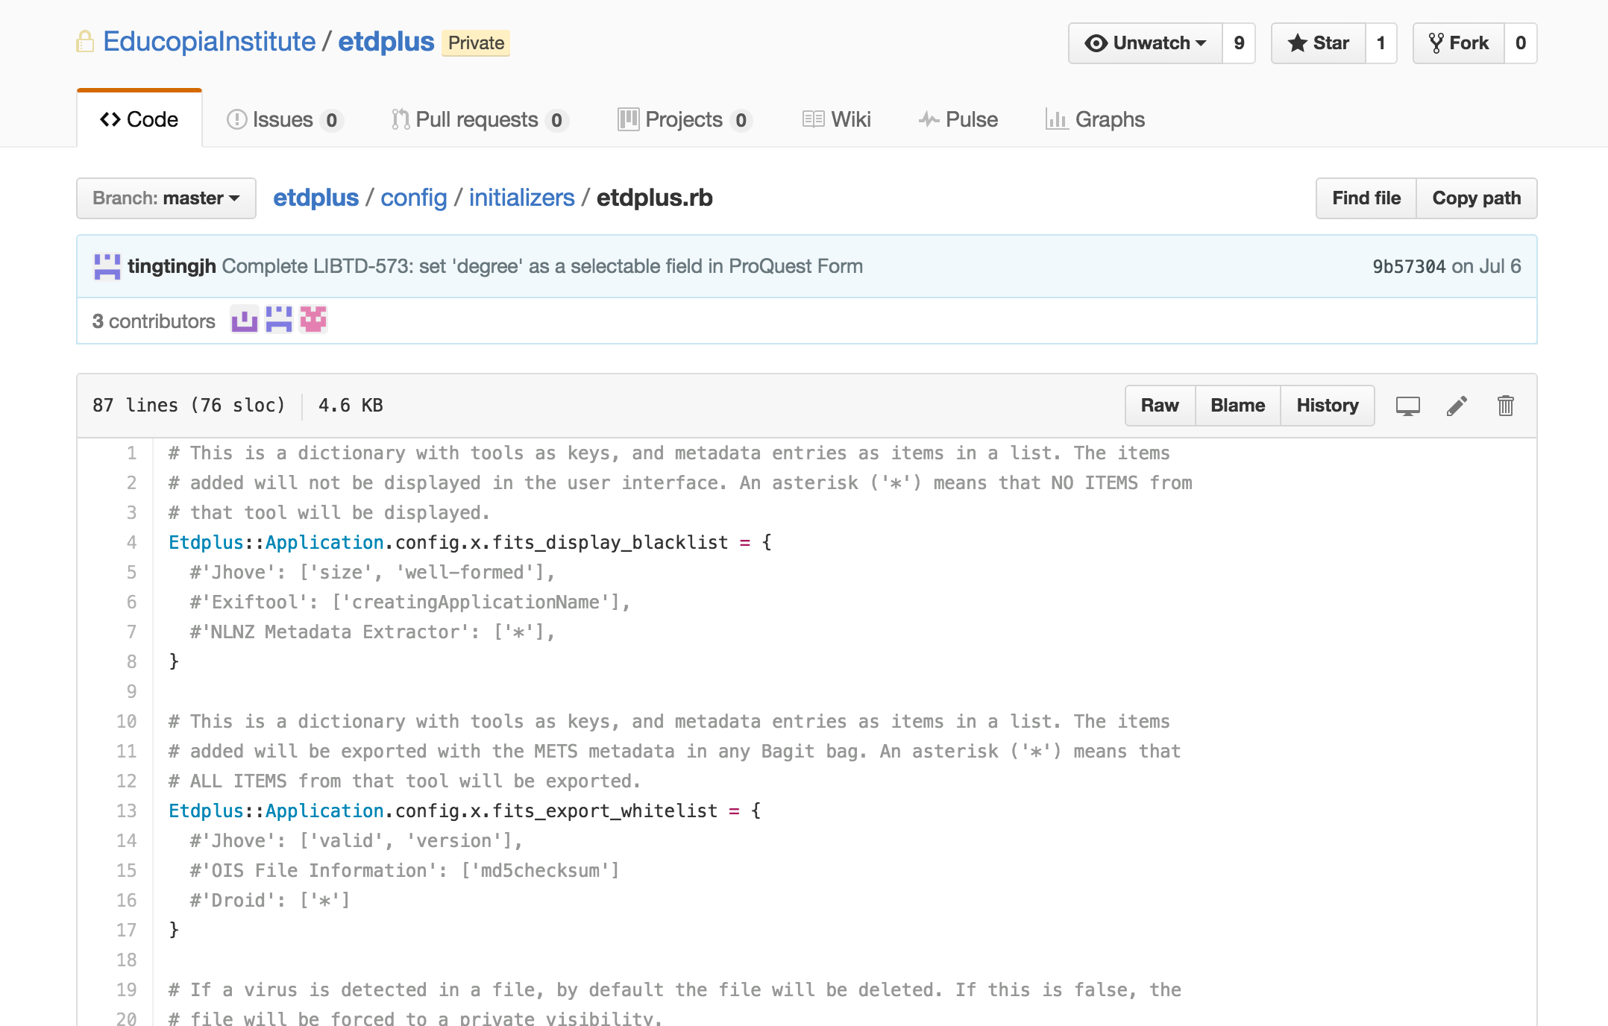

Slide 27
?
Notes:
Questions

