Slide 1
AWS Document Retrieval
Team Members: Daniel Kim
Fadi Durah
Xavier Pleimling
Brandon Le
Matthew Hwang
CS4624, Multimedia, Hypertext, and Information Access
Dr. Edward A. Fox
Virginia Polytechnic Institute and State University
Blacksburg, VA 24061
May 3, 2020

Slide 2
Outline
Project Overview
Project Design
Data Pipeline
Front End Application & Database
Future Goals
Lessons Learned
Acknowledgements
References

Slide 3
Project Overview

Slide 4
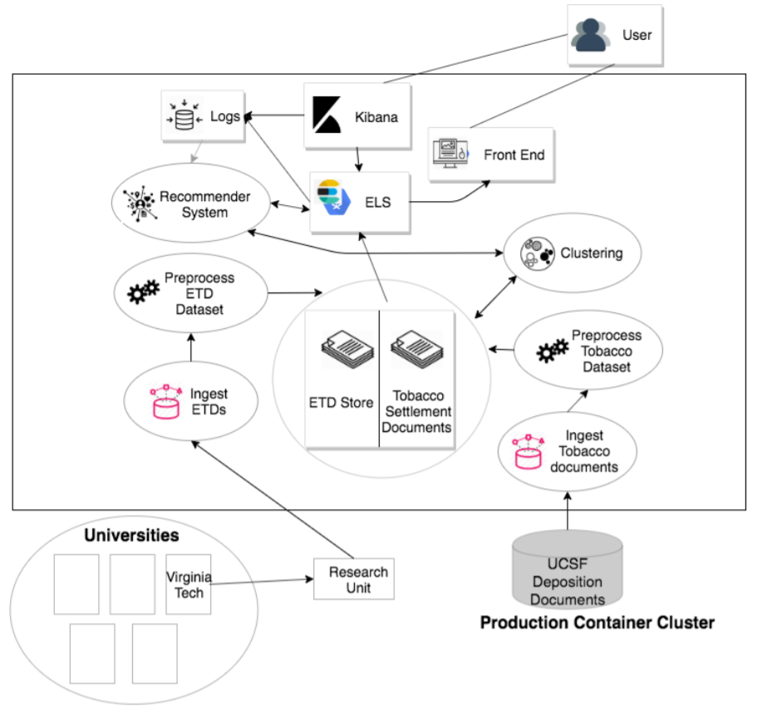
Project Overview - Background
In Fall 2019, a CS5604 class built a functional search engine / information retrieval system on the CS Container Cluster
Featured a user interface that would search and process various datasets
Two collections of documents were used for this:
14M tobacco settlement documents
200k electronic theses and dissertations
Previous system hosted on CS Container Cloud. (Agarwal, 2019)

Slide 5
Project Overview - Desired Deliverable
A fully operational version of the CS 5604 search engine on Amazon Web Services (AWS). In short, moving the functional search engine to AWS.

Slide 6
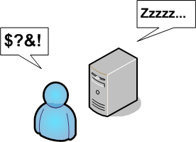
Project Overview - Need
A reliance on the Virginia Tech network could mean downtime when the servers or a node is down
AWS is a more stable service
An experiment to investigate other infrastructures

Slide 7
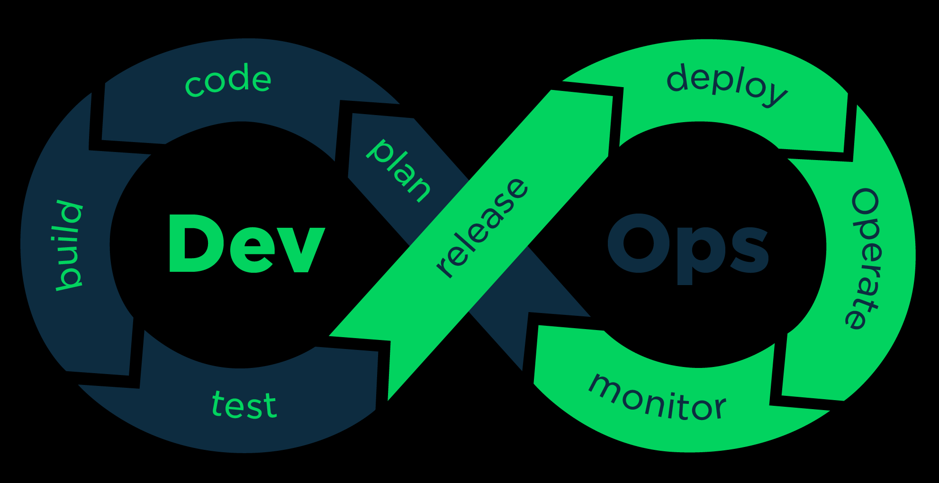
Project Overview - Nature
Less need of “developing”, original project was functional
Different aspect of CS projects, more of DevOps nature
Building infrastructure for existing code

Slide 8
Project Design

Slide 9
Main Concerns
Setting up common storage
Ingesting data into search engine (ElasticSearch)
Port front-end application and deploy into AWS ECS
Set up streaming platform for new data
Reach Goal: CICD for front end application or any other containers

Slide 10
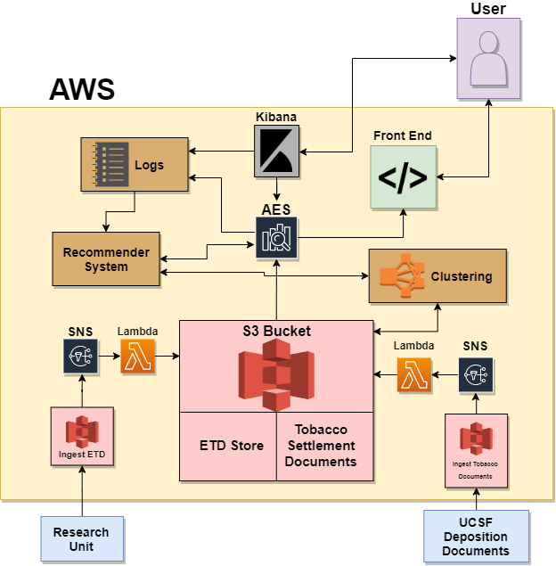
Initial Design
Data comes in from external source
Fed into large common storage (AWS S3)
ElasticSearch ingests data from S3
Kibana interact with ES, logs, and recommender
Front-End Application

Slide 11
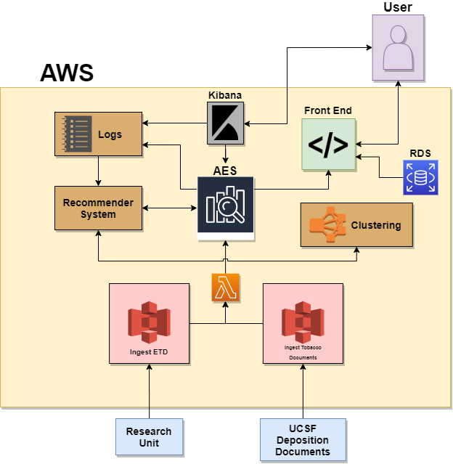
Updated Design
No centralized S3 bucket
Lambda now used to stream new data into ElasticSearch
SNS not needed
Included RDS for login verification

Slide 12
Data Pipeline

Slide 13
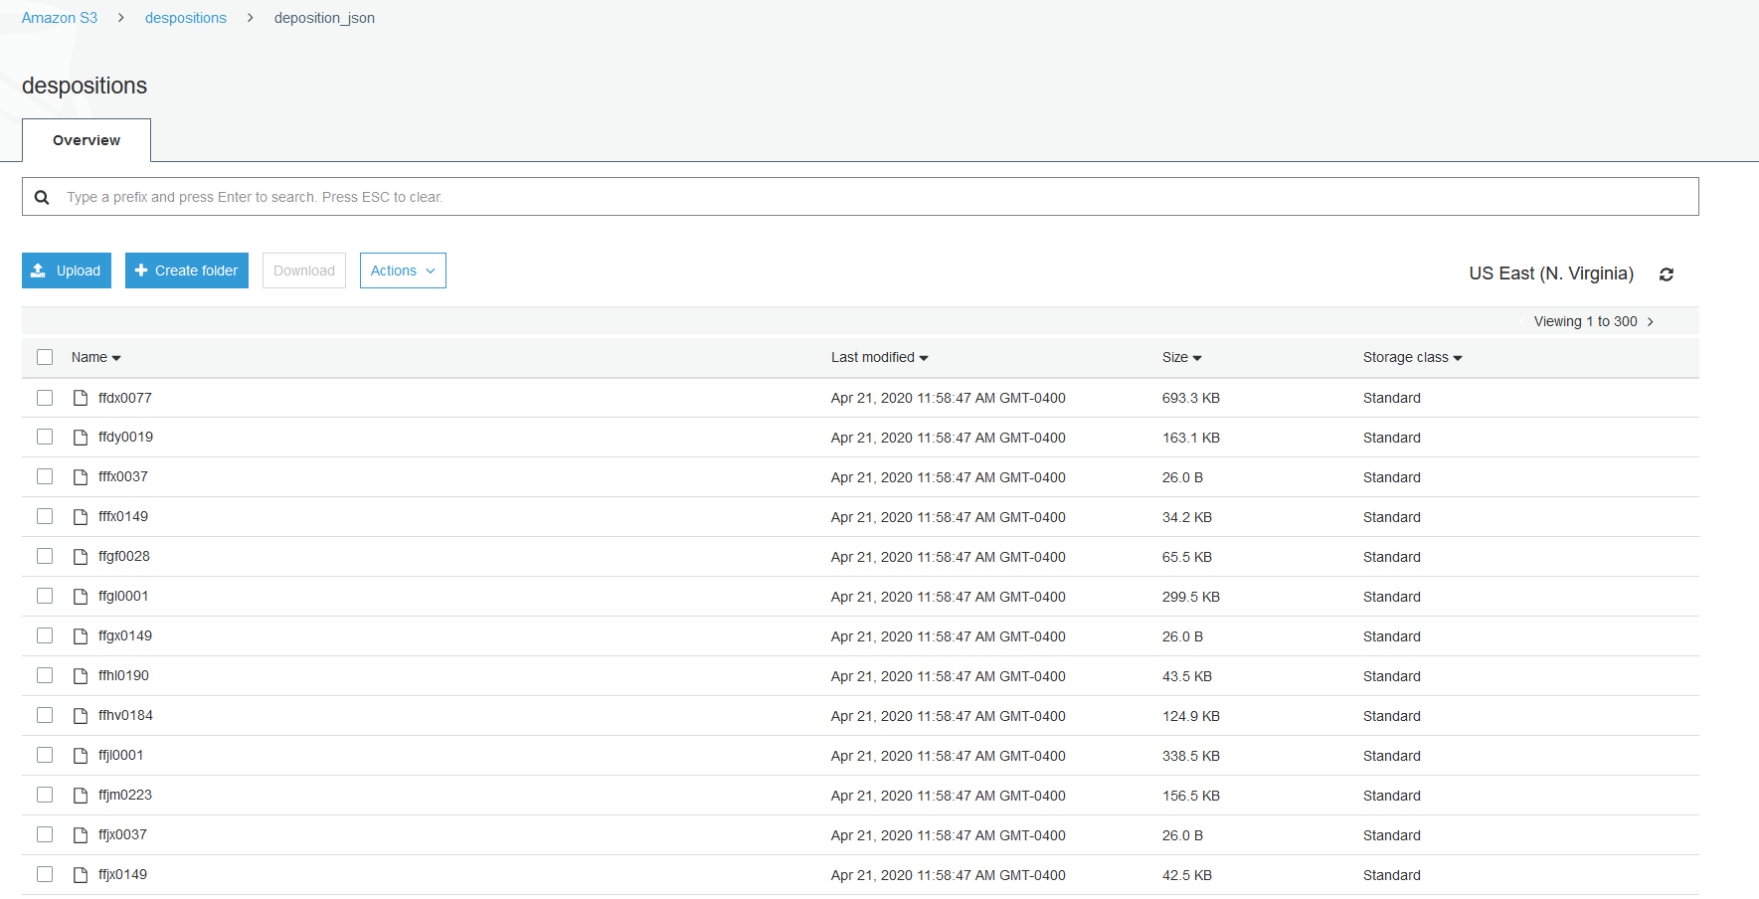
Common Storage
Used AWS S3 buckets to contain our data
One for ETDs and one for Tobacco Documents
Configured to allow access from other AWS services

Slide 14
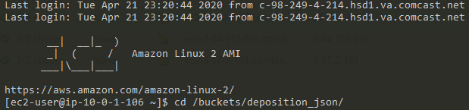
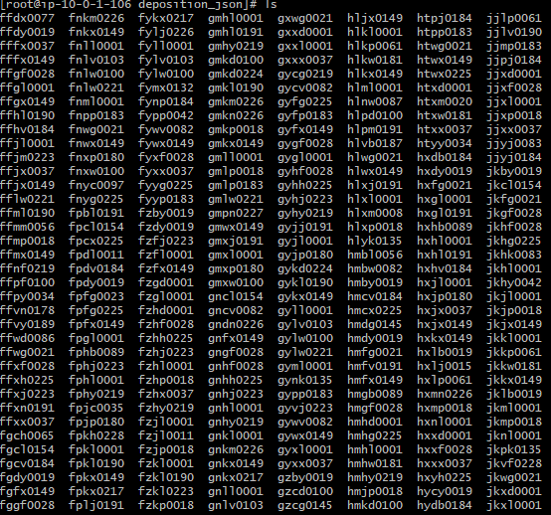
External File System
Created two AWS EC2 instances to act as external servers
Can ssh with a private .pem key
Each one has a bucket mounted on it
Able to list, read, and write to the buckets

Slide 15
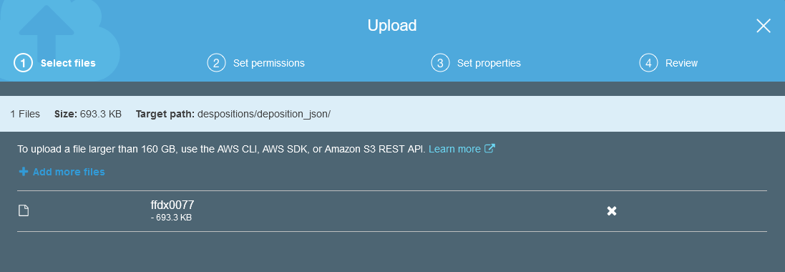
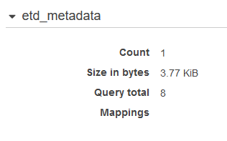
Data Streaming
Whenever new data is placed in the common storage (S3), it will be automatically processed into AWS ElasticSearch
AWS Lambda script is triggered whenever new data is put into the buckets

Slide 16
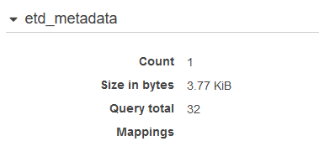

Slide 17
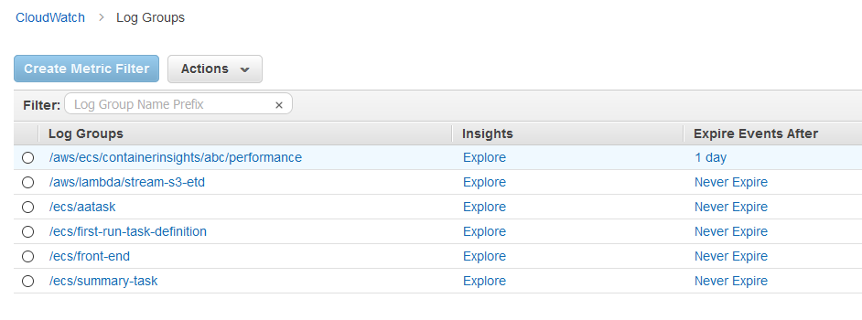
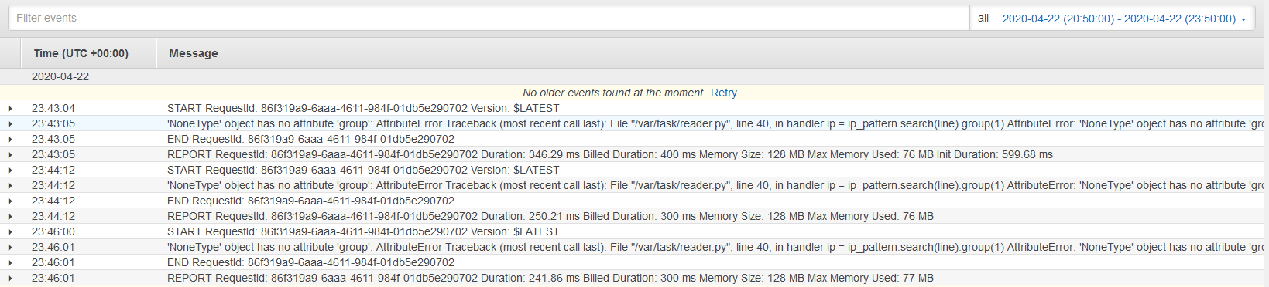
System Monitoring
Using AWS Cloudwatch allows easy viewing of function metrics and logs
Viewing what failed or succeeded with logs

Slide 18
Front End Application & Database

Slide 19
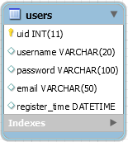
RDS Instance
User login database
Table schema from FEK group
Previous login information was not migrated
Front-end sign up form populates new entries

Slide 20

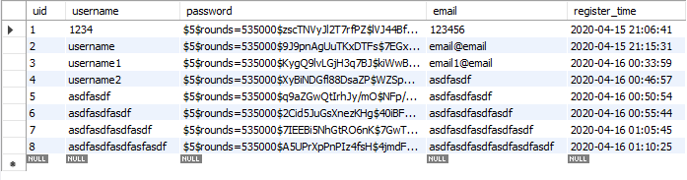
RDS Connection and Accessibility
Publicly accessible RDS instance
Connection test with MySQL Workbench 8.0
Workbench helps with schema configuration
Learned to connect to RDS endpoint and set up MySQL environment

Slide 21
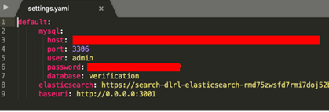



Connected Database and ElasticSearch
Learned that connections established through settings file
Created settings.yaml file
Inserted Database and ElasticSearch endpoints

Slide 22

Established Login Functionality
Initially only create account worked
Learned that original original code required missing field
Modified code to work with new database

Slide 23
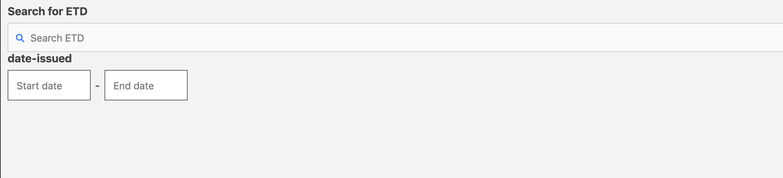
ElasticSearch UI
Learned that search UI is separate application
Displayed in main app through Iframe
Had to build separately before able to be displayed

Slide 24
Future Goals

Slide 25
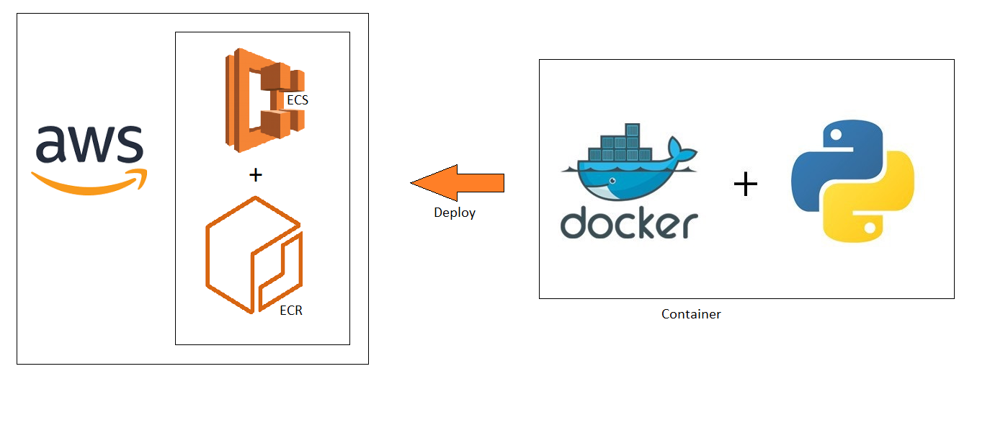
Front End Container
Upload container image to ECR
Deploy through ECS

Slide 26
Lessons Learned

Slide 27
Lessons Learned
Preventing permissions issues; ensuring all project resources are available to use
Process of setting up infrastructure
Understanding how the original project worked

Slide 28
Acknowledgements

Slide 29
Acknowledgements
Rahul Agarwal (Our Client)
Worked on original project in CS 5604
Part of Integration and Implementation (INT) Team of the original project
INT and FEK Groups
CS 5604 Class Students
Implemented original project
Bill Ingram
Director of IT at VT Library
ETD documents

Slide 30
Acknowledgements Cont.
ETD Project Grant IMLS LG-37-19-0078-19
Project funding
Dr. David Townsend
Tobacco documents
Dr. Edward Fox
Thank you for the continual guidance
Carlos Augusto
Thank you for the advice on how to approach presenting and illustrating our project

Slide 31
References

Slide 32
References
R. Agarwal, H. Albahar, E. Roth, M. Sen, and L. Yu, “Integration and Implementation (INT) CS5604 Fall 2019,” VTechWorks, 11-Dec-2019. [Online]. Available: http://hdl.handle.net/10919/96488. [Accessed: 04-Feb-2020].
ETDs: Virginia Tech Electronic Theses and Dissertations. VTechWorks. [Online]. Available: https://hdl.handle.net/10919/5534. [Accessed: 14-Feb-2020].
K. K. Kaushal, R. Kulkarni, A. Sumant, C. Wang, C. Yuan, and L. Yuan, “Collection Management of Electronic Theses and Dissertations (CME) CS5604 Fall 2019,” VTechWorks, 23-Dec-2019. [Online]. Available: https://hdl.handle.net/10919/96484. [Accessed: 03-May-2020].
Y. Li, S. Chekuri, T. Hu, S. A. Kumar, and N. Gill, “ElasticSearch (ELS) CS5604 Fall 2019,” VTechWorks, 12-Dec-2019. [Online]. Available: http://hdl.handle.net/10919/96310. [Accessed: 10-Mar-2020].
R. S. Mansur, P. Mandke, J. Gong, S. M. Bharadwaj, A. S. Juvekar, and S. Chougule, “Text Analytics and Machine Learning (TML) CS5604 Fall 2019,” VTechWorks, 29-Dec-2019. [Online]. Available: http://hdl.handle.net/10919/96226. [Accessed: 11-Feb-2020].
S. Muhundan, A. Bendelac, Y. Zhao, A. Svetovidov, D. Biswas, and A. Marin Thomas, “Collection Management Tobacco Settlement Documents (CMT) CS5604 Fall 2019,” VTechWorks, 11-Dec-2019. [Online]. Available: https://hdl.handle.net/10919/96437. [Accessed: 03-May-2020].
E. Powell, H. Liu, R. Huang, Y. Sun, and C. Xu, “Front-End Kibana (FEK) CS5604 Fall 2019,” VTechWorks, 13-Jan-2020. [Online]. Available: http://hdl.handle.net/10919/96418. [Accessed: 04-Feb-2020].
Truth Tobacco Industry Documents Library. [Online]. Available: https://www.industrydocuments.ucsf.edu/tobacco/. [Accessed: 14-Feb-2020].

Slide 33
Questions?

