Slide 1

Big Data Text Summarization - 2017 Westminster Attack
CS4984/CS5984 Final Presentation
Team 4: Aaron Becker, Colm Gallagher, Jamie Dyer,
Jeanine Liebold, Limin Yang
Instructor: Dr. Edward A. Fox
Virginia Tech, Blacksburg, VA

Slide 2
Objective
To generate summaries for a large dataset of web archives containing information about the 2017 Westminster Attack
Notes:
Jamie

Slide 3
Westminster Attack Dataset
 | Number of Documents | Number of Cleaned Documents | Number of Cleaned Documents Filtering Duplicates
Small Dataset | 422 | 299 | N/A
Big Dataset | 11298 | 6900 | 3996
Notes:
Jamie
Big data set reduced to 35% of size

Slide 4
Summaries Generated
A Set of Frequent Words
A Set of Frequent Word Synsets
A Set of Frequent Nouns, Verbs, and other Parts of Speech
A Set of Frequent Named Entities for Multiple Categories
A Set of Document Topics
An Extractive Summary Formed of Important Sentences
A Set of Values Extracted and Formed Into a Template
An Abstractive Summary Formed With Deep Learning
Notes:
Jamie

Slide 5
General Methodology
Preprocessing: jusText (remove boiler template), sklearn’s TFIDFVectorizer (remove duplicates)
Unit 1, 2, 3: NLTK built-in functions or corpus like word_tokenize, stopwords, Wordnet, Brown, Regular
Unit 5: spaCy’s statistical entity recognition system
Unit 6: Gensim's Latent Semantic Analysis
Unit 7: TextRank (gensim implementation) with K-Means clustering
Unit 8, 9: regular expression and spaCy’s rule-based matching
Unit 10: Pointer-generator Network
Notes:
Jamie

Slide 6
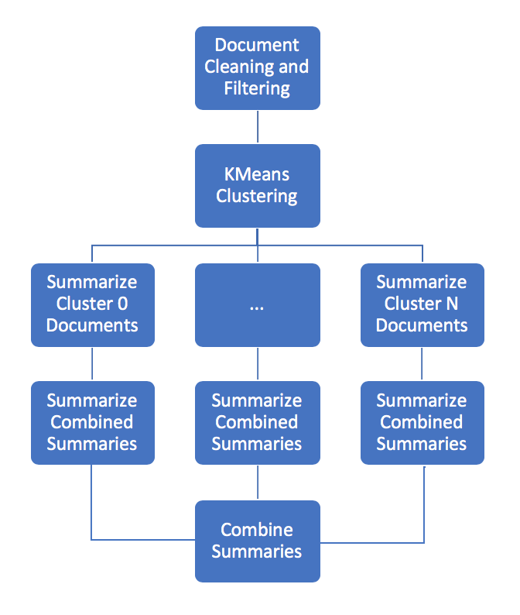
Methodology for Extractive Summary
Narrow dataset by ranking documents by use of frequent words from Unit 1
Filter out sentences longer than 50 words/tokens
Perform K-Means to cluster documents into N clusters
Generate summaries for each document in cluster using TextRank (reduced size by 90%)
Concatenate summaries for each cluster and run TextRank again (reduced size by 97.5%)
Concatenate cluster summaries as paragraphs in final result
Other Strategies Attempted:
Summarizing entire concatenated cluster
Clustering after summarizing documents
Clustering individual sentences, as well as groups of two or three sentences
Notes:
Colm

Slide 7
First paragraph of Extractive Summary
Five killed and 40 injured in Westminster terror attack. An assailant stabbed a policeman and was shot by police just outside Britain's parliament building in London on Wednesday (March 22) in what police described as a "terrorist incident". The ministry said minister Marco Minniti convened the Committee of Strategic Anti-terrorism Analyses following "the tragic facts in London," in which a vehicle mowed down pedestrians on a bridge and the attacker then stabbed a police officer outside the British Parliament. At least four people were killed and at least 20 injured in London on Wednesday after a car plowed into pedestrians and an attacker stabbed a policeman close to the British parliament, in what police called a terrorist incident.
Notes:
Colm: Duplicate sentence

Slide 8
Second paragraph of Extractive Summary
While police believe Khalid Masood, a 52-year-old British man with a history of violent crimes, carried out the attack on Westminster Bridge and outside parliament alone, they are investigating what help he may have received and whether he had any accomplices. The attacker who killed three people near parliament in London before being shot dead was named on Thursday as British-born Khalid Masood, who was once investigated by MI5 intelligence officers over concerns about violent extremism. An attacker - now named as 52-year-old Khalid Masood - killed three pedestrians and injured around 40 other people as he mowed down members of the public with a car on Westminster Bridge at about 2:40pm, before crashing into the railings in front of Parliament. An attacker - now named as 52-year-old Khalid Masood - killed three pedestrians and injured around 40 other people as he mowed down members of the public with a car on Westminster Bridge at about 2:40pm, before crashing into the railings in front of Parliament.
Notes:
Colm: Duplicate sentence

Slide 9
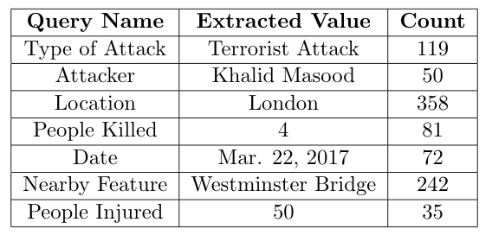
Methodology for Slot Value Extraction
Used spaCy’s Named Entity Recognition and Pattern Based Matching to extract values
Extracted: Date, Location, Nearby Features, Attacker Name, Type of Attack, Number Killed, and Number Injured
Challenges:
  Motivation of the attacker was unclear in articles
  Attack method vs. weapon too difficult to extract
  People killed and number injured changed when
injured victim died weeks later
Notes:
Jeanine

Slide 10
Slot Value Extraction Summary
Template:
On DATE a TYPEOFATTACK occurred in LOCATION near NEAR. The police investigated that the attacker was ATTACKER. During the TYPEOFATTACK the attacker killed KILLED people and injured INJURED.
Filled in Template:
On Mar. 22, 2017 a terrorist attack occurred in London near Westminster Bridge. The police investigated that the attacker was Khalid Masood. During the terrorist attack the attacker killed 4 people and injured 50.
Notes:
Jeanine

Slide 11
Methodology for Abstractive Summary
Model: Pointer-generator Network (PGN, pre-trained on CNN/Daily Mail dataset)
Test Dataset:
  999 articles (ranking every document by its inclusion of frequent words obtained in Unit 1)
  3 most relevant topics and corresponding concatenated articles (about 1500 articles)
Methodology:
  Concatenated 999 articles together and ran PGN on it
  Ran PGN on the 3 topics to generate 3 summaries and concatenate together
Notes:
Limin

Slide 12
Results
Extractive summary
  Quite relevant
  Includes important info like what, when, where, perpetrators, why, who was affected, countermeasures.
Abstractive Summary
  More natural, but focus on government’s attitude and reactions instead of the event itself
  Includes info like what, when, who was affected, countermeasures
Notes:
Limin

Slide 13
Evaluation - Mode 1
ROUGE-1, ROUGE-2: overlap of unigrams and bigrams between our summary and the golden standard
ROUGE-L: overlap of longest common sub-sequences (LCS)
ROUGE-SU4: overlap of skip-grams with a max length of 4 as well as unigrams
 | ROUGE
 | 1 | 2 | L | SU4
Extractive Summary | 0.21429 | 0.03704 | 0.10714 | 0.05263
Notes:
ROUGE-N: Overlap of N-grams between the gold standard and our extractive summary.
rouge-1: unigram
rouge-2: bi-gram
ROUGE-L: Longest Common Subsequence (LCS) based statistics
ROUGE-SU: Skip-bigram plus unigram-based co-occurrence statistics.

Slide 14
Evaluation - Mode 2 (Extractive Summary)
Max ROUGE-1 score: 0.71429
  [Predicted Sentence]
    An attacker - now named as 52-year-old Khalid Masood - killed three pedestrians and injured around 40 other people as he mowed down members of the public with a car on Westminster Bridge at about 2:40pm, before crashing into the railings in front of Parliament.
  [Golden Sentence]
    The attacker was later identified as 52 year old Briton Khalid Masood.
Max ROUGE-2 score: 0.33333
  [Predicted Sentence]
    While police believe Khalid Masood, a 52-year-old British man with a history of violent crimes, carried out the attack on Westminster Bridge and outside parliament alone, they are investigating what help he may have received and whether he had any accomplices.
  [Golden Sentence]
    The attacker was later identified as 52 year old Briton Khalid Masood.
Notes:
Aaron

Slide 15
Evaluation - Mode 3 (Extractive Summary)
Entity Coverage: 13.68%
Examples of matched named entities:
  Khalid Masood
  Keith Palmer
  Adrian Russell
  Westminster
  Westminster Bridge
  London
  The Houses of Parliament
  Islamic
  52-year-old
  Five
Notes:
Aaron
Khalid Masood: the attacker
Keith Palmer: the police officer killed in the attack
Five: the number of killed
Adrian Russell: the original name of the attacker

Slide 16
Lessons Learned
Data cleaning is difficult but important (and needs to be done early)
A classifier is an important tool which could have helped select documents for the extractive and abstractive summaries
Splitting the big dataset into smaller clusters saved time
Various issues may arise when the dataset gets bigger
Figure out time complexity before running the code
Notes:
Aaron

