Slide 1
Floods
Joe Acanfora, Myron Su, David Keimig and Marc Evangelista
CS4984: Computation Linguistics
Virginia Tech, Blacksburg
December 10, 2014

Slide 2
Introduction
Objective
Discussion of corpora
Final results
Tools we used for cleaning the data
Tools we used for language processing
Tools we did not use
What we learned
Conclusion

Slide 3
Objective
Generate summaries of flooding events based on collections of news articles.

Slide 4
Flood Data
ClassEvent - Islip_Flood
  11 Files
YourSmall - China_Flood
  537 files
YourBig - Pakistan_Flood
  20,416 files
Unclean data

Slide 5
U9 Results
In June 2011 a flood spanning 9.94 miles caused by heavy rain affected the yangtze river in China. The total rainfall was 170.0 millimeters and the total cost of damages was 760 million dollars. The flood killed 255 people, left 87 injured, and approximately 4 million people were affected. In addition 168 people are still missing. The cities of Wuhan Beijing and Lancing were affected most by flooding, in the provinces of Zhejiang Hubei and Hunan. Finally nearly all of the flood damage occurred in the state of China.

Slide 6
U9 Results
In August 2010 a flood spanning 600 miles caused by heavy monsoon affected the indus river in Pakistan. The total rainfall was 200.0 millimeters and the total cost of damages was 250 million dollars. The flood killed 3000 people, left 809 injured, and approximately 15 million people were affected. In addition 1300 people are still missing.
The cities of Nasirabad Badheen and Irvine were affected most by flooding, in the provinces of Sindh Mandalay and Punjab. Finally nearly all of the flood damage occurred in the state of Pakistan.

Slide 7
Tools We Used...

Slide 8
Cleaning the data
Removed files less than 5KiB
Machine Learning
  DecisionTreeClassifier = 90%
  NaiveBayesClassifier = 80%
  MaxEntropyClassifier= 73%
  SklearnClassifier = 92%
Picked top paragraphs from corpus
  Used WordNet on 20 words
  Tokenized by paragraph
  Picked paragraphs with at least 2 WordNet results
Notes:
Sklearn couldn’t be on hadoop

Slide 9
Cleaned Data
Collection | Pre-clean size | Post-clean size | % bytes reduced
YourSmall | 2.0 MiB | 288 KiB | 86%
YourBig | 136.7 MiB | 3.7 MiB | 98%
Merged remaining documents to one for parsing
Notes:
easier to work with relevant paragraphs in one doc

Slide 10
Classifier
Machine learning through decision tree classifier
 | Accurate | Inaccurate | Percentage
YourSmall | 90 | 10 | 90%
YourBig | 83 | 17 | 83%

Slide 11
Frequency Analysis
Purposes
  Cleaning data
  Generating summary
  Building YourWord list

Slide 12
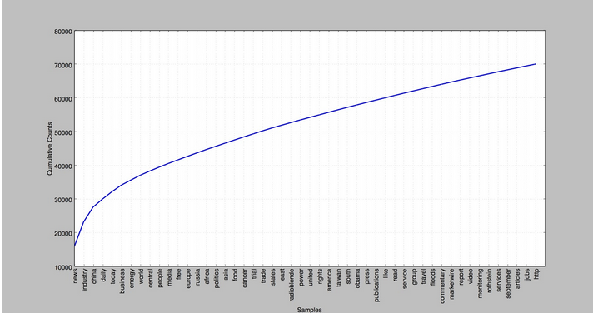

Slide 13
POS Tagging
Used the POS tagger for our regular expression “cause” string
Checked to see if the cause string returned by the regular expression contained some subject (noun)
In June 2011 a flood spanning 9.94 miles caused by heavy rain affected the yangtze river in China.

Slide 14
Regex
Best used on cleaned data
  Patterns prevalent in news reports
  Same methods of describing flooding event

Slide 15
Regex examples
"affected by ____", "result of ____", "caused by _____", "by ____"
day/month/year
____ people killed/missing/injured
____ (b|m|tr|etc...)illions dollars
____ miles/km/etc...
Notes:
marc reads this, pass off to Joe

Slide 16
NER Tagger
Rather than using the NER tagger for tagging locations we decided to use a Google Maps API...
Notes:
Joe does NER

Slide 17
Contextualizing Locations
Google Geocoder API
pygeocoder Python package

Slide 18
Tools We Did Not Use...

Slide 19
Bigrams & N-grams
Not used extensively
Bigrams were good, but already in YourWords
Operations we used were based on single words
Did help with regex

Slide 20
Useful bigrams | YourWords
flash flooding heavy rains inches rain rain fell | flood rain overflow dam storm severe water damage submerge washed collapsed river discharge downpour flash sweep torrential runoff

Slide 21
Useful bigrams | Some regexes
flash flooding heavy rains inches rain rain fell | (\d+.\d+\smillimeters)|(\d+.\d+\smm))|(\d+.\d+\s(inches|inch) due\sto(\s[A-Za-z]{3,}){1,3}|result\sof(\s[A-Za-z]{3,}){1,3}|caused\sby(\s[A-Za-z]{3,}){1,3}|by\s([A-Za-z]{4,}){1,2})|heavy\s([A-Z a-z]{3,}
Notes:
we could see the causes of flooding

Slide 22
Clustering & Mahout
Documents similar enough that clusters would be indistinguishable
Wanted data from all good sources
Clean data was good enough

Slide 23
Chunking
Finds multitoken sequences
Knowledge of existing data
  brainstormed our own chunks, which was good enough
  would be helpful if we didn’t know patterns
Regular expressions alone did the job well on clean data
Notes:
chunking finds phrases like “a result of” and stuff

Slide 24
Conclusion

Slide 25
Wrap Up - Challenges
New Technologies
  Hadoop - Map/Reduce
  NLTK Library
Group Logistics
  Times
  Work Distribution

Slide 26
Wrap Up - Strengths
Technical Strengths
  Python
  LaTeX
Team Strengths
  Willing to learn
  Team synergy

Slide 27
Conclusion - Improvements
Underestimates
  Deaths
  Damages
  Build statistical model to improve accuracy
Spatial locations
  Mean distances
  Generate map using Google API

Slide 28
Citations
https://pypi.python.org/pypi/geocoder/0.9.1
http://www.nltk.org/book_1ed

Slide 29
Many Thanks
Dr. Edward Fox
GTA Tarek Kanan
GTA Xuan Zhang
GRA Mohamed Magdy Gharib Farag
National Science Foundation, Computing in Context, NSF DUE-1141209
Villanova

Slide 30
Questions

