Slide 1
Open Access Week 2013
ETDs and Open Access: the Digital Landscape of Open Access in the Graduate School Arena
Gail McMillan
Director, Digital Research and Scholarship Services
Jordan Hill
Ph.D. Candidate, ASPECT
Karen DePauw
Vice President and Dean for Graduate Education
Virginia Tech
Notes:
An important fact of scholarly research is that the work is not complete until the results have been fully communicated, and are openly available for others to build upon. (Heather Joseph re Berlin Open Access Convergence, C&RL News, Feb. 2012, . 84) Open access to scholarship enables us to incorporate more information into our work.

Slide 2
2011-2013 ETD Survey Data
Gail McMillan
Director, Digital Research and Scholarship Services
University Libraries, Virginia Tech

Slide 3
“Comprehensive Study of National ETD Practices.” Gail McMillan, Shannon Stark, and Martin Halbert. US ETD Association Conference, Claremont, CA, July 24, 2013.
“Do Open Access Electronic Theses and Dissertations Diminish Publishing Opportunities in the Sciences?” Marisa L. Ramirez, Gail McMillan, Joan T. Dalton, Ann Hanlon, Heather S. Smith, Chelsea Kern. Accepted for publication by College & Research Libraries, anticipated publication date: Jan. 1, 2014. Preprint: http://crl.acrl.org/content/early/2013/09/20/crl13-524.abstract?sid=6bdd5bb4-a0da-48ef-829f-10923ded4183
“Do Open Access Electronic Theses and Dissertations Diminish Publishing Opportunities in the Social Sciences and Humanities? Findings from a 2011 Survey of Academic Publishers.” Marisa L. Ramirez, Joan T. Dalton, Gail McMillan, Max Read, and Nancy H. Seamans. College & Research Libraries, July 2013, 368-380. http://crl.acrl.org/content/74/4
Presentation slides http://vtechworks.lib.vt.edu/handle/10919/11338
Earlier (2000-2003) publications about publishers attitudes towards ETDs: http://scholar.lib.vt.edu/copyright/cprtetd.html
Notes:
Presenting data from 3 collaborations I have been part of in the last few years. These citations are for those of you that may want more info about how the surveys were conducted and validated since today I want to focus on the findings and leave the others time for their presentations.
This series of ETD surveys began with a collaboration in 2011 with colleagues at Windsor, Cal Poly SLP, British Columbia, and Georgia State.
The following year, colleagues at Windsor and Cal Poly stayed on and added a colleague at Wisconsin-Milwaukee, and 2 statisticians at Cal Poly.
With colleagues at the University of North Texas, in 2013 we conducted the first comprehensive survey of ETD programs and practices at academic institutions worldwide. This is where I’m going to start.

Slide 4
2013 Comprehensive Study of ETD Practices
161 institutions
  73% US
  27% International
93% have ETD programs
69% mandatory ETD submission
Will be a repeated every two years
Notes:
30 questions: Qualtrix
161 institutions responded: 73% US (132); 27% international (29)
from all targeted stakeholder communities, including individuals self-identified as ETD Librarians, Repository Managers, Deans/Administrators, Graduate Readers, Scholarly Communications Librarians, Collection Development Employees, Technical Services Employees, Cataloging/Metadata experts, and “Other.”
93% have an ETD program, 6% planning stages
120/69% mandatory ETD submission

Slide 5
Are surveyed institution’s ETDs publically available?
Notes:
Only 3 universities in the US reported that they do not make any of their ETDs publicly available. 1/3 of the US respondents and over half of the I’nat’l institutions make their entire ETD collections publicly available.

Slide 6
Do surveyed institutions temporarily limit ETDs to home university-only access?
Notes:
65% of the American survey respondents temporarily limit some or all ETDs to university-only access
International institutions are less likely to limit access to their ETDs, while US universities are more likely to.

Slide 7
Why do surveyed institutions limit ETDs to university-only access?
Notes:
While there are a variety of reasons that institutions limit some or all of their ETDs to university-only access, they were easily grouped into these categories.
There are some striking differences in the reasons for limiting access to ETDs to the home institution. American universities are more likely to do so because
they were directed by the authors,
for publishing and patent concerns.
About half-again as many faculty at international institutions request limited access. This surprised me because our graduate students tell us that their faculty are the main reason that they choose to limit access to their ETDs. Our international counterparts are seemingly less concerned by copyright and creative works.
However, international institutions are more likely to limit access to ETDs due to institution-wide policies or mandates and because of ETDs contain sensitive or confidential information.

Slide 8
Do surveyed institutions embargo ETDs?
Notes:
Another kind of restricting access is embargoing, which we defined as withholding an ETD from all access. When asked if institutions embargoed ETDs, only one international institution and one US institution responded that they embargoed all their ETDs

Slide 9
How long do surveyed institutions embargo ETDs?
Notes:
Embargo periods vary, with 85% reporting embargoing ETDs for more than one year.
Few institutions embargo ETDs permanently; only one in each category.
One year or more seems to be the norm worldwide.

Slide 10
Why do surveyed institutions embargo ETDs?
Notes:
Reasons for embargoing ETDs vary. In this chart is based on the survey respondents’ comments, which we categorized.
You can see that no international institutions gave faculty concerns as a reason to embargo ETDs. However, they are far more concerned about sensitive or confidential information in ETDs than were the American survey respondents.
Unlike the reasons for limiting access to the home institution, none mentioned institution-wide mandates for embargoing ETDs.
[This chart documents these based on 163 comments from 136 US institutions and 27 international institutions. ]

Slide 11
2011-2012 Publishers’ Surveys
The Primary Research Question
Which of the following statements best reflects the editorial policy or practice governing your enterprise?
Manuscripts that are revisions derived from openly accessible electronic theses and dissertations (ETDs) are…
  Always welcome for submission.
  Considered on a case-by-case basis.
  Considered ONLY IF the contents and conclusions in the manuscript are substantially different from the ETD.
  Considered ONLY IF the ETD has access limited to the campus or institution where it was completed.
  Not considered under any circumstances.
  Other (please elaborate)
Notes:
With colleagues at Cal Poly SLO, Georgia State, UBC, UWisc,- Milwaukee, Windsor
2 surveys of academic journals and university presses
2011 Social Sciences and Humanities journal editors and press directors
2012 Science journal editors

Slide 12
2011 Social Sciences, Arts and Humanities ETD Survey
75 (12% of 615) social sciences and arts and humanities journal editors
  8% history
53 (40% of 131) AAUP press directors
  80.5% history
17% response rate (128/764)
Notes:
Earlier (2000-2003) publications about publishers attitudes towards ETDs: http://scholar.lib.vt.edu/copyright/cprtetd.html
This study investigated social sciences, arts, and humanities journal editors’ and university press directors’ attitudes toward online theses and dissertations.
The study was conducted between May 17 and June 16, 2011, and was distributed to 615 social sciences and arts and humanities journal editors and 131 university press directors via Survey Monkey,

Slide 13
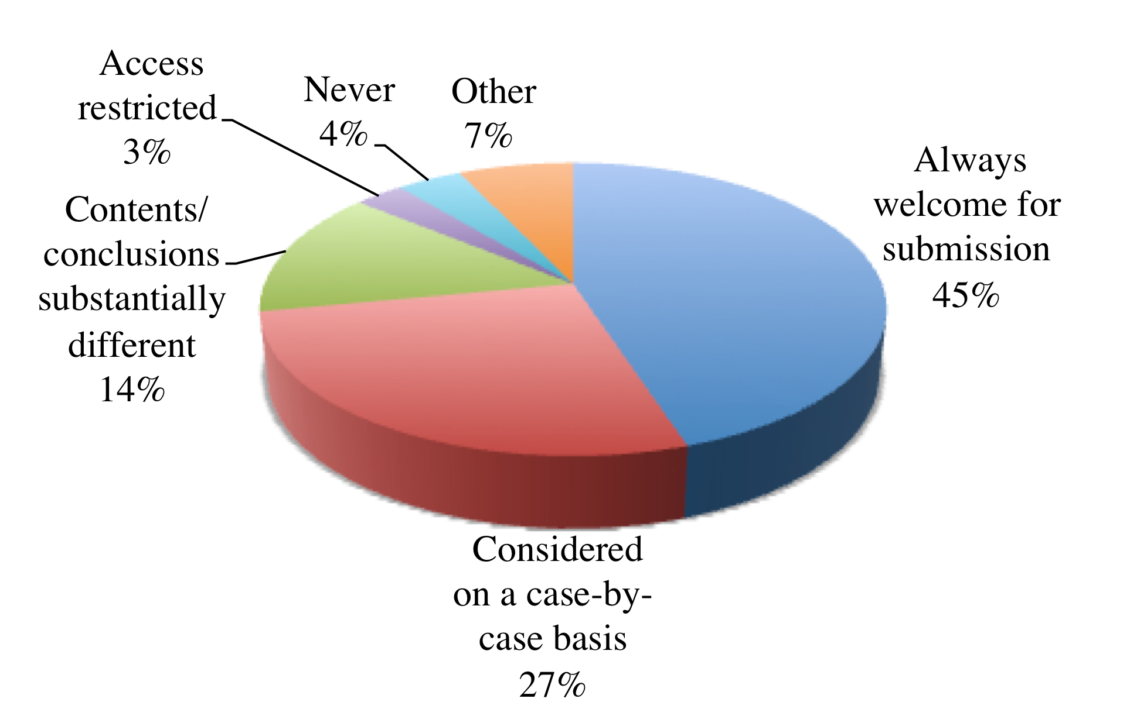
SoSci/Humanities publishers’ responses to “Manuscripts which are revisions derived from openly accessible ETDs are...”
Notes:
89% will accept manuscripts based on ETDs

Slide 14
sible ETDs are…
SoSci/Humanities Journals and Press Responses: “Manuscripts which are revisions derived from openly accessible ETDs are...”
Notes:
Here again are the overall survey results so we can clearly see where the similarities and differences are between the two constituencies in the 2011 survey. The results look quite different when we look at overall survey responses and then separately at university press directors’ and journal editors’ responses. Journal editors are more enthusiastic about receiving submissions based on ETDs than are university presses. Two-thirds of the journals “always welcome” submissions from ETDs, while one-tenth of the university presses do.
This is not to say the university presses discourage submissions based on ETDs. Nearly half consider ETD-based submissions on a case-by-case basis.
University presses are about two-and-a-half times as likely to “never” accept ETD-based submissions, than are journal editors. Only university presses find access restrictions necessary.
83% Welcome for submission
66% Always
17% Considered on a case-by-case basis
As expected, journals have migrated to digital delivery at a faster pace than monographs, reflected in this acceptance level of manuscripts derived from ETDs.
While Virginia Tech instituted the university-only restriction largely to appease journal publishers who were opposed to online theses and dissertations, the current survey revealed that restricted access is not necessary. The survey option to “Considered ONLY IF the ETD has access limited to the campus or institution where it was completed” was never selected by journal editors. Less than 3% of the university presses directors are in favor of ETDs with access limited to the home institutions.
54% Welcome for submission
10% Always
44% on a case-by-case basis
27% If contents and conclusions substantially different 7% If access restricted 7% Never

Slide 15
Comments: Social Sciences/Humanities Survey
“We do not consider the dissertation to be the equivalent of a book. It is student work; a book is professional work.”
“Dissertations have never counted as publications… A pdf of an unpublished work is still an unpublished work.”
“Prior availability through an IR is not usually the deciding factor. We are more interested in the quality of the work, how well it fits with our list, and whether it deserves wider dissemination and promotion.”
“The editorial review and publication process entails substantial refinement and revision of works that originate as part of doctoral work and thus we do not consider raw dissertations as competing with the works eventually published under our imprint.”
Notes:
Comments are as telling as the data. Nearly half of our survey respondents volunteered additional comments, and 42% gave us their names and email addresses so that we could follow-up with them.
Comments in favor of ETDs largely represented two categories: (1) judge the quality of the article or book submitted for publication, and (2) ETDs are NOT published works.
“Dissertations have *never* counted as publications… A pdf of an unpublished work is still an unpublished work.” (17)
#41 “The editorial review and publication process entails substantial refinement and revision of works that originate as part of doctoral work and thus we do not consider raw dissertations as competing with the works eventually published under our imprint.”

Slide 16
Comments: Social Sciences/Humanities Survey
“All essays go through extensive review and revision process, so even if the starting point is out there, the final product is not.”
“The American Psychological Association, which publishes over 40 journals across psychology, has an official policy that theses/dissertations, even if archived at a university site, are not counted as prior publication.”
“A chapter of a thesis or dissertation will virtually never be suitable as an article in my journal. Authors will often have to contextualize their discussion and explain the implications of their conclusions. And authors will often find that, after completing a dissertation, they are able to refine the argumentation a bit as well.”
Notes:
#49 “All essays go through extensive review and revision process, so even if the starting point is out there, the final product is not.”
#55 The APA, which publishes over 40 journals has an official policy that theses/dissertations, even if archived at a university site, are not counted as prior publication.
#53 “A chapter of a thesis or dissertation will virtually never be suitable as an article in my journal. Authors will often have to contextualize their discussion and explain the implications of their conclusions. And authors will often find that, after completing a dissertation, they are able to refine [their arguments.”
p. 14
http://etd.ohiolink.edu/view.cgi?acc_num=ohiou1273584209
A few other information resources touch on the topic of publishers’ attitudes towards ETDs. But these all discuss perceptions and are not the result of real data, except for Angie McCutcheon’s 2010 ETD on the Impact of Publishers' Policy on ETD Distribution Options within the United States. She surveyed graduate school personnel to learn if students had actually been rejected by publishers because their TDs were online. She reported at 1.8% rejection rate.

Slide 17
New Concerns about ETDs
ETDs make author anonymity difficult.
  “Easy to determine who the author is and thus undermines the strength and reliability of peer review. This could, ultimately, disadvantage young scholars.”
“I never thought about it until just now”…
“We ask authors to stop distribution of their ETD when we agree to publish their REVISED material.”
ETDs include already published articles.
Notes:
There are also new concerns about ETDs for Journal Editors and Academic Press Directors
“The one problem this creates, which I and the editorial board have not resolved, is that this makes anonymity in review difficult [and] easy to determine who the author is, and thus undermines the strength and reliability of peer review. This could, ultimately, disadvantage young scholars...” (18)
We were reminded that not all publishers are familiar with the issues surrounding publications derived from ETDs. One journal editor commented: My first thought on this matter, and I never thought about it until just now, was “why should anything derived from a dissertation be excluded?”—but thinking further—if dissertations can be as readily accessed by computer as is becoming the case with journals—then perhaps I need to consider some form of restriction...” [#4 Q5]
This comment may well indicate that either the publishers are out of touch with authors’ concerns, or it haven’t been raised as an issue by their authors or editors.
Very few editors or directors seem to be aware that ETDs are also beginning to include published articles. [See comments #22, 44, 51 Q6]
“We would prefer that students work with their major advisors to design thesis [sic] chapters for submission as research articles and review papers as part of the dissertation process to ensure a good fit with the journal. Ideally, the dissertation when completed will contain chapters that have already been published or accepted for publication so that the journal does not have to compete with content that is already freely available.” [comment #51 Q6]

Slide 18
2012 Science Journal Editors’ ETD Survey
27.9% response rate
  53 original SurveyMonkey respondents
  28 non-respondents phone interviews
17% response rate for 2011 SoSci/Hum survey
  1 follow-up email

Slide 19
Science editors reported that “Manuscripts which are revisions derived from openly accessible ETDs are…
Notes:
Therefore, 80% will accept articles from OA ETDs.
Removed the ”other” category/responses, those who Not encountered/Don’t know/Not applicable

Slide 20
Science Editors’ Comments
“A peer-reviewed publication that comes out of a dissertation or thesis should not only be encouraged but is crucially important for the scholar's development and advancement of scientific knowledge.”
“It is our job to archive and publish the best research. Thus we are quite happy to publish material which otherwise would sit languishing on an online archive.”
“Work which has not been published in archival peer reviewed journals is considered appropriate for submission, even if it is accessible elsewhere.”

Slide 21
Science Editors’ Comments
“While we recognise theses as legitimate and citeable publications, they are considered gray literature because they do not go through blind external peer review and are not published in a recognized peer reviewed outlet. They are not considered prepublication...”
“Our journal has essentially ignored any potential conflict arising from publication of ETDs, because the situation is really not different from the days of hard copy thesis holdings by University libraries. They … are simply more easily available now…

Slide 22
ETD Policies of Science vs. Hum/SoSci Journals
Notes:
While more Science editors always welcome OA ETD-based articles, the So Sci and Hum editors are actually more accepting overall of OA ETD-based articles, accepting 96%.

Slide 23
Publishers’ ETD Policies 2011/2012
Notes:
Most publishers will consider publications based on openly accessible ETDs.
However, in the particulars, Uni Presses and J eds vary among 3 categories: Always welcome, case-by-case, and if different.
Among the So Sci/Hum survey respondents, the option to “Considered ONLY IF the ETD has access limited to the campus or institution where it was completed” was never selected by journal editors. About 3% of the university presses directors prefer ETDs to have access restricted to the home institutions and only 2% of the science editors do.

Slide 24
Based on the 2011-2012 publishers’ survey
Submit works based on your ETDs.
Most publishers will consider them.
  89% SoSci/Humanities; 80% Sciences
  Harvard Press acquisitions editor: “If you can’t find it, you can’t sign it.”
Quality is the publishers’ main concern.
Adapt them for a new audience.
Peer review is radically different.
Scholarly Publishing Literacy
Notes:
Comments in favor of ETDs largely represented two categories: publishers are (1) judging the quality of the article or book submitted for publication, and (2) ETDs are not considered published works.
Other than the surveys reported here and those conducted a decade ago by Dalton, Seamans, and Holt, here is very little data on the topic of publishers’ attitudes about ETDs. Most of the information on this topic relies on perceptions of publishers’ attitudes. The contemporary data as well as that from a decade ago clearly contradict these perceptions.

Slide 25
Open Access Week 2013
American Historical Association's Support for Dissertation Embargoing and the Subsequent National Conversation
Jordan Hill
Ph.D. Candidate, ASPECT
Virginia Tech
Notes:
An important fact of scholarly research is that the work is not complete until the results have been fully communicated, and are openly available for others to build upon. (Heather Joseph re Berlin Open Access Convergence, C&RL News, Feb. 2012, . 84) Open access to scholarship enables us to incorporate more information into our work.

Slide 26
Open Access Week 2013
Administrative and Policy Perspectives on Open Access to ETDs
Karen DePauw
Vice President and Dean for Graduate Education
Virginia Tech
Notes:
An important fact of scholarly research is that the work is not complete until the results have been fully communicated, and are openly available for others to build upon. (Heather Joseph re Berlin Open Access Convergence, C&RL News, Feb. 2012, . 84) Open access to scholarship enables us to incorporate more information into our work.

Slide 27
Thank you for coming to
Open Access Week 2013
ETDs and Open Access: the Digital Landscape of Open Access in the Graduate School Arena http://vtechworks.lib.vt.edu
Gail McMillan
Director, Digital Research and Scholarship Services
Jordan Hill
Ph.D. Candidate, ASPECT
Karen DePauw
Vice President and Dean for Graduate Education
Virginia Tech
Notes:
An important fact of scholarly research is that the work is not complete until the results have been fully communicated, and are openly available for others to build upon. (Heather Joseph re Berlin Open Access Convergence, C&RL News, Feb. 2012, . 84) Open access to scholarship enables us to incorporate more information into our work.

