Slide 1
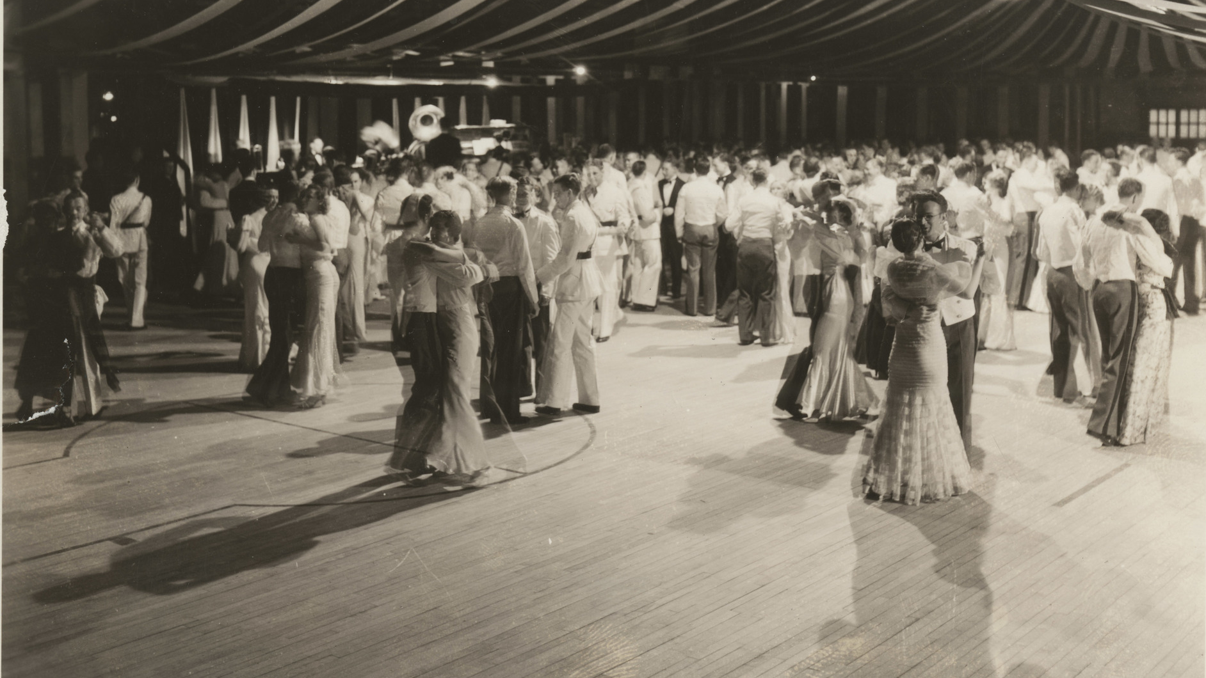
Dancing with Donors:
Trust-Building Across Gaps of Curation Priorities
September 17, 2024
Alan Munshower, Digital Collections Archivist, alanmun@vt.edu
Alex Kinnaman, Interim Assistant Director, Digital Libraries & Preservation, alexk93@vt.edu
Virginia Tech University Libraries
“Photograph, First Ring Dance, 1934-04-27,” VT Special Collections and University Archives Online, accessed September 3, 2024, https://digitalsc.lib.vt.edu/Photographs_001/HistPhot_FirstRingDance_Photograph_1934_0427.

Slide 2
Introduction
This paper stems from organic conversations between library collection curators at VTUL on known knowledge gaps in storage, preservation, description, metadata, rights, and how institutional libraries function as a service within the range of University, donor, cultural heritage, and other community partners.
Examining donors’ critical role in the longevity and preservability of a digital collection long after it is received by the library.
How does the evolving landscape of relationships between libraries and donors of digital material impact collection sustainability?

Slide 3
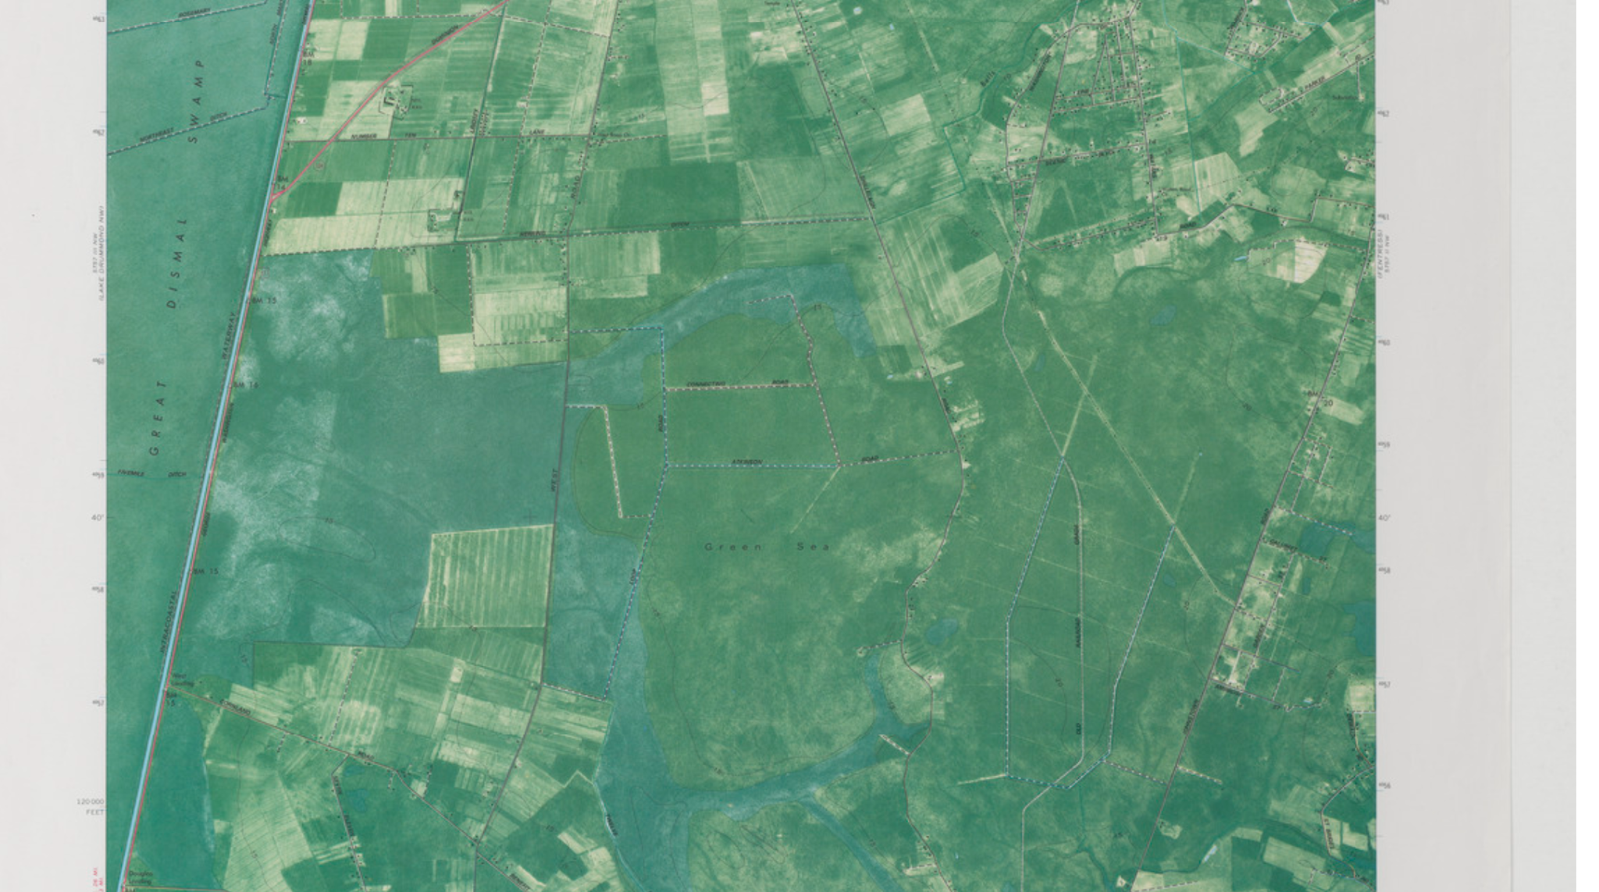
Literature Review
Deep Creek Quadrangle Virginia. Virginia Tech Digital Library, Virginia Tech Digital Libraries, Virginia Polytechnic Institute and State University, University Libraries. https://ssxezg5su1.execute-api.us-east-1.amazonaws.com/Prod/ark:/53696/7897d442

Slide 4
Types of Donors & Collaborators
“Traditional donors” - donor types articulated by Purcell
Not inclusive of community partners
New definition of “traditional donor” - may take a more passive role than a community or University partner, may be more inclined to have financial contribution over a contribution of labor, and may have less of a direct connection to the materials.
Non-traditional partners - embody the term “collaborator” more wholly
may frequently be users, curators, and creators of the material.

Slide 5
History & Trends in Technical vs. Interpersonal Solutions
Affordable, user-friendly consumer cloud storage products in the early 2010s showed potential for community archives
Growing popular recognition in the professional archival world of the role non-custodial collections could play in representative collection building
Earlier digital preservation researchers and practitioners already extending the idea that digital preservation was (and continues to be) user-centric, not just technology-based
Digipres models are more technical, omitting factors that require donor engagement (e.g. how to process and transfer content)
New developments to increase donor participation in ingest, digipres

Slide 6
Delineating the Role of Libraries and Partners in Sustainable Solutions
How do we define a “donor” and what are their needs?
76% of respondents are “collecting, curat[ing], and/or preserving materials created by the local public community or have done this work in the past.” (Makula, A. Y. & Turner, L. S. (2022))
There is a need to treat donors as people, and a need for more transparent, clearer communication with donors
Differences in what “sustainability” means → donors focus more on sustaining their community, libraries focus on sustaining the artifacts
Newer guidance on navigating relationships are not one-size-fits-all
Successful resources meet the needs of the diverse groups working with materials
Often a learning curve to collections maintenance, such as description and preservation standards

Slide 7
Scope Limitations
Based on anecdotal working relationships with current partners in the Virginia Tech and southwest Virginia communities.
Many of the insights on community collaborations in this paper are derived from conversations through a 2022 grant-funded forum (IMLS Community Catalyst LG-15-19-0137-19)
Reference personal experiences from one-on-one and group conversations
Not choosing specific existing guides to review
Choosing to not identify specific projects or collaborators
Focus on project types and their common successes and challenges
Notes:
Many guides exist for guiding the phases of the collections lifecycle, but few combine all aspects of donor/library relationships to guide librarians in the entire collaborative process

Slide 8
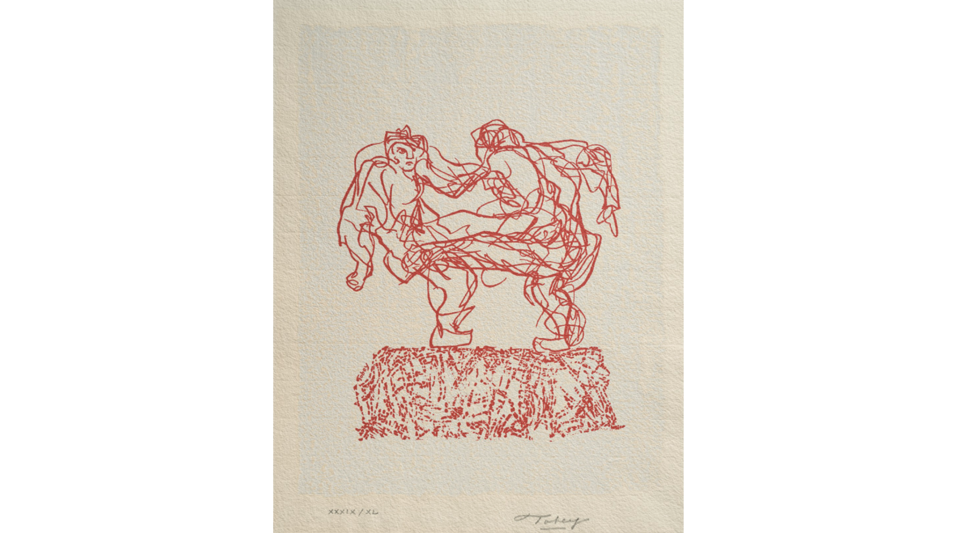
Types of Projects
Mark, Tobey. Folk Dance of Independence Day I. Virginia Tech Digital Library, Virginia Tech Digital Libraries, Virginia Polytechnic Institute and State University, University Libraries. http://idn.lib.vt.edu/ark:/53696/s884291z
Notes:
Alex start

Slide 9
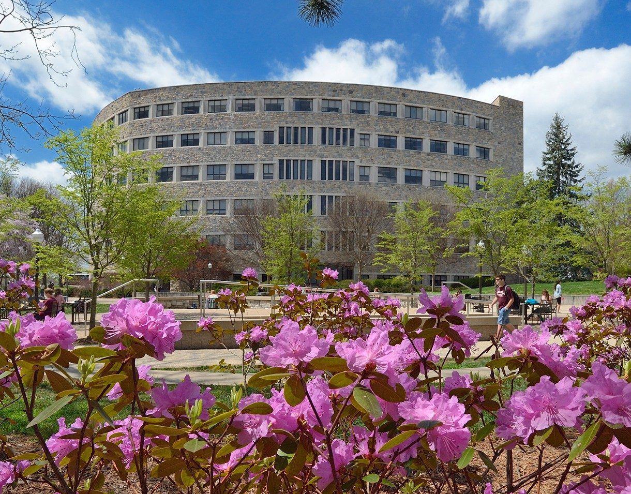
Institutional Context
Land-grant university in southwest Virginia
Serves University, Library, and cultural heritage community custodial needs
5 hosting & access services
VT Publishing
Data Repository
VTechWorks Institutional Repository
SCUA Online (Special Collections & University Archives)
VT Digital Library (Digital Libraries & Preservation)
Carol M. Newman Library. Source: https://www.vt.edu/about/locations/buildings/newman-library.html

Slide 10
Institutional Context
SCUA
Traditional donors giving physical and digital materials
Some University and community collaborations
Established scope and collection development policy
Serves a broad base of scholarly researchers across its collecting areas
Responsible for the interpretation and stewardship of legacy digital content
DL&P
Manages the Virginia Tech Digital Library (VTDL)
Caters to digitization projects out of scope for SCUA but in a larger scope of Virginia Tech and Virginia-related content
No collection development policy → proposal process for stakeholders to make a case for their materials to be included in the VTDL
Manages and maintains the central digital preservation system

Slide 11
Inter-Library Collaborations
Typically includes the unseen labor for University and community projects
Some are Library-specific or grant-funded
Focus on quality and consistency in digitization, metadata, and access
Desire for streamlined workflows and stakeholder input
Ongoing strategy to train colleagues in collection processing, description, and packaging
Scope creep is a risk because communication barriers are lower
The faculty member is also the Project Champion
No MOA required

Slide 12
Inter-Library Collaboration Project Example
Library owns a physical collection and wants to digitize it
Goal: assist colleagues with no prior experience in organizing and processing physical collections and produce minimal metadata
Stakeholders know their storage and access options, but little about processing and specialized metadata
Processing was slow, and the number of items drastically increased from the original estimate → we had to say no to more items
Communication confusion between stakeholders going to subject area experts rather than the collection manager

Slide 13
University Collaborations
Primary nexus for cultivating partnerships brought in via grants with other campus departments
Shared goals have a strong alignment with University mission and vision
Librarians often brought in as co-PIs or consultants
3-4 active PIs/co-PIs in a year, dozens as consultants
Requests are often on access, storage, and data management
*Rarely asked for metadata or digital preservation support
Can often (but not always) be involved with a project at or near the onset → better planning for storage and access
Potential for Library commitment without adherence to formal processes
A senior administrator prioritizes the work
Collaborators establish initial contact with Library personnel outside of the formal channels

Slide 14
University Collaboration Project Example
Grant funding for digitization from a third-party service, but without appraisal and identified storage and access
Goal: minimum baseline for organization, metadata, and documentation prior to ingest
Stakeholders possess limited knowledge of storage and access options and metadata
Requires more time and attention from librarians to understand their resources and capabilities
No MOA required

Slide 15
Community Collaborations
Regional cultural heritage organizations and communities
Building trust is a primary goal → unease or hesitation to trust a larger institution with holding physical materials, accurately representing material, and representing rights to the material
MOA is required
Higher barrier to entry
Community resources (funding, time, expertise) are less robust than University collaborators
Projects may not be fully processed or organized beforehand
Projects may be:
Digitized on-site - VTUL would provide general guidance on digitization specifications
Custody of materials may also be transferred temporarily to the VTUL Digital Imaging Lab for capture and digital processing
Digital facsimiles are returned to the collaborator with the physical materials

Slide 16
Community Collaboration Project Example
Materials that were digitized several years prior at community organization
Not fully organized and processed
Contain multiple file formats of varying quality with some items reaching a point where the VTDL shouldn’t accept it
Little organized metadata
MOA took months to be completed and no proposal documentation exists
VTDL chose to move forward with ingest, acknowledging that raising the visibility of the collection is a higher priority than maintaining a high bar for quality across the VTDL.

Slide 17
Comparison
Metadata creation is a primary, common bottleneck.
More reliance on the collaborators for metadata creation, with our role transitioning into quality control.
Leads to working on the timeline of the collaborators, with adjustments made for learning how to apply a metadata schema
VTUL has historically been more oriented to work with University collaborators
→ Our priorities have shifted to include more diverse collections that have previously been hidden and from collaborative relationships that differ from traditional donor and collections work
Notes:
ALEX END

Slide 18
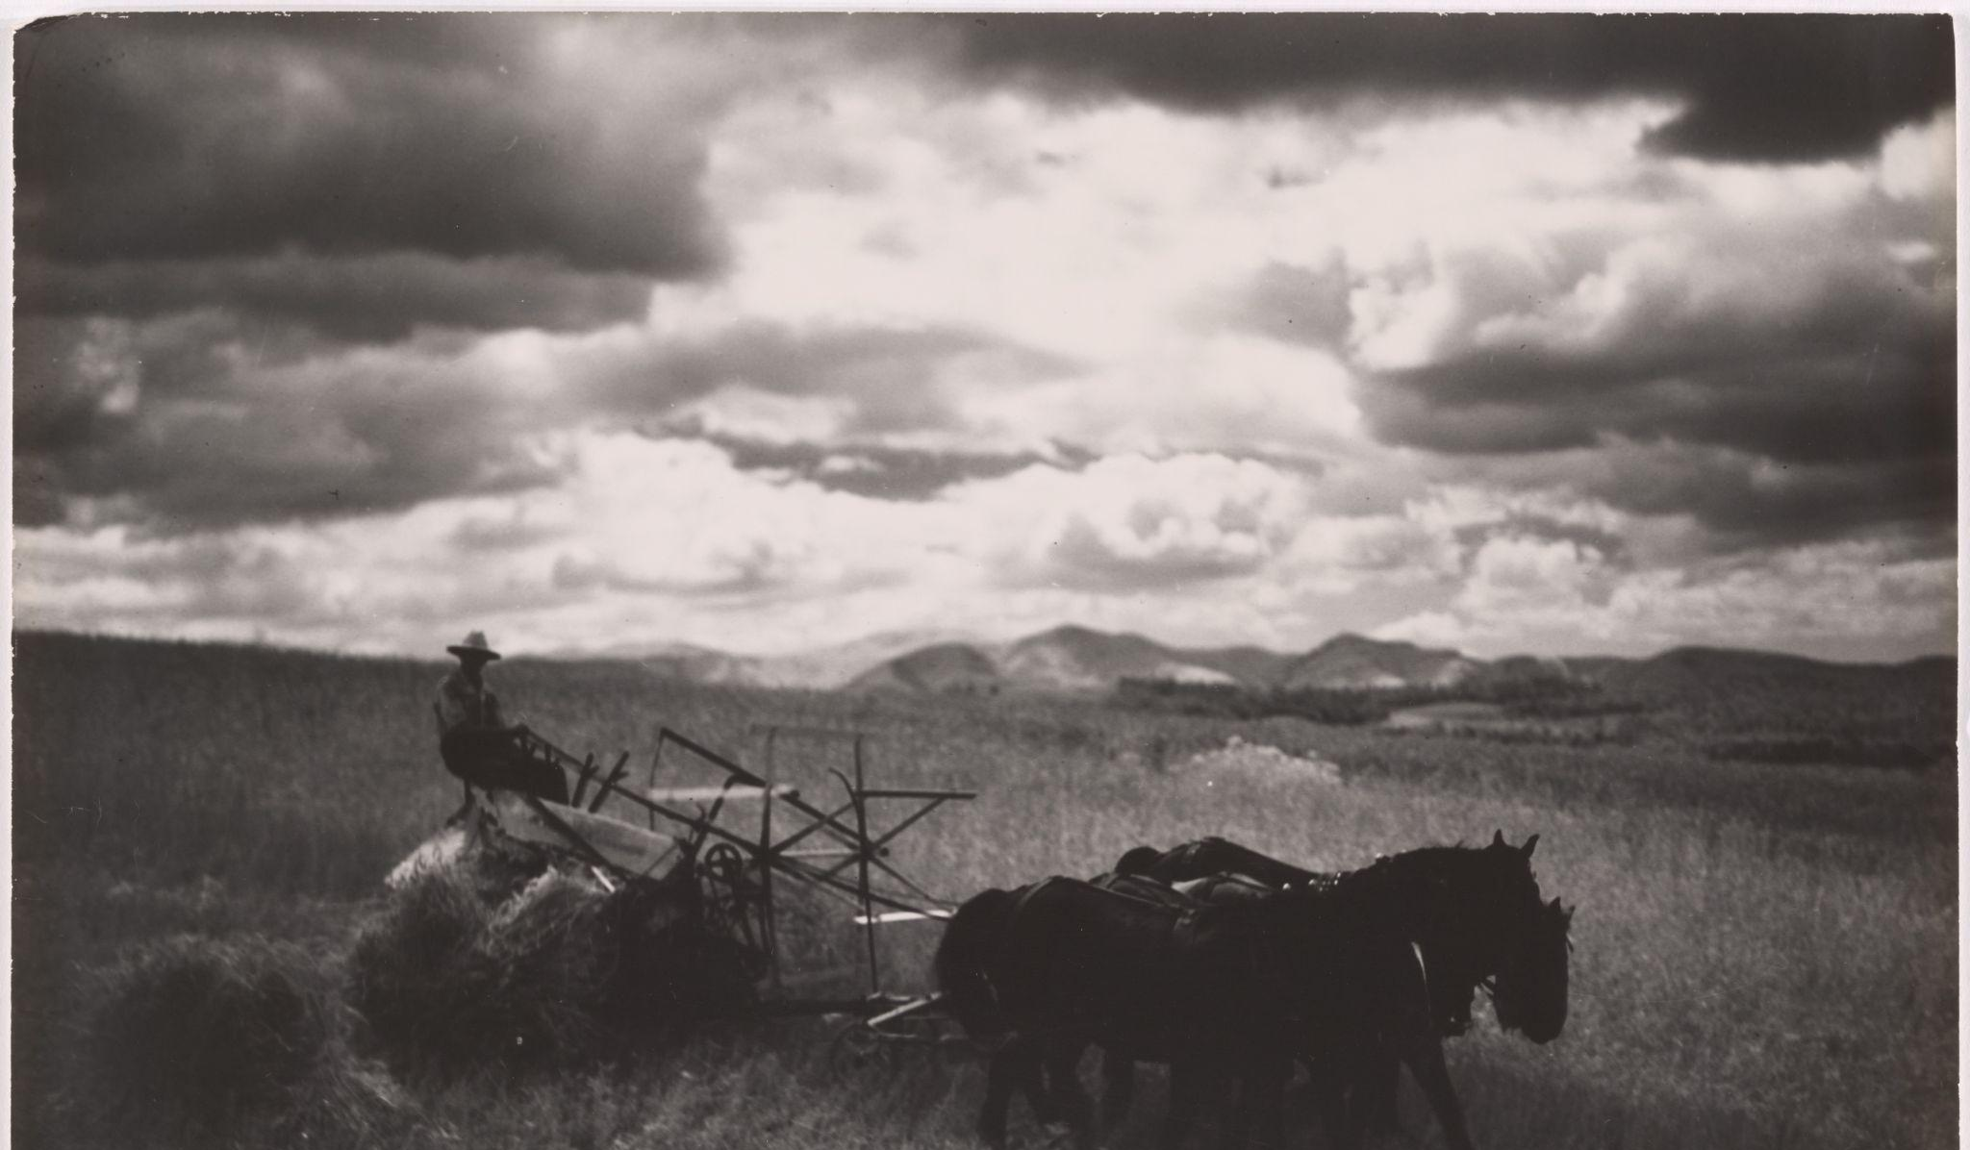
Barriers & Observations
No creator given, “Harvester working with horses in field,” VT Special Collections and University Archives Online, accessed August 29, 2024, https://digitalsc.lib.vt.edu/MC/MC200606061058.

Slide 19


Public understanding of libraries and archives is widely varied and not always accurate.
Digitization is considered the bulk of the work and the main component of preservation.

Slide 20


Labor of even minimal item metadata creation and its purpose in accessibility, and content organization is unanticipated.
Collaborators may not fully consider a variety of types of researchers and how they would like to use the material.

Slide 21


Understanding of rights is key for both parties
Deadlines, research obligations, and the desire to have ‘results’ are primary academic drivers

Slide 22
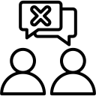
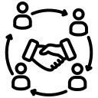
Collecting policies versus the requirements of the collaborator can be at odds.
Both parties need to be willing to learn, put work in, and compromise

Slide 23
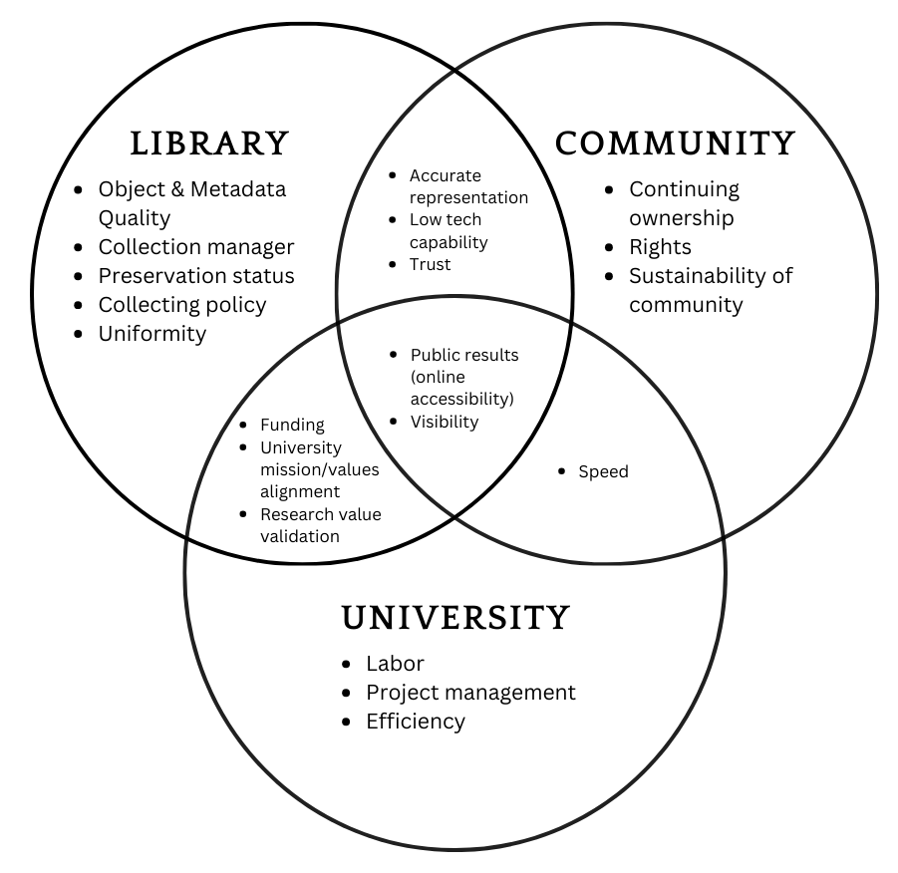
Figure 1: Curation priorities between library, university, and community collaborators
Notes:
BOTH

Slide 24
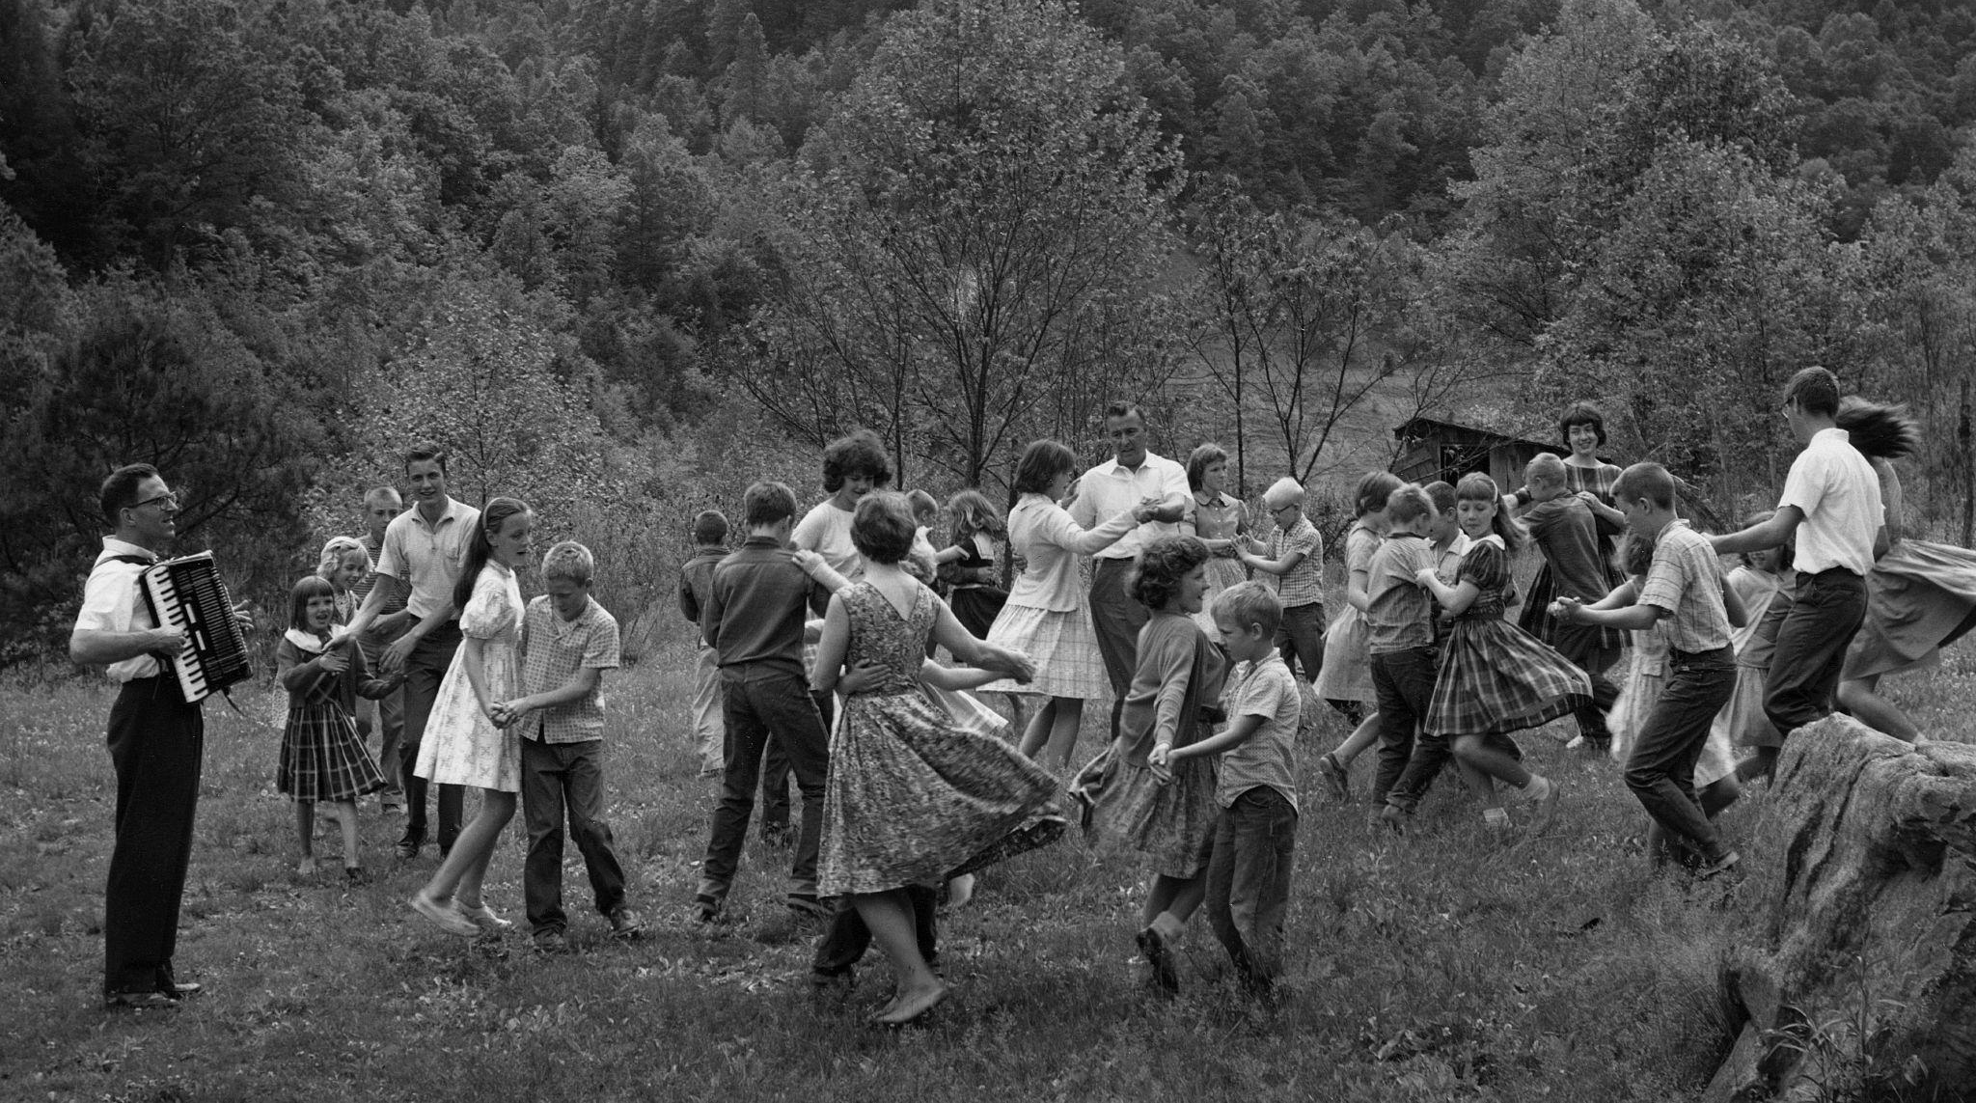
Adjustments, Concessions, & Compromises
Palmer, Earl, 1905-1996, “Folk Dancing,” VT Special Collections and University Archives Online, accessed September 3, 2024, https://digitalsc.lib.vt.edu/Ms1989-025/ep166.
Notes:
ALEX START AGAIN

Slide 25

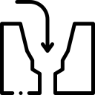
“Good” practices are better than no practices.
Decision-making around resource allocation is a gap being addressed at VTUL.

Slide 26


Shifting to consultations from on-demand services is a compromise.
One size does not fit all and the library must develop different versions of library resources to complement the project type.

Slide 27


Memorandums of Agreement (MOA) allow for transparency, agreement, and project documentation before the project begins.
Saying “no” is a reasonable conclusion to prevent unnecessary work when priorities cannot align.
VTUL Digitization Memorandum of Agreement: https://perma.cc/GD4S-V6US

Slide 28


Community Advisory Boards empower communities and establish a direct line of communication with the library.
Establishing a collection manager for the collaborative team outside of VTUL is key to project success.

Slide 29
Conclusion
Identified hindrances are not likely to slow the Library’s continued push for these collaborations.
Pace of growth in community outreach efforts, and the scholarly interest in the wealth of regional culture, continues to drive collection development.
Individual attention and care can be lost if growth is scaled up.
Adjustments, concessions, and compromises, are informed not only by technical needs but through a dialogue with community partners.
Recognizing curation priorities is key to understanding both the overall vision and the basic technical needs.
Consultant-type model helps identify constituent needs early.
Notes:
BOTH

Slide 30
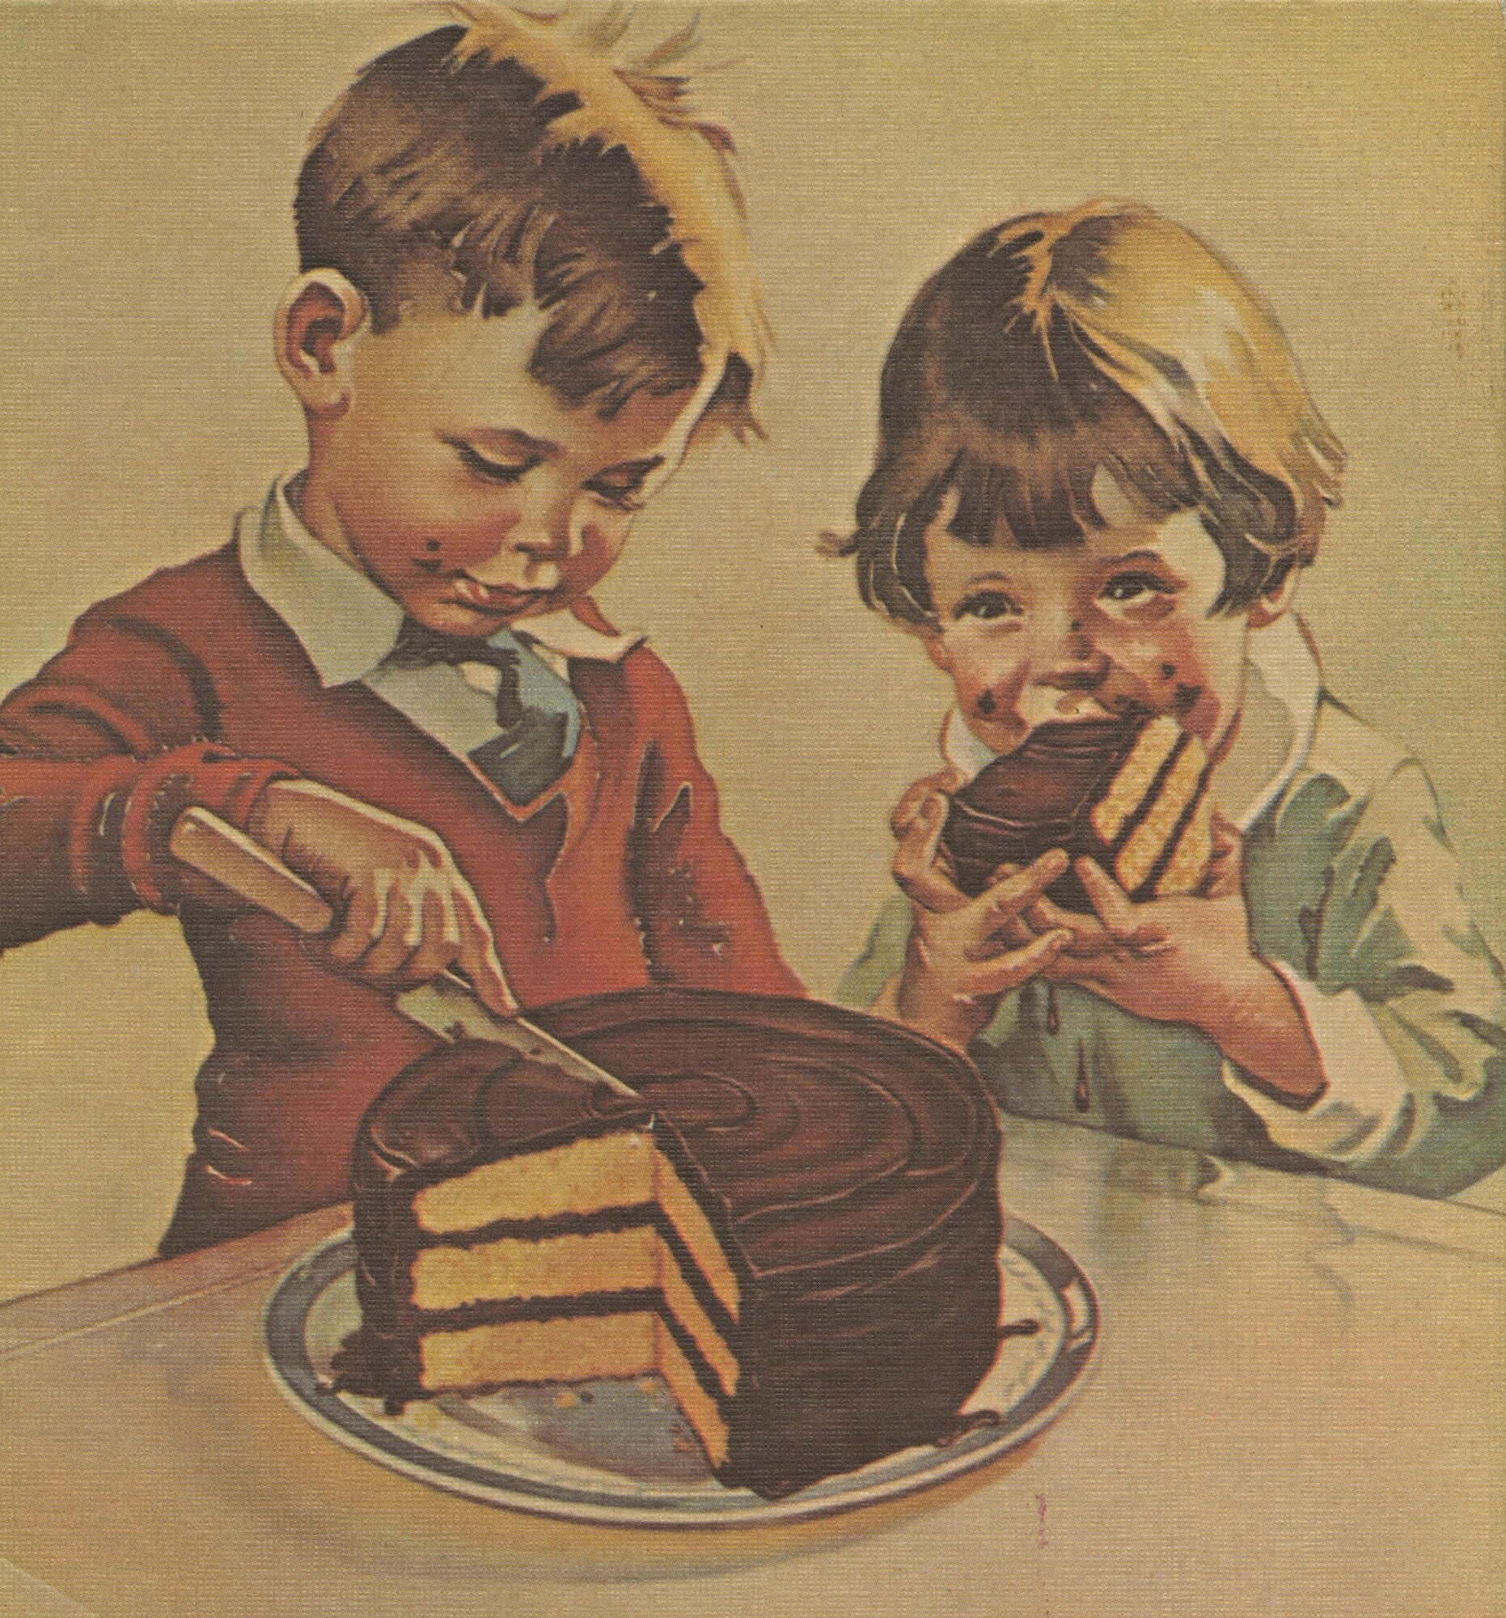
Thank you!
Alan Munshower
Digital Collections Archivist alanmun@vt.edu
Alex Kinnaman
Interim Assistant Director, Digital Libraries & Preservation
alexk93@vt.edu
SCUA Online
VT Digital Library
All icons sourced from Flaticon: https://www.flaticon.com/
Hershey, “Hershey's 1930s Chocolate Ad,” VT Special Collections and University Archives Online, accessed September 3, 2024, https://digitalsc.lib.vt.edu/ChocolateHistory/ChocolateHistory_026.

