Slide 1



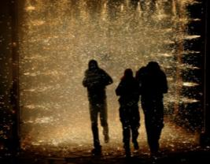

Understanding Strengths
Jonathan Manz, Graduate Assistant
Office of the Senior Associate Vice President for Student Affairs
Responsibility * Arranger * Harmony * Includer * Connectedness

Slide 2

Agenda
Historical Context
Overview of a Strengths Approach
Four Domains of Leadership Strength
The Next Step

Slide 3

Strengths Beginnings
The Gallup Organization
Don Clifton, Nebraska Faculty turned CEO
250,000 interviews
of high achieving
individuals
Notes:
Have you heard of the Gallup Organization? How? The company that does the Gallup Poll, Presidential Polls, etc.
The Gallup Organization…
has studied human nature and behavior for more than 70 years.
Has life-long learning programs that help individuals achieve higher levels of productivity and fulfillment.
Don Clifton taught and researched psychology at Nebraska before making the transition to Gallup as CEO. He was a forefather in the positive psychology movement.
One study focused on finding out what made high achieving individuals successful.

Slide 4

Gallup’s Research on High Achievers
Spend most of their time in areas of strength
Have learned to delegate or partner with someone to tackle areas that are not strengths
Apply their strengths to overcome obstacles
Invent ways of capitalizing on their strengths in new situations
Notes:
Gallup studied high achievers for 30 years, identifying 400 themes of talent, the most prevalent 34 are measured using the StrengthsQuest instrument.

Slide 5
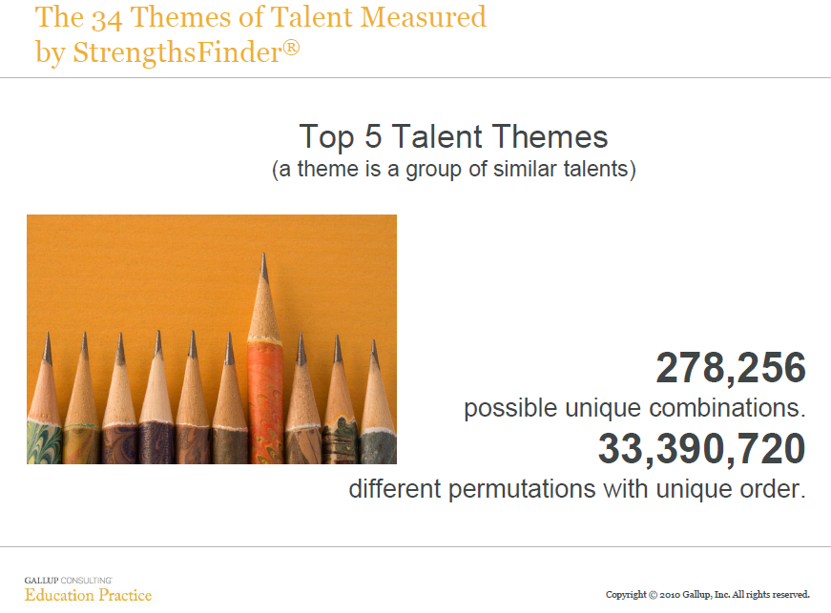
Notes:
The Strengths report will give you your top five talent themes. At this point you may be feeling like this is ‘just another personality test’ and we are trying to ‘box you in.’ Here are some figures of the likelihood that your top 5 will be just the same as someone next to you.

Slide 6

A strengths orientation is about a perspective, not a tool.
Aspirations for Student Learning
Notes:
Psychologists have historically focused on what is wrong with people and how we can in turn fix them. This assessment is grounded in Positive Psychology – the focus on what is right, not what is wrong
what is positive and normal about people
study of positive emotions (optimism, hope, etc.)
Pass out Aspirations for Student Learning booklet or open webpage for what we in DSA are aiming at and will use strengths to orient our students around these aspirations. (Curiosity, Self Understanding and Integrity, Civility, Courageous Leadership, Ut Prosim)

Slide 7
What is a strengths perspective?
Two basic premises:
Individuals already have within themselves what they need to succeed.
“Individuals gain more when they build on their talents, than when they make comparable efforts to improve their areas of weakness.”
Clifton & Harter, 2003, p. 112

Slide 8
Greatness Comes from Building on Natural Talents
2,900
3,000
Average Reader
2,500
Above Average Reader
2,000
1,500
1,000
350
500
90
150
0
Time
One
Time
Two
Time
One
Time
Two
Copyright © 2006 The Gallup Organization, Princeton, NJ. All rights reserved.
Notes:
Some years ago when there was a lot of activity with speed reading courses, Don Clifton had a good opportunity to study the relationship between growth and talent. One of the first discoveries he made was that the talent of the instructor made a greater difference than the program or system that was being used. Looking at large samples, he did not see a significant difference in growth between programs, but he did see that some instructors had groups that had much more growth than others. In addition, he saw the dramatic difference that the individual reader's talent made on their growth. As just one example, a person came into a program reading 90 words a minute. After completing the program, this person was reading 150 words a minute. What misleads us sometimes when we see information like this is that we get very excited about the over 65% growth. But our excitement should cool off when we ask ourselves, "What kind of reading is 90 words a minute?" Would you agree to the answer? "That it is poor." And then we ask ourselves, "What kind of reading is 150 words a minute?" Wouldn't you once agree to poor? If that is the case then that individual has spent considerable time, money and effort to go from poor to poor. And what is in fact exciting is the marked contrast of the person with reading talent who began at 350 words a minute and at the end of the same course was reading almost 3000 words a minute. This clearly underscores the need to build on strengths. Incidentally, the person who went from poor to poor in reading happened to be their city's champion bowler that same year. The time that person spent on bowling was a better investment of their time than on reading. Everyone has unique talents. That is where we get the greatest return on investment.

Slide 9

Writing Challenge
Notes:
Instructions:
Inform participants that they will have 30 seconds to sign their name as many times as they can. After 30 seconds discover who has signed their name the most (admittedly this is a very unscientific study). Inform participants that they have another 30 seconds to try to beat their record, but this time they have to use their opposite hand. After 30 seconds again determine who signed their name the most. Likely no one signed their name as many times the second time as they did the first time.
Take-away point:
You can ask them if they feel like they can eventually get their non-dominant hand to write as well as their dominant hand. It would likely take a long time for them to get that good at writing, but they could do it. “But why?” “Why spend all that time working on something you are not great at when you are already doing it well with your dominant hand?” “Why not work on what you are good at and make it better?”

Slide 10
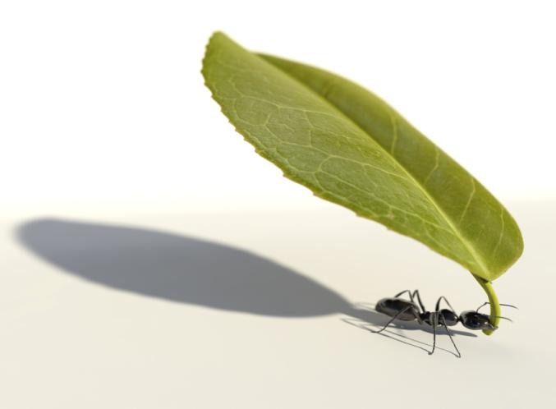
What is a Talent?
“A talent is a naturally reoccurring pattern of thought, feeling or behavior that can be productively applied.”
Notes:
A great number of talents naturally exist within you and each of them is very specific.

Slide 11
What is a Talent?
A talent theme is a group of similar talents
Enjoying hard work
A tendency to push hard to complete tasks
Achiever
Desire to achieve
Having internal motivation
Finding satisfaction in getting things done
Notes:
Talent theme and signature theme are interchangeable with Gallup’s language.
11

Slide 12
Raise Your Hand if You…
talk to people on elevators & airplanes
hate it when people talk to you on elevators & airplanes…
push the elevator button to “remind the elevator” you are there
ask too many questions
get uncomfortable when people ask you too many questions
clean your room before you can relax
like to relax by avoiding cleaning your room
hang items of clothing in your closet according to season
occasionally take the time to hang up items of clothing in your closet

Slide 13
Competence & Strengths
= Strength &
Competence
Talent
x Investment
Predisposition
Requires Effort
Developed
Investment is a MULTIPLIER of talent!
Investment includes time spent practicing, developing skills, & building knowledge
Notes:
“Talent is cheaper than table salt. What separates the talented individual from the successful one is a lot of hard work.”
Stephen King

Slide 14
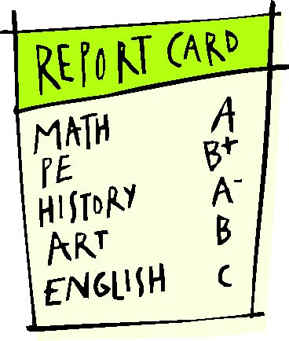
What do you notice first?
Notes:
Participants will likely answer “English” or “C.” Affirm that “yes, our culture tends to focus on what we are the worst at and spend less time in areas where we have excelled.”

Slide 15
Strengths Perspective is Counter Cultural
Current paradigm is deficit-based:
Supervisors spend most of their time working with the weakest performers and zeroing in on mistakes.
Parents and teachers focus on students’ lower grades rather than on their highest.
Weakness fixing prevents failure – strengths building promotes success
Notes:
Transition – Focusing on talent development motivates people. It drives engagement.

Slide 16
Strengths Drives Engagement
Copyright © 1993-1998, 2012 Gallup, Inc. All rights reserved.
*Source: Gallup Poll of Working Population, January-December 2012; n=151,290).
Notes:
This is from a 2012 study of engagement in the work place
This column shows in general the percentage of those actively disengaged, no engaged, and engaged
This demonstrates those whose supervisors completely ignored developing their staffs
Here is when a supervisor focused on weakness fixing
Here is when a supervisor focused on talent development

Slide 17
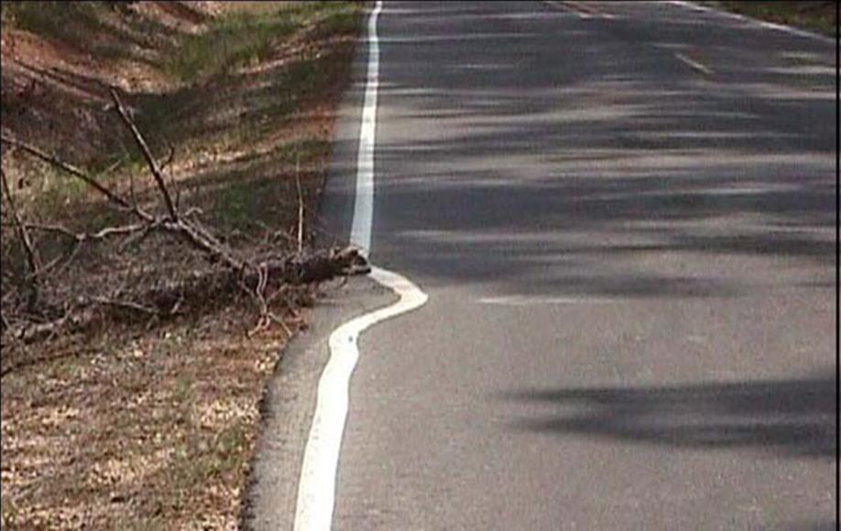
Actively Disengaged
Notes:
So this is what actively disengaged looks like

Slide 18
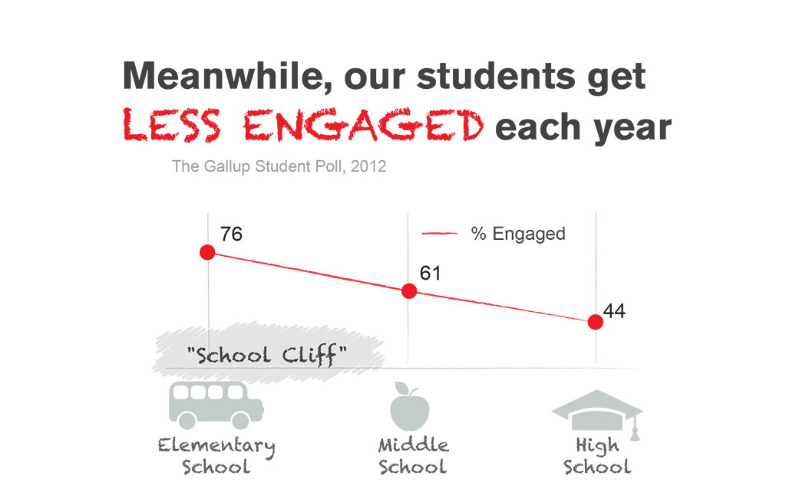
Strengths Drives Engagement
Copyright © 1993-1998, 2012 Gallup, Inc. All rights reserved.
*Source: Gallup Poll of Working Population, January-December 2012; n=151,290).
Notes:
Another 2012 study looked at engagement in our schools.
Interestingly enough, there is actually a small spike in engagement following the junior year. Any guess to why that is?
These are the students that are coming to us. The 44% engaged.

Slide 19
What % of the U.S. population says that their jobs allow them to spend most of the day in work that taps their strengths?
Q: How might your department or work area “beat the odds”
In ways that allows you and your colleagues to flourish?
© 2007. The Marcus Buckingham Company. All Rights Reserved.

Slide 20

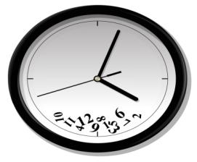


Our strengths affect the way we:
process information
experience others
view time and structure
accommodate change
communicate

Slide 21

Find someone who has a strength that you don’t understand.
Ask them to describe how that strength works for them.

Slide 22
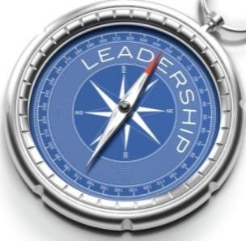
Four Domains of Leadership Strength
Relationship
Building
Executing
Strategic Thinking
Influencing
Notes:
Utilizing these 4 domains is one way to help group the strengths and understand them.

Slide 23
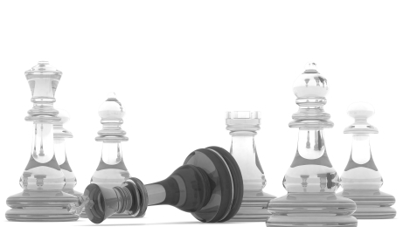
Executing
Knowing how to make things happen
Achiever
Arranger
Belief
Consistency
Deliberative
Discipline
Focus
Responsibility
Restorative
Rath & Conchie, 2009

Slide 24

Relationship Building
The glue that holds the team together
Adaptability
Developer
Connectedness
Empathy
Harmony
Includer
Individualization
Positivity
Relator
Rath & Conchie, 2009

Slide 25


Strategic Thinking
Keeping us focused on what could be
Analytical
Context
Futuristic
Ideation
Input
Intellection
Learner
Strategic
Rath & Conchie, 2009

Slide 26

Influencing
Reaching a broader audience
Activator
Command
Communication
Competition
Maximizer
Self-Assurance
Significance
Woo
Rath & Conchie, 2009

Slide 27
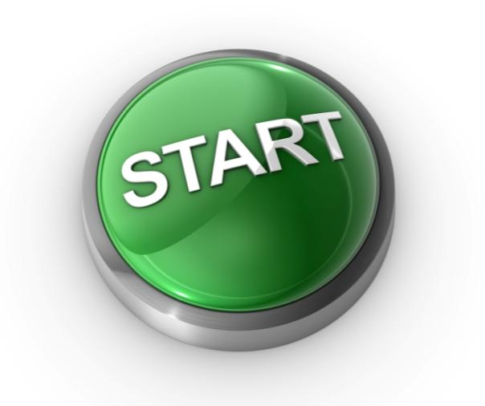
Practical Next Steps
E-mail your Top 5 report to a family member, friend, and to a colleague
Create a team talent map for your organization
Create a plan to develop one of your talents
Take advantage of the VT Gallup site to help take these steps

Slide 28
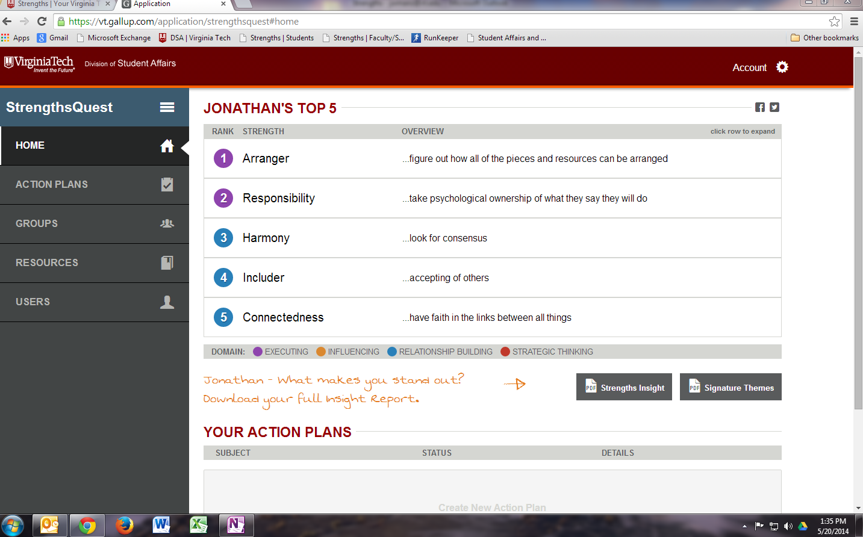
New Site

