Slide 1
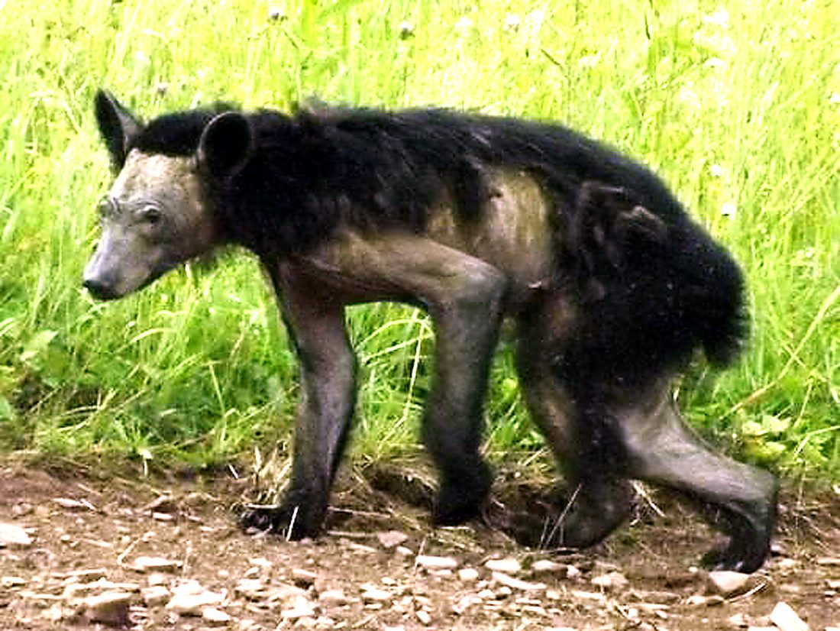
App Track Wildlife Diseases
Shangzheng Ji, Tenghui Zhang, Justin Vu, Jiarui Lyu
CS4624 Multimedia, Hypertext, and Information Access
Instructor: Edward A. Fox
Virginia Tech, Blacksburg, VA 24061, April 20, 2021

Slide 2

Outline
Project Introduction
Project Design
Timeline
Work Completed
  iOS Application
  Website
Testing
Future Works
Lessons Learned
Acknowledgement
References

Slide 3
Project Introduction
Our project focuses on tracking mange, an infectious disease in wildlife.
Design a free-of-cost smartphone IOS application and a website to monitor wildlife disease.
Summarize the data/images collected for posterior analysis and mapping.
Collect the information uploaded by the users

Slide 4
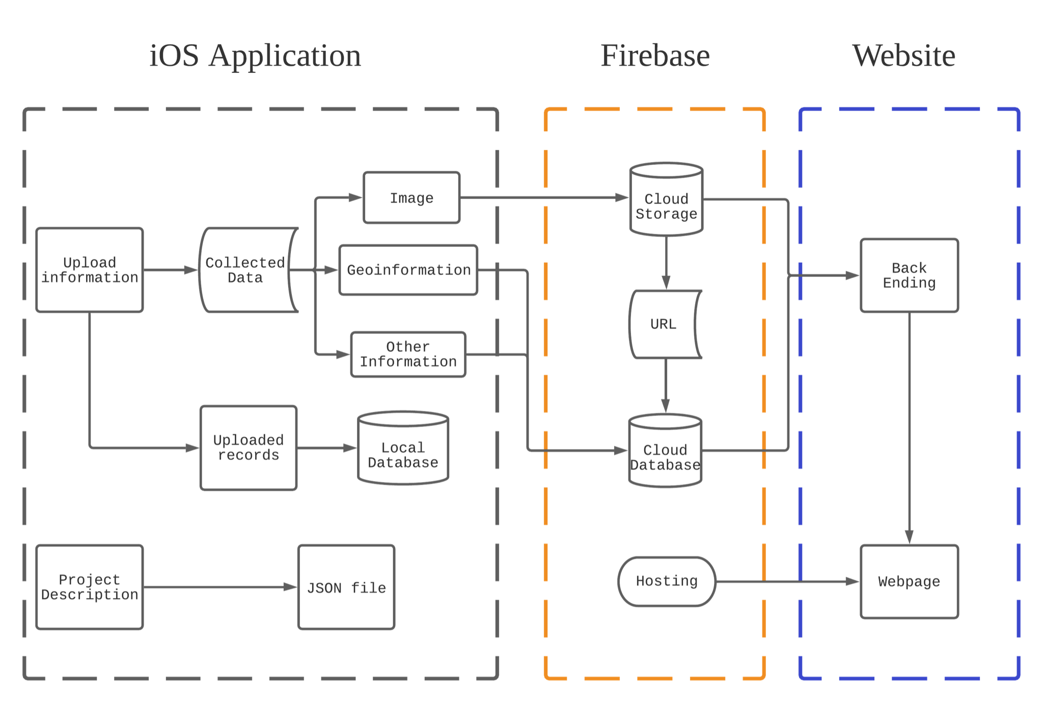
Project Design
iOS Application
Firebase Framework
Website

Slide 5
Timeline
Definition
Design
Implement &
Test
Deliver
January
February
March
April
Meet with Client
Developing Timeline
Establish Roles
Plan IOS application + Web Page
Design map overlay + data representation
First drafts
Test IOS + Web Applications
Bug Reports + Fix
Redesign + Retest
Finalize product
Final Reports

Slide 6
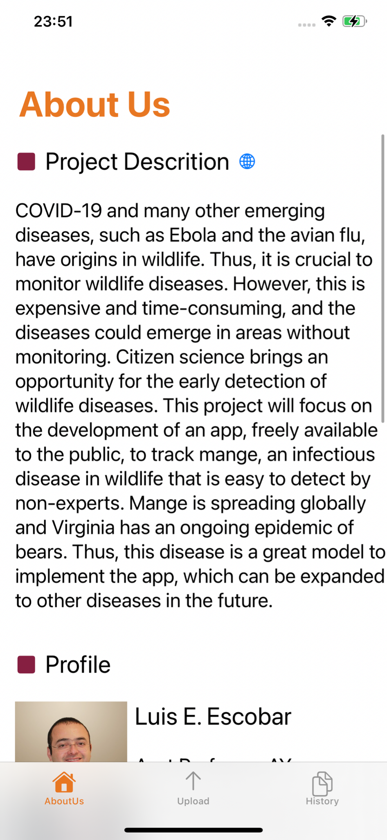
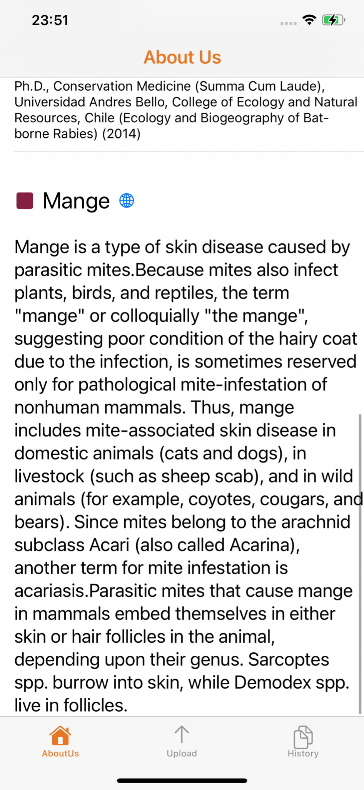
Work Completed - iOS Application
Description page
  Project description
  Profile
  Wildlife disease

Slide 7
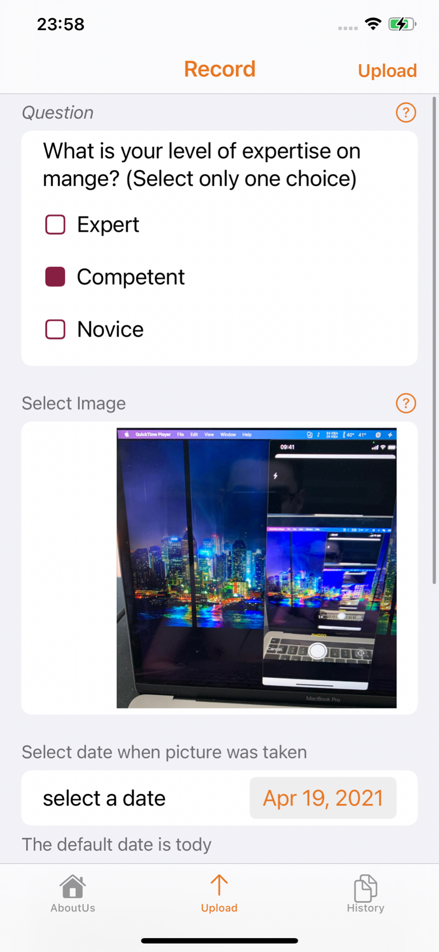
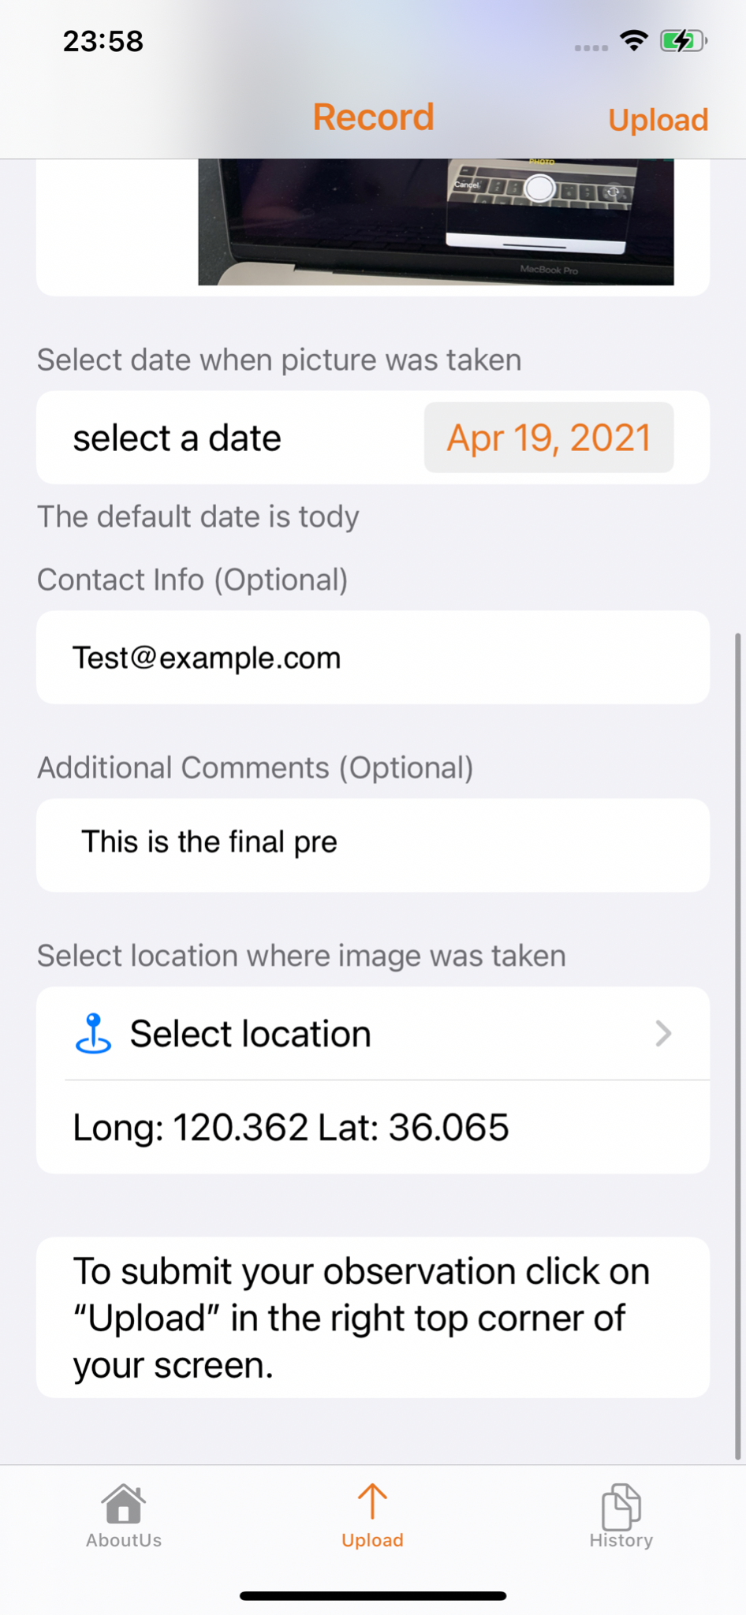
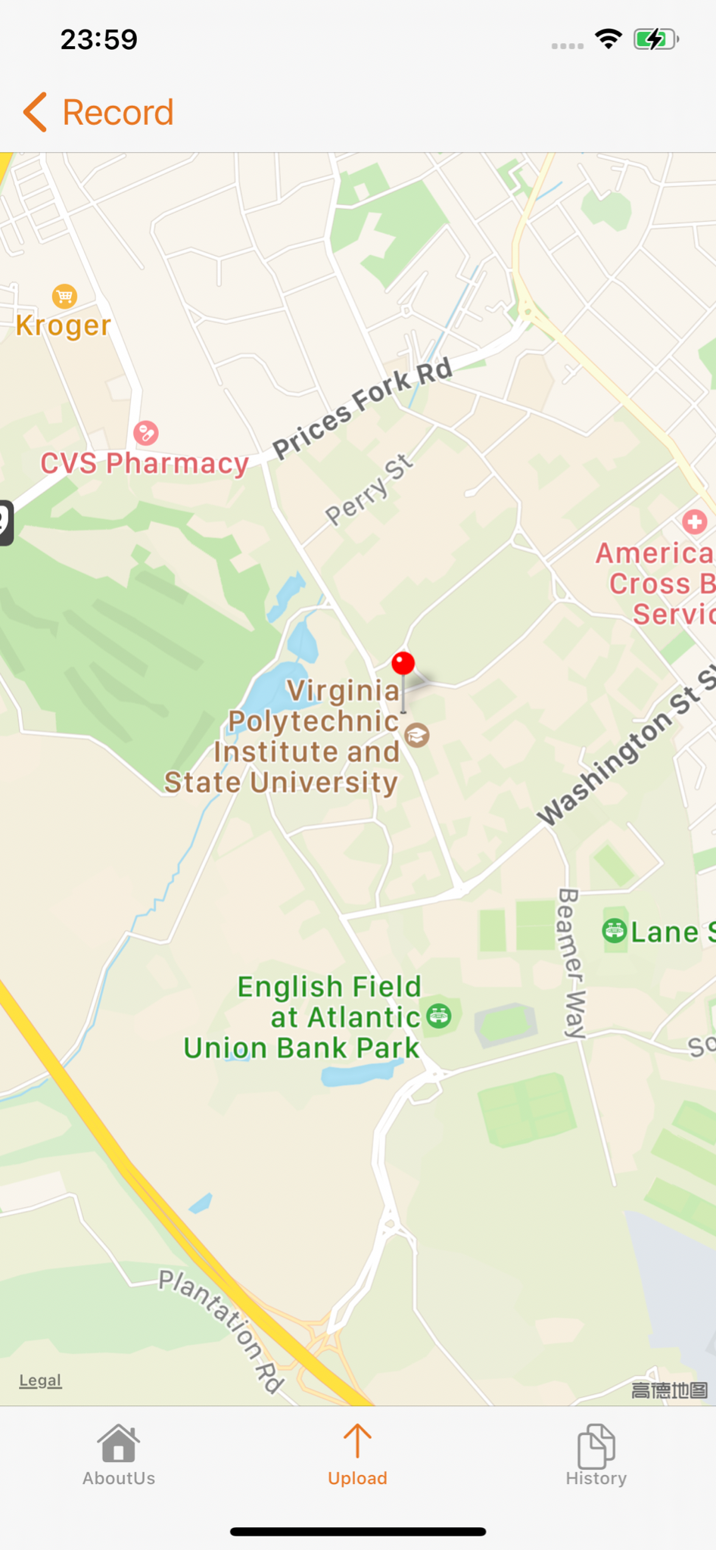
Work Completed - iOS Application
Upload page
  Take the image from camera or Photo Library
  Collecting other information
  Interactive map

Slide 8
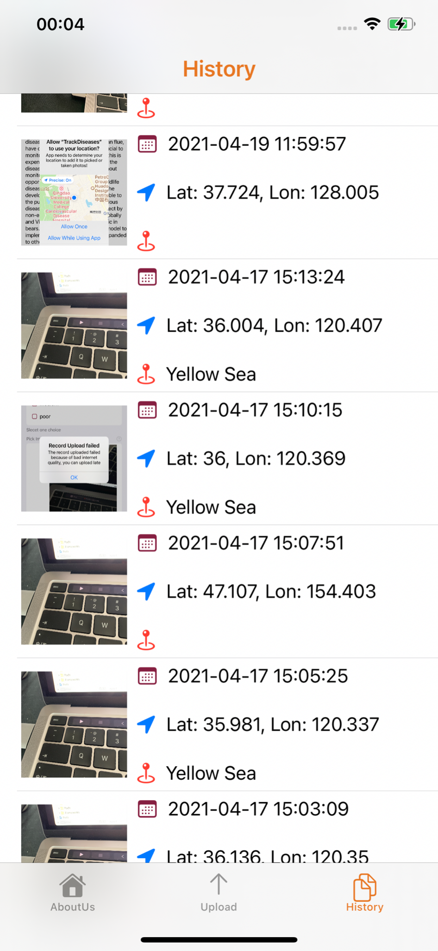

Work Completed - iOS Application
History page
  Track the personal upload history

Slide 9
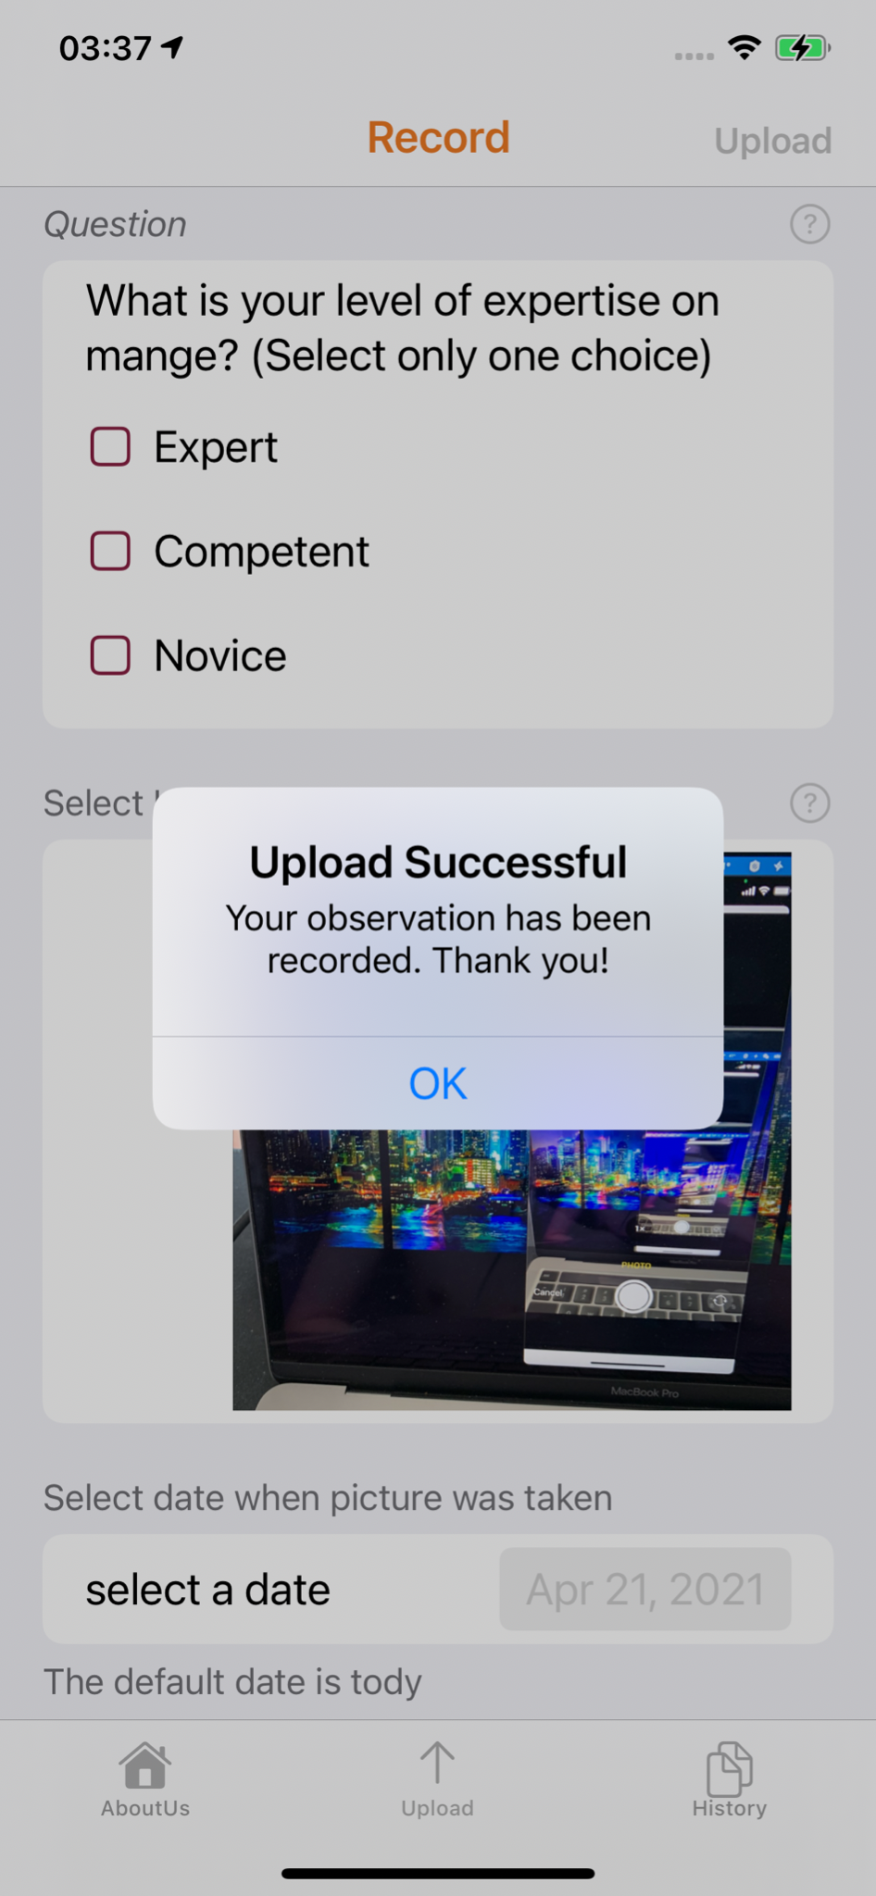
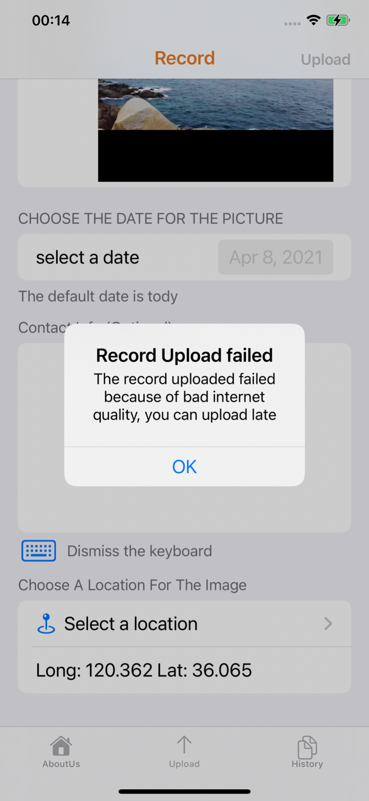
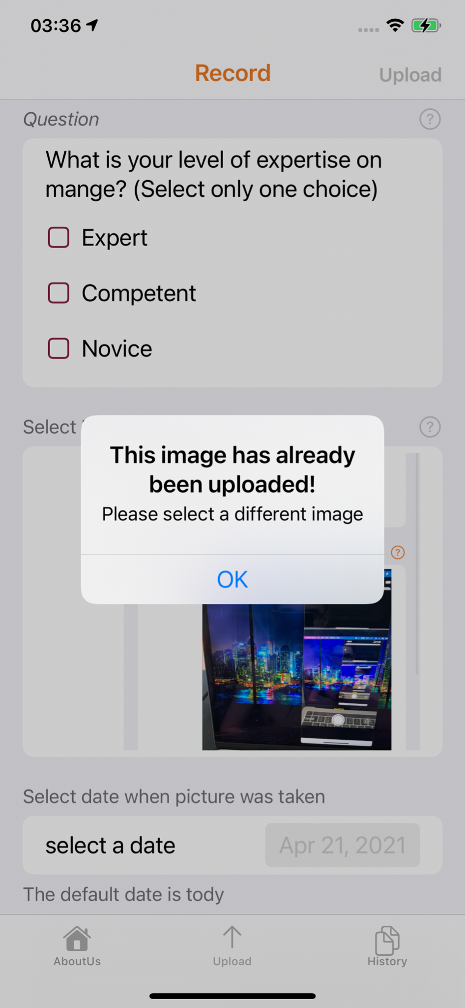
Work Completed - iOS Application
Alert for users
  Give users feedback when the user upload the record
  Keep user using the app in right way

Slide 10
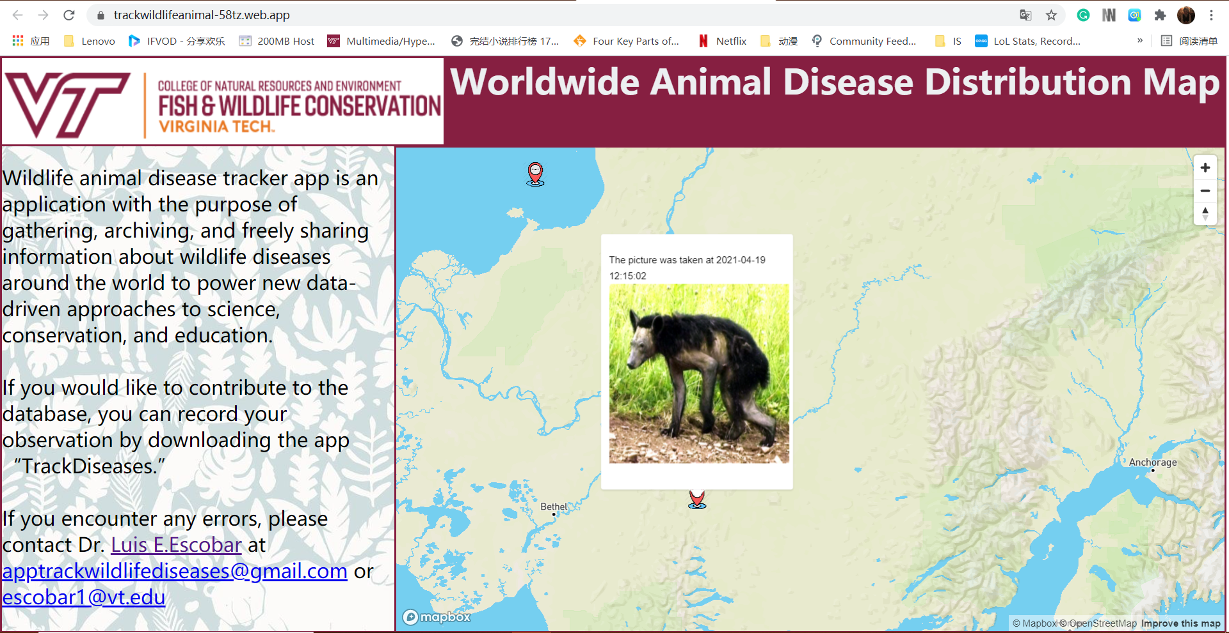
Work Completed - Website (User End)
Users are allowed to zoom in and zoom out for the map and click the popup for addition detail.

Slide 11
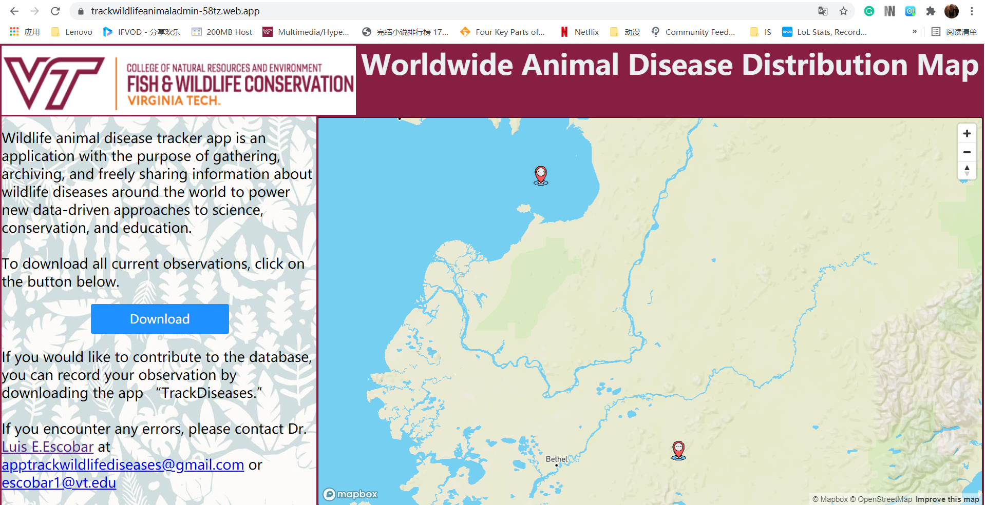

Work Completed - Website (Admin End)
Unique website address for the admin user for downloading all of the data.

Slide 12
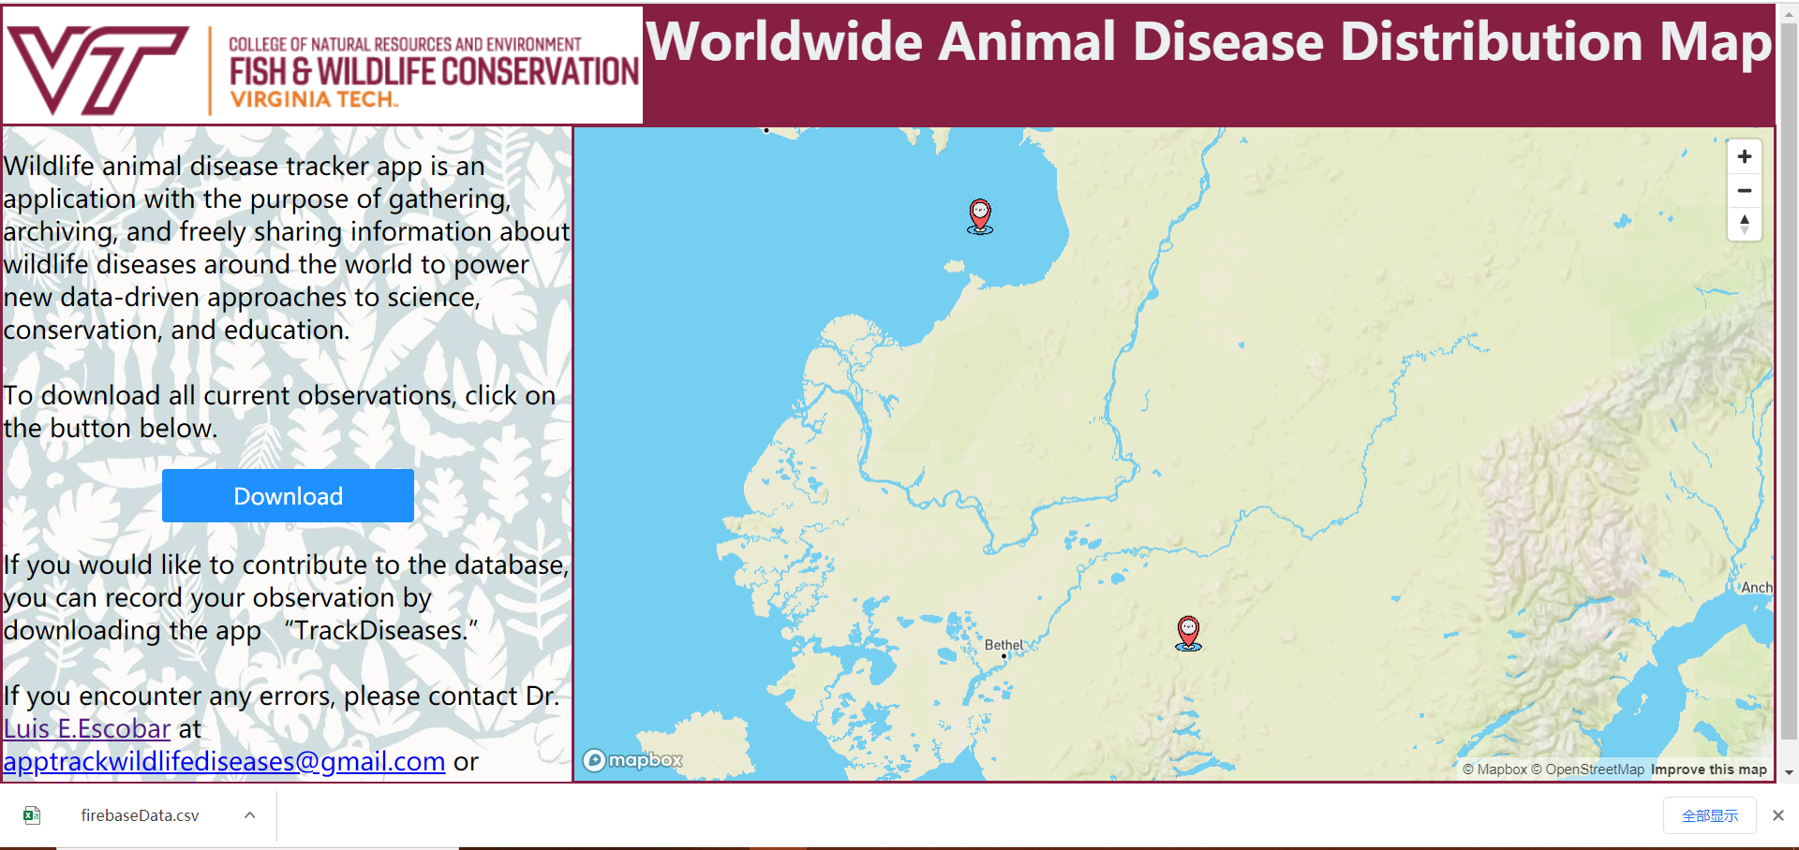
Admin end - Download Function

Slide 13
Testing
Functionality
App
Typos and format errors
Optimization
Website
Make the change according to app
Appearance
Add one more website

Slide 14



Lessons Learned
Developing in new databases (Firebase/Mapbox)
Importance of user experience
Teamwork!

Slide 15
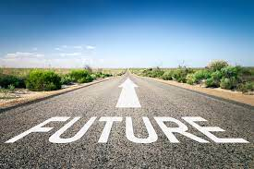

Future works
Testing
Improvements to the app
App more widespread

Slide 16
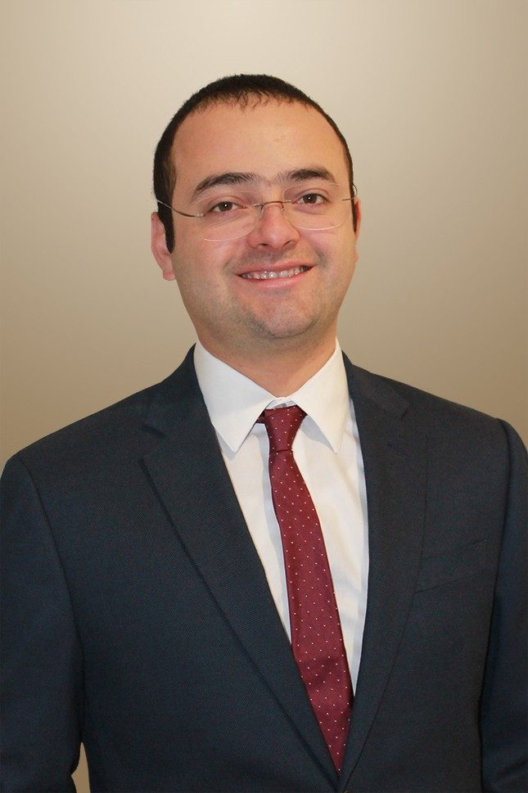
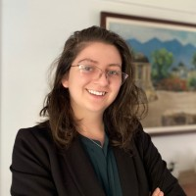
Acknowledgement
CLIENT
Luis Escobar, Assistant Professor,
Department of Fish and Wildlife Conservation
escobar1@vt.edu
Assistant Professor Luis E. Escobar
TESTER
Mariana Castaneda-Guzman
Department of Computational Biology and Disease Modeling
Mariana Castaneda Guzman - Virginia Tech - Annandale, Virginia, United States

Slide 17
References
Fish Disease Application - Fish Kill
Bear Mange - Pennsylvania bear mange epidemic focus of Penn State, Game Commission
iOS Design Application - Google Firebase
Mapbox - Web applications | Help

Slide 18
Questions?

