Slide 1
Opportunities for Cloverbuds
How to engage this young group of eager horse loving youth!

Slide 2
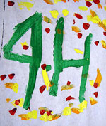
What is a Cloverbud?
Ages 5 – 8 as of January 1 of calendar year
Intended to create a fun and educational experience for youth to:
Work with others
Explore interests
Build self confidence
Prepare for regular “project” club or experiences
Fun little person full of enthusiasm and wonder!

Slide 3
Cloverbud participation principles
Introductory and exploratory program
Non-competitive atmosphere to provide experience
No score or rating
This age group progresses at own pace
Cloverbud participation is “activity focused” not “project focused”
Should not be an on-going project
Though they may be able to physically complete an activity, they may not understand the reason for process or result
Equally as problematic as youth who cannot safely perform activity and thus need this participation-only format

Slide 4
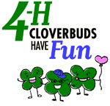
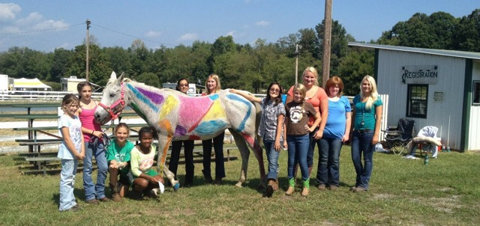
Cloverbuds in horse clubs
Safety first
Fun participation
Recognize successes of participating, not outcome
Requires more adult supervision
Attention span limited
Engaging, age-appropriate activities
Specific curriculum
VA 4-H
NC 4-H
SC 4-H

Slide 5
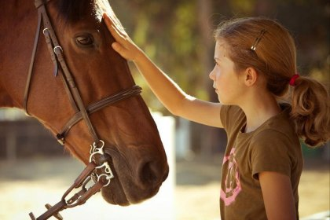
Activities
Record Books
Age appropriate
Avoid financial records or excessive horse management details
Include fun activities
word searches, coloring pages, drawing boxes, writing a 4-H story
Day camps
Half day is appropriate
Team work/cooperation
Physical activities
Barnyard Olympics, etc.
Subject matter knowledge
Hands-on activities
Parts of horse or tack
Learning what horses eat

Slide 6
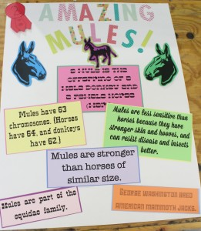
Activities
Creative contests
Excellent “horseless” horse project
Ex. Educational posters, crafts
School, home school groups, church, or within club

Slide 7
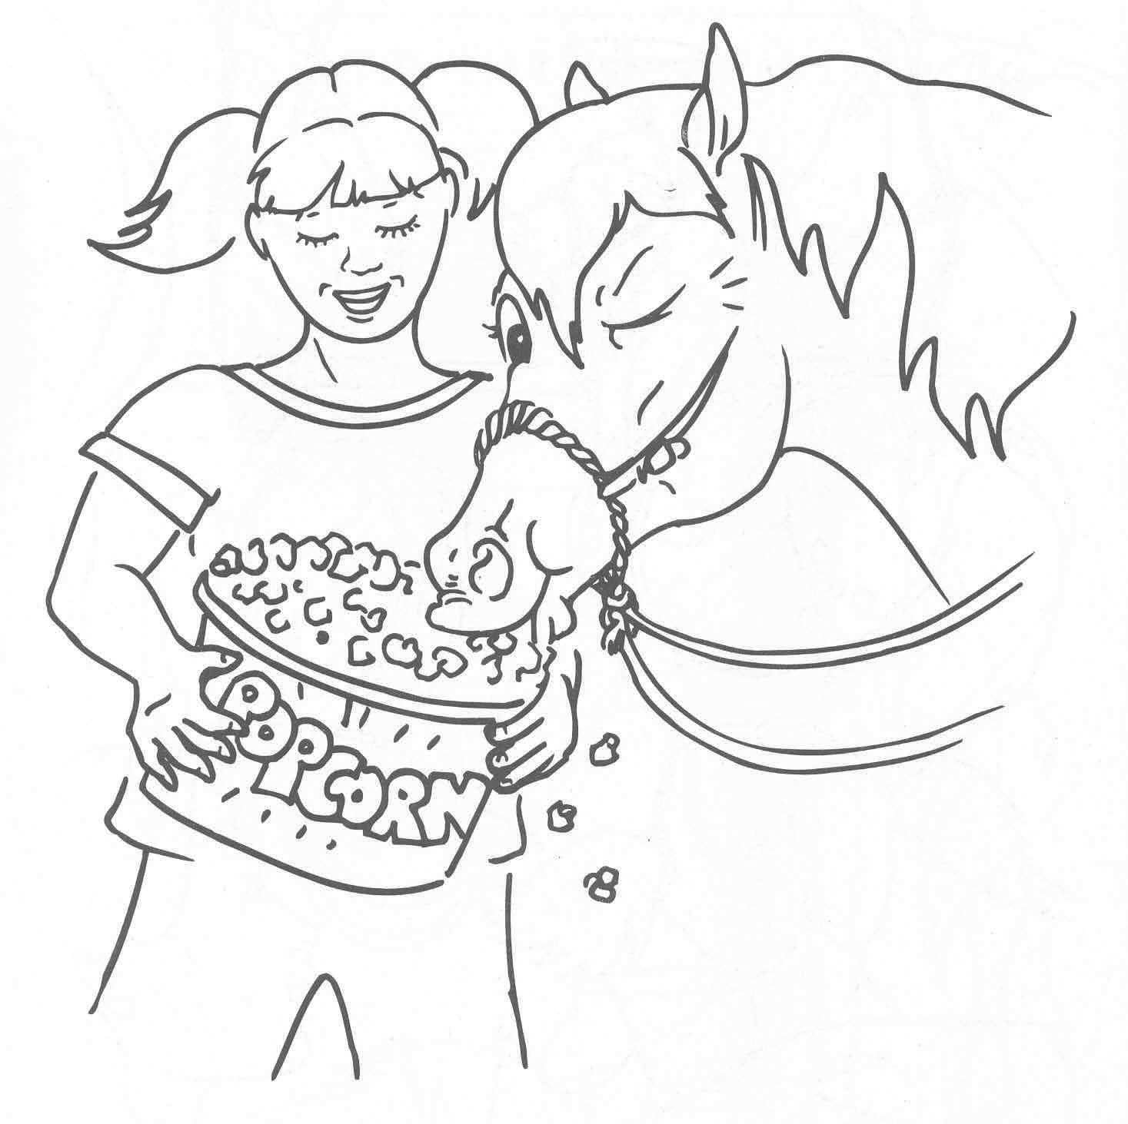
Activities
Fun nights
Game nights (Horseopoly, Horse Bingo)
Drawing horses and have Cloverbuds describe it
Name, how do you feed it, what does it do
Draw picture
Have older 4-H partner read it aloud for public speaking practice…often silly but fun!
Have kids go through a “trail pattern”, “barrel race” or “jump a course” with stick horse
Movie Nights – Horse in the Gray Flannel Suit, Spirit, etc.

Slide 8
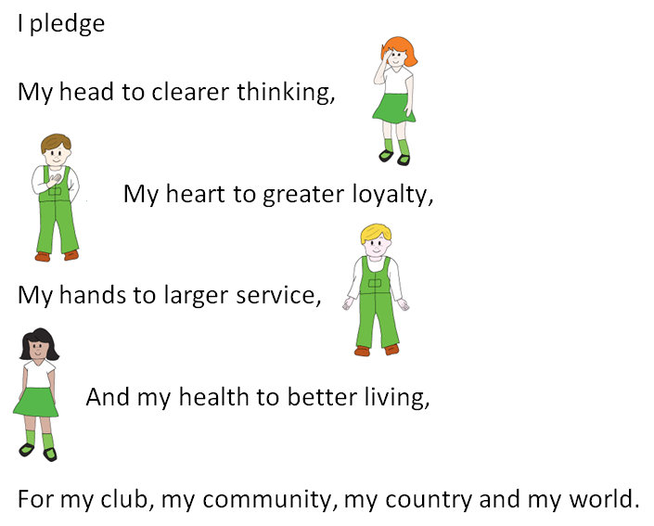
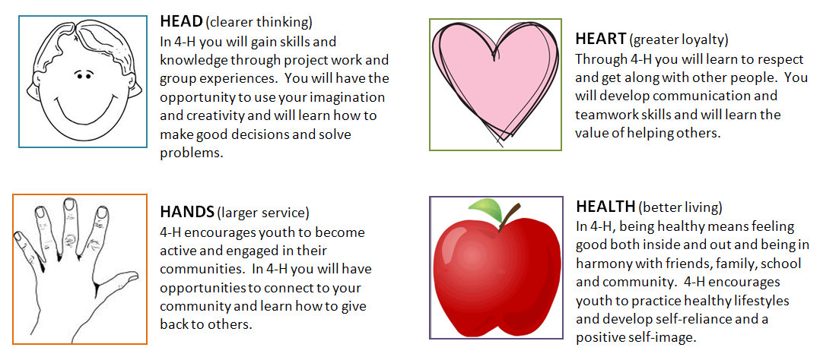
Activities
Learn the 4-H pledge
Introduces them to speaking aloud
Learn about all those H’s
Think about ways to connect these to horses

Slide 9
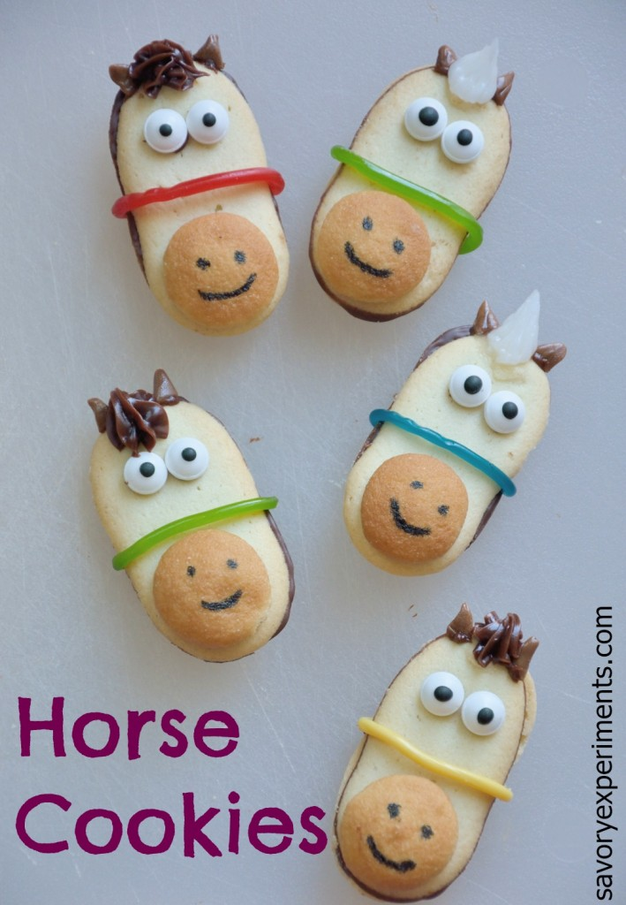
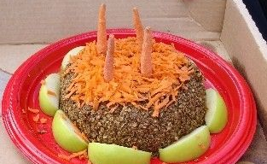
Activities
Make no bake horse treats
Ingredients
Following directions
Hands-on
OR…yummy horse treats for kids!

Slide 10
Activities
Cloverbud divisions of educational contests (depending on state)
Cloverbud Field Day
SC → has Cloverbud divisions for each educational contest
Merit/participation ribbons/awards
Makes it less “scary” when they participate at age 9 in Junior-level competition
Horse Show divisions (depending on state)
Exhibition only
SC allows walk/trot Cloverbud pleasure and showmanship classes
Have spotters in center of ring
All riders get a blue!
Virginia does not allow Cloverbuds to be in sole control of a horse
DO allow Leadline classes!

Slide 11
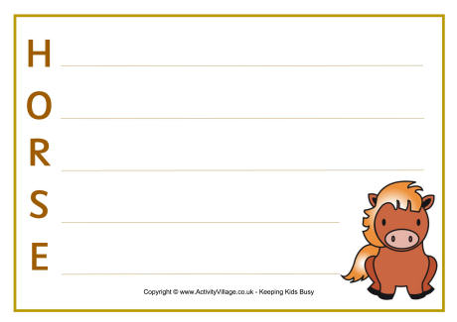
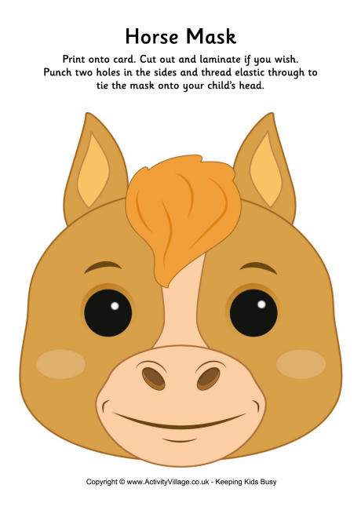
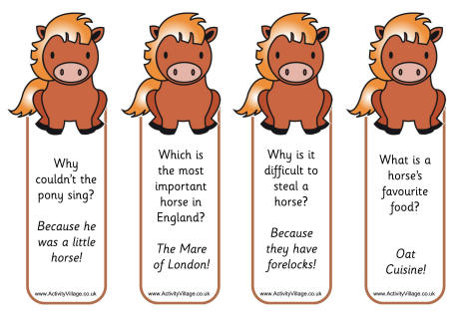
Idea Sharing…
What have you done with your Cloverbud 4-H youth?
Notes:
Acrostic poem – word with each letter
Make book marks (these have horse jokes)
Horse Mask

