Slide 1
Validation of Ebola LOD
Team Members:
Jonathan Downs
Yash Pant
Instructor: Dr. Edward Fox
Client: S.M.Shamimul Hasan
School: Virginia Tech - Blacksburg, VA
Date: 4/28/2016

Slide 2
Background
Ebola epidemic of 2014
Largest database of Ebola data
Large amount of data that needs to be verified
Validate data

Slide 3
Project Goal
Goal: To create script that allows a user to validate data in the Ebola database
Gather data sources that can validate the data in the database
Input CSV file of data into script
Run script to compare input CSV and Ebola database values
Produce output CSV, showing the result of the comparison
Input RDF file of Ebola database into script

Slide 4

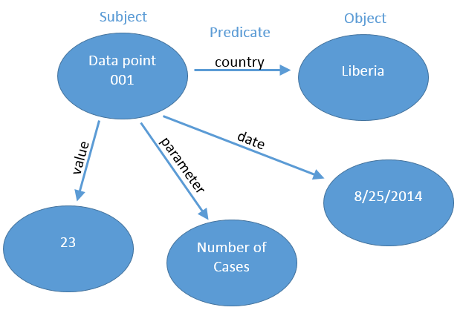
RDF

Slide 5
Prototype - Overview
Written in Python
Focused on specific dataset (time-series data in Guinea)
Focused on one validation file

Slide 6

Prototype - Algorithm
Matched every row in an input CSV file to one data point in the RDF database
Searched for data points by looking at country, date, and parameter
Compared the value at each data point to validate it
Example of row in CSV:

Slide 7
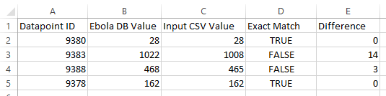
Prototype - Sample Results

Slide 8
Final Script - Overview
Final script generalizes prototype to take various input sources
Allows a user to input any relevant CSV file as an input, using a GUI
Delivers an output CSV showing a comparison of input and Ebola DB

Slide 9
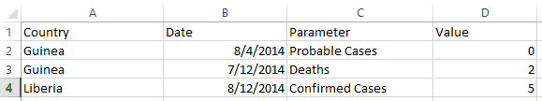
Modifications to Prototype - Parsing CSV’s
Changed script to parse any CSV inputted
CSV to RDF relationship:
Predicate
Object
Subject

Slide 10
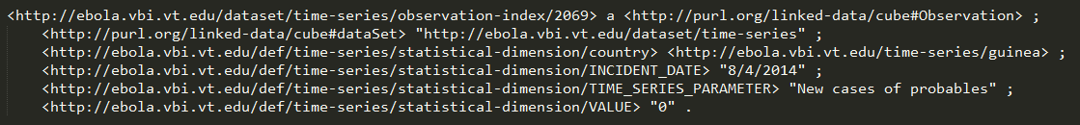
Modifications to Prototype - Searching
Create a composite key to search the database for data points
  Take pairs of predicate and object to find subject
  Validate one predicate (data field) at a time
Validating: 0 Cases in Guinea on 8/4/2014
  Create composite key with the following pairs of (predicate, object): (Country, Guinea) (Incident Date, 8/4/2014) (Time Series Parameter, New Cases of Probables)
  Run search based on this key to find the associated RDF subject (data point)
  Get the number of cases from the subject found

Slide 11
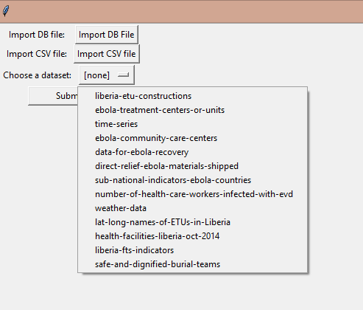
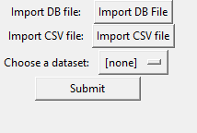
GUI Elements

Slide 12
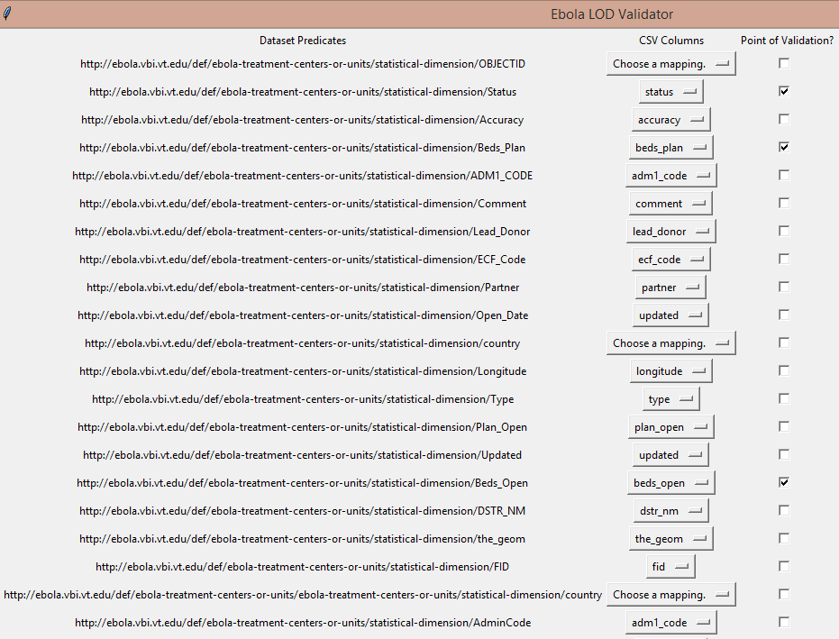

Slide 13
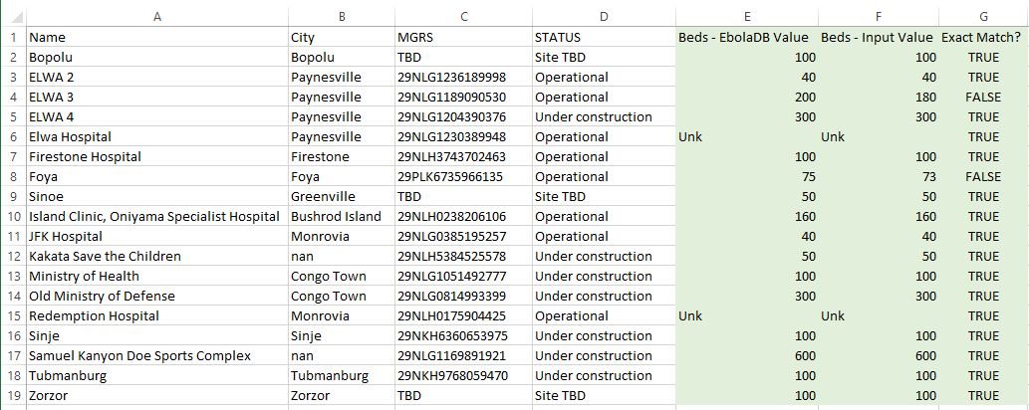
Sample Results

Slide 14
Sources
http://fadyart.com/en/images/stories/rdf.png

