Slide 1
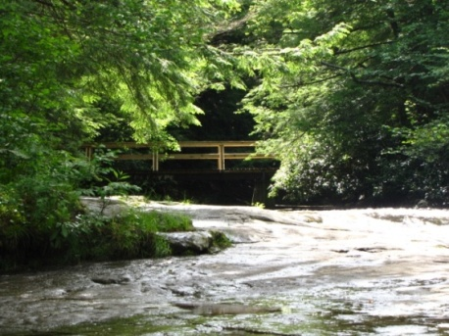
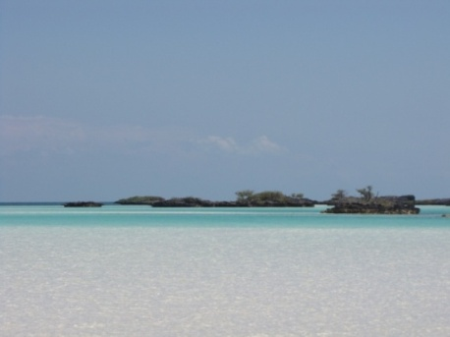
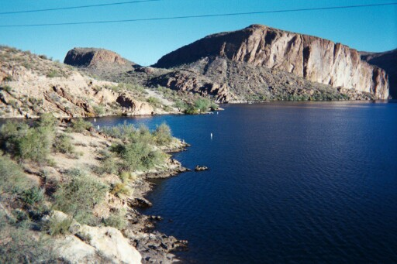
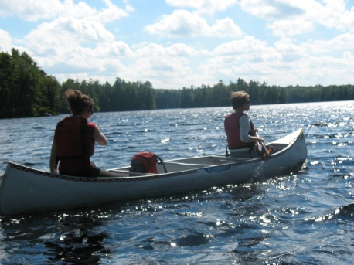

Water & Lands Recreation Opportunity Spectrum (WALROS)
An Inventory, Planning, and Management Tool
Dr. Joshua Carroll, Isabelle Mohl, Alexis Taylor
Radford University
Department of Recreation, Parks & Tourism

Slide 2
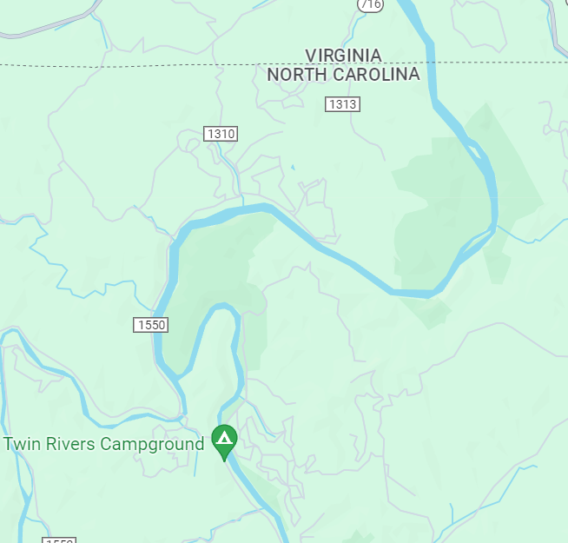
The New River
~320 miles - NC, VA, WV
N & S fork of New
Reservoirs
New River Gorge
Boating, Fishing,
Paddling, Hiking,
Cycling, Wildlife
Meets Gauley to form
Kanawha River
Notes:
Starts at the confluence of the south fork of new and north fork of new (arrow points to this point)

Slide 3
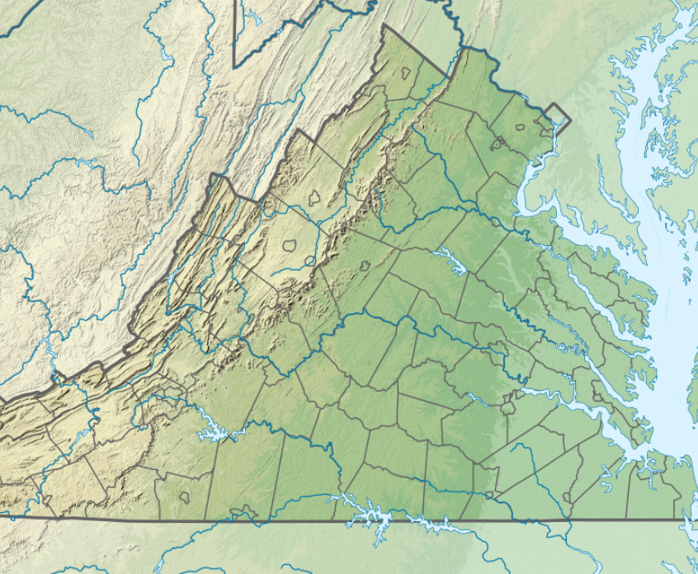
Claytor Lake
SW VA
4,500 surface acres
21 miles long
New River impoundment
1946–Claytor Lake State Park
  450 acres
  Water access & recreation (launch, trails, marina, waterside facilities, camping)
Boating, Fishing, PWC, Touring
Shoreside Development

Slide 4
Recreation Resource Management
Interdisciplinary nature: balance social, economic, and
ecological needs and preferences
Resource
Rules for Playing Field
Humans
Parks
Trails
Rivers
Reefs
Fishing grounds
Carrying capacity
NR’s
Ecological issues
Wildlife
Preferences
Needs
Behaviors
Motivations
Social
Conflict
Perceptions
Stakeholders
Livelihoods
Resource Allocation
Catch Limits
Permits
Access Points
Fees
Regulations

Slide 5
Water and Lands Recreation Opportunity Spectrum (WALROS)
Recreation
Activity + Setting = Experience > Benefits
Many activities
Physical attributes
Social attributes
Managerial attributes
Many dimensions
Multiple senses
Individual
Community
Economic
Environmental
Managers Recreationists Society
Manage Consume Gains

Slide 6
Setting Attributes
Physical
  Permanently fixed, not likely to change soon
  e.g., dams, bridges, buildings, parking lots, roads, NR modifications, natural ambiance, closeness to community
Social
  Visitor activities, behaviors, perceptions
  e.g., visitor presence, impacts, concentration, comforts,
  safety, recreation diversity, solitude
Managerial
  Managed or changed by agency
  e.g., management presence, access, regulations, facilities,
  patrols, services

Slide 7
Six WALROS Classes
Urban
Suburban
Rural
Developed
Rural
Natural
Semi
Primitive
Sub-classes (11)
Primitive
Notes:
7
Urban Rural Developed

Slide 8
WALROS is a Tool
Inventory tool
  Map current supply
Planning tool
  Proposed changes
Management tool
  Focus future efforts
  Set goals
Rivers
Lakes
Coastal zones
Marine protected areas
Trail systems
Forest lands
Parks

Slide 9
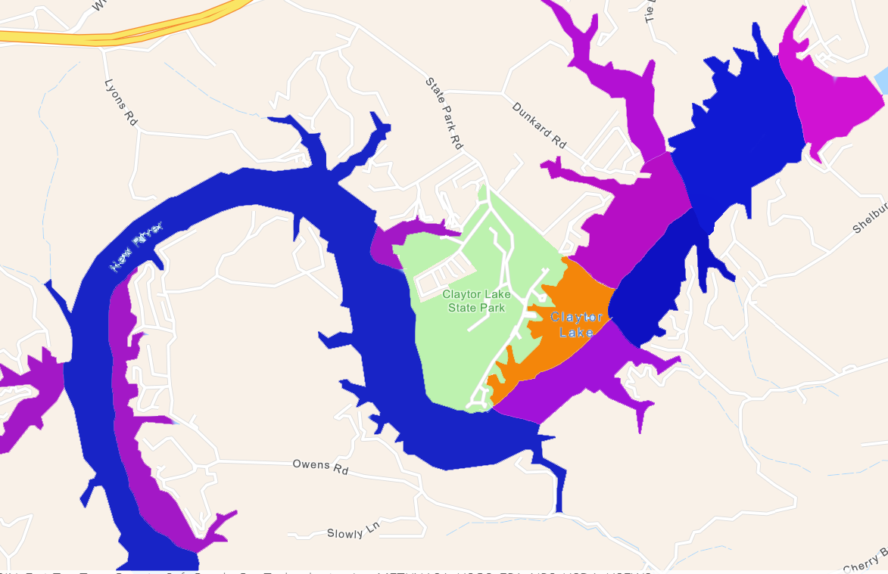
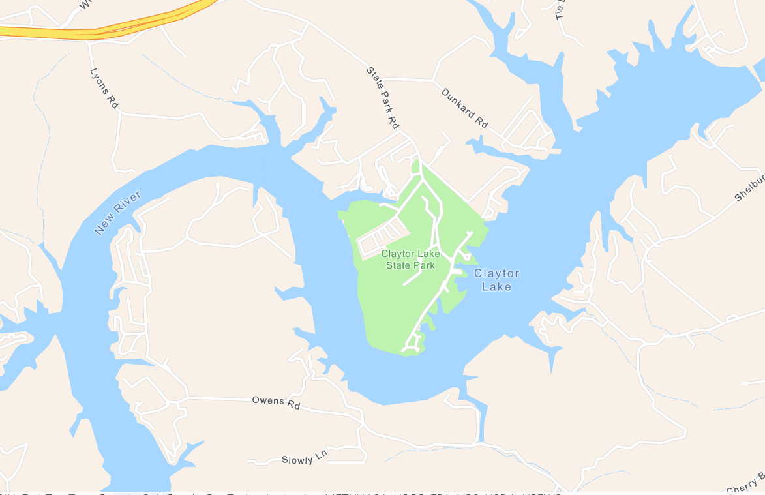
WROS Mapping: Claytor Lake
Urban
Suburban
Rural Developed
Rural Natural
Semi-Primitive
Primitive

Slide 10
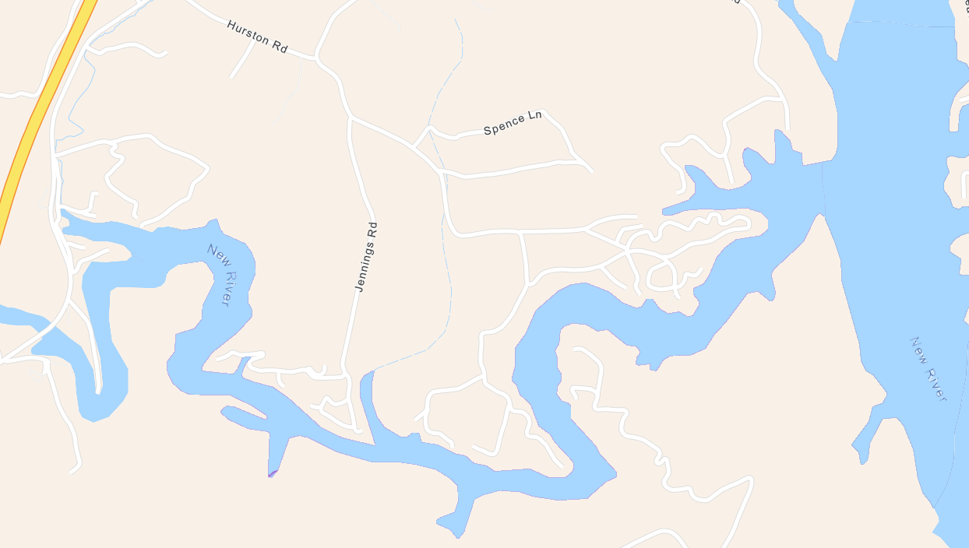
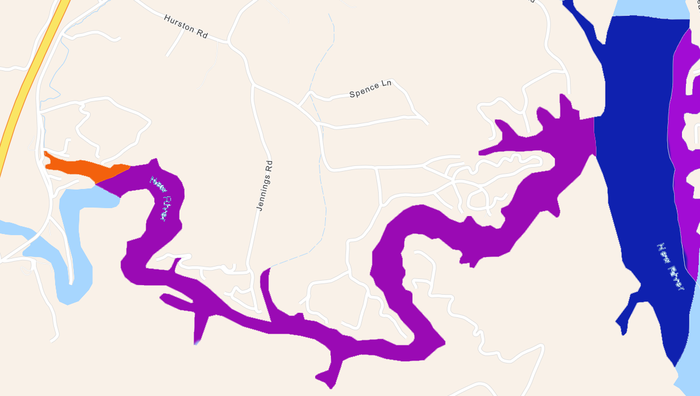
Claytor Lake: Peak Creek
Urban
Suburban
Rural Developed
Rural Natural
Semi-Primitive
Primitive

Slide 11
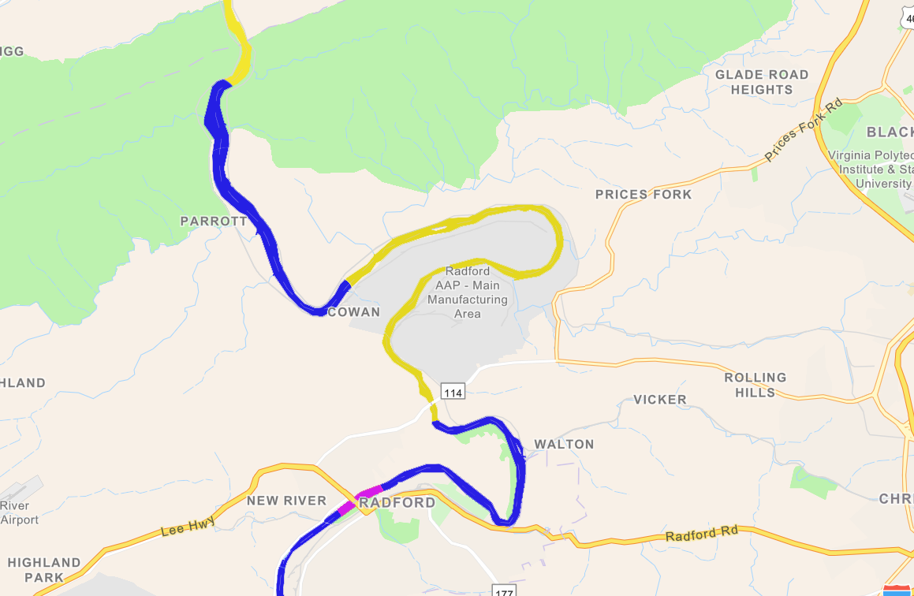
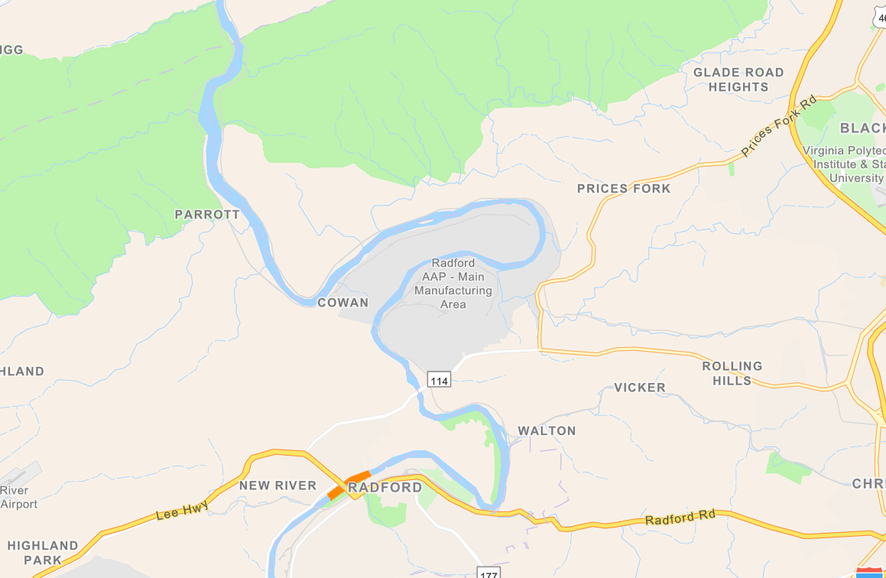
New River: Radford to McCoy
Urban
Suburban
Rural Developed
Rural Natural
Semi-Primitive
Primitive

Slide 12
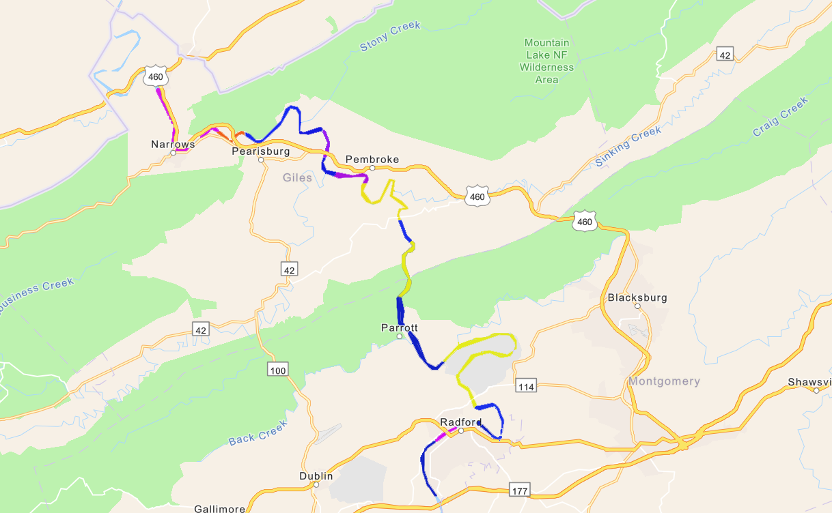
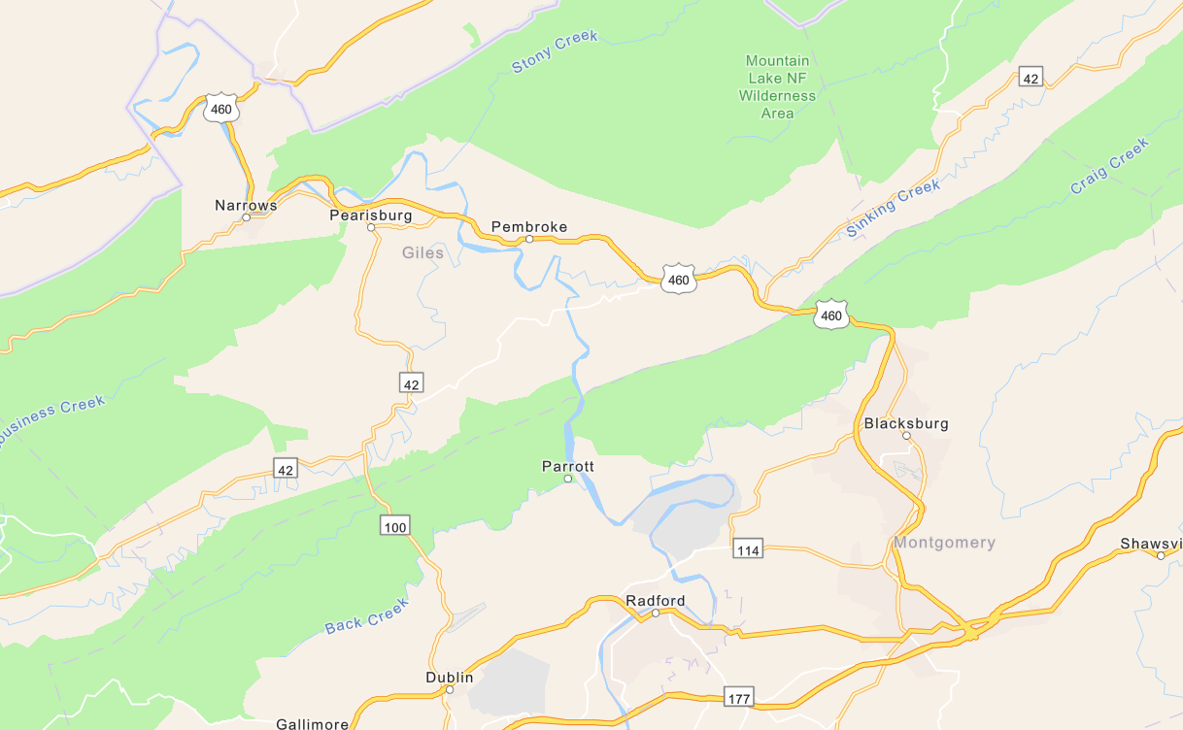
New River: Radford to WV Line
Urban
Suburban
Rural Developed
Rural Natural
Semi-Primitive
Primitive

Slide 13
Resource View: Claytor Lake
Notes:
another way to look at WALROS results – surface of the water resource across WALROS scores/categories. Depicts how much of the resource is allocated towards each type of recreation experience (e.g., RD, RN, Suburban…etc.

Slide 14
Resource View: New River (Rad - WV)

Slide 15
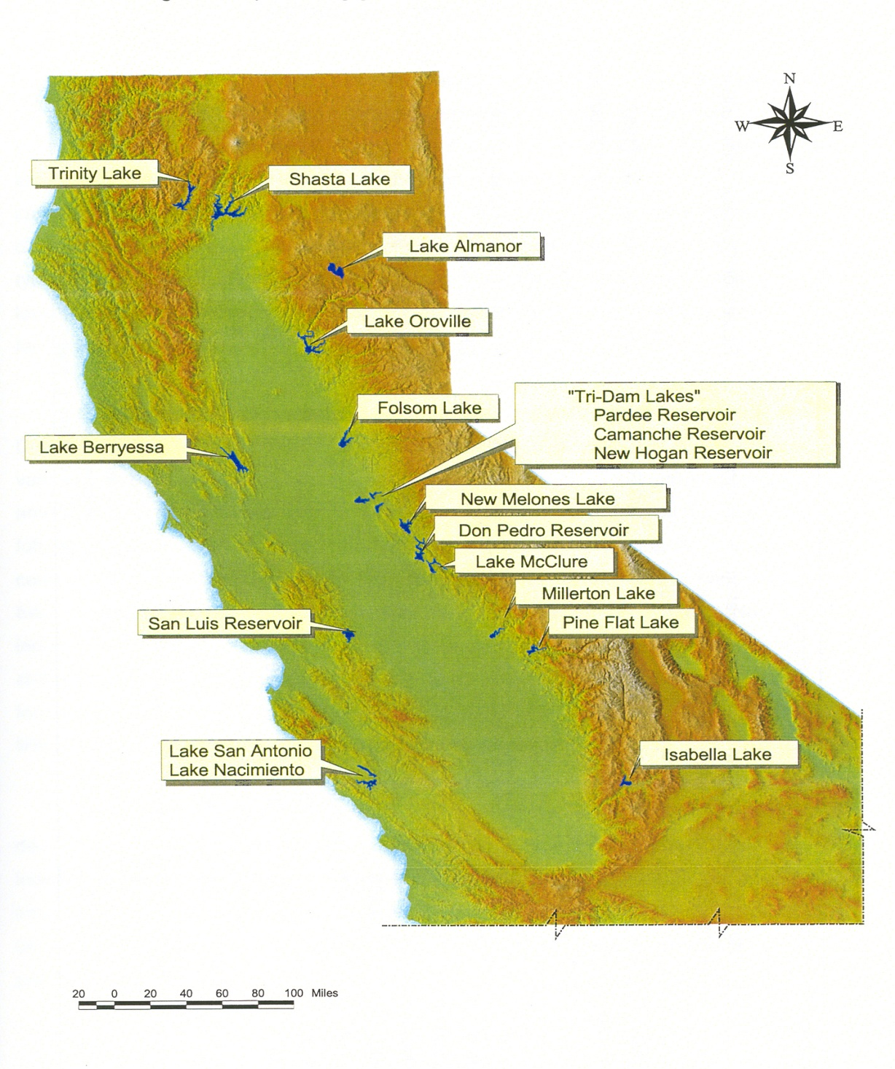
Planning: a Regional View

Slide 16
Planning: A Water body View
Percent Surface Acres

Slide 17
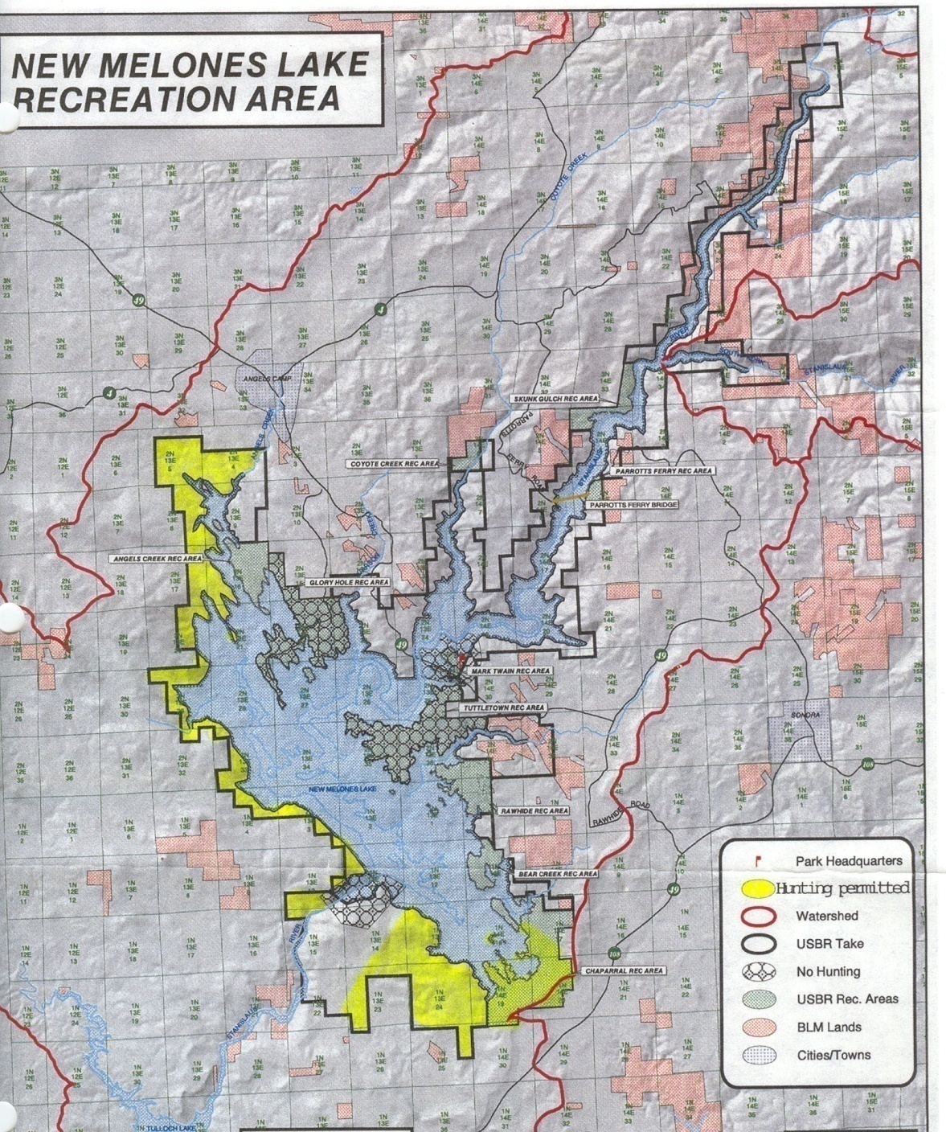
Map/inventory of Recreation Opportunities (Diversify)
Semi-Primitive
Rural
Natural
10
Suburban
9
8
Rural Natural
Rural Natural
1
6
7
5
2
3
Rural
Developed
4
Rural Natural

Slide 18
Benefits of WALROS
Visual map & understanding of settings & recreation opportunities
Assessment of proposed changes
Understandable/intuitive to public
Improve communication with stakeholders
Defensible decision making
Easy & inexpensive
High quality, diverse, recreation opportunities

Slide 19
Thank You!
Questions?
jcarroll6@radford.edu

