Slide 1

On the Effects of Directional Bin Size when Simulating Large Offshore Wind Farms with CFD
Peter Argyle, Simon Watson
CREST, Loughborough University, ENGLAND
p.argyle@lboro.ac.uk

Slide 2

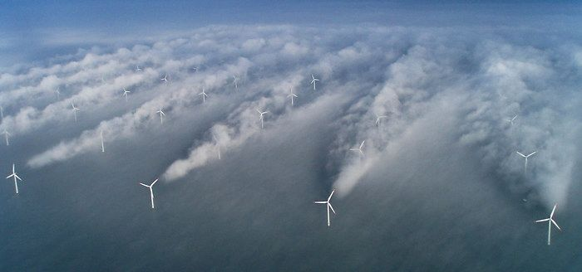
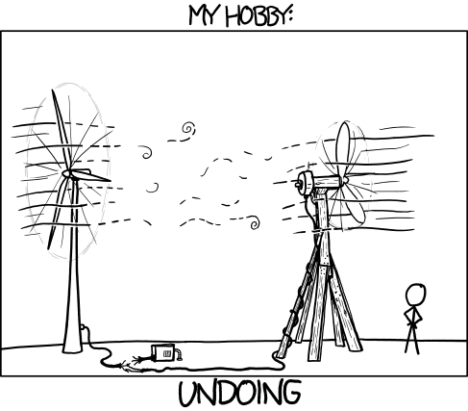
Reason for study
Many people have ideas about how to reduce the observed turbine wakes:
Solutions are often developed based on CFD results, but how do we ensure simulations actually represent reality?
Permanent link to this comic: http://xkcd.com/1119/

Slide 3
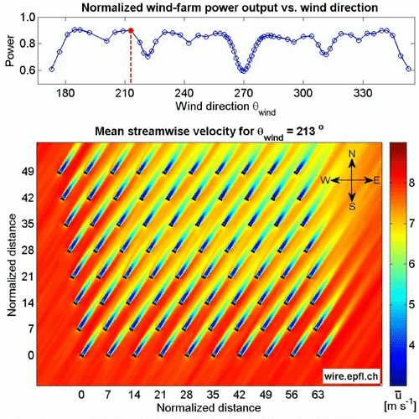

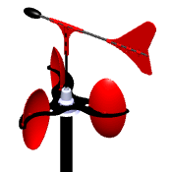
Why Does Bin Size Matter?
Wake Meandering / Vortex shedding
Wake Losses:
Porté-Agel, F.; Wu, Y.-T.; Chen, C.-H. A Numerical Study of the Effects of Wind Direction on Turbine Wakes and Power Losses in a Large Wind Farm. Energies 2013, 6, 5297-5313.

Slide 4
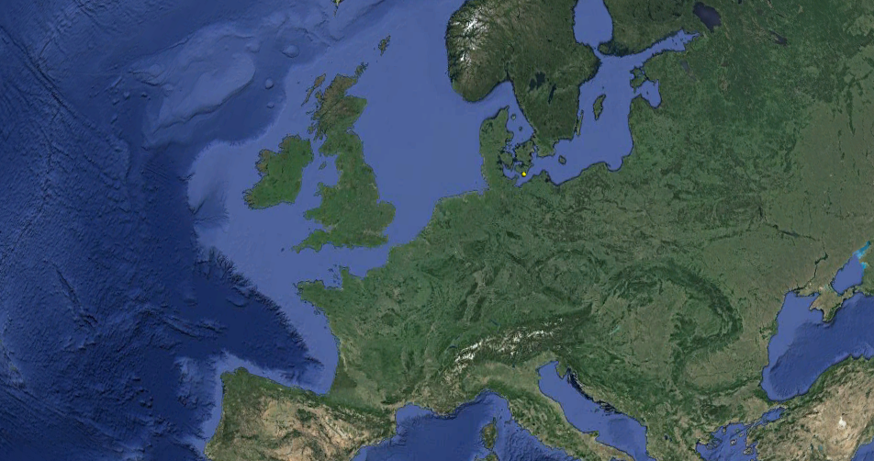

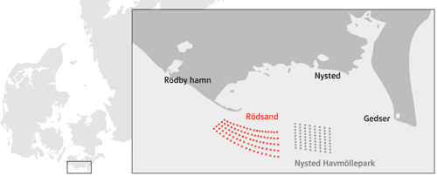
Case Study

Slide 5
Bin Size/Shape Considerations

Slide 6
Bin Size Effects on Measurements
Case Name | Directions Included | Bin Size | Events | Wind Speed | Colour
Case A | 278±0.5° | 1° | 173 | 7.53ms⁻¹
Case B | 278±1.5° | 3° | 485 | 7.60ms⁻¹
Case C | 278±2.5° | 5° | 687 | 7.64ms⁻¹
Case D | 278±3.5° | 7° | 977 | 7.67ms⁻¹
Case E | 278±4.5° | 9° | 1238 | 7.68ms⁻¹
Case F | 278±5.5° | 11° | 1368 | 7.68ms⁻¹

Slide 7
Simulation Results (Power Ratio)
CFD Model 1
CFD Model 2
CFD Model 3
Uniform
Normal
Weighted

Slide 8
Simulation Results (Percentage Difference)
CFD Model 1
CFD Model 2
CFD Model 3
Uniform
Normal
Weighted

Slide 9
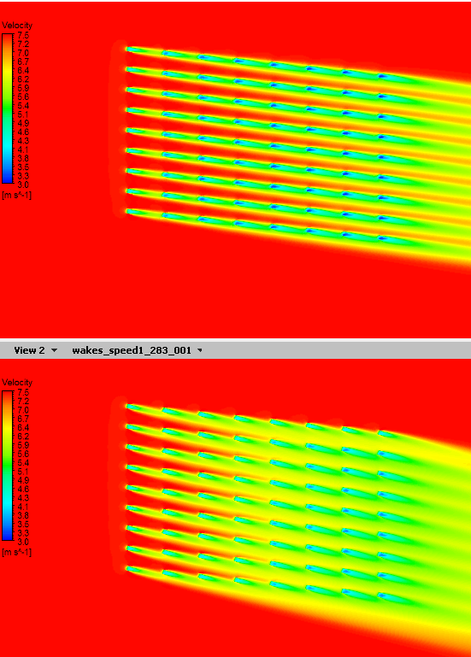
Peak Difference at Turbine 3
Wake Losses:
Porté-Agel, F.; Wu, Y.-T.; Chen, C.-H. A Numerical Study of the Effects of Wind Direction on Turbine Wakes and Power Losses in a Large Wind Farm. Energies 2013, 6, 5297-5313.

Slide 10
Model 3 Differences from Measured Values
Case A 278±3.5°
Case B 278±4.5°
Case C 278±5.5°
Case D 278±3.5°
Case E 278±4.5°
Case F 278±5.5°

Slide 11
Conclusions
Nothing Unexpected:
Wider bin sizes show lower wake losses
The significance of directional bin size is dependent on:
  The turbulence model
  The method used to weight simulations by direction
    Uniform distributions suggest lower wake losses
    Normal distributions suggest higher wake losses
Differences in results are most significant at turbine position 3
  Wake expansion reduces significance further into the farm
Not Considered:
Atmospheric stability
CFD model technique – RANS models were used here for speed
Variable free-stream wind speed
Turbine separation

Slide 12

Questions
The Authors would like to thank
E.ON for sponsoring this research through an EPSRC CASE award
and the
EPSRC Supergen Wind Energy Technologies consortium (grant number: EP/H018662/1).

