Slide 1
Multimedia Database
Virginia Polytechnic Institute and State University
Blacksburg, VA 24061
CS 4624 Multimedia, Hypertext and Information Access
Client Dr. Christopher Zobel
Omid Anvar
Michael Harvey
Justin Johnson

Slide 2
Background
Purpose
  Create a centralized location to upload and access (multimedia) projects
Users
  Virginia Tech Computer Science students
  All Virginia Tech faculty members
Multimedia Content
  Word documents, images, pdfs, videos, music, coding projects
Goal
  Facilitate finding research opportunities and candidates
Notes:
Talk about purpose of the project
Goals
Why this is necessary
Current status of project
Be more descriptive of the project description, mention multimedia content is the main purpose, support large multimedia projects
Who would use this?

Slide 3
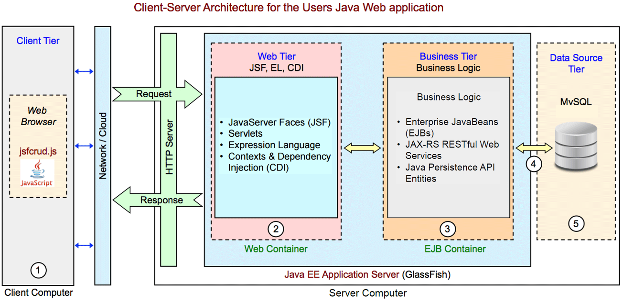
Architecture
Notes:
Database
MySQL
Wamp Server
Apache
Website
Netbeans
Java Server Faces
XHMTL and CSS
Backend
GlashFish

Slide 4
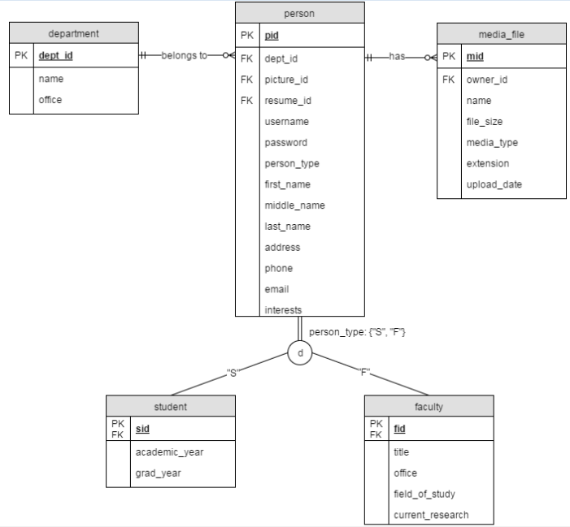
Database
Notes:
Talk about how tables are laid out. How the multimedia files are not stored directly in DB
Talk about media file upload limits
Switch this out with the EER diagram, show the media file pointing to another file

Slide 5
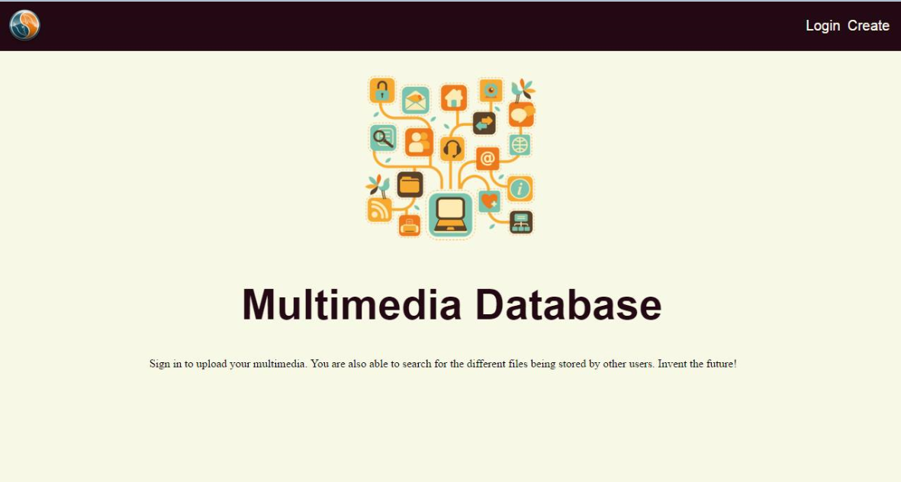
Website Homepage
Notes:
Make readable slides
Talk about how people upload,
Talk about website layout and design. What each page does. Purpose of each page
Talk about potential future server
Replace this with a transition diagram or cite map to show the transition of the web pages

Slide 6
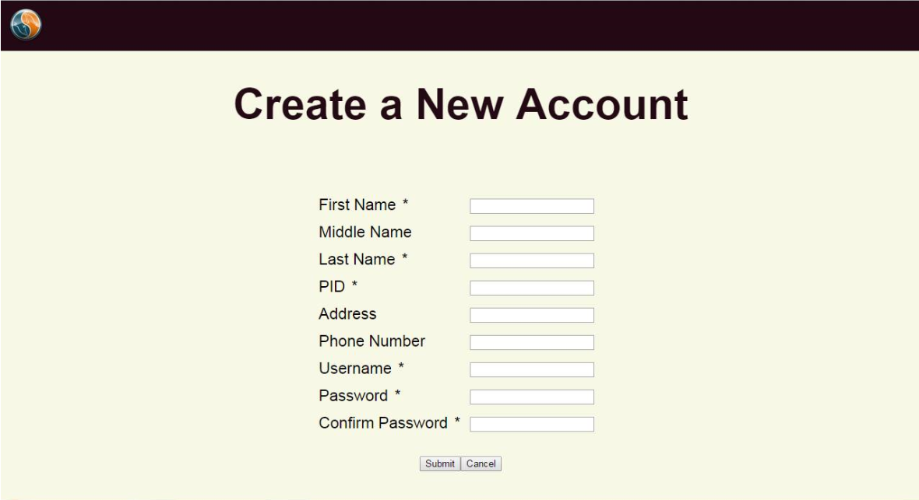
Account Creation Page

Slide 7
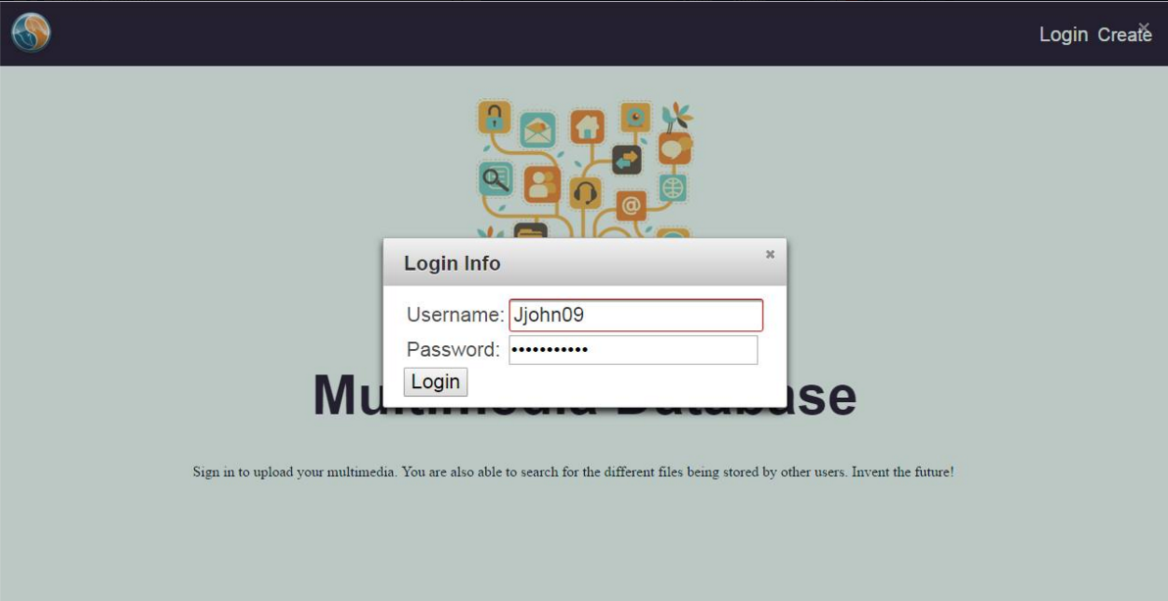
Logging in

Slide 8
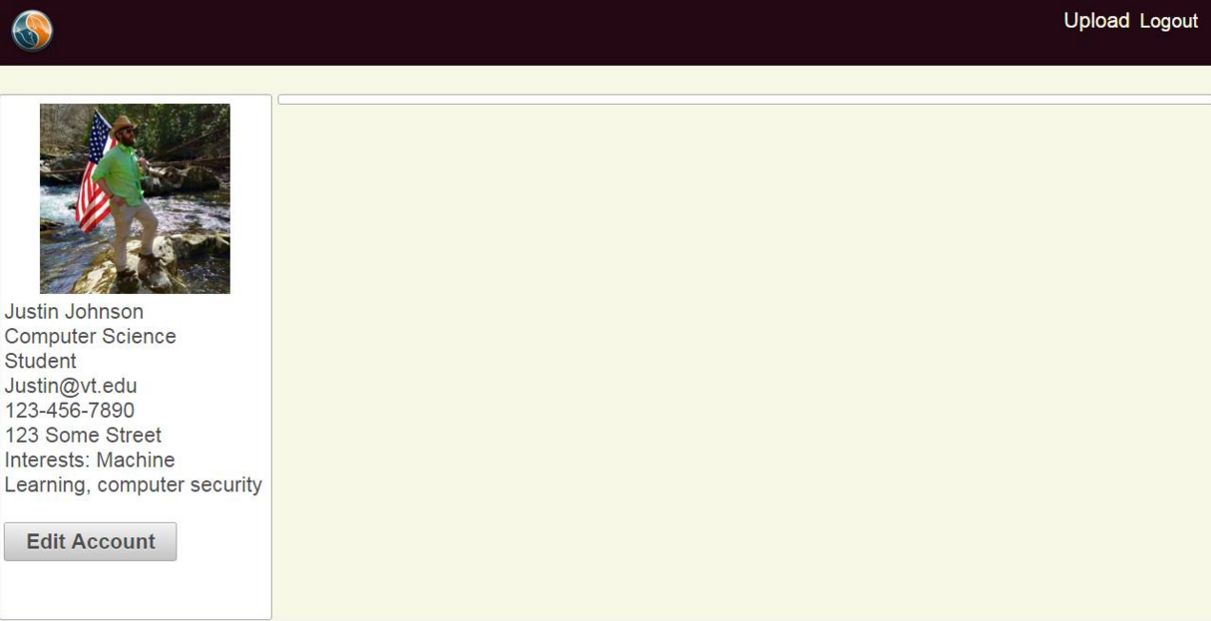
Profile Page

Slide 9
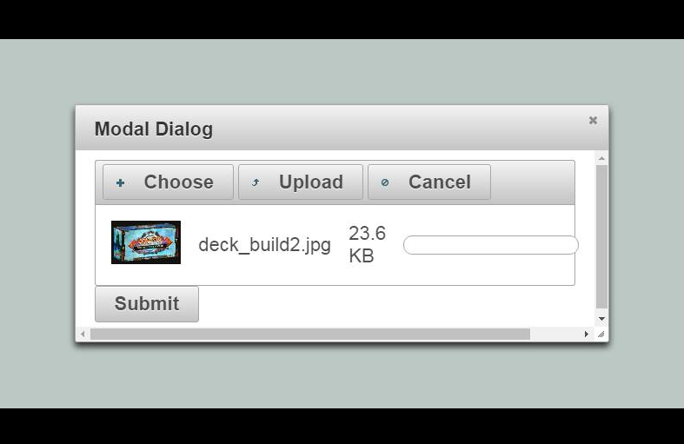
Upload Page

Slide 10
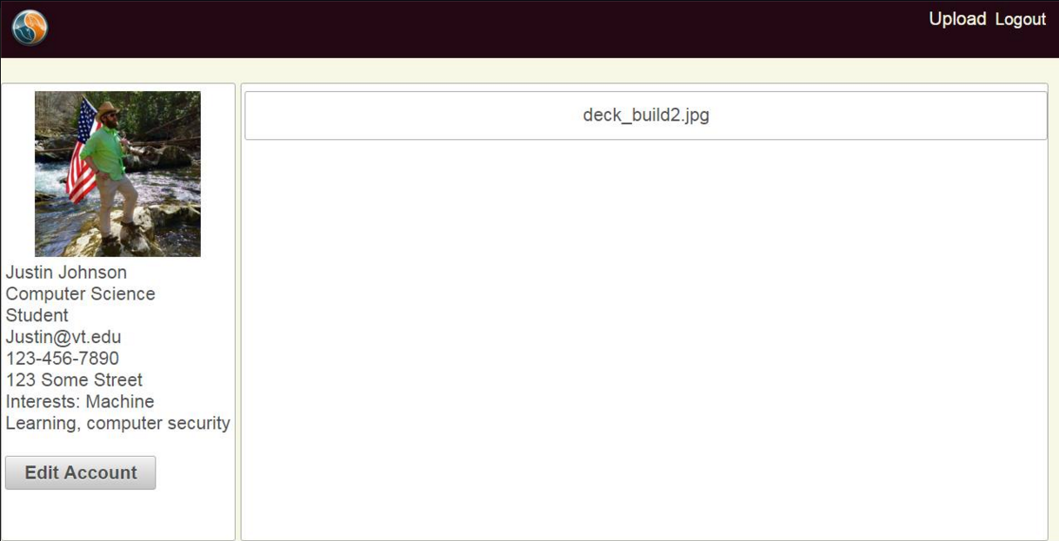
Successful Upload

Slide 11

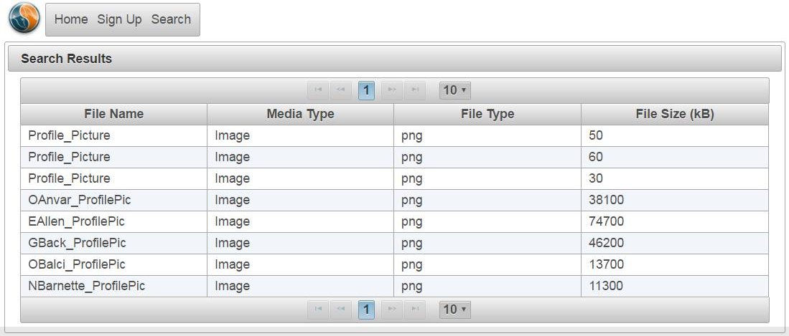
Search Page

Slide 12
Questions?
Thank you!
Dr. Christopher Zobel
Dr. Edward Fox
GTA Yilong Jin

