Slide 1

ETD Collection Management
CS5604 Team 1 Raghav Sethi, Ashrith Reddy Thukkaraju, Hirva Bhagat, Tanya Jain, Wen-yu Lee
S.M.E - Prof. Bill Ingram, Prof. Sung Hee Park
Notes:
Our Helper and advisor are bill ingram, the Assistant Dean and IT Director, University Libraries and professor sung hee park

Slide 2
Outline
Introduction
Background
Goals
Requirements
Approach
Tools and Technologies
Workflow
Architecture
Front-end Page (UI)
File System
Database
APIs
Knowledge Graph
Conclusion
Key Learnings
Future Work
Notes:
Introduction - H
Background - H
Goals - H
Requirements - T
Approach
Tools and Technologies - T
Workflow - W
Architecture
Front-end Page (UI) - W
APIs - A
File System - A
Database - A
Knowledge Graph - R
Conclusion - R
Key Learnings - R
Future Work - R

Slide 3
Introduction
Background
Goals
Requirements
Section 1

Slide 4
Background
ETDs are underutilized resources
Collective goal of CS5604:
Develop an ETD Search Engine
Team 1’s task:
ETD Management
Supporting persona:
Curator
Experimenter

Slide 5
Goals
To Provide the necessary services for the Persona “Curator”
Add single/stream of etds
Consistency check of file and database system
Statistical reports for collection
To provide APIs to enable the other teams with the access to the database and filesystem for experimenting with the content and storing the results

Slide 6
Requirements
As a curator, I want to add new ETD in the file system and database.
As a curator, I want to update data for the existing ETD if I found the data has anything wrong.
As curator, I want to check different statistical reports of the current collections.
As a developer from team 3, I want to organize the output of the object detection to database and file system.
As a developer from team 4, I want to get necessary and well organized data for me to make chapter segmentation, classification, and summarization. Then store them in the database and file system.
As a developer from team 2, I want to index all data in the database to set up elasticsearch.

Slide 7
Approach
Tools and Technologies
Workflow
Architecture
File System
Database
Front-end Page (UI)
APIs
Knowledge Graph
Section 2

Slide 8
Tools and Technologies
Back-end Framework: Flask
Database: PostgreSQL
RDF: Virtuoso
Database schema design: Vertabelo
API design and testing: Postman
VT CS Cloud (cloud.cs.vt.edu)

Slide 9
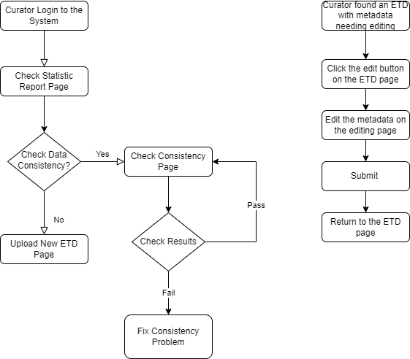
Workflow
To provide the necessary services for the Persona “Curator”
Add single/stream of ETDs
Consistency check of file system and database
Statistical reports for collection
Edit ETD metadata
Notes:
Here we designed some workflows to describe how curator can use this system through the front-end website.

Slide 10
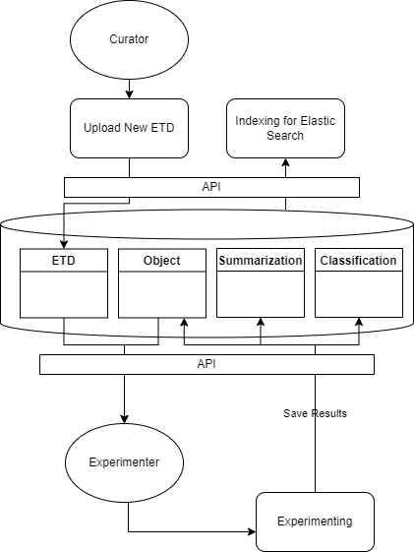
Workflow
Provide data access for other teams and different services
Notes:
Search by title instead of id

Slide 11
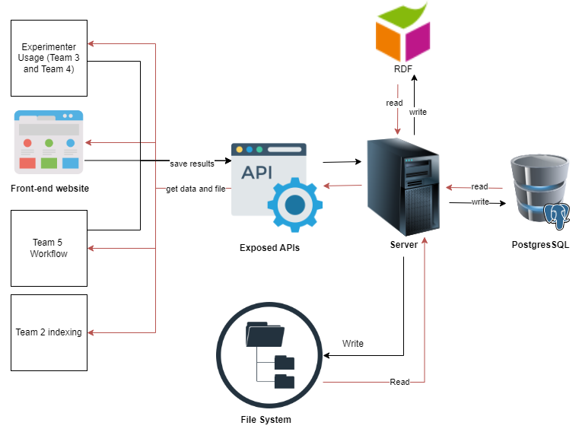
Architecture

Slide 12
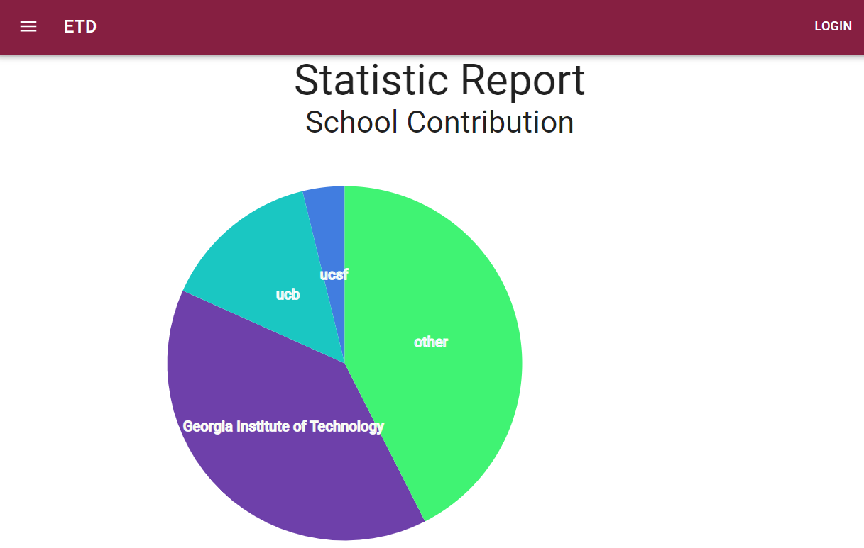
Front-End Page - Statistics
*Based on 50k records of ETDs in the database.

Slide 13
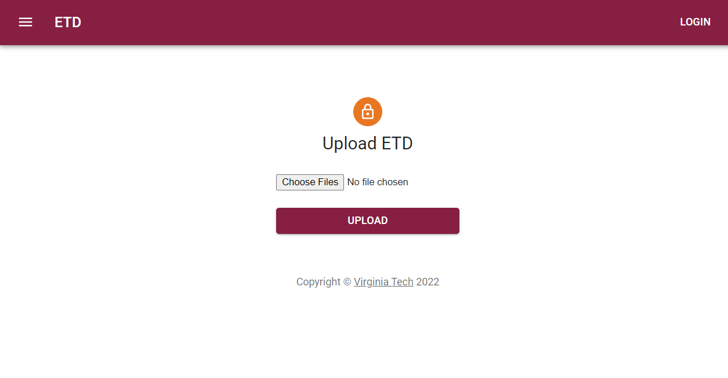
Front-end Page - Upload new ETD

Slide 14
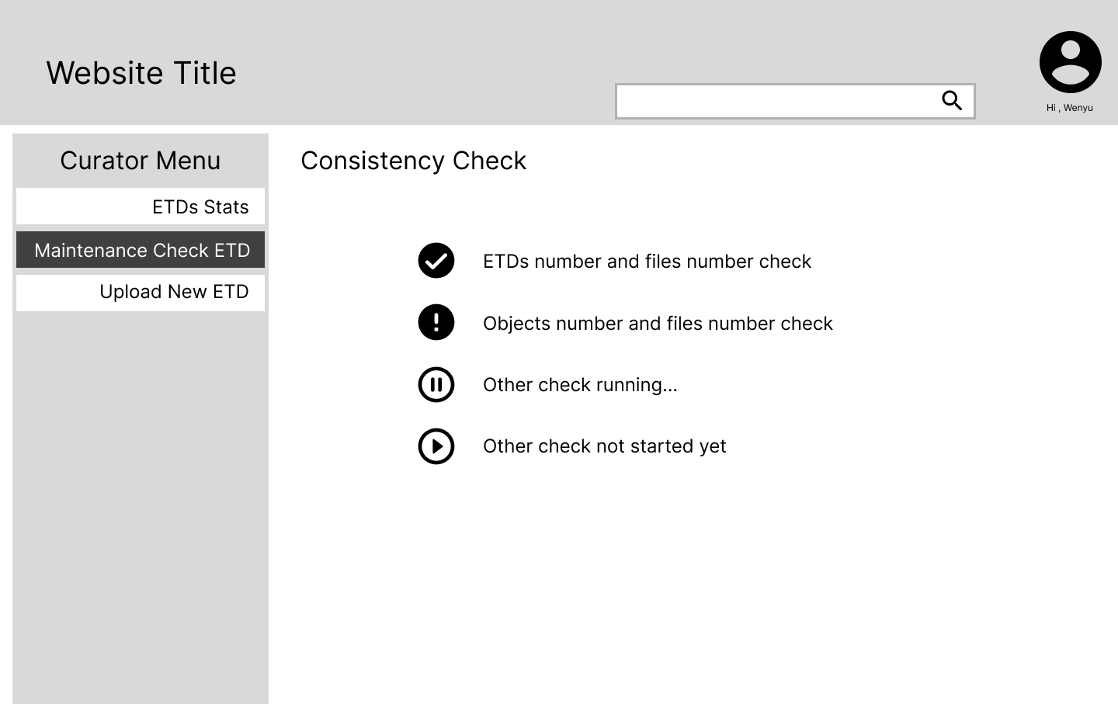
Wireframe - Consistency check

Slide 15
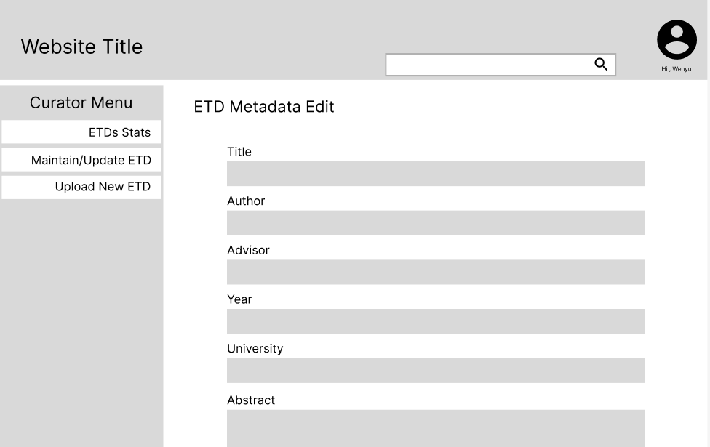
Front-end Page - Edit ETD Metadata

Slide 16
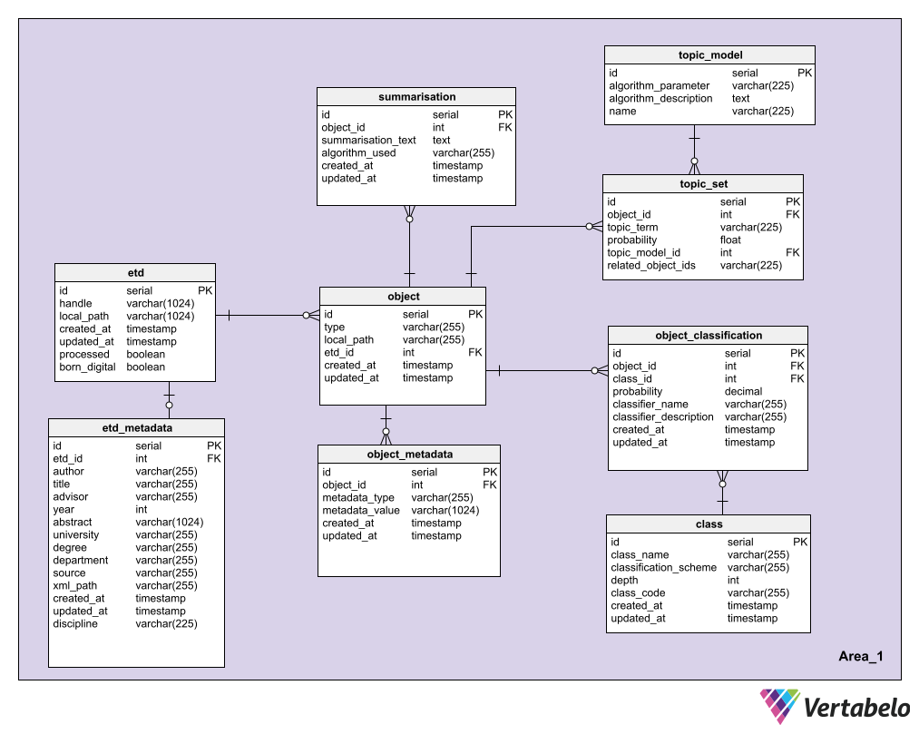
Database
PostgreSQL
Allows storing large text fields in the DB.
Required for storing chapter summaries
DB Schema
Tables
- etd - topic_model
- etd_metadata - topic_set
- object - object_classification
- summarisation - class
- object_metadata

Slide 17
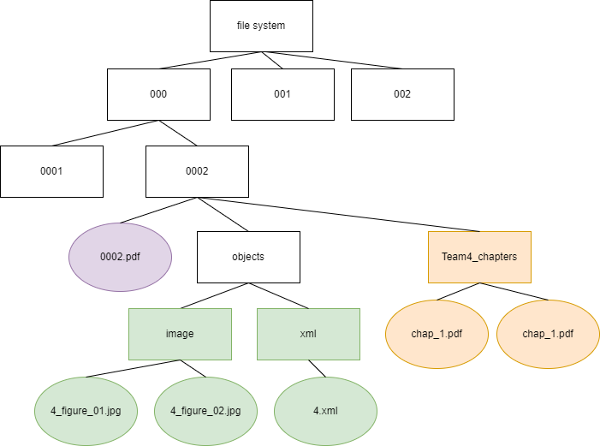
File System
Hierarchy
Notes:
Search by title instead of id

Slide 18
API - (Postman Collection link)
Add new ETD
Save detected object
Save detected objects
Save ETD page images
Save Topic modeling results
Save summarisation
Save classification
Get all ETDs and objects
Get ETD by ETD id
Get objects by ETD id
Get ETD page image
Get ETD pdf by ETD id
Get object file by object id
Get Statistical report
Handle and etd-id mapping
Get knowledge graph by ETD id
Mark ETD processed
Notes:
Use etd instead of metadata

Slide 19
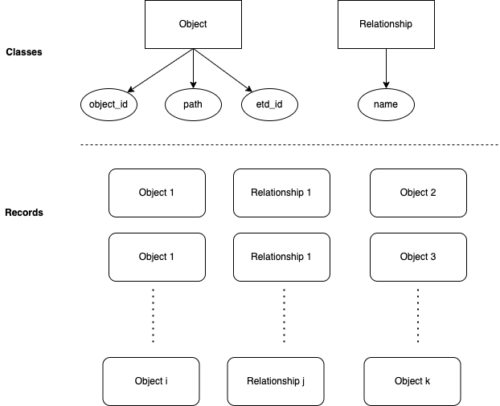
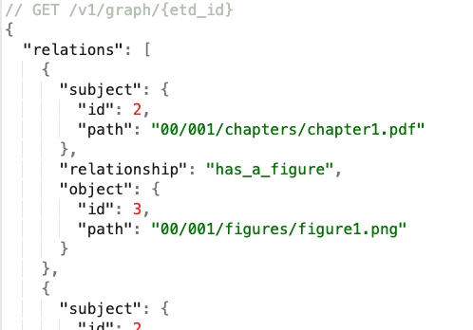
Knowledge Graph

Slide 20
Conclusion
Key Learnings
Future Work
Section 3

Slide 21
Key Learnings
Understand how different modules work together for ETD Management System
Dealing with changing user requirements
Handling data at scale

Slide 22
Future Work
Knowledge Graph
Support Question Answer module
UI Module
Provide more features to Curator, e.g.: Consistency Check
Present detailed Statistical Results
Explore messaging queues to share data
Enhance backend system
Set up dashboard and alerts for metrics, e.g.: API error growth, CPU usage, disk usage
Error Handling
Set up Kibana to monitor logs

Slide 23
Questions?

