Slide 1
Tweet URL Analysis
Guoxin Sun, Kehan Lyu, Liyan Li
CS 4624 Multimedia, Hypertext, and Information Access
Dr. Edward Fox
Virginia Tech, Blacksburg VA 24061
2018/05/01

Slide 2
Overview
Recap
Issues
Results
Future plan
Acknowledgement
References

Slide 3
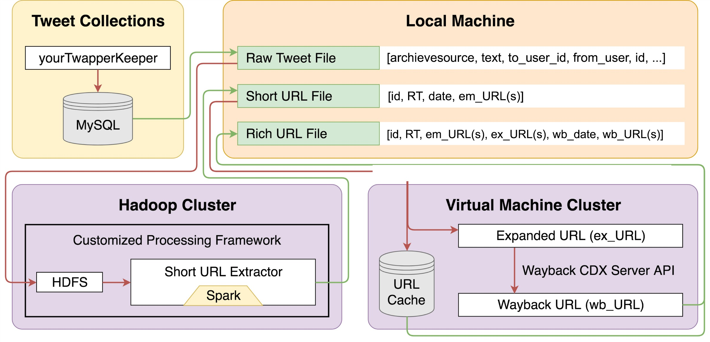
Recap
Analyze the characteristics of URLs embedded in tweets.
Figure 1: Architecture of the URL Analysis System [1]

Slide 4
Issues
Bad separator for long URL files
http://www.theictm.org/big-diabetes.....|paugustine||ekb3vfg74m|thei.....
Halt caused by using articleDateExtractor library

Slide 5
URL Characteristic Analysis
Percentage of the URL(s) with Keyword per year
Percentage of Tweets with URL(s) per year
Tweets with Different Number of URL(s)
Percentage of Unique URL(s) in Tweet Collections
Percentage of Unique URL(s) with different status code
Percentage of successful retrieved URL(s) per year
Time interval between Tweet Post Date and Webpage Date
Time interval between Tweet Post Date and Wayback Machine Archive Date Top 10 Domains in Tweets/Retweets Top 10 URLs in Tweets/Wayback Machine

Slide 6
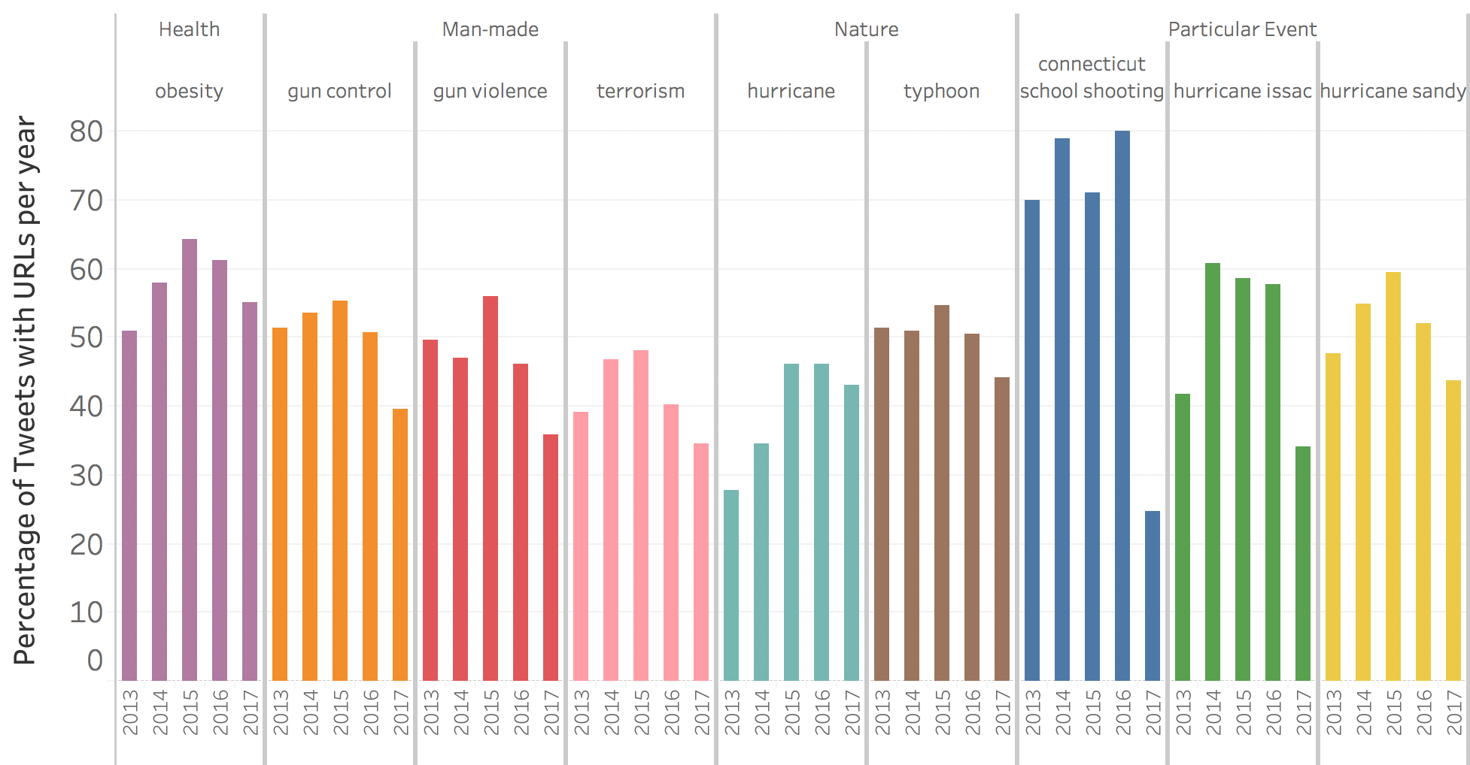
Percentage of Tweets with URL(s) per year
Statistics:
50% of Tweets have URLs on average
People are more interested in embedding URLs in Tweets from 2013~2015
The Interest faded away from
2015~2017

Slide 7
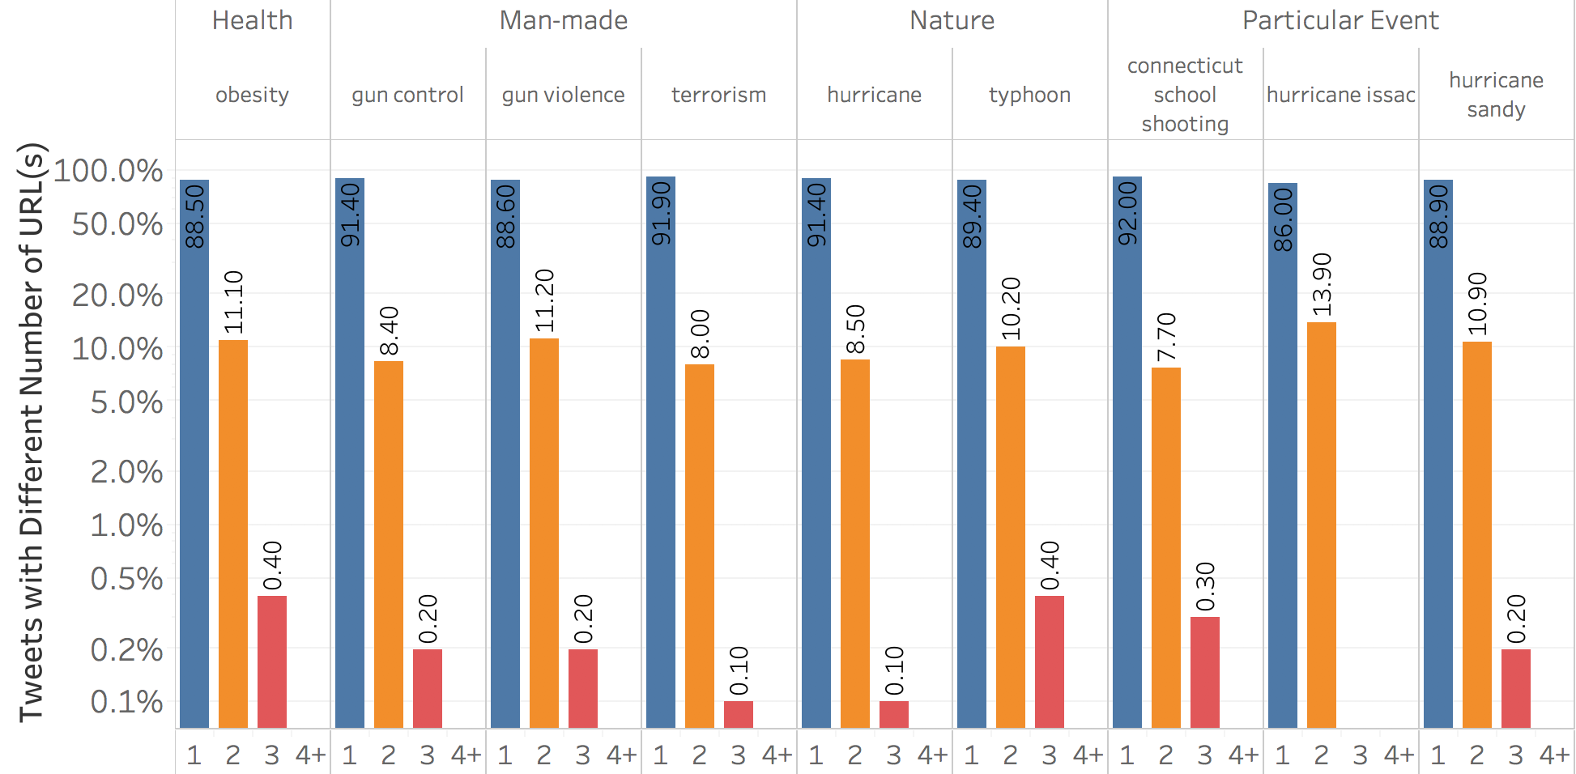
Tweets with Different Number of URL(s)
Statistics:
90% of Tweets have 1 URL
10% of Tweets have 2 URLs
Less than 1% of Tweets have 3 or more URLs

Slide 8
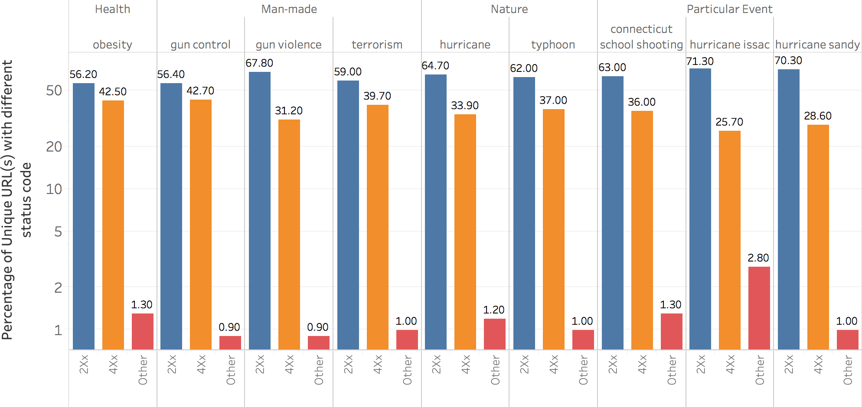
Percentage of Unique URL(s) with different status code
Statistics:
55%~70% of URLs have status code 2xx
25%~42% of URLs have status code 4xx
Around 1% of URLs have other status codes

Slide 9
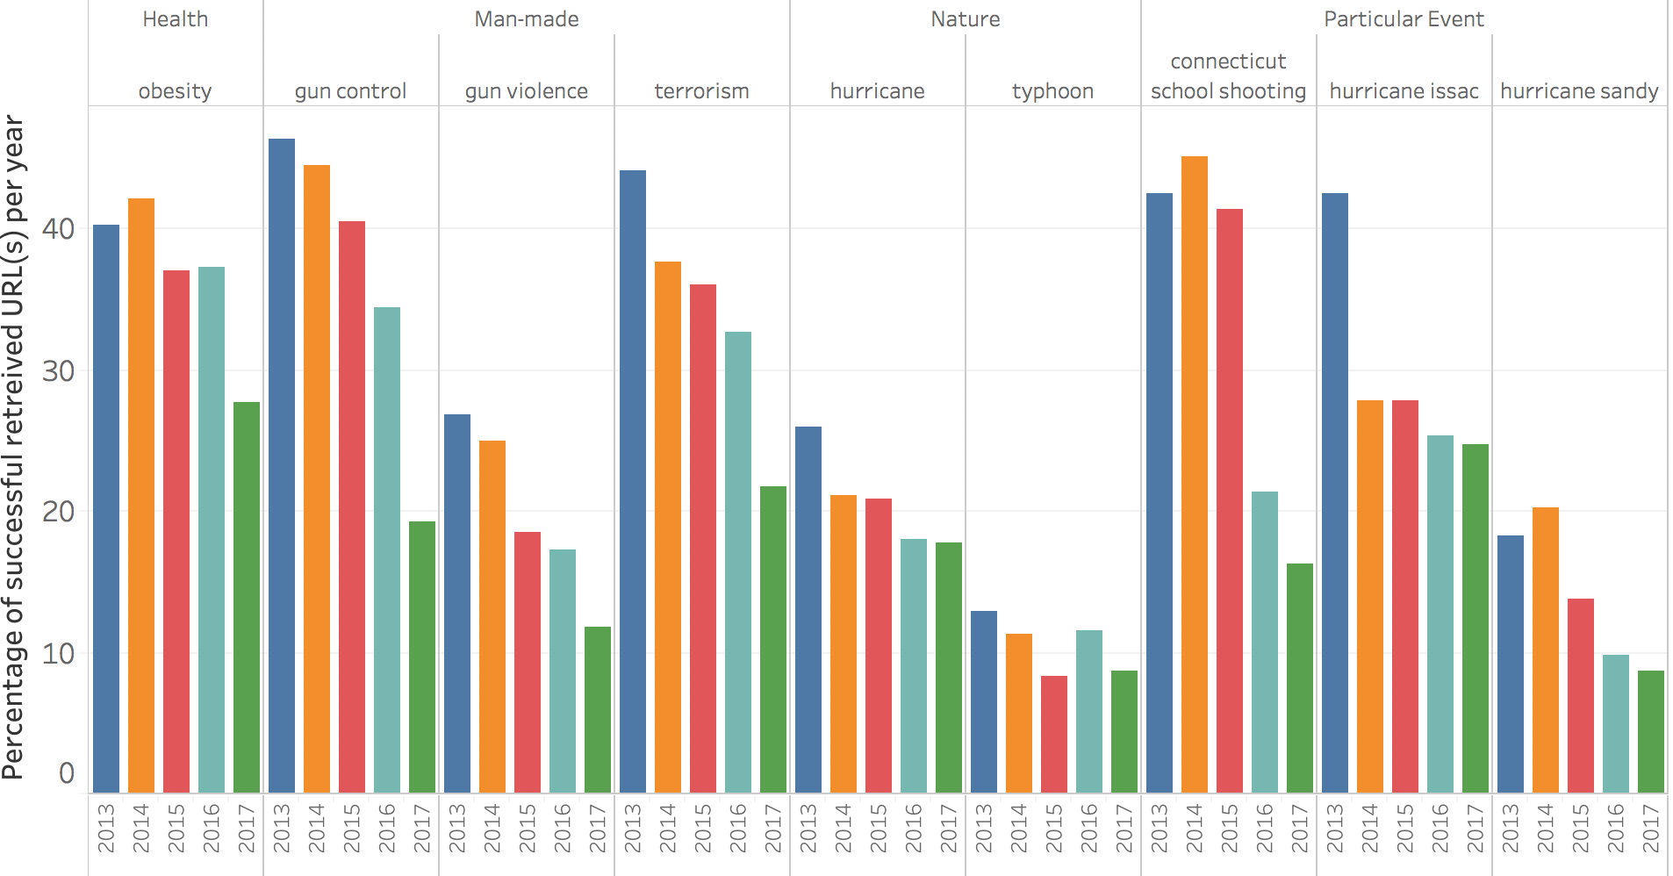
Percentage of successful retrieved URL(s) per year
Statistics:
URLs in earlier Tweets have higher chance to be archived by Wayback Machine

Slide 10
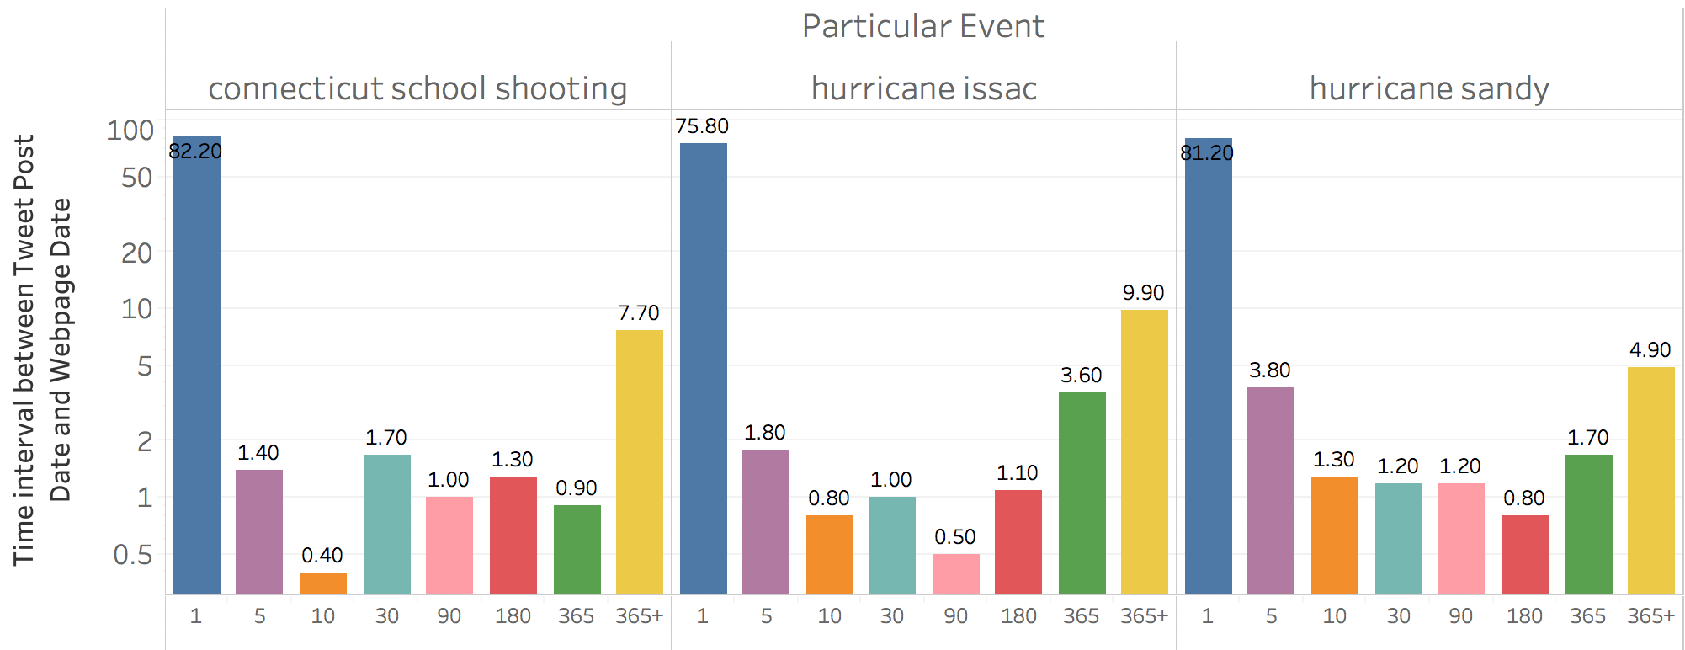
Time interval between Tweet Post Date and Webpage Date
Statistics:
Most of Tweet posted on the same day of Webpage posted.

Slide 11
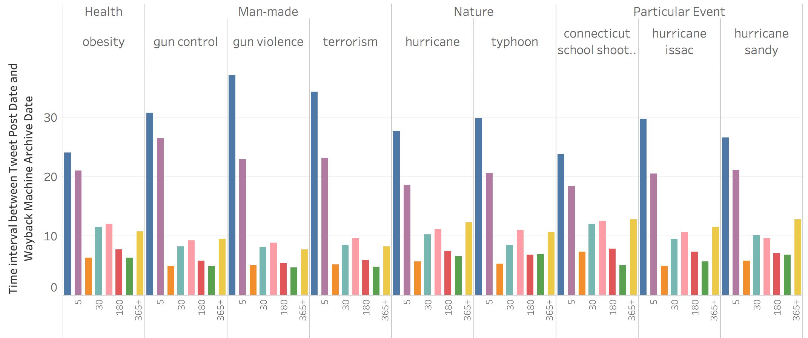
Time interval between Tweet Post Date and Wayback Machine Archive Date
Statistics:
Most of archived URLs were archived within 5 days of Tweets post date

Slide 12
Future Plan
Finalizing the report
Analyzing more collections

Slide 13
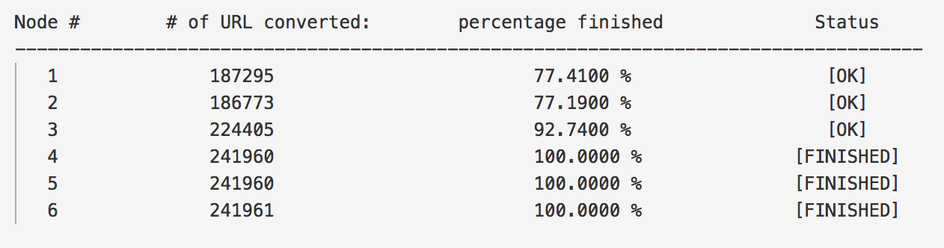
Future Plan - Possible Improvement
Utilizing idle machines

Slide 14

Acknowledgement
Liuqing Li
Graduate Research Assistant in DLRL (Digital Library Research Laboratory)
Ph.D. candidate, Department of Computer Science, Virginia Tech
Thanks go to NSF for support by grant IIS-1619028.

Slide 15
References
Liuqing Li and Edward A. Fox. 2018. A Study of Historical Short URLs in Event Collections of Tweets. Web Archiving and Digital Libraries (WADL 2018), a workshop held in conjunction with ACM/IEEE-CS Joint Conference on Digital Libraries (JCDL 2018). ACCEPTED
https://github.com/internetarchive/wayback/tree/master/wayback-cdx-server, access date: 10 April 2018
https://archive.org/help/wayback_api.php, access date: 10 April 2018
http://urlex.org, access date: 10 April 2018

Slide 16
Thank you!
Questions?

