Slide 1
Grickit
William Vuong, Michael Long
Date: 4/28/2015 | Course: 4624
Institution: Virginia Tech | Instructor: Ed Fox
Department: Computer Science | Client: Dr. Steven Sheetz
City, State, Country: Blacksburg, VA, USA
Notes:
Introduction
Names
Project: Grickit
Client: Dr. Steven Sheetz

Slide 2
Problem Introduction
AHP Algorithm
Back-end Implementation
UI/UX Development
Social Network Integration
Deployment to Hardware
Notes:
What is Grickit?
Group-based decision tool
more detail
Three Distinct Phases
--PoC & Design
Command Line Tool
AHP: Criteria + Alternatives
--Server and UI implementation
This phase is the majority of the development and testing of the project, and will be explained in detail in the coming slides
--Deployment
Changes to the software necessary for deployment to hosting hardware

Slide 3
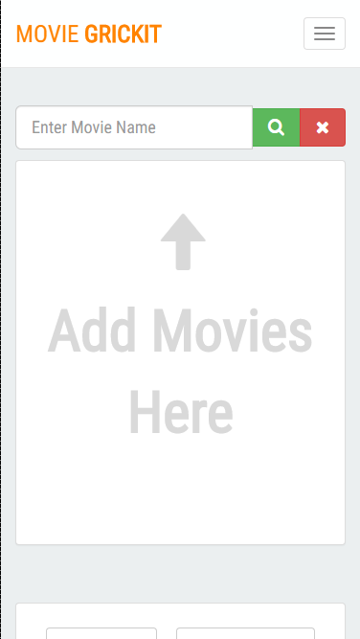
Design
Place your screenshot here
“General Solution” Back-end
Node.js REST API
Modern UI
HTML5
Bootstrap 3.0
Mobile Responsive
IMG
Notes:
Two Part Solution
Service Tier
Presentation Layer
Service Tier
Handles all the calculations.
Exposes the AHP algorithm through a RESTful API
Allows for a variety of presentation layers
Mobile apps, web apps, desktop applications
Multiple Interpretations
Without worrying about implementing the algorithm.
Presentation Layer
Modern looking
Responsive design
Web app scales and reorganizes elements to make it look appropriate on a smaller screen.
Main Goals
Minimal
Expose simple and clear interfaces for the user to pick the information we need for the AHP algorithm.
Clear workflow
Allows new users to quickly figure out how to use the system
While not frustrating returning users extraneous buttons, hints, or other features that cater to a first time user.

Slide 4
Back-end Implementation
All AHP calculations
Grickit Management
Database interactions
Live Documentation
Notes:
Back-end Introduction
Our goal with the server implementation was to create a completely general solution so that future development teams would not have to make any changes in order to use it effectively.
--AHP
All of the matrix calculations are implemented on the server so they can be completed with an HTTP call that has a correctly formatted payload
--Grickit Management & Database interactions
The server manages all currently active grickits within a noSQL database.
--Documentation
We use a tool called Swagger to provide live documentation for our API, which we will now take a look at.

Slide 5
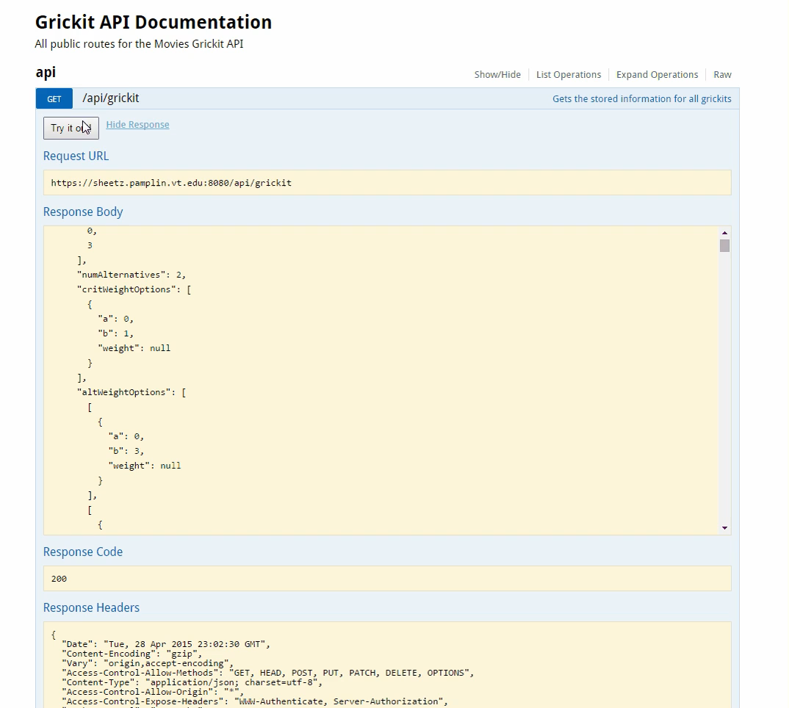
Notes:
This is a live documentation tool for REST APIs, and here we’re going to watch as this user creates a new grickit using the POST route, and then performs a GET on the specific id they just created.
All of the functionality of the API can be tested through this interface.

Slide 6
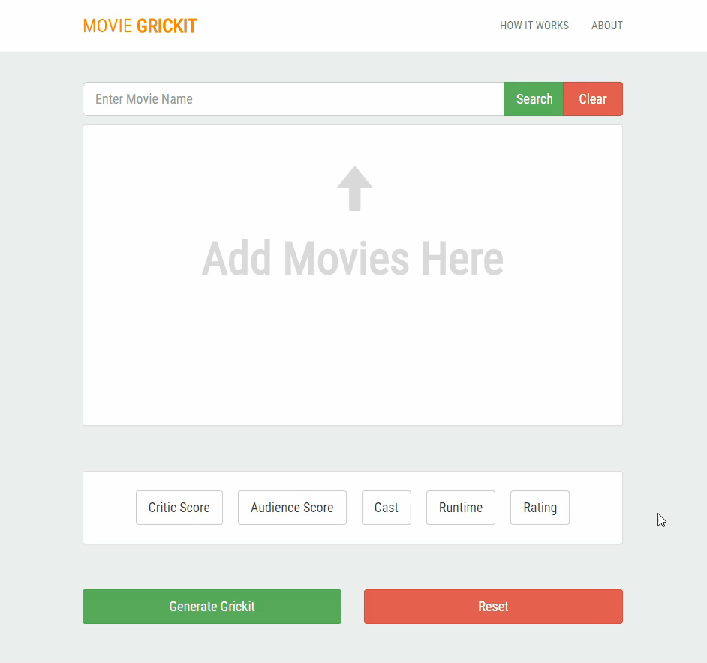
Notes:
Presentation Layer
Consists of two pages: Creator view and the Weighting view
Creator
Search bar to find movies
Table of movies selected
The criteria that one can compare various movies on
Generate/Reset button

Slide 7
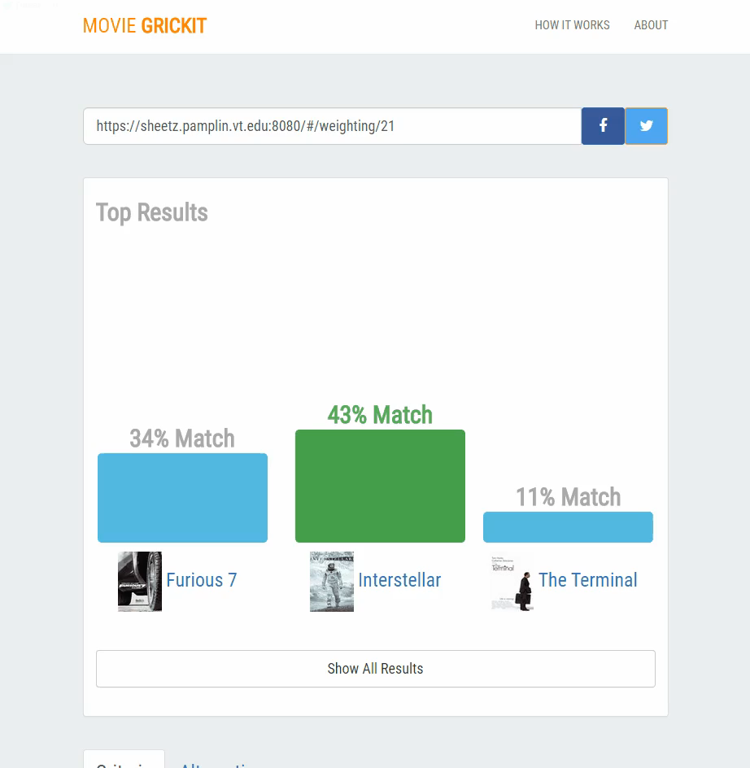
Notes:
Weighting
Generate button clicked
New Grickit API route hit
Various combinations of pairs of movies and pairs of criteria are calculated
This new data is returned to the website
Three main sections
Sharing the grickit via copying the link, facebook, or twitter.
Viewing the current ranked listed for this grickit based on previous users.
Weighting section
Where you set your preference for each pair of criteria and alternatives.
We utilized a simple slider with strong preference on the edges and neutral in the middle.
It wasn’t necessary for us to expose the actual numerical value of the weights to the user.
There is also an auto-advance checkbox that allows the next pair to be shown as soon as the user weights the current pair.
This makes the process much faster for alternative weighting.

Slide 8
Lessons Learned & Future Work
Deployment is never easy
Security is important
Full General Solution
Educational Aspect
Notes:
Lessons Learned
--If you have to deploy a product, research the deployment hardware during the design phase so changes in either the design or the hardware itself can be made.
--Learn about security. It may not have been important during class project, but it is extremely important in the real world.
Future Work
-We feel we have set a great foundation for the future work on this project. We hope that a future group from this class will be able to implement a fully generalized solution, and even apply that solution to mobile devices through native applications
-Our only real regret is that time constraints forced us to miss out on included a “What is AHP?” section, that would walk the user through the Grickit process while informing them about this incredibly interesting algorithm.

Slide 9
Thanks!
ANY QUESTIONS?

Slide 10
Client Contact Information
Steven D. Sheetz
Email: sheetz@vt.edu
Phone: 540-231-6096
Office: Pamplin 3080

