Slide 1

Michael Shuffett
Virginia Tech
Blacksburg, VA shuffett@cs.vt.edu
CS6604
Twitter Metadata
Primary Client: Mohamed Magdy, (mmagdy@vt.edu)

Slide 2
Background
Large number of tweet collections about events
  CTRNet
  IDEAL
  QCRI
No collection level metadata standard
+
No easy merging solution
=
Poor collaboration support
Notes:
Collections about same thing
These three collect information about events (among other things)

Slide 3
Project Goals
Develop metadata standards for tweet collections
  start, end timestamps
  geographic coverage
  details of how collection was prepared
    Filtering
    Cleaning
    Enriching
Create software package that merges and describes multiple collections
Notes:
Geographic coverage includes tweets, users tweeting
Details such as what keywords or hashtags were used, how data was filtered. Was

Slide 4
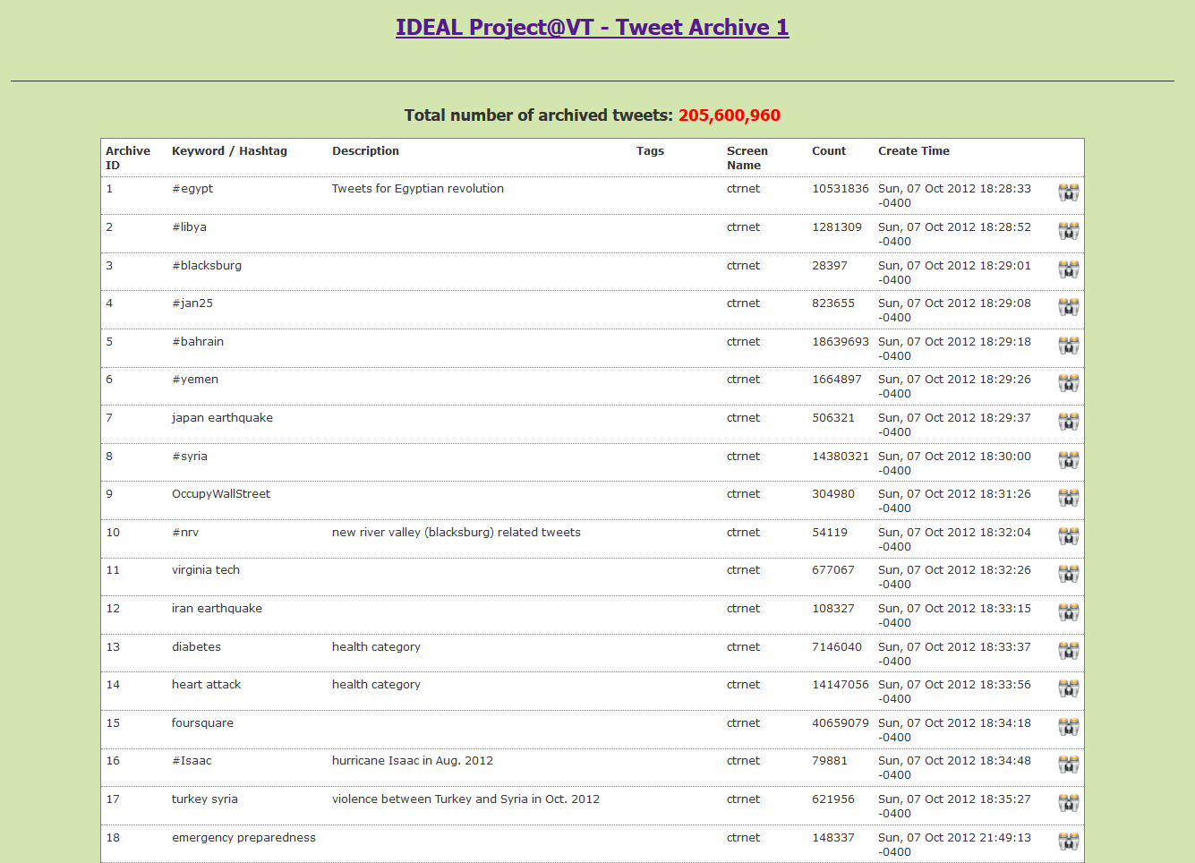

Slide 5
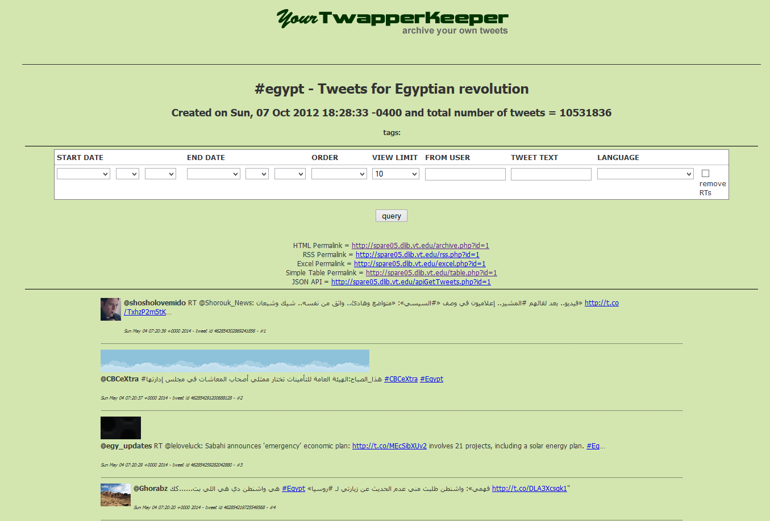

Slide 6
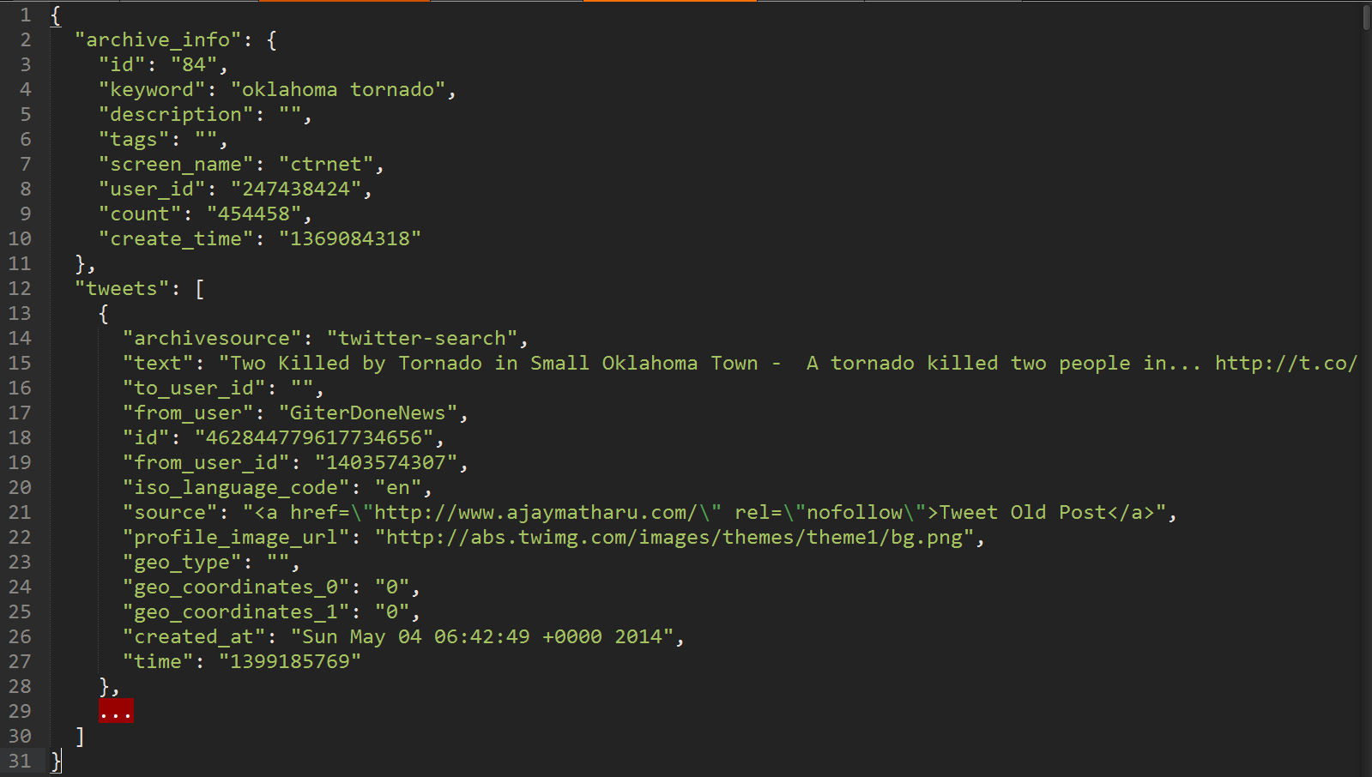

Slide 7
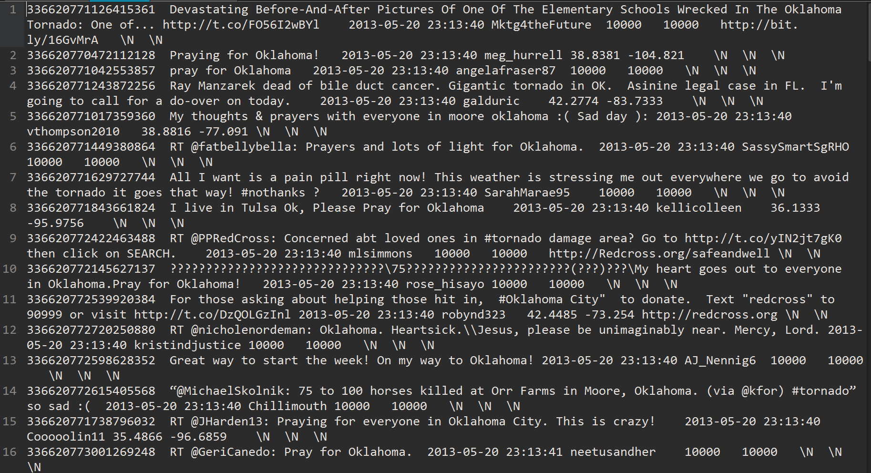

Slide 8
Tweet-Level Metadata
All tweets originate from API
Leverage standard present in API
  https://dev.twitter.com/docs/platform-objects/tweets
  https://dev.twitter.com/docs/api/1/get/statuses/show/:id
Namespace JSON

Slide 9
Collection-Level Metadata
Descriptive Metadata
What
How
When
Who
Provenance

Slide 10
Collection-Level Metadata
Descriptive Metadata
What
Dublin Core Terms
title, description

Slide 11
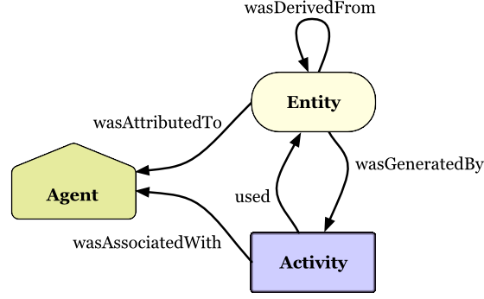
How
When
Who
Provenance
  PROV/PROV-O http://www.w3.org/TR/2013/NOTE-prov-overview-20130430/

Slide 12
Starting Point Classes

Slide 13
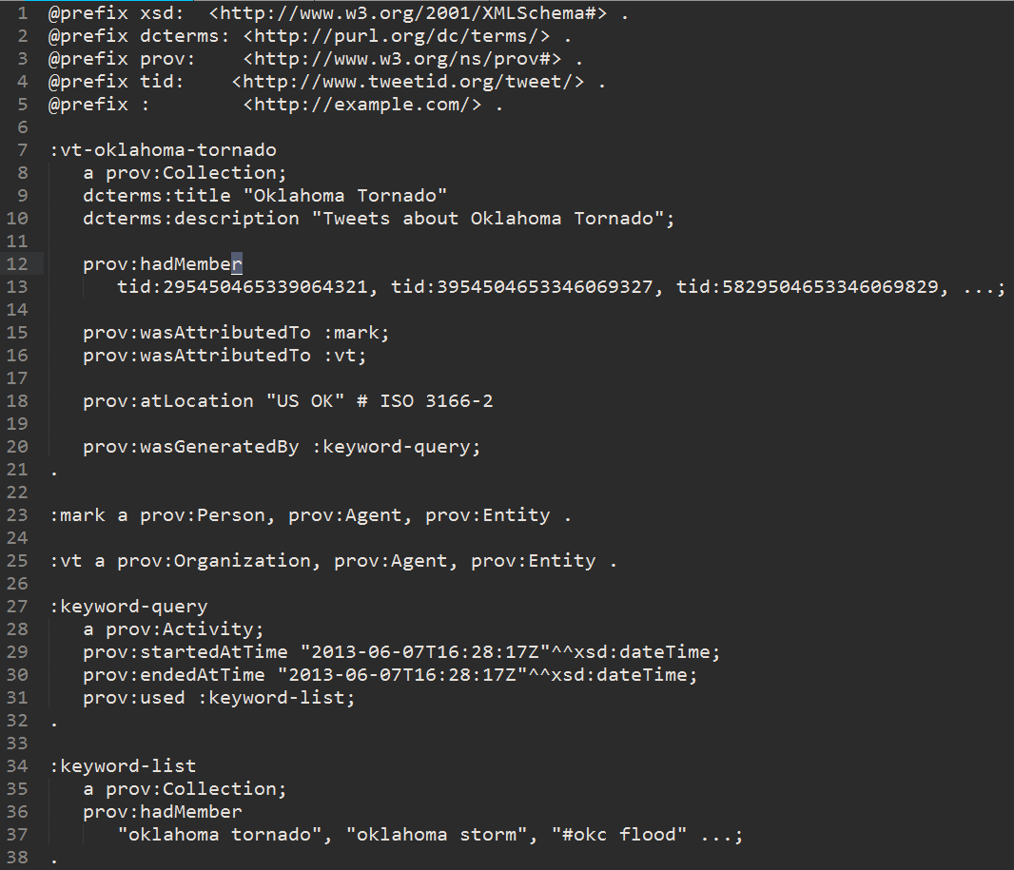

Slide 14
Summary of Collection-Level Metadata
Dublin Core
  Title, Description
PROV-O
  Starting Point Classes
  collection, organization, hadMember, atLocation
ISO 3166-2 for locations
W3/XMLSchema#dateTime

