Slide 1
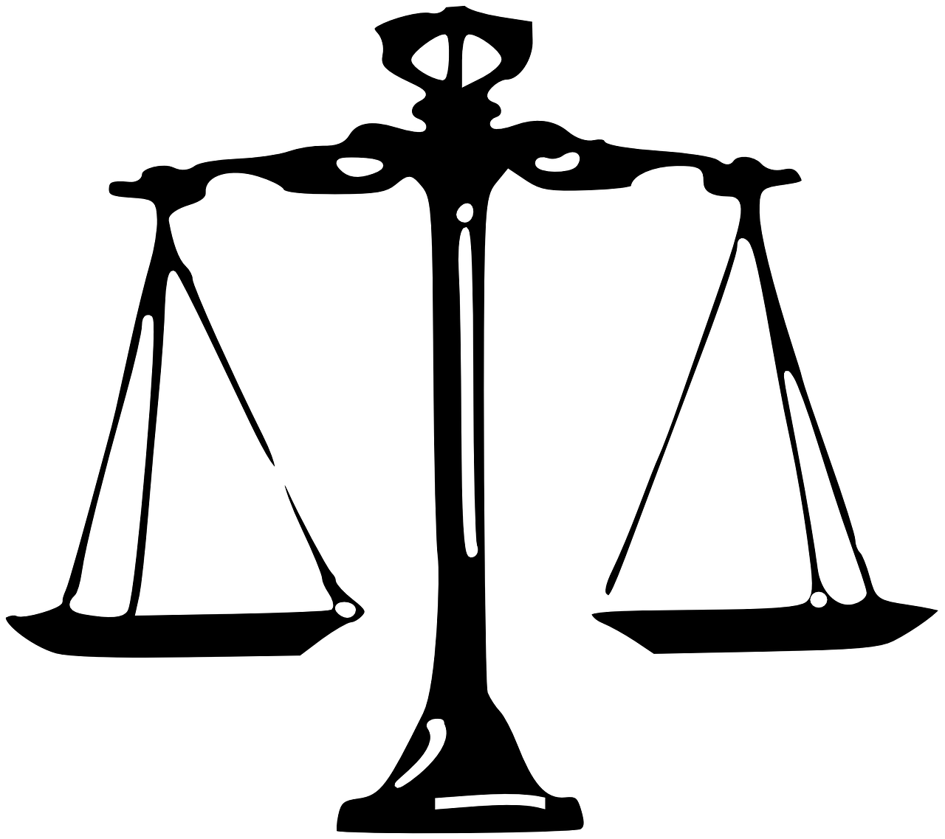
Is it a fair use?
A Hands-On Discussion
Virginia Pannabecker, Health, Life Science & Scholarly Communication Librarian
vpannabe@vt.edu
Anita Walz,Open Education, Copyright & Scholarly Communications Librarian
arwalz@vt.edu
This presentation is licensed with a CC-BY-SA 4.0 license.
Resource Folder: http://tinyurl.com/IsItAFairUse-Wrkshp-2016
Scale image credit: CC0 public domain image, by OpenClips, via Pixabay: http://pixabay.com/en/scales-justice-law-equal-fair-152494/

Slide 2
Session Goals
After this session, participants will:
Be familiar with U.S. Copyrights
Be able to identify when and how to evaluate a use as a ‘Fair Use’
Have experience using tools and resources for applying a Fair Use analysis
NOTE: This workshop’s purpose is to provide information, resources, and facilitate discussion. It should not be construed as legal advice.
Notes:
NOTE: This workshop’s purpose is to provide information, resources, and facilitate discussion. It should not be construed as legal advice.

Slide 3
Session Activities
U.S. Copyright overview
5-step evaluation process
Fair Use Evaluator Tool
Group activity: case study analysis
Discussion

Slide 4
What is Copyright?
"The Congress shall have power
... to promote the progress of science and useful arts, by securing for limited times to authors and inventors the exclusive right to their respective Writings and Discoveries."
U.S. Constitution, I S8
Copyright Definition
Copyright FAQ - U.S. Copyright Office

Slide 5

Copyright Basics
Copyright holder’s exclusive rights for life + 70 years
Reproduce the work
Distribute the work
Publicly perform the work
Publicly display the work
Publicly perform sound recordings by means of a digital audio transmission
Create derivative works
© Screenshot from “Get Creative” Creative Commons CC BY-NC-SA

Slide 6
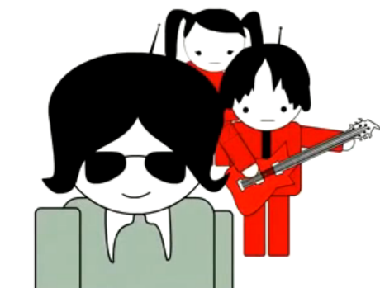
You may want to (legally) …
Reproduce
Distribute
Publicly perform
Publicly display
Publicly perform by means of a digital audio transmission, and/or
Create derivations of . . .
. . . works for which someone else owns copyright
© Screenshot from “Get Creative” Creative Commons CC BY-NC-SA

Slide 7
5 Steps
© Screenshot from “Get Creative” Creative Commons CC BY-NC-SA
Is the work protected by copyright?
Is there a specific exemption in © law that covers my use?
Is there a license that covers my use?
Is my use covered by fair use?
Do I need permission from the copyright owner for my use?
A Framework for Analyzing any U.S. Copyright Problem.
By Smith, K., Macklin, L. A., and Gillilan, A. T., CC-BY-SA 4.0.
Modified by Anita Walz, CC-BY-SA 4.0.

Slide 8
Copyright Basics
Works that can be copyrighted:
Literary works, musical, and dramatic works
Pantomime & choreographical works
Pictoral, graphic and sculptural works
Sound recordings
Motion pictures and other audiovisual works
Computer programs
Architectural works
Works that cannot be copyrighted:
Ideas, procedures, and methods
Titles, names, slogans (may be trademarked)
Facts, news, and research data
Works in the public domain http://librarycopyright.net/resources/digitalslider
Unrecorded, unwritten, un“fixed” works

Slide 9
Step 1: Is the work protected by copyright?
No - it’s a type of work that cannot be copyrighted
No - it’s in the Public Domain
http://librarycopyright.net/resources/digitalslider
No - it’s my original work -- and I did not sell or give
away my rights
Yes, it is protected by copyright - See Step 2

Slide 10
5 Steps
© Screenshot from “Get Creative” Creative Commons CC BY-NC-SA
Is the work protected by copyright?
Is there a specific exemption in © law that covers my use?
Is there a license that covers my use?
Is my use covered by fair use?
Do I need permission from the copyright owner for my use?
A Framework for Analyzing any U.S. Copyright Problem.
By Smith, K., Macklin, L. A., and Gillilan, A. T., CC-BY-SA 4.0.
Modified by Anita Walz, CC-BY-SA 4.0.
Notes:
Highlight the importance of documenting one’s use of an exemption (if used) - this is really important!!!

Slide 11
Step 2: Is there a specific exemption in © law that
covers my use?
Examples of exemptions related to research and teaching
Section 108: Library copying
Section 109(a): First sale doctrine
Section 109(c): Exemption for public displays
Section 110(1): Displays/performances in face to face teaching
Section 110(2): Displays/performances in distance learning
Section 117: Computer software
Section 120: Architectural works
Section 121: Special formats for persons who are blind or have other disabilities
Persistent Links to library resources:
http://www.lib.vt.edu/help/scholar/persistentlinks.html
Also valuable:
Documentation of the exemption you used -- that you acted “in good faith.”
Know Your Copyrights chart:
http://www.knowyourcopyrights.org/storage/documents/kycrmatrixcolor.pdf
Notes:
*These are some examples of specific exemptions outlined in U.S. copyright law - there are many more!

Slide 12
5 Steps
© Screenshot from “Get Creative” Creative Commons CC BY-NC-SA
Is the work protected by copyright?
Is there a specific exemption in © law that covers my use?
Is there a license that covers my use?
Is my use covered by fair use?
Do I need permission from the copyright owner for my use?
A Framework for Analyzing any U.S. Copyright Problem.
By Smith, K., Macklin, L. A., and Gillilan, A. T., CC-BY-SA 4.0.
Modified by Anita Walz, CC-BY-SA 4.0.

Slide 13
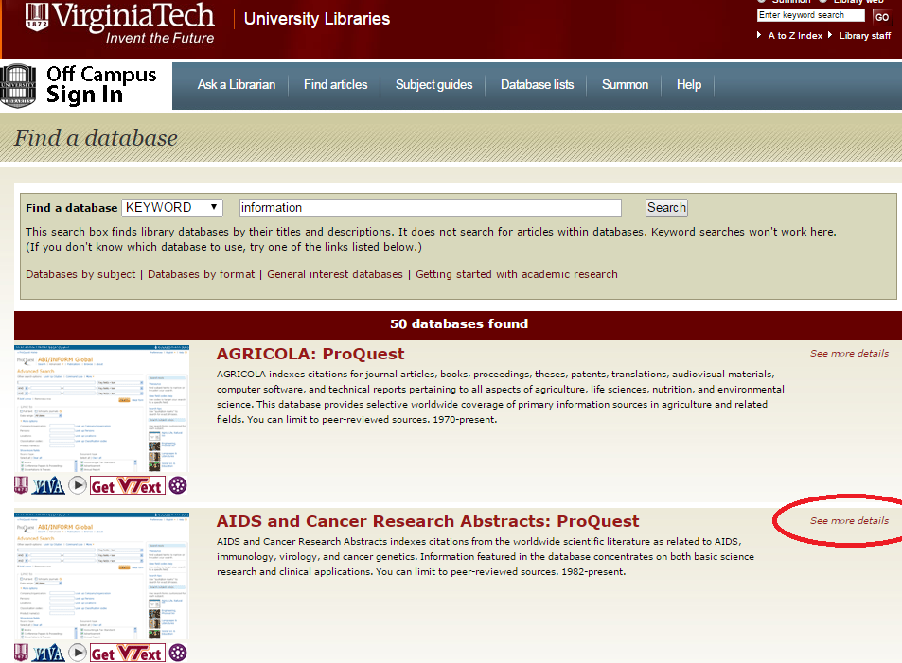
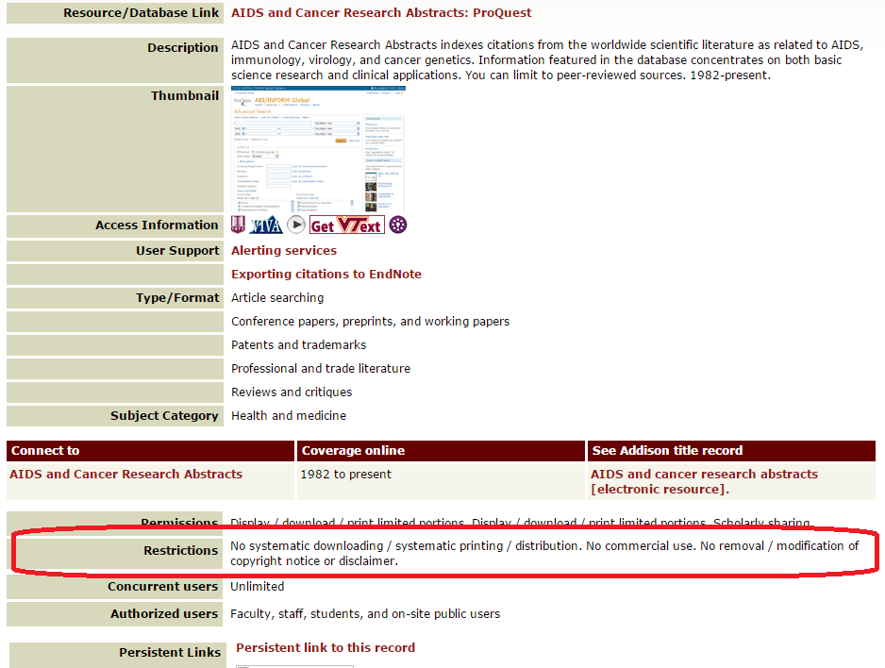
3) Is there a license that covers my Use?
Screenshots taken from pages on lib.vt.edu, using Snippy screenshot tool and image editor, by Anita Walz.
Notes:
This slide relates to resources / materials that are subscribed to or purchased by libraries for use by their communities. Such subscriptions (and sometimes purchases) often include a license that specifies details about who may use the content, including the conditions under which the content may be used (when, how, how often, how much).

Slide 14
3) Is there a license that covers my Use?
(or, could I use alternate material that has a Creative Commons license?)
Creative Commons Licenses
CC licence logos from Creative Commons site, About Creative Commons Licences, CC-BY
About Creative Commons Licenses
Notes:
There are many types of open content licenses that copyright holders may consider applying to their works to explicitly state the conditions under which others may use them without asking for permission. *Such licenses don’t prevent other uses that are already allowable in applicable copyright law. In this presentation, we use and link to the Creative Commons group of open content licenses.

Slide 15
5 Steps
© Screenshot from “Get Creative” Creative Commons CC BY-NC-SA
Is the work protected by copyright?
Is there a specific exemption in © law that covers my use?
Is there a license that covers my use?
Is my use covered by fair use?
Do I need permission from the copyright owner for my use?
A Framework for Analyzing any U.S. Copyright Problem.
By Smith, K., Macklin, L. A., and Gillilan, A. T., CC-BY-SA 4.0.
Modified by Anita Walz, CC-BY-SA 4.0.
Notes:
Highlight the importance of documenting one’s Fair Use analysis when using copyrighted materials under the Fair Use exemption - this is really important!!!

Slide 16
Fair Use: 4 Factors
The purpose and character of your use
The nature of the copyrighted work
The amount and substantiality of the portion taken
The effect upon the potential market
A Framework for Analyzing any U.S. Copyright Problem.
By Smith, K., Macklin, L. A., and Gillilan, A. T., CC-BY-SA 4.0.
Modified by Anita Walz, CC-BY-SA 4.0.
Notes:
Highlights: (1) Any Fair Use analysis must consider all 4 factors, (2) It’s important to document (and keep a record of) your fair use analysis for future reference.

Slide 17
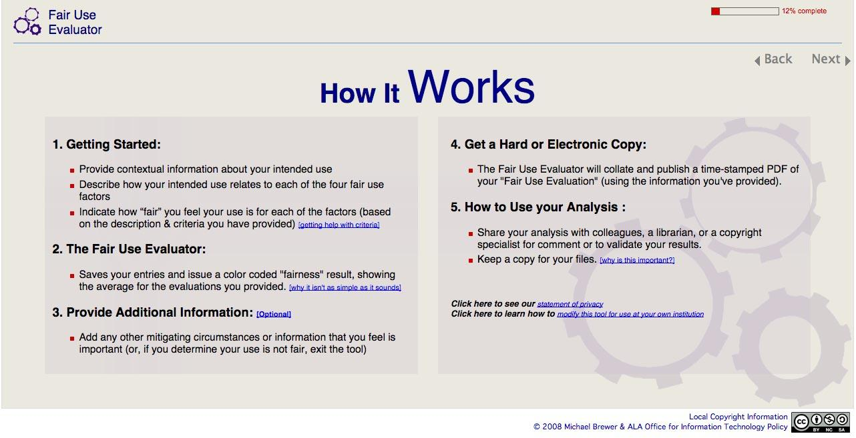
Fair Use Evaluator Tool
CC-BY-NC-SA license

Slide 18
Case Study Example
Dr. R is planning to teach a class on film that will include watching films, reading and writing film criticism, and a student assignment to make a short film individually or with a small group. One student plans to use an entire copyrighted song from a popular group in the background and plans to upload her completed film to YouTube as well. Is the student’s use of the song a fair use?
Modified from a “Scenario for Copyright Framework Analysis,” from Coursera hosted MOOC, Copyright for Educators & Librarians, taught by Kevin Smith, M.L.S., J.D., Lisa A. Macklin, J.D.,M.L.S., Anne Gilliland, JD, MLS: https://d396qusza40orc.cloudfront.net/cfel/Reading%20Docs/MOOCFinal.pdf
CC-BY-SA 4.0 license

Slide 19
Case Study Example 2
- Library Training
Ms. R, an academic librarian, is planning to provide a training session for college instructors on library ebook platforms. To catch people’s interest she wants to start the session with a clip of Pharrell William’s song “Happy” to get everyone in a good mood. To be sure it’ll work in any teaching environment she downloads the song file to her computer, and embeds the file in her PPT presentation. Later a participant asks if she can share her slides and she says she’ll post them to SlideShare.

Slide 20
Case Study Group Activity
2 Groups
Open Group Case Study Document
Choose Group Recorder & Reporter
Open Fair Use Evaluator Tool
Analyze your case study for Fair Use applicability
Record your analysis in the Fair Use Evaluator tool and create a PDF
Have the PDF at hand for our full group discussion
Notes:
Get in a group
Choose a moderator, time keeper, and recorder
Open your case study
Use the Fair Use Evaluator

Slide 21
Discussion
Notes:
Recap: (1) Any Fair Use analysis must consider all 4 factors, (2) It’s important to document (and keep a record of) your fair use analysis for future reference, (3) Not a Fair Use? Discuss changes that could make a use more ‘fair’

Slide 22
5 Steps
© Screenshot from “Get Creative” Creative Commons CC BY-NC-SA
Is the work protected by copyright?
Is there a specific exemption in © law that covers my use?
Is there a license that covers my use?
Is my use covered by fair use?
Do I need permission from the copyright owner for my use?
Can I identify alternative content or create my own content to use?
A Framework for Analyzing any U.S. Copyright Problem.
By Smith, K., Macklin, L. A., and Gillilan, A. T., CC-BY-SA 4.0.
Modified by Anita Walz, CC-BY-SA 4.0.
Notes:
Mention DOCUMENTATION of exemption (if used) is really important!!!

Slide 23
5) Do I need permission from the copyright owner for my use?
Resources for Getting Permission
How to Obtain Permission - a circular from the U.S. Copyright Office
http://www.copyright.gov/circs/m10.pdf
The Basics of Getting Permission, from Stanford University
http://fairuse.stanford.edu/overview/introduction/getting-permission/

Slide 24
6) Can I identify alternative content or create my own content to use?

Slide 25
Openly licensed Images
Creative Commons Search → Search via CC license on multiple content platforms (Flickr, Google, more)
Flickr → After you type in something to search, on the top left, use the ‘Any License’ dropdown to change to ‘All Creative Commons Licences’
Wikimedia Commons - openly licensed or public domain
Pixabay - all images are CC0 (public domain)
Tin Eye - *Do you have a picture you found online and aren’t sure of its license? Paste it in Tin Eye to find out where it’s from.
Always Attribute when reusing Creative Commons works.

Slide 26
Resources
Copyright Definition
http://www.copyright.gov/help/faq/definitions.html
Copyright FAQ - U.S. Copyright Office
http://www.copyright.gov:8081/help/faq/
U.S. Copyright Office Records Search
http://www.copyright.gov/records/
Copyright Slider - Works in the Public Domain
http://librarycopyright.net/resources/digitalslider/
A Framework for Analyzing Any U.S. Copyright Problem
http://guides.lib.vt.edu/ld.php?content_id=9271483 modified by Anita Walz, CC-BY-SA 4.0
http://tinyurl.com/5-stepsForCopyrightQs by Smith, K., Macklin, L. A., and Gillilan, A., CC-BY-SA 4.0
Fair Use Evaluator Tool
http://www.librarycopyright.net/resources/fairuse/howitworks.php
How to Obtain Permission - a circular from the U.S. Copyright Office
http://www.copyright.gov/circs/m10.pdf
The Basics of Getting Permission, from Stanford University
http://fairuse.stanford.edu/overview/introduction/getting-permission/
Creative Commons Search filter - a starting point for finding openly licensed content
https://search.creativecommons.org/
Scholarly Communications (and Copyright), University Libraries
http://scholar.lib.vt.edu/cgi-bin/comment.pl
Follow the Four Factors of Fair Use (video) http://youtu.be/mYB3f7U9NFs
Fair Use Case examples
Webster University, Fair Use by Use: http://www.webster.edu/faculty/fair-use/use.html
Stanford University, Summaries of Fair Use Cases: http://fairuse.stanford.edu/overview/fair-use/cases/
Coursera hosted MOOC, Copyright for Educators & Librarians, taught by Kevin Smith, M.L.S., J.D., Lisa A. Macklin, J.D.,M.L.S., Anne Gilliland, JD, MLS, Scenario for framework analysis: https://d396qusza40orc.cloudfront.net/cfel/Reading%20Docs/MOOCFinal.pdf CC-BY-SA 4.0
Workshop Materials:
http://tinyurl.com/IsItAFairUse-Wrkshp-2016

