Slide 1
Tweets Metadata
May 4, 2015
CS 4624 - Multimedia, Hypertext and Information Access
Department of Computer Science
Virginia Polytechnic Institute and State University
Blacksburg, VA 24061

Slide 2
Project Personnel
Principal Investigator:
Dr. Edward Fox, Virginia Tech Department of Computer Science
  email: fox@vt.edu
Clients:
Mohamed Magdy, Virginia Tech Department of Computer Science
  email: mmagdy@vt.edu
Student Team Members:
Chris Conley
Alex Druckenbrod
Karl Meyer
Samuel Muggleworth

Slide 3
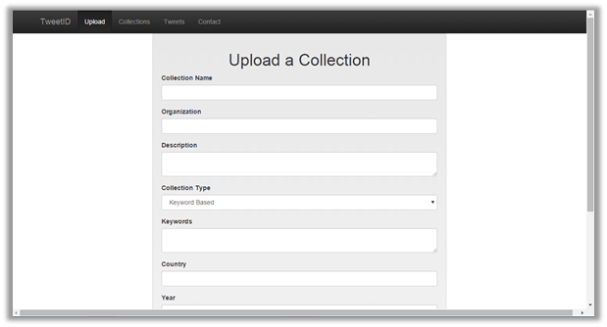
// Background
CTRnet, QCRI, etc. collect and archive tweets surrounding events
Desired some central database for tweet collections
Michael Shuffet started project in 2014
Implemented to support CTRnet and QCRI data formats
Figure 1: Michael Shuffett’s Upload information page

Slide 4
// Goals
Tweet and tweet-collection metadata standard
  Enable collection sharing and consistency
  Standard exists at collection and tweet levels
To implement methods for merging such collections
To create a web-app tool that will allow a user to upload new collections and execute merging of collections.

Slide 5
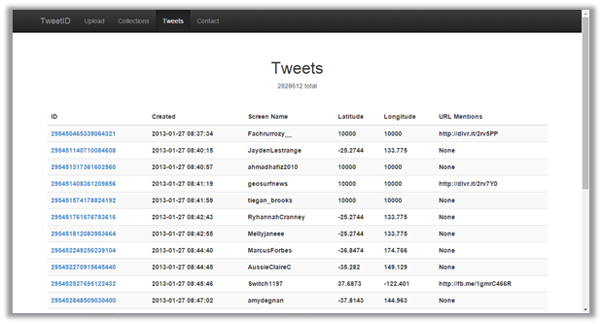
// Code Base, Technologies
Shuffetts TweetID tool as starting point
  Implemented upload and merging specifically geared towards IDEAL and QCRI collections
Technologies used:
  Python 2.7.9 - scripting
  SQLlite - database
  HTML5/CSS/Bootstrap - web development
  jQuery/Flask-script - client side scripting
  jinja2 - dynamic HTML templating/rendering
  Flask/WTForm - forms and upload
Figure 2: Shuffett’s tweet listing page

Slide 6
// Discoveries
All files converted to .tsv
expected a ‘text’ field, but never writes it to database
Using collection.name as principal key in database
Supports only:
  One schema type
    9 fields: 7 data fields + 2 \N fields*
  Two file types
    .csv or .tsv
Notes:
DISCOVERIES ABOUT MICHAEL SHUFFETT’S IMPLEMENTATION

Slide 7
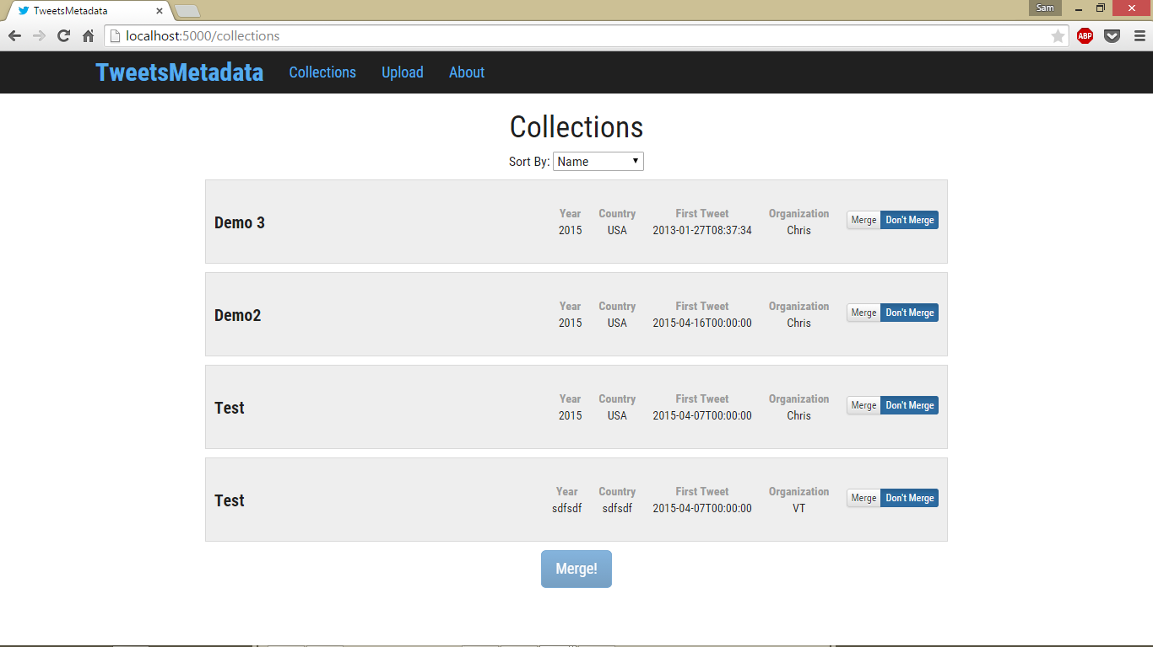
// What we did
Determined standard
  What data is necessary?
Updated Interface
Created collection.id field as principal key
Allowed multiple schemas/formats
  Request schema from uploader
  Map and record only standardized data to our schema.
  Original merge process unchanged
Figure 3: Our Updated Collection Page

Slide 8
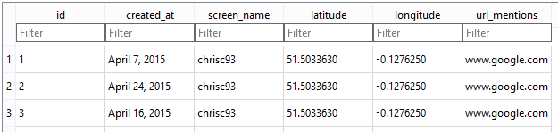
// Standards
Figure 4: Tweet metadata as captured from our test database.
Figure 5: Collection metadata as captured from our test database.

Slide 9
// Lessons Learned
Attempted to switch to Python3
  Learned about incompatible libraries
Commenting code is very important
  Continuing a project is much easier with documentation
Be aware of database size
  Better to implement for large database from the start
  I.e. avoid iterating through the entire database

Slide 10
// Future Plans
Implement autonomous capabilities
  More complex schemas
  Less manual mapping/schema info
Become largely more flexible
  Less reliant on specific formatting
  Accept more file types
Persist Merges
Scale the technologies appropriately depending on size of project.

Slide 11
// References
"Developer Policy." Developer Policy. Twitter, Inc., 22 Oct. 2014. Web. <https://dev.twitter.com/overview/terms/policy>.
Shuffett, Michael. “Twitter Metadata.” Twitter Metadata. VTechWorks, 10 May 2014. Web. 09 Feb. 2015. <https://vtechworks.lib.vt.edu/handle/10919/47949>.
"Twitter Terms of Service." Twitter, Inc., 8 Sept. 2014. Web. <https://twitter.com/tos?lang=en>.
“QCRI.” Quatar Computing Research Institute, 2015. Web. <http://www.qcri.com>.
“CTRnet - Events Archive.” Virginia Polytechnic Institute and State University. Web. < http://www.ctrnet.net/>

Slide 12

??? Questions ???

