Slide 1

Chapter 8
Health and Well-Being Considerations
Unless otherwise noted, this slide deck is (c) Erin A. Hopkins.
It is released under a Creative Commons Attribution NonCommercial ShareAlike 3.0 license (CC BY NC-SA 3.0).

Slide 2
Chapter Sections
8.1 Introduction
8.2 Physical Dimension
8.3 Mental Dimension
8.4 Social Dimension
8.5 Smart Device Technology as an Ally to Health and Well-Being in Sustainable Property Management
8.6 Conclusion

Slide 3
Learning Objectives
Identify building certifications that focus on health and well-being of humans within the built environment
Describe strategies to enhance the physical dimension of health and well-being in the built environment
Describe strategies to enhance the mental dimension of health and well-being in the built environment
Describe strategies to enhance the social dimension of health and well-being in the built environment
Identify various smart devices that can enhance health and well-being in the built environment

Slide 4
8.1 Introduction
The World Health Organization (WHO) defines health as a “state of complete physical, mental and social well-being and not merely the absence of disease or infirmity”

Slide 5
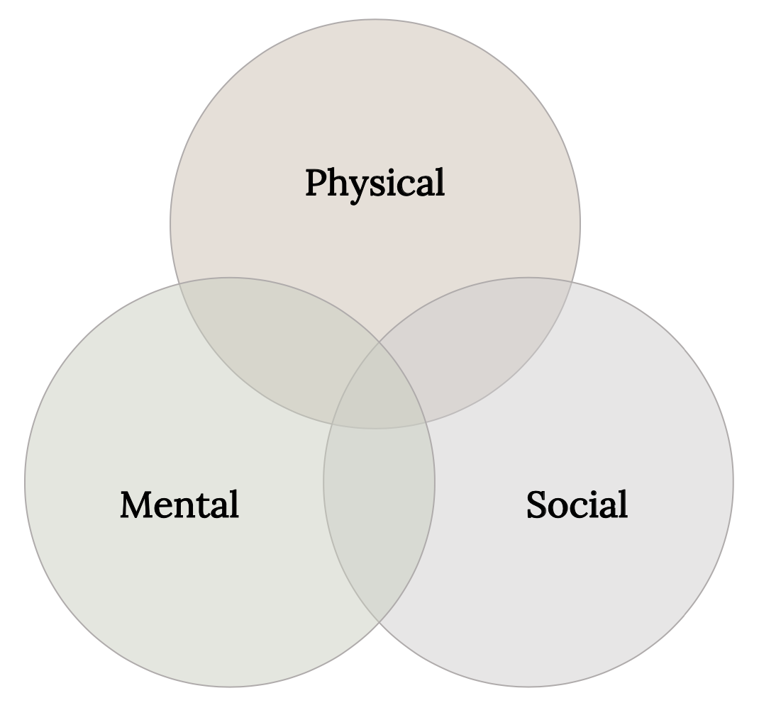
The three dimensions of health and well-being in sustainable property management
Figure 8.1: The three dimensions of health and well-being in sustainable property management. Kindred Grey. 2023. CC BY 4.0.

Slide 6
8.2 Physical Dimension
Sustainable property management can address physical health and well-being through physical space alterations and programming

Slide 7
Strategies
More physical activity opportunities
Increased access to healthy food and drink
Building user safety promotion

Slide 8
8.3 Mental Dimension
We intrinsically know that the mind and body are connected

Slide 9
Strategies for the Mental Dimension
Mental health resources
Restorative spaces and programming
Wayfinding

Slide 10
8.4 Social Dimension
Humans are social beings

Slide 11
Strategies for the Social Dimension
Amenities that encourage socialization
Equitable and inclusive spaces and programs
Community engagement program

Slide 12
8.5 Smart Device Technology as an Ally to Health and Well-Being in Sustainable Property
Management
While these smart devices can promote a healthier lifestyle, programming should be offered to educate and train potential smart device users for optimal effectiveness

Slide 13
8.6 Conclusion
The careful selection of health and well-being strategies can not only attract and retain tenants, but also make building users engaged community citizens

Slide 14
Chapter Activity
Research a WELL certified or Fitwel certified project and report back:
  Project name and location
  5 key features of the building that qualified for certification

