Slide 1
Chapter Class Summ
Miles Jackson
CS 4624 Multimedia, Hypertext and Information Access
Instructor: Edward A. Fox
Virginia Tech
Blacksburg, VA 24061
5/7/2024

Slide 2
Outline
Timeline
Motivation
Design
Implementation
5. Testing
6. Problems Faced
7. Future Work
8. Acknowledgements.

Slide 3
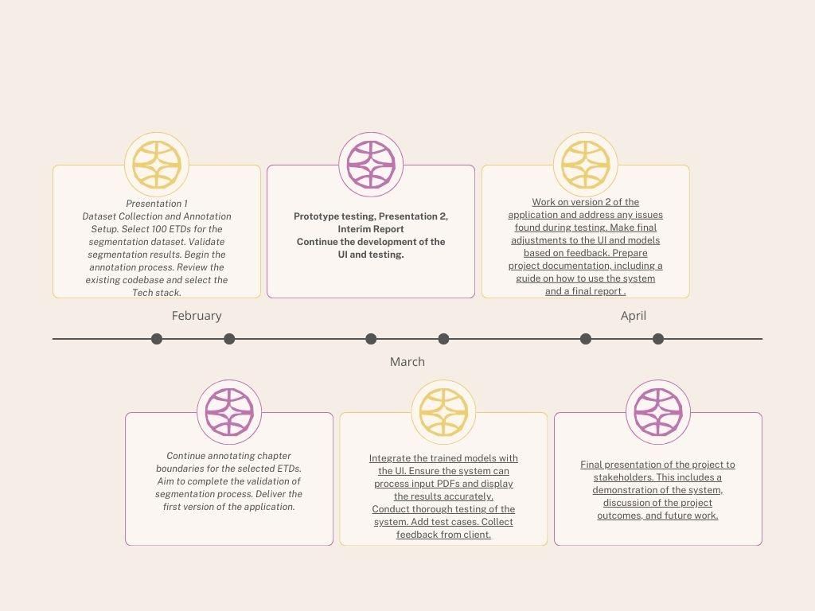

Slide 4

Motivation
Most students are required to cite scholarly sources for their reports, essays, and papers.
A valuable type of source is Electronic Theses and Dissertations (ETDs),
Our project aims to reduce the hassle students endure when searching through ETDs to find relevant material for their writings

Slide 5
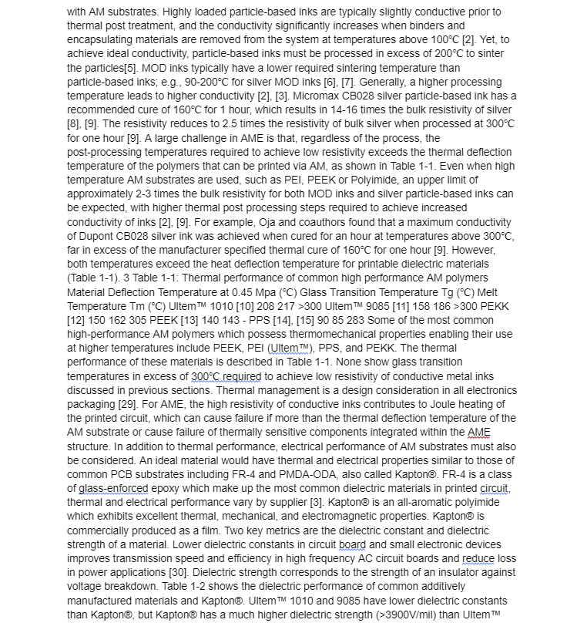
If you have never had to search through an ETD, imagine searching through 40 pages that look like this….

Slide 6
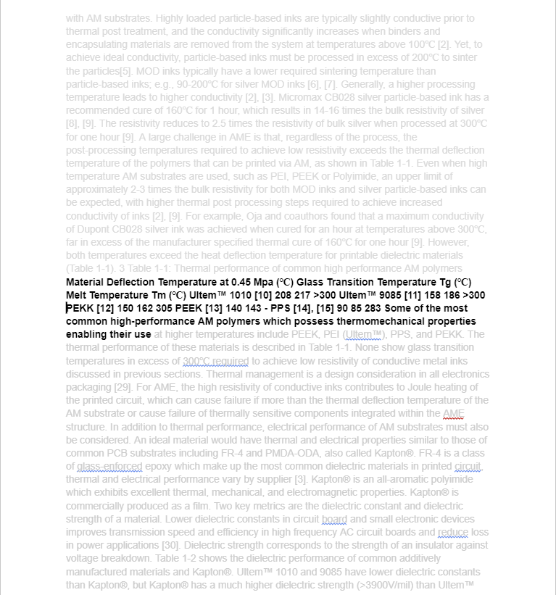
To find this

Slide 7
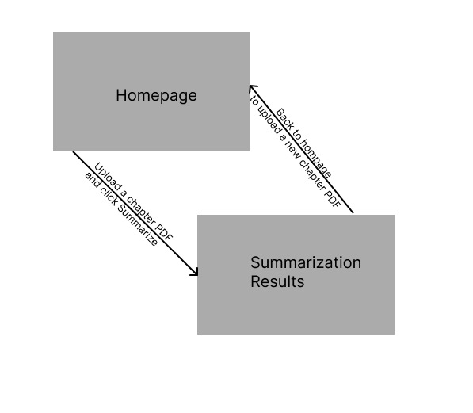
Designed Interaction Loop
User upload PDFs on the homepage and view the summarization results on another page. To upload another PDF, the user must restart the cycle.

Slide 8
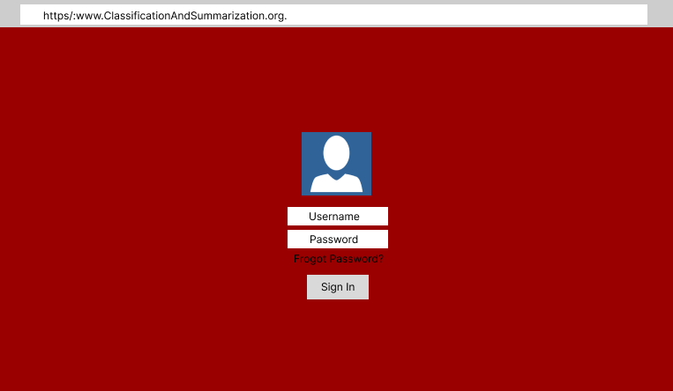
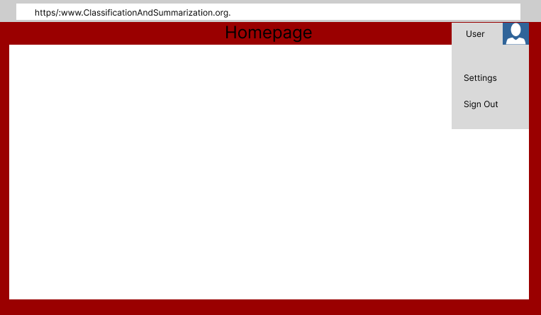
Login and User Tracking System

Slide 9
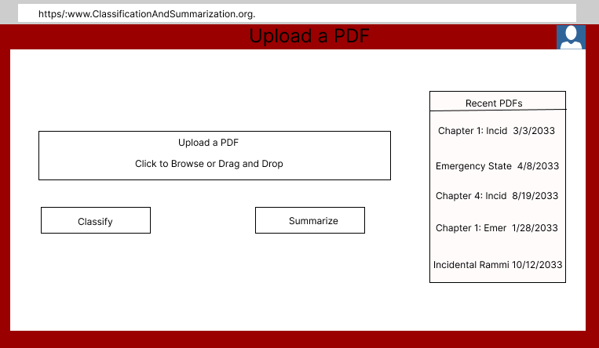
PDF Uploading

Slide 10
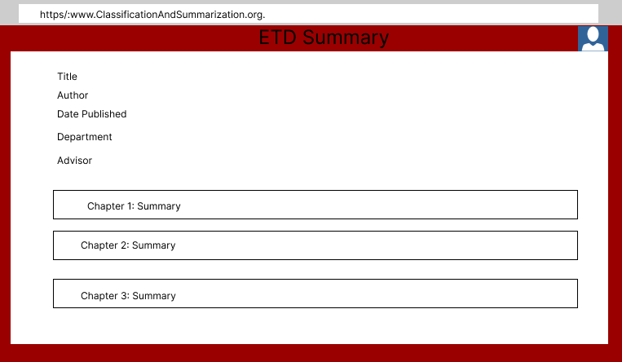
Summarization of Uploaded PDFs (Full ETD)

Slide 11
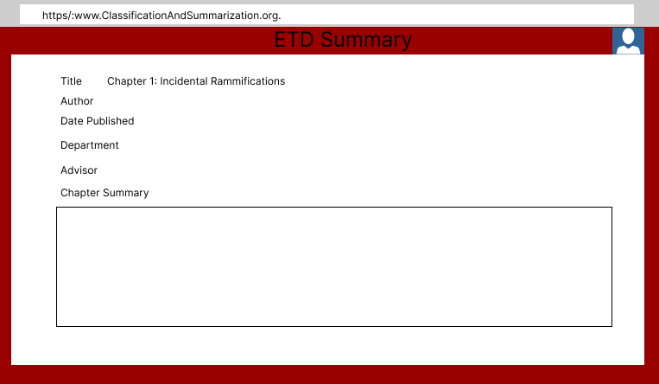
Summarization of Uploaded PDFs (ETD Chapter)

Slide 12
Implementation

Slide 13
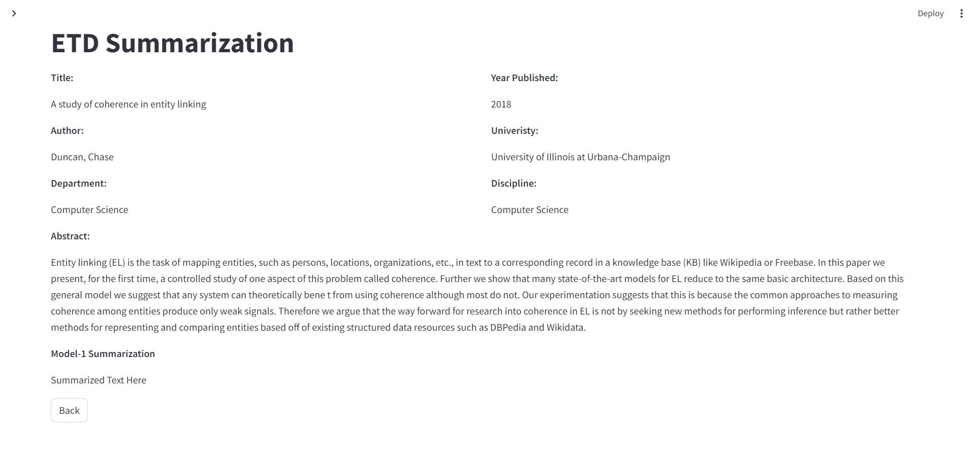
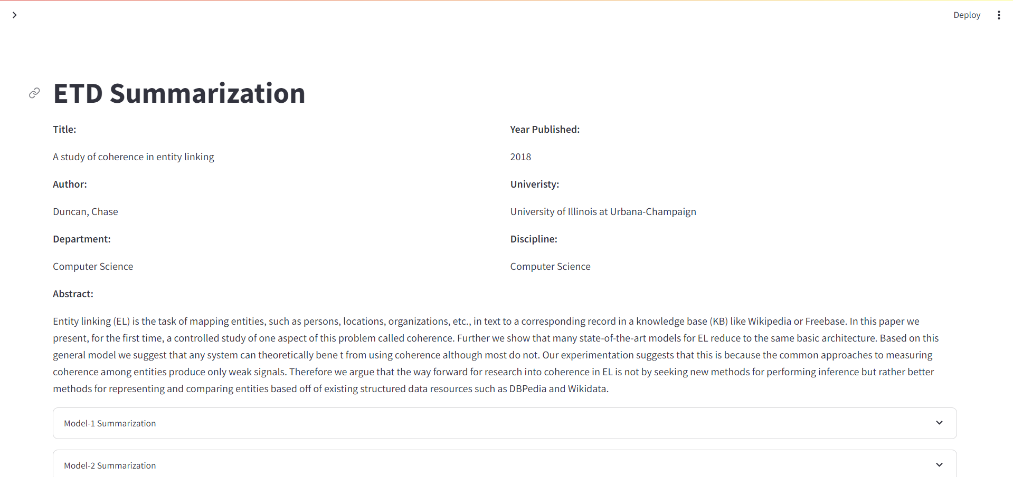
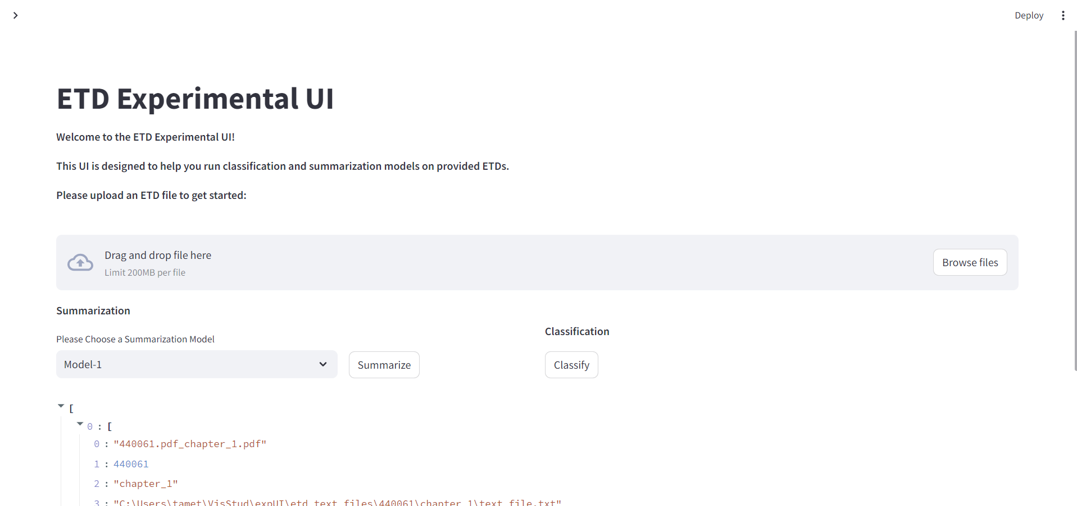
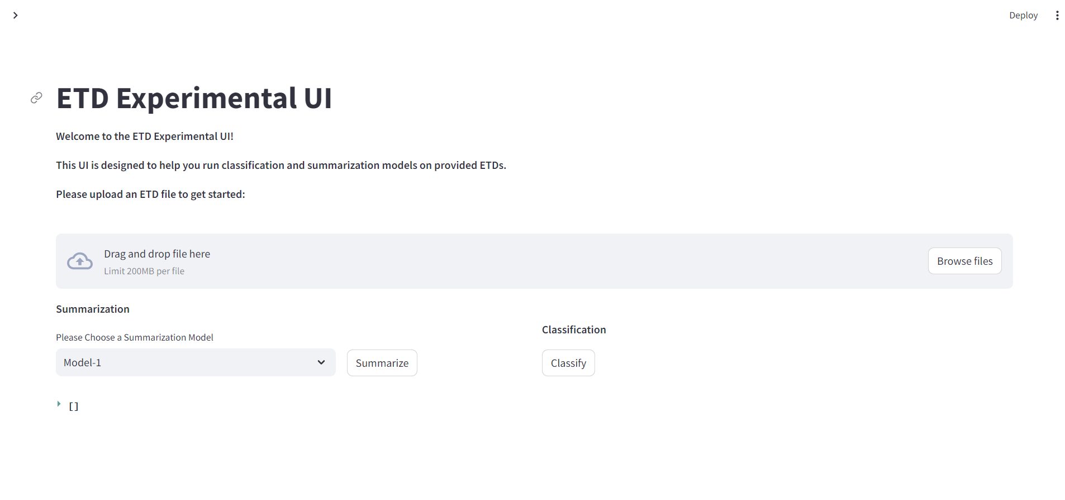
Application Step-through

Slide 14
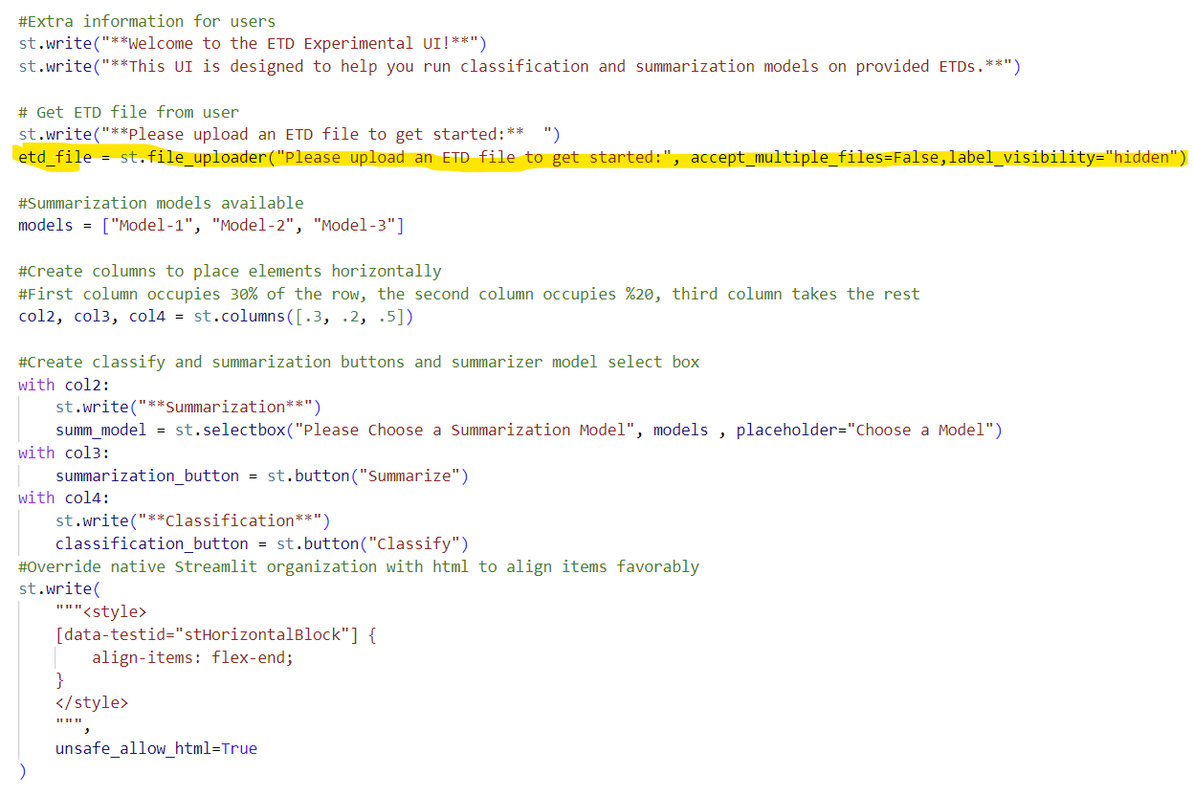
Back-End
PDF is uploaded into FileUploader object

Slide 15
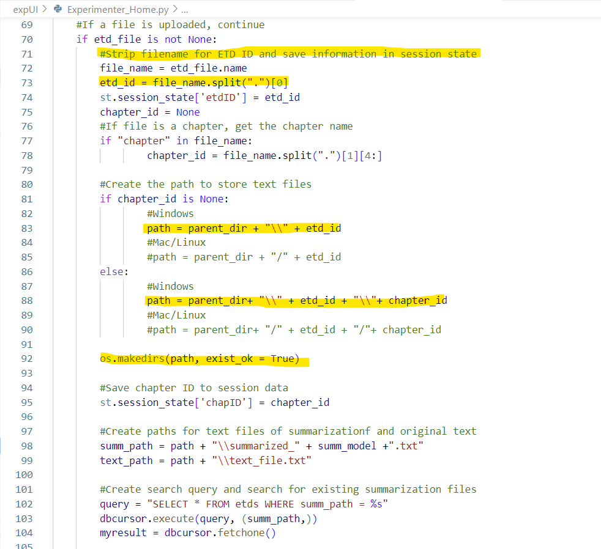
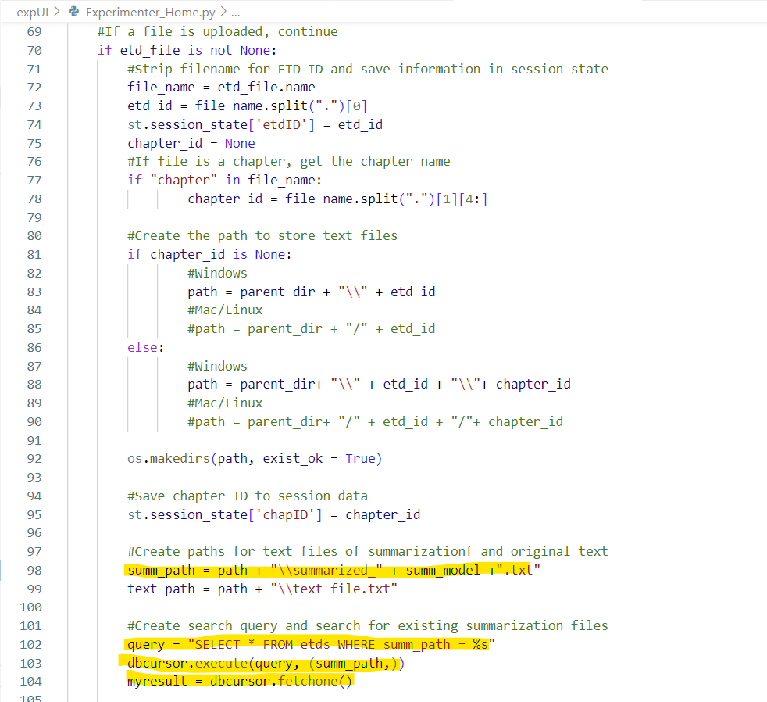
Back End
The filename is used to determine the ETD ID and determine directories for text storage
We then check if the file paths for summarization already exist in the database

Slide 16
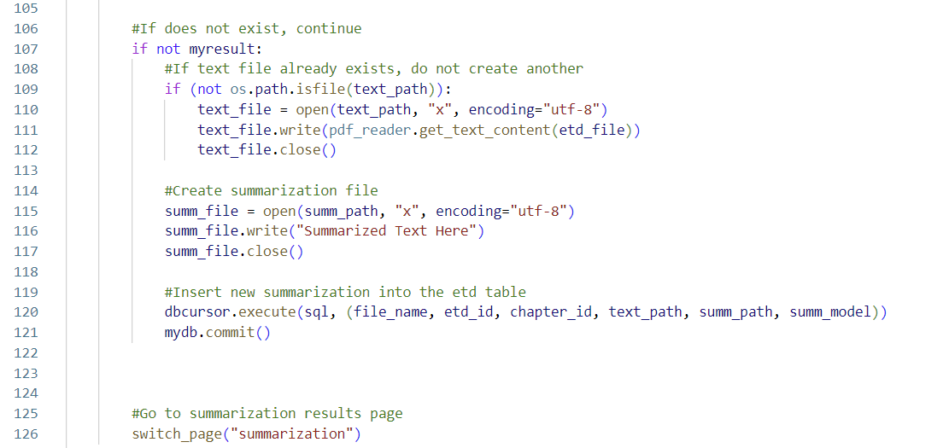
Back-End
If the summarization path is not in the database, then that means we need to add that summary to the database and then switch to the summarization page.

Slide 17
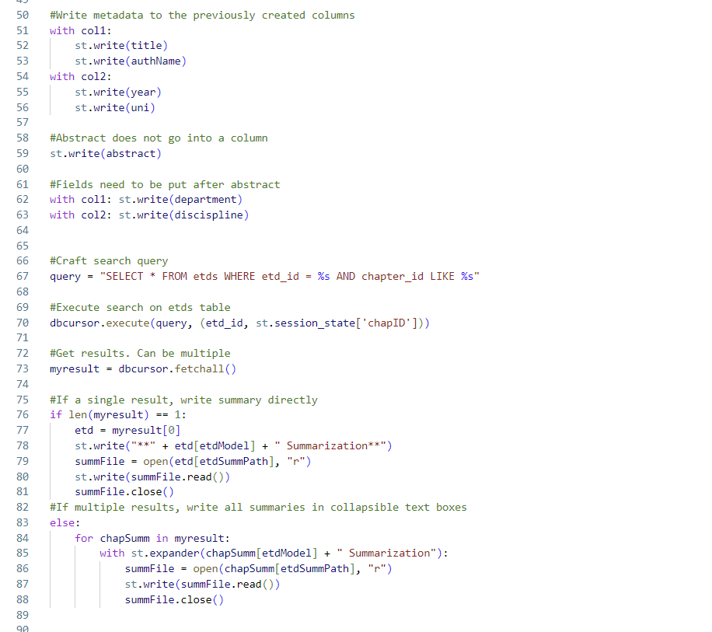
Back-End
The summarization page simply reads data from the tables using the ETD ID passed from the homepage and displays said data

Slide 18

Testing - Method
User testing was difficult to conduct without implementing the machine learning models
Testing was conducted by our client, Bipasha Banerjee
The client attempted to populate the ETD database while stress testing the code

Slide 19
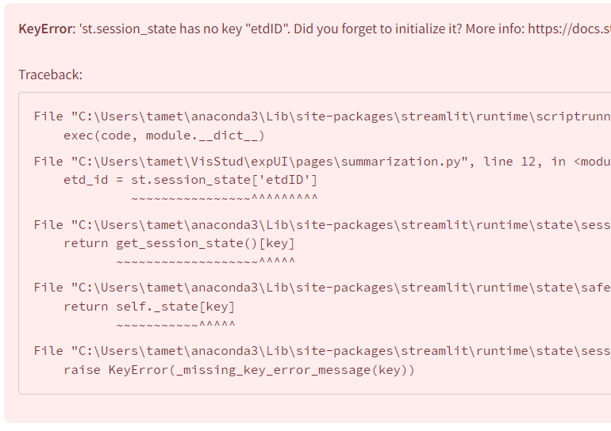
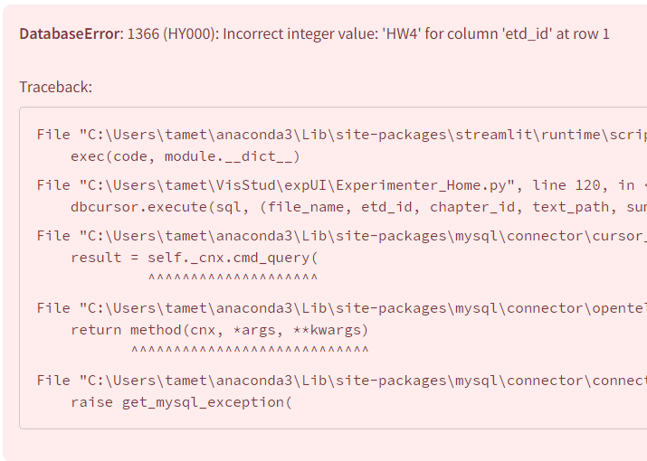
Testing - Results
Insufficient input validation before attempting to insert values into database
Summarization page can be navigated to before a PDF is uploaded causing null errors
Site currently only works for client’s ETD database

Slide 20
Problems Faced - Accessing a Large CSV File
Problem:
The metadata file used for the project was an Excel spreadsheet that contained 500k entries. Searching through this file was extremely time consuming.
Solution:
We converted the Excel spreadsheet into a MySQL database, which allowed for database searching in a fraction of the time.

Slide 21
Problems Faced - Storing Large Text Files
Problem:
When storing entire ETDs into the database, a chunk of the ETD would be truncated due to a character limit imposed by the database itself.
Solution:
Instead of saving the entire ETD in the database, we saved the ETD into a text file and copied the path of that text file into the database instead.

Slide 22
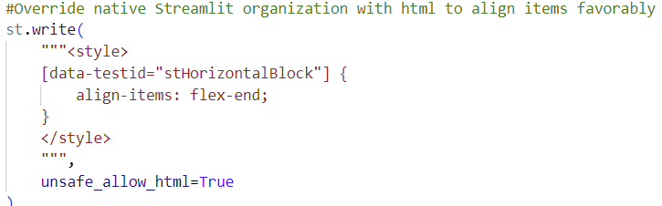
Problems Faced - Streamlit Formatting
Problem:
Streamlit components are top-aligned by default. This means that elements in the same row have their labels aligned. Unfortunately, this cause most of our buttons to be misaligned due to only some of them requiring labels.
Solution:
We used HTML code to override the native Streamlit formatting and align elements manually.

Slide 23
Future Work
Integration of machine learning models into the project
Implementation of user input validation to prevent catastrophic errors
Expand ETD database to support more ETDs (Currently only supports 500,000)

Slide 24


Acknowledgements
Yingjie Zhao (Jack)
Bipasha Banerjee
Edward Fox

Slide 25
References
Lipps, J. (2020, September 2). What is testing? RSS. https://www.headspin.io/blog/what-is-testing
Public Policy Institute of California. (2018, February 14). Asian student studying in library. Public Policy Institute of California. https://www.ppic.org/blog/retraining-workers-future-economy/asian-student-studying-in-library/

Slide 26
Questions?

