Slide 1
CS 3604 Case Study Library
CS4624: Multimedia, Hypertext, and Information Access
Instructor: Dr.Fox
Brian Wieder, Kyle Papili, Brain Nguyen, Drew Marin, Sohil Jain, Kidus Bekele
Blacksburg VA 24061, 05/07/2022
Notes:
Brian Nguyen presents

Slide 2
Outline
Project Overview
What we currently have
Progress Updates
Deployment
In Progress
OKRs Review
Future Work
Notes:
Brian Nguyen presents this

Slide 3
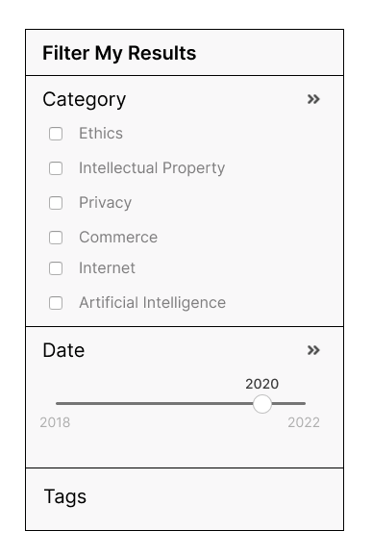
Project Overview
Submission & Presentation platform for CS3604 Projects
Support for over 500 student submissions per semester
Search and categorization based on:
Category
Date
Presentation Title
Notes:
Brian Nguyen presents this

Slide 4
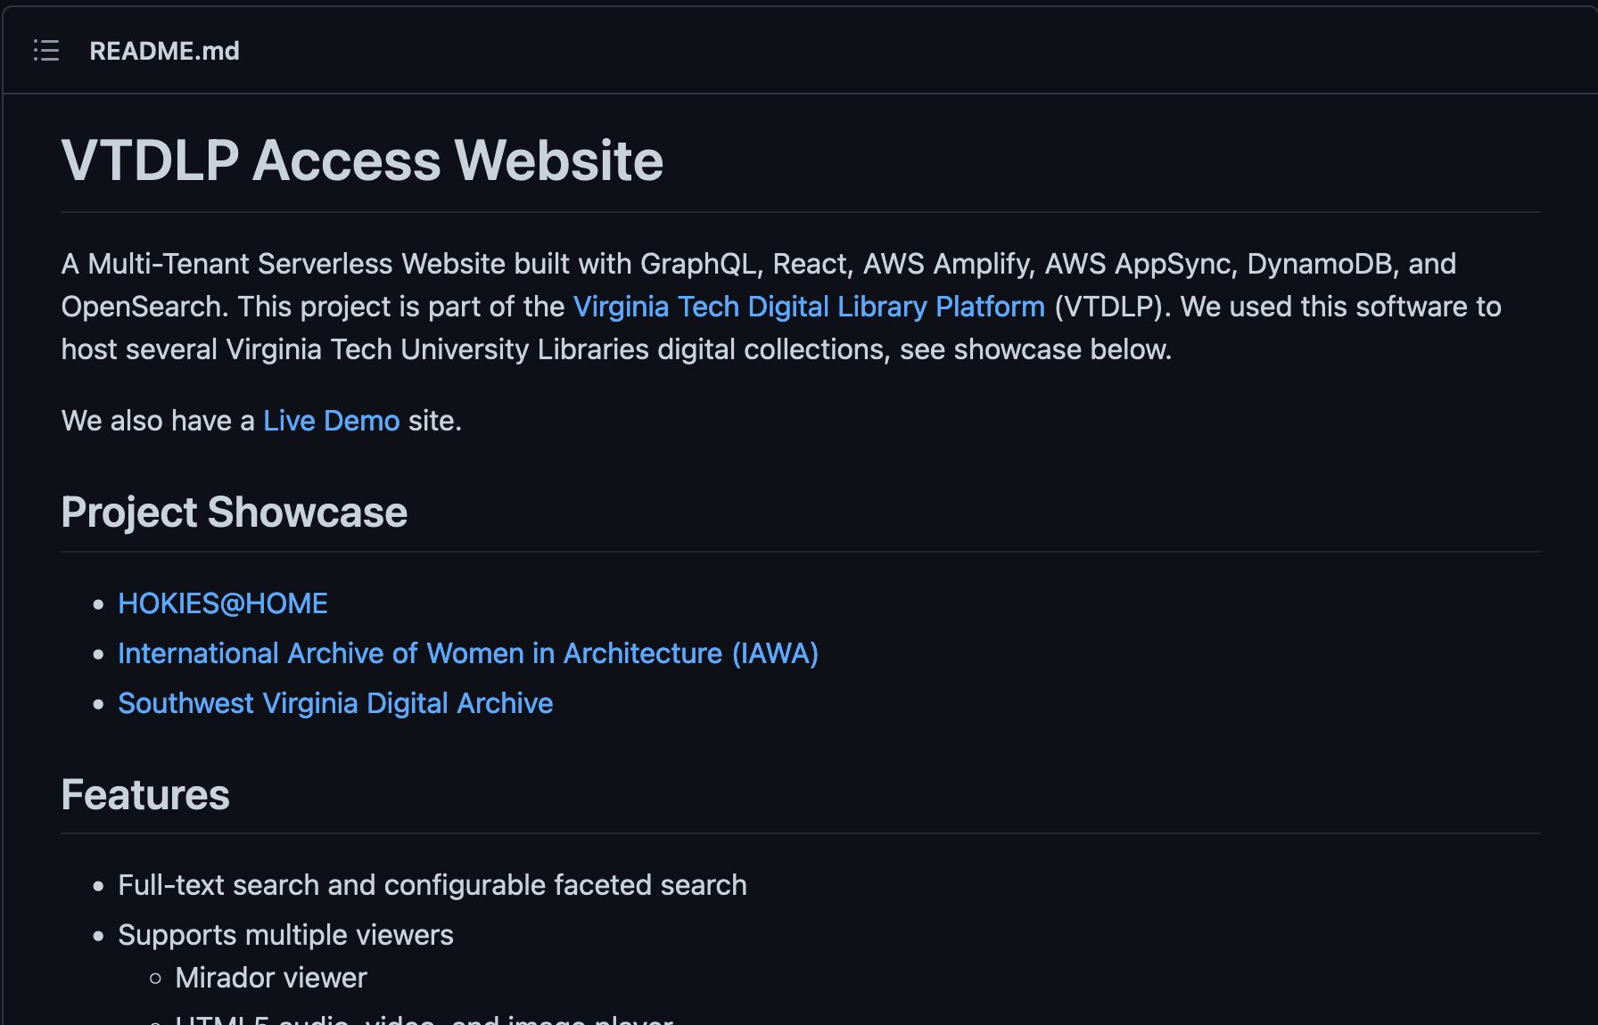
What we currently have
Archival Submission Data
Deployed VT-DLP on custom Domain
https://casestudies.cs.vt.edu
Our own AWS account
Python script for mass uploading.
Notes:
Kidus Bekele

Slide 5
Progress Updates: Deployment
Retrieved the custom domain name from TechStaff
Worked with Dr.Chen to address the issues related to uploading content onto the website
Got a permanent AWS Account
Redeployed existing site onto the new AWS account
Working on updating the custom domain
to point to the site on the new AWS account
Notes:
Brian Wieder

Slide 6
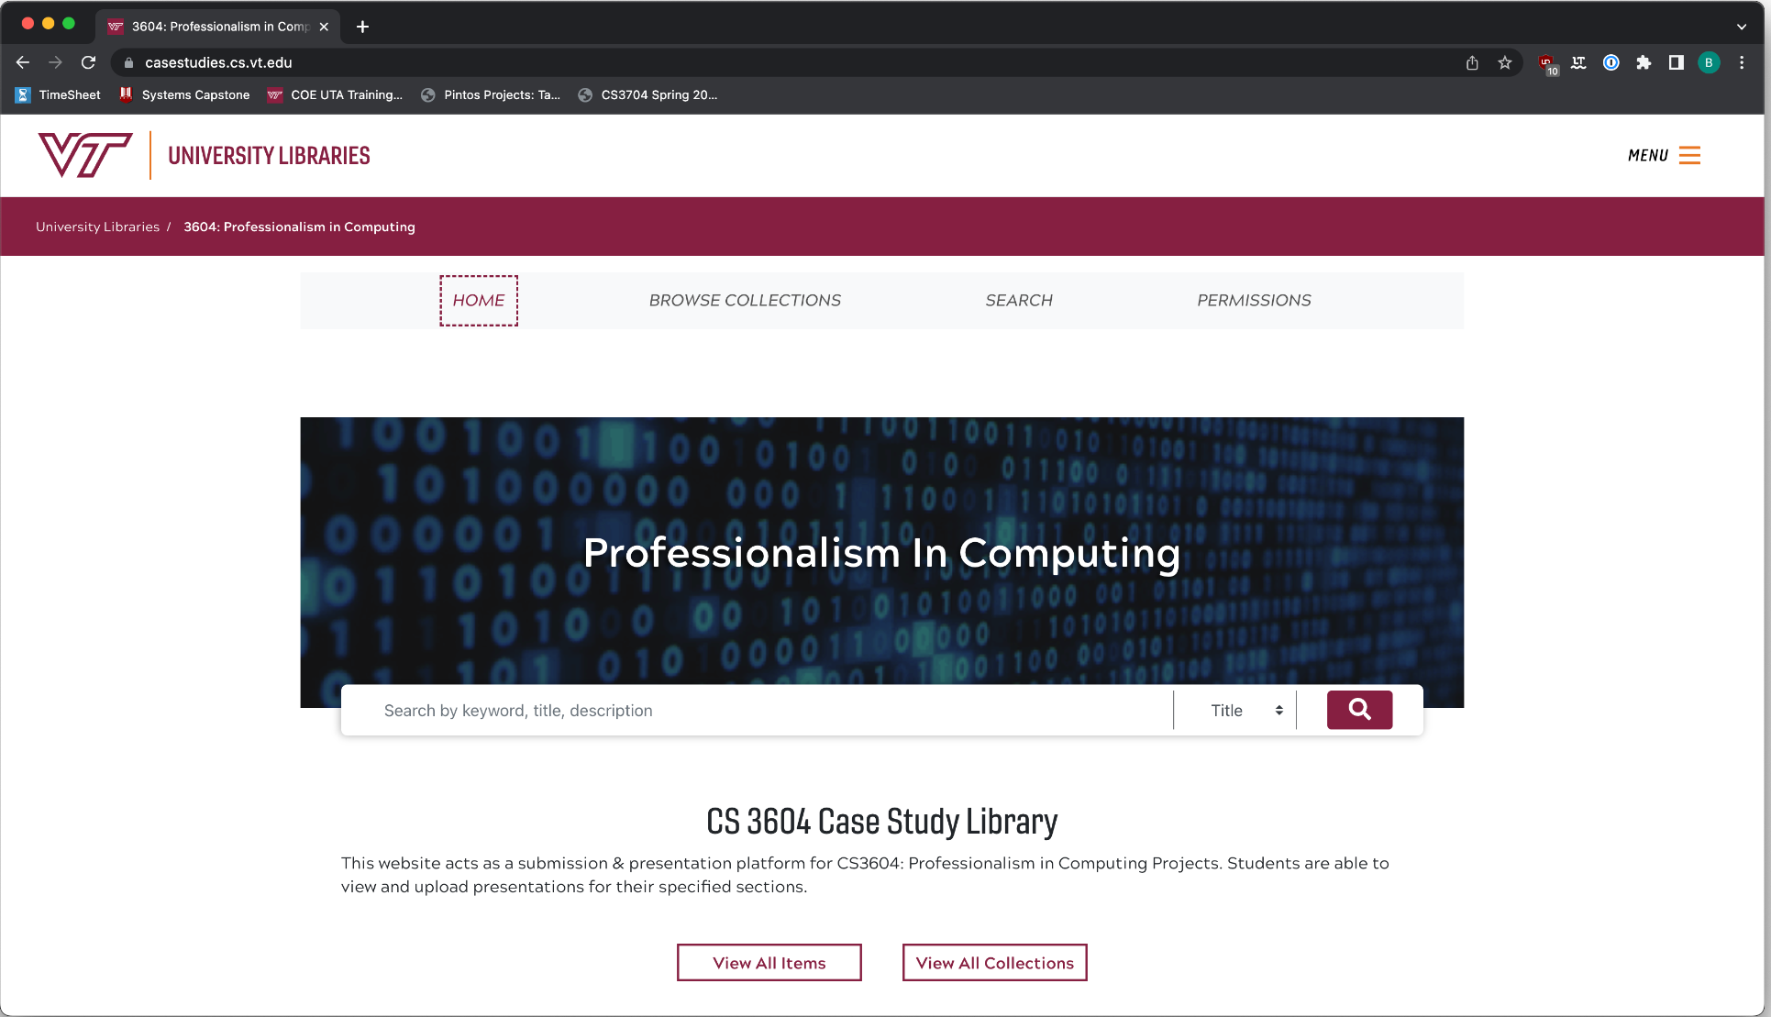

Slide 7



Data Migration
Archived project repository
~3 GB of historical project submissions
Sorted by semester and labeled with student names
Python Script unzip and mass upload the files
Categorize Files
Notes:
Kyle presents

Slide 8
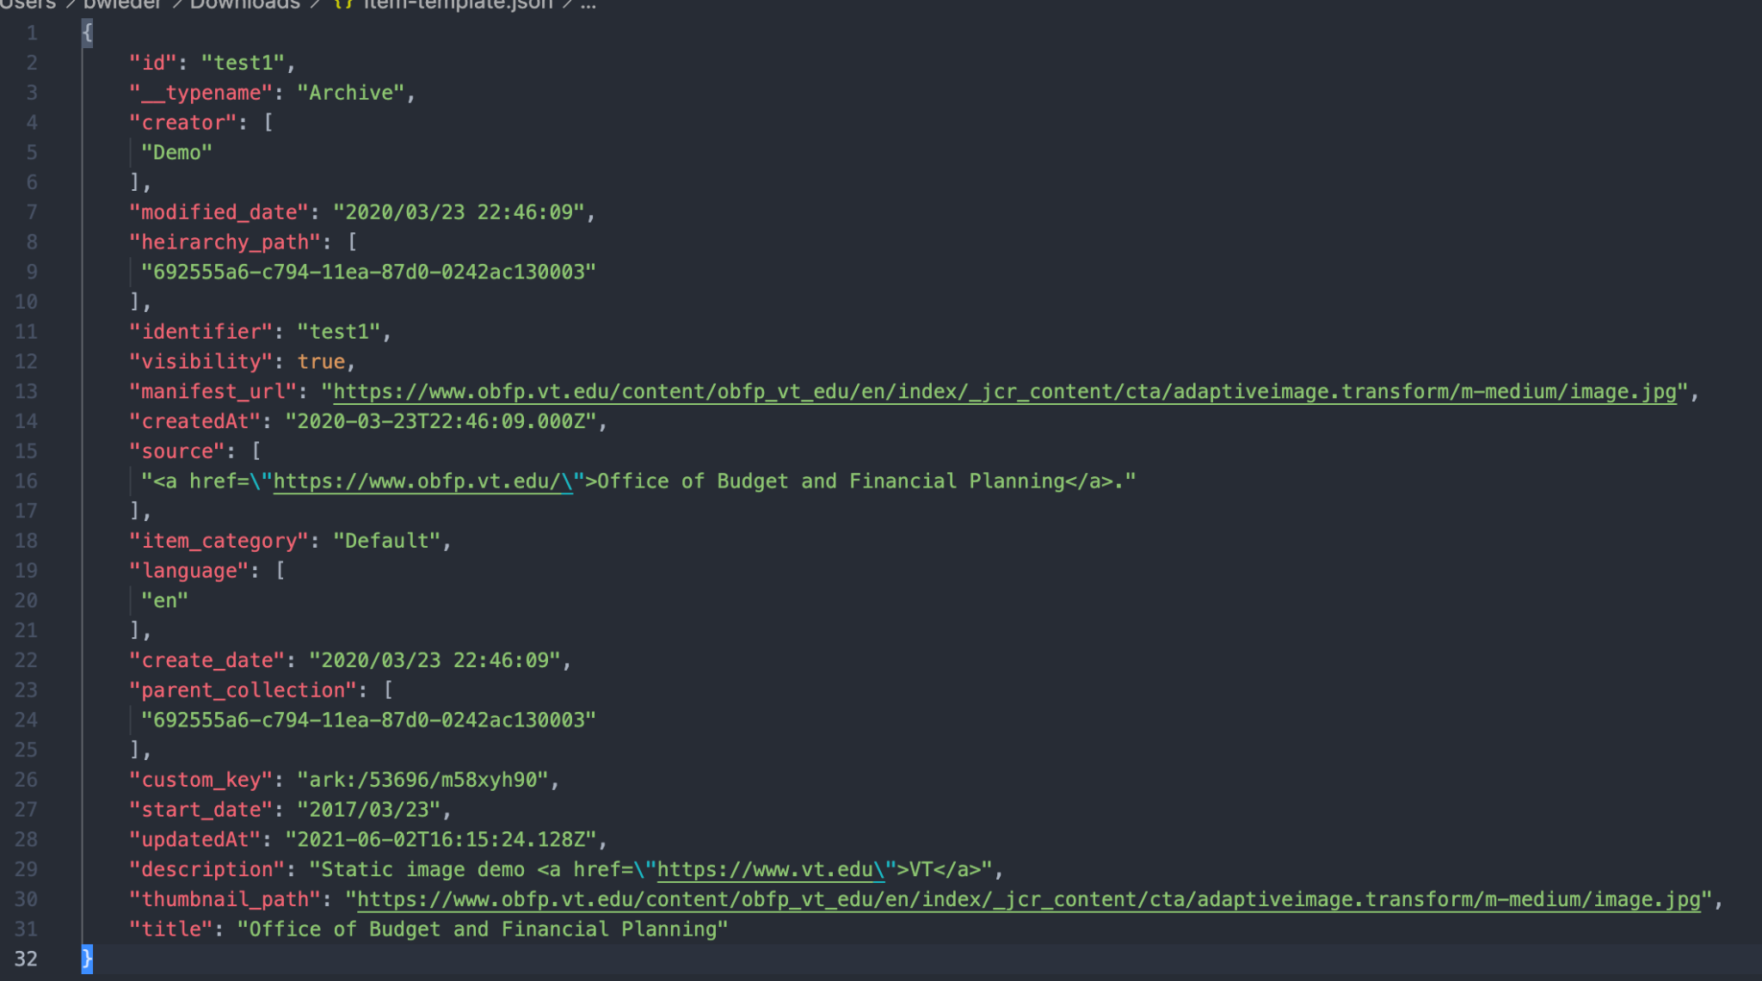
Data Migration
Upload data using a script that modifies the JSON Item template and uploads it to AWS DynamoDB
Notes:
Kyle presents

Slide 9
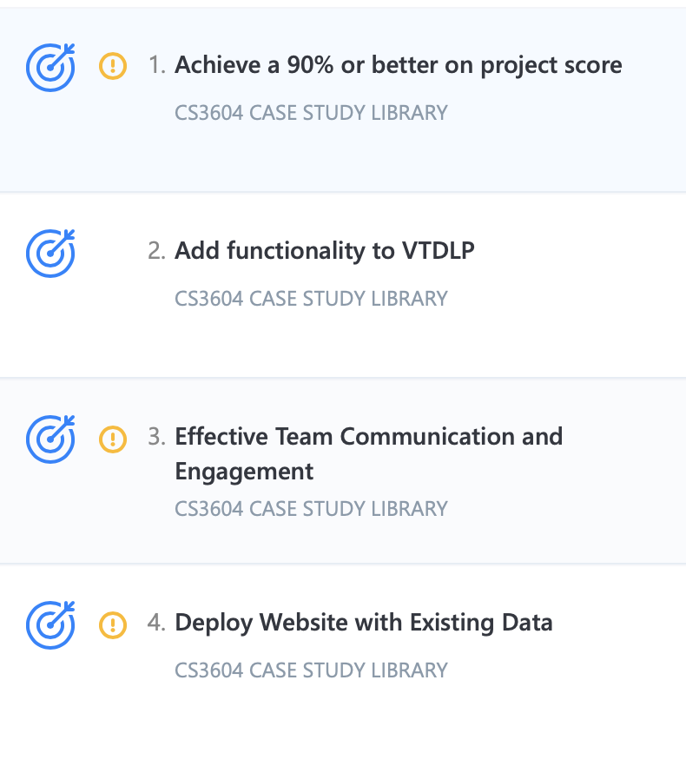
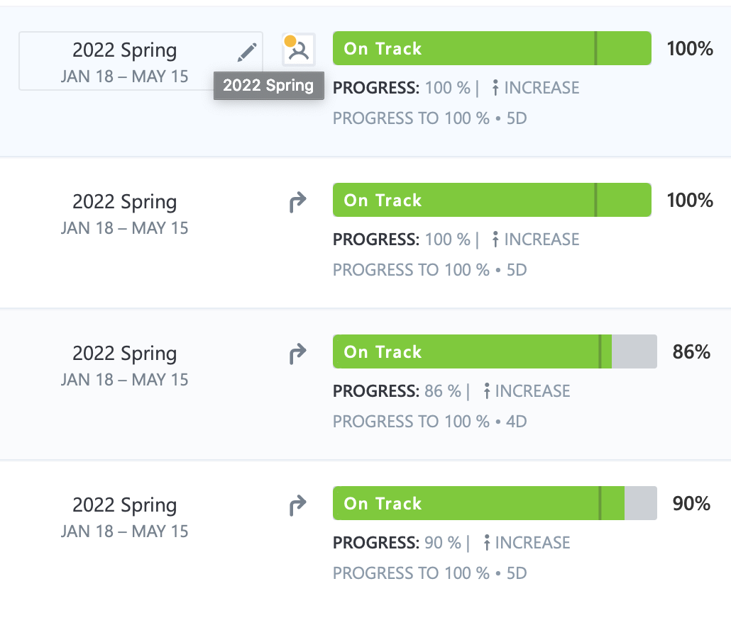
OKR Review
²
Emphasize Agile Software Development Lifecycle
Utilize sprint planning to complete milestones
Notes:
Sohil
Delegate Tasks
Test Assumptions
And Iterate on designs
Helped keep a consistent flow throughout the semester without cramming toward the end

Slide 10
Future
Work
Testing
Maintain the AWS account
Students to upload directly on the website
Notes:
Drew presents this

Slide 11
Acknowledgements
Daniel Dunlap¹: Virginia Tech, Dept. Computer Science, Adjunct -> Instructor
VTDLP Access Website²: Dr. Yinlen Chen, Lee Hunter, Tingting Jiang, Andrea Waldren (2021)
Edward Fox³: Virginia Tech, Dept. Computer Science, Advisor -> CS4624 Professor
¹ https://vt.academia.edu/DanielDunlap
² https://github.com/vtul/dlp-access
³ https://fox.cs.vt.edu/foxinfo.html

Slide 12
References
Chen, Yinlin, et al. “VTUL/DLP-Access: DLP Access Website: A Multi-Tenancy Serverless Web Application.” GitHub, 2022, http://github.com/BrianWieder/dlp-access. Accessed on 4/21/2022.
Chen, Yinlin, et al. “VTUL/DLP-Access: DLP Access Website: A Multi-Tenancy Serverless Web Application.” GitHub, 2019, http://github.com/VTUL/dlp-access. Accessed on 4/21/2022.
Node.js. Node.js, OpenJS Foundation, 2021, http://nodejs.org/en/. Accessed on 4/21/2022.
Chen, Yinlin. “DLP-Access/Site.json at CS3604 · Brianwieder/DLP-Access.” GitHub, 2021, http://github.com/BrianWieder/dlp-access/blob/cs3604/examples/jsons/site.json. Accessed on 4/21/2022.
Digital Library Development Team, "Virginia Tech Digital Libraries Platform," 2022, University Libraries, Virginia Tech, Blacksburg, VA 24061 USA, https://about.digital.lib.vt.edu/. Accessed on 4/21/2022.

