Slide 1
CS 3604 Case Study Library 3
Will Denman, Katie Geibel, Theo Ouzhinski, Thrilok Shivaraman
CS4624: Multimedia, Hypertext, and Information Access
Instructor: Professor Edward A. Fox
Client: Professor Daniel R. Dunlap
Virginia Tech, Blacksburg VA 24061
May 2, 2023
Notes:
Will

Slide 2
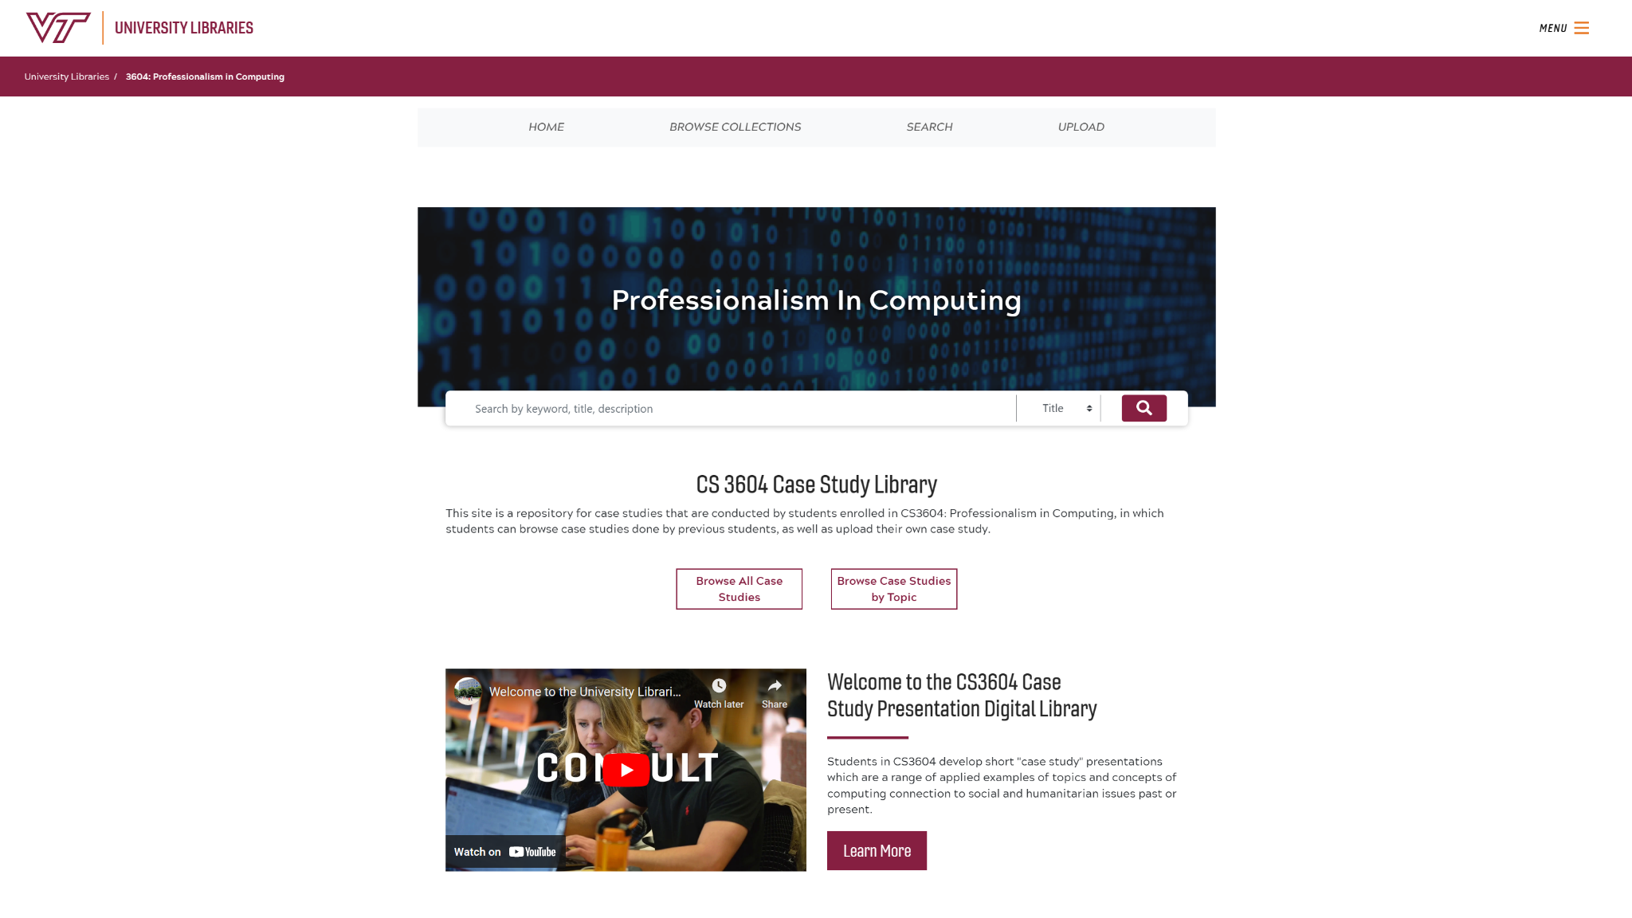
Outline
Overview
Work Completed
Challenges Faced
Future Plans
Notes:
Katie

Slide 3

Project Overview
Third team to work on this website used in Professionalism in Computing
Deliverables
  Cleanup
  Authentication
  Frontend and Metadata
Notes:
Katie

Slide 4
Timeline and Milestones:
Project launch
AWS and Case Study Library Credentials obtained
Meet with client
Base requirements set and approval obtained from Dr. Dunlap
Like button completed
Metadata tagging completed
Edit functionality progress
March
Completion
February
April
Github migration
Planning
Logout
Redeploy
Use cases
Case Study library up and running
Notes:
Tree

Slide 5
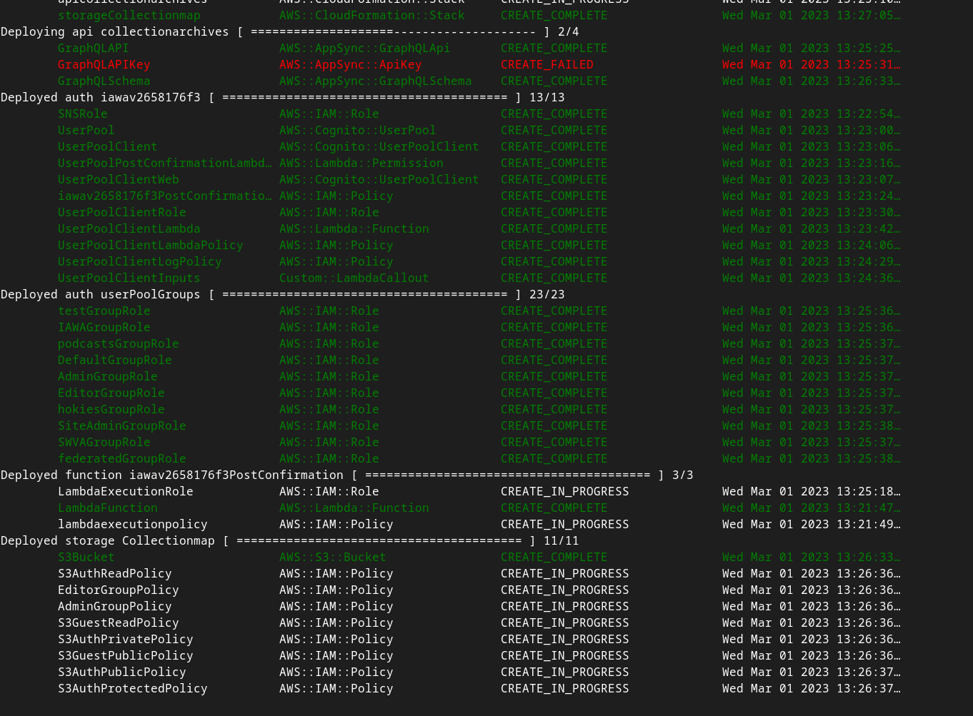
Work Completed: Cleanup
Personal GitHub repo -> GitHub org
Redeploy with CloudFormation
  Fix issues from manual intervention
Better documentation
Backup and restore tested
Notes:
Theo

Slide 6
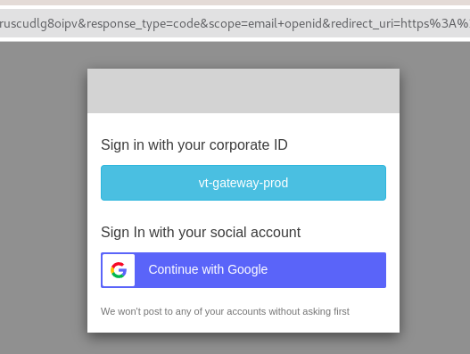
Work Completed: Authentication
Poor docs for Cognito
Original: CAS
  Required contacting people
  Redirect URI must be vt.edu
  Documented process
New: Google
  Better documentation
  App setup
Notes:
Theo

Slide 7
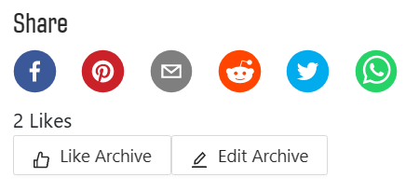
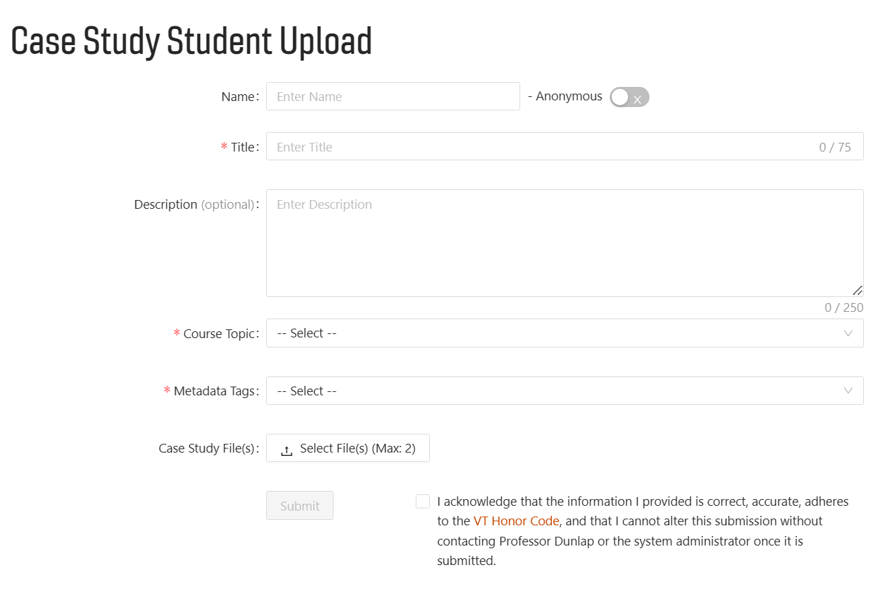
Work Completed: Frontend
Edit and Like buttons
  Like value is currently hard-coded
Hard-coded dropdown for case study tags
Notes:
Will

Slide 8
Challenges
Acquainting with the current system
Migrating on github
Redeploying AWS (down time)
OIDC vs. Google Auth
Resilience upgrades
Reformatting goals due to the large amount of problems we found
Notes:
Tree

Slide 9
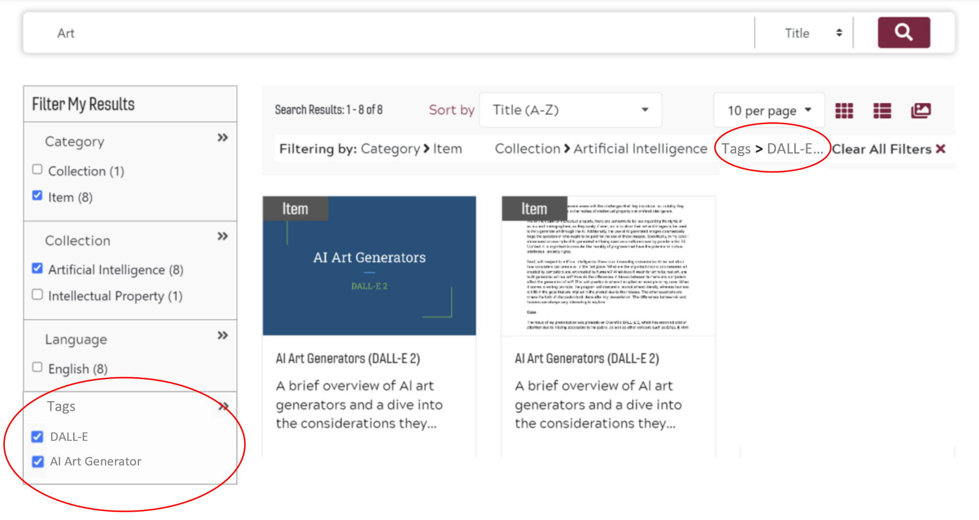
Future Work
Finalization of edit page
Connecting front and back ends via metadata
Store which user likes what
Include tags as filter option
Display tags on archive page
Notes:
Katie

Slide 10
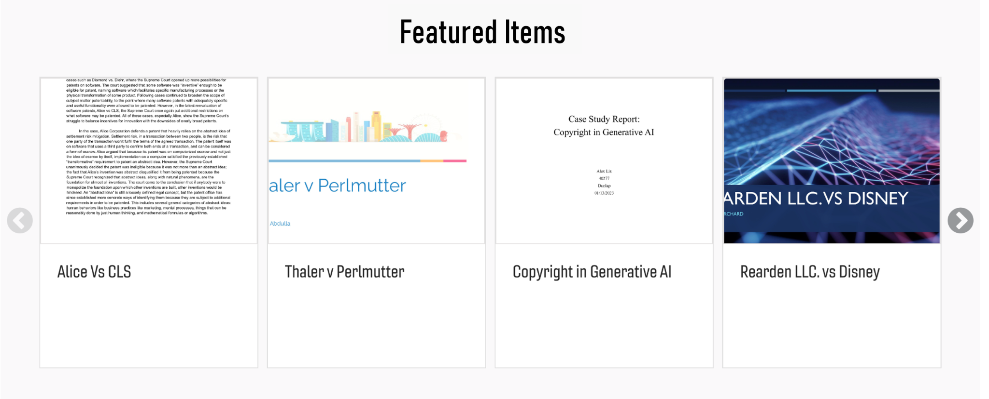
Future Work
Use like number to calculate and display recommendations
Extend tag options to be a living list
  Students can create new ‘Hashtags’
Add ability to comment
Notes:
Katie

Slide 11
Acknowledgments
Previous groups
Dr. Dunlap and Dr. Chen
Dr. Fox (and the TAs)
Notes:
Will

Slide 12
References
https://casestudies.cs.vt.edu/
https://vtechworks.lib.vt.edu/handle/10919/112915
http://hdl.handle.net/10919/109970
Notes:
Will

