Slide 1
Microaggressions @ VT
microaggressions.cs.vt.edu
CS 4624 - Multimedia, Hypertext, and Information access
April 28, 2016
Blacksburg, VA 24061
Client: Josh Iorio
Principal faculty in the Myers-Lawson School of Construction
Arunima Singh, Brandon Falcone, Cyndy Ejanda, Robert Wenger

Slide 2
Outline
Introduction
  What is Microaggression?
  Motivation
  Project Goals
Site Map
Implementation Overview
Database Tables
Technical Solutions
  Website features
  Admin/Moderator Dashboard
Conclusion
References

Slide 3

Introduction
Microaggressions are seemingly harmless insults that target an individual based on their group membership.
“Microaggressions are actually more damaging than overt expressions of bigotry precisely because they are small and therefore often ignored or downplayed, … leading the victim to feel isolated” [1].
Goal: Make faculty members feel more included at Virginia Tech.
Faculty will feel less isolated
Faculty will choose to stay at Virginia Tech
Improves the cultural climate of Virginia Tech
Increases diversity of faculty
Gives Virginia Tech a competitive advantage
Notes:
Quote bigger
Goal: sentences and verb phrase
No sentences
Less isolation
Merge impact slide here

Slide 4
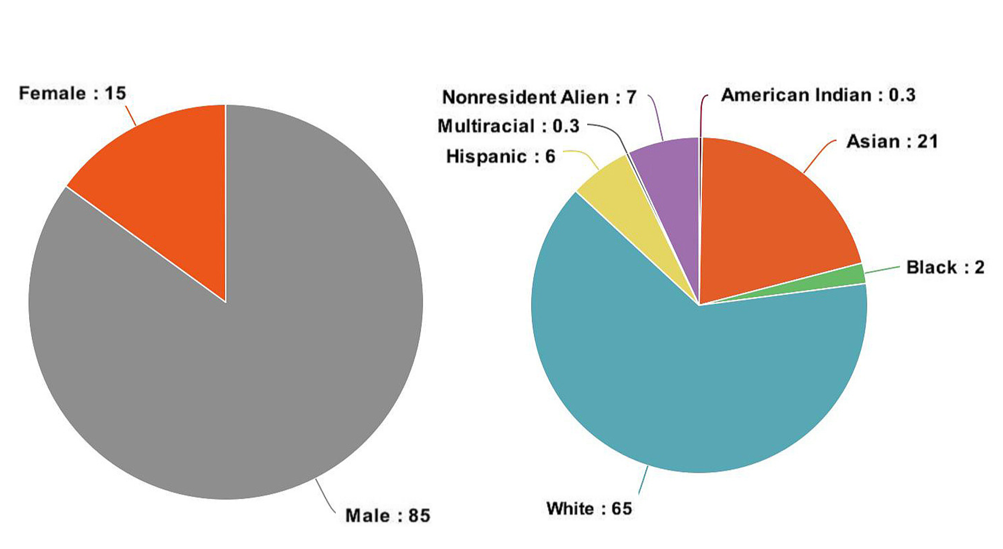
Diversity of Faculty
Notes:
Fonts bigger

Slide 5
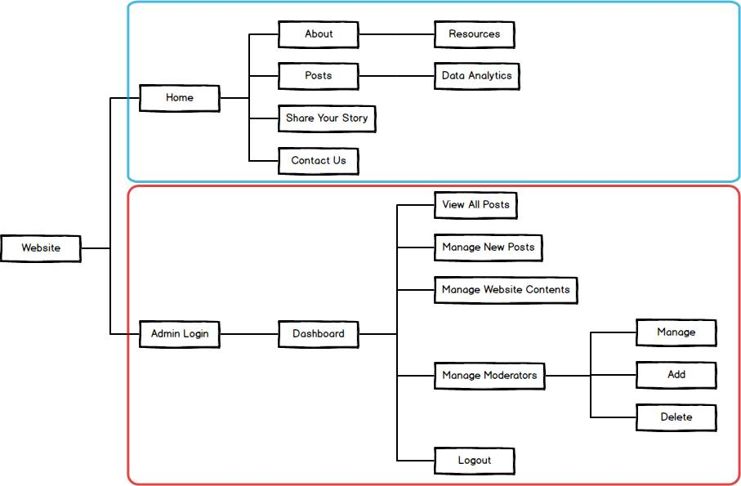
Site Map

Slide 6
Implementation Overview
Back-end
PHP, MySQL
PhpMyAdmin
Implementation
Main Website
Front-end
Foundation Framework
HTML, CSS, PHP, Javascript, Jquery
Admin Panel
Notes:
Iterative Approach

Slide 7
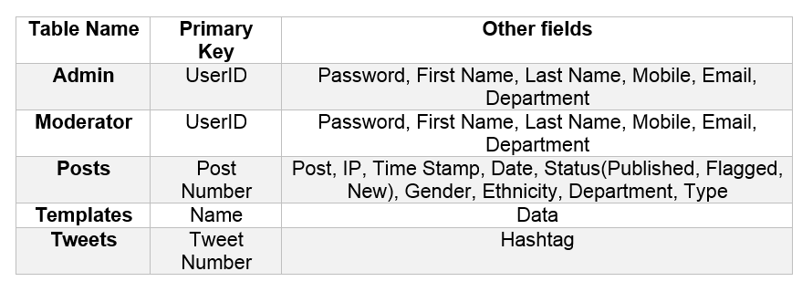
Database tables

Slide 8
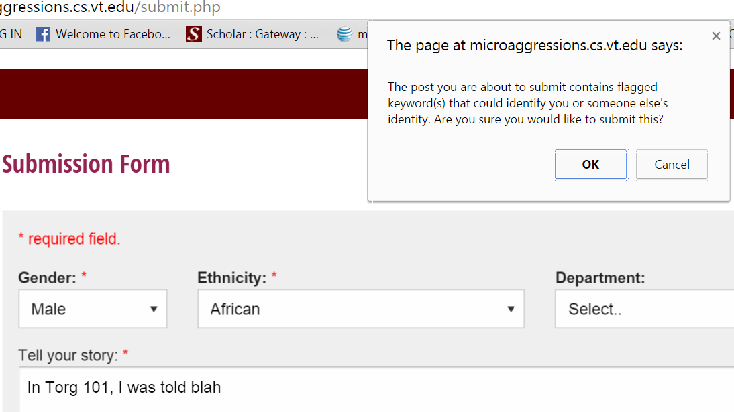
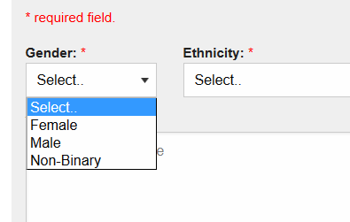
Technical Solutions
Share posts anonymously
  Rules for posting
  Validations
  Anonymity checker
  Security
Anonymity Checker
Avoiding microaggression

Slide 9
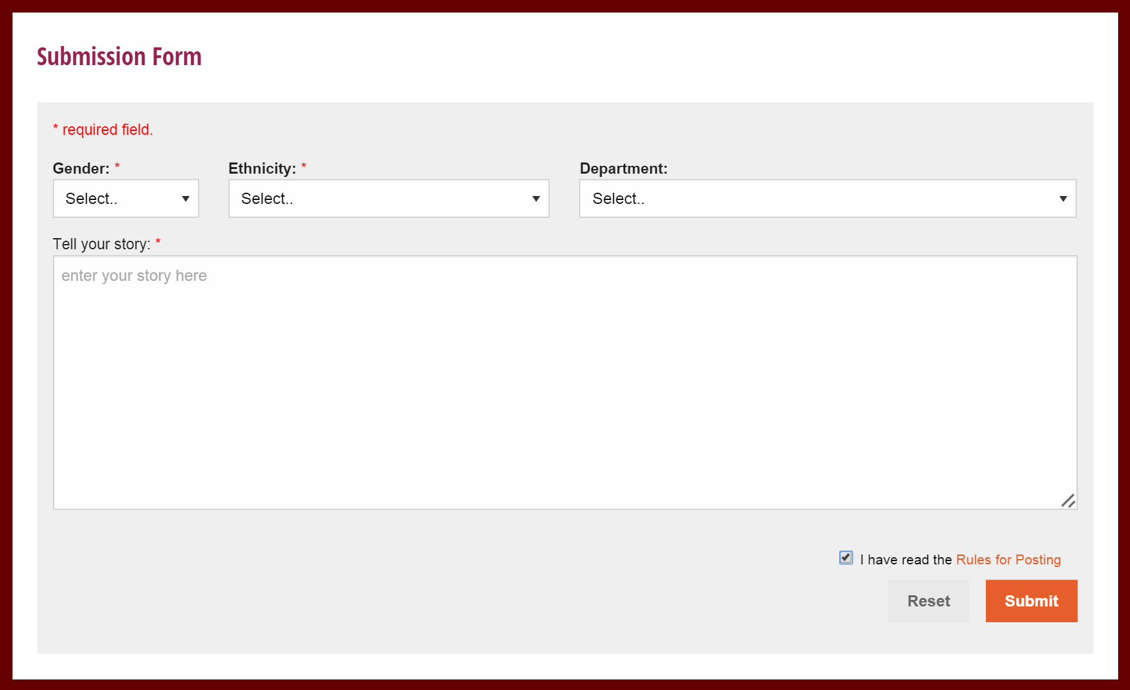
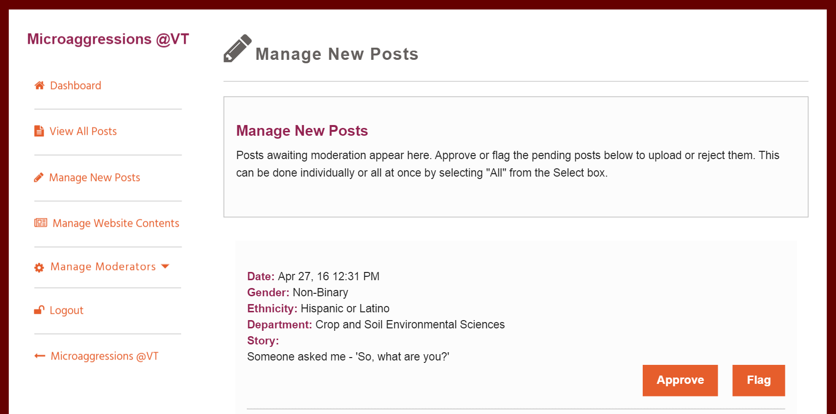
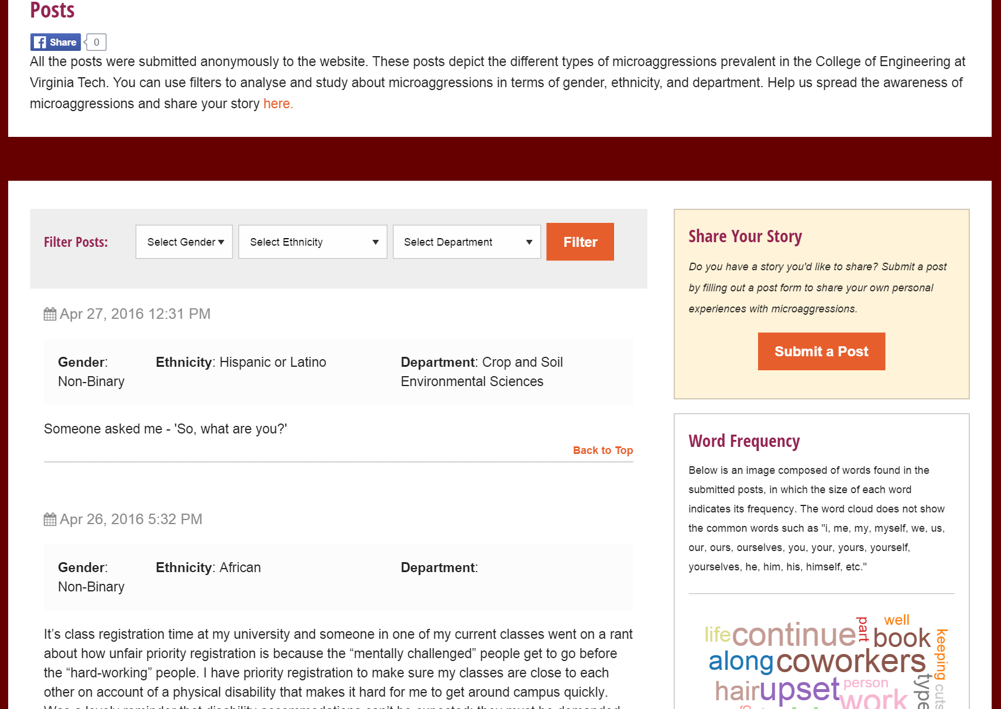
Screenshots
Share posts anonymously
Admin/Moderator Dashboard
View all approved posts on the website

Slide 10
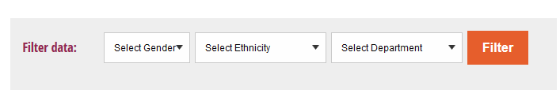
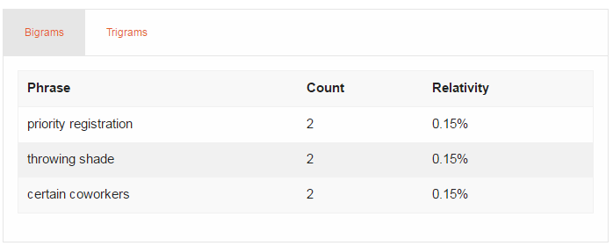
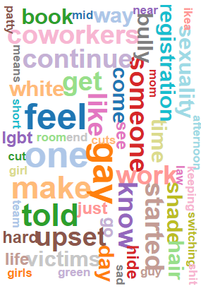
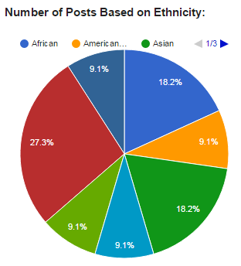
Technical Solutions Contd.
Data Analysis
  N-grams (bigrams and trigrams)
  Tag Cloud (D3 Word Cloud API)
  Pie Graphs (Google Visualization API)
  Filtering Posts
Tag Cloud

Slide 11
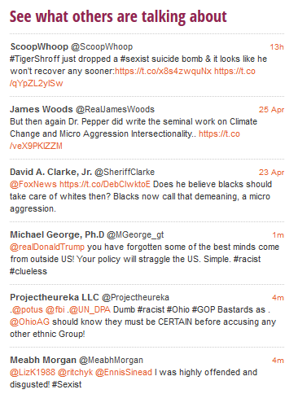
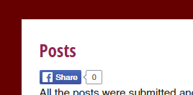
Technical Solutions Contd.
Data Analysis
  N-grams (bigrams and trigrams)
  Tag Cloud (D3 Word Cloud API)
  Pie Graphs (Google Visualization API)
  Filtering Posts
Other Features
  Facebook Sharing (Facebook API)
  Twitter Widget - Display Related Tweets (Twitter API)
    #microagression, #racist, #sexist
  Search
Content Management System
Twitter Widget

Slide 12
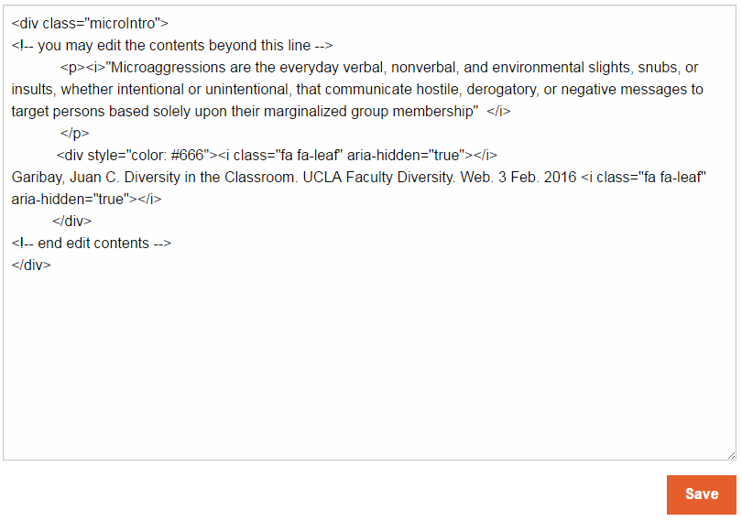
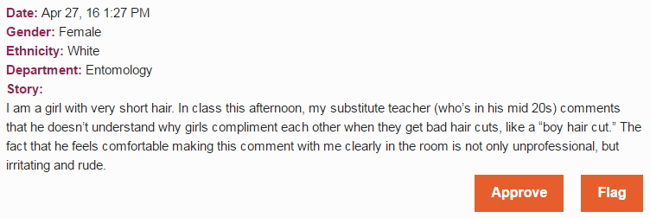
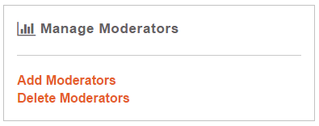
Admin/Moderator Dashboard
Manage website contents (pages, twitter hashtags)
Add or delete moderators
  Accessible only to the admin
Approve or flag posts
Manage website content
Approve or flag posts
Notes:
Put labels on screenshots
Remove slide

Slide 13

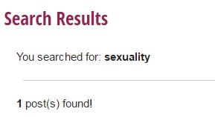
Search
Search from any page
Uses MySQL “LIKE”
Displays results on a separate page

Slide 14
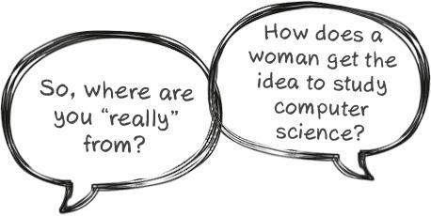
Conclusion
Seemingly benign phrases that are a type of microaggressions
University microaggressions needs to be addressed
The negative impact of microaggressions
Our project can also be extended to include microaggressions among students
Notes:
Combine with problems faced, and technical solutions

Slide 15
References
[1] Lundberg, Paula K. (2011). Women and Mental Disorders. Praeger. pp. 89–92. ISBN 0313393192.
[2] http://www.ic.edu/Customized/Uploads/ByDate/2015/August_2015/August_10th_2015/081015_diversity-wall-V116184.jpg
Notes:
Make Prof.Fox admin
Edit Developer’s manual
Upgrading issues in the future?
Analytics page- show number of visitors, clicks, downloads (discuss with client) [this can be in future work section]
Future work- don’t show filters if num posts in departments is too small, improvements to anonymity checker (Departments, buildings, first names)
Improvements to stop words
Words can be adjacent if “stop words” in between
Instructions for moderators

