Slide 1
Postcustodial Participatory
Community Archives
May 23, 2017
10:00 AM
Presented by
Anthony Wright de Hernandez

Slide 2
About me
Anthony Wright de Hernandez
MLIS
BA Community Studies
Recent work
Traditionally marginalized communities
Outreach
Liaison

Slide 3
Prompt
Consider your current field of interest within the library profession. Identify a significant trend within your area of interest and describe how you can lead your library in advancing in this area.

Slide 4
Prompt
Consider your current field of interest within the library profession. Identify a significant trend within your area of interest and describe how you can lead your library in advancing in this area.
My current field of interest:
Archives & Special Collections

Slide 5
Prompt
Consider Archives & Special Collections. Identify a significant trend within Archives & Special Collections and describe how you can lead your library in advancing in this area.
My selected trend:
Postcustodial participatory community archives

Slide 6
Definitions

Slide 7
Definitions
Postcustodial theory of archives
n. ~ The idea that archivists will no longer physically acquire and maintain records, but that they will provide management oversight for records that will remain in the custody of the record creators.
Notes: The postcustodial theory shifts the role of the archivists from a custodian of inactive records in a centralized repository to the role of a manager of records that are distributed in the offices where the records are created and used.
Society of American Archivists: Glossary of Archival and Records Terminology

Slide 8
Definitions
Participatory Archives
n. ~ An archives where constituents (patrons, donors, etc.) contribute their knowledge or resources to improve understanding of the archival materials.

Slide 9
Definitions
Community Archives
n. ~ 1) An archives formed by a community of people to document their own history, typically in response to a perception of misrepresentation or neglect by established archives. 2) A set of archival collections focused on a specific community.

Slide 10
Definitions
Community
n. ~ A group of people living in the same place or having a particular characteristic in common.
Oxford Dictionaries Online

Slide 11
Postcustodial participatory community archives

Slide 12
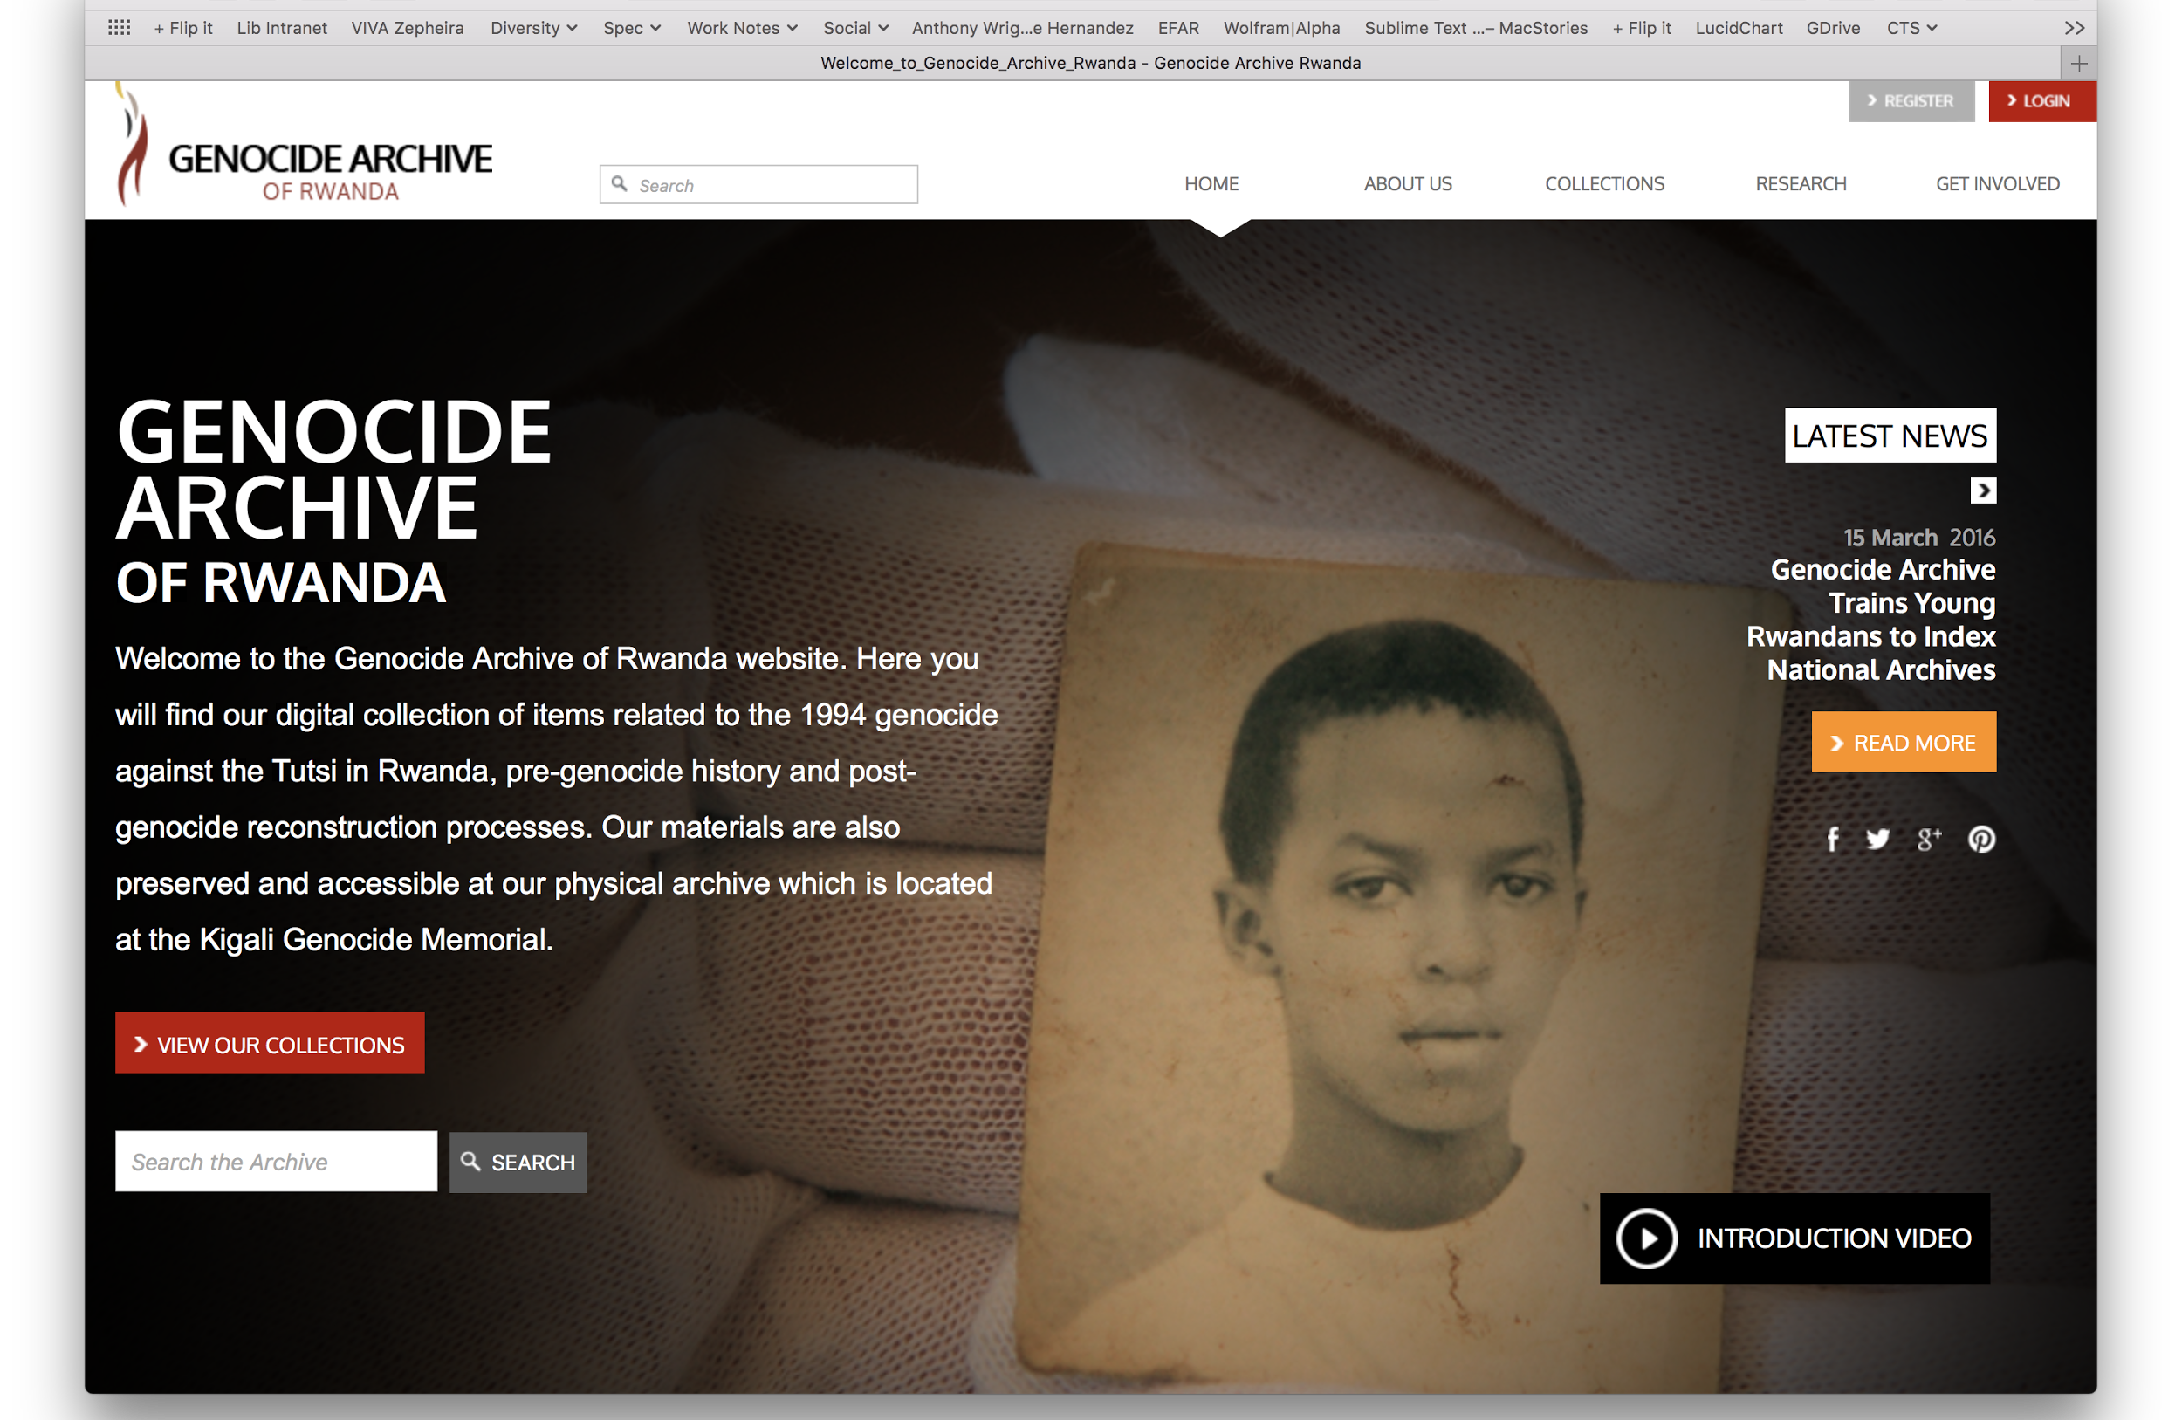
Examples
Genocide Archive of Rwanda
Part of the Human Rights Documentation Initiative at the University of Texas at Austin.
Key features:
Ongoing relationships with the community
Community experts consult on cultural heritage aspects
Physical material retained by community - archives provides digital preservation and access
http://genocidearchiverwanda.org.rw/index.php?title=Welcome_to_Genocide_Archive_Rwanda

Slide 13
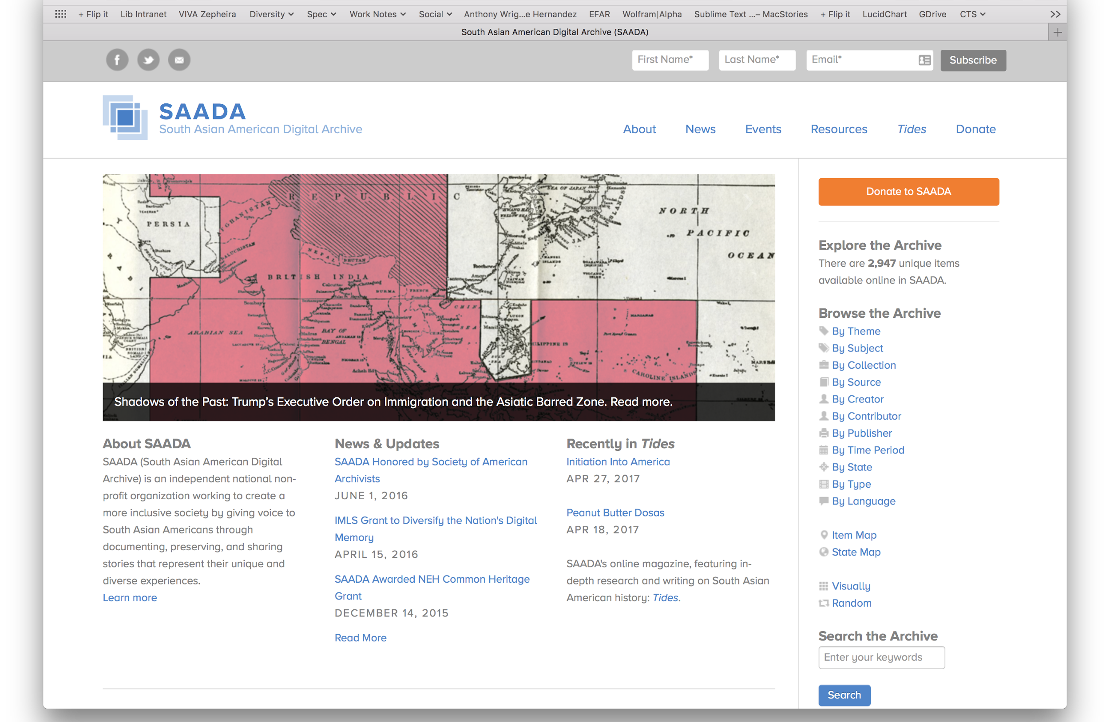
Examples
South Asian American Digital Archive
Independent community archive established by the community.
Key features:
Established by experts within the community
Board of Directors
Digital focus
Postcustodial
https://www.saada.org

Slide 14
Postcustodial participatory community archives
Leading Virginia Tech
Strengthen existing relationships with traditionally marginalized communities
Focus on establishing first participatory community program
Expand to other communities

Slide 15
Postcustodial participatory community archives
Strengthen existing relationships
LGBTQ+ community
Growing history of partnership
Regional efforts to build upon
Black community
Good relationships on campus
More strained relationships off campus (Christiansburg Institute)
Native American community
Good initial response to events
University is working to better relations with this community

Slide 16
Postcustodial participatory community archives
Establish initial participatory community archives
Focus on LGBTQ+ community in SouthWest Virginia
Partner with:
LGBTQ+ Center, LGBT Caucus, and other campus groups
Roanoke College, Hollins University, Radford University
Community groups in Floyd, Roanoke, and other regional areas
Establish regional online repository for all existing collections
Host digital replicas of primary source materials
Allow online community submission of new digital content
Form a board to help direct representation of the community

Slide 17
QUESTIONS?

