Slide 1


Open Science Across Borders: India vs. U.S. Institutional Approaches plenary session: U.S. Institutional Approaches
Virginia (Ginny) Pannabecker
Assistant Dean and Director, Research Collaboration and Engagement
University Libraries at Virginia Tech
vpannabe@vt.edu
Presented on
September 26, 2025
USETDA 2025 Conference

Slide 2

Outline
National legislation and policy, open-access and open science platforms, collaborative initiatives
Obstacles and opportunities for promoting open science
Libraries and library leaders’ roles in promoting open science

Slide 3
National legislation and policy, open access and open science platforms, and collaborative initiatives

Slide 4
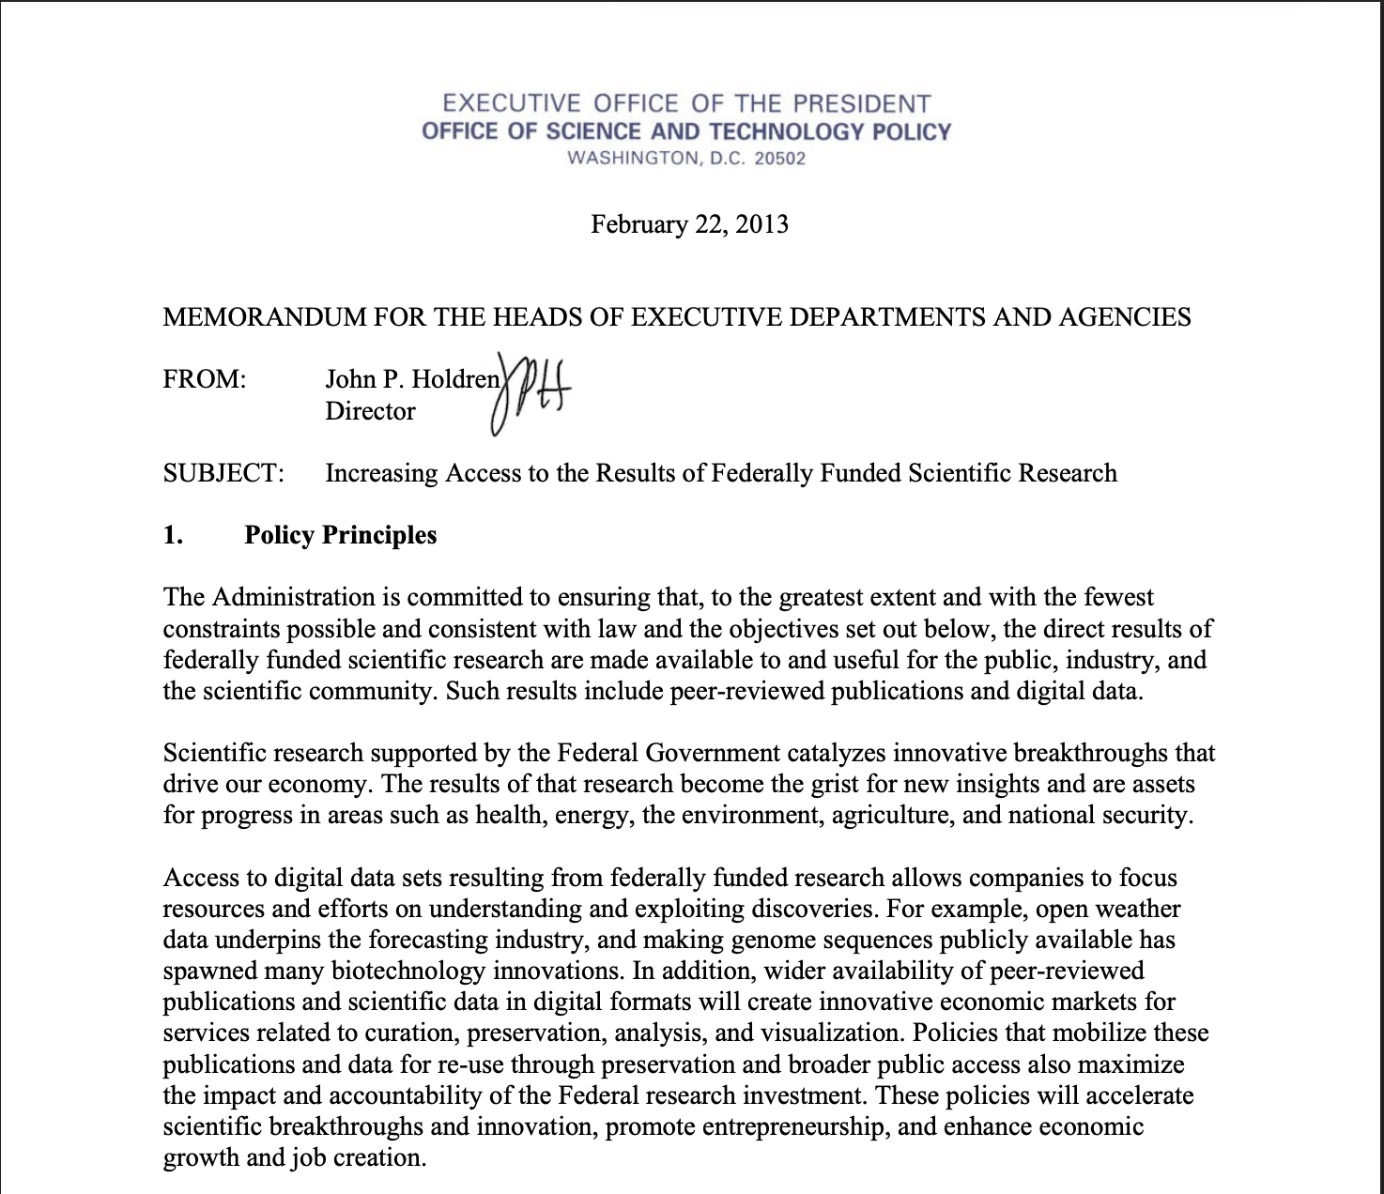
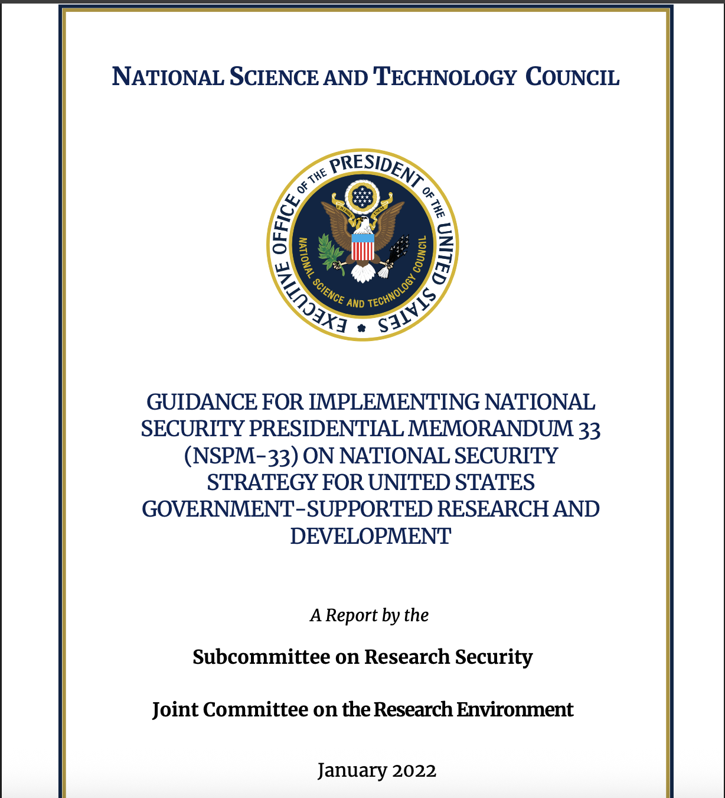
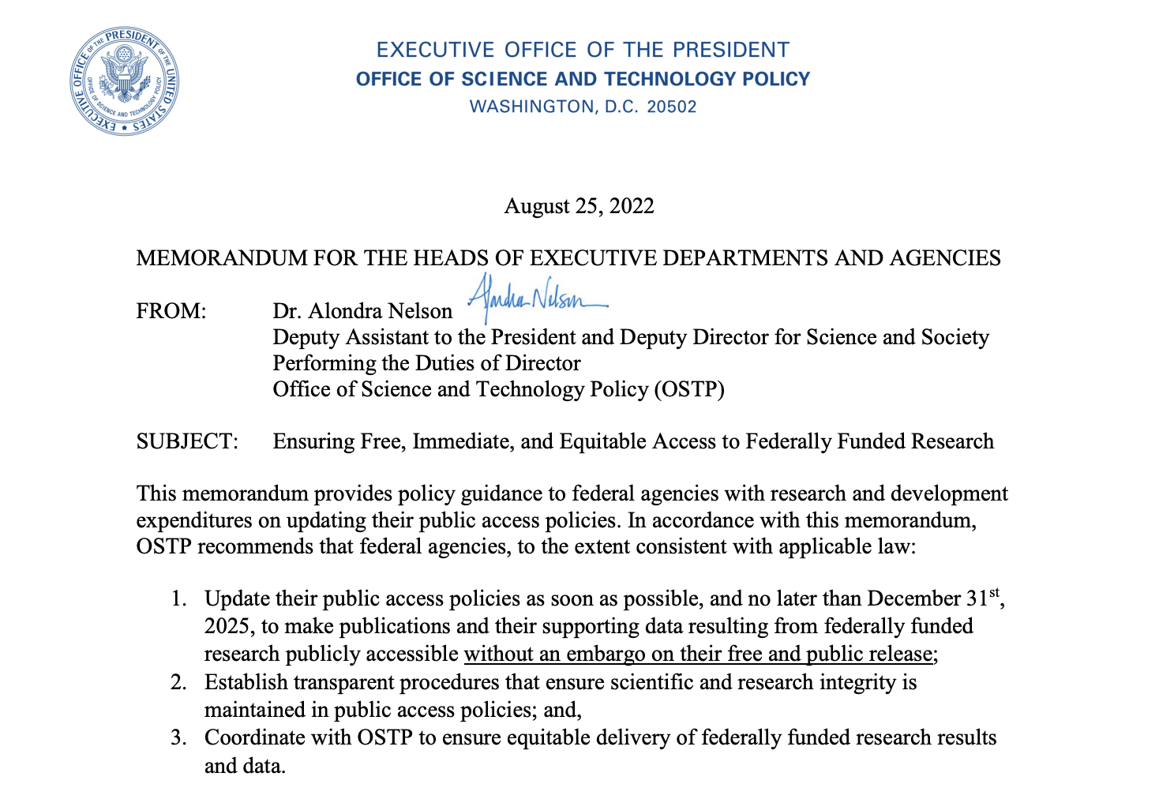
National legislation and policy
Office of Science and Technology Policy (OSTP) Memo (2013)
We the People Petition | America COMPETES Reauthorization Act of 2010 (P.L. 111-358)
Guidance For Implementing National Security Presidential Memorandum 33 (NSPM-33) On National Security Strategy For United States Government-Supported Research And Development (2022)
Office of Science and Technology Policy (OSTP) ‘Nelson’ Memo (2022)
Federal purpose license (§ 200.315 Intangible property) in place since 1976

Slide 5
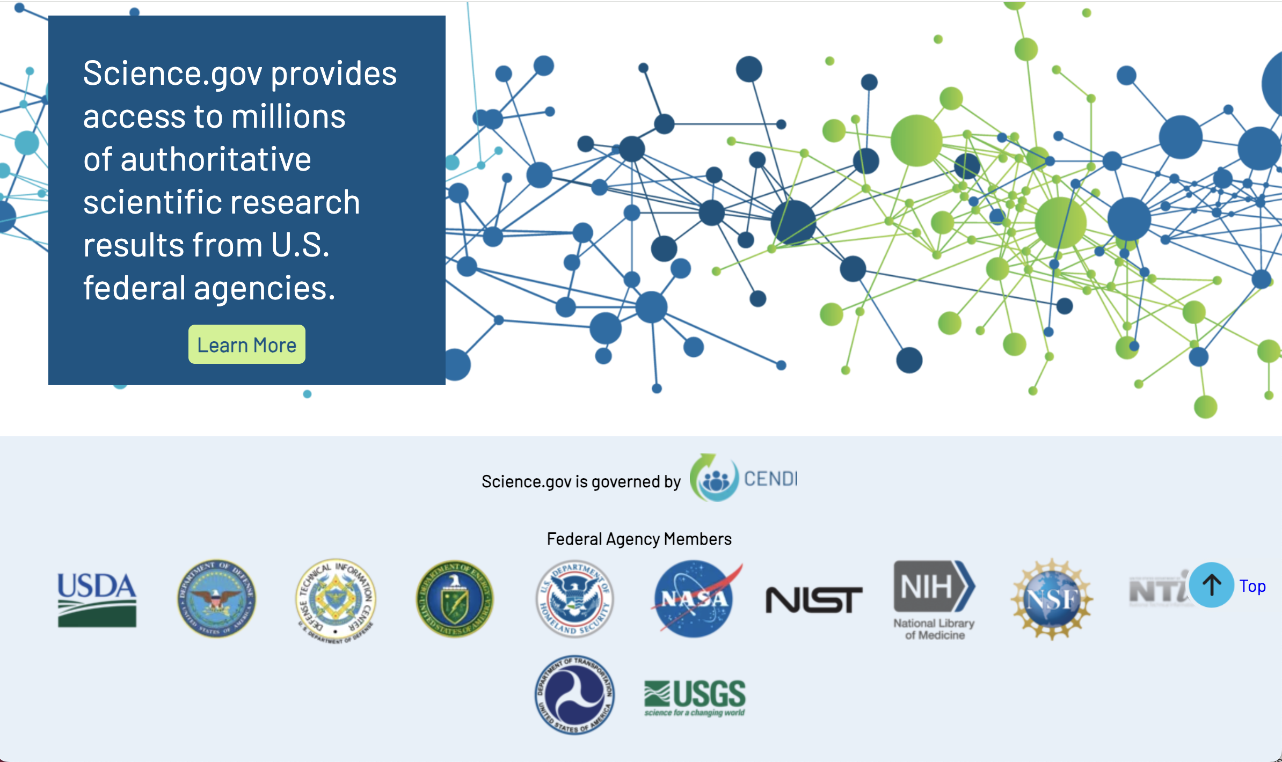

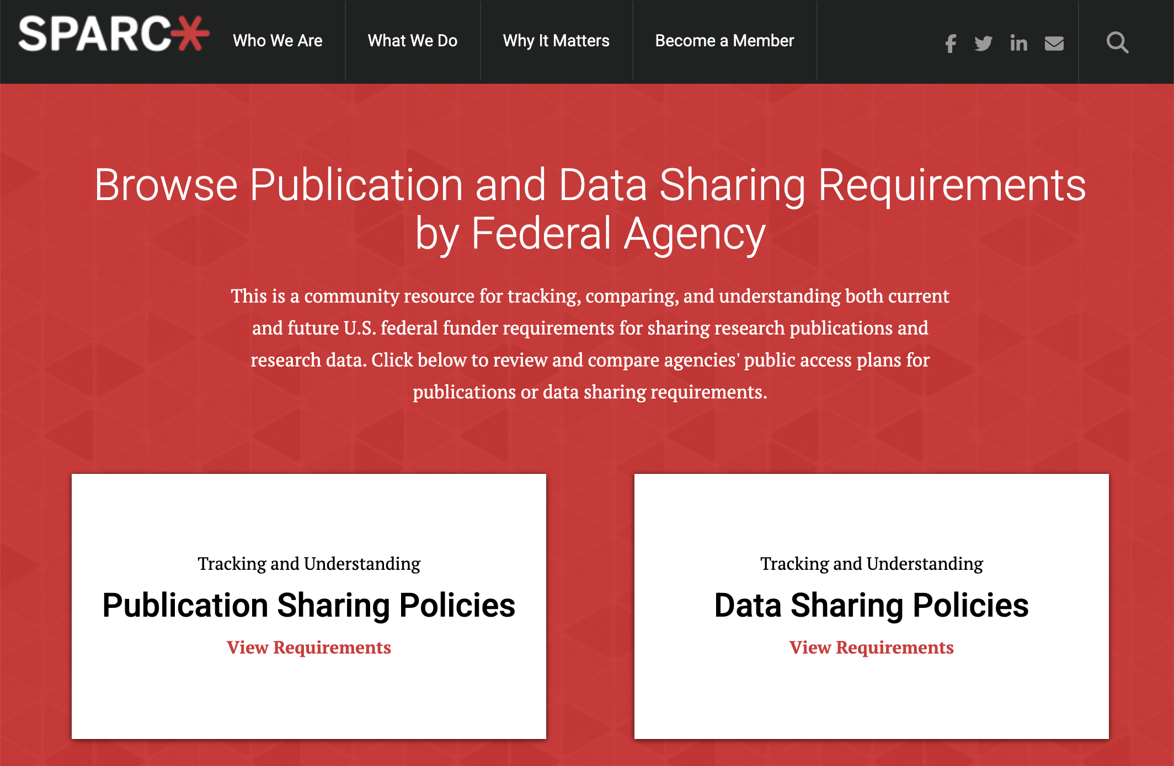
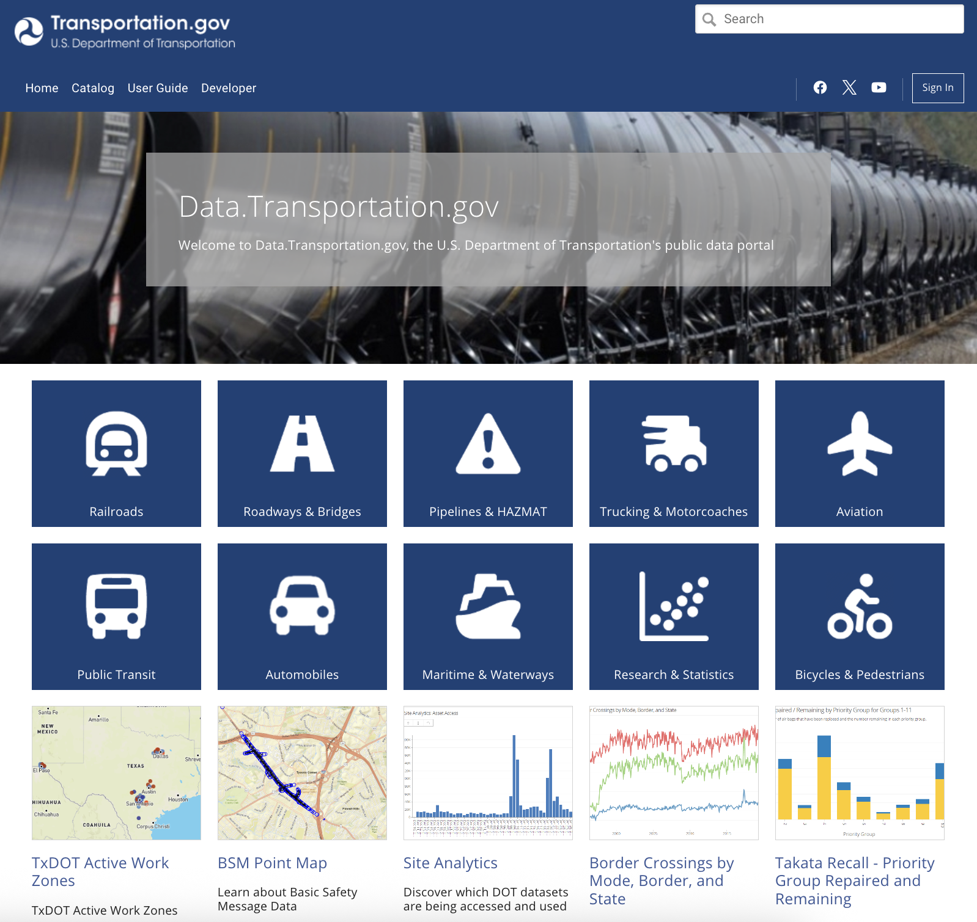
Open access and open science platforms & Infrastructure
U.S. government agencies data and publication sharing requirements and portals
Non-profit organizations collaborating with researchers, institutions, government, publishers
Publishers requiring dataset deposit or publication, providing diamond, green open access
Notes:
Example text from https://www.transportation.gov/data/plan : “Goal 1: Enhance Public Access and Discoverability - To maximize the impact and utility of our data [14,15], we are dedicated to making it Findable, Accessible, Interoperable, Reusable, and Delightful [16,17,18,19,20,21] (FAIR-D). This approach paves the way for a more efficient and effective transportation ecosystem. By making government data secure [22], trustworthy [23,24], and open by default [25] through standardized procedures, we are not only increasing public access but also fostering new ideas and economic growth. This commitment to open data also makes government operations more efficient and accountable to the public we serve. ”

Slide 6

Collaborative Initiatives
HELIOS
Center for Open Science
Higher Education Leadership Initiative for Open Scholarship cohort of colleges and universities
To increase openness, integrity, and reproducibility of research
SPARC
TOME
Supports open systems for research and education
A collaborative exploration of open scholarly monograph publishing

Slide 7
Obstacles and opportunities for promoting open science

Slide 8

OBSTACLES
Culture change: academic practices and incentives, disciplinary differences
Shifting priorities for funding, international collaboration, research security
Cost
Technical infrastructure
Scholarly communication system and publishing models

Slide 9
OPPORTUNITIES
Increasing adoption by researchers
Increasing incentives and requirements from funders, publishers, government
Open funding for research across topics
Opportunities to increase public involvement in, awareness, and use of research
Opportunities to update academic incentives for promotion, tenure
Opportunities to increase interoperability (ORCID, ROR)
New partnerships (USRN)
Open Science training and by our communities and government agencies (NASA Open Science)

Slide 10
Libraries and library leaders’ roles

Slide 11
Libraries and library leaders’ roles in promoting open science
Embedding open throughout library services and initiatives
Providing training, education, public engagement events
Developing and managing technical infrastructure (eTDs, scholarly and data repositories, scholarly publishing, profile and research information management (RIM) systems)
Provide access to community, coalition infrastructure
Developing and promoting licensing for open use
Building institutional culture
Partnerships (institutional, professional associations, coalitions)
Policy contributions and building public awareness
Notes:
OCLC Research Partnerships – recent open research involvement examples from research libraries in the U.S. - Open research as a strategic priority: Insights from an OCLC RLP leadership roundtable – April 2025 https://hangingtogether.org/open-research-as-a-strategic-priority-insights-from-an-oclc-rlp-leadership-roundtable/

Slide 12
Q & A and Open Floor Discussion

Slide 13

Q&A and Open Floor Discussion
Share your perspectives and examples for
promoting open science:
National legislation / policy
Open access / open science platforms
Collaborative initiatives
Obstacles
Opportunities
Libraries / Institutions and library / institutional leaders’ roles in promoting open science

