Slide 1

Chapter 1
Teamwork in Business
(c) Virginia Tech, Department of Management, Pamplin College of Business. CC BY NC SA 4.0.
Available from: http://hdl.handle.net/10919/105157

Slide 2
Objectives
Define a team and describe its key characteristics.
Explain why organizations use teams and describe different types of teams.
Explain why teams may be effective or ineffective.
Identify factors that contribute to team cohesiveness.
Understand the importance of learning to participate in team-based activities.
Identify the skills needed by team members and the roles that members of a team might play.
Learn how to survive team projects in college (and actually enjoy yourself).
Explain the skills and behaviors that foster effective team leadership.

Slide 3
WHAT IS A TEAM?
A team (or a work team) is a group of people with complementary skills who work together to achieve a specific goal.
The Razr Team achieved its goal by integrating specialized but complementary skills in engineering and design and by making the most of its authority to make its own decisions and manage its own operations. We can see the fundamentals of teamwork not only in Razor But also current technology powerhouses such as Apple, and many other big business around the world
Market Challenge
New Product Development
Strategy Development
M&A Integration
And more

Slide 4
LET US TALK ABOUT TEAMS
What Makes a Team Cohesive?
Some Key Characteristics of Teams
share accountability for achieving specific common goals.
function interdependently.
require stability.
hold authority and decision-making power.
operate in a social context.
Size
Similarity
Success
Exclusiveness
Competition

Slide 5
WHY DO BUSINESSES USE TEAMS?
Area of performance Firms reporting improvement
Product and service quality 70%
Customer service 67%
Worker satisfaction 66%
Quality of work life 63%
Productivity 61%
Competitiveness 50%
Profitability 45%
Absenteeism/turnover 23%
Figure 1.2: Performance improvements due to team-based operations.

Slide 6
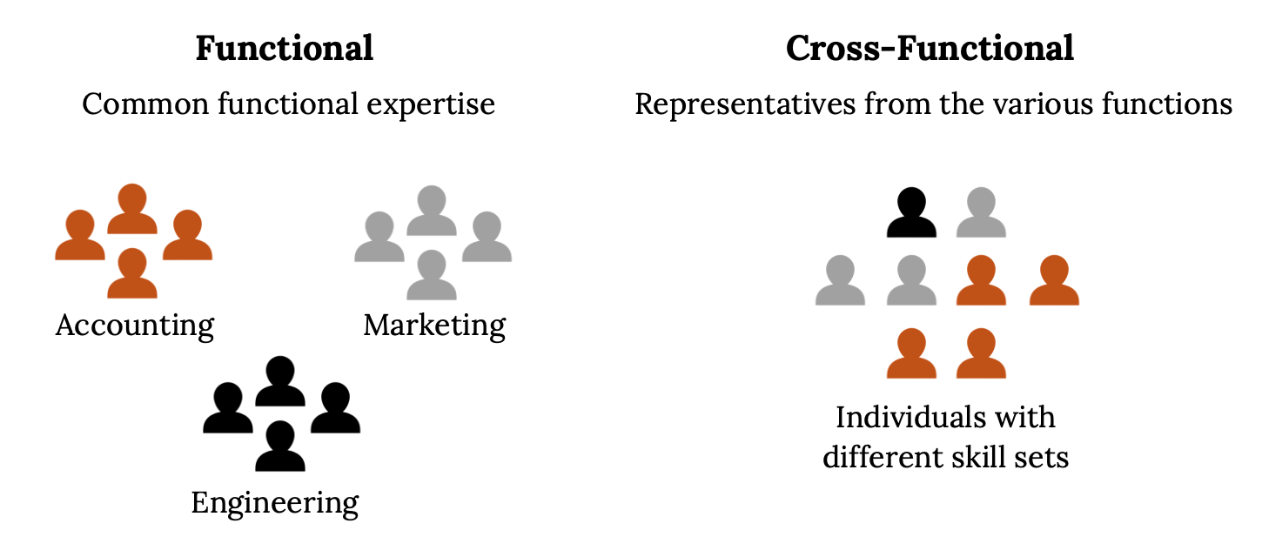
The Team and the Organization
Manager-led teams
Self-managed teams
Cross-functional teams
Virtual teams

Slide 7
OBSTACLES TO SUCCESS
Groupthink
Tendency to conform to group pressure in making decisions, while failing to think critically or to consider outside influences
Motivation and Frustration
All team members have personal and professional ‘ups and downs. Members must notice and find ways to avoid
Others
Unwillingness to cooperate
Lack of managerial support
Failure of managers to delegate authority

Slide 8
SKILL SETS THAT TEAMS NEED
Every team requires some mixture of three skill sets
Technical skills: skills needed to perform specific tasks
Decision-making and problem-solving skills: skills needed to identify problems, evaluate alternative solutions, and decide on the best options
Interpersonal skills: skills in listening, providing feedback, and resolving conflict
Learning about each team member’s strengths in the beginning helps to provide a path for the team to have leaders in each of the above

Slide 9
TEAM MEMBER ROLES
Task-facilitating roles
This role addresses challenge number one—accomplishing the team goals. Task facilitators are especially valuable when assignments aren’t clear or when progress is too slow.
Examples: Information seeking -“Does anyone know if this is the latest data we have?”
Reality testing -“Can we make this work and stay within budget?”
Relationship-Building Roles
Challenging unmotivated behavior or help other team members understand their roles and addressing challenge number two—maintaining or improving group cohesiveness.
Includes activities that improve team “chemistry,” from empathizing to confronting. Having a ‘feel’ of the room.
Examples: Energizing -“It’s been a long time since I’ve had this many laughs at a meeting in this department.”
Consensus building -“Do we agree on the first four points even if number five needs a little

Slide 10
TEAM MEMBER ROLES
Blocking Roles
Blocking roles consist of behavior that inhibits either team performance or that of individual members. Every member of the team should know how to recognize blocking behavior. If teams don’t confront dysfunctional members, they can destroy morale, hamper consensus building, create conflict, and hinder progress.
Examples include: Stalling, deflecting, and presenting opinions as if they were facts.
Stall-Frustrate efforts to come to conclusions: decline to agree, sidetrack the discussion, rehash old ideas.
Resist-Throw up roadblocks to progress; look on the negative

Slide 11
TEAMS STRUGGLES-WHY?
Lack of mutual trust. Team members do not fully trust each other or the team as an entity.
Inability to manage conflict. Not dealing with conflict openly and transparently and allowing grudges to build up can destroy team morale.
Lack of goal clarity. Team members are unsure about their roles and the ultimate team goals, resulting in a lack of commitment and engagement.
Poorly defined roles and responsibilities. Team members are not clear about what they must do (and what they must not do) to demonstrate their commitment to the team and to support team success.
Relationship issues. The bonds between the team members are weak, which affects their efficiency and effectiveness.
Negative atmosphere. An overall team culture that is not open, transparent, positive and future-focused

Slide 12
LEADING A TEAM
Demonstrate integrity. Do what you say you’ll do and act in accordance with your stated values. Be honest in communicating and follow through on promises.
Be clear and consistent. Let members know that you’re certain about what you want and remember that being clear and consistent reinforces your credibility.
Generate positive energy. Be optimistic and compliment team members. Recognize their progress and success.
Acknowledge common points of view. Even if you’re about to propose some kind of change, recognize the value of the views that members already hold in common

Slide 13
LEADING A TEAM
Manage agreement and disagreement. When members agree with you, confirm your shared point of view. When they disagree, acknowledge both sides of the issue and support your own with strong, clearly-presented evidence.
Encourage and coach. Motivate members when they run into new and uncertain situations and when success depends on their performing at a high level.
Share information. Give members the information they need and let them know that you’re knowledgeable about team tasks and individual talents. Check with team members regularly to find out what they’re doing and how the job is progressing

Slide 14
Takeaways
A team (or a work team) is a group of people with complementary skills and diverse areas of expertise who work together to achieve a specific goal.
Work teams have five key characteristics.
They are accountable for achieving specific common goals.
They function interdependently.
They are stable. They have authority.
And they operate in a social context.
Work teams may be of several types:
In the traditional manager-led team, the leader defines the team’s goals and activities and is responsible for its achieving its assigned goals.
The leader of a self-managed team may determine overall goals, but employees control the activities needed to meet them.
A cross-functional team is designed to take advantage of the special expertise of members drawn from different functional areas of the company.
On virtual teams, geographically dispersed members interact electronically in the process of pursuing a common goal.

Slide 15
Takeaways
Group cohesiveness refers to the attractiveness of a team to its members. If a group is high in cohesiveness, membership is quite satisfying to its members; if it’s low in cohesiveness, members are unhappy with it and may even try to leave it.
As the business world depends more and more on teamwork, it’s increasingly important for incoming members of the workforce to develop skills and experience in team-based activities.
Every team requires some mixture of three skill sets:
Technical skills: skills needed to perform specific tasks
Decision-making and problem-solving skills: skills needed to identify problems, evaluate alternative solutions, and decide on the best options
Interpersonal skills: skills in listening, providing feedback, and resolving conflict

Slide 16
Q & A
(c) Virginia Tech, Department of Management, Pamplin College of Business. CC BY NC SA 4.0.
Available from: http://hdl.handle.net/10919/105157

