Slide 1
Classifying ETDs
CS4624: Multimedia, Hypertext, and Information Access
Professor Edward Fox
Virginia Tech, Blacksburg VA 24061
17 May, 2023
By -
Vedant Shah
Reema Daniel
Vaishali Ramesh
Mihir Gathani
Notes:
Same

Slide 2
Outline
Team Member Roles
Client
What’s the Project about?
Deliverables
Timeline
Task Completed
Dataset
Text Classification Models
Website Development
7. Website Challenges
8. Future Work
8.1 Website
8.2 DL Models
9. Acknowledgements
10. References
Notes:
Edit accordingly. (Mihir will do at the end)

Slide 3
Team Member Roles
Mihir Gathani
Team Lead, R&D (Data Preprocessing work), Website Building, Annotation.
Vedant Shah
R&D (Text Classification models), Point of Contact with Client, Dataset Development.
Reema Daniel
Point of Contact with Dr. Fox, Annotation, and Website Development and Integration.
Vaishali Ramesh
Noting minutes meeting, Website Development, and Annotation.
Notes:
Decide if we want to add a picture for each of us

Slide 4
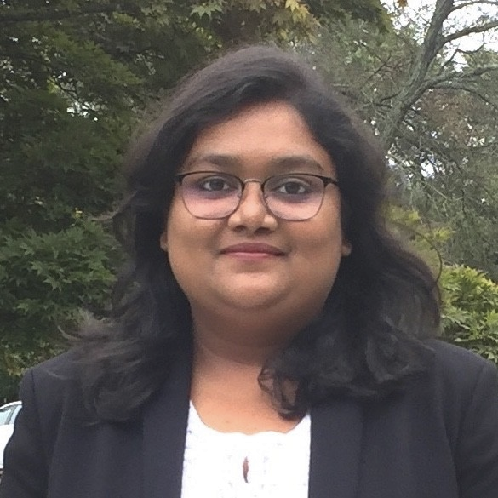
Client
Name: Bipasha Banerjee
Occupation: PhD student on GRA (Graduate Research Assistant) advised by Dr. Fox
Area of Expertise: Machine Learning, Natural Language Processing
Research Focus: Information Retrieval from book length documents.
Note: Image approved by the client
Notes:
Bipasha Approved the Picture

Slide 5
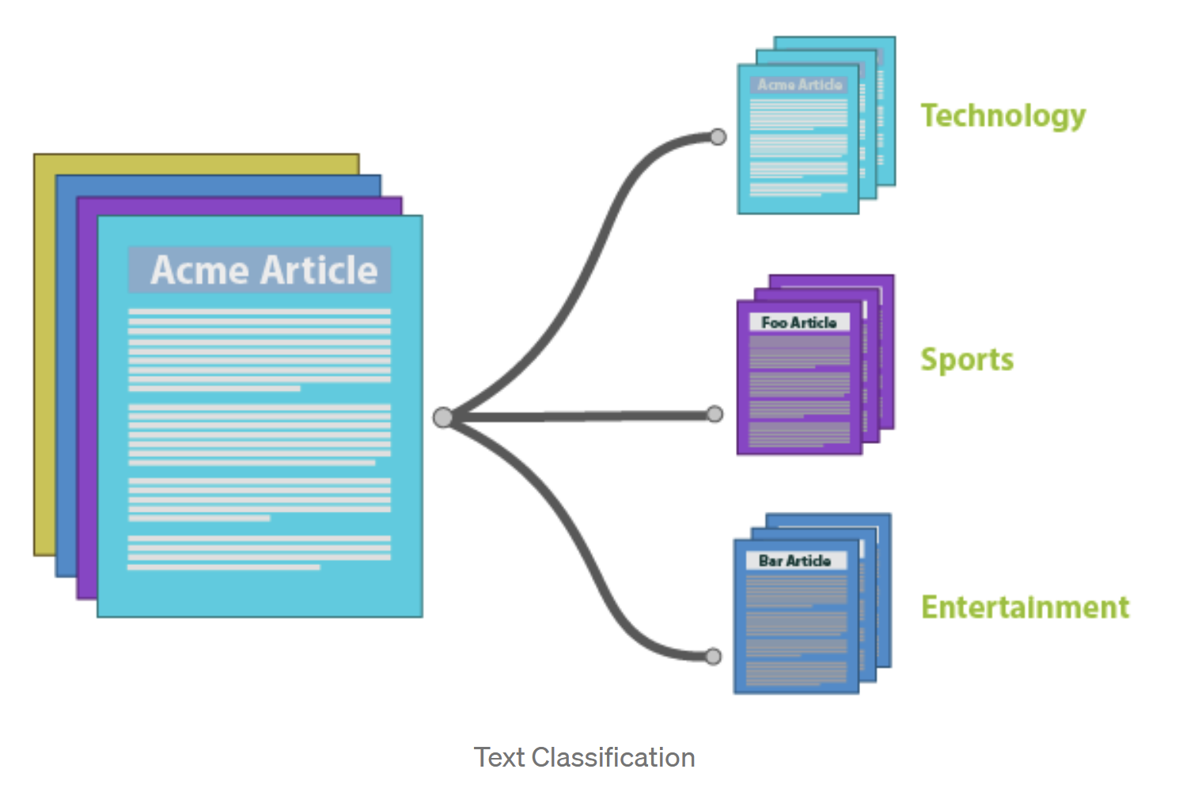
What’s the Project about?
Classification - Process of identifying and grouping objects or ideas into predetermined categories.
Electronic Theses and Dissertations (ETDs) - are documents explicating and expressing research in a form suitable for both machine archives and worldwide retrieval.
Purpose - Automate the process of classification of ETDs.
Notes:
To refresh your memory about this project, the goal of this project is to perform automatic classification of ETD’s with missing metadata.
Electronic Theses and Dissertations (ETDs) contain important information that can be utilized in a wide variety of machine learning tasks such as classification.

Slide 6

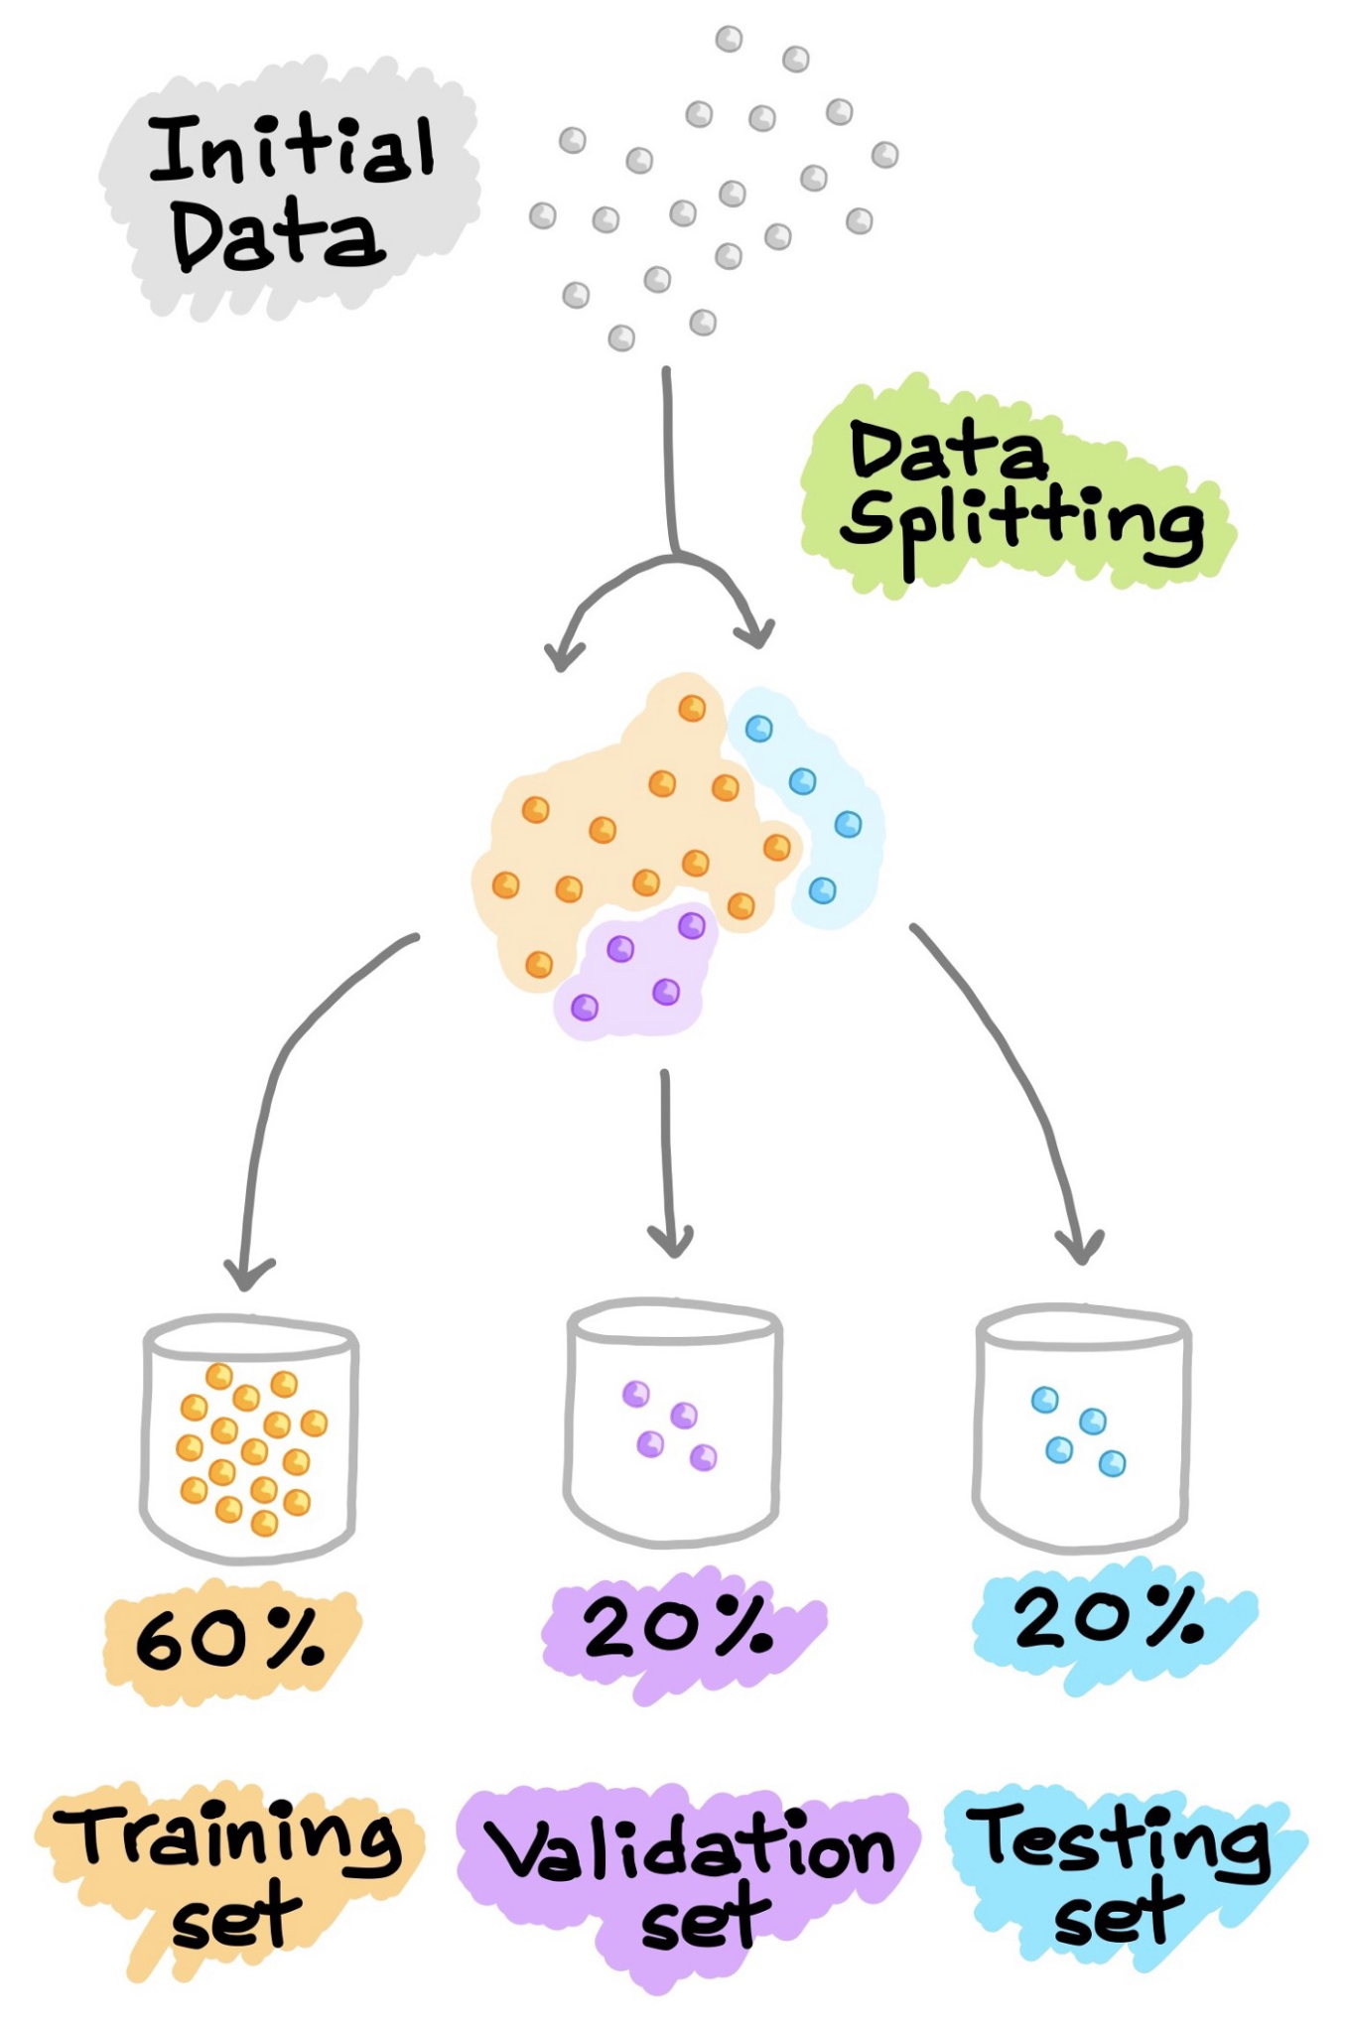

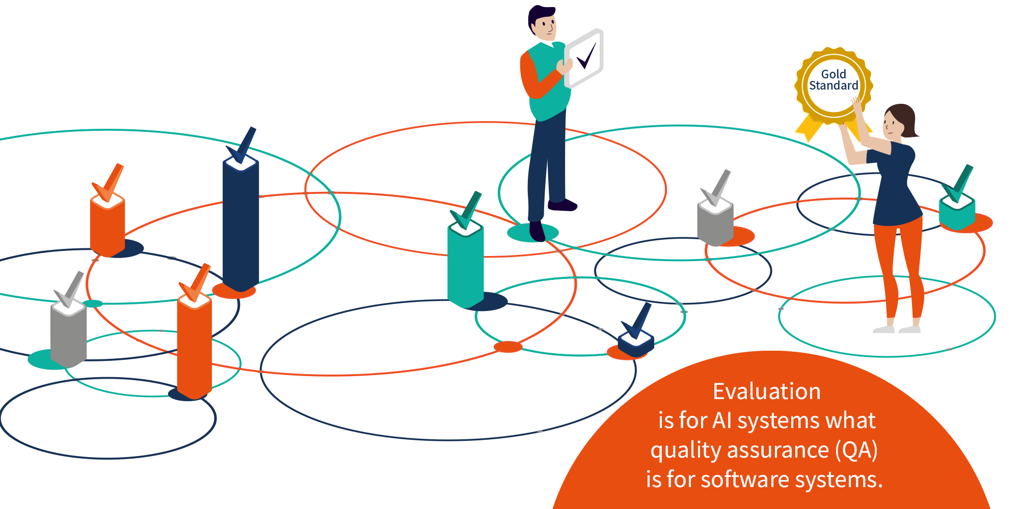
Deliverables
Gold standard dataset
Interactive website for visualization
High Precision Text Classification Model

Slide 7
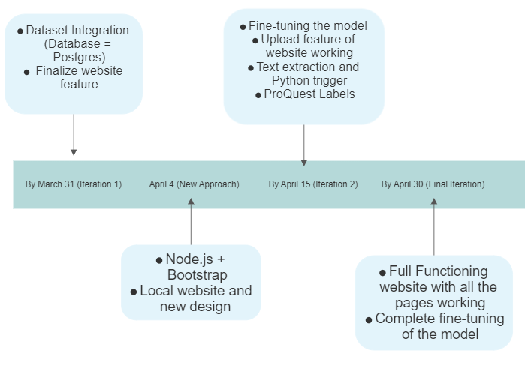
Timeline

Slide 8
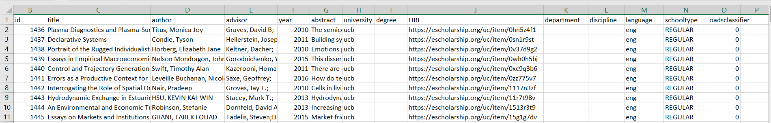
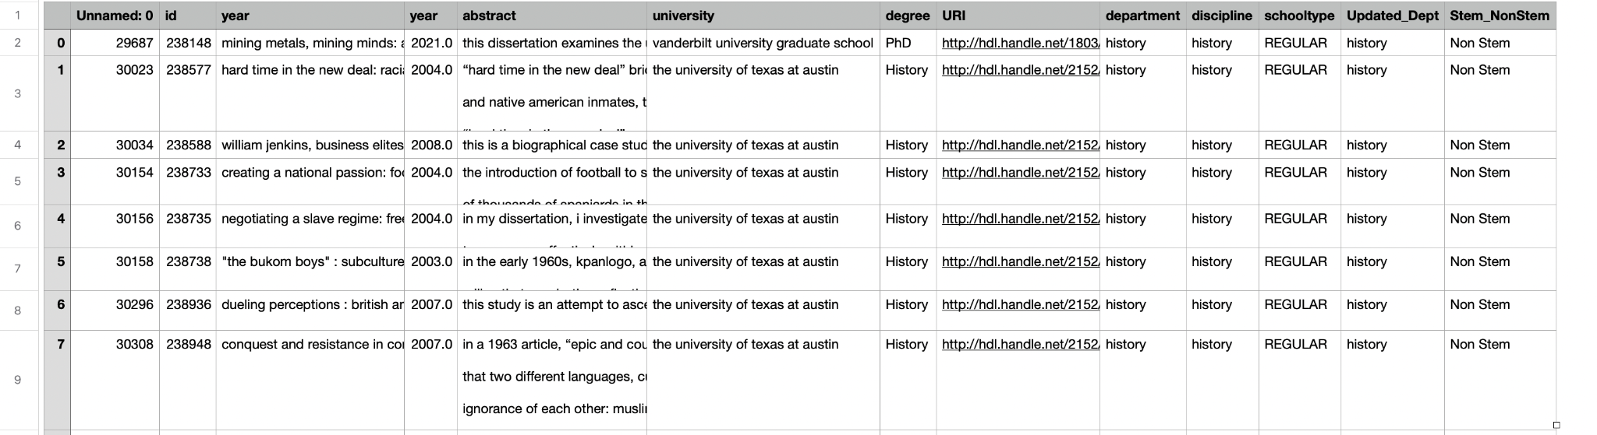
Task Completed : Dataset
Original Metadata
Final Metadata
Notes:
Dropped the unneeded columns
Dropped rows with NaN values
Make all the labels lower case
Spaces (lstrip and rstrip)
Spell Check on departments
Dropped ETDs with IDs 52 and above due to lack of access to those documents

Slide 9
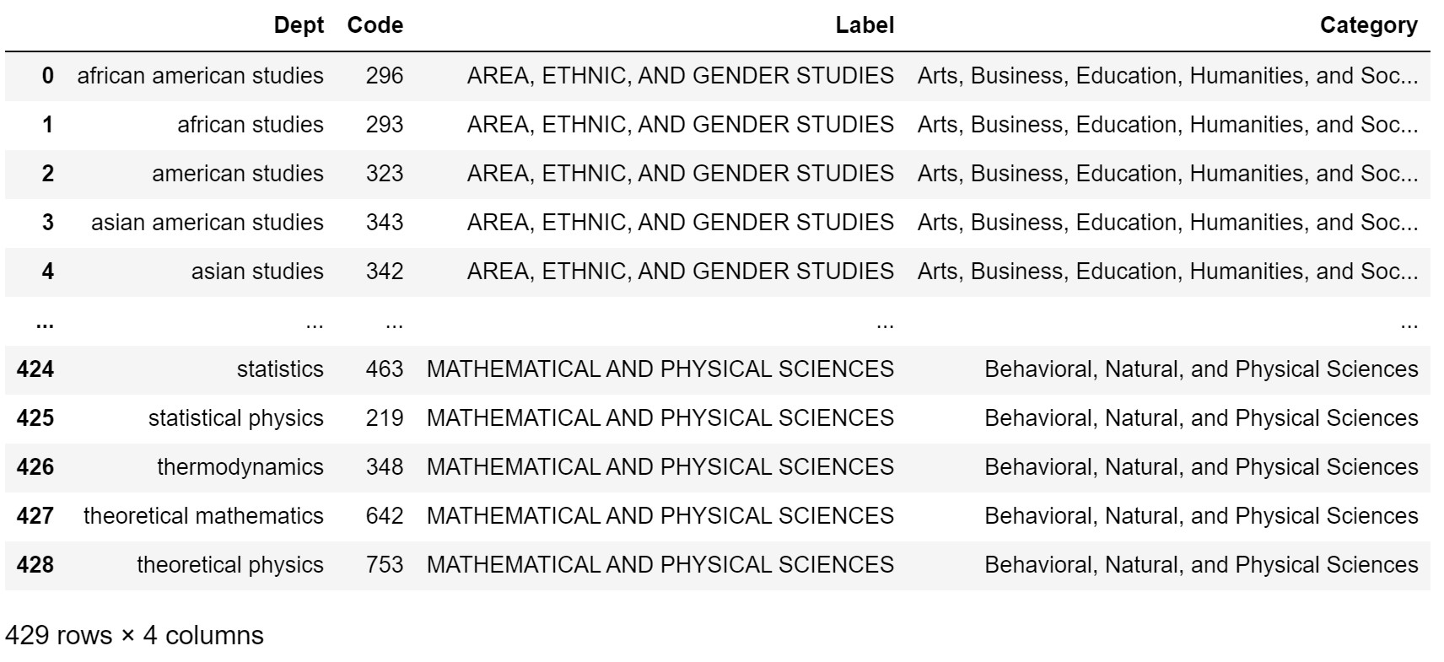
ProQuest Dataset

Slide 10
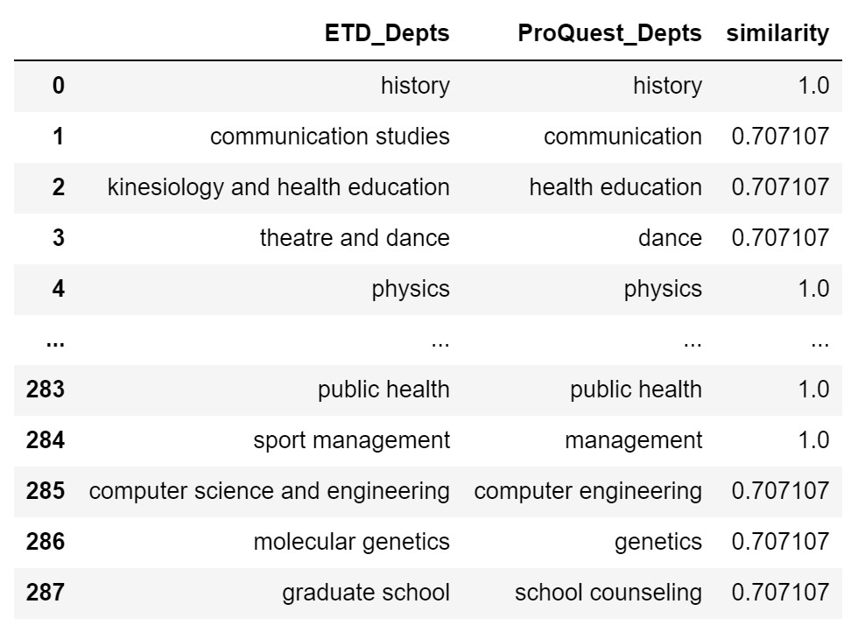
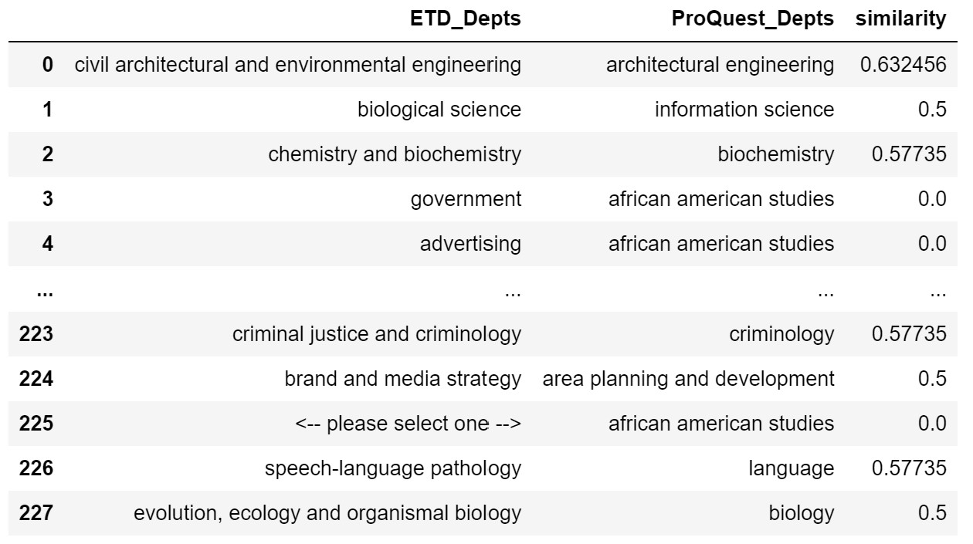
Cosine Matches
Cosine Misses

Slide 11
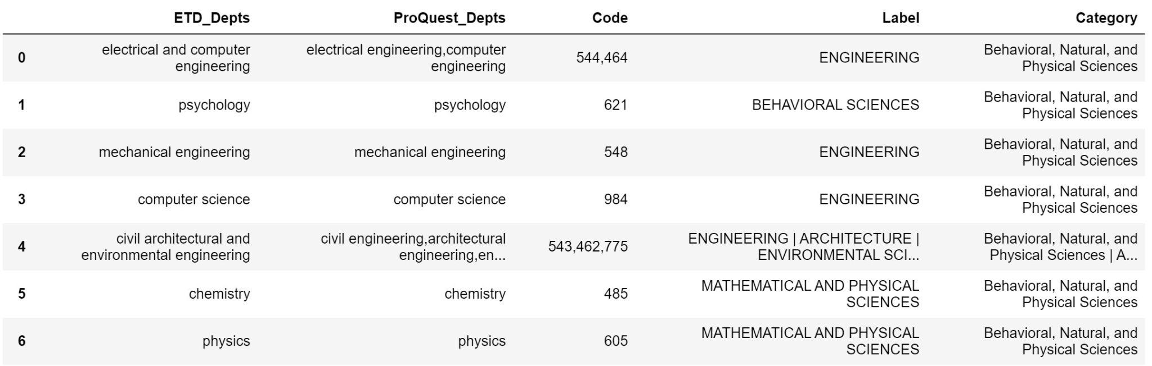
Final Mappings Matches

Slide 12
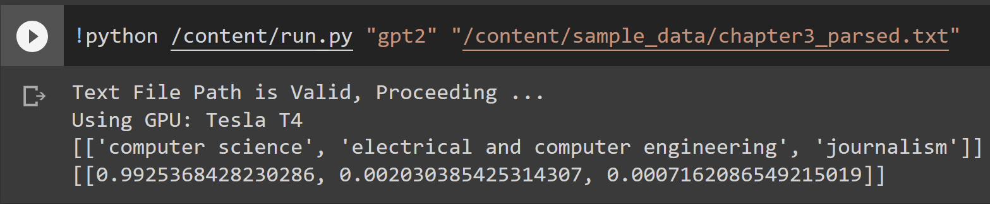
Task Completed : Text Classification Models
Developed Code for Fine-Tuning LLMs.
Developed Inference Code for Generating Probabilistic Outputs.

Slide 13
MODEL NAME | METRICS Train: Title + Abstract Train: Full ETD Text
SciBERT | F1-Score: 72.4% 78.4%
BioBERT | F1-Score: 72.4% 74%
GPT-2 | F1-Score: 73.8% -
BigBird-Pegasus | F1-Score: 73.4% -
Table of Baseline Predictions for different Fine-Tuned Models.

Slide 14
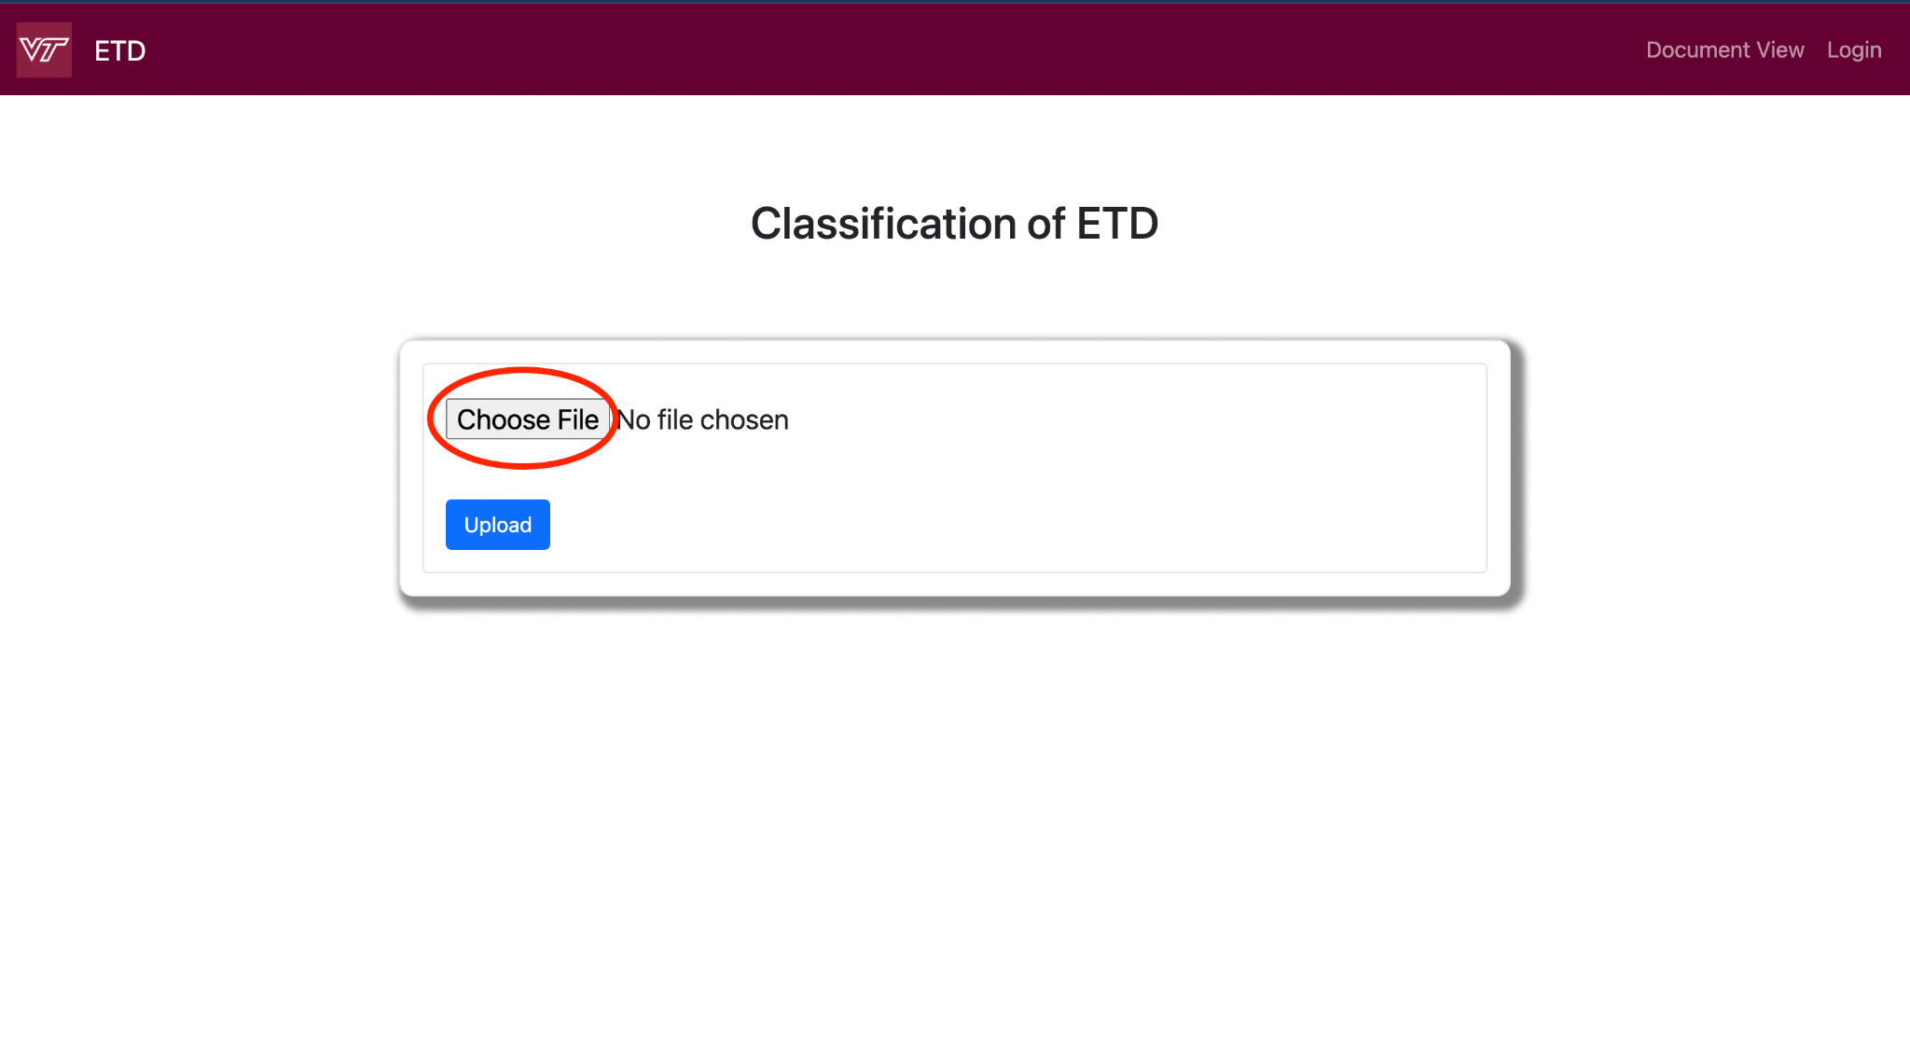
Task Completed - Website Development

Slide 15
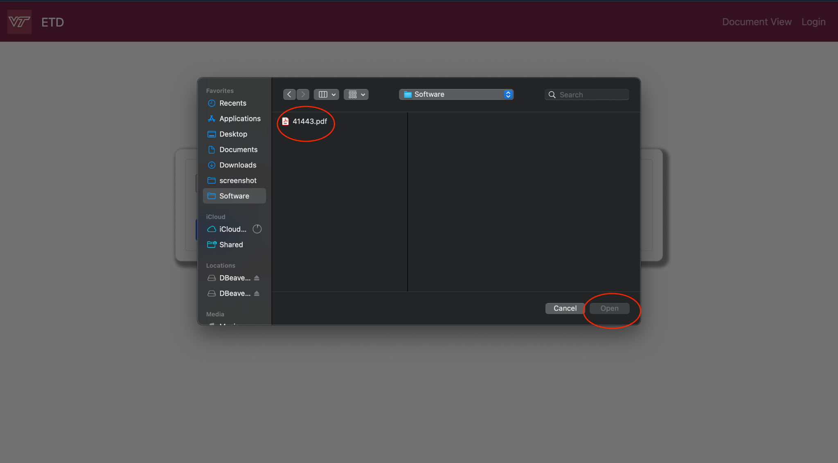
Upload Feature

Slide 16
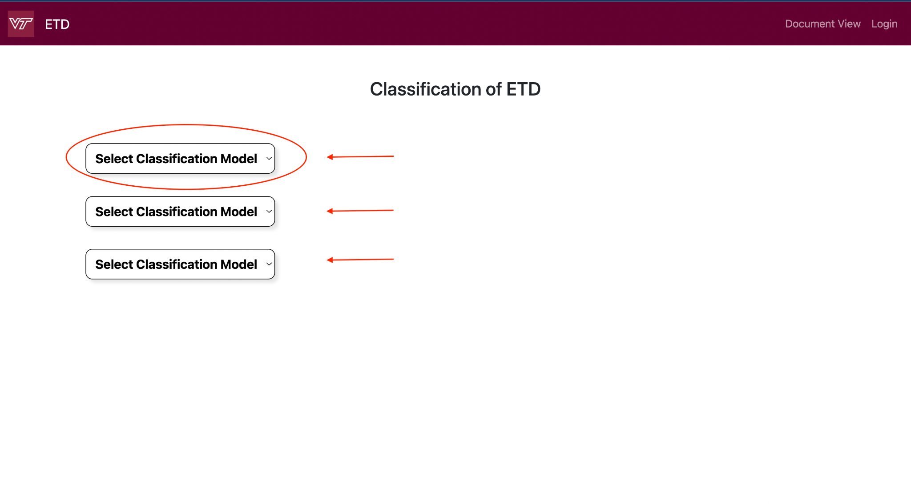
Classification Model

Slide 17
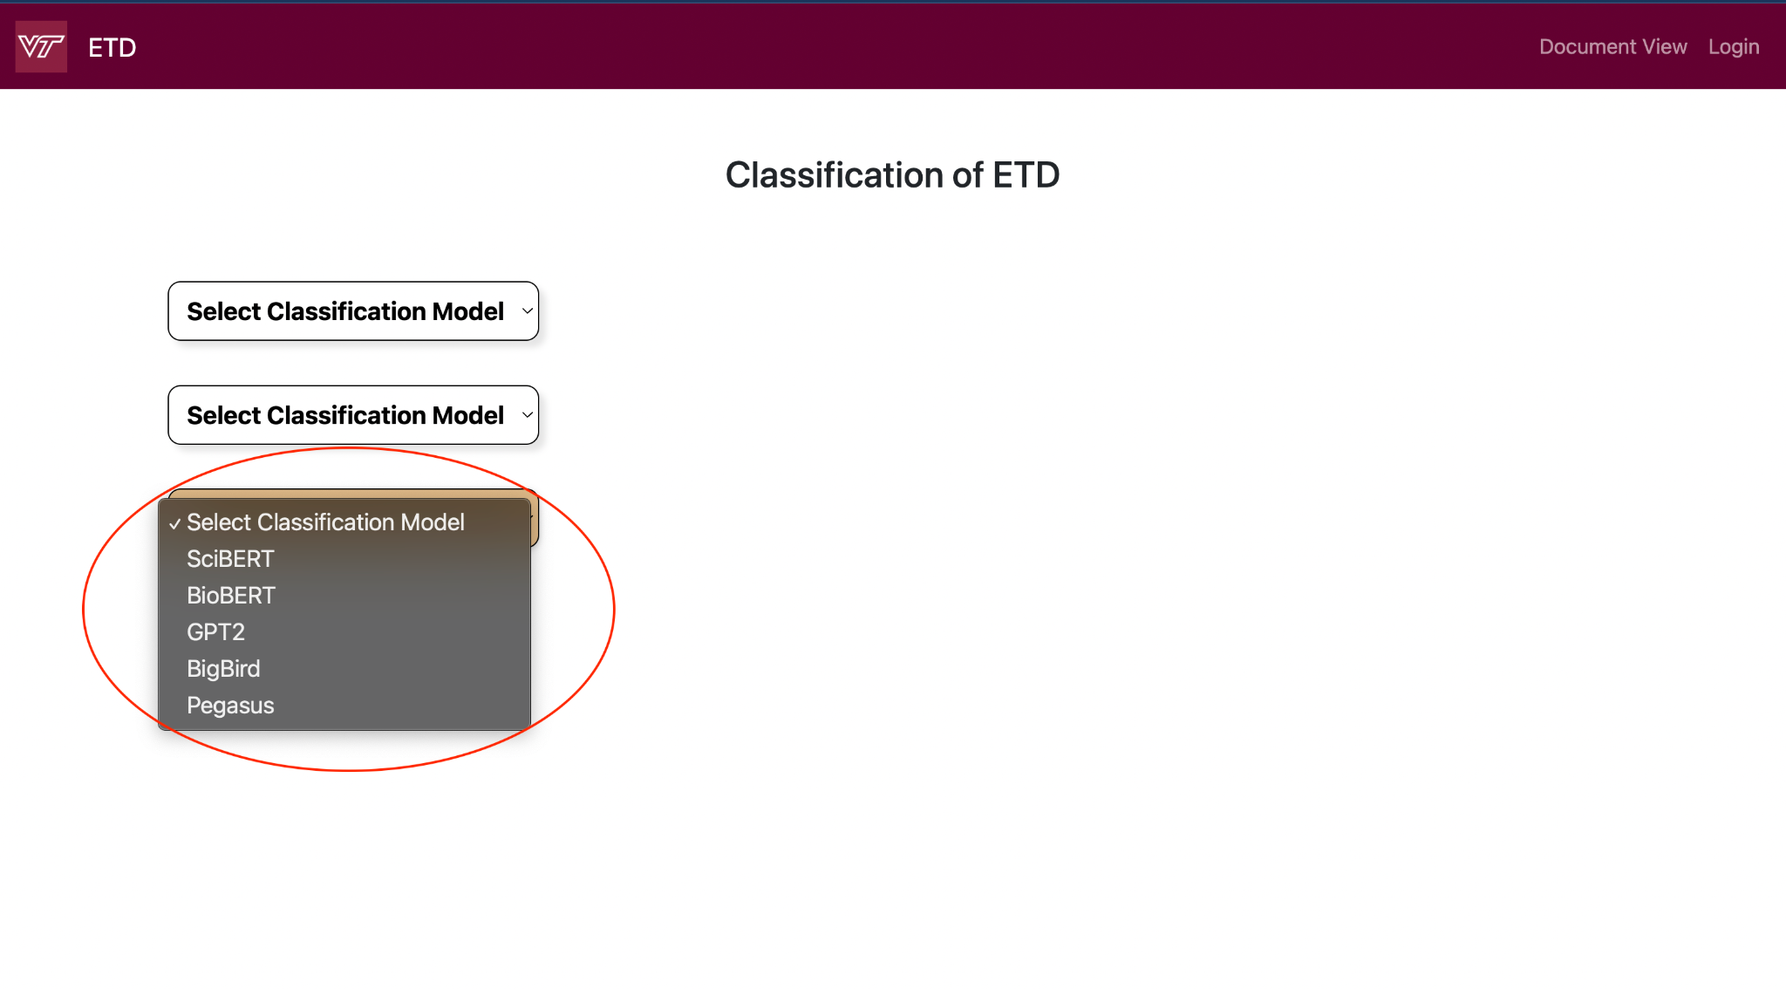
Classification Model

Slide 18
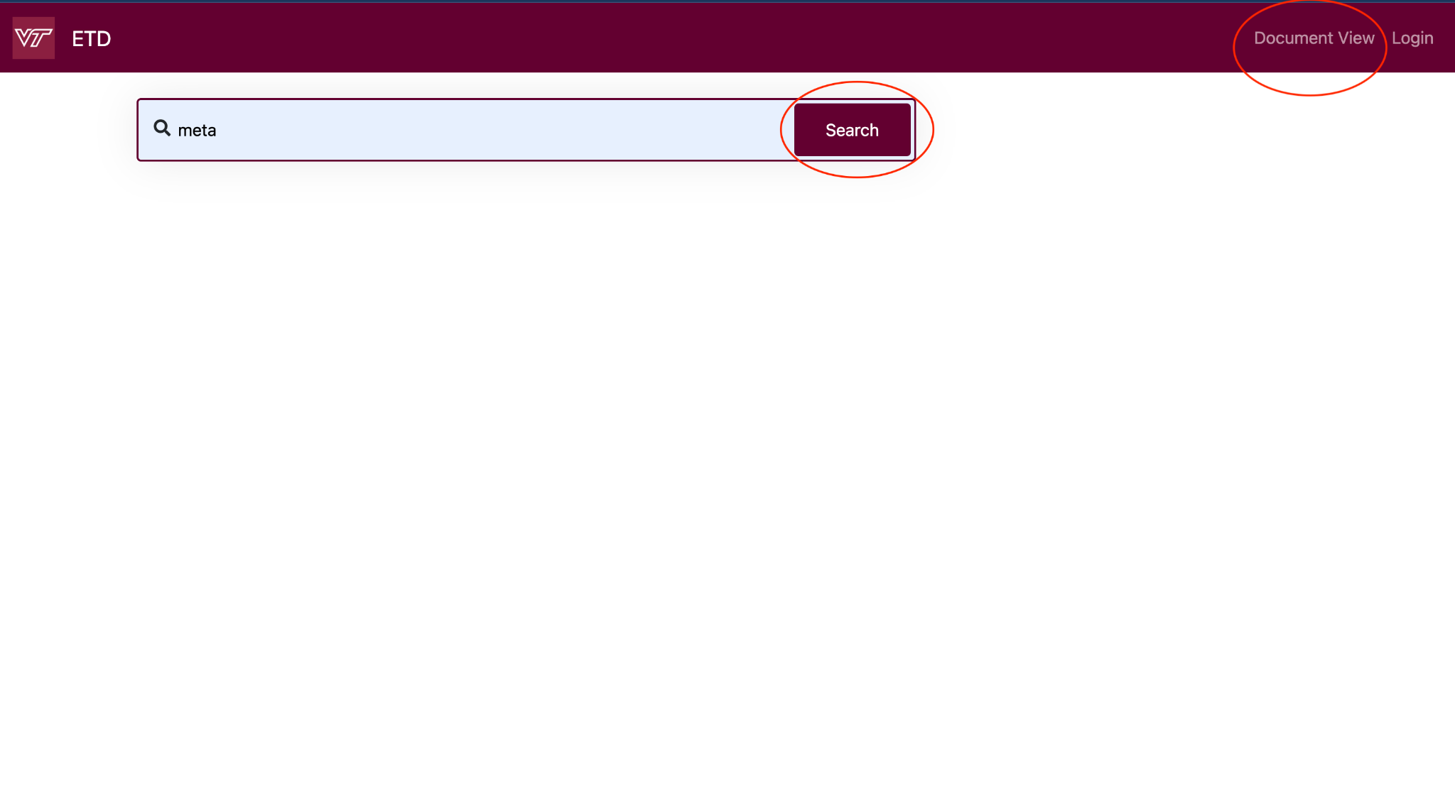
Document View Page

Slide 19
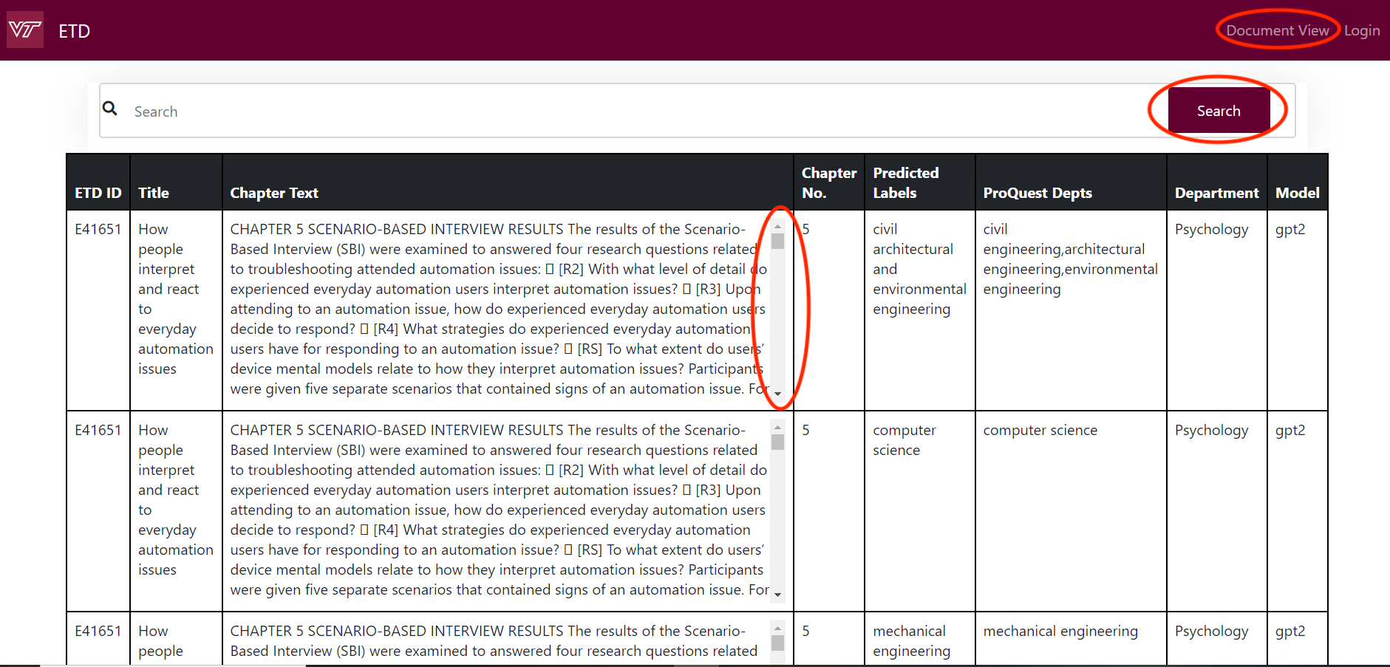
Document View Page

Slide 20
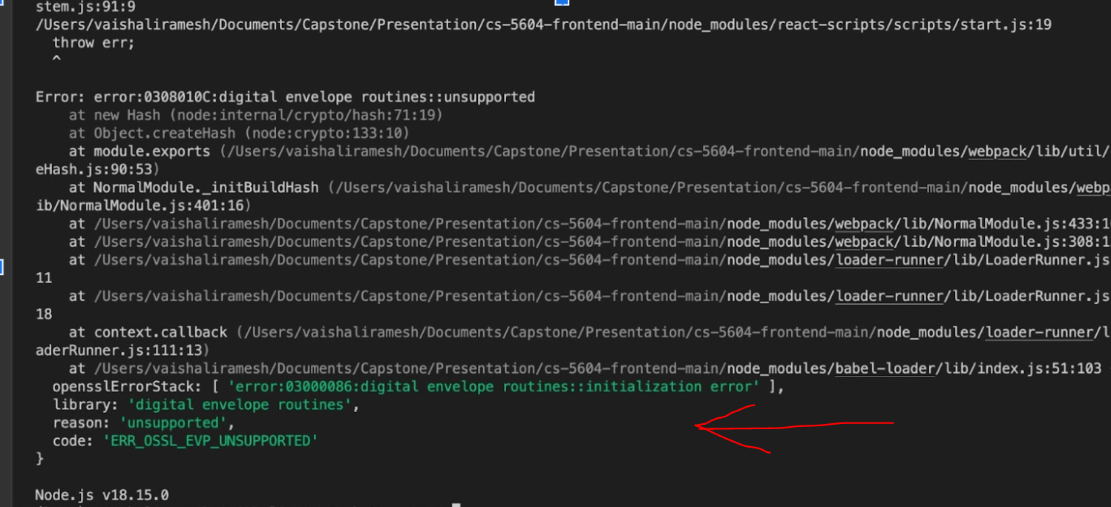
Website Challenges
Installation issues with Node.js and React.

Slide 21
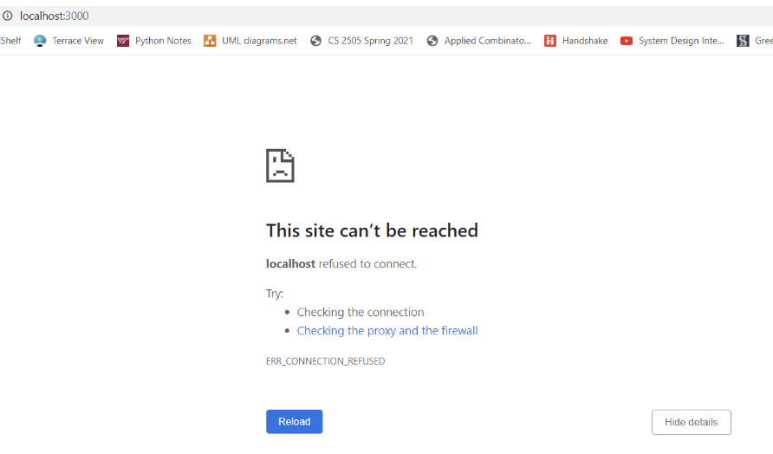
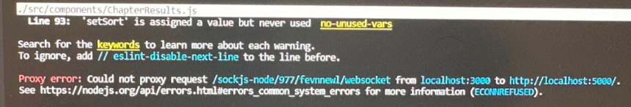
Refusing connection to our local host
Proxy Error

Slide 22

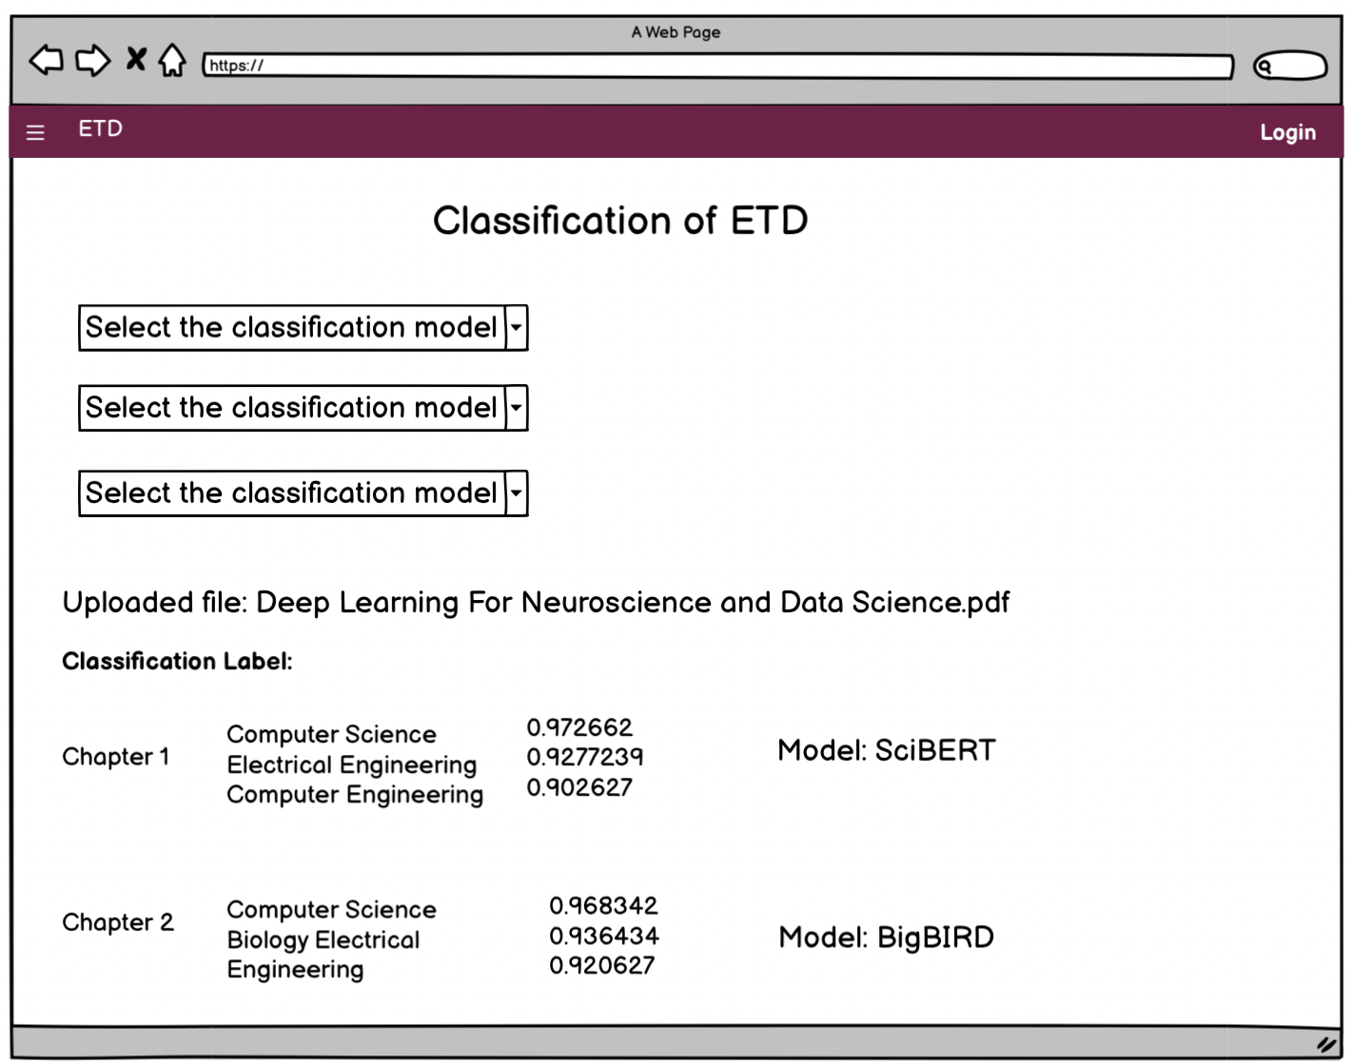
Future Work - Website
Hosting website on a Server
Running Predictions from End-User POV.
Testing the website

Slide 23
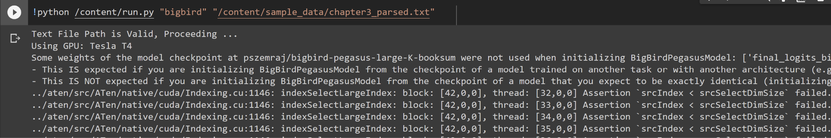
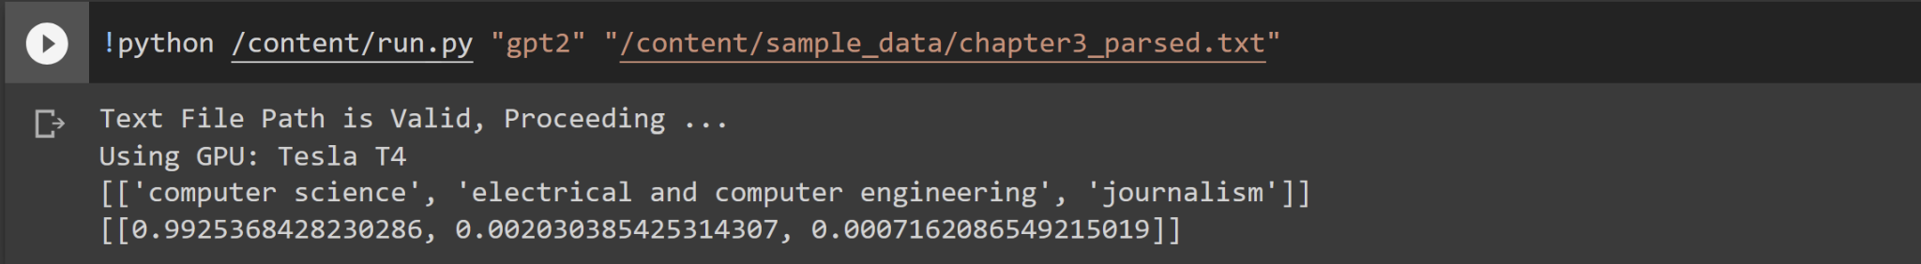
Future Work - DL Models
Analyze and Resolve embedding error for specific model and chapter combinations.
Fine-Tune better Models for this task.

Slide 24
Acknowledgements
We would like to sincerely thank Dr. Edward A. Fox for the opportunity to work on this project, and for all his support and guidance throughout.
We would also want to thank our client, Ms. Bipasha Banerjee for letting us work on this meaningful project, and for always helping and guiding us.
Finally, we would like to acknowledge everyone who’s currently working on this project or has worked on this project before us.
Notes:
Same

Slide 25
References
Bethany Lord. 2021. What platform should I use to build my own website? (March 2021). Retrieved February 6, 2023 from https://theartsdevelopmentcompany.org.uk/resources/what-platform-should-i-use-to-build-my-own-website/
Gergana Petkova. 2022. The gold standard - the key to information extraction and data quality control. (May 2022). Retrieved February 6, 2023 from https://www.ontotext.com/blog/gold-standard-key-to-information-extration-data-quality-control/
Chanin Nantasenamat. 2021. How to build a machine learning model. (June 2021). Retrieved February 6, 2023 from https://towardsdatascience.com/how-to-build-a-machine-learning-model-439ab8fb3fb1
Sam Aenderson, Don Stroud, Dick Lyon, Karan Gupta. 2023. Outline of academic disciplines. (January 2023). Retrieved February 6, 2023 from https://en.wikipedia.org/wiki/Outline_of_academic_disciplines
Hugging Face Community Contributors (2019). Hugging Face-Pretrained Models - transformers 2.4.0 documentation. Retrieved from https://huggingface.co/transformers/v2.4.0/pretrained_models.html
Notes:
Update as needed

Slide 26
References
PyTorch Contributors. PYTORCH documentation(2023). Retrieved March 13, 2023 from https://pytorch.org/docs/stable/index.html
Paszke, A., Gross, S., Massa, F., Lerer, A., Bradbury, J., Chanan, G., Killeen, T., Lin, Z., Gimelshein, N., Antiga, L., Desmaison, A., Köpf, A., Yang, E., … Chintala, S. (2019, December 3). Pytorch: An imperative style, high-performance deep learning library. arXiv.org. Retrieved March 13, 2023 from https://arxiv.org/abs/1912.01703
CS5604 Fall 2022 Class. ETD project website.(2022). Retrieved March 13, 2023 from https://frontend.discovery.cs.vt.edu/
Javed Shaikh. (2017). "Machine Learning, NLP: Text classification using scikit-learn, Python, and NLTK." October 2017. Retrieved February 6, 2023 from https://towardsdatascience.com/machine-learning-nlp-text-classification-using-scikit-learn-python-and-nltk-c52b92a7c73a

