Slide 1
SafeRoad
CS 4624
Virginia Tech, Blacksburg, VA
4/29/16
Matthew Longobardi Paradiso
Matthew Morrison
Julio Suriano Siu
Client: Xuan Zhang

Slide 2
Introduction
SafeRoad’s goal:
Analyze common complaints
Predict car recalls
NHTSA: National Highway Transportation Safety Administration
Use machine learning to predict common complaints
Evaluate and improve the results

Slide 3
Data and Tools
NHTSA databases:
Complaint database
Recall database
Java DataBase Connection (JDBC) - access SQL database through Java
Java Machine Learning (JML) - provides functionality for classifying complaints

Slide 4
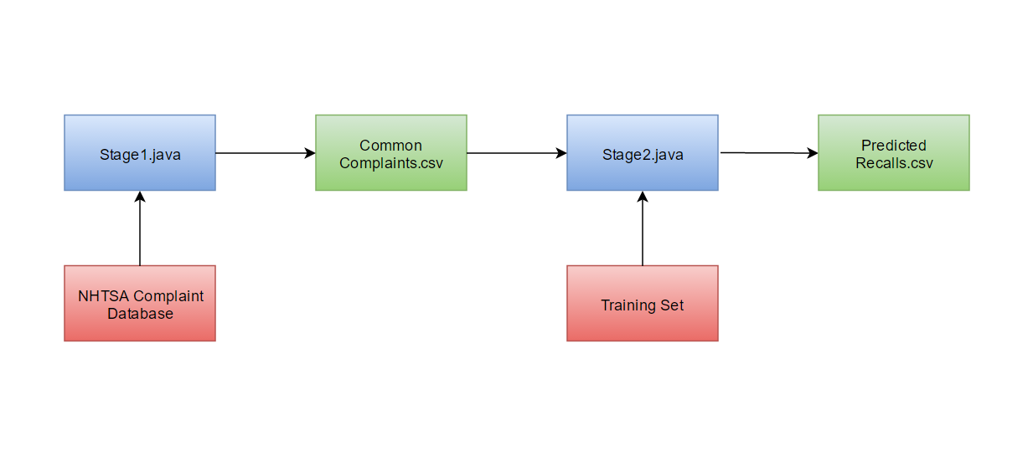
Architecture of the Program

Slide 5
Raw complaint data:
500001,10089761,HONDA (AMERICAN HONDA MOTOR CO.),HONDA,ELEMENT,2003,N,20040825,N,0,0,VISIBILITY:WINDSHIELD,FALLS CHURCH,VA,5J6YH28503L,20040825,20040825,,1,"WHILE DRIVING A ROCK FROM THE STREET HIT THE WINDSHIELD, CAUSING A CRACK THREE TO FOUR INCHES IN DIAMETER. CONSUMER DROVE THE VEHICLE TO THE DEALER FOR INSPECTION, AND MECHANIC DETERMINED THAT THE ROCK WAS THE CAUSE OF THE PROBLEM. CONSUMER INFORMED THE MECHANIC THAT THIS PROBLEM OCCURRED LESS THAN A YEAR AGO, AND PROBLEM RECURRED.*AK",EVOQ,N,,Y,Y,Y,4,4WD,FI,DS,AUTO,55,,,,,,,,,,,,,,V,
Processed complaint data:
2003, HONDA, ELEMENT, VISIBILITY, N, N, 0, 0, "WHILE DRIVING A ROCK FROM THE STREET HIT THE WINDSHIELD, CAUSING A CRACK THREE TO FOUR INCHES IN DIAMETER. CONSUMER DROVE THE VEHICLE TO THE DEALER FOR INSPECTION, AND MECHANIC DETERMINED THAT THE ROCK WAS THE CAUSE OF THE PROBLEM. CONSUMER INFORMED THE MECHANIC THAT THIS PROBLEM OCCURRED LESS THAN A YEAR AGO, AND PROBLEM RECURRED.*AK", U

Slide 6
Classifier
Use machine learning classifiers to classify complaints
JML classifiers work with numbers
Use a HashMap to map words to numbers
Use 1’s and 0’s for boolean values
2004,Honda,Element,Service Brakes,N,N,0,0,”Vibration when braking”,N
2004,7,201,103,0,0,0,0,”Vibration when braking”,N

Slide 7
HashMap
1 FORD
2 CHEVROLET
3 TOYOTA
4 DODGE
5 JEEP
6 NISSAN
7 HONDA
8 CHRYSLER
9 HYUNDAI
10 GMC
11 PONTIAC
12 VOLKSWAGEN
13 BMW
14 SATURN
15 KIA
16 MERCEDES BENZ
17 MAZDA
18 BUICK
19 MERCURY
20 SUBARU
21 CADILLAC
22 LEXUS
23 VOLVO
24 ACURA
25 SUZUKI
26 MINI
27 MITSUBISHI
28 INFINITI
29 LINCOLN
30 AUDI
31 RAM
32 OLDSMOBILE
33 LAND ROVER
34 SAAB
35 SCION
36 ISUZU
37 YAMAHA
38 JAGUAR
39 HUMMER
40 DAEWOO

Slide 8
Prototype and Testing - F-Score
F-test score is a measure of accuracy for binary classification
F = 2 * (P * R) / (P + R)
P = correct recall classifications / all recall classifications
R = correct recall classifications / expected number of recall classifications

Slide 9
Prototype and Testing
Tested prototype with training set containing 350 records
Performed 3 different tests:
Naive Bayes classifier with full training set
Naive Bayes classifier with short training set
K-Nearest Neighbors classifier with short training set

Slide 10
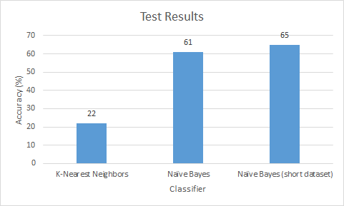
Prototype and Testing - Results

Slide 11
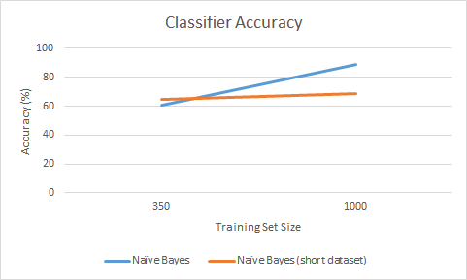
Final Results
Training set increased to 1,000 records

Slide 12
Final Results
Classifier Used | Naive Bayes
Test Set Size | 1,000
Amount of Complaints Classified as Recalls | 1.5%
% of Complaints DB that are Recalls | 1.5%
Classifier Accuracy | 88%
Program Runtime | ~2 minutes

Slide 13
QUESTIONS?

