Slide 1
IDEAL CLIMATE CHANGE
Michael Steele, Somn Kafley, Samyak Singh
CS 4624, Virginia Tech, Blacksburg, VA24061 5/4/2016
Instructor - Edward A. Fox
Client - Mohamed M. Gharib Farag

Slide 2
OBJECTIVE
Provide a digital library and search-engine for graduate students, researchers, and anybody interested in Climate Change.

Slide 3
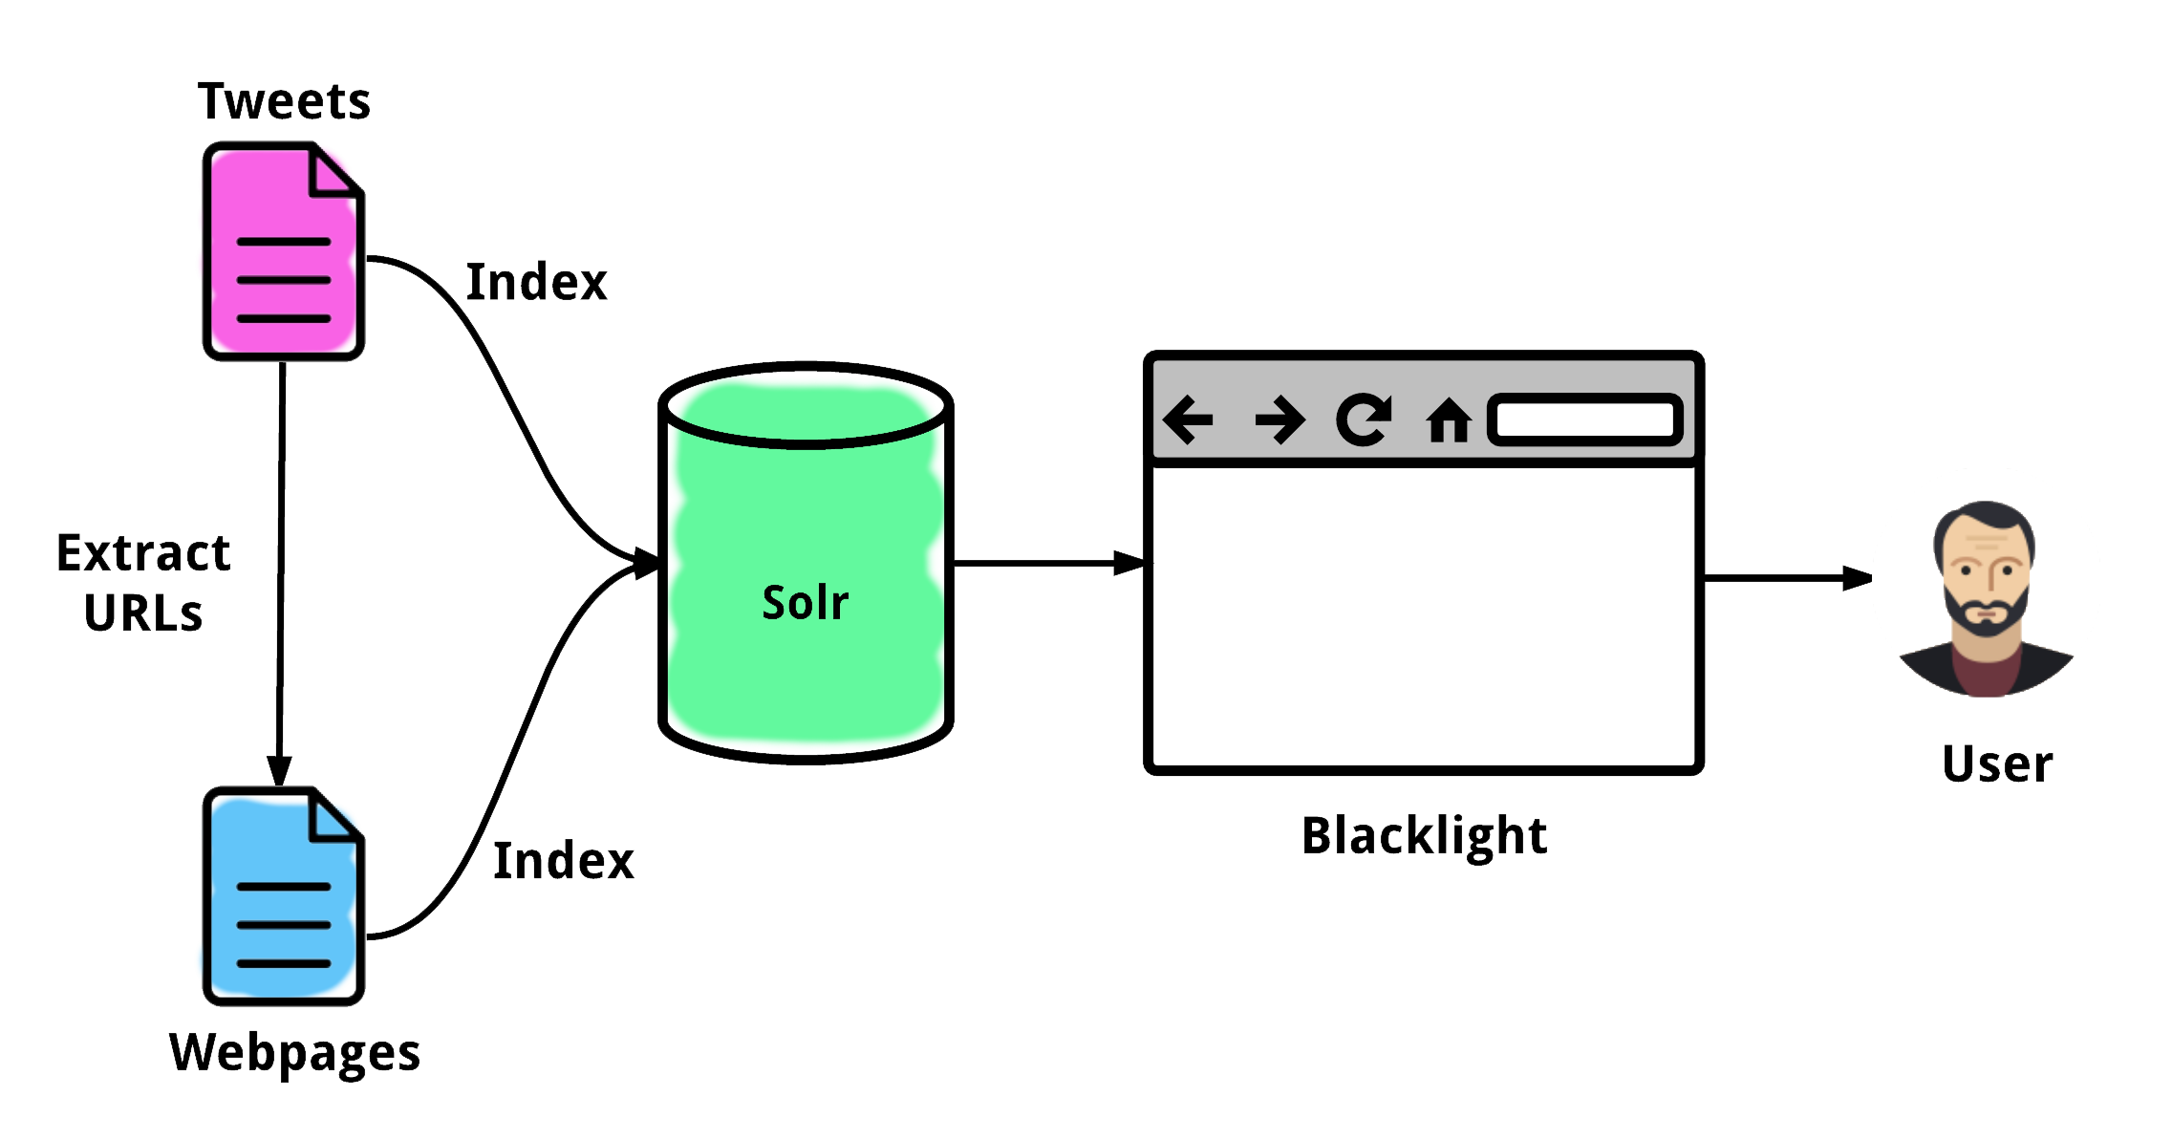
SYSTEM MAP

Slide 4
FUNCTIONALITY

Slide 5
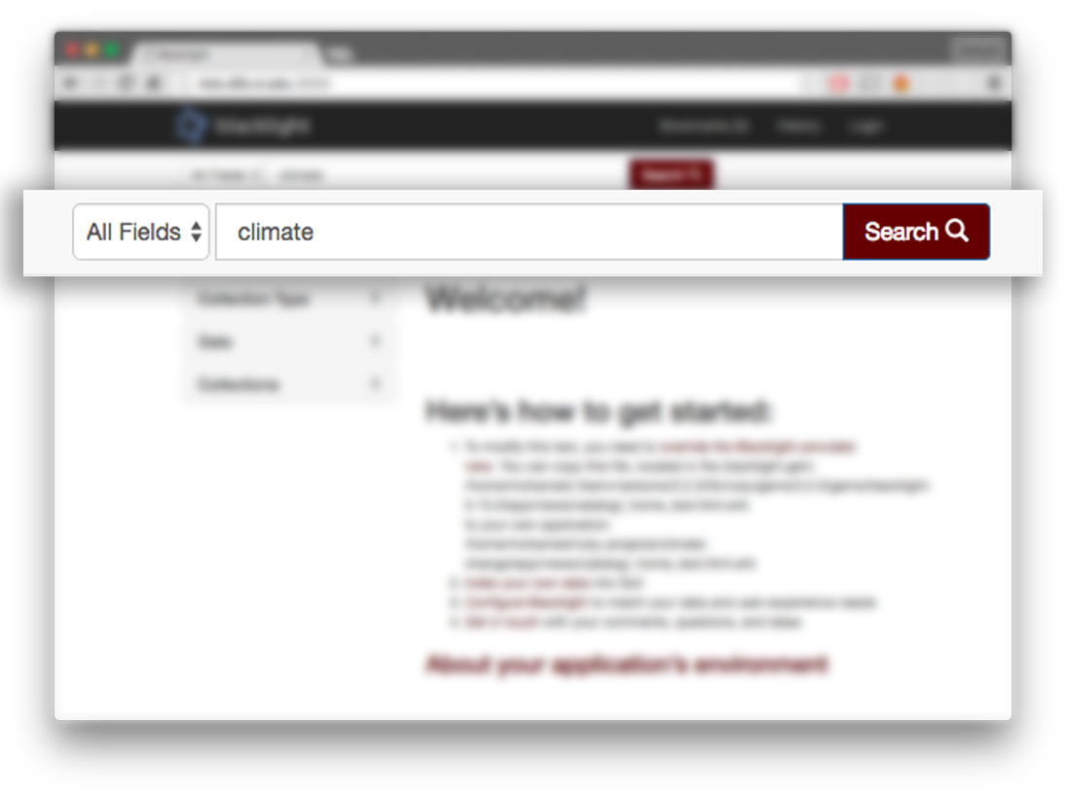
SEARCH

Slide 6
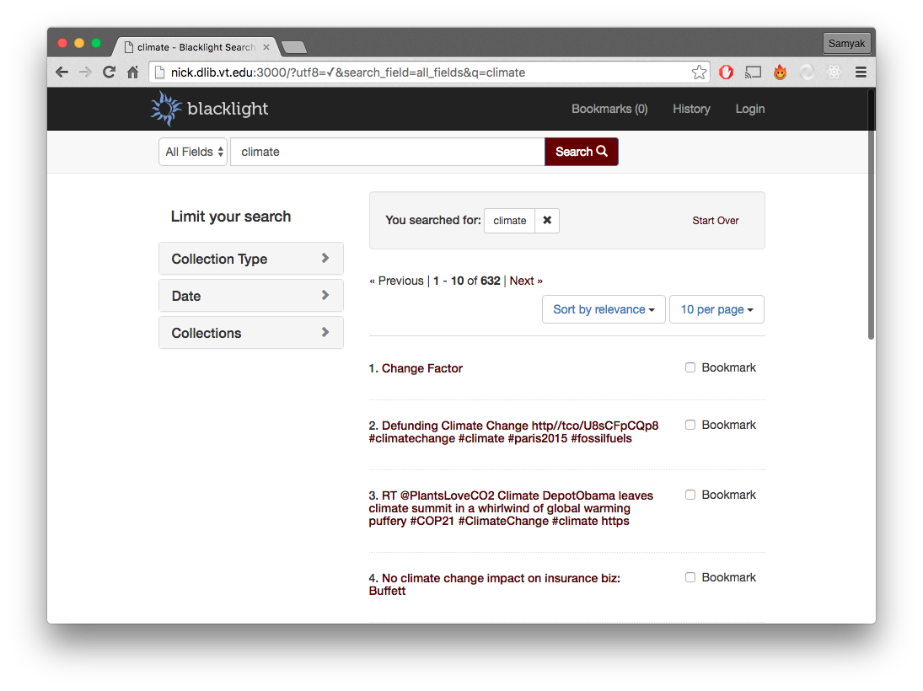
SEARCH

Slide 7
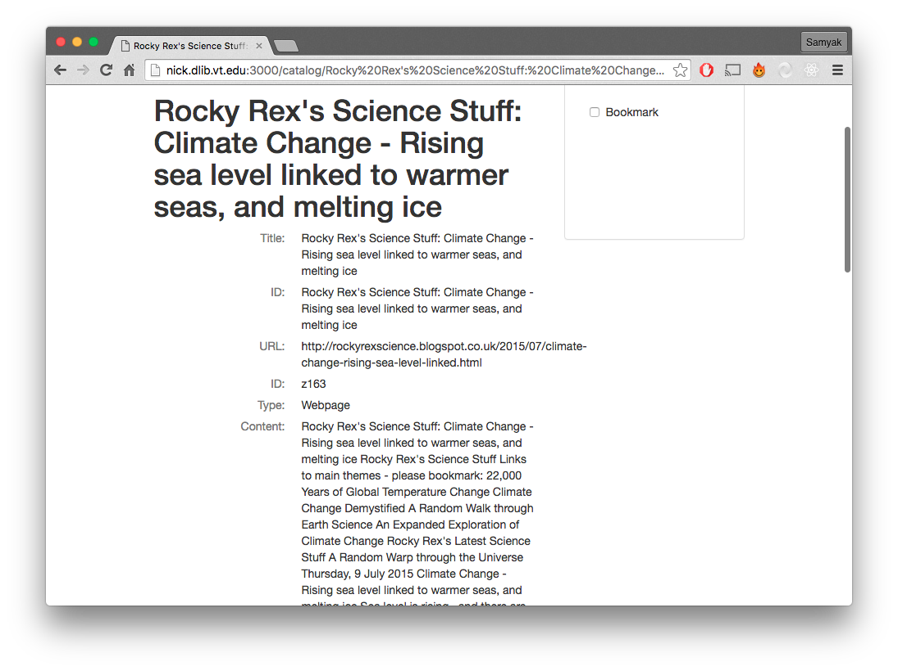
SEARCH

Slide 8
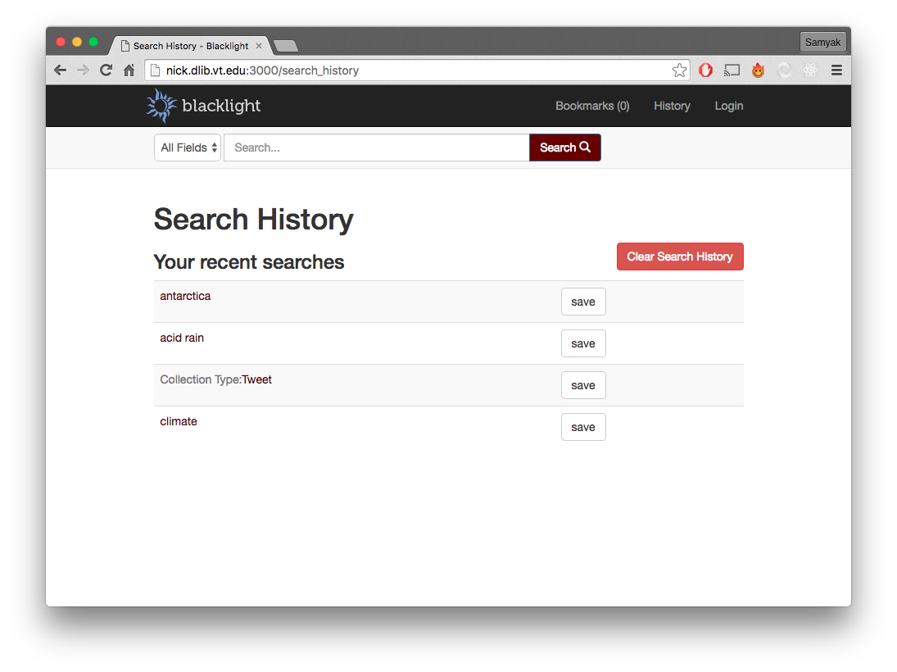
SEARCH
HISTORY

Slide 9
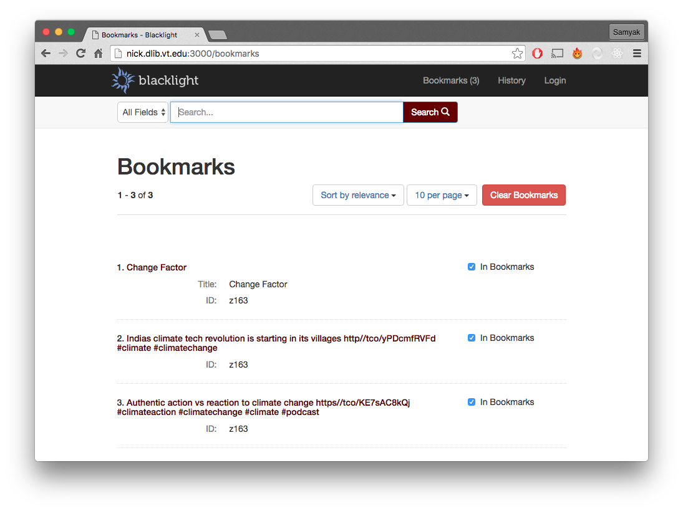
BOOKMARKS

Slide 10
TESTING
Black Box testing for usability by students.
Functionality testing for search by Somn, Sam, and Michael.

Slide 11
FUTURE WORK
Python-configuration files for scalability.
Upgrade Python to 3.5.
Continue to upload more data.

Slide 12
THANK YOU!

Slide 13
ACKNOWLEDGEMENT
Thanks go to National Science Foundation grant IIS - 1319578, III: Small: Integrated Digital Event Archiving and Library (IDEAL).
our sincere appreciation to Dr. Edward Fox for providing us the climate changes project and guiding us with valuable and constructive suggestions.
we would like to thanks Mr. Mohammed M. Gharib Farag for providing us the valuable information we needed.

