Slide 1
Topic Modeling Toolkit
Kevin Liu, Jiayue Lin, Mingkai Pang
CS 4624: Multimedia, Hypertext, and Information Access
Dr. Edward Fox
Virginia Tech, Blacksburg VA 24061
April 13, 2023

Slide 2
Outline
Project Overview
Work Completed
  Frontend
  Backend
  Database
Testing
Lessons Learned
Future Work
Acknowledgements
References

Slide 3
Project Overview
Objective: A web-based platform that enables users to browse and search for topics within a database of text documents.
Using BERTopic, LDA, and CTM to extract similar topics from the database
Recommendation system, text-filtering framework, and usable user interface

Slide 4
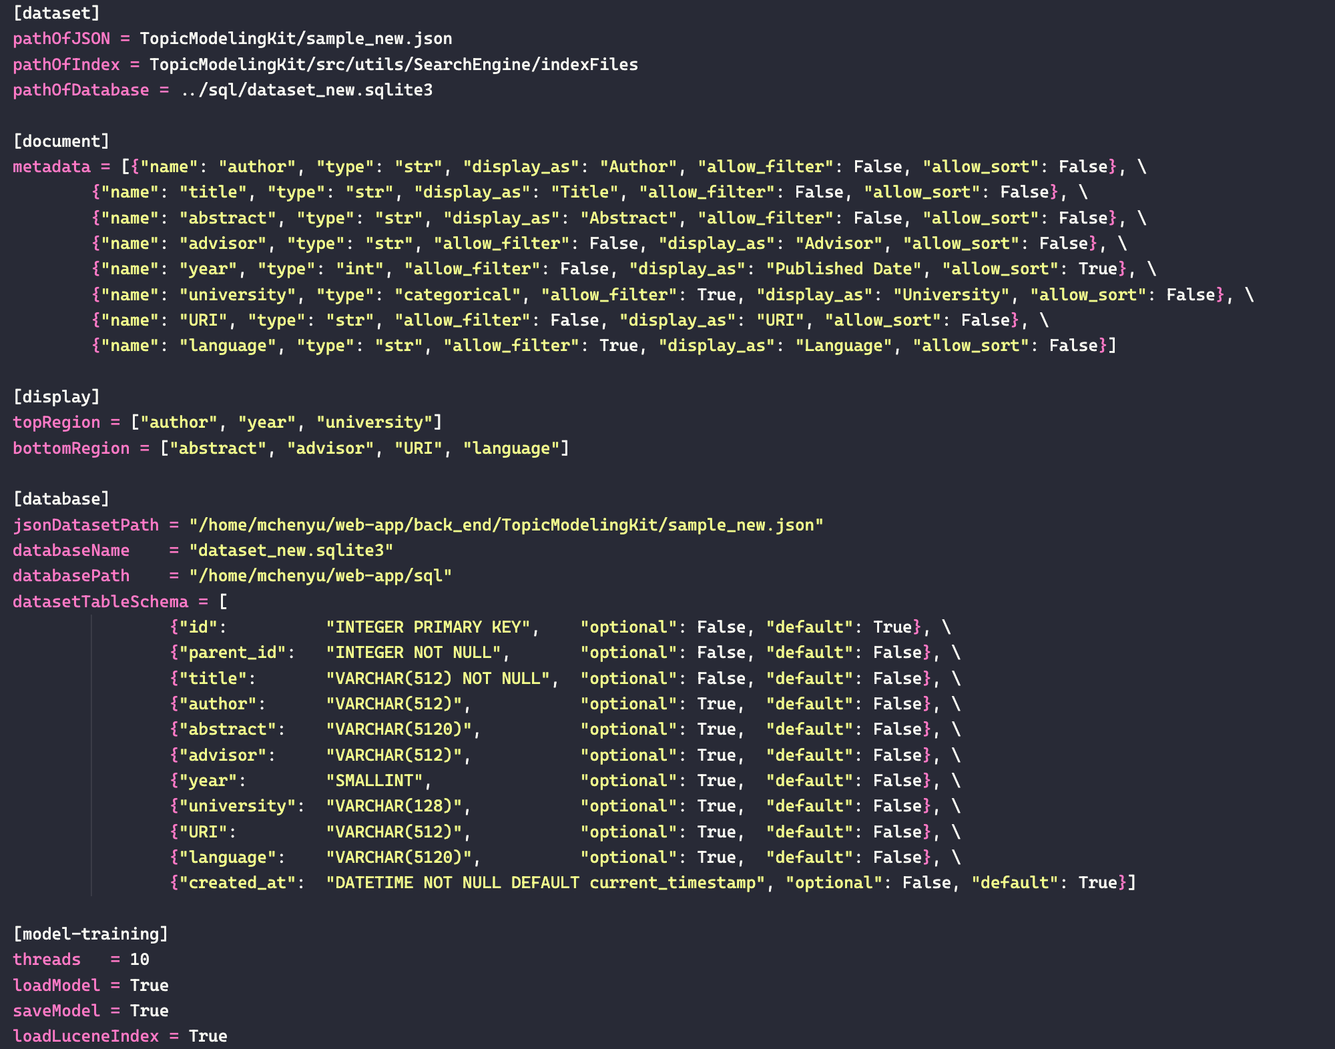
Configuration File
Global config file improves app's dynamic capabilities.
Centralizes management of settings and parameters.

Slide 5
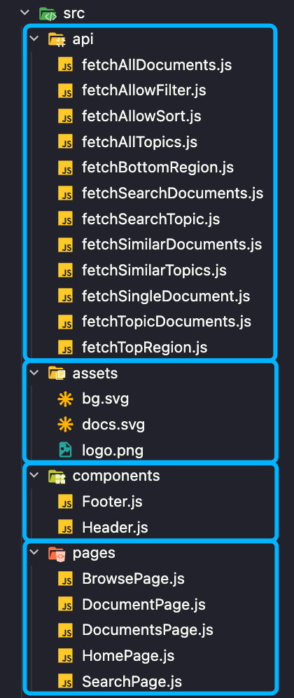



Frontend
Migrated the frontend interface from Flask to React
Designed and implemented a landing page
Developed a document searching page to help users find specific documents
Created a topic browsing page for users to browse through related topics
Implemented a responsive design to ensure a consistent user experience across different devices and screen sizes

Slide 6
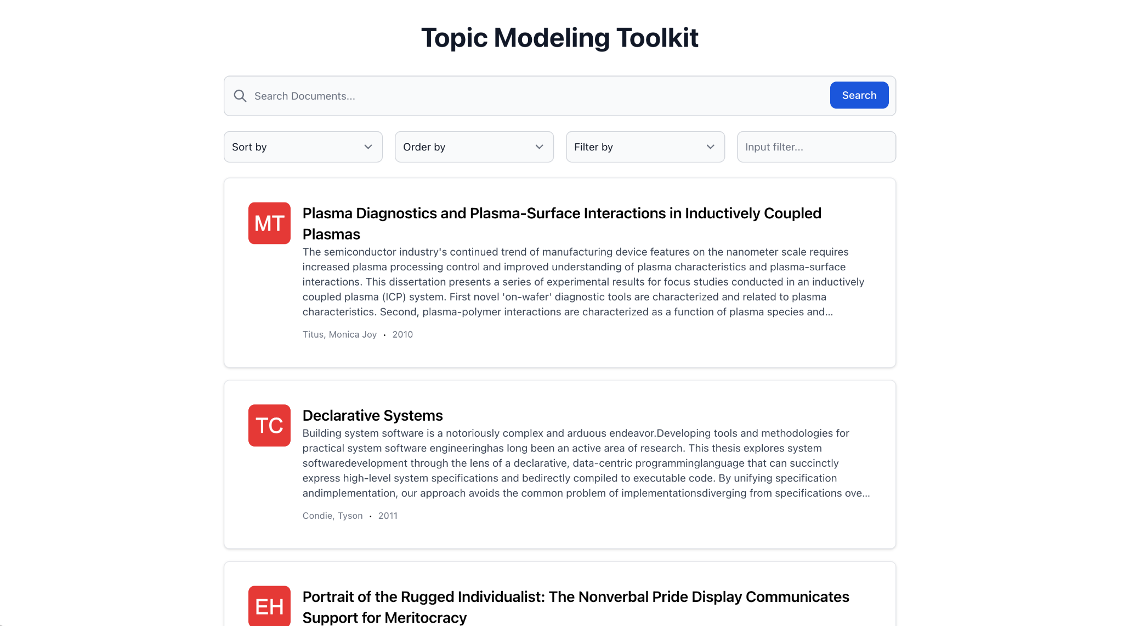
Document Searching

Slide 7
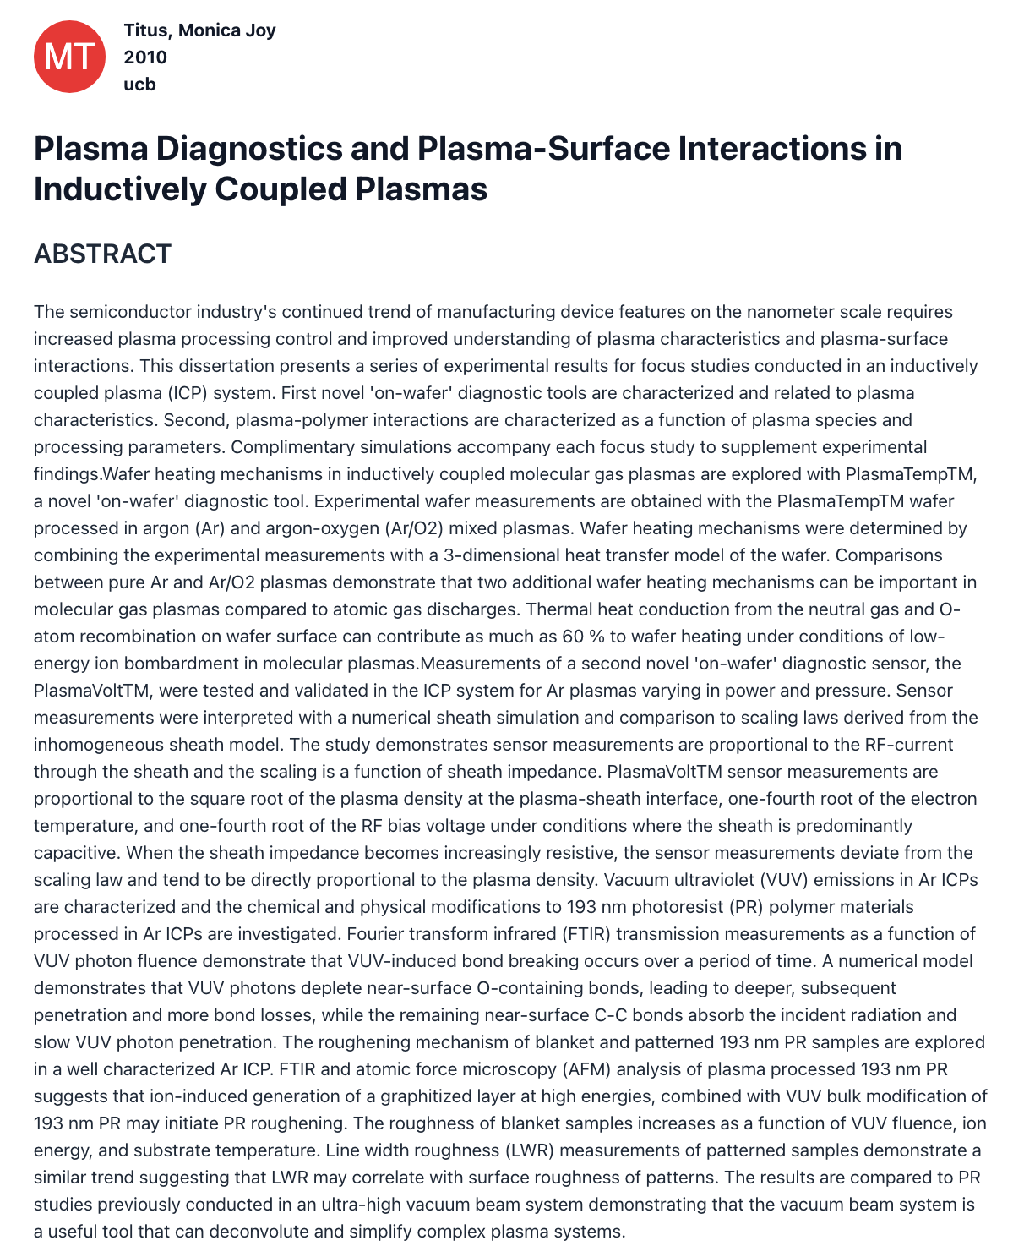
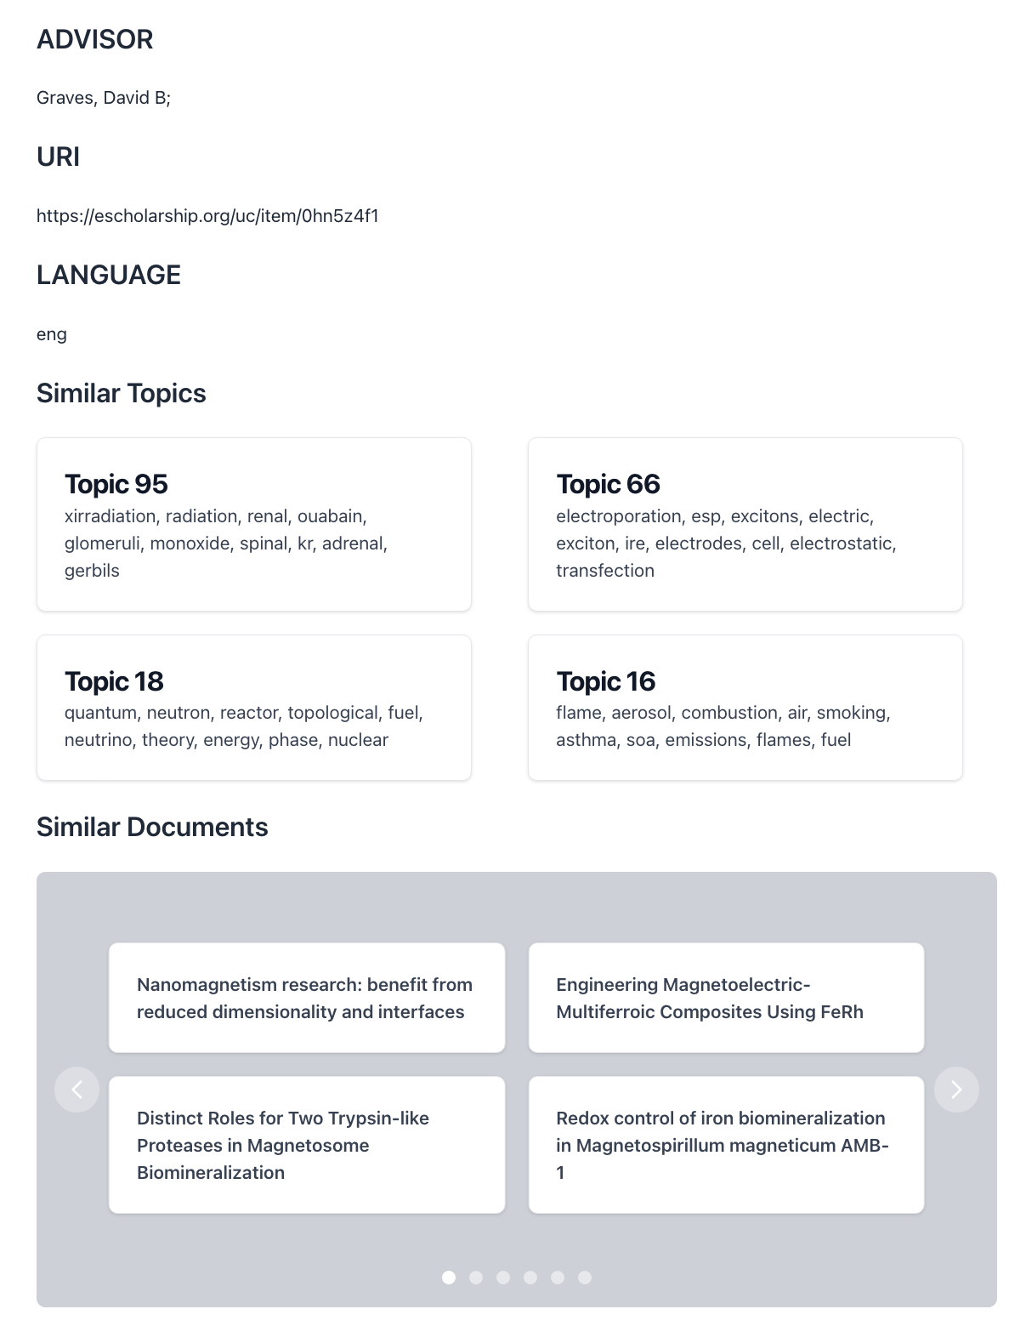

Slide 8
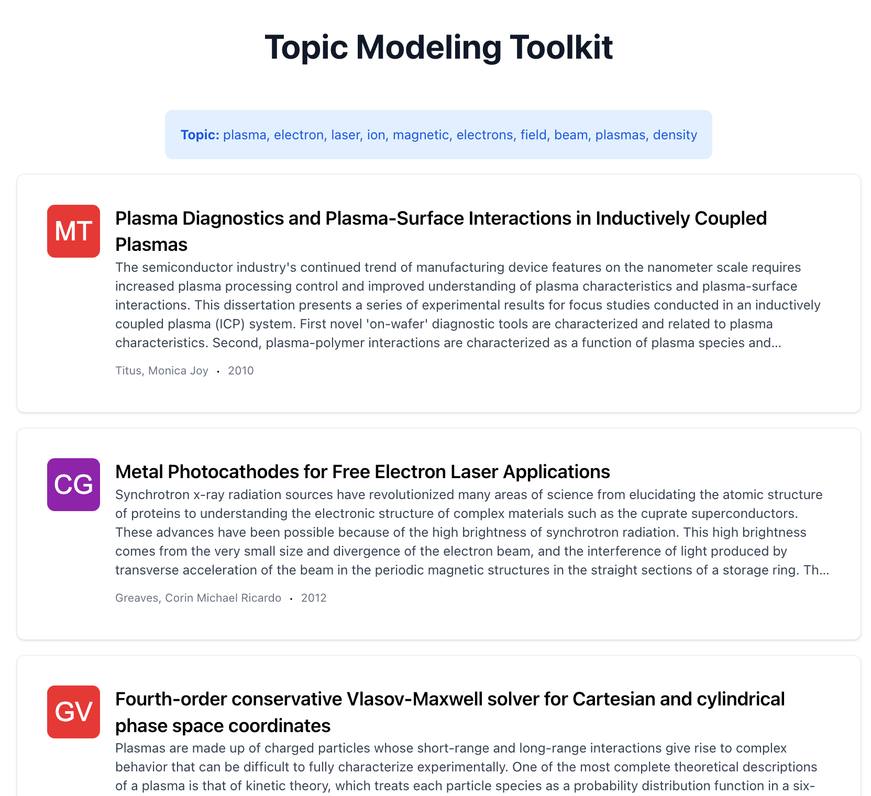
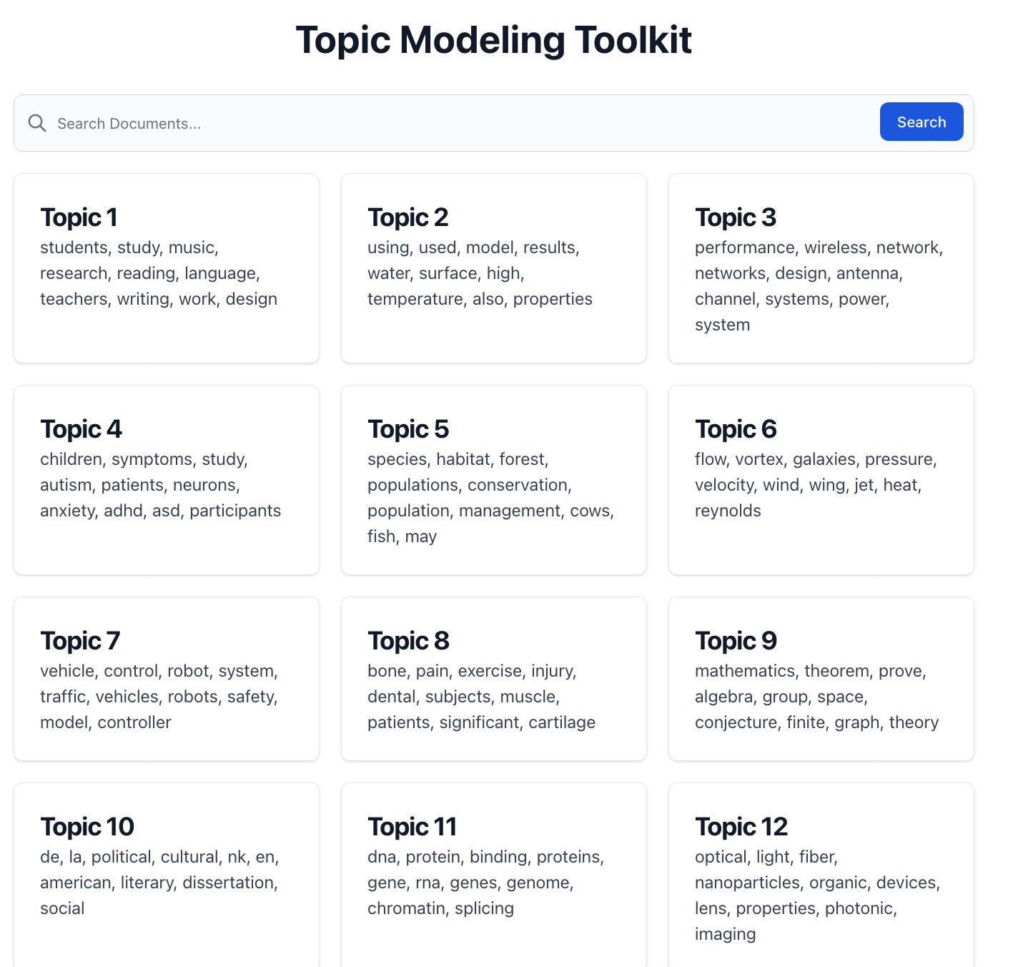
Topic Browsing

Slide 9
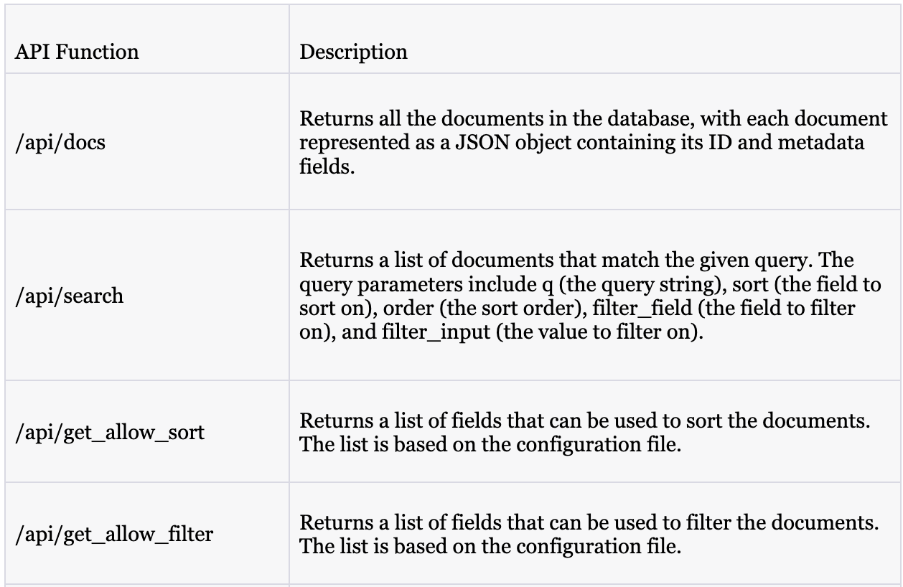


Backend
Flask Backend and Lucene Indexing:
Developed RESTful APIs in Flask.
Indexed documents using Lucene based on their abstracts and titles.
Implemented different search options in Lucene, including BM-25 and TF-IDF.

Slide 10
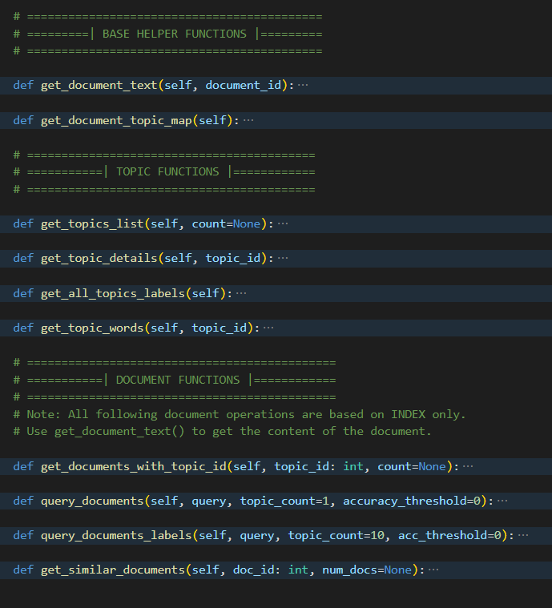

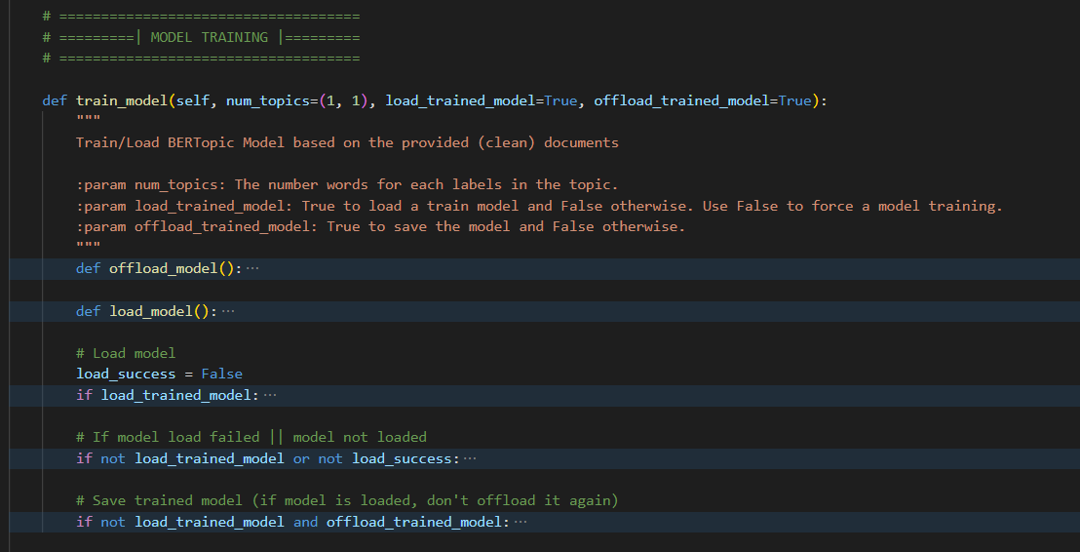
BERTopic
Models are trained with cuML's GPU acceleration of UMAP and HDBSCAN.
Trained BERTopmic model and its corresponding IDX_ID map can be saved and loaded locally.
Models can be trained by the user on their local machine based on their specified parameters in the global config file.

Slide 11
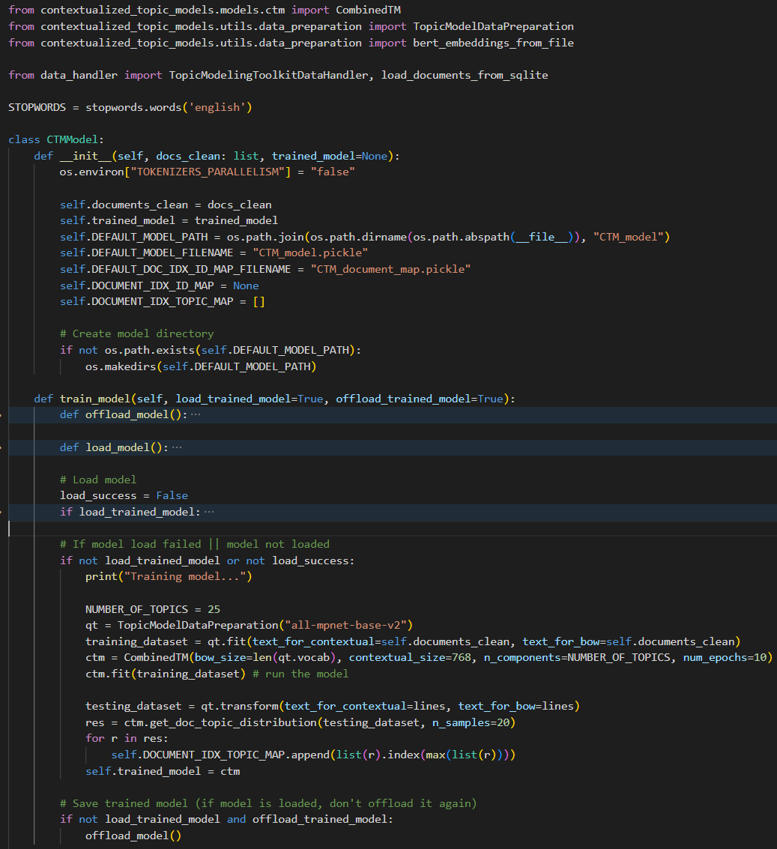
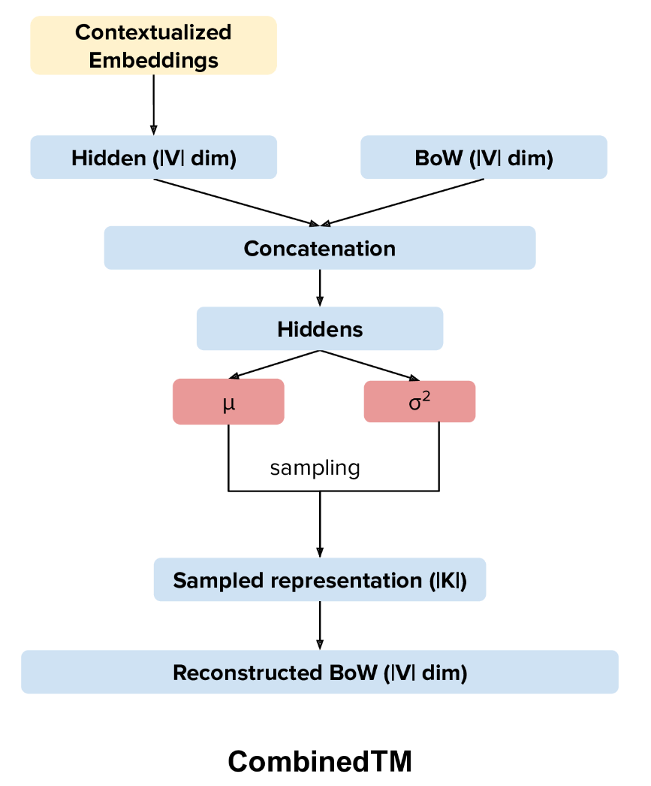
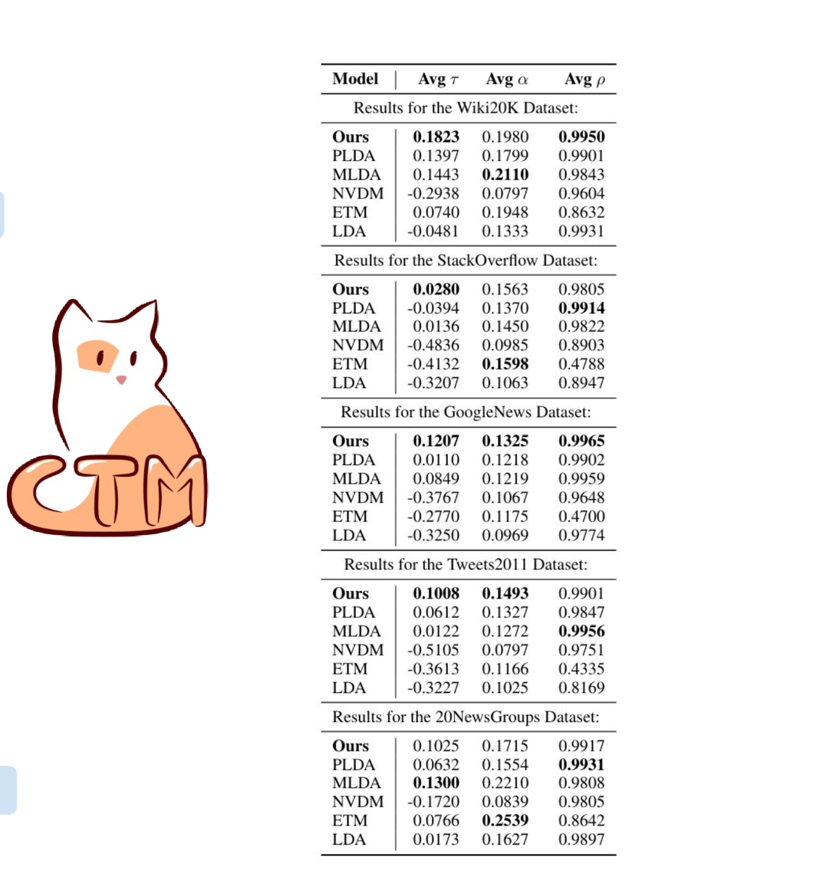
CTM - Contextualized Topic Model
Models are trained with CombinedTM in CTM (contextualized topic model).
Trained CTM model and its corresponding IDX_ID map can be saved and loaded locally.
Models can be trained by the user on their local machine based on their specified parameters in the global config file.

Slide 12
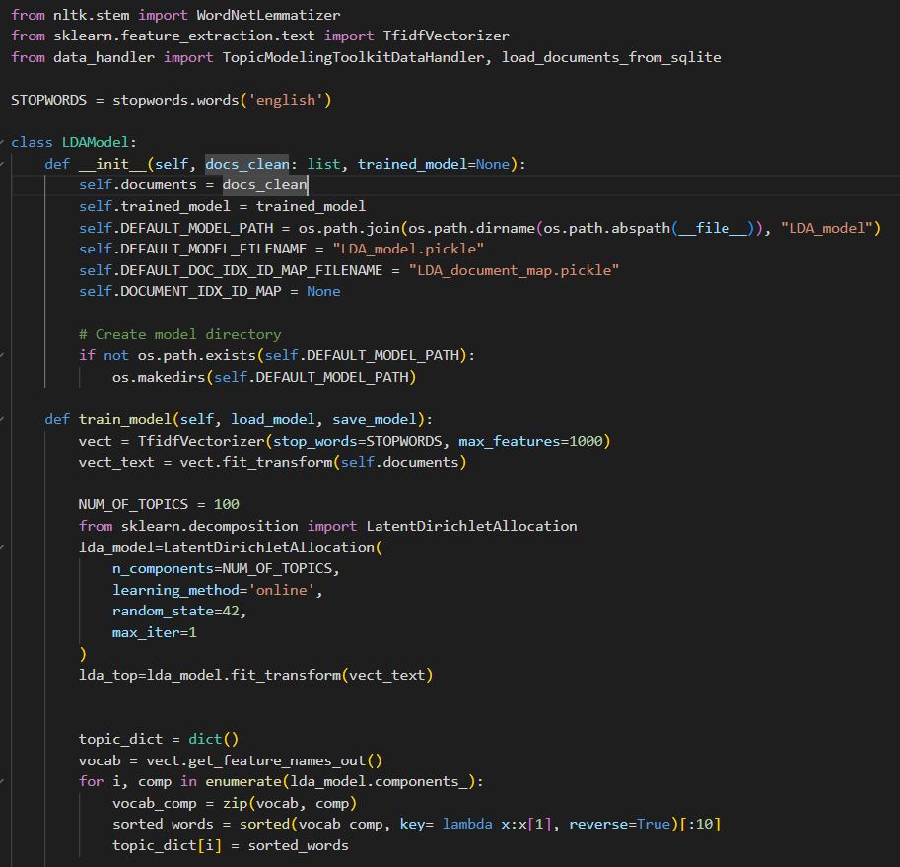
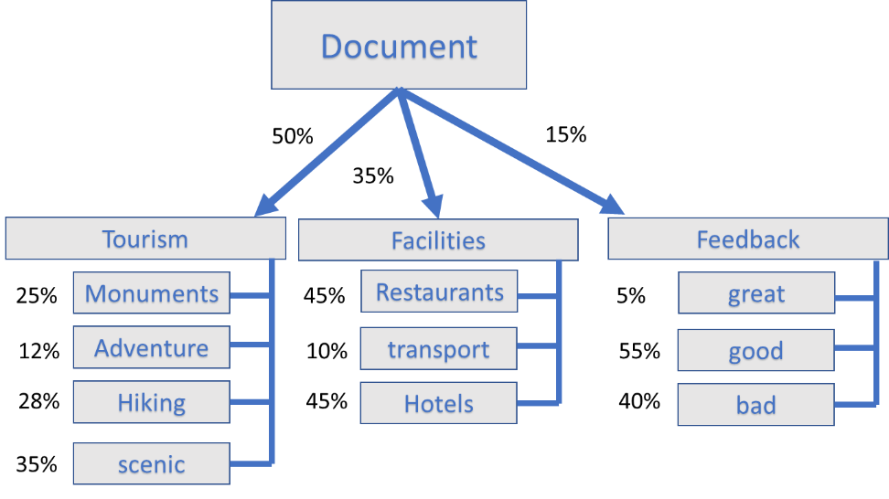
LDA - Latent Dirichlet Allocation
Models are trained with LDA (with inbuilt TF-IDF vectorizer).
Trained LDA model and its corresponding IDX_ID map can be saved and loaded locally.
Models can be trained by the user on their local machine based on their specified parameters in the global config file.

Slide 13
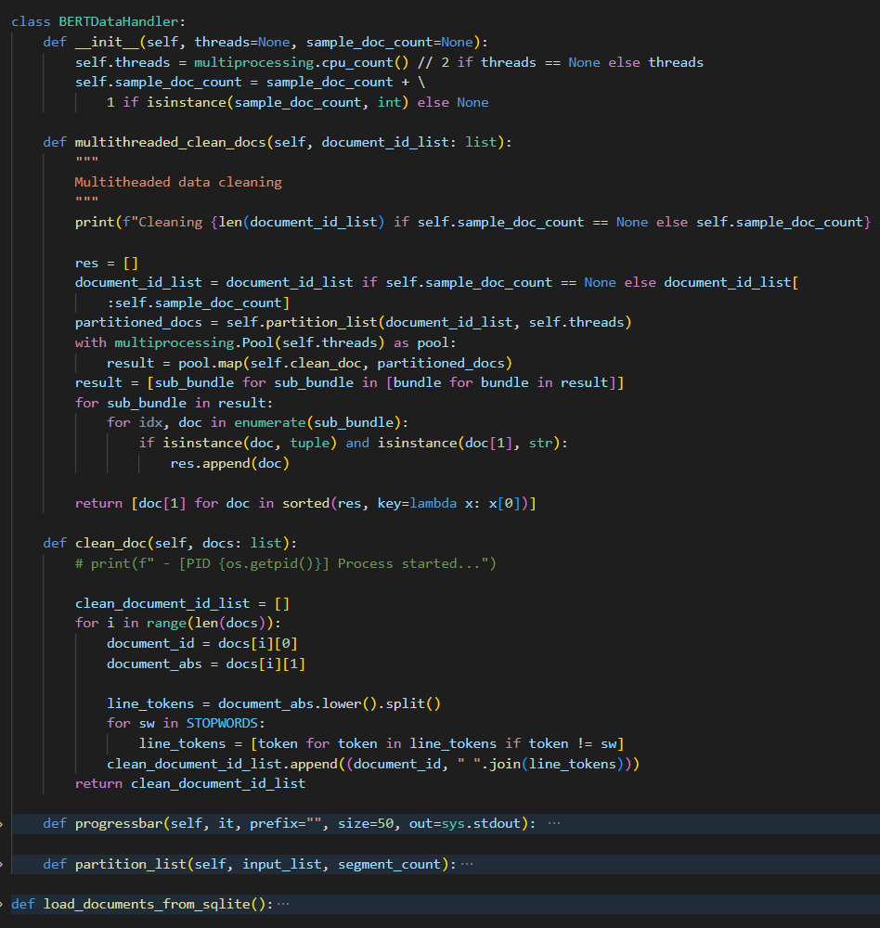
Data Cleaning
User uploaded dataset is cleaned using NLTK (Natural-Language Toolkit) and other criteria based on the configuration file.
The data cleaning threadpool spawns “CPU count // 2” threads by default.
A map between the document index and the document ID from the SQLite DB is generated during this process.

Slide 14
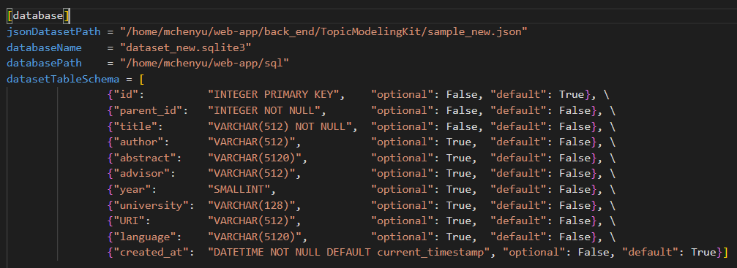

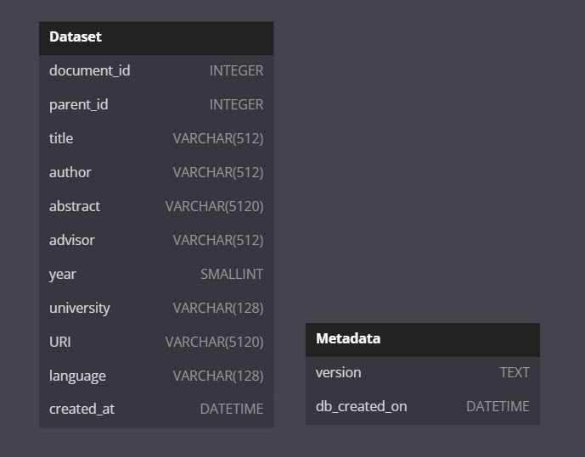
SQL Database
The toolkit relies on an SQLite database as its main data source for arranging and processing datasets.
The database schema is dynamically generated based on the user configuration and the user uploaded dataset.
[DB Configuration in config.ini]

Slide 15
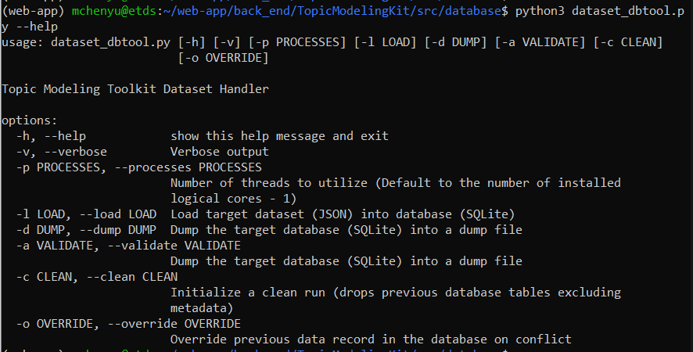
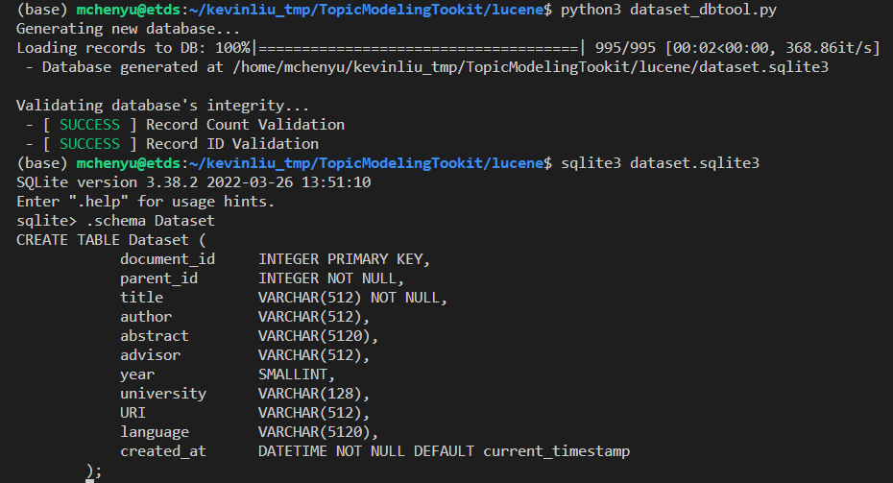
Data Handler
Python topic modeling data handler
  Converts user uploaded CSV to JSON.
  Converts datasets into a SQLite3 DB based on the global config (user defined).
  Automatically update the DB schema when the config has been modified.
  Offers utility functions to modify and validate the SQLite3 DB.

Slide 16
Testing
Database
  The SQLite3 DB was tested for inserting data with different data types and data formats (including all corner cases).
  The SQLite3 DB validation was tested based on validating correct and incorrect data format and data count.
Backend
  Encompass all conceivable edge cases, and the results of the tests are evaluated based on pass or fail criteria, as well as the accuracy of any actions performed during a machine learning model query.
Frontend
  Used API GET and POST queries to evaluate the request results for correctness and efficiency.
  Tested to display various types of datasets, including datasets with missing required values.

Slide 17
Lessons Learned
Problem: Quality of the ETD data
Solution: Validate and clean the data
Problem: Topic model performance
Solution: Use model fine-tuning

Slide 18
Future Work
Implementation of additional machine learning models
Evaluation of different machine learning models
Integration with additional data sources
User interface improvements
Integration with additional search engines
Optimization for scalability and performance
Testing
  Implementation of Continuous Integration/Continuous Deployment (CI/CD) tests

Slide 19
Acknowledgement
Instructor: Dr. Edward Fox
Client: Aman Ahuja
Student Volunteer: Chenyu Mao
Previous work completed by students in the CS 5604

Slide 20
References
https://canvas.vt.edu/courses/165469/pages/2023sproject-topicmodelingtoolkit
https://maartengr.github.io/BERTopic/index.html
https://github.com/allenai/scibert
http://hdl.handle.net/10919/109986
https://lucene.apache.org/core/9_1_0/index.html
https://reactjs.org/docs/getting-started.html
https://tailwindcss.com/docs/installation
https://reactrouter.com/en/main/router-components/browser-router

