Slide 1
The Mayfair Project
Cristhian Benitez | Connor Cason | Lee Chea | Owen Pilewski | Peter Wang | Carl Yao
CS 4624 Multimedia, Hypertext, and Information Access
Department of Computer Science, Virginia Tech
Dr. Edward A Fox
Blacksburg, VA 24061
Tuesday, April 30 2019

Slide 2
Outline
Project Recap
Demos
Current Progress
Meetings
VTURCS
Final touches
After we are done
Acknowledgement

Slide 3
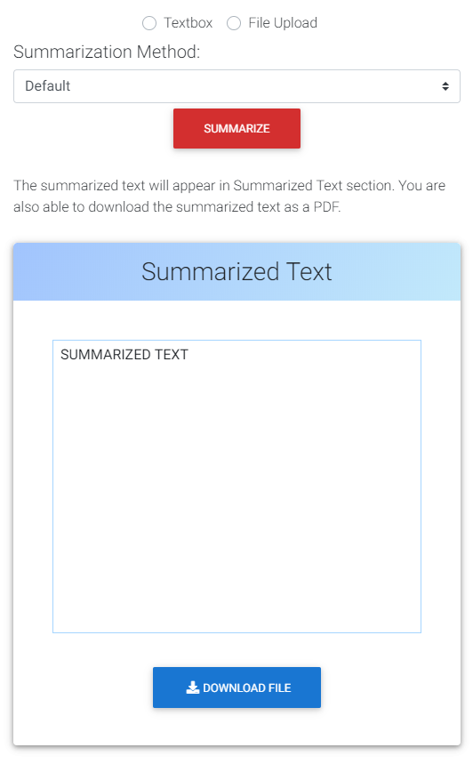
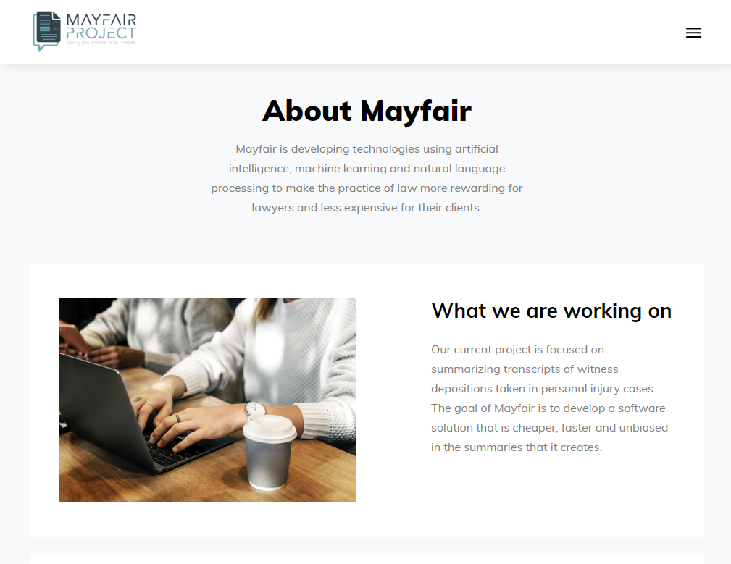
Project Recap
✅ Main Mayfair site (final touches)
✅ Esumy finished
✅ Betterdep progress

Slide 4

Mayfair Home Page(H)

Slide 5
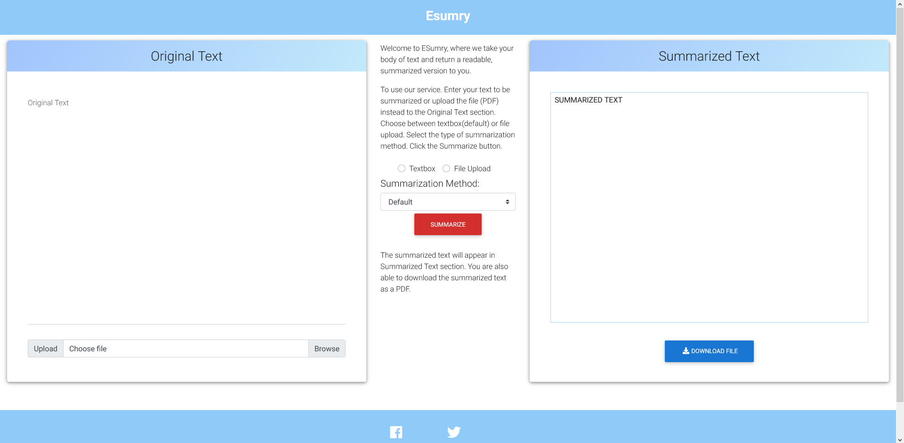
Esumry

Slide 6
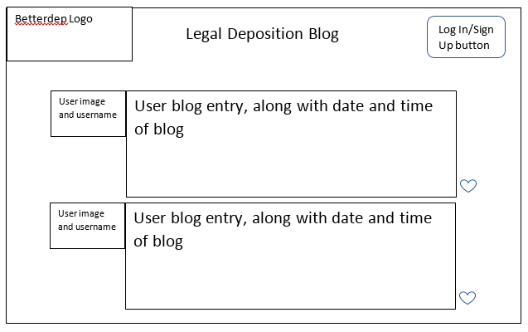
Current Progress - Betterdep
Last major piece is Betterdep
Blogging Website for sharing
legal deposition strategies
Implementation started, no
demo yet

Slide 7
Demonstrations/Meetings
Since the last presentation we’ve had 2 important meetings
Meeting 1 - April 12th
  Senior Mayfair executives and employees were present
  Included Susan & James Chapman
Meeting 2 - April 27th
  Madhan Subhas - Alumnus from CS@VT
  Volunteer advisor for Mayfair

Slide 8
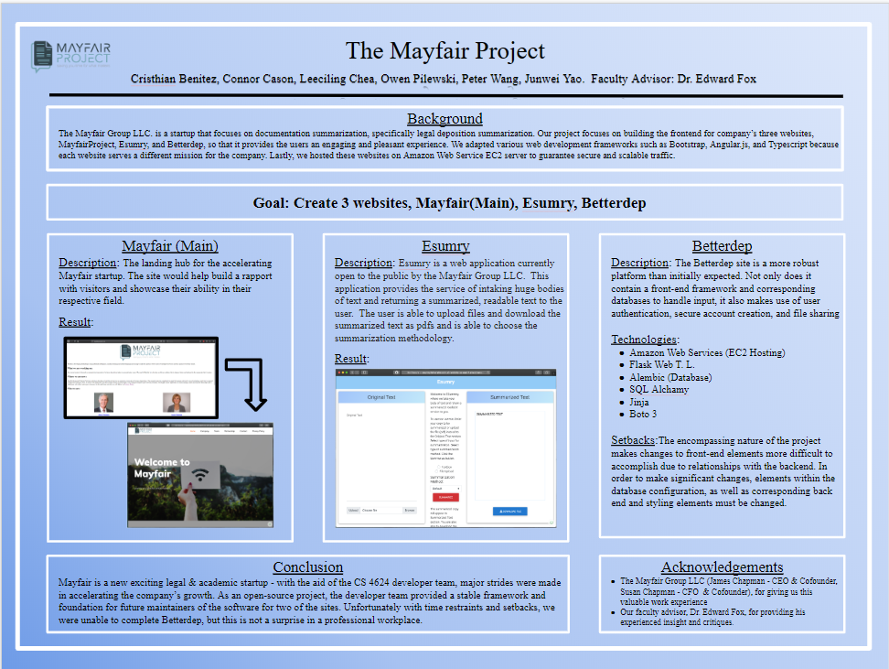
VTURCS
Give background on project
Show demos of websites on laptop and smartphone
Receive feedback on improvements to design or functionality.

Slide 9
Final Touches
EC2 instance for each of the following (Hosted them on AWS and tested usability):
  betterdep.com
  mayfairproject.com
  esumry.com
  files.mayfairproject.com
Link together sites for a cohesive final product
Transitioning to the new team
  Will be taking over once the semester ends
Notes:
Carl

Slide 10
After we are done
The Mayfair company will continue to grow and we want future teams to build on the progress we have made
In addition to the websites, social media such as Facebook, Twitter, and LinkedIn can be improved
A new team will be taking over once the semester ends
  Feedback gathered has been added to our report
  Mayfair (Main)
    Improved Analytics
    More dynamic features (Proper EC2 Support)
    Refined integration of of the other two sites within
  Esumry
    Multiple File Uploads
    Drag & drop features
    Better use of summarization API
    Improved Security options

Slide 11
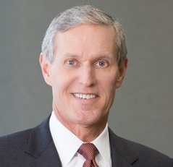
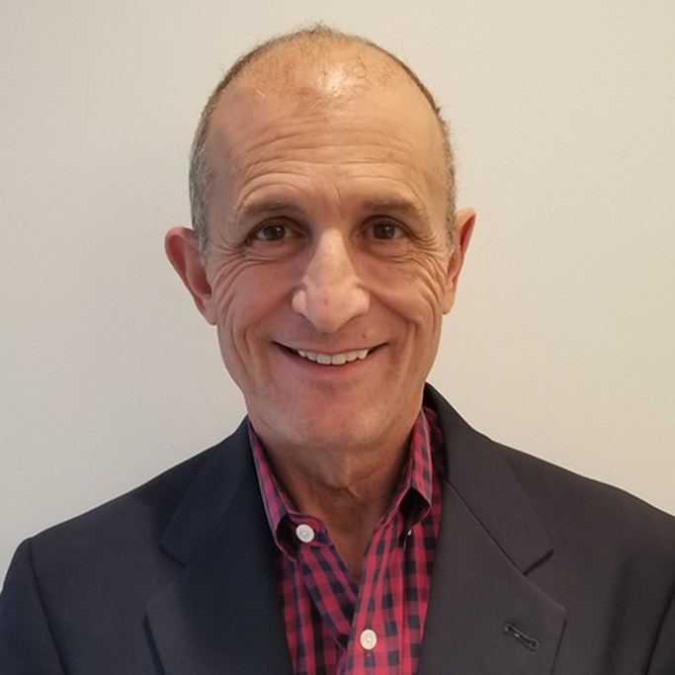
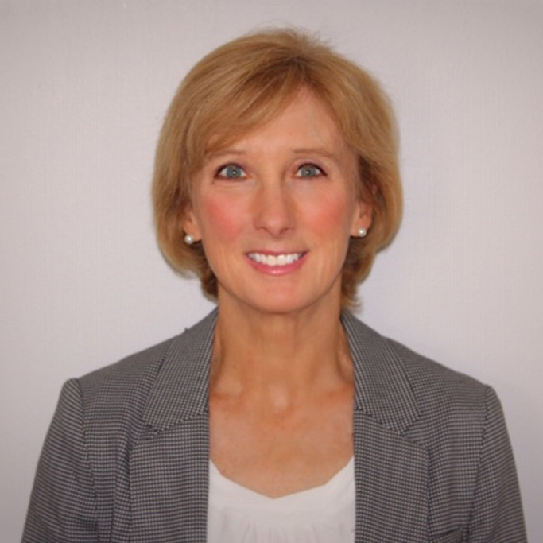
Acknowledgement
Susan Chapman and James Chapman
  CEO/FOUNDER/LAWYER - CFO/FOUNDER/ADMINISTRATOR
Madhan Subhas
  ADVISORY COUNCIL for CS@VT, MAYFAIR ADVISOR
Adithya Upadhya
  VT MASTER STUDENT, ETD summarization
Dave Klein
  ADVISOR/COACH/ENTREPRENEUR
Dr. Edward Fox

