Slide 1

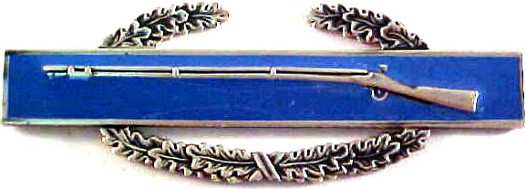

From “The Veteran Problem” to people with problems: The American WWII Veteran
Agenda
“The Veteran Problem”
  Propositions
An image of “The Veteran Problem”
Initial findings
Todd McDonald
(toddm19@vt.edu)
Public Administration and Policy
Ph.D. student at Virginia Tech

Slide 2
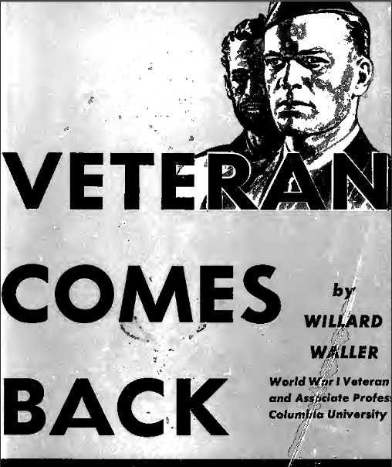
Willard Waller’s (1944) The Veteran Comes Back
  “The veteran is, and always has been a problematic element in society, an unfortunate, misused, and pitiable man, and, like others whom society has mistreated, a threat to existing institutions” (p. 13).
NBC’s “Words At War” (1944)
“This time if we do not get what we want, if we don’t get what we’ve been promised, if we do not get what we deserve, you can kiss your democracy goodbye,”
“G.I Joe,” the American WWII veteran
Notes:
https://archive.org/details/WordsAtWar_995/1944-09-05NbcWordsAtWar63TheVeteranComesBack.mp3
Time (6 min. 36 sec.): starts “the veteran is a threat”

Slide 3
Research Question
How did people discussing veterans’ reintegration policy during the WWII era respond to Willard Waller’s account of veterans as a social problem?

Slide 4
Proposition 1: “The Veteran Problem” is Waller’s (1944) attempt to conceptualize and contemplate solutions to a set of circumstances that he believed would systematically occur among postwar societies when veterans’ particular needs were not met.
  Social constructionist academic tradition
    People’s perceptions of “social problems” emerge through social interactions and experiences (Loseke, 2017)
  Framing theory (van Hulst & Yanow, 2016)
    “What is going on here?” (van Hulst & Yanow, 2016)

Slide 5
Waller’s (1944) framing of “The Veteran Problem”
  Claim 1: institutionalization
    ``The proper term for what has happened to every soldier, and not just to the psychoneurotic, is perhaps not shell-shock but institutionalization.
    …some damage to their sense of self and to their power to think for themselves; it involves a redirection of their emotional life into channels acceptable to the military system… (p. 119)
  Claim 2: The military’s institutionalization creates undemocratic citizens
    “a core of anger in the soul of almost every veteran” (p. 109)
    Political preferences - “the veteran is dangerous to society” (p. 186)

Slide 6
Data & Initial Findings

Slide 7
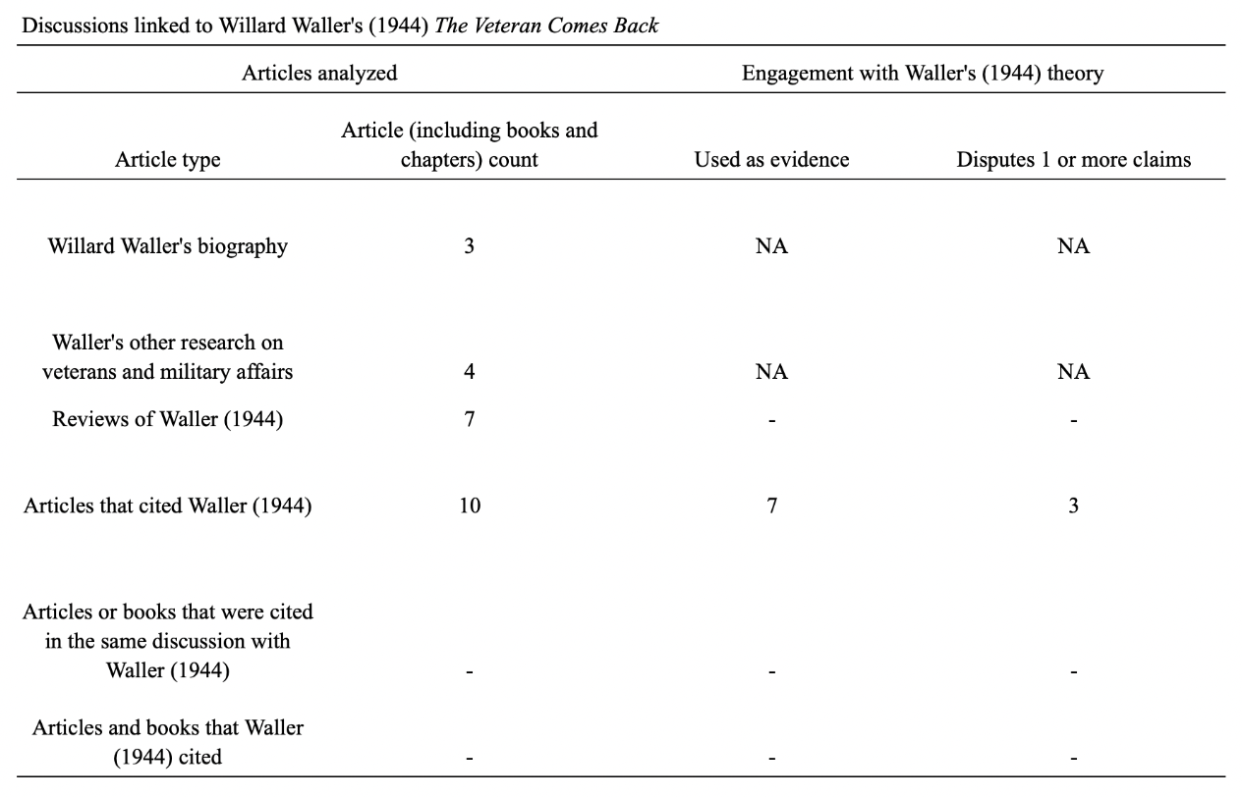

Slide 8
The positive reception
“Positive reception” - people who used Waller (1944) as evidence to discuss a social problem / issue that should be changed
Coding types of problems in each article (7 articles):
  Removing the military’s institutional structures and dependency
  Social change, family and gender roles, race relationships
  Emotional and mental instability, sometimes described with violent tendencies
  Economic subsistence and fulfillment
Keep in mind: scholars made vast generalizations about all veterans

Slide 9
Removing the military’s institutional structures and dependency
Hollinshead (1946, 439): “Adjustment to the military situation,' viewed as a social process in the life of the person, has three principal phases and several subphases. The three main phases may be delimited as the premilitary, the military, and the postmilitary”
  “In the military situation his physical needs and many of his personal desires were cared for by the government… [the soldier] did not need to do anything but serve to have these things [needs and wants] assured to him” (p. 446)
  Many veterans will be faced with the problem of developing a sense of social responsibility, for social responsibility is definitely negated, if not destroyed, in the military situation (p. 447)

Slide 10
Social change, family and gender roles, race relationships
Cameron (1945, p. 30): “A very large number of discharged veterans will return to a home which and… may feel that they have certainly not changed for the better in his absence…
  A serious difficulty arises when a woman, once satisfied with subordination and dependence, finds unexpected pleasure in her expanded sense of importance, her new-found independence, and her unchallenged suzerainty over the household and the children”
McDonagh (1946, p. 453): “Naturally, soldiers who have used their spare time as they desired and women who made decisions without consulting their mates find the sharing of authority a bit of a problem”

Slide 11
Emotional and mental instability, sometimes described with violent tendencies
Cameron (1945, p. 35): “The neglected veteran who is allowed to go on being socially maladjusted is in real danger of being recruited into the ranks of the neurotic or psychotic, the chronically malcontented or the outright antisocial.”
Zimmerman’s review (1944, p. 230): “I believe, based upon my own experiences in two wars… he [Waller] has the soldier's mentality correctly… People want wars, but they do not like to fight them and do not want to pay others for losses when they willingly or unwillingly brutalize themselves…
  “...[veterans] who are now discussing this thing [reintegration] in camps and barracks, organize and push through some large scale rehabilitation programs expeditiously, things may go along all right… this will involve considerable reorientation of the Veterans Administration. If not, then fear the veteran.”

Slide 12
Negative reception:
people who cited Waller (1944) but offered a counter theory or claim

Slide 13
Hakeem (1946): This study compares rates and types of crime between the U.S. civilian and veteran using government documents
  Will veterans’ “war ethics” re-emerge during times of peace? (p. 122)
    The author examine this proposition but does not assume that “war ethics” exist in the sense that Waller (1944) and others suggest
  Conclusion:
    “The point being made is not that military training, army life, and combat experience may not have some relationship to criminality…
    The point is that such a relationship has not been exactly formulated, demonstrated, and proved and that something other than logical assumptions and a priori reasoning will be needed to prove the existence of such a relationship” (p. 131)

Slide 14
Next steps
Code the number of problem representations in each article
  Categorize and quantify the problem and solution representations (frames)
  Discussion the relationships as general perceptions
    Evaluation in terms of democracy - people with problems (title)
Likely add documents
  Academics, War department administrators, and Congressional hearings
  Compare across institutional contexts

Slide 15
From “The Veteran Problem” to people with problems: The American WWII Veteran
Todd McDonald
(Toddm19@vt.edu)
Public Administration and Policy
Ph.D. student at Virginia Tech

Slide 16
Citations
Bonus March pictures:
Brulliard, N. (2018). The Forgotten March. National Parks Conservation Association. Retrieved August 26, 2022, from https://www.npca.org/articles/1915-the-forgotten-march
NBC’s “Words At War” presentation of Waller (1944):
NBC Words at War 63 The Veteran Comes Back (1944). Internet Archive. Retrieved from https://archive.org/details/WordsAtWar_995/1944-09-05NbcWordsAtWar63TheVeteranComesBack.mp3
My data examined in this presentation (still in development):
Hollingshead, A. B. (1946). Adjustment to military life. American Journal of Sociology, 51(5), 439-447.
Cameron, N. (1945). The Socially Maladjusted Veteran. The ANNALS of the American Academy of Political and Social Science, 239(1), 29-37.
McDonagh, E. C. (1946). The discharged serviceman and his family. American Journal of Sociology, 51(5), 451-454.
Zimmerman, C. C. (1944). [Review of The Veteran Comes Back., by W. Waller]. American Journal of Sociology, 50(3), 229–230. http://www.jstor.org/stable/2771021
Crespi, L. P., & Shapleigh, G. S. (1946). “THE” VETERAN—A MYTH. Public Opinion Quarterly, 10(3), 361-372.
Hakeem, M. (1946). Service in the armed forces and criminality. J. Crim. L. & Criminology, 37, 120.
Chicago

Slide 17
Citations
Secondary literature:
Aristotle (2007). Chapter X Aristotle: Justice and Virtue. In Sandel, M. J. (Ed.), Justice: A reader (pp. 264-300). Oxford University Press on Demand.
Ford, N.G., Mettler, S (2012). 5 “put fighting blood in your business”: The U.S. War Department and the reemployment of World War I Soldiers. In S.R. Ortiz (Ed.), Veterans’ policies, veterans’ politics: New Perspectives on veterans in the modern United States (pp. 119-145).
Katznelson, Ira, and Suzanne Mettler. "On race and policy history: A dialogue about the GI Bill." Perspectives on politics 6, no. 3 (2008): 519-537.
Mettler, S. (2012). Veterans' Policies, Veterans' Politics: New Perspectives on Veterans in the Modern United States. Gainesville: University Press of Florida.
Mettler, Suzanne. (2005). Soldiers to citizens: The GI Bill and the making of the greatest generation. Oxford University Press on Demand.
Mettler, Suzanne. "Bringing the state back in to civic engagement: Policy feedback effects of the GI Bill for World War II veterans." American Political Science Review 96, no. 2 (2002): 351-365.

Slide 18
Mettler, Suzanne. "The creation of the GI Bill of Rights of 1944: Melding social and participatory citizenship ideals." Journal of Policy History 17, no. 4 (2005): 345-374.
Ortiz, S.R., and Mettler, S. (2012). 7 Rethinking the Bonus March: Federal Bonus Policy, Veteran Organizations, and the Origins of a Protest Movement. In S.R. Ortiz (Ed.), Veterans' Policies, Veterans' Politics: New Perspectives on Veterans in the Modern United States (pp. 173-198).
Severo, R., & Milford, L. (2016). The Wages of War: When America's Soldiers Came Home: From Valley Forge to Vietnam. Open Road Media.
Waller, W. (1944). The veteran comes back. New York: Dryden.

Slide 20
The appendix
What can I find here?
  I have numbered each slide and provided some details to indicated what it is about below
  (slide 1) additional examines of “The Veteran Problem” in academic papers that cited Waller (1944)
  (slide 2-5) War department documents I might use
  (slide 7) A graph of academic papers that use the terms “veteran” and “unemployment” in Jstor and measures of national unemployment and people serving in the military
  (slide 8) contribution to knowledge
  (slides 9 & 19) dropped - not enough time
This information may or may not be part of my future research.

Slide 21
(Slide 1) Removing the military’s institutional structures and dependency
Hill (1945, p. 33): “There is good reason to suppose that many returning fathers are going to need fully as much help as mental patients in returning to family and community living… There is a period of emotional intoxication with the new-found freedom in the man's first few weeks at home, but later he is plagued with anxieties…”
Emotional and mental instability, sometimes described with violent tendencies
Here are excerpts from the same point in Cameron’s (1945) argument
“Acquiring social maturity in military service means just what it does in civilian life-the organization of one's social personality in accordance with the demands of the prevailing cultural pattern, so that one becomes a useful member of his society…
  The soldier is trained to act directly with appropriate vigor. He becomes a stranger to the arts of compromise, argument, and persuasion. When the newly discharged veteran blows off steam in a soldier's way, he is likely to be misunderstood by civilians…
He has lived according to the rules of an almost exclusively masculine society. He must now become adept again at regulating his conduct in terms of a society filled with older and weaker men, with women and children… (pp. 33-34)

Slide 22
Administrative documents (1 of 3)
(Slide 2)
  The National Resource Planning Board (1934-1943)
  Requested the Secretary of War, Henry Stimson, to start planning in October 23, 1942 (Sparrow, 1952, p. 29)
Post-War Agenda (1942)
Demobilization and Readjustment (1943): “the first draft blueprint in the federal government’s plan for demobilization and reconversion of civilian and military personnel” (Sparrow, 1952, p. 28).
The Office of War Mobilization, the NRPB’s successor
Report on War and Post War Adjustment Policies (1944)
The Office of War Mobilization and Reconversion (1944)
  Directed by James F. Byrnes

Slide 23
Administrative documents (2 of 3)
(slide 3)
The War Department’s prior planning
  The Army Chief of Staff, George Marshall, had recalled Brig. Gen. John MaC. Palmer to the military to serve as an advisor
    Knowledge of “politico-military institutions” and “peace establishment” (Sparrow, 1952, p. 30)
  The Special Services Division, Services Supply (later Army Service Forces)
    Commanded by Lt. Gen. Brehon Somervell (p. 32)
Outline of Proposed Demobilization Plan (1943)
Demobilization as a Current Problem (1943)

Slide 24
Administrative documents (3 of 3)
( Slide 4) Army Service Division continued
  Somervell appointed Maj. Gen. George Grunert to study demobilization (1943)
    The Project Planning Division is created at Grunert’s request
      Gen. W.F. Tompkins is appointed director
      The organization established guiding principles
Survey of Demobilization Planning (1943)
  Sent to the Sec. of War; he was pleased with its insights (p. 34)
Sec of War, Stimson
  All contact with other gov agencies be done through his office
  Consolidated the Army Air Forces training and Project Planning Division
    Report to the Under Secretary of War but still under the Army Service D.

Slide 25
War Department documents
(slide 5) National Resource Planning Board (1934-43)
Post-War Agenda (1942)
Demobilization and Readjustment (1943)
The War Department
  The Special Services Division, Services Supply (later Army Service Forces)
Outline of Proposed Demobilization Plan (1943)
Demobilization as a Current Problem (1943)
The Project Planning Division
Survey of Demobilization Planning (1943)
Report on War and Post War Adjustment Policies (1944)

Slide 26
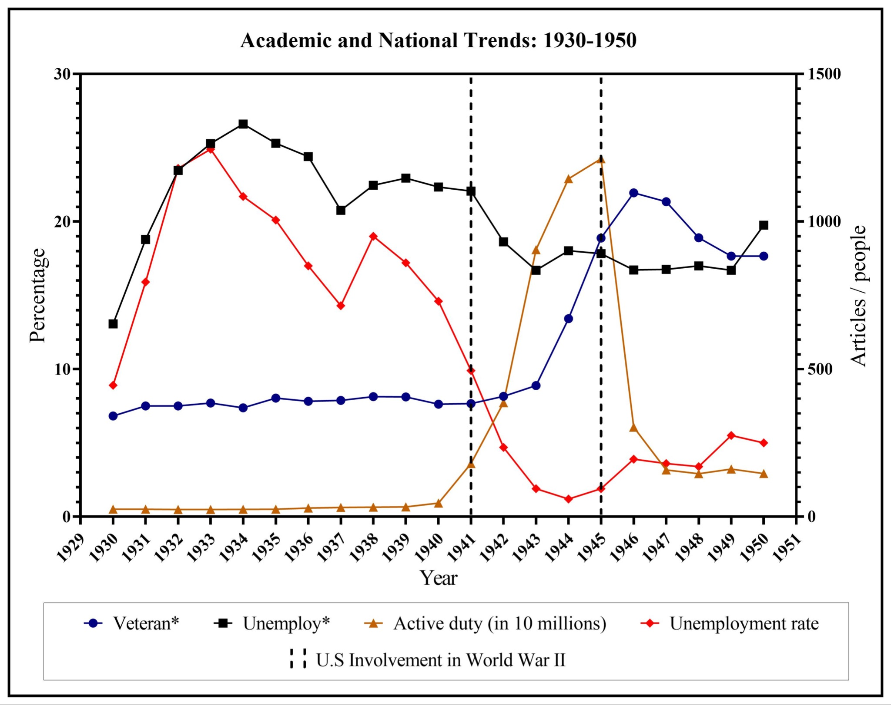
(Slide 7)

Slide 27
Case studies: 3 different bodies of discourse in the 1940s
  (slide 8) Discussions among…
    Academics
      Academic papers that cited Waller (1944)
      Academic papers that did not cite Waller (1944) but were cited as having a similar argument
      The sources that Waller (1944) cited
    War Department administrators and the U.S. Army’s demobilization
      Documents from the NRPB (1942)
      Army Service Forces
      The Project Planning Division (1944)
    Congressional officials
      The Servicemen’s readjustment Act of 1944
      The Full Employment Bill of 1945

Slide 28
(slide 9) Proposition 2: ``The Veteran Problem,'' in the sense that military veterans pose a disproportionate threat to public safety and U.S. democracy, was an issue that other policy experts were discussing prior to and during the WWII era.

Slide 29
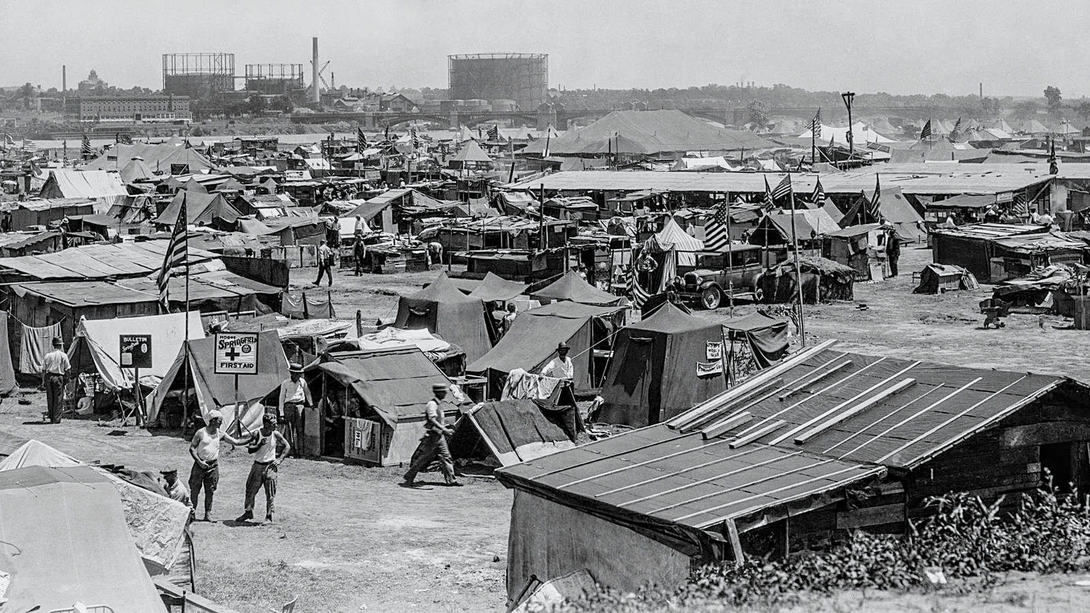
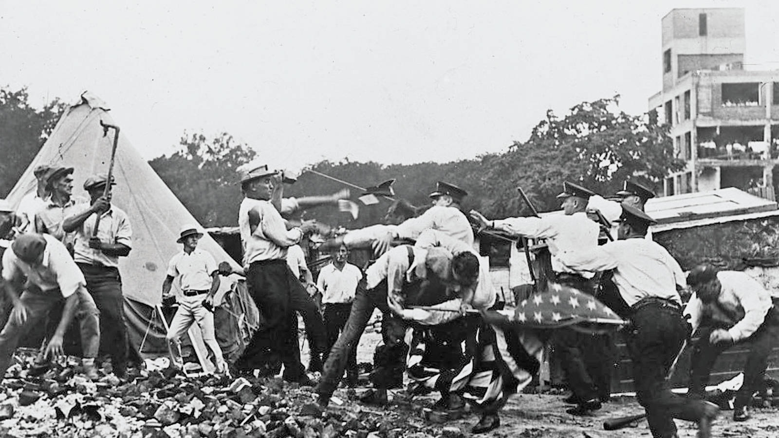
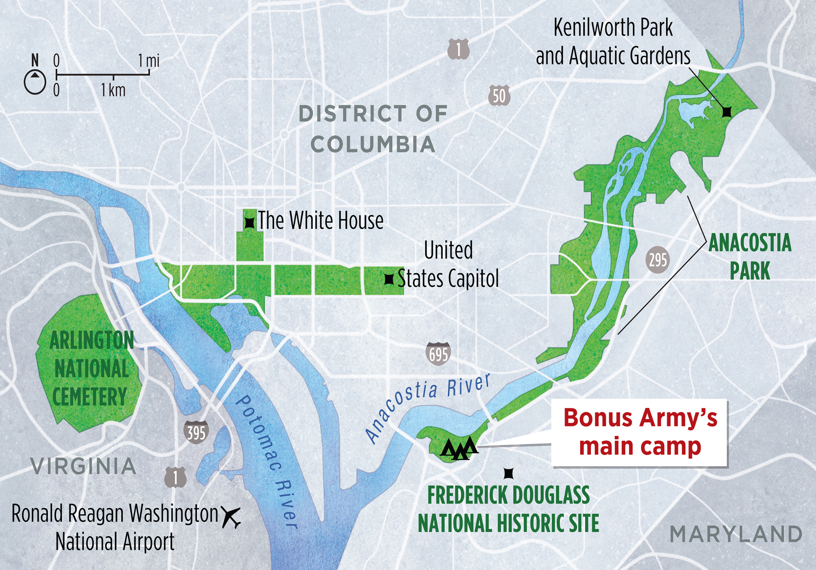
The Bonus March (1932),
An Image of “The Veteran Problem”
Brulliard, N. (2018). The Forgotten March. National Parks Conservation Association. Retrieved August 26, 2022, from https://www.npca.org/articles/1915-the-forgotten-march

