Slide 1
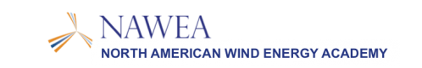


An Analytical Procedure for Evaluating Aerodynamics of Wind Turbines in Yawed Flow
2015 Symposium
June 9-11, 2015
Blacksburg, Virginia
By:
Dr. R. Ganesh Rajagopalan
Kanchan Guntupalli
Mathew V. Fischels
Luke A. Novak

Slide 2
Yawed Flow Aerodynamics
Turbines are subjected to changing wind directions leading to yaw error and reduced power output
Zero yaw in free stream, yet turbines in middle of farm see yawed flow
Analytical prediction based on yaw error is helpful for onboard computations.

Slide 3
Analytical Formulation

Slide 4
Analytical Formulation
Based on momentum theory
Cp = f(γ, v)
  where;
  Cp = Coefficient of power for Horizontal Axis Wind Turbine (HAWT)
  γ = Yaw error angle
  v = deficit velocity at rotor disk
4

Slide 5

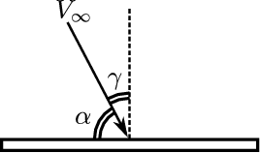


Analytical Formulation
Yaw error angle and Tip-path-plane angle:
Inflow ratio:
Advance ratio:
where:
γ = Yaw error angle
V∞ = Free stream velocity
α = angle between rotor plane and horizontal: Tip-path-plane (TPP) angle
Ω = rotor angular velocity
R = rotor radius
v = induced velocity on the rotor plane

Slide 6





Analytical Formulation
Power Coefficient:
Thrust Coefficient:
Relation between k_{P} and k_{T}:
Note:
k_{P} and k_{T} are simply manipulations of generally accepted definitions of C_{P} and C_{T}, where;

Slide 7


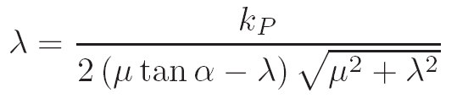
Analytical Formulation
By momentum conservation in rotor normal direction:
Non-dimensionalizing T:
Replacing k_{T} with k_{P} using:
Re-arrange above Eq. in a form solvable by Newton-Raphson’s iterative solution technique
7

Slide 8

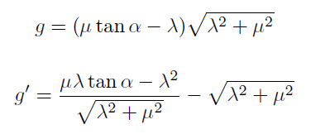
Analytical Formulation
k_{P} – Inflow Equation
where:
Solve using Newton-Raphson’s iterative solution technique
Therefore, k_{P} = f(λ, α) = f(inflow, yaw-error)
8

Slide 9
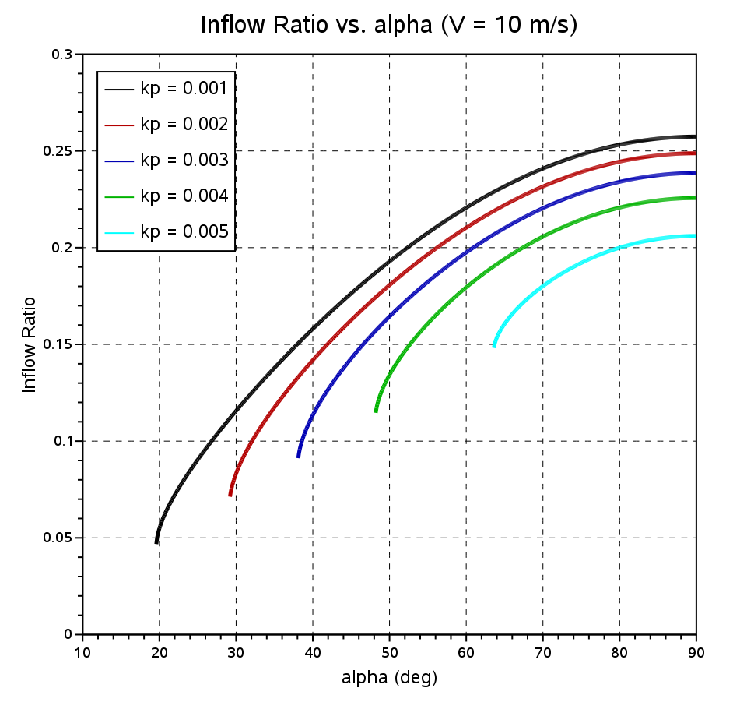
Analytical Formulation
Solution of k_{P} – Inflow equation
for V∞ = 10 m/s
9

Slide 10
Numerical Method

Slide 11
Rot3DC
Structured finite volume solver with turbine treated as momentum sources.
Solves 3D, unsteady, incompressible RANS Navier-Stokes equations
Rotor momentum source depends on:
- local flow properties
- turbine rotor geometry
- 2D aerodynamic characteristics of blade cross-section

Slide 12
Rot3DC Validation
NREL Combined Experiment

Slide 13
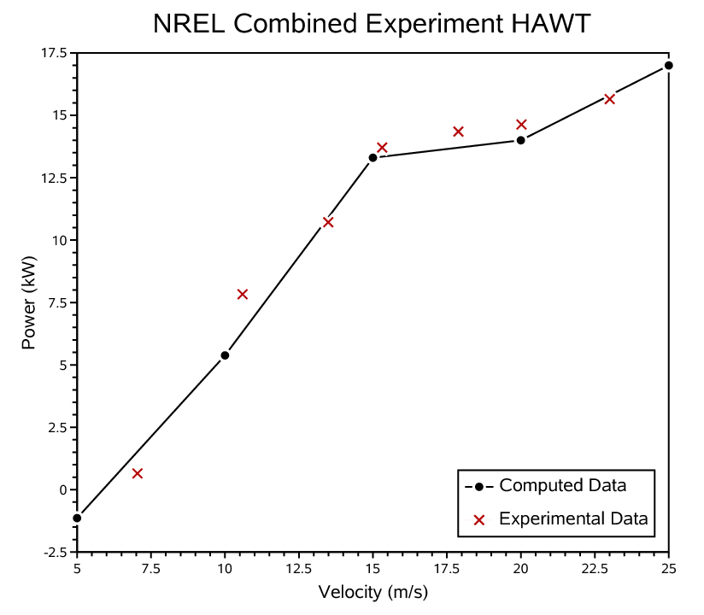
NREL Combined Experiment : Power Comparison
Power vs. Windspeed

Slide 14
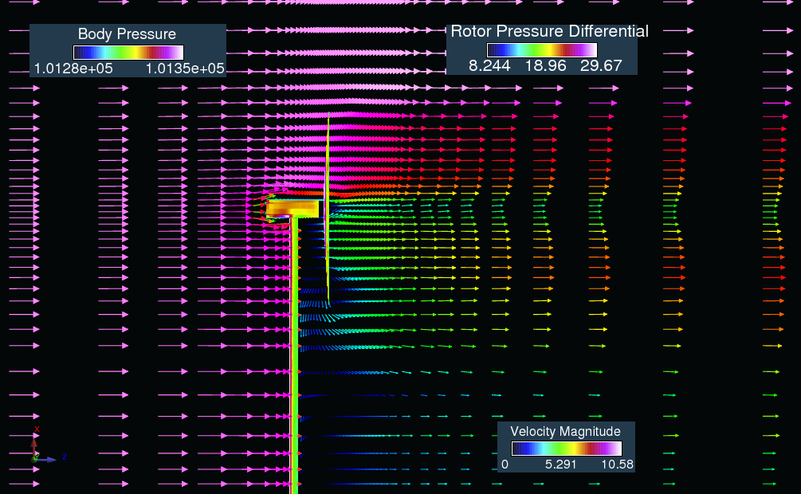
NREL Combined Experiment : Flow Solution
Y-plane through rotor center
V∞ = 10 m/s

Slide 15
NREL Isolated Rotor: Yaw Study
NREL rotor without tower and nacelle, in upwind position
Free stream at angles of [-40⁰, 40⁰]
Relation between Yaw and TPP angle:
γ = 90⁰ - α

Slide 16
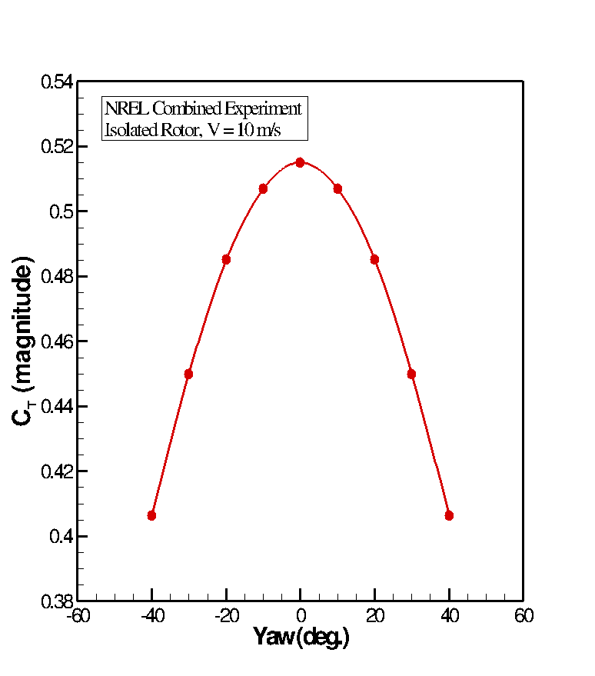
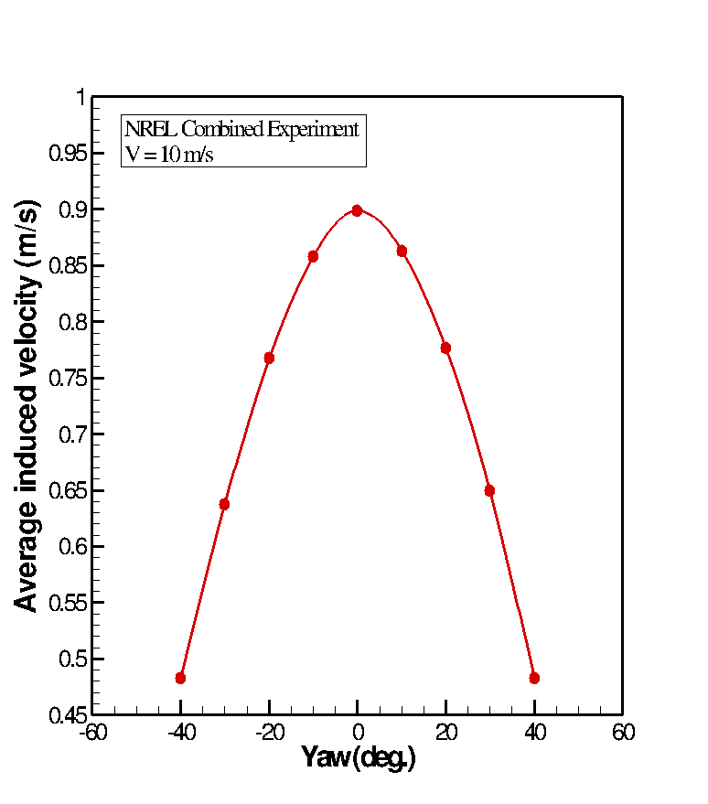
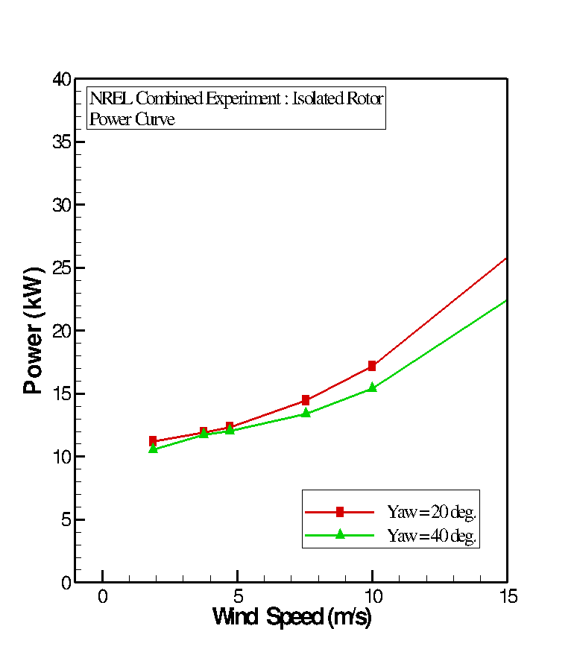
NREL Isolated Rotor:
Yawed Free Stream (V∞ = 10 m/s)
Average induced velocity
vs. yaw angle
C_{T} vs. yaw angle
Power vs. Wind-speed
Note: Rot3DC calculated solution

Slide 17
Analytical Method and Rot3DC Correlations

Slide 18
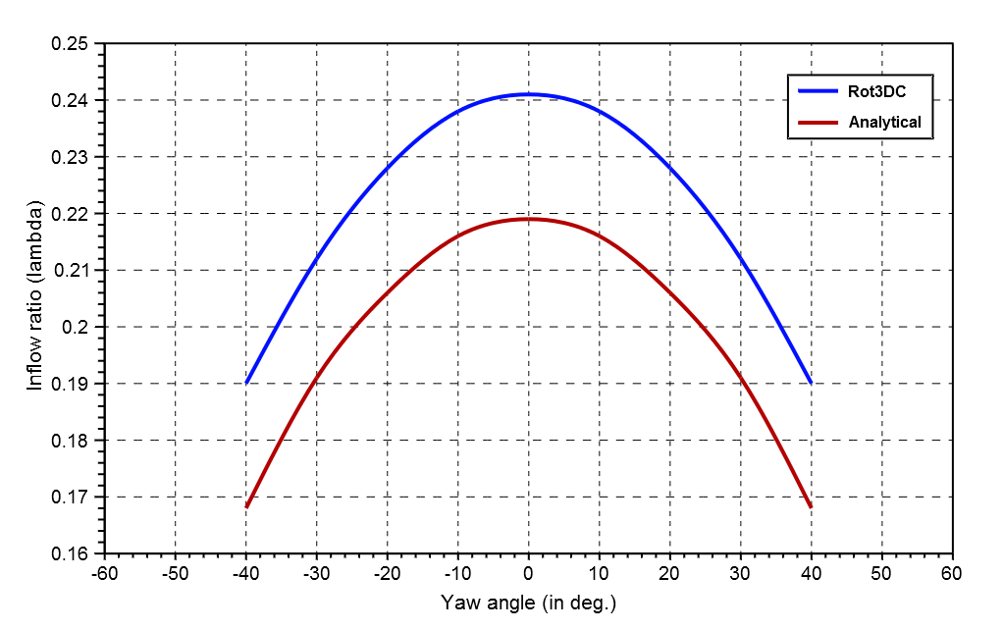
Correlations:
Comparison of Inflow Ratio (V∞ = 10 m/s)
Inflow Ratio (λ) vs. Yaw Angle

Slide 19
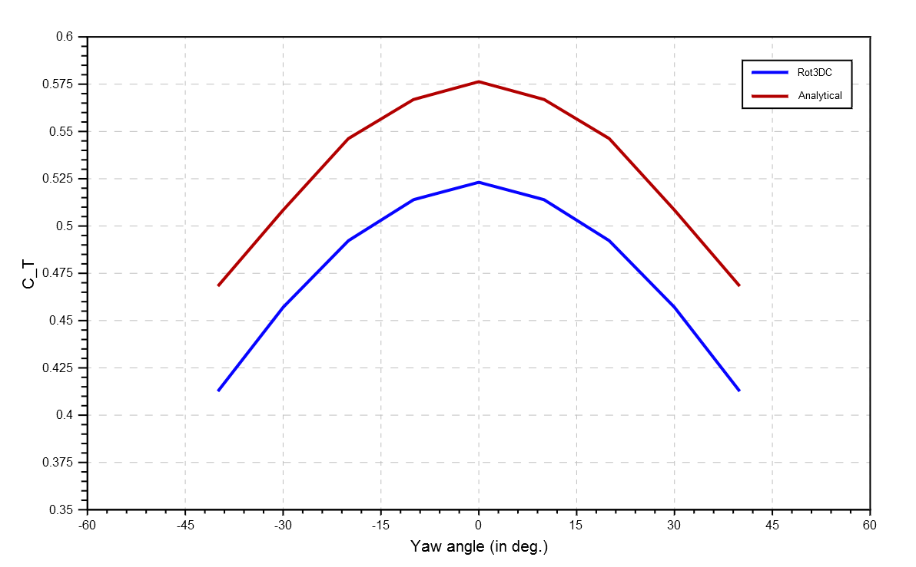
Correlations:
Comparison of C_{T} (V∞ = 10 m/s)
Coefficient of Thrust vs. Yaw Angle

Slide 20
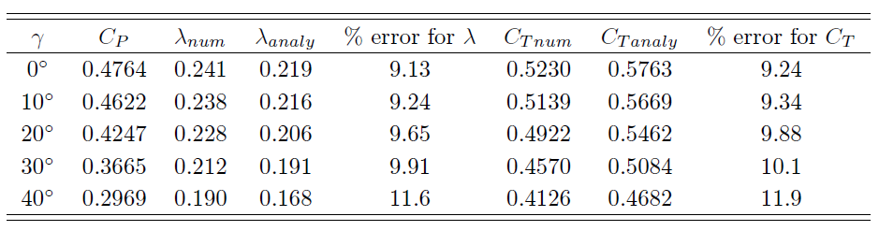
Correlations:
Yawed Free stream (V∞ = 10 m/s)
Comparison between Analytical Solution and Rot3DC
Note: α = 90⁰ - γ

Slide 21
Conclusions
Simple analytical solution procedure for evaluating wind turbine performance in yawed flow
Analytical solution within 10% error margin of computational fluid dynamics (Rot3DC) simulations
CFD results compare well with experiments and adequately predict turbine performance under conditions of yaw
Simplicity of the developed analytical expression can be exploited to provide input to onboard yaw control feedback systems

Slide 22
Questions ?
Thank You!

