Slide 1

Center for Wind Energy
James Madison University
Engaging a Multidisciplinary Group of Students in Wind Energy Education through the Planning and Execution of a KidWind Challenge at James Madison University
Remy Pangle¹, Kyle Gipson, PhD²,
Jonathan Miles, PhD^{1,3}, Grace Mauro⁴, & April See⁴
¹ Center for Wind Energy at James Madison University
² College of Integrated Science & Engineering; Engineering Department
³ College of Integrated Science & Engineering; Integrated Science & Technology Department
⁴ School of Hospitality, Sport and Recreation Management; Hospitality Management Program
For: North American Wind Energy Academy 2015 Symposium
Virginia Tech - Blacksburg, Virginia, June 10, 2015
4A: Panel Session: Workforce Development & Education
Notes:
Kyle

Slide 2
James Madison University
A public regional university located in Harrisonburg, VA
~20,000 students across all academic programs with ~1,700 enrolled within a graduate program
Notes:
Kyle

Slide 3
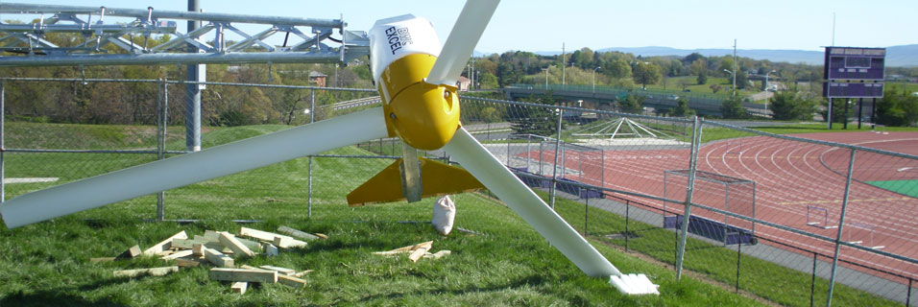
Center for Wind Energy
Located at James Madison University
Focuses on research, education & outreach pertaining to wind, solar and energy efficiency
Serves the entire Commonwealth of Virginia and engages stakeholders at local, state, regional & national levels
Notes:
Kyle

Slide 4
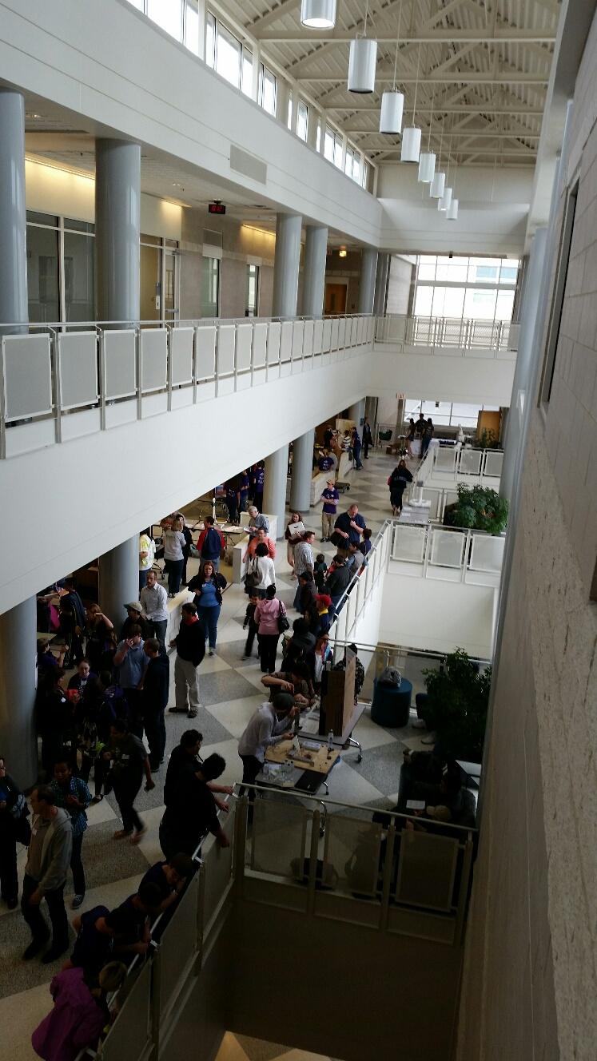
CrEATE a KidWind Challenge Event Course
Collaborative Educational Activities that are focused on Technology for renewable Energy
A course constructed to be an educational experience for students and faculty from multiple disciplines in teams to design, prototype, implement, manage and execute age appropriate educational activities for K-12 students during the East Coast Regional KidWind Challenge Event
Notes:
Kyle

Slide 5
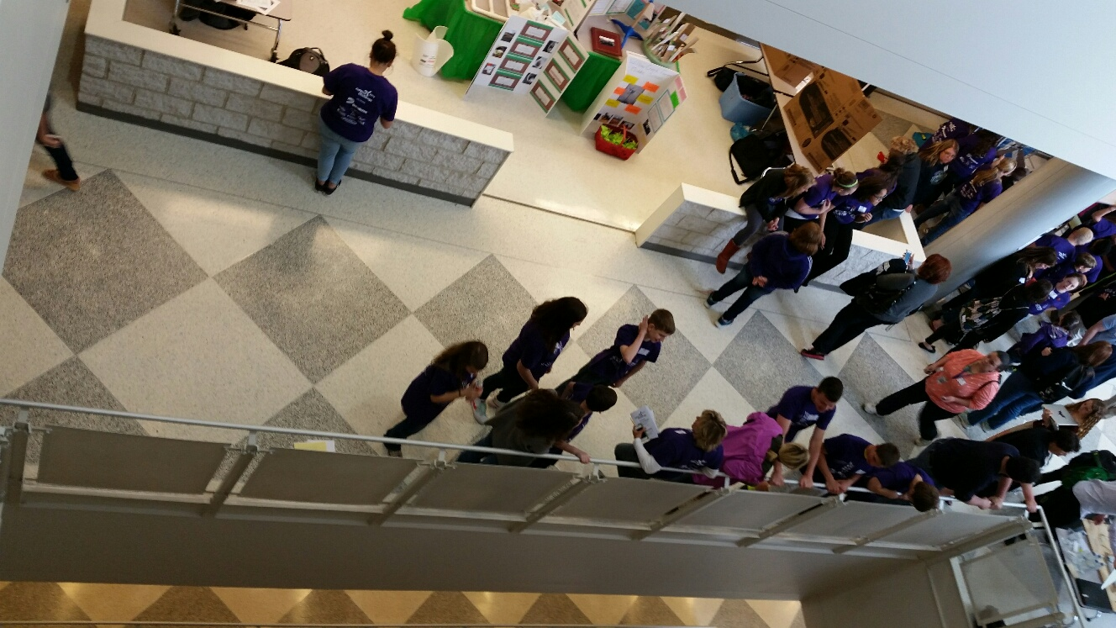
Avenue to gain understand about a structure of an enterprise
Opportunities to discover broader applications of the disciplines through the renewable energy platform
An endeavor that fosters an enhanced sense of civic responsibility
Motivation
Notes:
Kyle

Slide 6
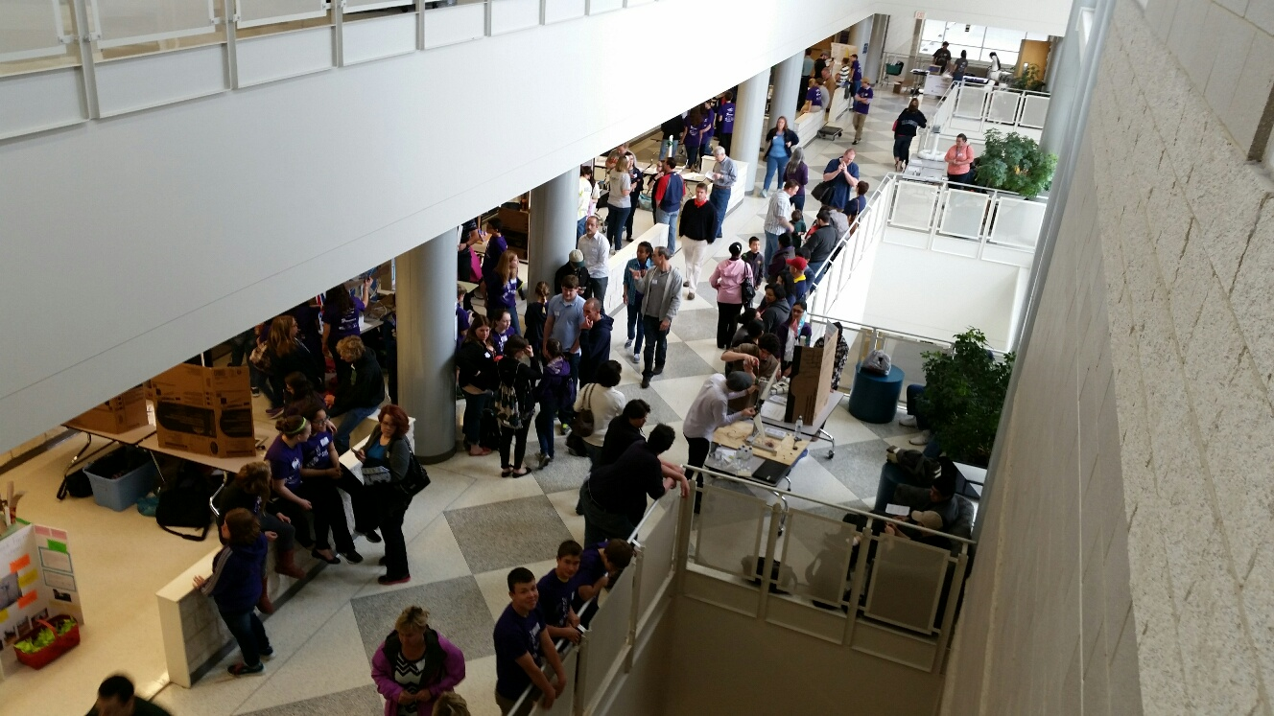
Project funded
Course - 4VA JMU
Challenge - Dominion Virginia Power
CISE level course
Disciplines sought/participated
  Education, Psychology, Hospitality, Engineering, ISAT
Project based learning, experiential learning
  10 big questions from KWC rule book
  Mock KidWind Challenge
Non-profit business canvas
Overview
Notes:
Kyle

Slide 7
To provide opportunities for students to:
Apply academic knowledge and skills within a “real world” setting
Improve leadership skills
Enhance connection to professional responsibility
Establish effective working relationships with supervisors, peers, and others
Expand view of multiple disciplines in terms of community engagement
Engage personally with new communities and in self-regulated learning
GOALS

Slide 8
Students will be able to:
Work toward solutions of student-identified issues within the framework of the KidWind Challenge
Work outside of disciplinary boundaries on multidisciplinary teams
Demonstrate and apply discipline related knowledge to multidisciplinary issues
Explore environmental, economical, technical and societal dimensions in regards to the KidWind Challenge Event
OBJECTIVES
Notes:
Kyle

Slide 9
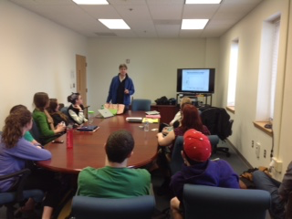
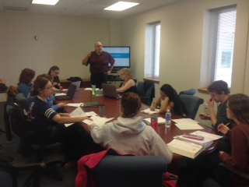
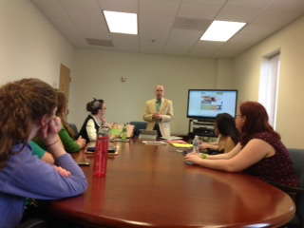
Course Structure
Organizational Structure
Mock KidWind Challenge
Event
Planning
Kenn Barron, PhD
Professor
Psychology
Reg Foucar-Szocki, PhD
Professor
School of Hospitality
David Slykhuis, PhD
Associate Professor
College of Education
Notes:
Remy

Slide 10
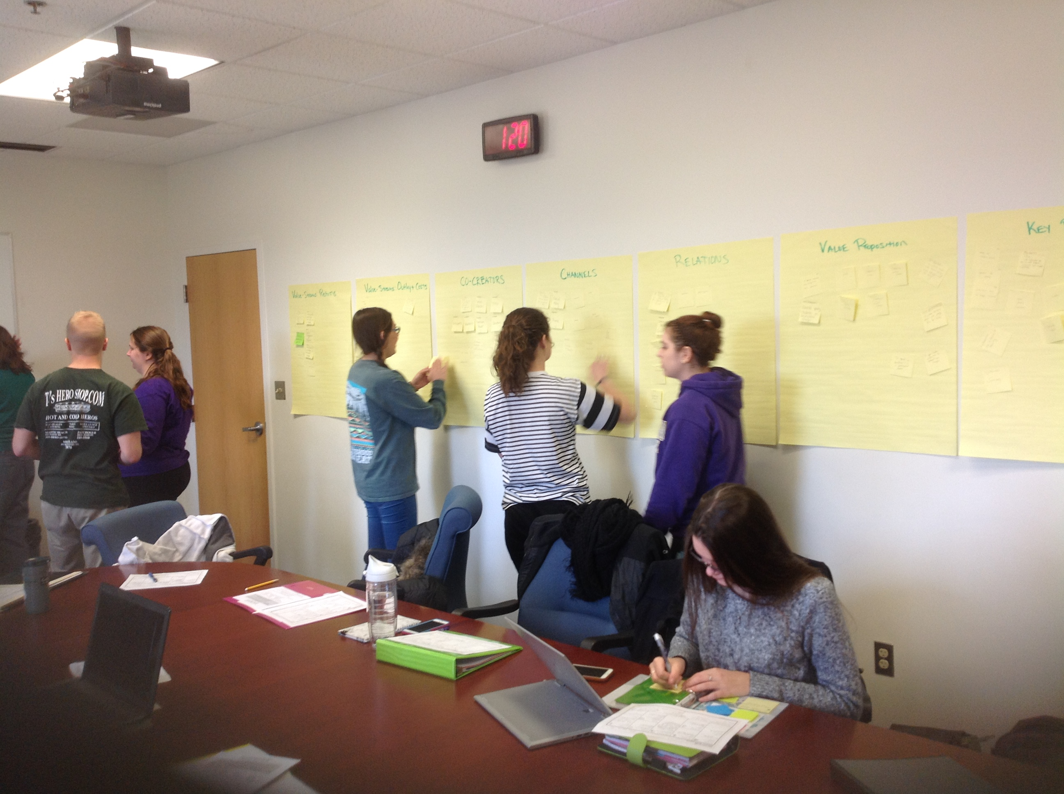
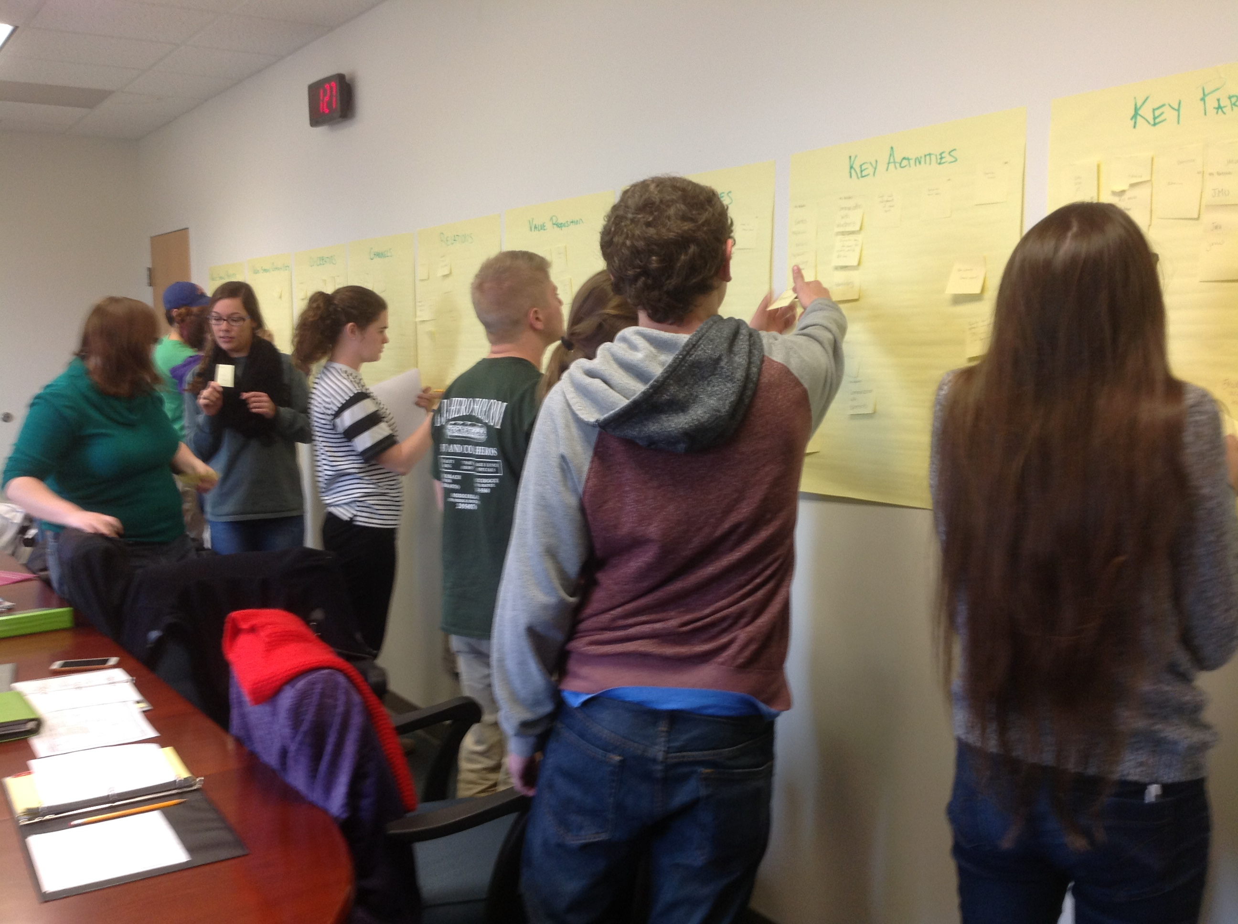
Organizational Structure
Individual and Group Business Canvas
Organization Name and Mission Statement
Identify Committees
Interview Students and Place on Committees
Notes:
April

Slide 11
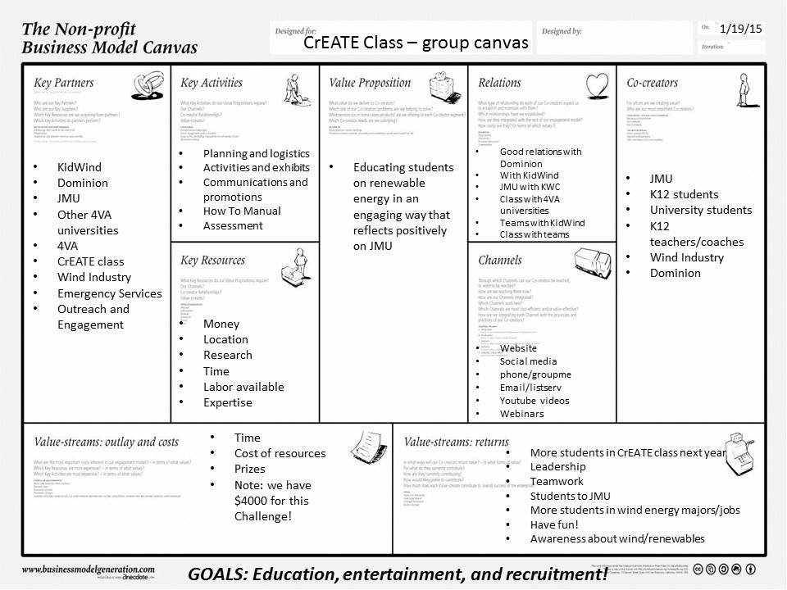
Organizational Structure

Slide 12
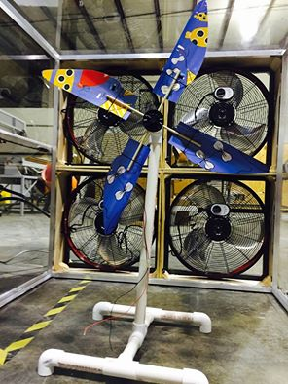
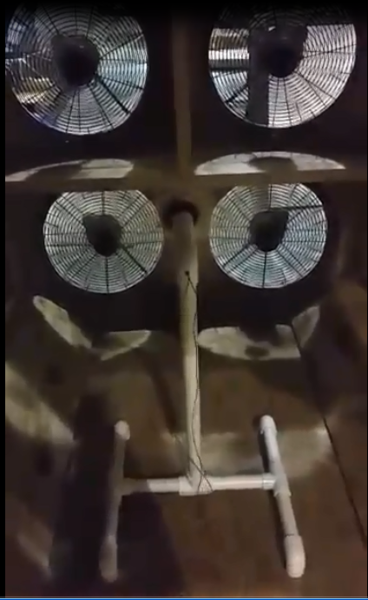
Mock KidWind Challenge
Overview of KidWind Challenge and Rules
Research Phase – Investigation Stations
Design Phase – Prototyping and Modifying
Challenge and Judging
Notes:
April and Grace

Slide 13
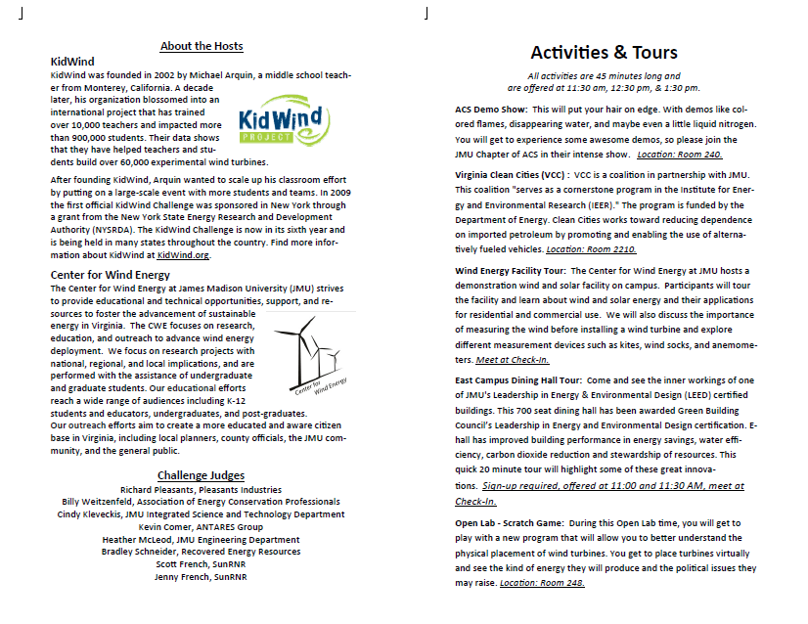
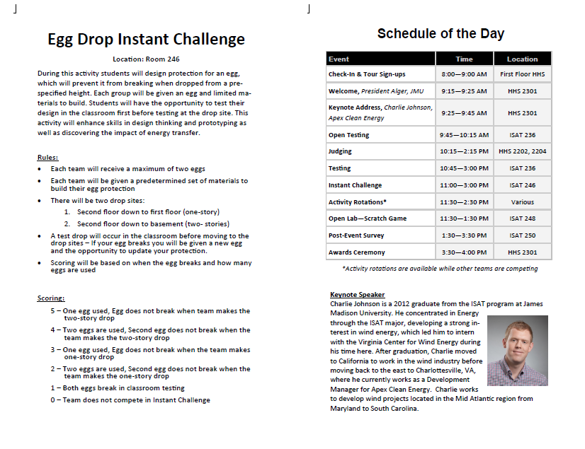
Event Planning
Committee Mission Statements
Committee Guiding Documents
Staff Meetings
KidWind Challenge Regionals at JMU
Committee Reports and Presentations
Notes:
Grace – mention GMU telecons

Slide 14

Course Results
Notes:
Remy – event components and overview of succes

Slide 15
ASSESSMENTS
Participant Survey
Student Pre-Post Test
Committee Reports
Student Peer Evaluations
Student Course Evaluations
Notes:
Remy – discuss different assessment tools – participant survey, student peer evaluations, student pre-post tests, student course evaluations, committee report/recommendation
- discuss Pre post results

Slide 16
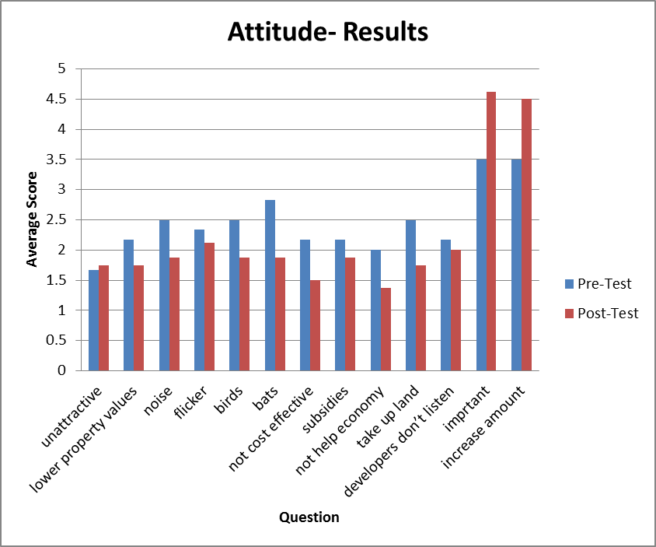
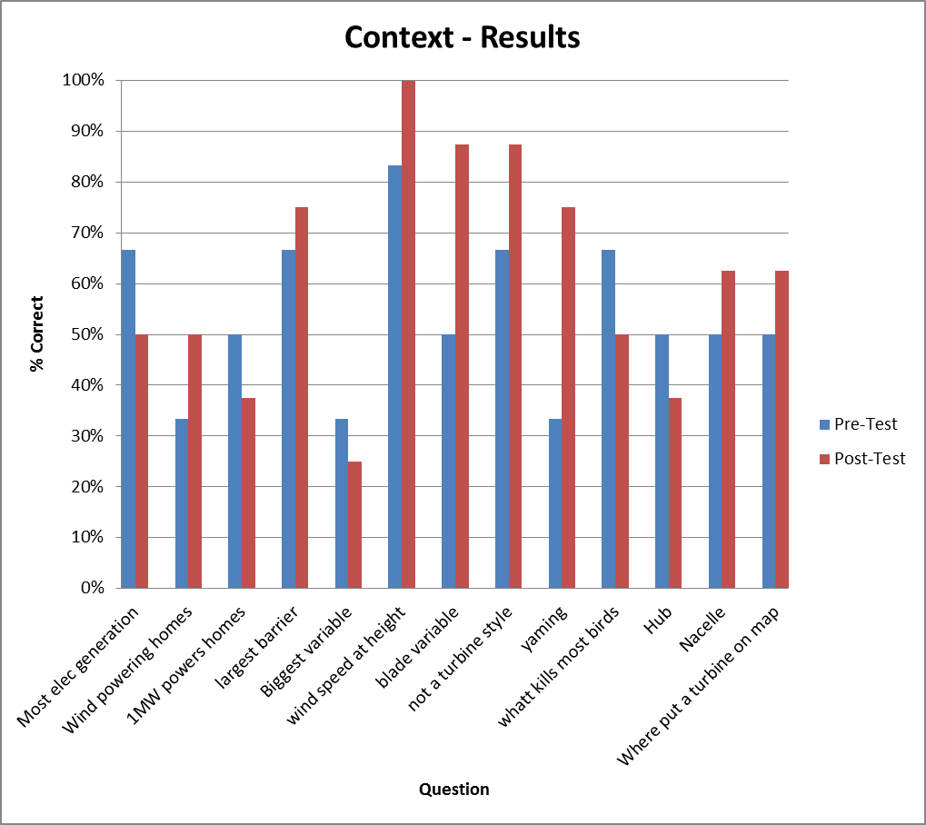
Assessment Results
Notes:
Remy – discuss different assessment tools – participant survey, student peer evaluations, student pre-post tests, student course evaluations, committee report/recommendation
- discuss Pre post results

Slide 17
Assessment Results
Lower is better
Notes:
Remy – discuss different assessment tools – participant survey, student peer evaluations, student pre-post tests, student course evaluations, committee report/recommendation
- discuss Pre post results

Slide 18
Assessment Results
Higher is
better
Notes:
Remy – discuss different assessment tools – participant survey, student peer evaluations, student pre-post tests, student course evaluations, committee report/recommendation
- discuss Pre post results

Slide 19
Assessment Results
Notes:
Remy – discuss different assessment tools – participant survey, student peer evaluations, student pre-post tests, student course evaluations, committee report/recommendation
- discuss Pre post results

Slide 20
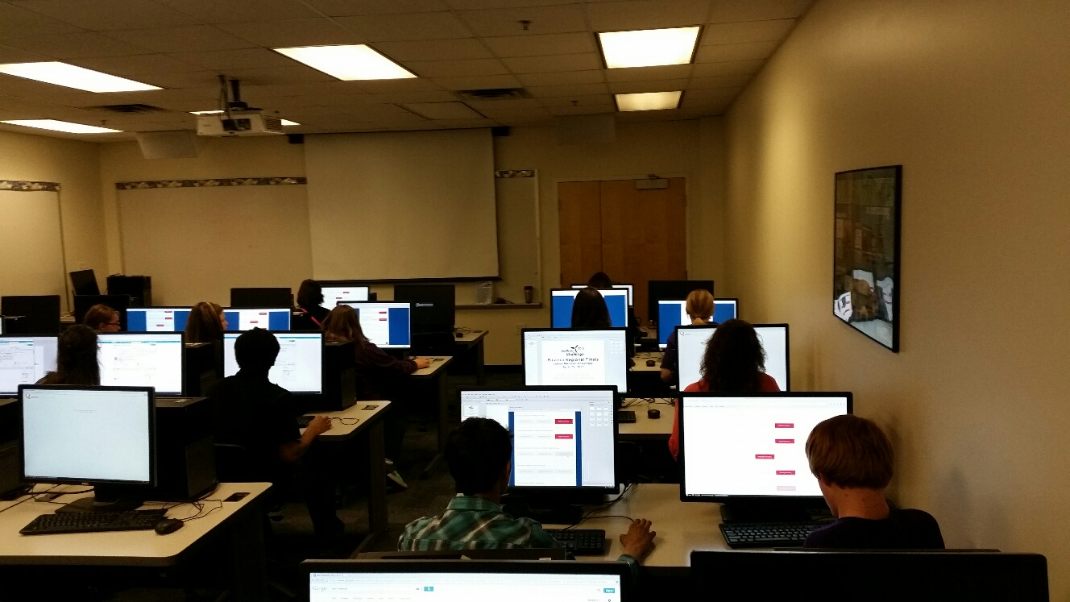
Recommendations
  Challenge Participant Surveys:
  Make sure wind tunnels put out the same wind speed
  More and larger variety of STEM activities
  Longer time for testing and judging – time marshall
  More room for team tables
  Tours for older kids
  Committee Recommendations:
  Start planning earlier
  Pre-survey to teachers to understand what they want out of event
  Parent/Teacher/Coach lounge – with coffee
  Meals for volunteers
  Market activities better
  More tasks for Communications Committee
  Recruit volunteers earlier
  Executive Board Recommendations:
  Use MS Project
  More science throughout
  Structure telecons better
  Include Ed/Psych students
Notes:
Grace and April
Add in your personal impact

Slide 21
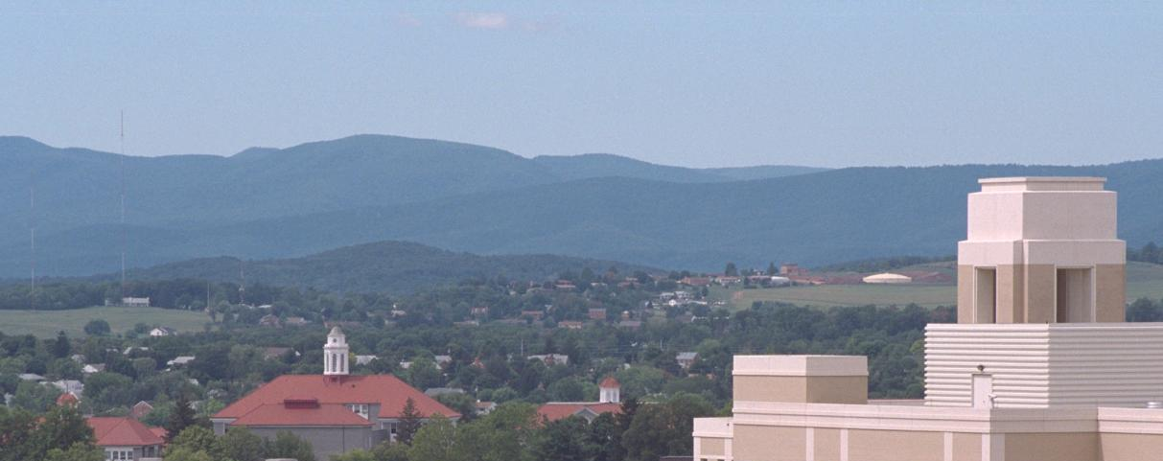
THANK YOU &
QUESTIONS?

Slide 22
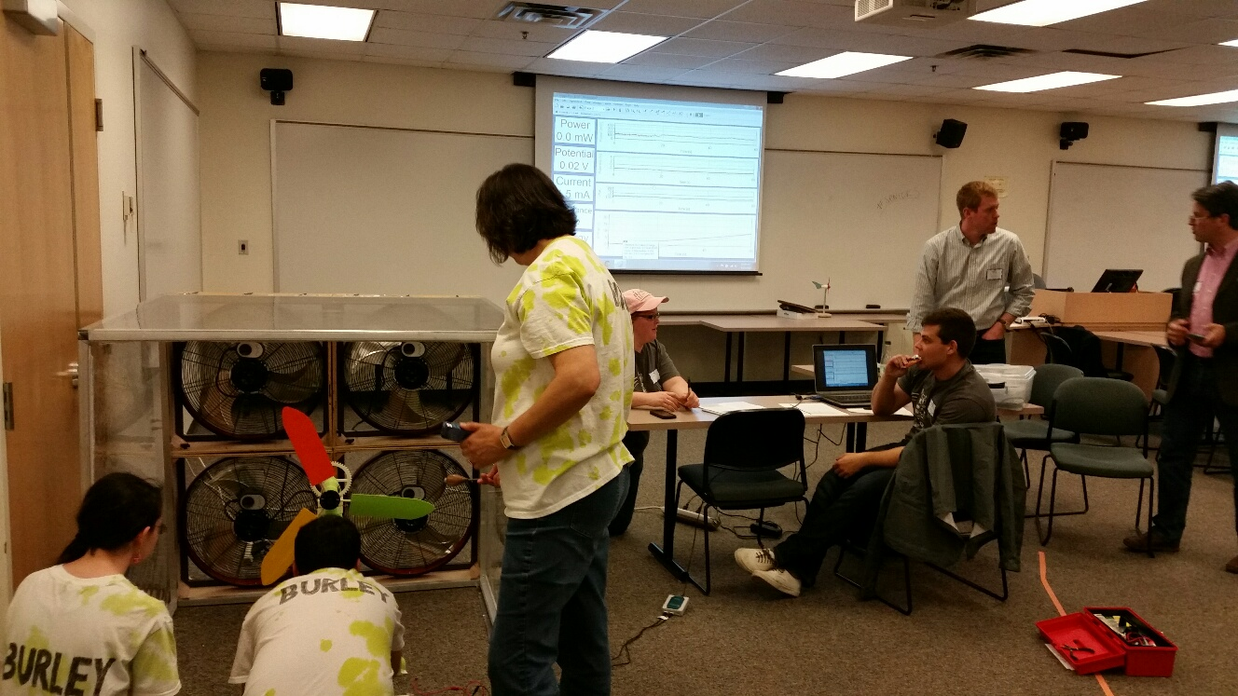
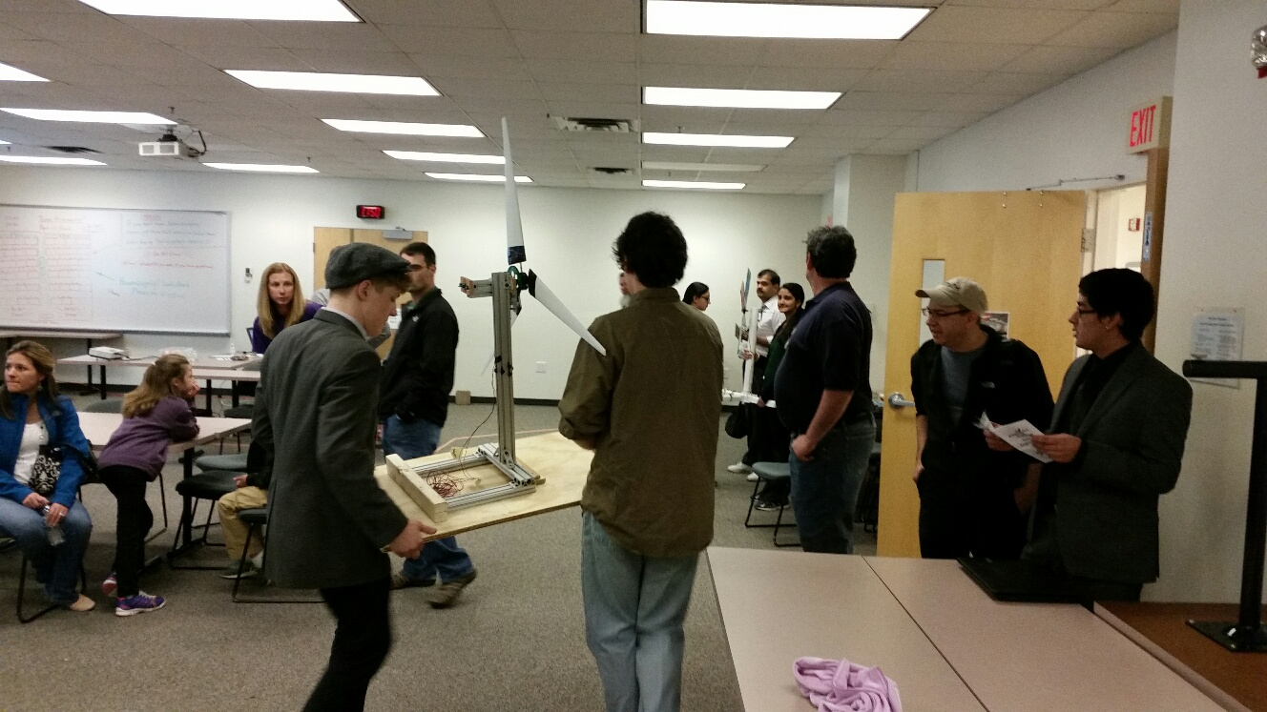

Slide 23
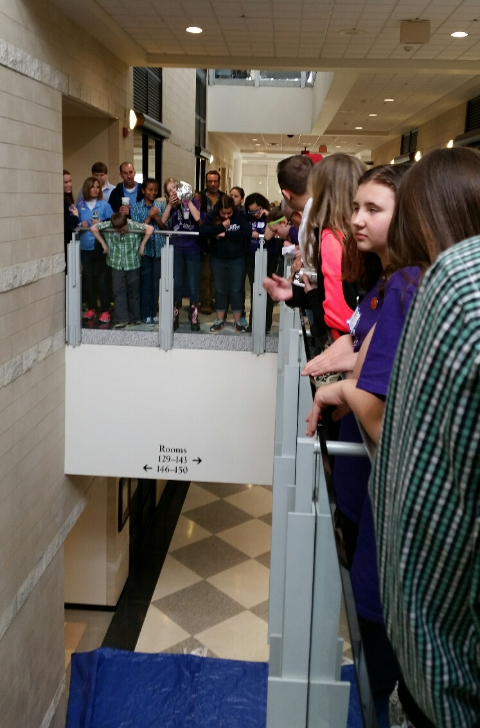

Slide 24
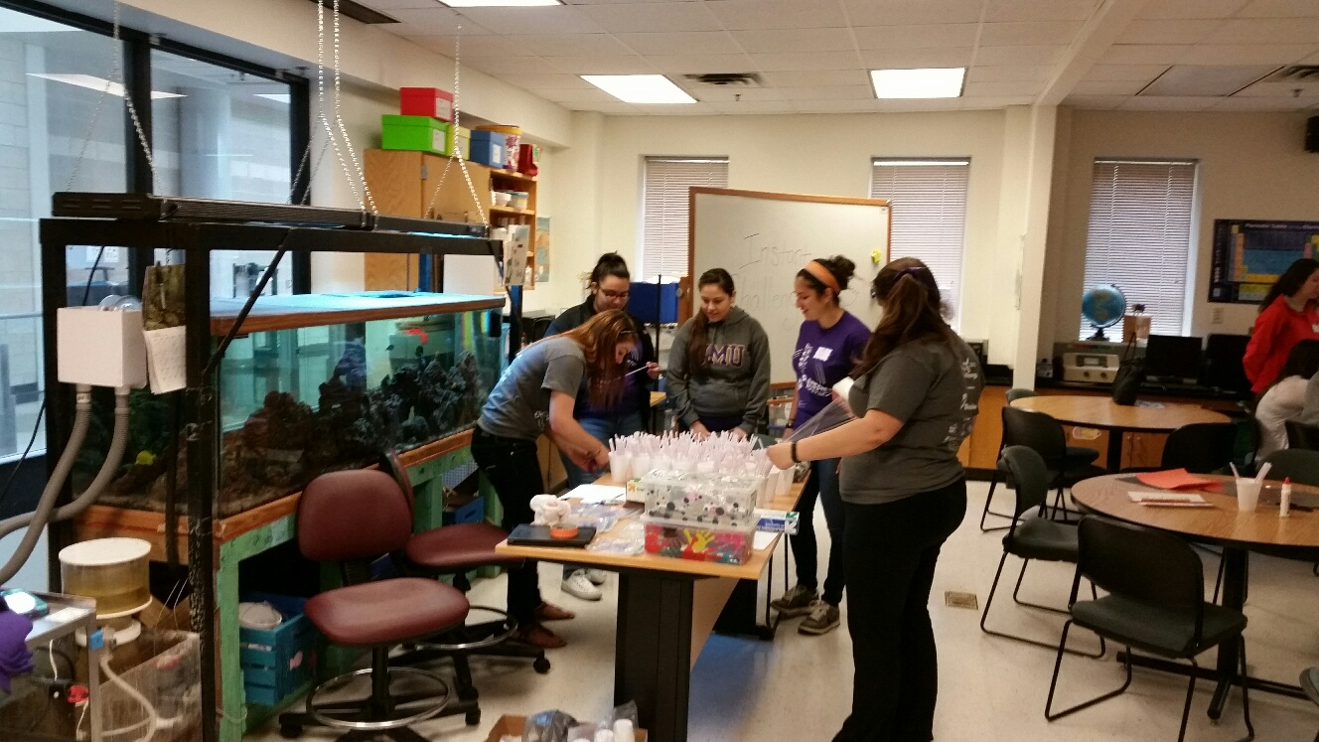
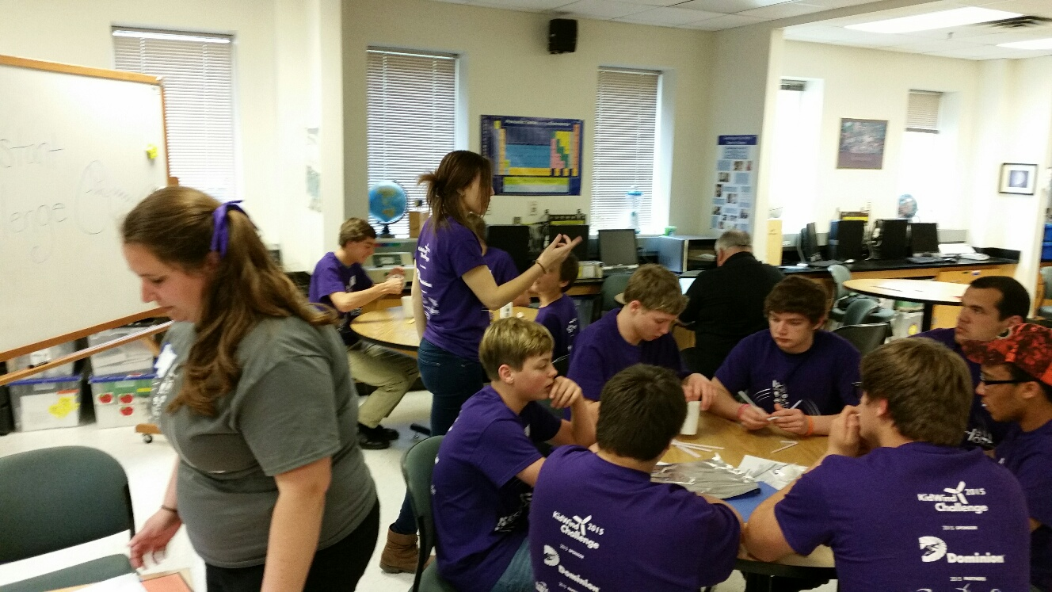
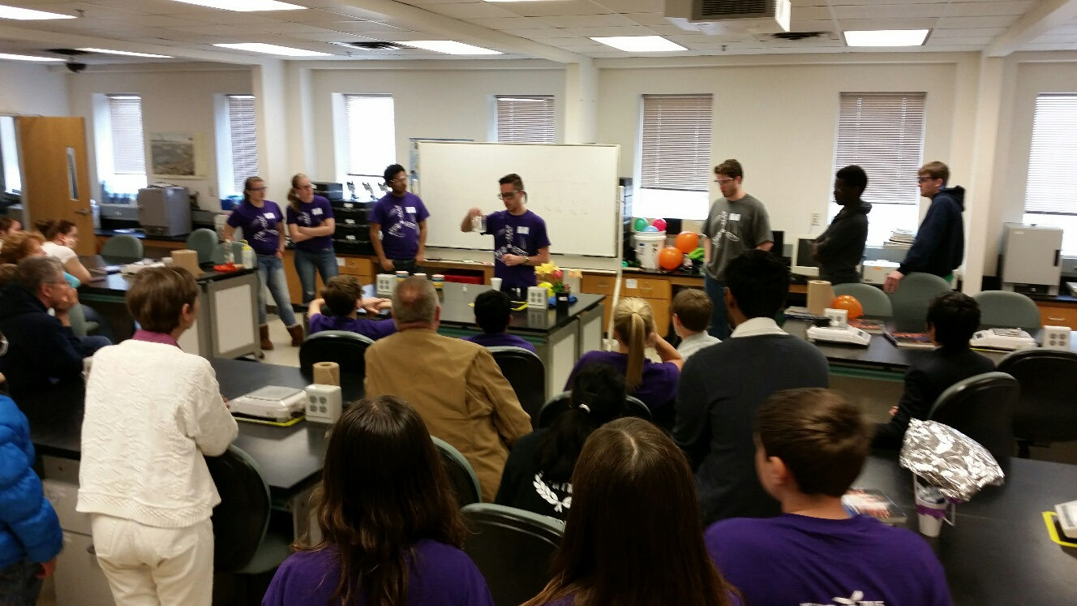
Student Org. Participation
ACS
NSBE
SANCAS

